Slide 1







Slide 2

Zanesljive, pametne in varne rešitve za bolje povezan svet

Slide 3
www.kontron.si

Slide 4
Sodobna oblačna in hibridna Azure SQL okolja
Jure Kranjc

Slide 5
Agenda
SQL Server environments
Deploy Anywhere
Azure ARC
Central management, Azure Arc-enabled SQL Server
Extending SQL Server to Azure
Hybrid AG, Managed Instance link, Data Sync, …
Business Continuity
Increase availability with Azure SQL
Cost optimization
Reduce costs with Azure Hybrid Benefit

Slide 6








SQL Server environment
Intelligent edge
Intelligent cloud
Develop once deploy anywhere
Azure SQL Edge
SQL Server 2022
SQL on Linux,
containers, k8s
Azure Arc-enabled SQL Server
Azure Arc-enabled SQL managed instance
SQL Server
on Virtual Machines
Azure SQL managed instance
Azure SQL database
Familarity
Tools
Flexibility

Slide 7
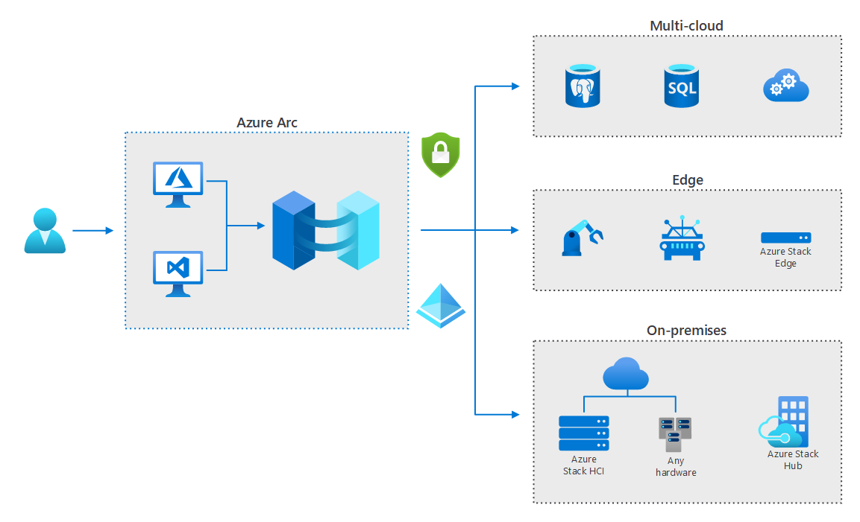
Azure ARC

Slide 8







Azure Arc-enabled SQL Server
Pay-as-you-go-licensing
Free inventory of instances and databases
Azure Arc-enabled
SQL Server
SQL Best Practices Assessment
Organize, inventory, and monitor
Governance and Security
Use with your existing SQL servers
SQL on Windows or Linux servers
Microsoft Defender for SQL
Microsoft Entra ID authentication*
Microsoft Purview access policies*
* SQL Server 2022 only

Slide 9
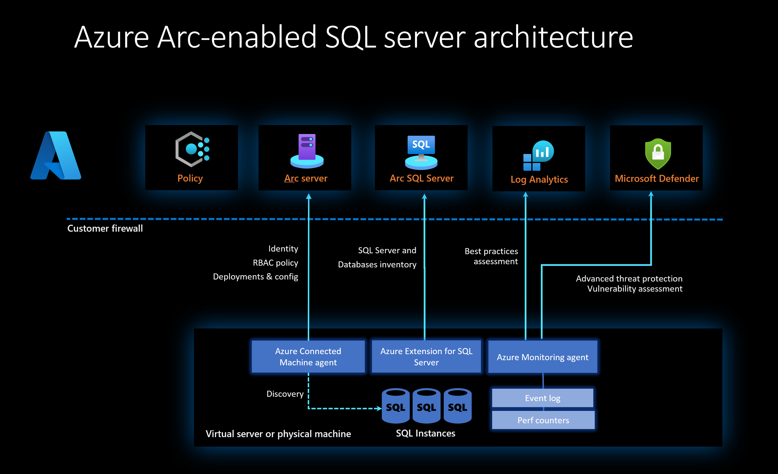
Azure Arc-enabled SQL Server

Slide 10
Azure Arc-enabled SQL Managed Instance
PaaS on existing infrastructure
Kubernetes platform
Azure Data services
Direct or Indirect connectivity
“Evergreen”
Built in management tools

Slide 11
Extending SQL Server to Azure
Native solutions for scaling out to Azure

Slide 12









Read Scale out
SQL Server on Azure VM
AG
S
R/W
R/O
R/O
A
R/W
AG
R/W
R/W
LISTENER
A
P - FCI

Slide 13
IaaS Agent extension
SQL Server on Azure VM
Integration with the Azure portal
Automated backup, patching
Bring your own license
SQL best practices assessment for SQL Server on Azure VMs

Slide 14
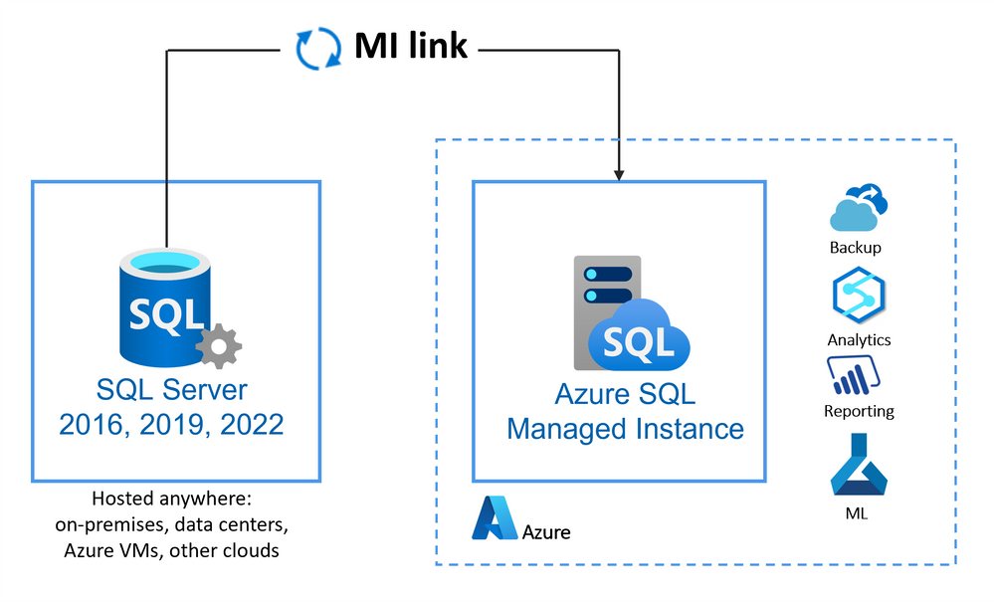
Managed Instance link
Azure SQL Managed Instace

Slide 15
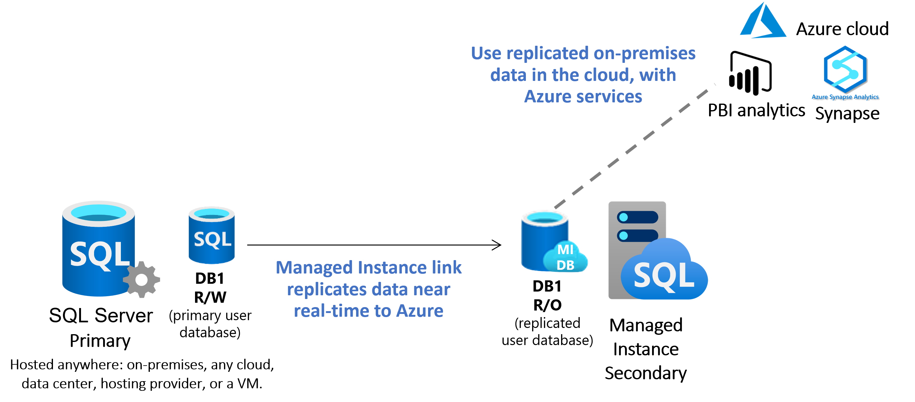
Read Scale out
Managed Instance link

Slide 16
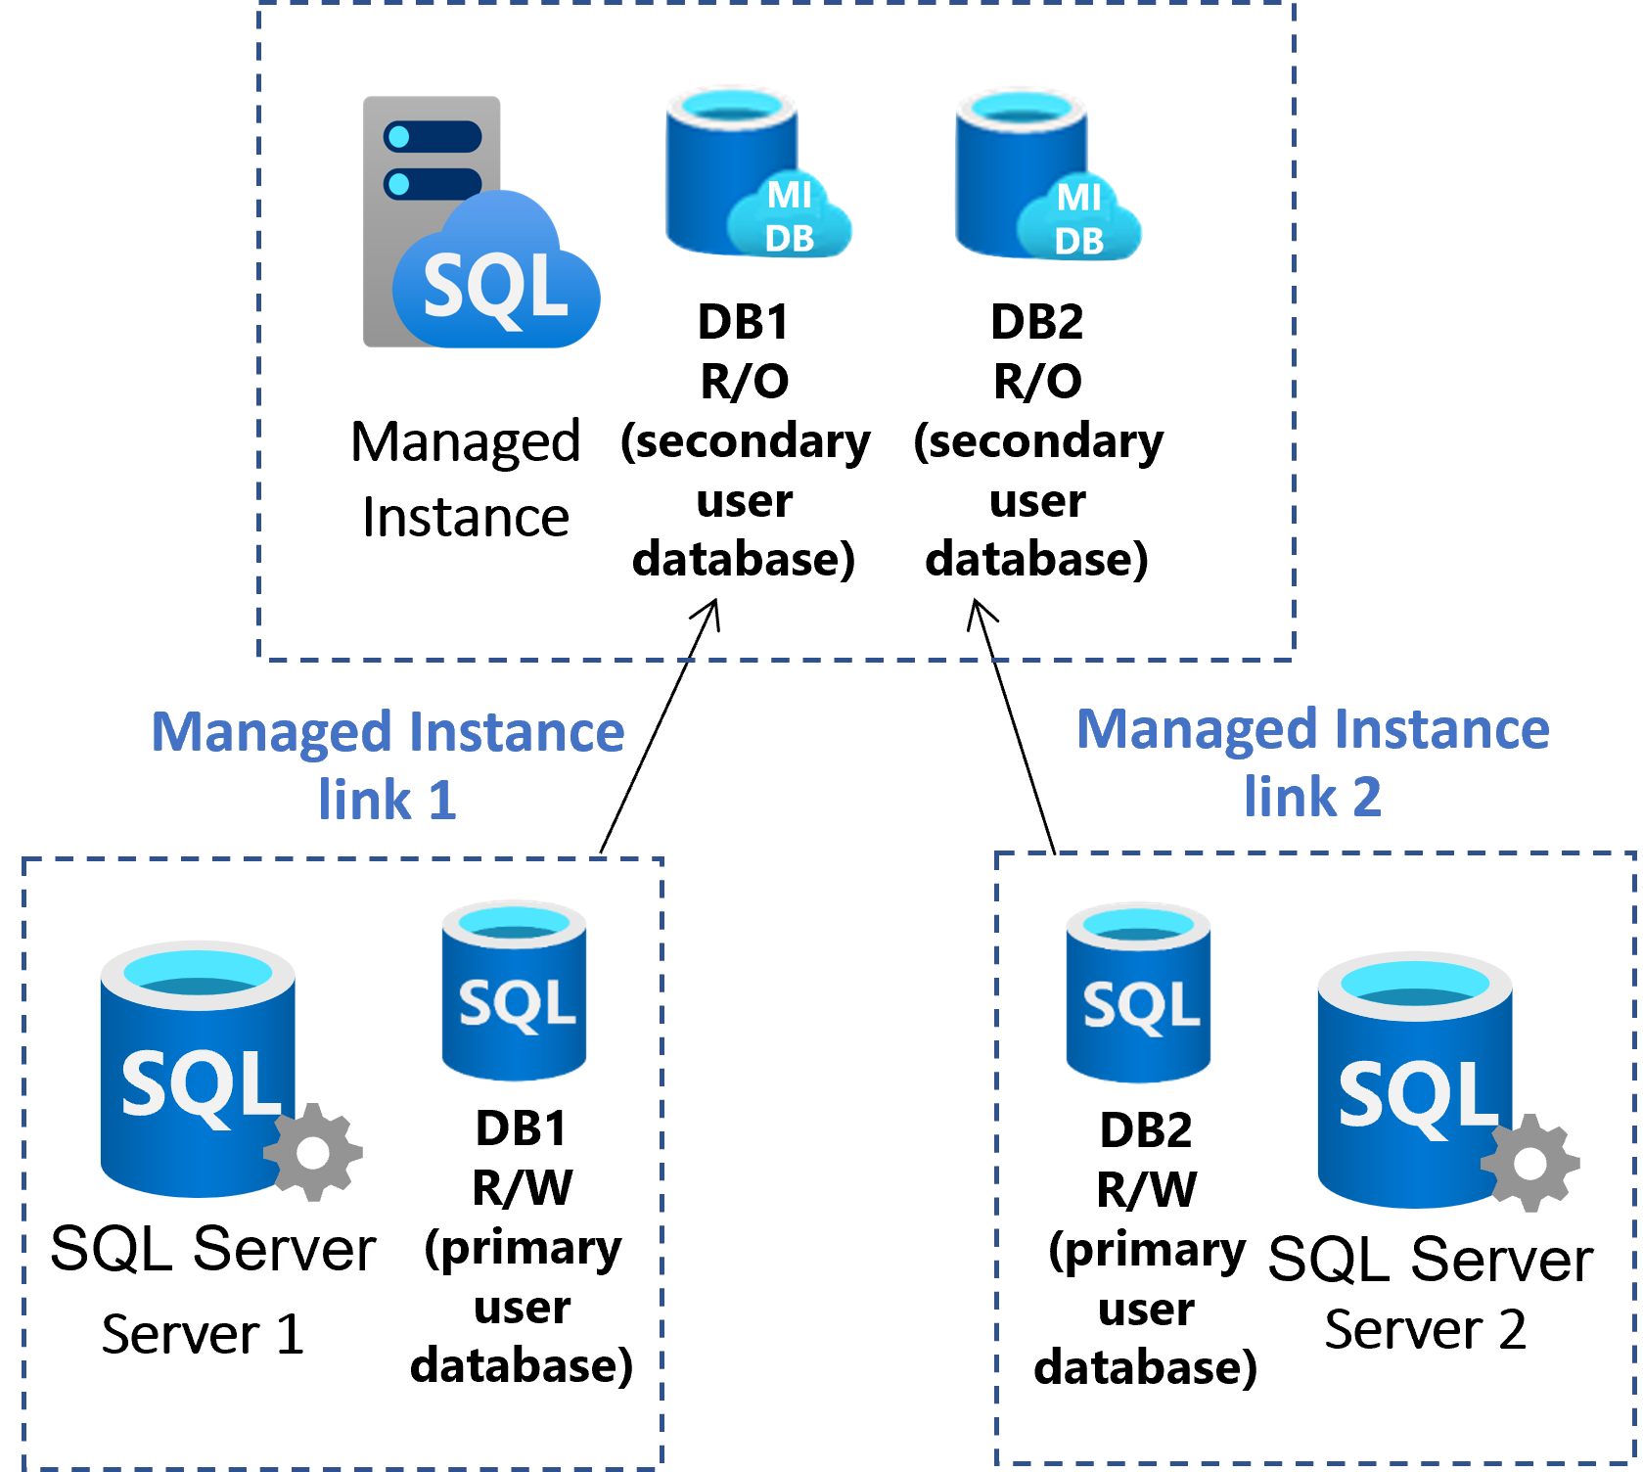
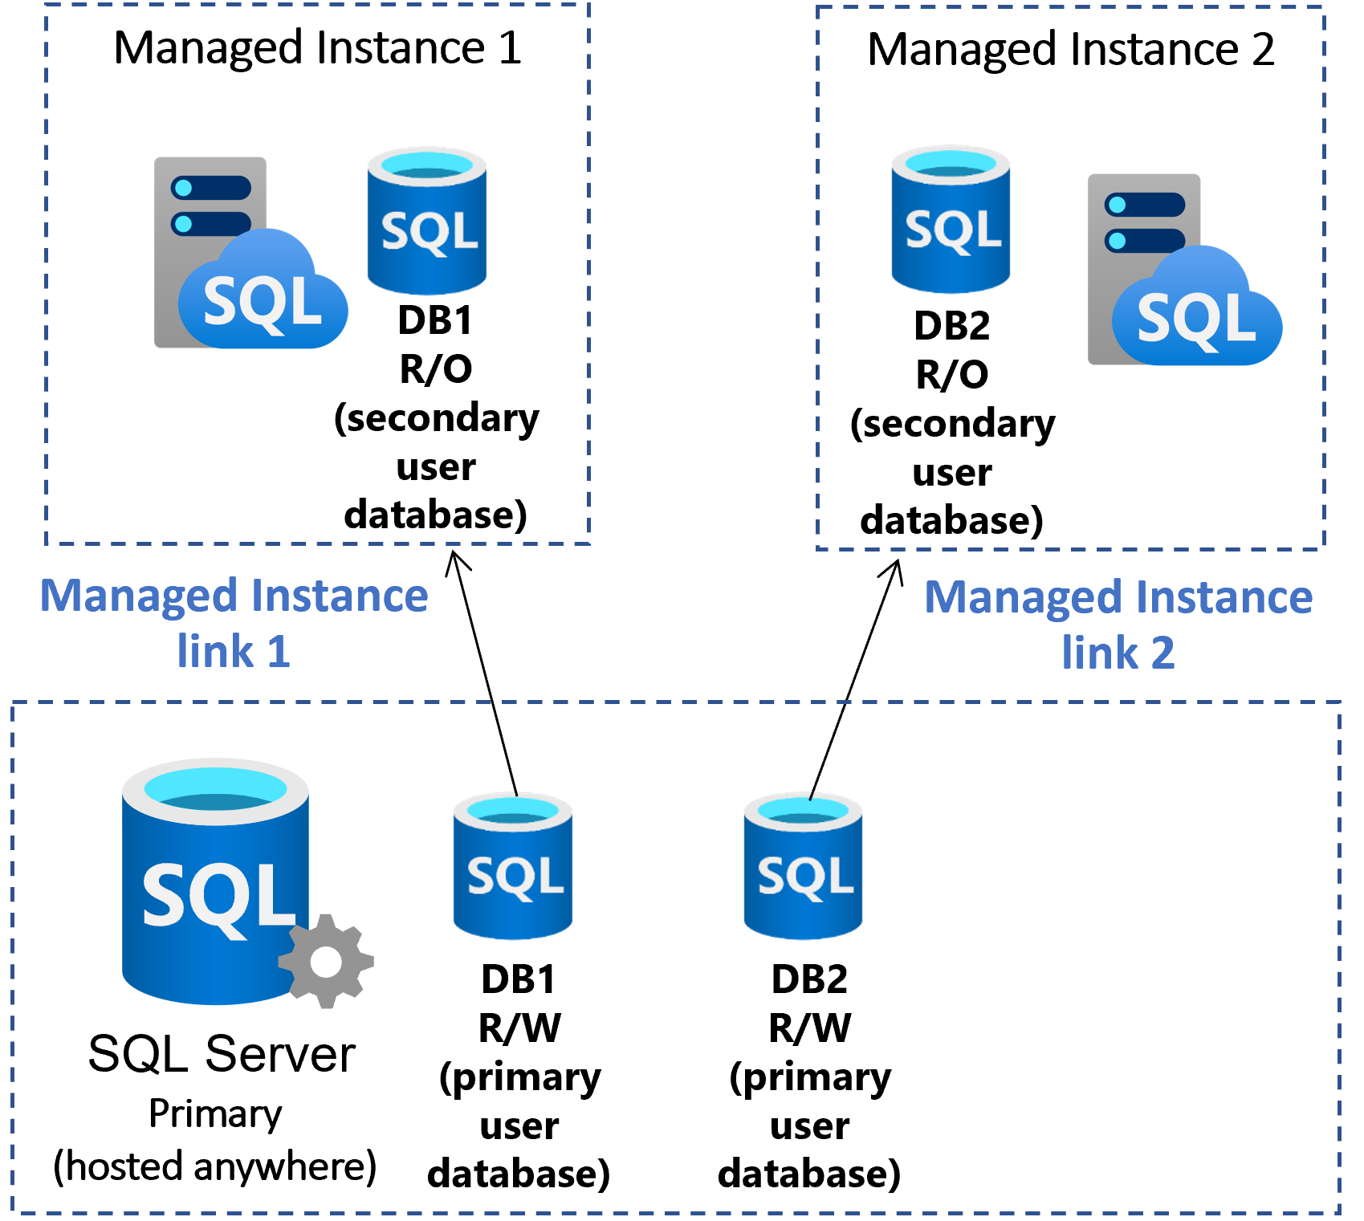
(De) Consolidation
Managed Instance link

Slide 17
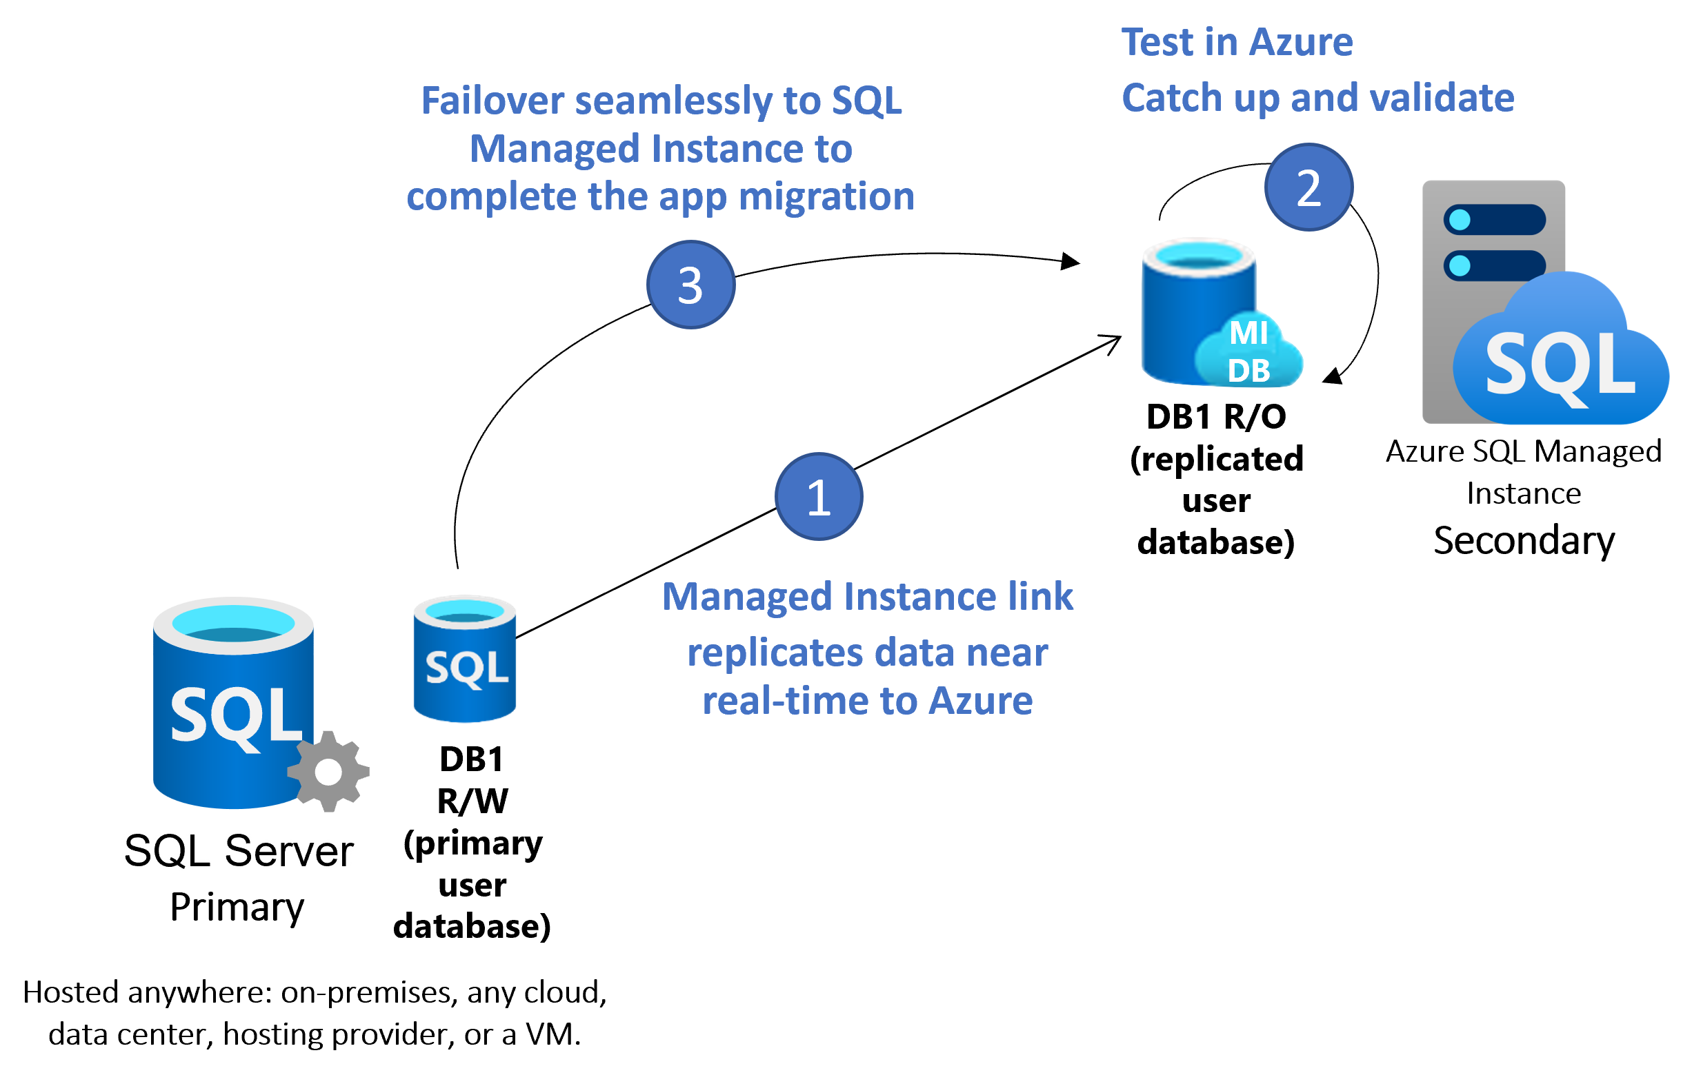
Migration
Managed Instance link

Slide 18
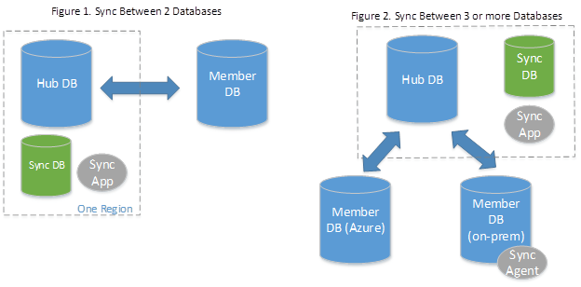
Data Sync
Azure SQL Database
Active-active
Hybrid Data Synchronization
Distibuted Applications
Globally Distributed Applications

Slide 19
Business continuity
Increase uptime with Azure SQL

Slide 20
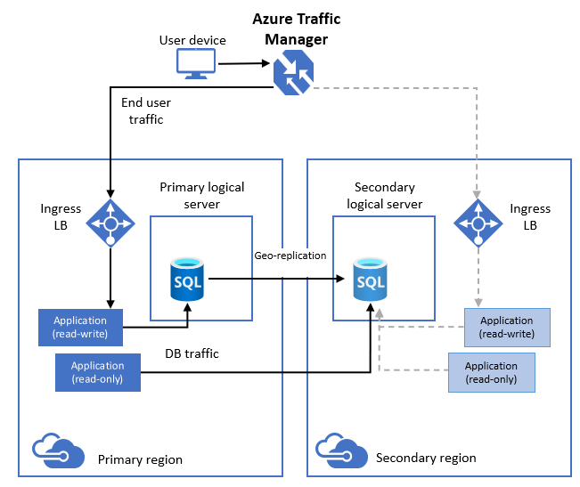
Active geo-replication
Azure SQL Database

Slide 21
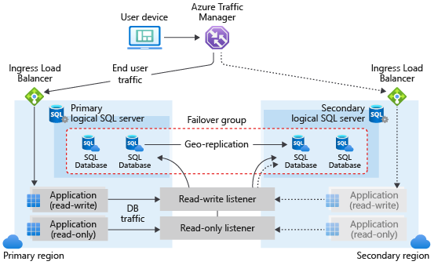
Auto-failover groups
Azure SQL Database

Slide 22
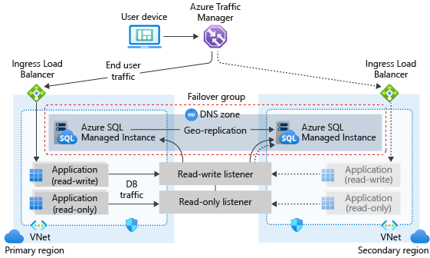
Auto-failover groups
Azure SQL Managed Instance

Slide 23
Cost optimization

Slide 24
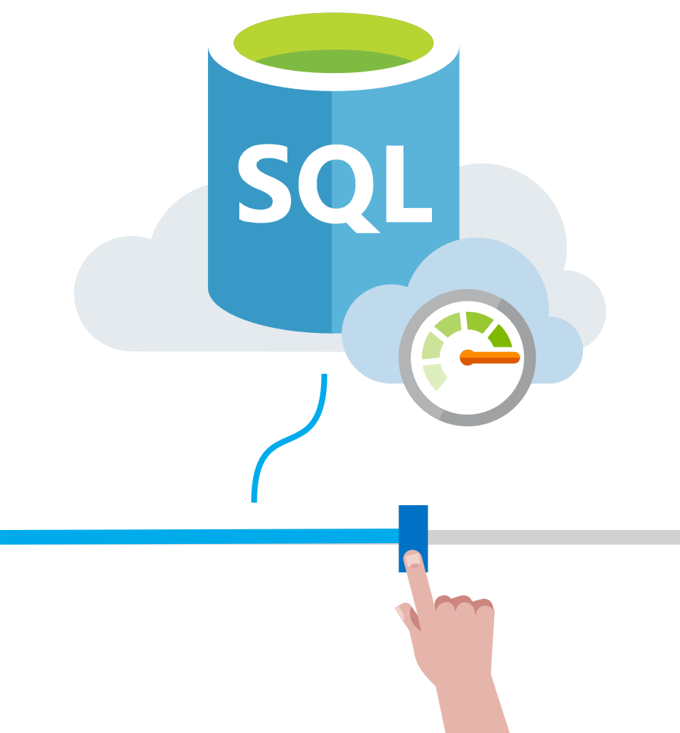
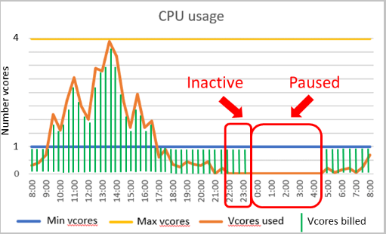
Dynamic scaling
Serverless Azure SQL DB
Scale Down and Scale up

Slide 25
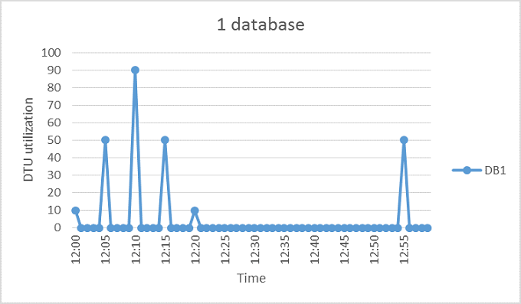
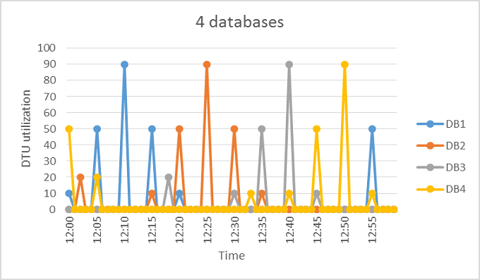
Azure Elastic Pool
Azure SQL Database
Share a set number of resources
Overprovision vs Underprovision
Predictable budget

Slide 26
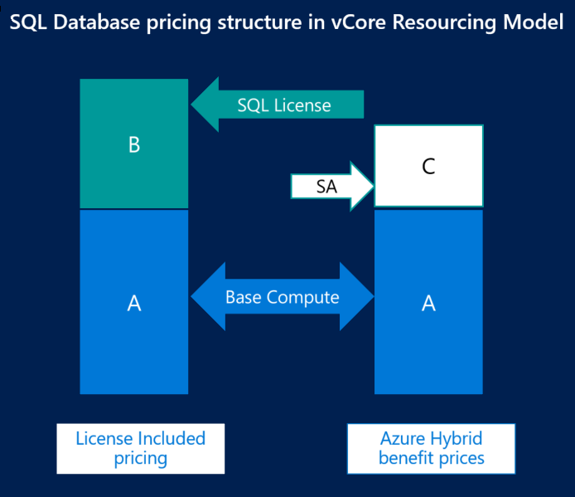
Azure Hybrid Benefit
Save up to 85%
Bring your own license
  Software Assurance (SA)
SQL and OS
Calculator :
    https://azure.microsoft.com/pricing/hybrid-benefit/

Slide 27

Summary
Scalability
Business Continuity
Integration with Azure Ecosystem
Improved Disaster Recovery
Cost optimization

Slide 28
Contact
Jure Kranjc
jure.kranjc@kontron.si

