Slide 2
Vzdrževanje SCCM in WSUS okolja
Jože Markič
Jože Markič s.p.

Slide 3
Agenda
WSUS Clients
Windows Server Update Services (WSUS)
Windows Internal Database (WID)
WSUS DB Maintenance

Slide 4
WSUS Clients – Windows 10
Enable support for FODs (Features on Demand) and/or “Turn Windows features on or off”
  Computer Configuration > Policies > Administrative Templates > System
    Specify settings for optional component installation and component repair
      Download repair content and optional features directly from Windows Update instead of WSUS
  Computer Configuration > Policies > Administrative Templates > Windows Components > Windows Update
    Do not connect to Windows Update Internet addresses
Update to enable WSUS support for Windows 10 feature upgrades
  Windows Server 2012 & 2012 R2
  How to delete upgrades in WSUS

Slide 5
WSUS Clients - Office
Office 2019 = Office 365

Slide 6
Windows Server Update Services (WSUS)
WSUS Role, Configuration, and Folders/Files
IIS Role, Configuration, and Folders/Files
WID Feature, Configuration, and Database Files
Notes:
WSUS on Server Core
Install-WindowsFeature UpdateServices –Restart
"C:\Program Files\Update Services\Tools\wsusutil.exe" postinstall CONTENT_DIR=C:\WSUS
Enable Remote IIS Management
Apply “Private Memory Limit (KB)” fix
Open “Windows Server Update Services” mmc and connect to server Core
Run through the wizard as you would normally and perform synchronization.

Slide 7
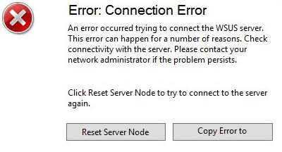
WSUS – IIS Role
WSUS application pool in IIS “WsusPool” has reached it’s maximum private memory limit
  Internet Information Services (IIS) Manager
  Application Pools
  WsusPool -> Advanced Settings
  Change Private Memory Limit (KB) from default (1843200)
    0 – no limit
    3686400 (2x 1843200) ~ 4GB
  IISRESET
Notes:
IIS on Server Core - https://blogs.msdn.microsoft.com/benjaminperkins/2015/11/02/configure-an-iis-server-core-server-for-remote-management/
Install-WindowsFeature Web-Server
Install-WindowsFeature Web-Mgmt-Service
HKLM\SOFTWARE\Microsoft\WebManagement\Server -> set EnableRemoteManagement to 1
Net start WMSVC
sc config WMSVC start=auto
netsh advfirewall firewall add rule name=”IIS Remote Management” dir=in action=allow service=WMSVC’

Slide 8
WSUS – IIS Role (high number of clients)
A worker process with process id of '%1' serving application pool '%2' has requested a recycle because the worker process reached its allowed processing time limit.
  Internet Information Services (IIS) Manager
  Application Pools
  WsusPool -> Advanced Settings
    Change 'Queue Length' from the default 1,000 to 25,000
    Change ‘”Service Unavailable” Response Type' from the default HttpLevel to TcpLevel
    Change 'Failure Interval (minutes) from the default 5 to 30
    Change 'Maximum Failures' from the default 5 to 60
  IISRESET
Notes:
https://blogs.msdn.microsoft.com/the_secure_infrastructure_guy/2015/09/02/windows-server-2012-r2-wsus-issue-clients-cause-the-wsus-app-pool-to-become-unresponsive-with-http-503/

Slide 9
WSUS – IIS Role (SCCM)
The computer that hosts a software update point requires the following configurations for IIS application pools:
Increase the WsusPool Queue Length to 2000.
Increase the WsusPool Private Memory limit by four times, or set it to 0 (unlimited).
Internet Information Services (IIS) Manager
  Application Pools
  WsusPool -> Advanced Settings
    Private Memory Limit (KB)
IISRESET
Notes:
https://docs.microsoft.com/en-us/sccm/core/plan-design/configs/recommended-hardware

Slide 10

DEMO

Slide 11
Windows Internal Database (WID)
Designed to only be accessible to Windows Services running on the same machine (no remote named pipe connections)
Windows Authentication only
Connect to local instance of WID
  WSUS 3 (2003-2008): \\.\pipe\MSSQL$MICROSOFT##SSEE\sql\query
  WSUS 4 (2012+): \\.\pipe\MICROSOFT##WID\tsql\query

Slide 12
Windows Internal Database (WID)
Server Version | SQL Core | DB Location
Windows Server 2008 WID | SQL Server Express 2005 32bit | C:\Windows\sysmsi\ssee
Windows Server 2008 R2 | SQL Server Express 2005 32bit | C:\Windows\sysmsi\ssee
Windows Server 2012 | SQL Server Express 2012 64bit | C:\Windows\WID
Windows Server 2012 R2 | SQL Server Express 2 SQL 2012 64bit | C:\Windows\WID
Windows Server 2016 | SQL Server Express 2014 64bit | C:\Windows\WID
Windows Server 2019 | SQL Server Express 2014 SP2 64bit | C:\Windows\WID

Slide 13
WSUS DB Maintenance
SQL Server Management Studio (SSMS) ali
Sqlcmd (Microsoft SQL Server Feature Pack)
  Microsoft ODBC Driver for SQL Server
  sqlcmd -S np:\\.\pipe\MICROSOFT##WID\tsql\query –i <...>\WsusDBMaintenance.sql
Maximum Memory
WSUS Re-Index script
Enhancing WSUS database cleanup performance SQL script
WSUS Cleanup (script)
Notes:
Get-WsusServer | Invoke-WsusServerCleanup –CleanupObsoleteUpdates -CleanupUnneededContentFiles -CompressUpdates -DeclineExpiredUpdates –DeclineSupersededUpdates
https://blog.ctglobalservices.com/configuration-manager-sccm/kea/house-of-cardsthe-configmgr-software-update-point-and-wsus/
$A = New-ScheduledTaskAction -Execute "PowerShell.exe" -Argument ‘-ExecutionPolicy ByPass -File F:\Install\scripts\wsus\Invoke-CleanUPWSUSTASK.PS1’
$T = New-ScheduledTaskTrigger -WeeksInterval 1 -DaysOfWeek Sunday -At "01:00" -Weekly
Register-ScheduledTask -User "NT AUTHORITY\SYSTEM" -TaskName ‘WSUS Clean UP TASK’ -Trigger $T -Action $A
https://stevethompsonmvp.wordpress.com/2018/05/01/enhancing-wsus-database-cleanup-performance-sql-script/

Slide 14
WSUS DB Maintenance
Backup DB
Move WID DB
  Stop-Service IISADMIN; Stop-Service WsusService
  Detach SUSDB
    Drop Existing Connections
  Copy the SUSDB files
  Attach SUSDB
  Start-Service IISADMIN; Start-Service WsusService
Notes:
https://docs.microsoft.com/en-us/windows-server/administration/windows-server-update-services/manage/wid-to-sql-migration
Detach SUSDB
sqlcmd -S \\.\pipe\Microsoft##WID\tsql\query
use master
GO
alter database SUSDB set single_user with rollback immediate
GO
sp_detach_db SUSDB
GO
Attach SUSDB
USE master;
GO
CREATE DATABASE SUSDB ON (FILENAME = 'C:\Program Files\Microsoft SQL Server\MSSQL12.MSSQLSERVER\MSSQL\Data\SUSDB.mdf'), (FILENAME = 'C:\Program Files\Microsoft SQL Server\MSSQL12.MSSQLSERVER\MSSQL\Log\SUSDB_Log.ldf') FOR ATTACH;
GO

Slide 15
WSUS DB Maintenance
Migrating the WSUS Database from WID to SQL
  Stop the IIS and WSUS services on the WSUS server
  Detach SUSDB from the Windows Internal Database
  Copy the SUSDB files to the SQL Server
  Attach SUSDB to the SQL Instance
  Verify SQL Server and Database Logins and Permissions
  Edit the registry to point WSUS to the SQL Server Instance
  Start the IIS and WSUS services on the WSUS server
Notes:
https://docs.microsoft.com/en-us/windows-server/administration/windows-server-update-services/manage/wid-to-sql-migration

Slide 16
WSUS Content Maintenance
Move Content
  Cd C:\Program Files\Update Services\Tools\
  wsusutil.exe movecontent %content path% %logfile%
    wsusutil.exe movecontent D:\WSUS\ D:\wsusmove.log or
    wsusutil.exe movecontent D:\WSUS\ D:\wsusmove.log –skipcopy
      Only changes server config
Notes:
https://docs.microsoft.com/de-de/security-updates/windowsupdateservices/18127395

Slide 17
DEMO

Slide 18
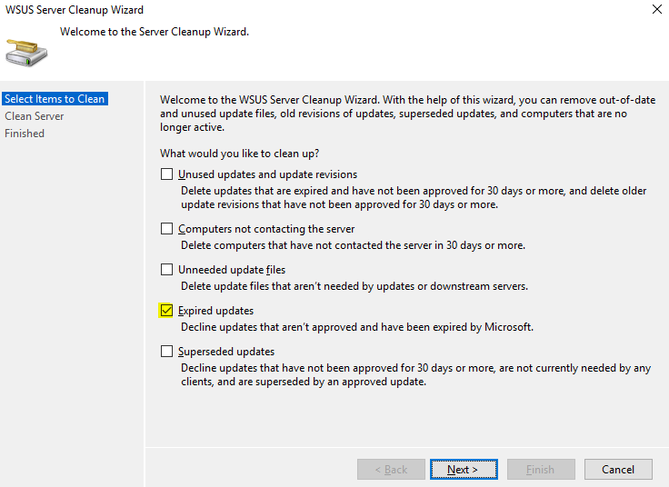
SCCM & WSUS
WSUS cleanup behavior in version 1802 and earlier
Notes:
https://docs.microsoft.com/en-us/sccm/sum/deploy-use/software-updates-maintenance

Slide 19
SCCM & WSUS
WSUS cleanup behavior starting in version 1806
  The Expired updates option for WSUS servers on CAS and primary sites.
    WSUS servers for secondary sites don't run the WSUS cleanup for expired updates.
  Configuration Manager builds a list of superseded updates from its database. The list is based on the supersedence behavior in the Software Update Point component properties.
    The update configuration items meeting the supersedence behavior criteria are expired in the Configuration Manager console.
    The updates are declined in WSUS for CAS and primary sites but not for secondary sites.
  A cleanup for software update configuration items in the Configuration Manager database occurs every seven days and removes unneeded updates from the console.
    This cleanup won't remove expired updates from the Configuration Manager console if they're currently deployed.
Notes:
https://docs.microsoft.com/en-us/sccm/sum/deploy-use/software-updates-maintenance

Slide 20
SCCM & WSUS
WSUS cleanup behavior starting in version 1806
  WSUS Server Cleanup Wizard options aren't run on the CAS and primary sites:
    Unused updates and update revisions
    Computers not contacting the server
    Unneeded update files
  WSUS Server Cleanup Wizard options run on the CAS and primary sites:
    Expired Updates
    Superseded Updates
Notes:
https://docs.microsoft.com/en-us/sccm/sum/deploy-use/software-updates-maintenance

Slide 21
SCCM & WSUS
WSUS cleanup behavior starting in version 1810
  The Expired updates option for WSUS servers on CAS, primary, and secondary sites.
  Configuration Manager builds a list of superseded updates from its database. The list is based on the supersedence behavior in the Software Update Point component properties.
    The update configuration items meeting the supersedence behavior criteria are expired in the Configuration Manager console.
    The updates are declined in WSUS for CAS, primary, and secondary sites.
  A cleanup for software update configuration items in the Configuration Manager database occurs every seven days and removes unneeded updates from the console.
    This cleanup won't remove expired updates from the Configuration Manager console if they're currently deployed.
Notes:
https://docs.microsoft.com/en-us/sccm/sum/deploy-use/software-updates-maintenance

Slide 22
SCCM & WSUS
WSUS cleanup behavior starting in version 1810
  The following WSUS Server Cleanup Wizard options aren't run on the CAS, primary, and secondary sites:
    Unused updates and update revisions
    Computers not contacting the server
    Unneeded update files
  WSUS Server Cleanup Wizard options run on the CAS primary and secondary sites:
    Expired Updates
    Superseded Updates
Notes:
https://docs.microsoft.com/en-us/sccm/sum/deploy-use/software-updates-maintenance

Slide 23
SCCM & WSUS
The complete guide to Microsoft WSUS and Configuration Manager SUP maintenance
  Backup the WSUS database
  Create custom indexes
  Re-index the WSUS database
  Decline superseded updates
  Run the WSUS Server Cleanup Wizard
  Re-index the WSUS database
  Troubleshooting
  Automating WSUS maintenance
Notes:
https://support.microsoft.com/en-us/help/4490644/complete-guide-to-microsoft-wsus-and-configuration-manager-sup-maint

Slide 24
SCCM & WSUS
Fully Automate Software Update Maintenance in Configuration Manager - Invoke-DGASoftwareUpdateMaintenance
  Detect if a synchronization is occurring and wait for success before resuming.
  Decline superseded updates.
  Decline updates by a list of titles.
  Decline updates based on external plugin scripts.
  Output a comma-delimited list of declined updates.
  Run the WSUS Cleanup Wizard.
  Initiate a software update synchronization.
Notes:
https://damgoodadmin.com/2017/11/05/fully-automate-software-update-maintenance-in-cm/
https://damgoodadmin.com/2018/10/17/latest-software-maintenance-script-making-wsus-suck-slightly-less/

Slide 25
SCCM & WSUS
Invoke-DGASoftwareUpdateMaintenance
  Remove expired and declined updates from software update groups.
  Delete software update groups that have no updates.
  Combine software update groups into yearly groups.
  Set the maximum run time for updates by title.
  Remove unneeded files from the deployment package source folder.
  Update the deployment packages used by ADRs either monthly or yearly.
  Directly call the stored procedures to delete obsolete updates.
  Add crucial indexes that make WSUS run faster overall.
  Delete updates that have been declined from the WSUS database entirely.
Notes:
https://damgoodadmin.com/2017/11/05/fully-automate-software-update-maintenance-in-cm/
https://damgoodadmin.com/2018/10/17/latest-software-maintenance-script-making-wsus-suck-slightly-less/

Slide 26
SCCM & WSUS
Invoke-DGASoftwareUpdateMaintenance Plugins
  Decline-Office365Editions
  Decline-Windows10Editions
  Decline-Windows10Languages
  Decline-Windows10Versions
Notes:
https://damgoodadmin.com/2017/11/05/fully-automate-software-update-maintenance-in-cm/
https://damgoodadmin.com/2018/10/17/latest-software-maintenance-script-making-wsus-suck-slightly-less/

Slide 27
DEMO

Slide 28
WSUS SSL
SSL Server Auth certificate (2048 bit)
IIS Sites - WSUS Administration
  Configure HTTPs Binding and enforce SSL encryption
    APIremoting30
    ClientWebService
    DSSAuthWebService
    ServerSyncWebService
    SimpleAuthWebService
WSUSUtil.exe configuressl myserver.mydomain.local
Reconfigure clients…
Notes:
https://docs.microsoft.com/en-us/windows-server/administration/windows-server-update-services/deploy/2-configure-wsus

Slide 29
“It is better to fail in originality than to succeed in imitation.”
Herman Melville

Slide 30

MOC tečaji - Kompas Xnet
Administering System Center Configuration Manager
  Termin: 22.7. – 26.7.2019
Integrating MDM and Cloud Services with System Center Configuration Manager
  Termin: 1.7. – 2.7.2019
Securing Windows Server 2016
  Termin: 26.8. - 30.8.2019
Info: www.kompas-xnet.si

Slide 31
Q&A

Slide 32
Hvala

