Slide 1
Windows without windows...
First steps….Remote Management
By Matjaž Žnidar

Slide 2
Server is installed. How do I manage it now?
Yesterday we saw:
Few tools that are still running in CORE
A lot of PowerShell commands
Few tricks to install drivers
A lot of very manual and clumsy procedures
Can we do IT better?

Slide 3
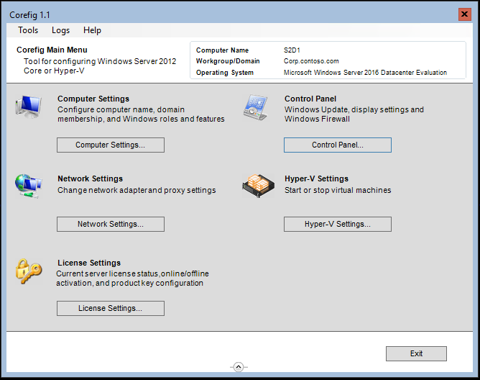
CoreFig

Slide 4
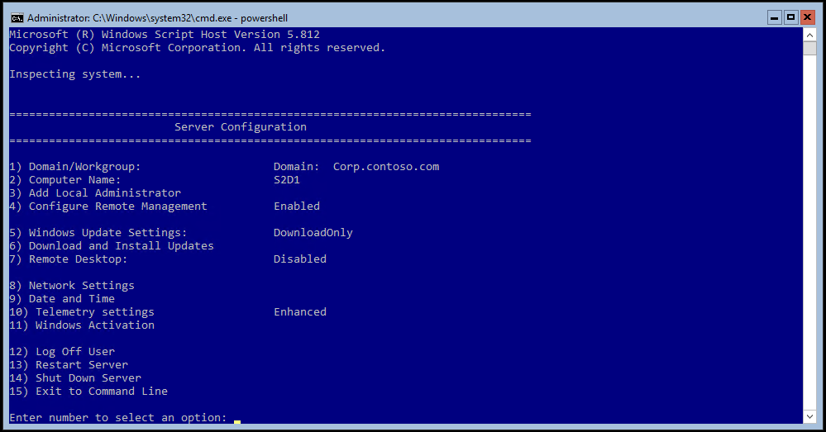
Server Config tool
Notes:
Tools that already exist in Windows server 2012

Slide 5
Demo
Server Config tool

Slide 6
Server Config tool
Join server to domain
Change Computer Name
Enabling/Disabling Remote Management and Remote Desktop
Managing Windows Updates
Network Settings
Time Settings
Windows activation
Restarting

Slide 7
Remote Server Administration Tools
Adding servers
Adding/removing roles and features
Remote Event Viewer access (beware of FW rules needed)
Remote Disk Management (beware of FW rules needed)
Basic performance measure
Best Practice analysis

Slide 8
Demo
Remote Server Administration Tools

Slide 9
Power Shell - remotely
Verb-Noun –Computername
Invoke-Command -ComputerName Something -ScriptBlock {Get-Service}
Enter-PSSession
PowerShell direct
Enter-PSSession -VMName NTK-CORE -Credential
(Get-Credential)

Slide 10
Demo
Power Shell - remotely

Slide 11
Power Shell – Replacement for common tools
Get-NetIPConfiguration → ipconfig
Get-NetAdapter → network adapter
Test-NetConnection → ping
Resolve-DnsName → nslookup
Get-NetTCPConnection → netstat
Get-SmbConnection
Get-SmbOpenFile

Slide 12
Demo
Power Shell – Replacement for common tools

Slide 13
Why do you torture me with this PowerShell
Portability and repeatability
Automation of processes
Scalability (do it once on several servers at the same time)
Faster documentation
There still (again) is an elegant way for GUI lovers.
Manage from Web Browser → Honolulu (now Windows Admin Center)

Slide 14
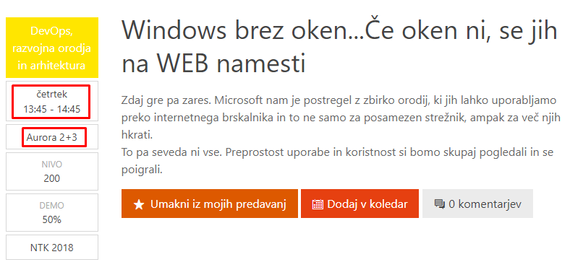
And what now?
Story continues here at NTK 2018

Slide 15
How to proceed with Windows Server CORE
Go and start using PowerShell (e.g. mva.ms )
Implement your first Windows Server Core (you can use aka.ms/WSLab )
Learn some more PowerShell
Get info from several servers at once
Stop loosing time
Invest gained time to learn something new
There are several conferences and community events available, where you can learn new and interesting “stuff” (e.g. ExpertsLive.eu, SloWug.si...)

Slide 16
Few words about me
Follow me on Twitter → @MatjazZnidar
Visit my blog → https://m-12.net
Mail me → matjaz@m-12.net
Stay curious and never stop learning!!
Thank you

