Slide 2
Why do we have so many successful cyber attacks?
Damir Dizdarević
Logosoft d.o.o.
Sarajevo

Slide 4



Navigating a shifting world
Conventional security tools have not kept pace
The nature of business and work have changed
Cost of breaches and regulations are increasing
Notes:
Talk track:
We are in an era of unprecedented economic uncertainty. Many organizations face constrained resources as they navigate new business challenges. Virtually overnight, companies have seen the need to accelerate digital transformation, which ensures worker productivity and responds to rapidly shifting customer expectations. As the technology, business models, and overall landscape evolves, the way people work has changed: we no longer expect to access the myriad of corporate resources solely from the office and on company-owned devices. In many ways, every company is now a technology company, providing services for their customers and employees. And as security teams are charged with protecting an ever-growing digital footprint, they now face added pressure to cut costs.
To secure their environments, organizations must develop new digital capabilities and break down data silos. Data and information are the lifeblood of the transformation, but they also increasingly attract cybercriminal activity. Traditional security approaches have failed us. A hardened perimeter (privileged corporate network) is, at best, a psychological security blanket, but it won’t hold. Siloed on-premises tools and datasets hinder visibility, correlation, and automation. Paradoxically, adding more tools typically makes you less secure due to compatibility issues and assumptions about your coverage.
On top of all of this—and perhaps because of it—the cost and number of breaches increase every year. As governments try to keep up, regulatory rules are constantly changing, and the cost of compliance increases as well. Over 1,000 regulatory bodies around the world release an average of 217 updates per day.¹ Keeping up isn’t easy. Since you can’t be compliant without first being secure, everything starts with security.
1 https://images.marketing.refinitiv.com/Web/ThomsonReutersFinancialRisk/%7Bf798765e-1a9b-4975-98c9-a133945d21e8%7D_Cost_of_compliance_2020_FINAL230620.pdf

Slide 5

Shift from multiple portals….
Email
Endpoints
Identities
Cloud Apps
Posture
Network
Notes:
Typical challenge = number of portals/experiences – case for both us and competitors,
Our advantage is that we have best-in-class staff natively – show the reality of today. BUT we can do better -

Slide 6
Key customer pain points
Zero days
Network boundaries
Cross-platform
Zero days continue to plague the industry
Perimeters are eroding, unique solutions are required to harden
Heterogeneous environments make
it challenging
Bottom line: Organizations struggle to proactively adjust their security posture
Notes:
Add a new pain point for operationalized ?

Slide 7
Key customer pain points
Solutions that depend on regular updates can not protect against the 7 million unique threats that emerge per hour
The game has shifted from blocking recognizable executable files to malware that uses sophisticated exploit techniques (e.g: fileless)
While Attack Surface Reduction can dramatically increase your security posture you still need detection for the surfaces that remain
We live in a world of hyper polymorphic threats with 5 billion unique instances per month

Slide 8
Key customer pain points
46% of compromised systems had no malware on them
As attacks become more complex and multi-staged,
it’s difficult to make sense of the threats detected
Following an advanced
attack across the network
and different sensors can
be challenging
Click on a URL
Installation
Persistency
Reconnaissance
Collecting evidence and
alerts, even from 1 infected device, can be a long
time-consuming process
Exploitation
C&C channel
Privilege escalation
Lateral movement
Living off the land - Attackers use evasion-techniques

Slide 9
Key admin’s pain points
More threats, more alerts leads to analyst fatigue
Analysts overwhelmed by manual alert investigation & remediation
Alert investigation
is time-consuming
Alert queue
Expertise is expensive
Manual remediation requires time
Analyst 1
Analyst 2
Talent shortage in cybersecurity

Slide 10
Key admin’s pain points
Need for additional threat context
No threat expert to
contact when needed
As threats are becoming complex,
I could need additional context and
guidance on alert handling
Missing guidance
on alert handling
Click on
a URL
Installation
Exploitation
C&C channel
Persistency
?
Reconnaissance
Lateral movement
Important alerts
might get missed
Does this alert or event really matter to my org?

Slide 11

Historical roles & friction
Security Team
IT Team
Responsible for security monitoring and reducing risk
Analyze threats, security incidents, exposure and identify mitigations
Define security policies
Priority is on quick remediation
on impacted devices/users
Responsible for policy configuration including security policies
Analyzes change impact and stages rollout of global policies
Priority is a stable IT environment and low costs

Slide 12
Anatomy of an on-premises and cloud environment attack
One example of how an attack happens and compromises an entire organization
Day 137–143:
Attackers create rules on Contoso’s SharePoint and email to automate data exfiltration to a cloud storage solution
Exfiltrate
data
Compromised
credential
Day 1–11:
Attacker compromises
privileged user’s non-
MFA-enabled account
Day 16–218:
Attackers perform mailbox searches across Office 365
Pivot
to on-prem
Day 16–163
(on-premises):
Attacker uses stolen
credentials to VPN into corporate network
Day 163–243
(on-premises):
Attacker moves laterally throughout organization’s network, compromising privileged credentials
Move
laterally
Notes:
This is an example of a real attack which helps to show how attackers exploit vulnerabilities and can move throughout an organization’s environment – both on-premises and in the cloud. Most SecOps teams review the data from on-premises and cloud environments separately, which makes it very difficult to correlate information between these environments and see the full scope of an attack.
Let’s look at how an attack in this environment might occur …
In this case they gained access to an admin user where the account wasn’t protected with multi-factor authentication.
Using this compromised account, they had the ability to search through email and SharePoint documents where they also wee able to exfiltrate data by creating automated rules.
This gave them access to the cloud environment, but they also found a way to pivot into the on-premises environment.
The attacker found VPN credentials as part of the email search and used these to logon to the on-premises environment.
Once there, they were able to gain access to the on-premises environment, now they then move laterally to future compromise the environment.
As they move laterally, they can find and compromise additional users and seek out users with greater privileges--eventually seeking out users with admin rights and finally taking over the entire organization.
Unfortunately, the path doesn't take the attackers that long to traverse.
The SecOps team needs to understand the full scope of these types of attacks, from on-premises to the cloud, and that were Microsoft can help.

Slide 13
Broad introduction to response before the detail
It’s easy to miss risky configurations…
Threats can originate anywhere…
Activity volume makes prioritization difficult…
Notes:
Here is where we introduce the risks with an environment that is enterprise-scale, includes on-premises and cloud assets, and is highly complex.
We want to convey the following:
It’s easy to miss risky configurations, which can lead to critical vulnerabilities.
Threats can originate anywhere, and hackers can find many potential weaknesses in large, complicated environments.
SecOps teams can’t chase down every potential threat; they need help to prioritize massive activity volume.
Additionally, if SecOps teams don’t have the best products in place to deal with these security risks, both time and resources can easily be wasted, and most can’t afford that kind of inefficiency—especially in times that are challenging for nearly all businesses.

Slide 14
Attacks go across perimeter defense stack boundaries
Applications
Application protection
Endpoints
Endpoint protection
Identity
Identity protection
Data
Email and data protection
Brute force account,
use stolen account
User receives an email
Open an attachment
Click on a URL
Exploitation
Installation
C&C channel
Persistence
Privilege escalation
Reconnaissance
Lateral movement
Access to
shared resources
User browses
to a website
User runs
a program
Notes:
Hidden, as this builds on the information from slide 3, but allows for more detail if the audience request.
To understand where Microsoft Defender for Identity fits into the broader array of Microsoft security products, it helps to look at a typical attack sequence.
In most attack campaigns, hackers get their initial foothold by phishing the user:
Say an employee received a malicious mail and clicked the attachment.
Microsoft’s first line of defense is Microsoft Defender for Office 365, leveraging URL and attachment detonation on any incoming e-mail.
If Microsoft Defender for Office 365 is not in use by the organization, or if the email came through a different path, for example your personal e-mail, then the attachment will try to run a malware on the device where it was opened.
The Exploitation & Installation and the Command & Control phases typically occur on end-points where Microsoft Defender for Endpoint can detect attacks.
This is not the only way to attack an organization. It only takes one account to be compromised for the attacker to establish an entry point, and attacks like Password Spray attacks are remarkably efficient:
Say there is an account without Multi Factor Authentication enabled, and has a password that is easily guessed or susceptible to brute force attacks.
Once that account is compromised, attackers leverage that user's identity to look for opportunities to discover and enumerate groups with privileged or VIP users.
Attackers will then attempt to compromise those discovered VIPs (including CxO users, or domain/enterprise admins) to access and then exfiltrate company resources.
Attacks can occur across all domains – Applications, Devices, Identity and Data. The Microsoft 365 Defender suite of products allows you too see these attacks across all of these domains. Microsoft Defender for Identity has a unique role to play in the attack kill-chain by helping to protect Identities. Specifically, Microsoft Defender for Identity analyzes Active Directory data from the network, security events and tracing data, in on-premises environments, to help protect these environments from would-be attackers. Together with Azure Active Directory Identity Protection, and Microsoft Defender for Cloud Apps, Microsoft Defender for Identity helps to protect Identities both on-premises and in the cloud.

Slide 15
A new security perimeter—user identity
Users are the new perimeter, and a single compromised user can lead to a business shutdown
Notes:
It only take one user to potentially compromise and entire organization!
Because attackers can potentially gain access to an entire organization through compromising a single user, identity has become the new security perimeter.
And for the hybrid enterprise, securing user identity across an entire organization can be a daunting Security Operations challenge.

Slide 16
A cyber attack – real-life example

Slide 17
A real-life example of cyber attack
(most likely) a click on malicious link in an email
Installing a malware on the workstation
Extracting the hash of admin password
Creating a new admin account
Preparing the field for attack (mostly by using Group Policy)
Actual attack

Slide 18
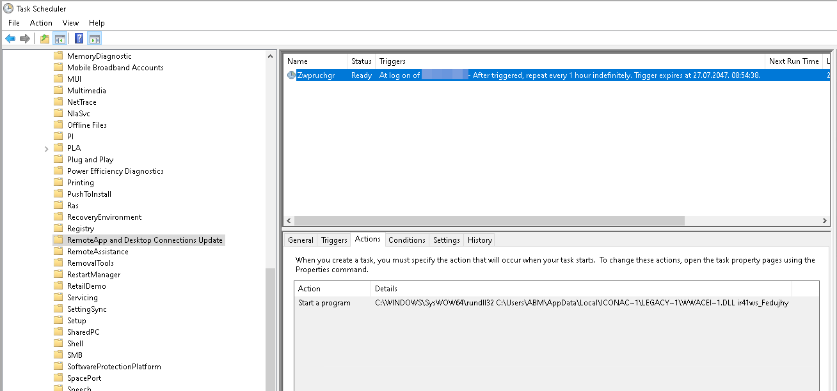
Task Scheduler – a great place to hide

Slide 19
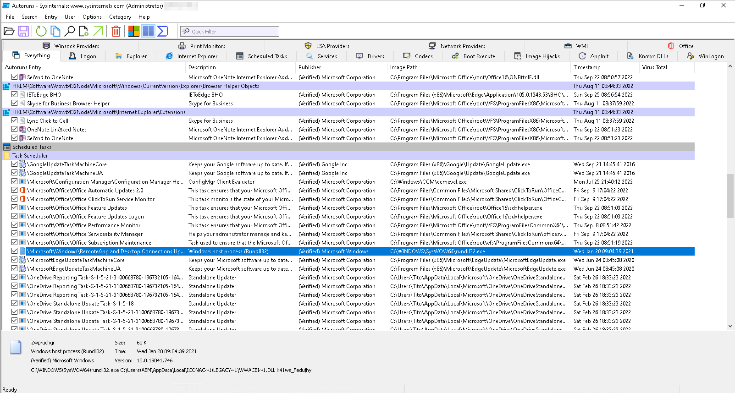
Sysinternals – it can greatly help

Slide 20
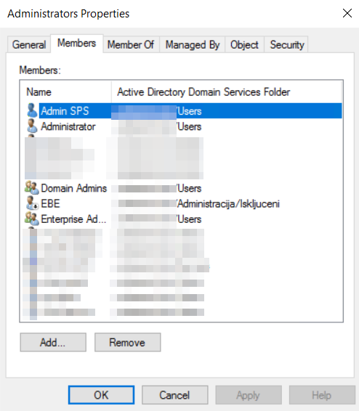
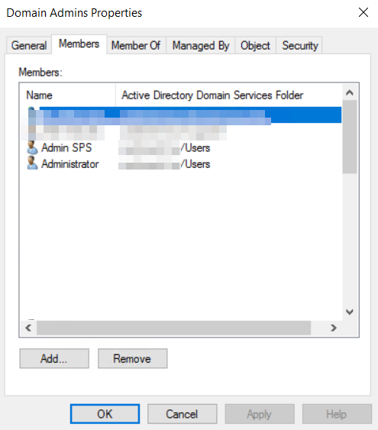

Additional admin account creation

Slide 21
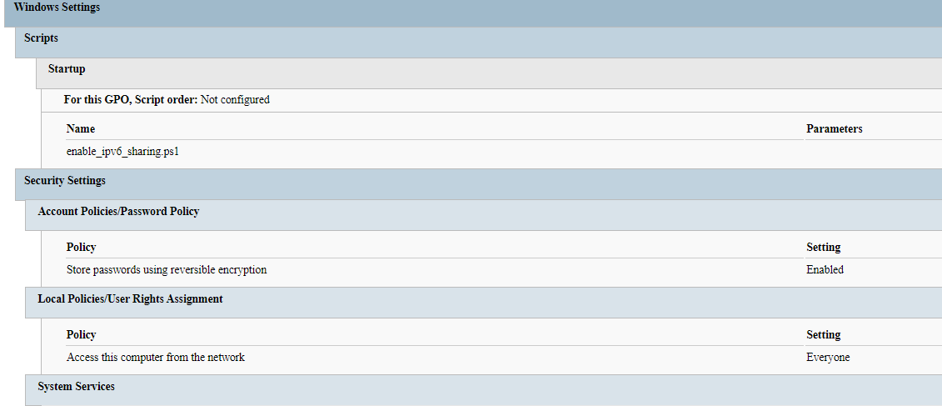
Group Policy – Preparation and defence disabling

Slide 22
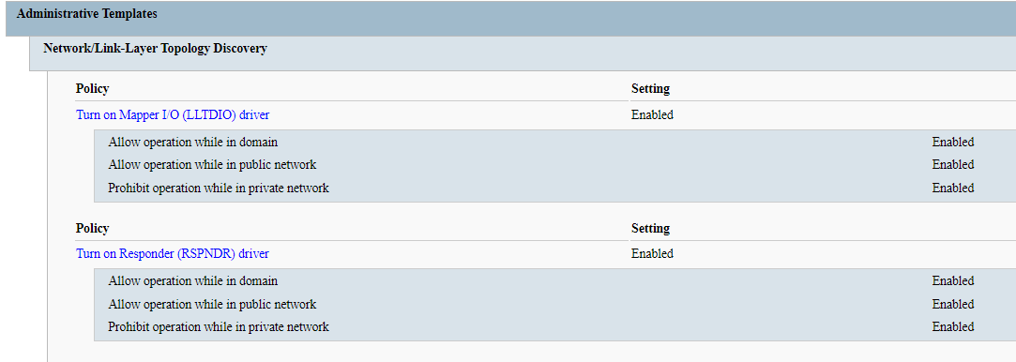
Group Policy – Preparation and defence disabling

Slide 23
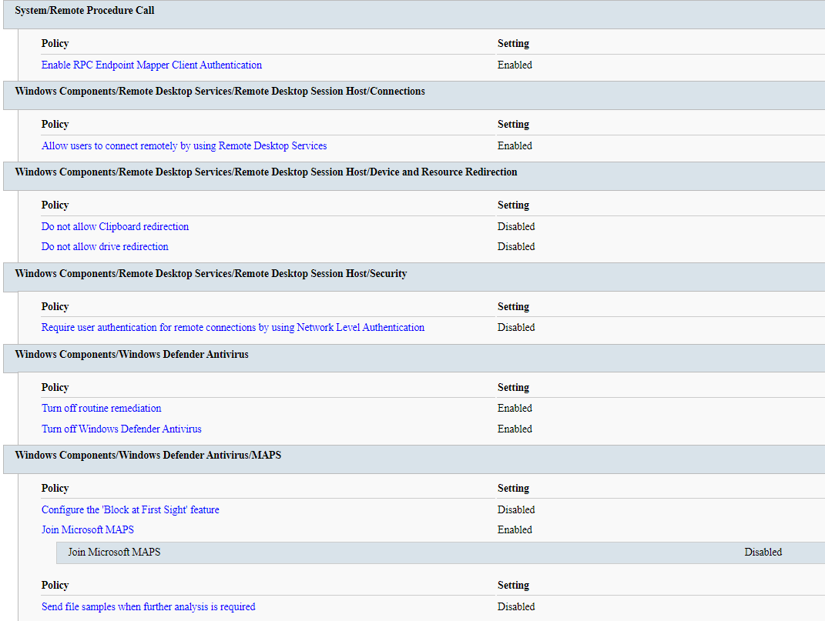
Group Policy – Preparation and defence disabling

Slide 24
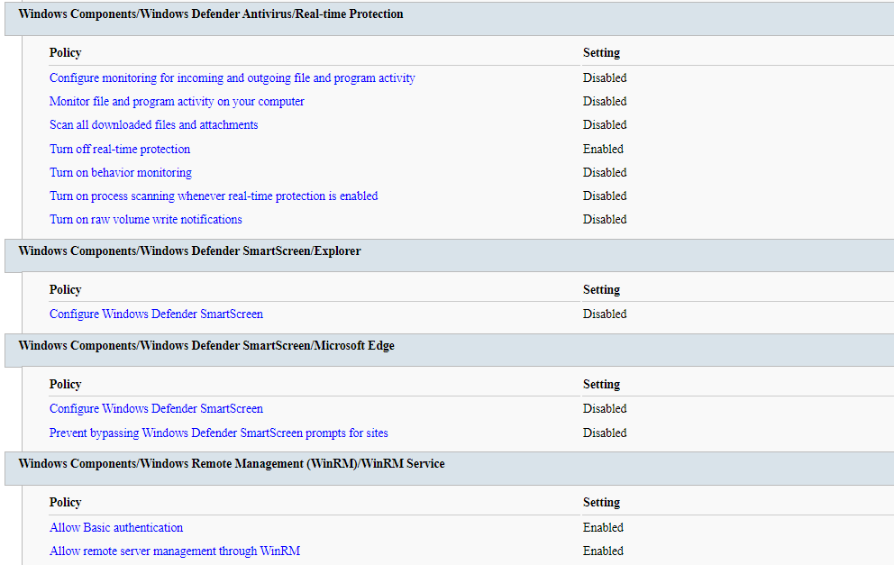
Group Policy – Preparation and defence disabling

Slide 25
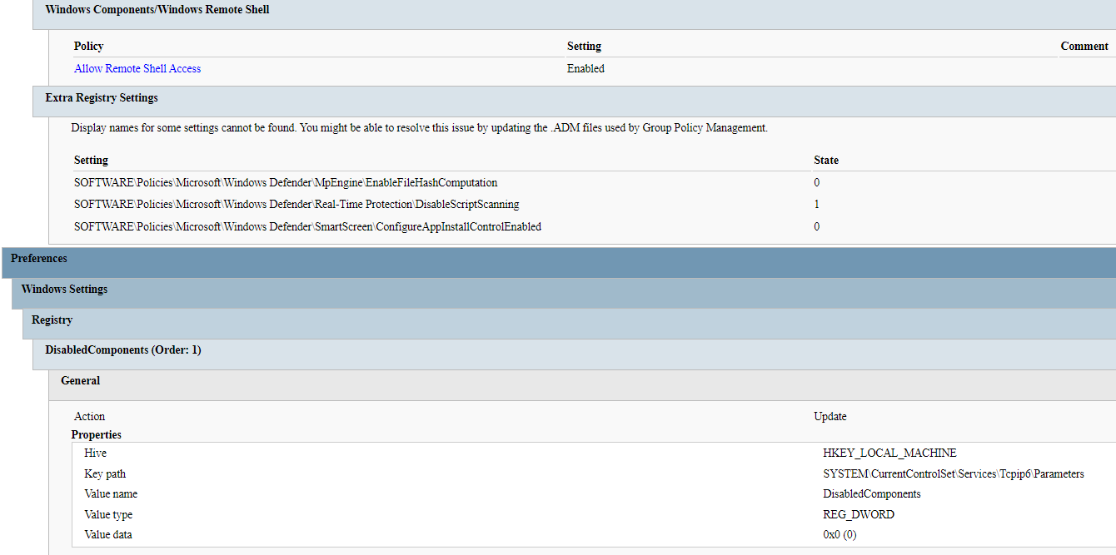
Group Policy – Preparation and defence disabling

Slide 26
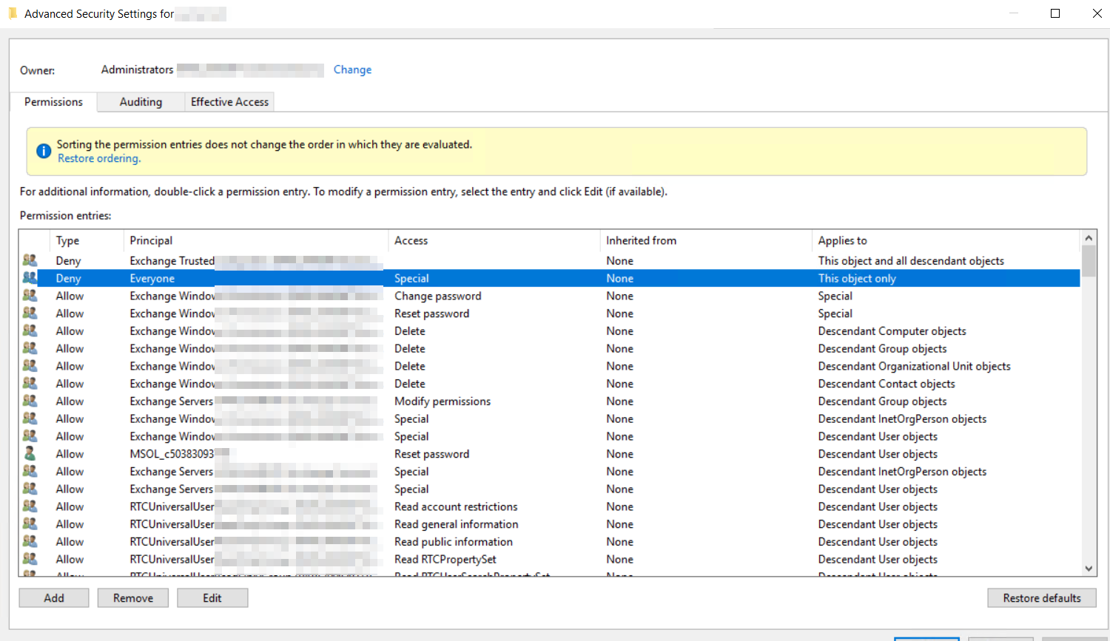
Making things harder to fix

Slide 27
What do we need today?
We need a solution to detect suspicious activities not just files
We need a solution to detect exposed identites and devices against current situation
We need a solution to automatically remediate threats
We need a solution to provide meaningful information to admins

Slide 28

Detection breadth: suspicious activities and behavior analysis
Alerts
Suspicious activities
High confidence suspicious
activities representing attacks
User behavior anomalies,
represent low fidelity signals
Greater visibility
Notes:
Microsoft Defender for Identity also generates more than just alerts:
Alerts provide signals regarding high-confidence suspicious activities that represent likely attacks. Alerts include the following:
Known Attack patterns
Entity Behavior
Suspicious activities are lower fidelity signals that point to anomalous user behaviors and focus on the following:
Learned entity behavior
Comparison to Peer behavior
Statistics / Machine Learning
Taken together, analysis of both high-fidelity alerts and suspicious activities provides SecOps with greater visibility into potential threats.

Slide 29
Suspicious activity analysis process
Example: User accesses the ‘finance’ server
Is the ‘finance server’ accessed by many users in the organization?
Has this user accessed this server before?
Does this user have a usual pattern of logons to servers?
Do the peers of this user login to this server?
Normal
Suspicious
Notes:
In a simplified depiction of suspicious user activity analysis, Microsoft Defender for Identity looks at an activity and determines where that activity falls on a spectrum of “normal” to “suspicious.”
In this instance, the user accesses the finance server:
Microsoft Defender for Identity then looks to see if the finance server is accessed by many users within the organization.
It also looks at whether this is the first time this user has accessed the finance server.
It then analyzes whether this user has a usual pattern of logons to servers.
And finally, is this user’s behavior consistent with peer behavior with respect to this server?
With this type of analysis, Microsoft Defender for Identity can identify truly suspicious user behaviors that can indicate real threats.

Slide 30


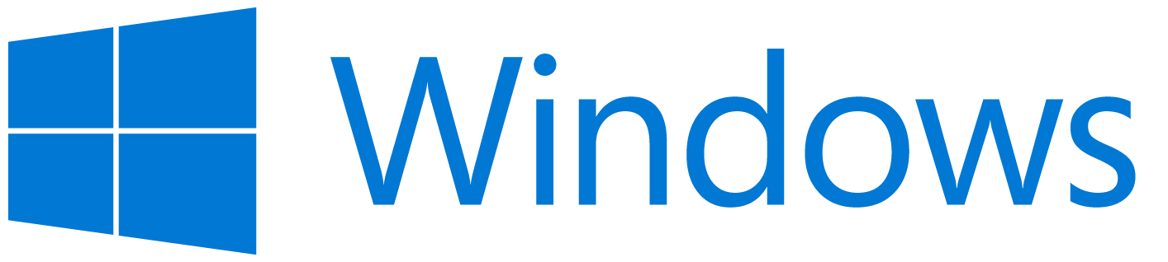




Microsoft Defender – multiplatform approach
Cisco
Juniper Networks
HP Enterprise
Palo Alto Networks
Azure Virtual Desktop
Endpoints and servers
Mobile device OS
Virtual desktops
Network devices

Slide 31




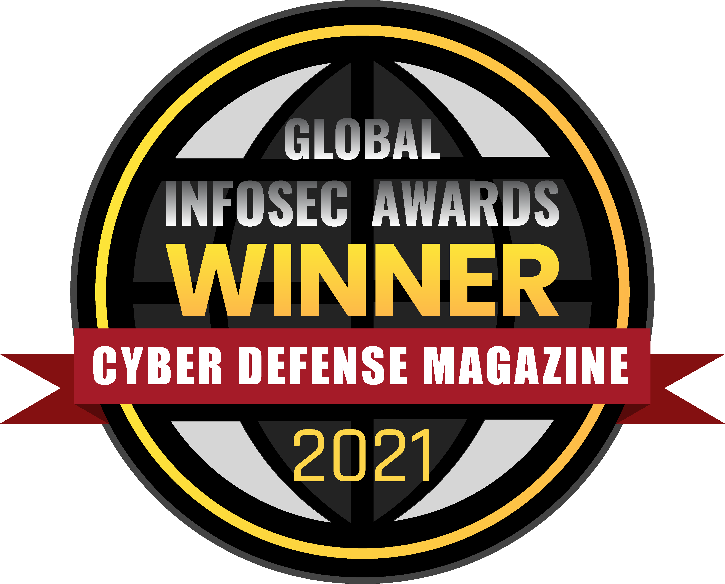

An industry leader in endpoint security
Gartner names Microsoft a Leader in 2021 Endpoint Protection Platforms Magic Quadrant.
Microsoft leads in real-world detection in
MITRE ATT&CK evaluation.
Forrester names Microsoft a Leader
in 2021 Endpoint Security Software as a Service Wave.
Microsoft Defender for Endpoint awarded a perfect 5-star rating by SC Media in 2020 Endpoint Security Review
Forrester names Microsoft a Leader
in 2020 Enterprise Detection and Response Wave.
Microsoft won six security awards with Cyber Defense Magazine at RSAC 2021:
Best Product Hardware Security
Market Leader Endpoint Security
Editor's Choice Extended Detection and Response (XDR)
Most Innovative Malware Detection
Cutting Edge Email Security
Our antimalware capabilities consistently achieve high scores
in independent tests.

Slide 32
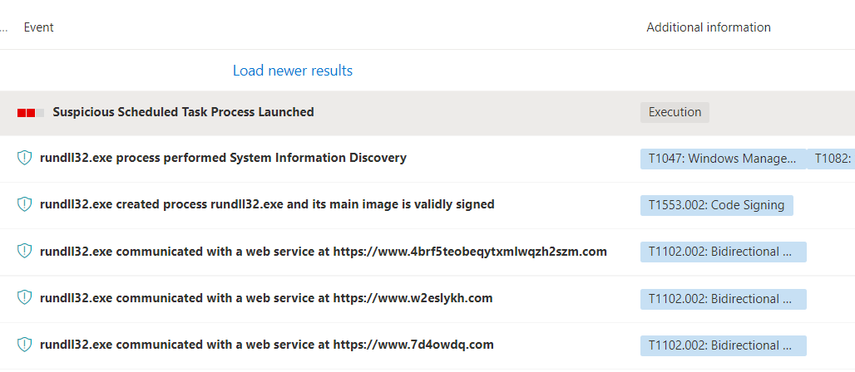
Microsoft Defender platform – suspicious activities

Slide 33
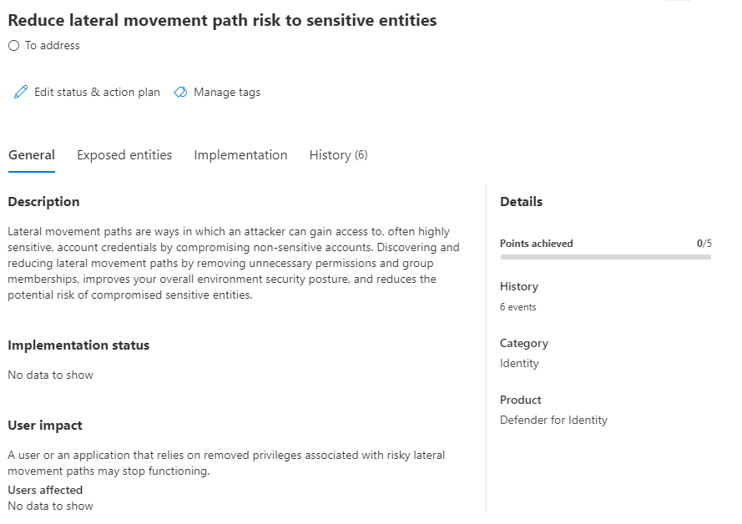
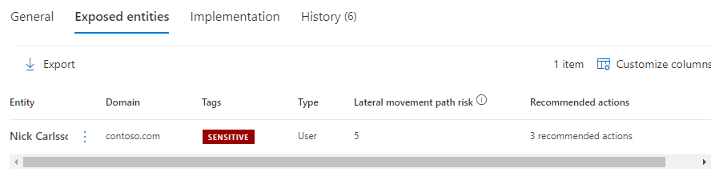
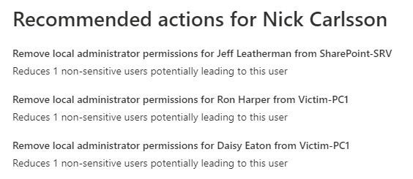
Microsoft Defender - risky lateral movement paths
View top sensitive accounts that carry lateral movement risk

Slide 34
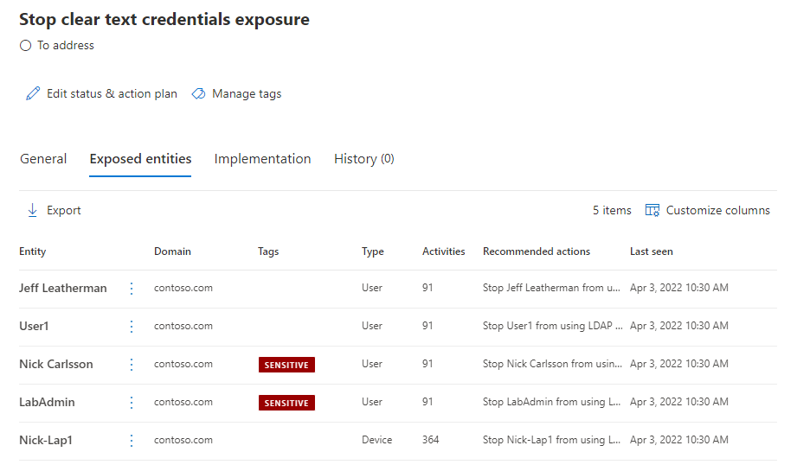
Microsoft Defender - Exposure of clear-text credentials
View top entities that are exposing credentials in clear text
Notes:
Another example of eliminating risky configurations is identifying entities that are exposing clear-text credentials—but Microsoft Defender for Identity does much more than just point out which applications are using clear-text authentication:
Microsoft Defender for Identity provides significant information to help SecOps understand clear-text authentication risks.
Through this view, SecOps can start to understand which applications, users, and devices are potentially impacted if clear-text authentication capabilities are switched off.
SecOps can also begin to understand the potential business impact of curtailing clear-text authentication usage.
By providing investigation tools, Microsoft Defender for Identity allows SecOps to contact application owners and plan for finding alternate approaches for applications still using this risky configuration.

Slide 35
Microsoft Defender for Endpoint Auto IR
Security automation is…
mimicking the ideal steps a human would take
to investigate and remediate a cyber threat
Security automation is not…
if machine has alert → auto-isolate
When we look at the steps an analyst is taking as when investigating
and remediating threats we can identify the following high-level steps:
1
2
3
4
  Determining whether the threat requires action
  Performing
  necessary
  remediation actions
  Deciding what
  additional investigations should be next
  Repeating this as many times as necessary
  for every alert ☺

Slide 36
This is not school, but we
love to get grades.
Please fill out our
questoineers and leave
us your feedback.
You may even win some
cool rewards.

