Slide 2
Privileged Access Workstation
Luka Obersnu
Premier Field Engineer

Slide 3
Session Objectives And Takeaways
Session Objective(s):
Refresh knowledge about „new“ security paradigm
Educate you about PAW and credential theft
Understand PAW value proposition
Key Takeaway 1
PAW is a safe place to use privileged credentials
Key Takeaway 2
PAW is a key building block for credential theft mitigation

Slide 4
Agenda
The Modern Enterprise
Identity is the new security “perimeter”
Problems at securing Identity
Protect the Identity
Credential Theft
Securing Privileged Access
Storyline
What is the PAW Solution
PAW Scenarios
PAW Hardware Options
PAW Controls
How do we put it all together?

Slide 5

The Modern Enterprise
Azure Active Directory
Rights Management Services
Key Management Services
PaaS
IaaS
3rd Party IaaS
Office 365
Microsoft Azure
Admin Environment
3rd Party SaaS
High Value Assets
On-Premises Datacenters
Customer and Partner Access
Branch Office
Intranet and Remote PCs
Mobile Devices

Slide 6

Identity is the new security “perimeter”
Active Directory and Administrators control all the assets
Active
Directory
Azure Active Directory

Slide 7
Identity is the new security “perimeter” under attack
Active Directory and Administrators control all the assets
Browsing
Attackers Can
Steal any data
Encrypt any data
Modify documents
Impersonate users
Disrupt business
operations
Active
Directory
One small mistake can
lead to attacker control
Azure Active Directory

Slide 8
Why do we bother?
To protect personal identities.
  Protect from stealing our „cyber“ identity
  Protect our property (documents, pictures, video, …)
  Protect from lawsuits, prison, …
To protect our business identities.
  Prevent from stealing/destroying company property
  Prevent from leaking company/customer/personal data
  Prevent from losing partners trust
At the end it all translates to $ or €

Slide 9
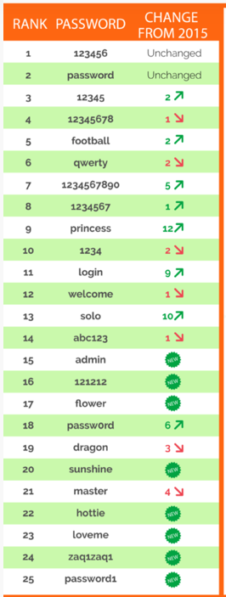

Problems at securing Identity
Notes:
https://www.teamsid.com/worst-passwords-2016/

Slide 10
More problems at securing Identity - Admins
Joe needs permissions to manage some resource (e.g. Exchange)
Joe calls helpdesk, his account is added to the “Domain Admins” group in AD
Joe logs in and receives “Domain Admins” membership throughout session lifetime
Joe completes task
(Joe should call helpdesk back but …)
Server
Exchange
Group
Domain Admins
Computer
Joe’s Workstation
Joe remains in “Domain Admins” group indefinitely; Any program run by Joe is run as a Domain Admin
User Account
Joe

Slide 11
More problems at securing Identity - Patching
Security Updates deployed less frequently than every month
Latest Update Installation Older Than 60 Days
Missing hotfixes
The organizations does not apply security updates for hardware proactively
The organizations does not apply security updates for software proactively

Slide 12
More problems at securing Identity - Password policy and privileged groups membership
Password Policy (Allows Blank, Simple Passwords, Password length, Complexity, FGPP, ….)
Administrative Group Contains Many Members
Configure service accounts and applications with the minimum required permissions
Enforce rigorous password policies for administrative accounts
Ensure administrative credentials are not shared between IT team members
Member of Well Known Administrative Group Has Password Never Expires Set
5 Percent or More Users Have Password Never Expires
User accounts found with Password not required flag set

Slide 13
Administrative privileges
All the commonplace attacks exploit privileged accounts:
  Stolen admin
  credentials
Malicious service
provider staff
  Insiders
❶
❷
  Administrator privileges will be compromised:
  social engineering, bribery, private initiative
  20 years ago we gave
  the administrator
  the keys to the kingdom; we can’t just take it away

Slide 14
The need for privileged access management
Attackers target accounts with privileges
  Use non-privileged accounts to get into the front door
  Footprint the organization to determine which accounts are privileged
  Lure administrators to workstations to execute credential theft attack
Microsoft, how do we secure privileged accounts?
  Everyone should do their day-to-day business as an unprivileged user
  Only grant privileged access when needed, and remove it afterwards (JIT)
  Retain and review audit activity pertaining to privileged accounts
Customers know this advice, but very few follow it
  Requires a lot of effort in terms of process and technology

Slide 15
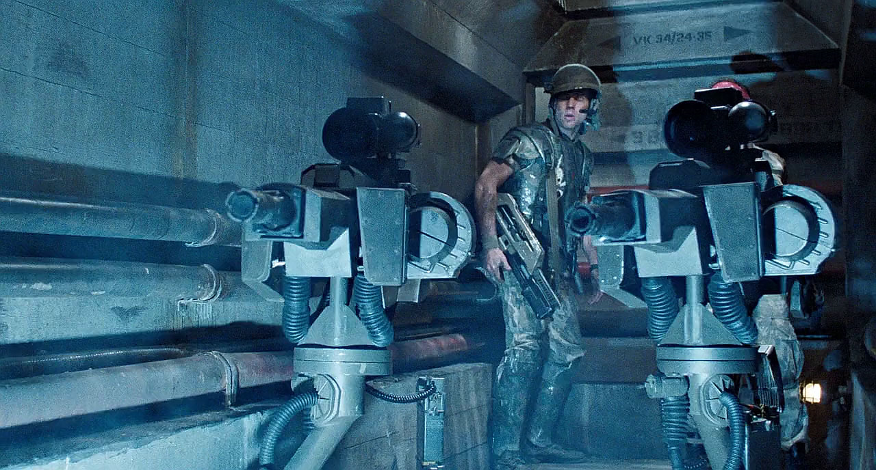
Protect the Identity

Slide 16
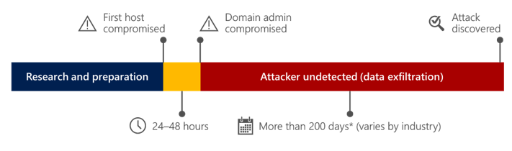
Protect Identity
Typical Attack Pattern
  Initiate
  Escalate
  Execute Mission

Slide 17










Protect Identity: Typical Attack Pattern
Compromises privileged access
Tier 0
Domain &
Enterprise
Admins
  24-48 Hours
Directory Database(s)
Beachhead (Phishing Attack, etc.)
Lateral Movement
  Steal Credentials
Domain Controllers
  Compromise more hosts & credentials
Tier 1
Server
Admins
Privilege Escalation
  Get Domain Admin credentials
Execute Attacker Mission
  Steal data, destroy systems, etc.
  Persist Presence
Tier 2
Workstation
& Device
Admins

Slide 18
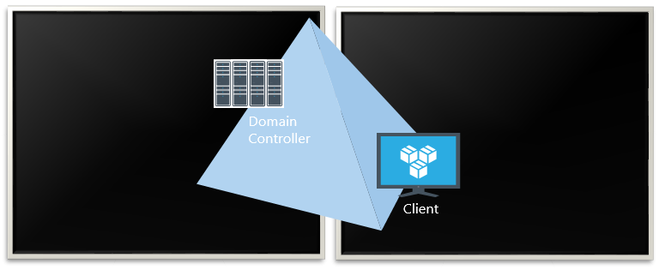
Demonstration
Domain Controller
Client
1. Initiate
2. Escalate
Attack Operator
Domain Admin

Slide 19
Securing Privileged Access
Three Stage Mitigation Plan
Stage 1
Stage 2
Stage 3

Slide 20


Securing Privileged Access
Stage 1
Stage 2
Stage 3
First response to the most frequently used attack techniques
3. Unique Local Admin Passwords for Workstations
http://Aka.ms/LAPS
4. Unique Local Admin Passwords for Servers
http://Aka.ms/LAPS
Active
Directory
Azure Active Directory
1. Separate Admin account for admin tasks
2. Privileged Access Workstations (PAWs)
Phase 1 - Active Directory admins
http://Aka.ms/CyberPAW

Slide 21



Securing Privileged Access…
Stage 1
Stage 3
Stage 2
Build visibility and control of administrator activity, increase protection against typical follow-up attacks
6. Attack Detection
http://aka.ms/ata
2. Time-bound privileges (no permanent admins)
http://aka.ms/PAM http://aka.ms/AzurePIM
3. Multi-factor for elevation
Active
Directory
9872521
Azure Active Directory
1. Privileged Access Workstations (PAWs)
Phases 2 and 3 –All Admins and additional hardening (Credential Guard, RDP Restricted Admin, etc.)
http://aka.ms/CyberPAW
4. Just Enough Admin (JEA) for DC Maintenance
http://aka.ms/JEA
5. Lower attack surface of Domain and DCs http://aka.ms/HardenAD

Slide 22
Securing Privileged Access
Stage 1
Stage 3
Stage 2
5. Shielded VMs for virtual DCs (Server 2016 Hyper-V Fabric)
http://aka.ms/shieldedvms
Move to proactive security posture
1. Modernize Roles and Delegation Model
Active
Directory
Azure Active Directory
2. Smartcard or Passport Authentication for all admins
http://aka.ms/Passport
3. Admin Forest for Active Directory administrators
http://aka.ms/ESAE
4. Code Integrity Policy for DCs (Server 2016)

Slide 23
Securing Privileged Access
Attack
Defense
Credential Theft & Abuse
Prevent Escalation
Three Stage Mitigation Plan
Prevent Lateral Traversal
Stage 1
Stage 2
Stage 3
Increase Privilege Usage Visibility
DC Host Attacks
Harden DC configuration
Reduce DC Agent attack surface
AD Attacks
Assign Least Privilege
Attacker Stealth
Detect Attacks

Slide 24

Storyline
SQL
Alice
Corporate PC

Slide 25
Why is this a problem?

Slide 26



SQL
Alice
Corporate PC

Slide 27
What is the PAW solution?
Privileged Access Workstations
Safe place to use privileged accounts
Secured throughout lifecycle
Used to administer workstations, servers, applications and cloud

Slide 28

Tier Model
Control
Tier-0
Data and
Services
Tier-1
Access
Tier-2

Slide 29

Credential Hygiene
Control
Tier-0
Service
Interactive
Batch
All
Network
Data and
Services
Tier-1
Service
Interactive
Batch
All
Network
Service
Interactive
Batch
All
Network
Access
Tier-2

Slide 30
What problems do PAWs solve?
Privileged creds not exposed on standard clients
Credential exposure contained to same trust level
Enables tighter security controls

Slide 31
Tier 1 Administration Security
Human admins of Servers, Cloud Services, Virtualization, Management Tools, etc. (that aren’t Tier 0)
  Isolated User Mode (IUM)
  Microsoft Passport and Windows Hello
  Device Guard, Credential Guard
Best
  Detection - Advanced Threat Analytics
  Multi-factor Authentication (Smartcards, One Time Passwords, etc.)
  Just in Time (JIT) Privileges - Privileged Access Management
  Modification of IT Process and Privilege Delegation
Better
Separate Admin Desktops (PAW)
Separate Admin Accounts (standard user on PAW)
Associated IT Admin process changes
Enforce use of RDP RestrictedAdmin Mode
Local administrator password randomization (LAPS or similar)
Good/Minimum

Slide 32
Tier 2 Administration Security
Human admins of User Workstations, User Devices, Printers, etc. (Typically helpdesk and PC support)
  Isolated User Mode (IUM)
  Microsoft Passport and Windows Hello
  Device Guard, Credential Guard
Best
  Detection - Advanced Threat Analytics
  Multi-factor Authentication (Smartcards, One Time Passwords, etc.)
  Just in Time (JIT) Privileges - Privileged Access Management
  Modification of IT Process and Privilege Delegation
Better
Separate Admin Desktops (PAW)
Separate Admin Accounts (standard user on PAW)
Associated IT Admin process changes
Enforce use of RDP Restricted Admin Mode
Local administrator password randomization (LAPS or similar)
Good/Minimum

Slide 33
PAW Scenarios
PAW– Server Administration
Network Logon
RDP w/ Restricted Admin
RDP w/ LAPS Local Account
RDP w/ JIT Domain Account

Slide 34
PAW Scenarios
PAW – Workstation Administration
Remote Assistance
RDP w/ Restricted Admin
RDP w/ LAPS Local Account
Help Desk

Slide 35

PAW Scenarios
PAW– Tier 0 Administration
ESAE* is better
Network Logon
RDP
AD
(IPsec strongly recommended)
*Enhanced Security Administrative Environment

Slide 36
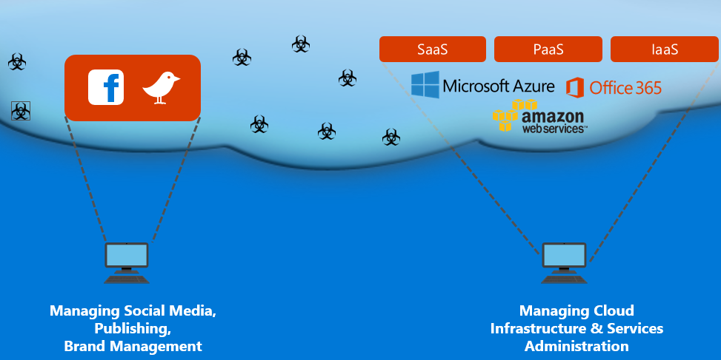
PAW Scenarios
PAW – Cloud Scenario

Slide 37
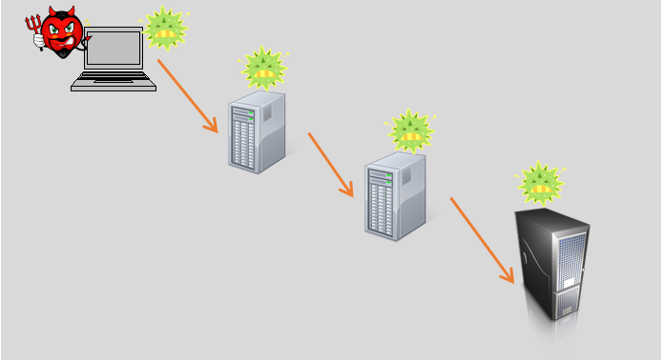
PAW Hardware Options
Clean Source Principle

Slide 38
PAW Hardware Options
Dedicated PAW Hardware
A
U
Separate dedicated hardware for PAW and Productivity

Slide 39

PAW Hardware Options
Hyper-V*
A
U
PAW as the host, Productivity as the guest

Slide 40



PAW Hardware Options
RDP Separation
PAW must be the RDP client
Productivity apps run on the RDP target which could be RDS, RemoteApp or VDI

Slide 41
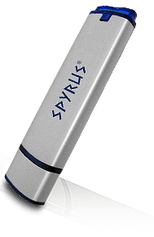
PAW Hardware Options
USB Bootable Device for PAW OS
U
A
A
U
PAW can be either the Windows-To-Go device or the physical workstation

Slide 42










Internet?
Internet Connectivity: Option 1
Virtual Machines
Corporate PC
Domain joined
Physical Machine
PAW Machine (tier 1)
Domain Joined

Slide 43



Internet?
Internet Connectivity: Option 2
Virtual Machines
Corporate PC
Domain joined
Physical Machine
VPN
PAW Machine (tier 1)
Domain Joined

Slide 44

PAW Add-ons
Smart Cards
IPsec
ITSM

Slide 45
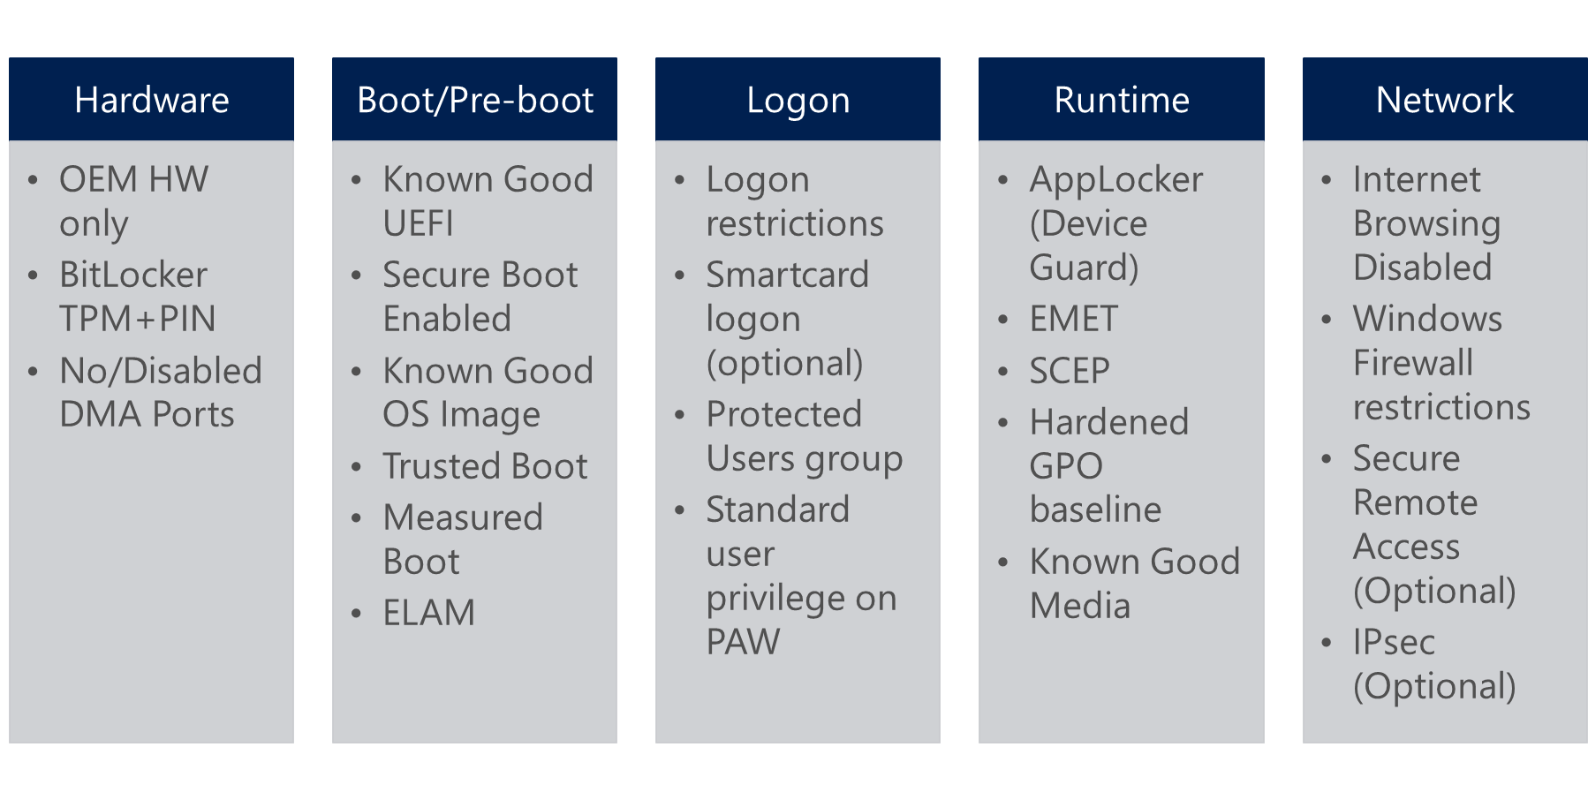
PAW Security Controls - Overview

Slide 46
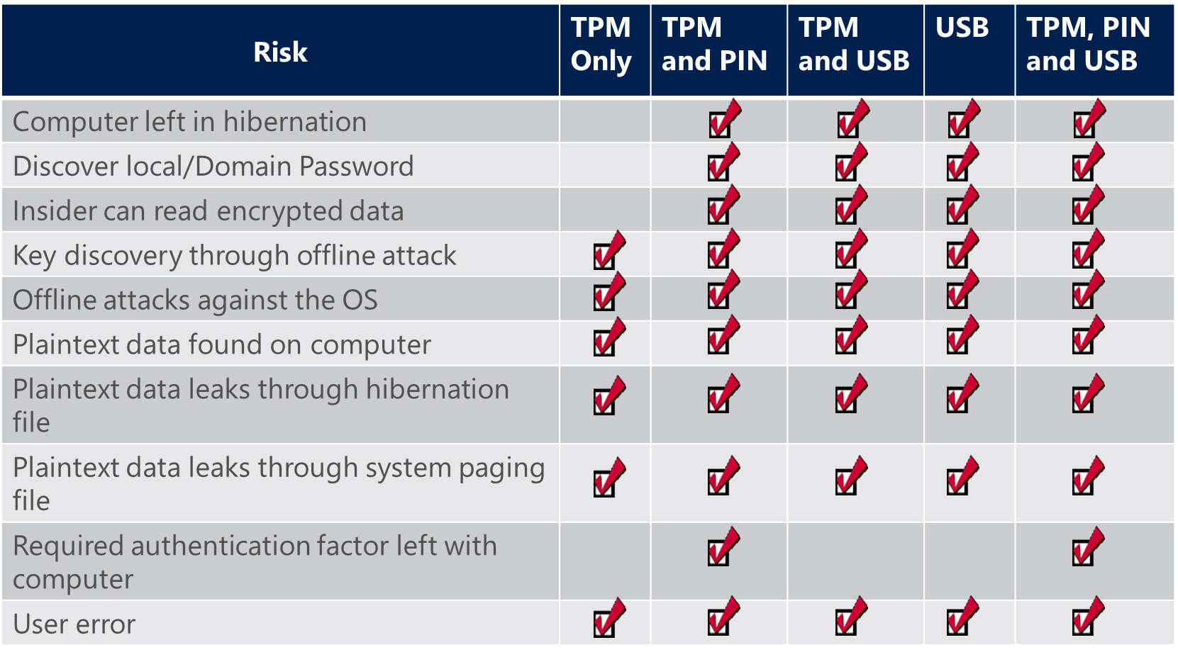
BitLocker

Slide 47
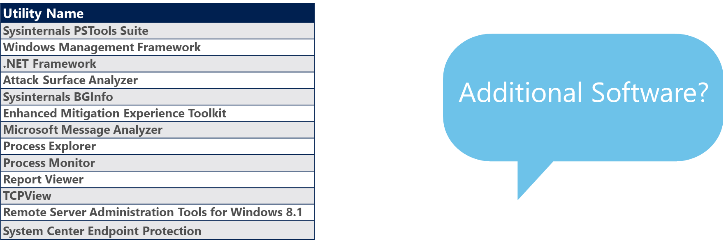
Software and Agents
Default software running on PAW

Slide 48
Firewall Design
Deny all incoming connections with the following exceptions:
  ICMP echo request/reply
  Remote Assistance

Slide 49
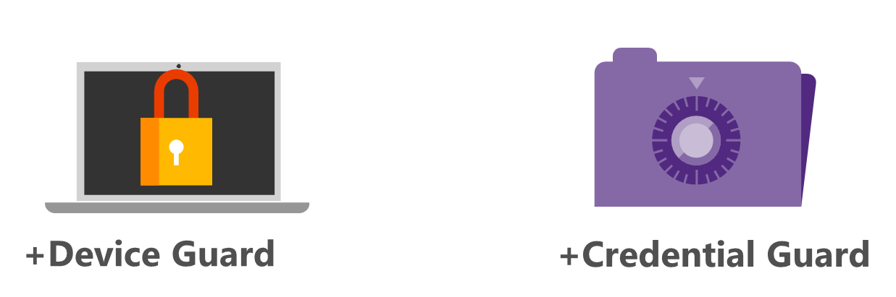
Windows 10

Slide 50
How do we put it all together?
Manual Build Process
Download Windows and other Software – Verify Hash’s
Install Windows and other Software (EMET, SCEP, etc.)
Harden Windows – Apply Windows 10 SCM Baseline, AppLocker (Device Guard), BitLocker, Windows Firewall, Encourage use of RDP Restricted Admin Mode
Enable for Cloud, Tier 1, Tier 2, or other Administration

Slide 51
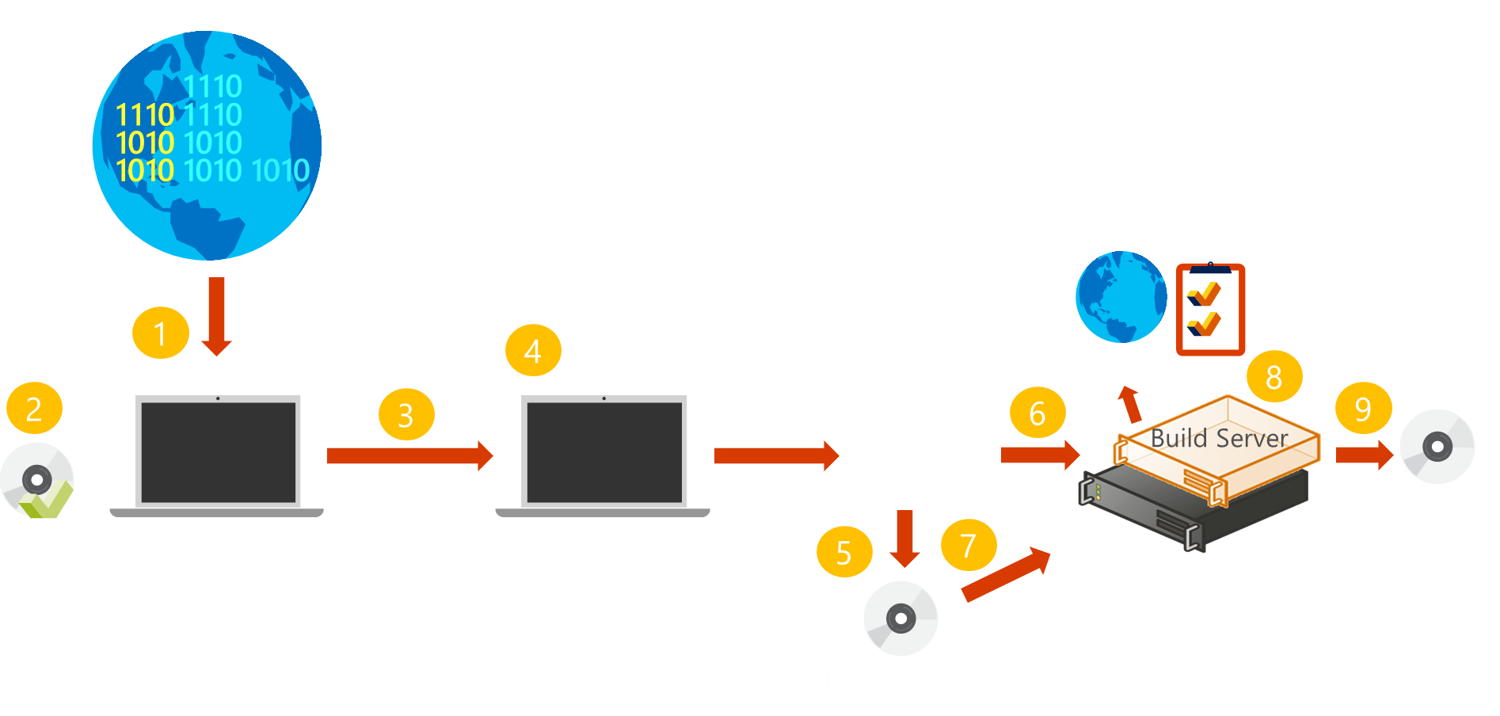
How do we put it all together?
Known Good Media Process - MDT

Slide 52
How do we put it all together?
Go to: Privileged Access Workstations:
https://docs.microsoft.com/en-us/windows-server/identity/securing-privileged-access/privileged-access-workstations
Download AD config Scripts: Privileged Access Workstation (PAW) Content:
https://gallery.technet.microsoft.com/Privileged-Access-3d072563
Download AD Remote Server Administration Tools for Windows 10:
https://www.microsoft.com/en-us/download/details.aspx?id=45520
Download AD Security baseline for Windows 10 (“Threshold 2”) – DRAFT:
https://blogs.technet.microsoft.com/secguide/2015/11/13/security-baseline-for-windows-10-threshold-2-draft/
Follow Privileged Access Workstations install guide:
https://docs.microsoft.com/en-us/windows-server/identity/securing-privileged-access/privileged-access-workstations

Slide 53
Let’s hear from you!
Where are you on the road to secure modern enterprise?
Are you using…
Dedicated Privileged Access Workstation (PAW) for IT administrators?
Advanced Threat Analytics (ATA) or 3rd party UEBA solution?
Local Administrator Password Solution (LAPS) Tool or 3rd party PAM solution for
  All Servers?
  All Workstations?

