Slide 2
Azure Networking Inside and Out
MUSTAFA TOROMAN

Slide 3

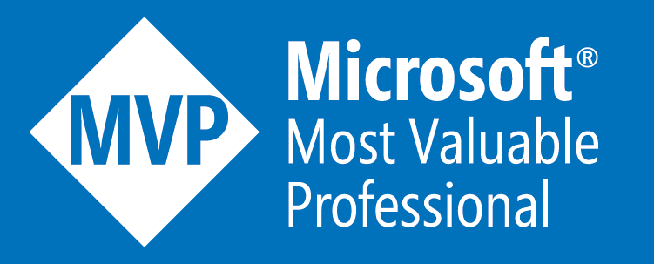
MUSTAFA TOROMAN
CTO@ run.events
Microsoft Azure MVP
MCSE, MCP, MCSA, MCITP, MCSD, MCT, MS v-TSP

Slide 4


EUROPEAN CLOUD SUMMIT 2023
WIESBADEN, GERMANY | 4-6 DECEMBER 2023
NTK20 for 20% discount
www.cloudsummit.eu

Slide 5
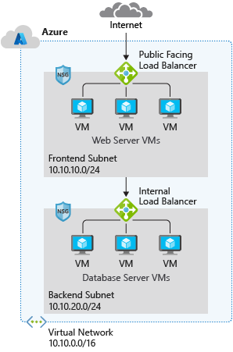
Capabilities of Azure Virtual Networks
Communication with the Internet
Communication between Azure resources
Communication between on-premises resources
Filtering network traffic
Routing network traffic
5
Notes:
Capabilities of Azure Virtual Networks
Azure VNet enables resources in Azure resources to securely communicate with each other, the internet, and on-premises networks.
Communication with the internet. All resources in a VNet can communicate outbound to the internet, by default. You can communicate inbound to a resource by assigning a public IP address or a public Load Balancer. You can also use public IP or public Load Balancer to manage your outbound connections.
Communication between Azure resources. There are three key mechanisms through which Azure resource can communicate: VNets, VNet service endpoints and VNet peering. Virtual Networks can connect not only VMs, but other Azure Resources, such as the App Service Environment, Azure Kubernetes Service, and Azure VM Scale sets. You can use service endpoints to connect to other Azure resource types, such as Azure SQL databases and storage accounts. When you create a VNet, your services and VMs within your VNet can communication directly and securely with each other in the cloud.
Communication between on-premises resources. Securely extend your data center. You can connect your on-premises computers and networks to a virtual network using any of the following options: Point-to-site virtual private network (VPN), Site-to-site VPN, Azure ExpressRoute.
Filtering network traffic. You can filter network traffic between subnets using any combination of network security groups and network virtual appliances like firewalls, gateways, proxies, and Network Address Translation (NAT) services.
Routing network traffic. Azure routes traffic between subnets, connected virtual networks, on-premises networks, and the Internet, by default. You can implement route tables or border gateway protocol (BGP) routes to override the default routes Azure creates.

Slide 6
Virtual Network address space
RFC 1918
10.0.0.0 - 10.255.255.255 (10/8 prefix)
172.16.0.0 - 172.31.255.255 (172.16/12 prefix)
192.168.0.0 - 192.168.255.255 (192.168/16 prefix)
Azure reserves 5 IP addresses
x.x.x.0: Network address
x.x.x.1: Reserved by Azure for the default gateway
x.x.x.2, x.x.x.3: Reserved by Azure to map the Azure DNS IPs to the VNet space
x.x.x.255: Network broadcast address
Unavailable address ranges:
224.0.0.0/4 (Multicast)
255.255.255.255/32 (Broadcast)
127.0.0.0/8 (Loopback)
169.254.0.0/16 (Link-local)
168.63.129.16/32 (Internal DNS)
Logical representation of your own network
Create a dedicated private cloud-only virtual network
Securely extend
your datacenter with virtual networks
Enable hybrid
cloud scenarios
6
Notes:
Azure Virtual Networks - https://azure.microsoft.com/en-us/services/virtual-network/
What is Azure Virtual Network? - https://docs.microsoft.com/en-us/azure/virtual-network/virtual-networks-overview
Address space: When creating a VNet, you must specify a custom private IP address space using public and private (RFC 1918) addresses. Azure assigns resources in a virtual network a private IP address from the address space that you assign. For example, if you deploy a VM in a VNet with address space, 10.0.0.0/16, the VM will be assigned a private IP like 10.0.0.4.

Slide 7
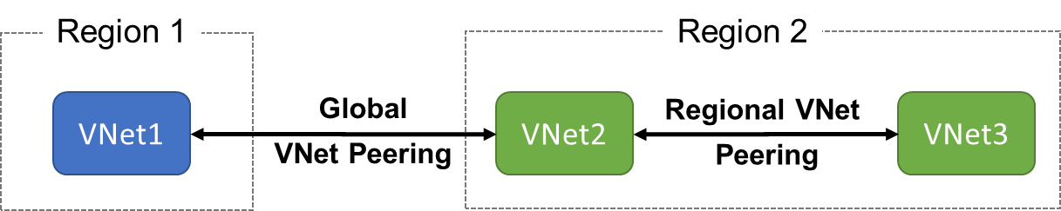
VNet Peering
VNet peering connects two Azure virtual networks
Two types of peering: Regional and Global
Peered networks use the Azure backbone
for privacy and isolation
You can peer across subscriptions and tenants
VNet peering is not transitive
7
Notes:
Virtual network peering - https://docs.microsoft.com/en-us/azure/virtual-network/virtual-network-peering-overview
Not encrypted traffic
Egress traffic is billable

Slide 8
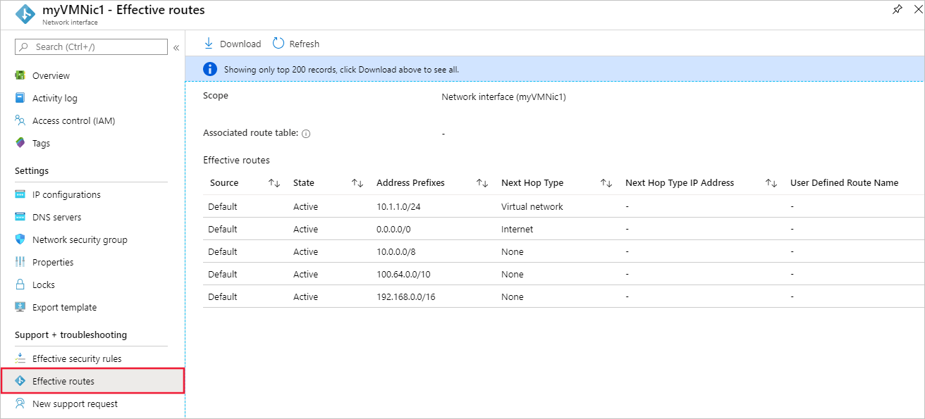
Virtual network traffic routing
System routes
Default routes
Custom routes
8
Notes:
Azure virtual network traffic routing | Microsoft Docs
System routes
Azure automatically creates system routes and assigns the routes to each subnet in a virtual network. You can't create system or remove routes, but you can override some system routes with custom routes. Azure creates default system routes for each subnet, and adds additional optional default routes to specific subnets, or every subnet, when you use specific Azure capabilities.
Default routes
Each route contains an address prefix and next hop type. When traffic leaving a subnet is sent to an IP address within the address prefix of a route, the route that contains the prefix is the route Azure uses. Whenever a virtual network is created, Azure automatically creates the following default system routes for each subnet within the virtual network:
In routing terms, a hop is a waypoint on the overall route. Therefore, the next hop is the next waypoint that the traffic is directed to on its journey to its ultimate destination. The next hop types listed in the previous table represent how Azure routes traffic destined for the address prefix listed. The next hop types are defined as follows:
Virtual network: Routes traffic between address ranges within the address space of a virtual network. Azure creates a route with an address prefix that corresponds to each address range defined within the address space of a virtual network. Azure automatically routes traffic between subnets using the routes created for each address range.
Internet: Routes traffic specified by the address prefix to the Internet. The system default route specifies the 0.0.0.0/0 address prefix. Azure routes traffic for any address not specified by an address range within a virtual network to the Internet, unless the destination address is for an Azure service. Azure routes any traffic destined for its service directly to the service over the backbone network, rather than routing the traffic to the Internet. You can override Azure's default system route for the 0.0.0.0/0 address prefix with a custom route.
None: Traffic routed to the None next hop type is dropped, rather than routed outside the subnet. Azure automatically creates default routes for the following address prefixes:
10.0.0.0/8 and 192.168.0.0/16: Reserved for private use in RFC 1918.
100.64.0.0/10: Reserved in RFC 6598.
If you assign any of the previous address ranges within the address space of a virtual network, Azure automatically changes the next hop type for the route from None to Virtual network. If you assign an address range to the address space of a virtual network that includes, but isn't the same as, one of the four reserved address prefixes, Azure removes the route for the prefix and adds a route for the address prefix you added, with Virtual network as the next hop type.

Slide 9
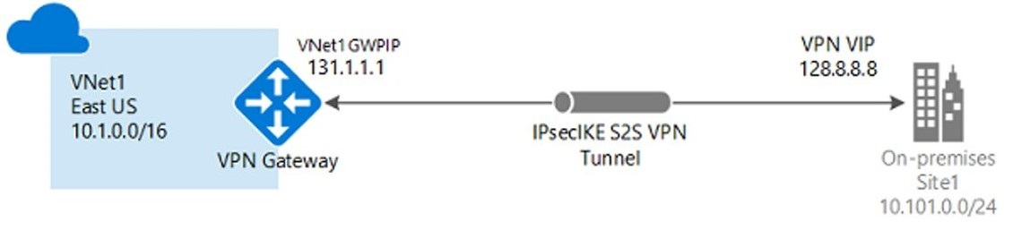
Plan a VPN Gateway
Site-to-site connections connect on-premises datacenters to Azure
virtual networks
VNet-to-VNet connections connect Azure virtual networks (custom)
Point-to-site (User VPN) connections connect individual devices to Azure virtual networks
9
Notes:
What is VPN Gateway? - https://docs.microsoft.com/en-us/azure/vpn-gateway/vpn-gateway-about-vpngateways
When you're planning a VPN gateway, there are three architectures to consider:
Point to site over the internet
Site to site over the internet
Site to site over a dedicated network, such as Azure ExpressRoute
Factors that you need to cover during your planning process include:
Throughput - Mbps or Gbps
Backbone - Internet or private?
Availability of a public (static) IP address
VPN device compatibility
Multiple client connections or a site-to-site link?
VPN gateway type
Azure VPN Gateway SKU

Slide 10
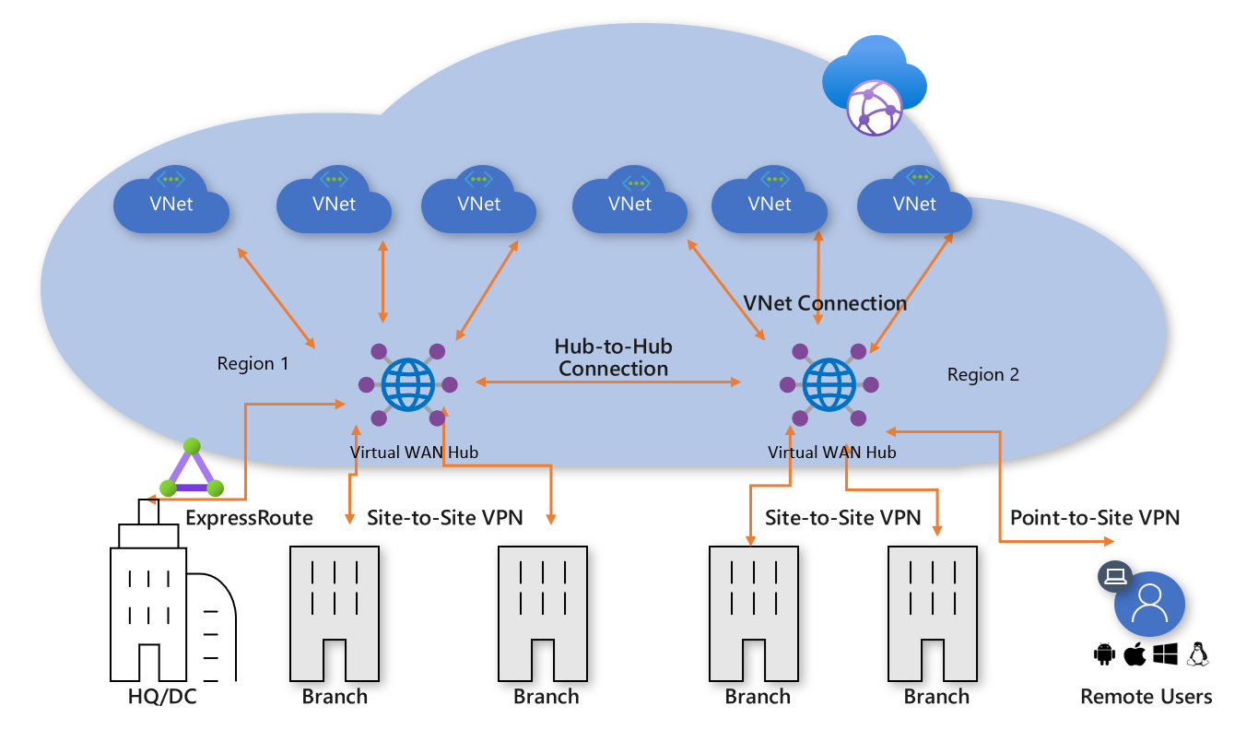
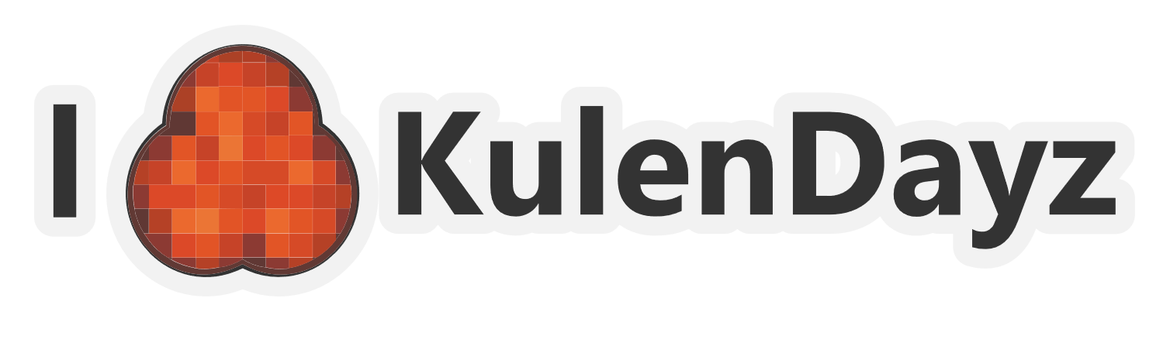
What is Azure Virtual WAN?
Brings together S2S, P2S, and ExpressRoute
Integrated connectivity using a hub-and-spoke connectivity model
Connect virtual networks and workloads to the Azure hub automatically
Visualize the end-to-end flow within Azure
Two types: Basic and Standard
Kulendayz IT Innovation conference | osijek 03-05.09.2021.
10
Notes:
About Azure Virtual WAN - https://docs.microsoft.com/en-us/azure/virtual-wan/virtual-wan-about
A virtual network gateway VPN is limited to 30 tunnels. For connections, you should use Virtual WAN for large-scale VPN. You can connect up to 1,000 branch connections per region (virtual hub) with aggregate of 20 Gbps per hub. A connection is an active-active tunnel from the on-premises VPN device to the virtual hub. You can have one hub per region, which means you can connect more than 1,000 branches across hubs.
Tutorial: Create a Site-to-Site connection using Azure Virtual WAN - https://docs.microsoft.com/en-us/azure/virtual-wan/virtual-wan-site-to-site-portal
The following diagram shows an organization with a single Virtual WAN hub connecting the spokes. VNets, Site-to-site and point-to-site VPNs, SD WANs, and ExpressRoute connectivity are all supported .

Slide 11
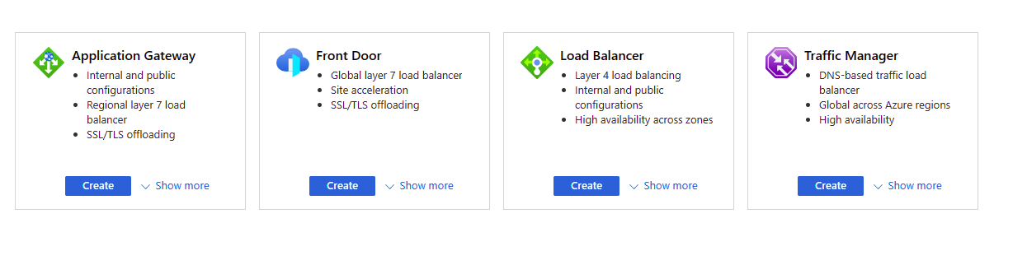
Load balancing options for Azure
Kulendayz IT Innovation conference | osijek 03-05.09.2021.
11
Notes:
Global vs regional
Global load-balancing services distribute traffic across regional backends, clouds, or hybrid on-premises services. These services route end-user traffic to the closest available backend. They also react to changes in service reliability or performance, in order to maximize availability and performance.
Regional load-balancing services distribute traffic within virtual networks across virtual machines (VMs) or zonal and zone-redundant service endpoints within a region. You can think of them as systems that load balance between VMs, containers, or clusters within a region in a virtual network.
HTTP(S) load-balancing services are Layer 7 load balancers that only accept HTTP(S) traffic. They are intended for web applications or other HTTP(S) endpoints. They include features such as SSL offload, web application firewall, path-based load balancing, and session affinity.
non-HTTP(S) load-balancing services can handle non-HTTP(S) traffic and are recommended for non-web workloads.
Azure provides various load balancing services that you can use to distribute your workloads across multiple computing resources, but the following are the main services:
Azure Load Balancer - this is a high-performance, ultra-low-latency Layer 4 load-balancing service (inbound and outbound) for all UDP and TCP protocols. It is built to handle millions of requests per second while ensuring your solution is highly available. Azure Load Balancer is zone-redundant, ensuring high availability across Availability Zones.
Traffic Manager - this is a DNS-based traffic load balancer that enables you to distribute traffic optimally to services across global Azure regions, while providing high availability and responsiveness. Because Traffic Manager is a DNS-based load-balancing service, it load-balances only at the domain level. For that reason, it can't fail over as quickly as Front Door, because of common challenges around DNS caching and systems not honoring DNS time-to-live values (TTLs).
Azure Application Gateway - this provides application delivery controller (ADC) as a service, offering various Layer 7 load-balancing capabilities. Use it to optimize web farm productivity by offloading CPU-intensive SSL termination to the gateway.
Azure Front Door - this is an application delivery network that provides global load balancing and site acceleration service for web applications. It offers Layer 7 capabilities for your application like SSL offload, path-based routing, fast failover, caching, etc. to improve performance and high-availability of your applications.

Slide 12
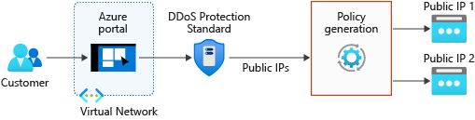
Azure DDoS protection features
Basic and Standard (multiple subscriptions) service tiers
Mitigates volumetric attacks, protocol attacks, and application layer attacks
Checks for malformed packets and spoofing
12
Notes:
Native platform integration: Natively integrated into Azure and configured through portal.
Turnkey protection: Simplified configuration protecting all resources immediately.
Always-on traffic monitoring: Your application traffic patterns are monitored 24 hours a day, 7 days a week, looking for indicators of DDoS attacks.
Adaptive tuning: Profiling and adjusting to your service's traffic.
Attack analytics: Get detailed reports in five-minute increments during an attack, and a complete summary after the attack ends.
Attack metrics and alerts: Summarized metrics from each attack are accessible through Azure Monitor. Alerts can be configured at the start and stop of an attack, and over the attack's duration, using built-in attack metrics.
Multi-layered protection: When deployed with a web application firewall (WAF), DDoS Protection Standard protects both at the network layer (Layer 3 and 4, offered by Azure DDoS Protection Standard) and at the application layer (Layer 7, offered by a WAF).

Slide 13
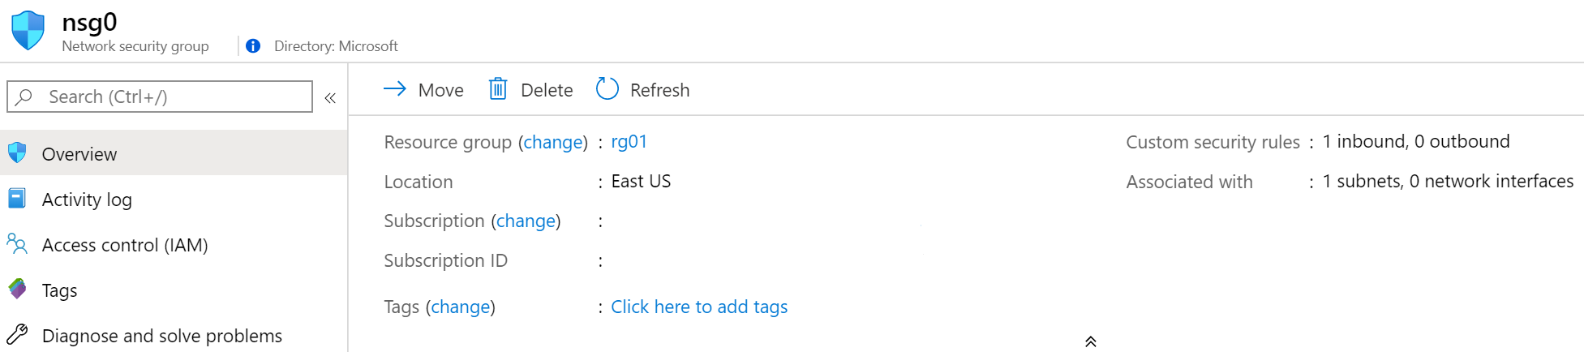
Network Security Groups
Limits network traffic
to resources in a
virtual network
Lists the security rules that allow or deny inbound or outbound network traffic
Associated
to a subnet or a
network interface
Can be associated multiple times
13
Notes:
Network Security Groups - https://docs.microsoft.com/en-us/azure/virtual-network/security-overview#network-security-groups
✔️ To simplify management of security rules, it's recommended that you associate a network security group to individual subnets, rather than individual network interfaces within the subnet.

Slide 14
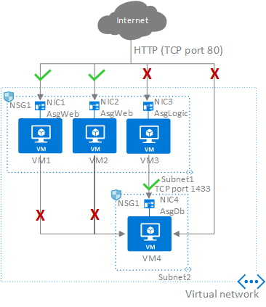
Application Security Groups (ASG)
Configure ASG as a natural extension of an application's structure
ASG can be the source and destination in a security rule
All NIC assigned to an ASG must exist in the same virtual network that the first NIC assigned to the ASG is in
If you specify an ASG as the source and destination in a security rule, the NIC in both ASG must exist in the same virtual network
14
Notes:
An Application Security Group (ASG) enables you to configure network security as a natural extension of an application's structure, allowing you to group virtual machines and define network security policies based on those groups. You can reuse your security policy at scale without manual maintenance of explicit IP addresses. The platform handles the complexity of explicit IP addresses and multiple rule sets, allowing you to focus on your business logic.
To minimize the number of security rules you need, and the need to change the rules, plan out the application security groups you need and create rules using service tags or application security groups, rather than individual IP addresses, or ranges of IP addresses, whenever possible.
Application security groups have the following constraints:
There are limits to the number of application security groups you can have in a subscription, as well as other limits related to application security groups. For details, see Azure limits.
In the Azure portal, you can specify only one application security group as the source and destination in a security rule. In the REST API (including PowerShell/Azure CLI), you can specify multiple application security groups in the source or destination.
All network interfaces assigned to an application security group have to exist in the same virtual network that the first network interface assigned to the application security group is in. For example, if the first network interface assigned to an application security group named AsgWeb is in the virtual network named VNet1, then all subsequent network interfaces assigned to ASGWeb must exist in VNet1. You cannot add network interfaces from different virtual networks to the same application security group.
If you specify an application security group as the source and destination in a security rule, the network interfaces in both application security groups must exist in the same virtual network. For example, if AsgLogic contained network interfaces from VNet1, and AsgDb contained network interfaces from VNet2, you could not assign AsgLogic as the source and AsgDb as the destination in a rule. All network interfaces for both the source and destination application security groups need to exist in the same virtual network.

Slide 15
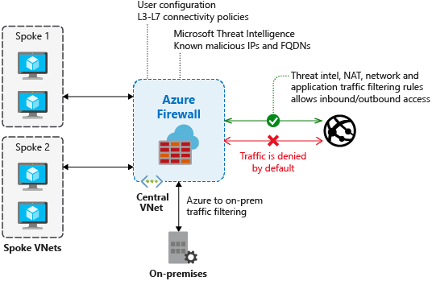
Azure Firewall features
Stateful firewall as a service
Built-in high availability with unrestricted cloud scalability
Create, enforce, and log application and network connectivity policies
Threat intelligence-based filtering for L3-L7
Fully integrated with Azure Monitor for logging and analytics
Support for hybrid connectivity through deployment behind VPN and ExpressRoute Gateways
Standard and Premium SKUs
15
Notes:
Azure Firewall documentation - https://docs.microsoft.com/en-us/azure/firewall/
Standard and Premium SKUs
Compare NSG and Firewall

Slide 16
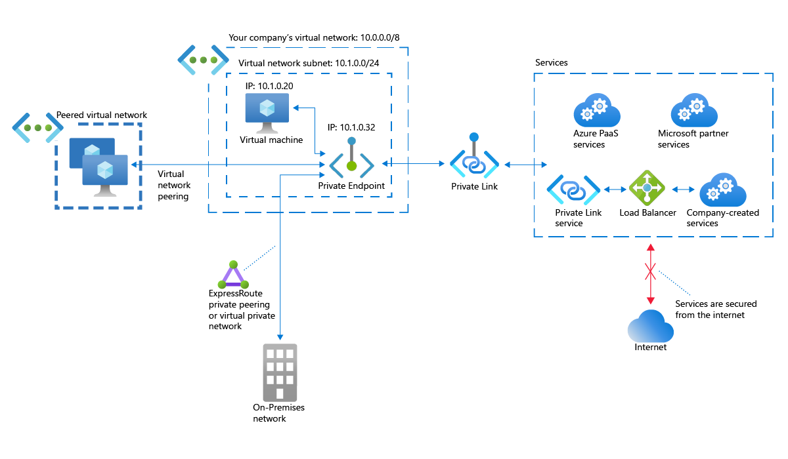
What is Azure Private Link ?
Integration with on-premises and peered networks
In the event of a security incident within your network, only the mapped resource would be accessible
Private connectivity to services on Azure. Traffic remains on the Microsoft network, with
no public internet access
16
Notes:
Private Link Documentation - https://docs.microsoft.com/en-us/azure/private-link/
Azure Private Link provides the following benefits:
Privately access services on the Azure platform: Connect your virtual network to services in Azure without a public IP address at the source or destination. Service providers can render their services in their own virtual network and consumers can access those services in their local virtual network. The Private Link platform will handle the connectivity between the consumer and services over the Azure backbone network.
On-premises and peered networks: Access services running in Azure from on-premises over ExpressRoute private peering, VPN tunnels, and peered virtual networks using private endpoints. There's no need to configure ExpressRoute Microsoft peering or traverse the internet to reach the service. Private Link provides a secure way to migrate workloads to Azure.
Protection against data leakage: A private endpoint is mapped to an instance of a PaaS resource instead of the entire service. Consumers can only connect to the specific resource. Access to any other resource in the service is blocked. This mechanism provides protection against data leakage risks.
Global reach: Connect privately to services running in other regions. The consumer's virtual network could be in region A and it can connect to services behind Private Link in region B.
Extend to your own services: Enable the same experience and functionality to render your service privately to consumers in Azure. By placing your service behind a standard Azure Load Balancer, you can enable it for Private Link. The consumer can then connect directly to your service using a private endpoint in their own virtual network. You can manage the connection requests using an approval call flow. Azure Private Link works for consumers and services belonging to different Azure Active Directory tenants.

Slide 17
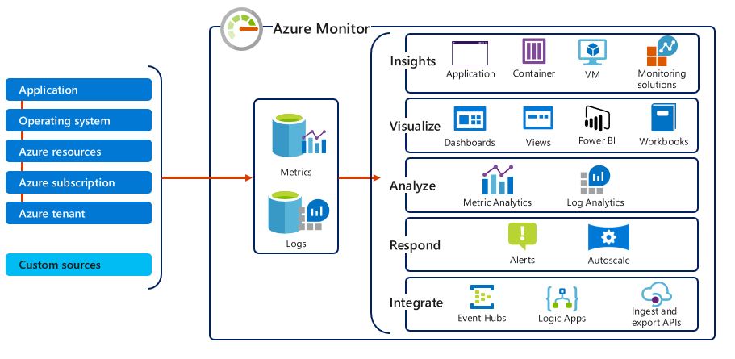
Azure Monitor
Monitoring data types: Metrics & Logs
Metrics are numerical values that describe some aspect of a system at a point in time
They are lightweight and capable of supporting near real-time scenarios
Logs contain different kinds of data organized into records with different sets of properties for each type
Telemetry (events, traces) and performance data can be combined for analysis
17
Notes:
Azure Monitor for Networks provides a comprehensive view of health and metrics for all deployed network resources, without requiring any configuration. It also provides access to network monitoring capabilities like Connection Monitor, flow logging for network security groups, and Traffic Analytics. For more information, see Azure Monitor Network Insights.
Azure Monitor helps you maximize the availability and performance of your applications and services. It delivers a comprehensive solution for collecting, analyzing, and acting on telemetry from your cloud and on-premises environments. This information helps you understand how your applications are performing and proactively identify issues affecting them and the resources they depend on.
Just a few examples of what you can do with Azure Monitor include:
Detect and diagnose issues across applications and dependencies with Application Insights.
Correlate infrastructure issues with VM insights and Container insights.
Drill into your monitoring data with Log Analytics for troubleshooting and deep diagnostics.
Support operations at scale with smart alerts and automated actions.
Create visualizations with Azure dashboards and workbooks.
Collect data from monitored resources using Azure Monitor Metrics.
The diagram below offers a high-level view of Azure Monitor. At the center of the diagram are the data stores for metrics and logs, which are the two fundamental types of data used by Azure Monitor. On the left are the sources of monitoring data that populate these data stores. On the right are the different functions that Azure Monitor performs with this collected data. This includes such actions as analysis, alerting, and streaming to external systems.

Slide 18
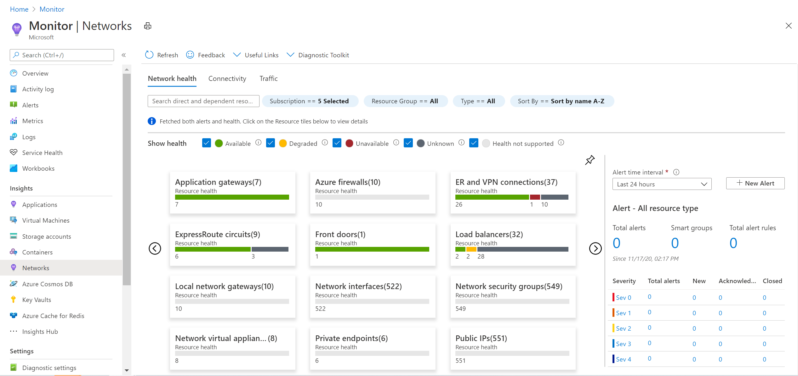
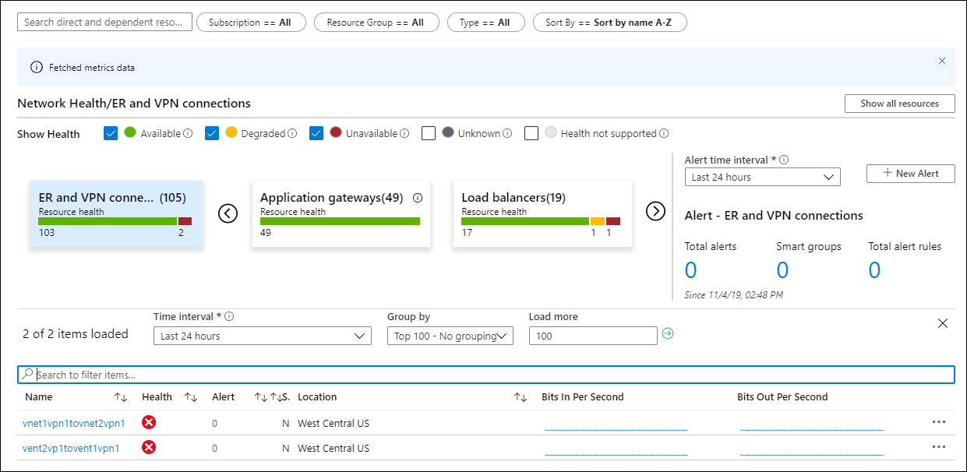
Azure Monitor Network Insights
Network health and metrics
Connectivity
Traffic
Diagnostic Toolkit
Kulendayz IT Innovation conference | osijek 03-05.09.2021.
18
Notes:
Azure Monitor Network Insights is structured around these key components of monitoring:
Network health and metrics
Connectivity
Traffic
Diagnostic Toolkit

Slide 19
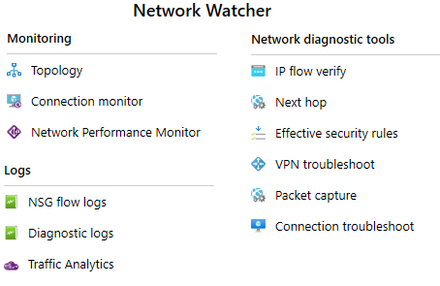
Network Watcher
A regional service that provides various network diagnostic and monitoring tools​
IP Flow Verify diagnoses connectivity issues
Next Hop determines if traffic is being
correctly routed
VPN Diagnostics troubleshoots gateways and connections
NSG Flow Logs maps IP traffic through a network security group
Connection troubleshoot shows connectivity between source VM and destination
Topology generates a visual diagram of resources
19

Slide 20
This is not school, but we
love to get grades.
Please fill out our
questoineers and leave
us your feedback.
You may even win some
cool rewards.

Slide 21
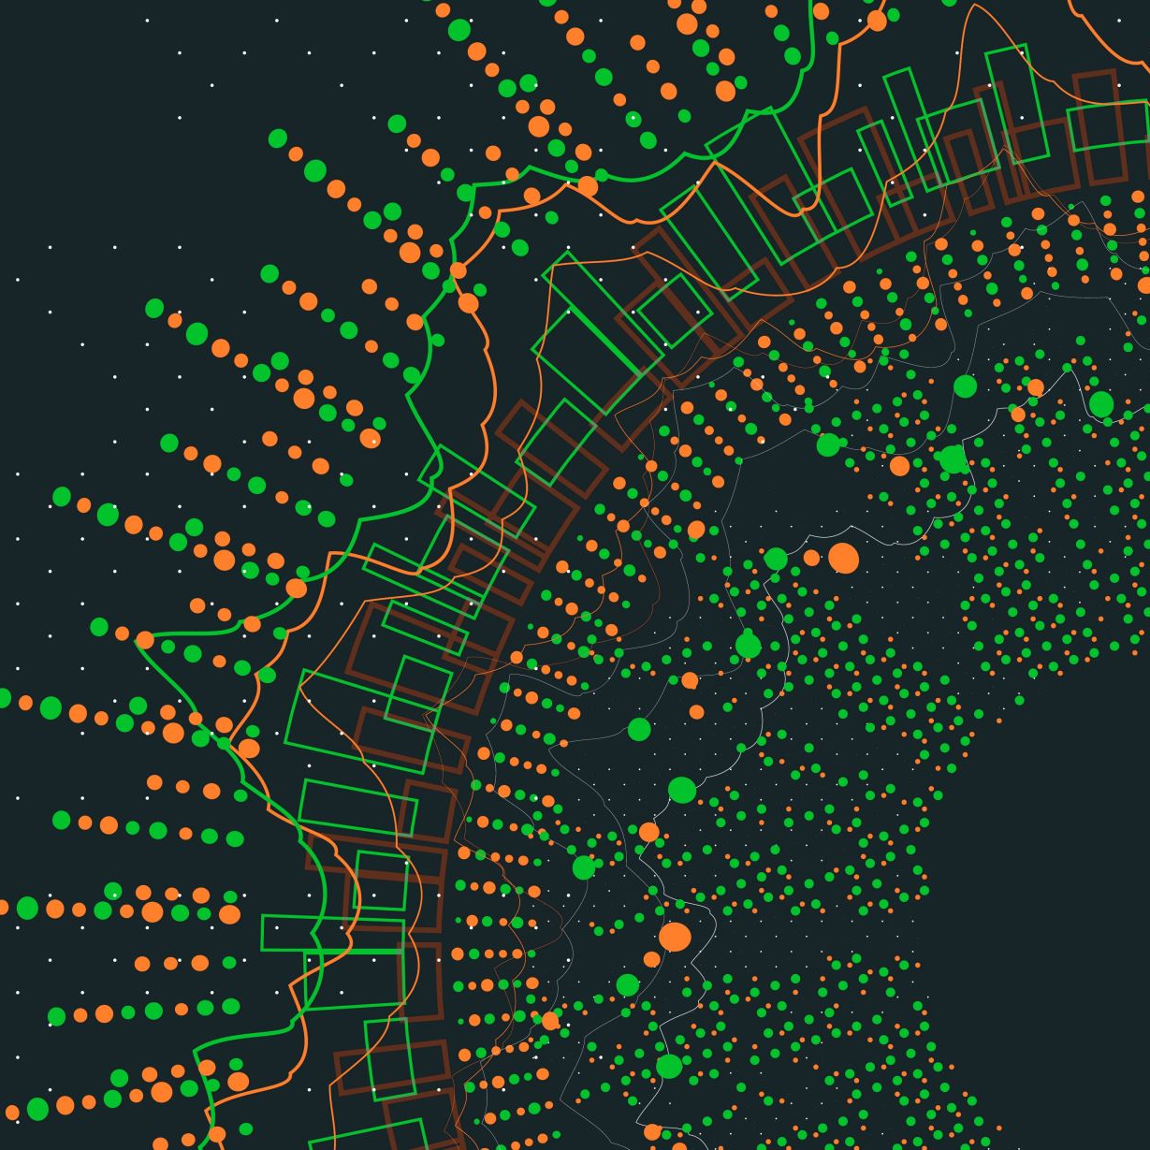
Thank you!

