Slide 2
Lap Arround Power Platform
Me:Anton Sivic

Slide 3







Power Platform?
Power Apps
Power Automate
Power BI
Power Virtual Agents
Data Connectors
AI Builder
Dataverse

Slide 4





Can be on it‘s own, but can work together
Power Apps
Automate apps and drive business processes.
Embed Power Apps into dashboards and add Power BI tiles to apps.
Power Automate
Power BI
Dataverse
Drive actions to apps and services from chatbot conversations.
Analyze chatbot activity to refine and expand conversations.
Power Virtual Agent

Slide 5
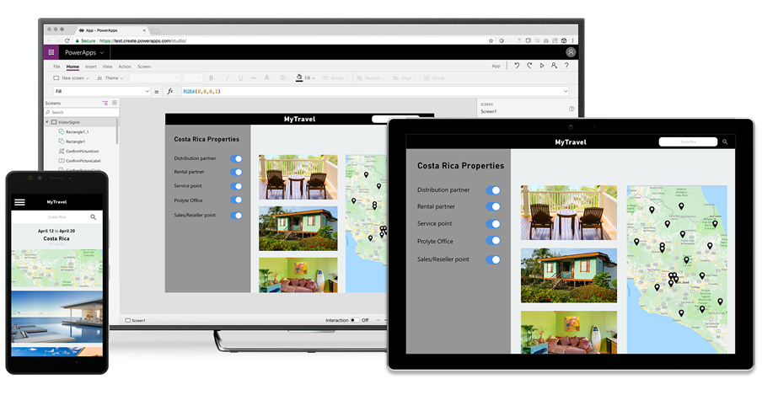
Power Apps
Canvas apps with data from one or multiple sources
Mode driven apps, starting from your data model or/and business processes
Access this apps across web and mobile, embedded/standalone - on any device

Slide 6
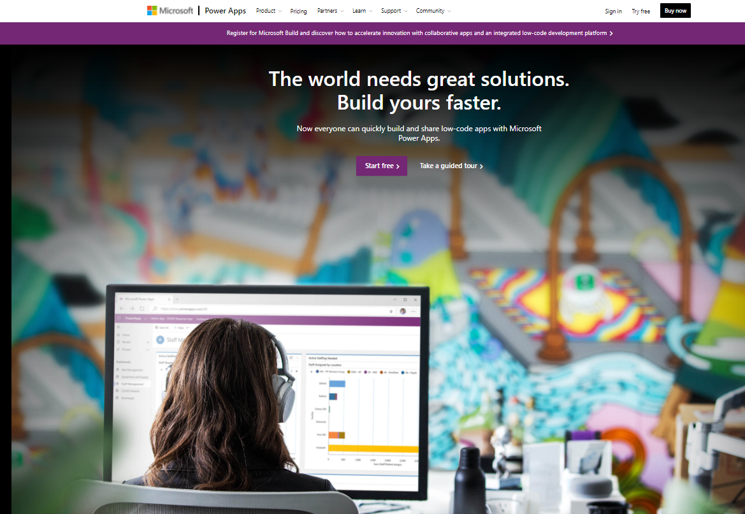
Power Apps – main tooling
Power Apps Home Page
Power Apps Studio
Power Apps Admin center
Power Apps Mobile

Slide 7
Demo

Slide 8
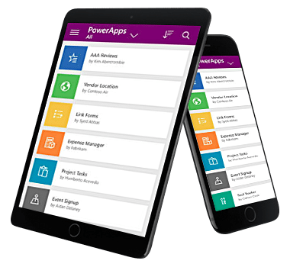
Power Apps – mobile
For Windows
iOS
Android

Slide 9
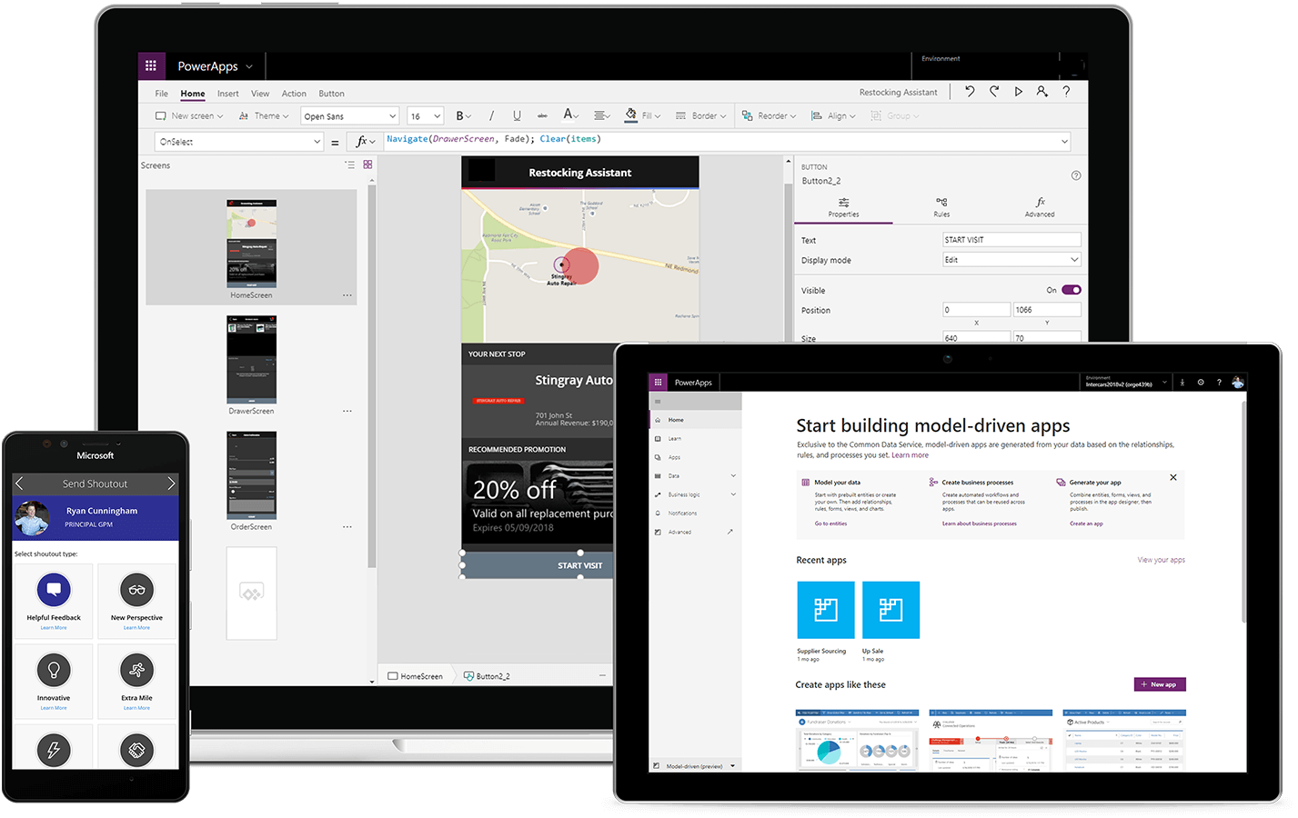
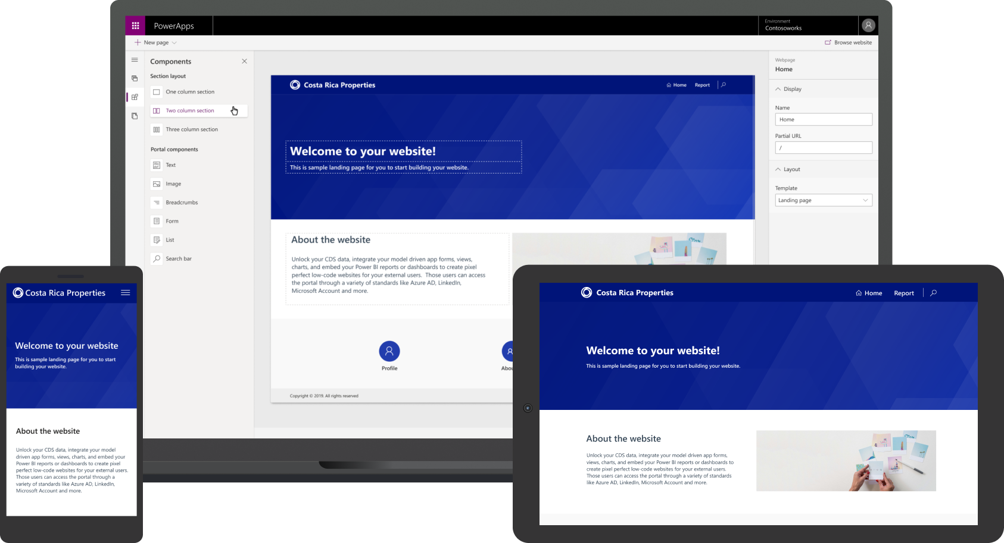
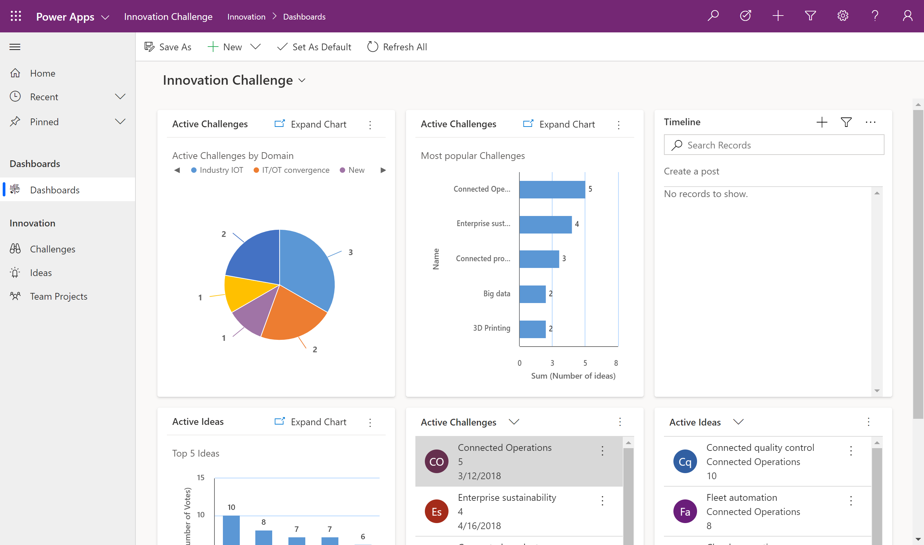
Power Apps – Types
Portal apps
    Enable makers to build responsive websites
    Engage with external stakeholders
    Improve and manage content with no code required
    Built on Dataverse
Canvas Apps
    WYSIWYG designer
    Start with user experience
    Task-based & role-based apps
    Mash-up data from hundreds of sources
Model-driven apps
    Start with a data model, relationships, and business processesStart with user experience
    Build end-to-end business applications
    Built on Dataverse

Slide 10
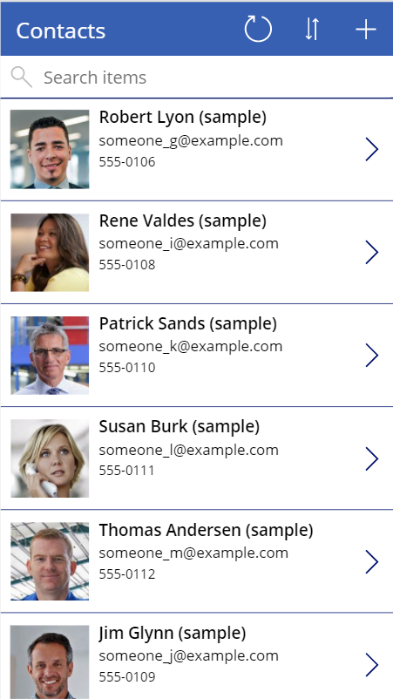
Power Apps – Canvas apps
Targets internal facing users
Designed around the user experience
Connect to hundreds of data sources
Automation
Built-in support for Microsoft Dataverse
Customizable with or without professional developers

Slide 11
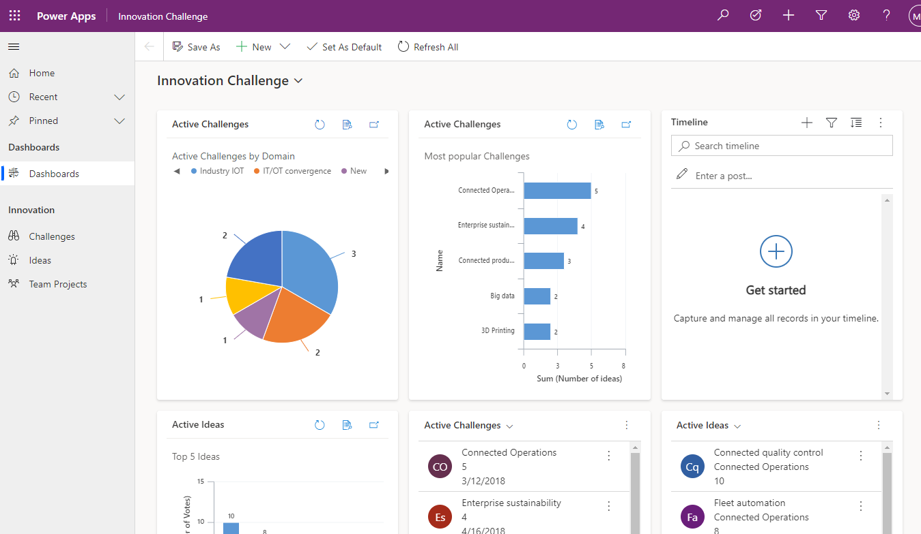
Power Apps – Model driven apps
Targets internal facing users
Designed around the data
Powered by Microsoft Dataverse
Automation
Customizable and consistent user experience
Customizable with or without professional developers

Slide 12
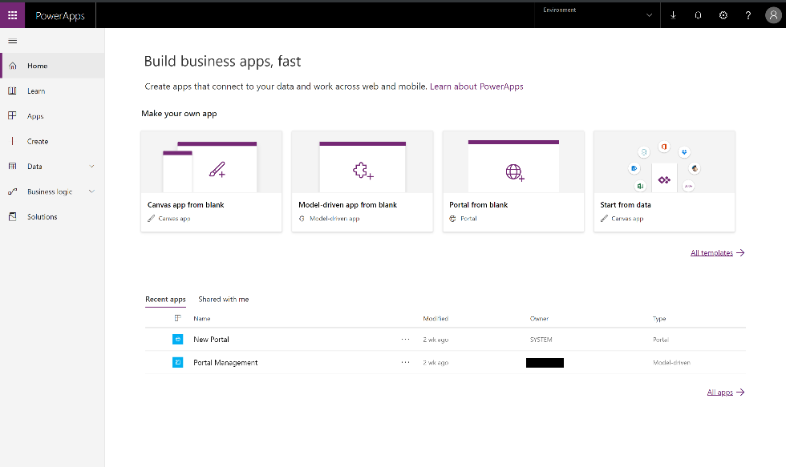
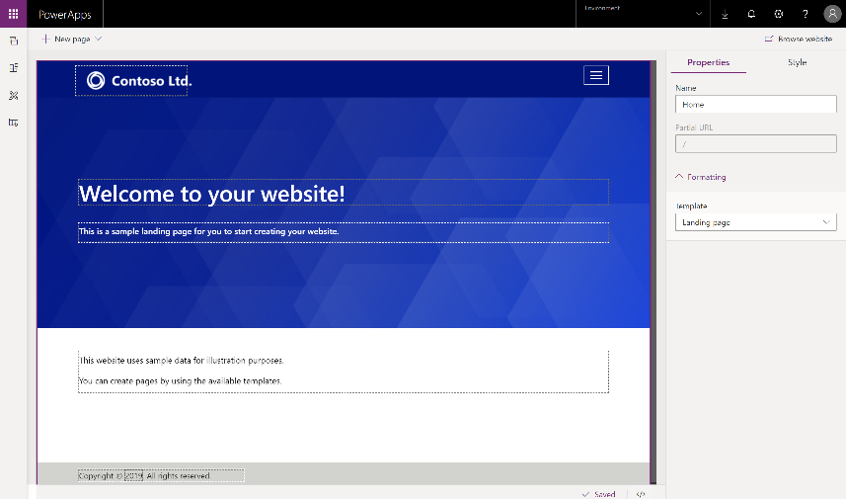
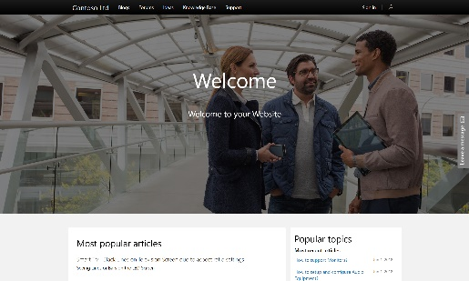

Power Apps – Portals
Targets external stakeholders
Public-facing website
Powered by Dataverse
Customizable with or without professional developers

Slide 13
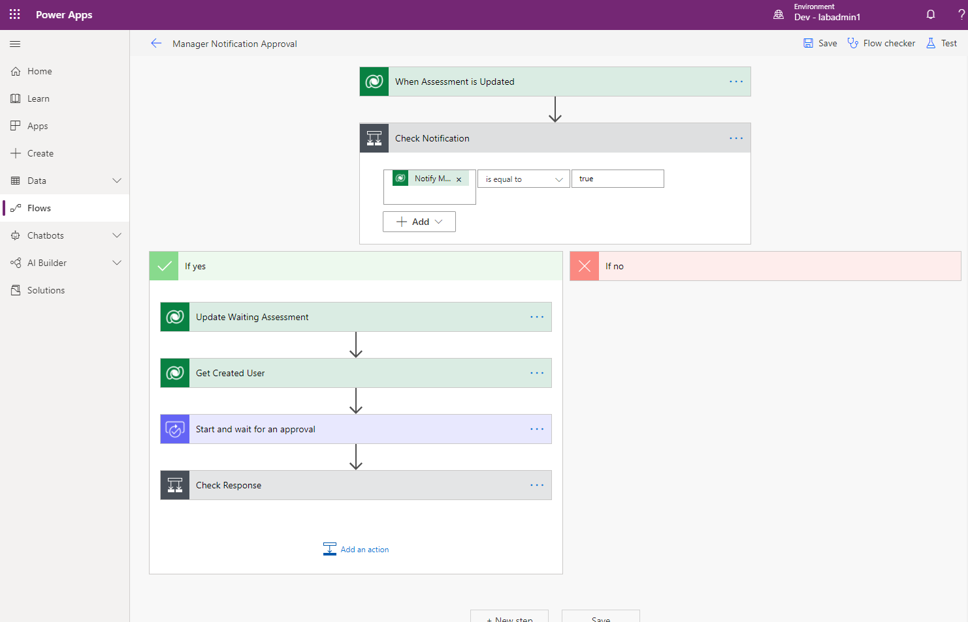
Power Apps – Power Automate
Automate and model business processes across your apps and services
From simple automations to advanced scenarios with branches, loops, and more
Trigger actions, grant approvals, and get notifications right where you work
Automate legacy, on-prem and cloud-based applications and services

Slide 14
Power Automate – Type of flows
Automated flows
Instant flows
Business process
flows
Desktop flows
Scheduled flows
Cloud flows

Slide 15
Demo

Slide 16
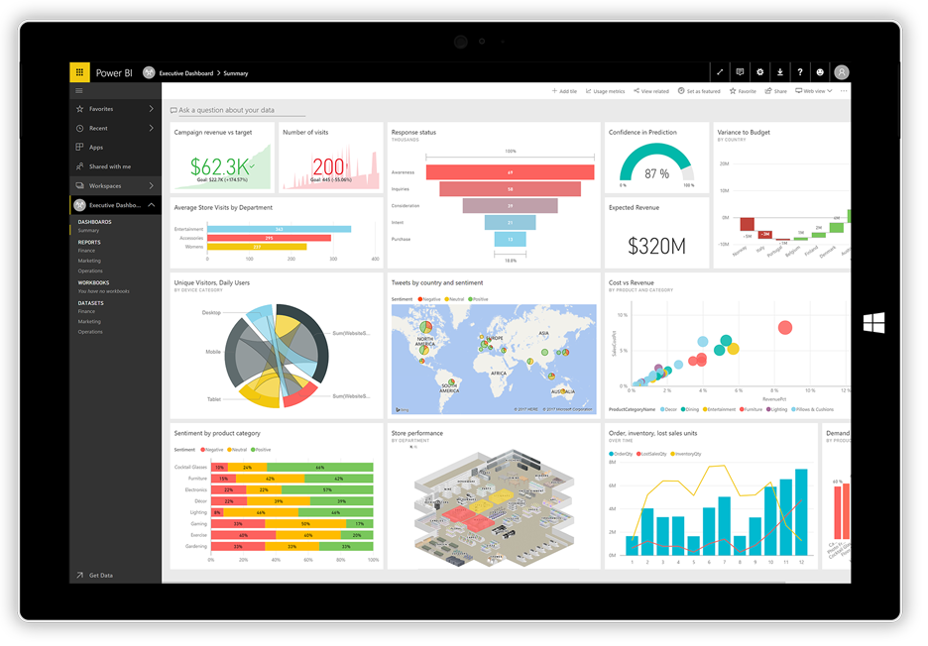
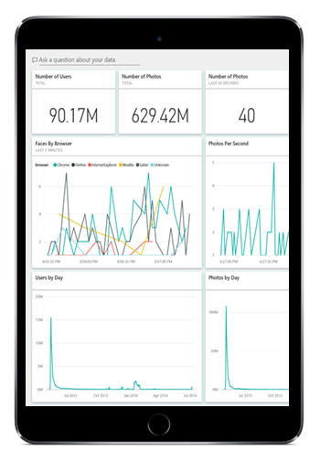
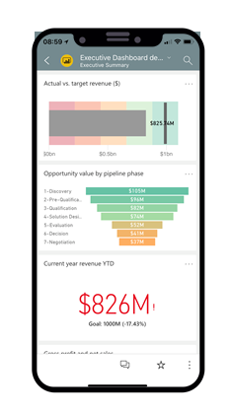
Power Apps – PowerBI
Connect to all your data and get a consolidated view across your business through a single pane of glass
Build smart apps by infusing insights from your data and drive action with the power of Microsoft Power Platform
Create ad-hoc analysis, live dashboards and interactive reports that are easy to consume on the web and across mobile devices

Slide 17
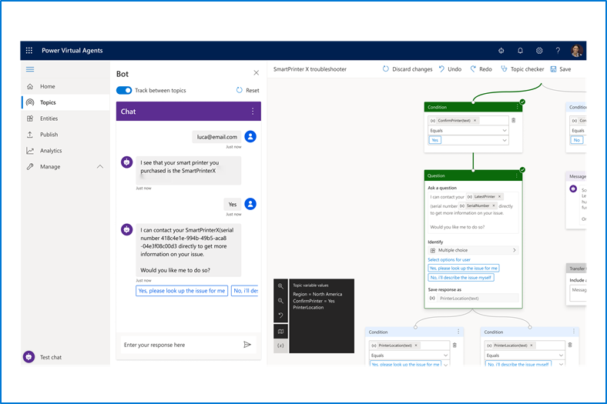
Power Apps – Virtual Agents
Enable subject matter experts to easily create powerful virtual agents using a guided, no-code graphical interface—all without the need for data scientists or developers
Enable the virtual agent to take action on the customer’s behalf. Easily integrate your virtual agent with hundreds of services and systems out of the box or create custom workflows
Keep an eye on how your virtual agent is performing by using conversational metrics and dashboards. Get in-depth AI-driven insights to improve bot performance

Slide 18

Microsoft Dataverse
Microsoft Dataverse (formerly Common Data Service): Cloud-scale database used to securely store and manage data for Business Applications
Common Data Model: Definition of standard tables that represent commonly used concepts and activities

Slide 19
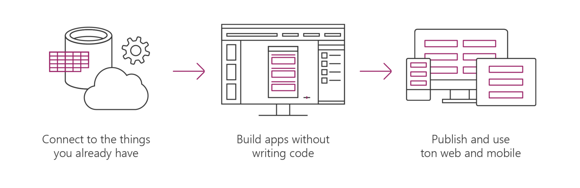



Microsoft Dataverse
Allows you to securely store and manage the data used in apps
Dataverse is how Power Apps, Office, and the Dynamics suite of products integrate with a single system of record for business data
Store data in standard and custom tables with rich metadata
Build Power Apps apps and automate workflows against the data stored in Dataverse
Add business rules & validation Define role-based security

Slide 20
Microsoft Dataverse
Simple to manage - Both the metadata and data are stored in the cloud. You don't need to worry about the details of how they're stored
Helps to secure data - Data is stored so that users can see it only if you grant them access. Role-based security allows you to control access to tables for different users within your organization
Access your Dynamics 365 Data - Data from your Dynamics 365 applications is also stored within the Dataverse, which allows you to quickly build apps that use your Dynamics 365 data and extend your apps by using Power Apps
Rich metadata - Data types and relationships are used directly within Power Apps
Logic and validation - Define calculated columns, business rules, workflows, and business process flows to ensure data quality and drive business processes
Productivity tools - Tables are available within the add-ins for Microsoft Excel to increase productivity and ensure data accessibility

Slide 21
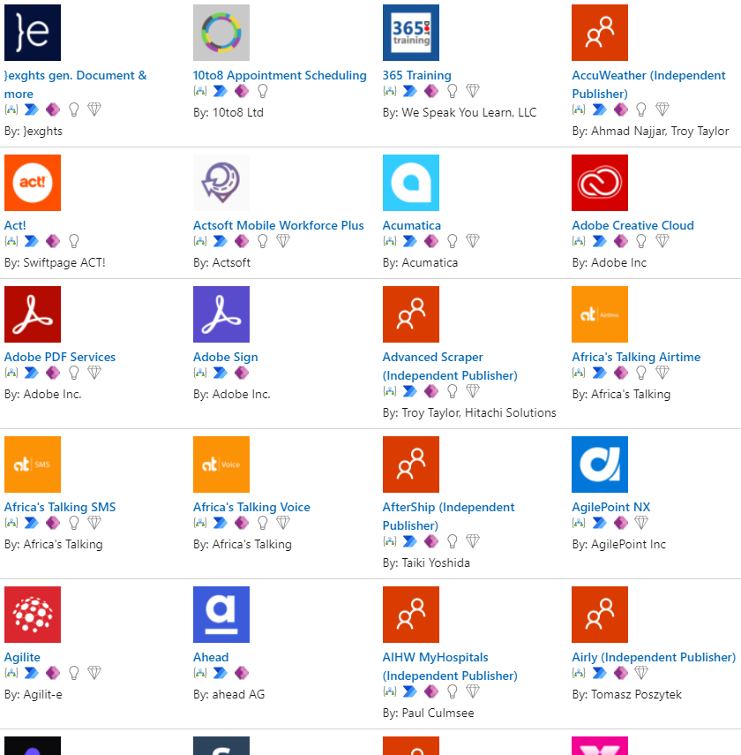
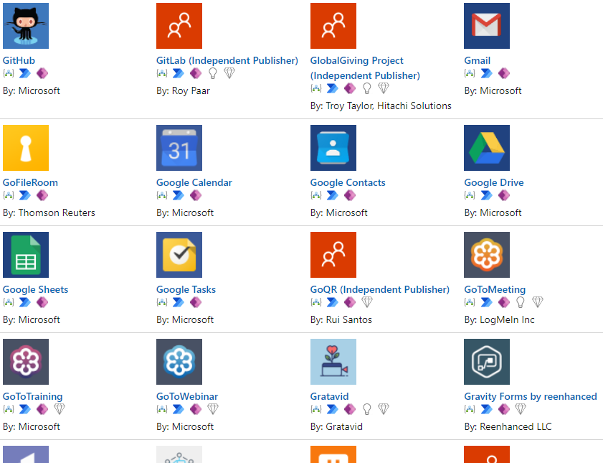
Data connectors
Available for use in multiple products
Custom connectors

Slide 22
AI Builder
Analyze text for classification, key phrases, language, and sentiment
Predict whether something will happen
Process business card information
Process text from images
Read and save information from standard documents
Recognize and count items in images

Slide 23
Solutions
Solutions are containers of Power Platform components
Transport these customizations from one environment to another
Part of an overall strategy for application lifecycle management (ALM)

Slide 24
HVALA!

