Slide 1
Modern development for Dynamics 365 for Financials and Dynamics NAV
Jaka Konda

Slide 2
Agenda
Dynamics 365 FF, NAV and AppSource
Brief History
New development environment (ModernDev)
Create simple extension
Q&A

Slide 3
Dynamics 365 for Financials
“NAV Online”
New ERP SaaS solution for SMB
Up to 250 users
November 2016 – US & Canada
May 2017 – Great Britain (Preview) !
Q4 2017 – Denmark and Netherlands
…

Slide 4
AppSource – Reason to develop
Online App Store for Business Solutions
Office 365, Power BI, Dyn CRM, Dyn FF…
Dyn FF is new here
Slovenia
Allows you to sell your products
Free advertising
Offers additional IP protection compared to classic NAV

Slide 5
Brief history

Slide 6
Few things to know for new devs…
It’s old
It’s very old – 1984
Database – 1984
Custom programming language – C/AL (Pascal based)
MVC = TPC

Slide 7
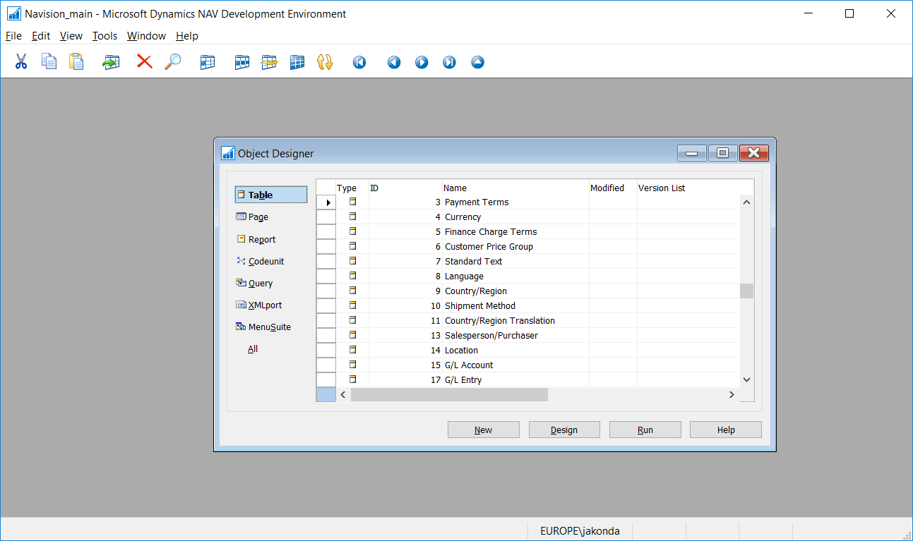
** 3 ** slike iz CSIDE

Slide 8
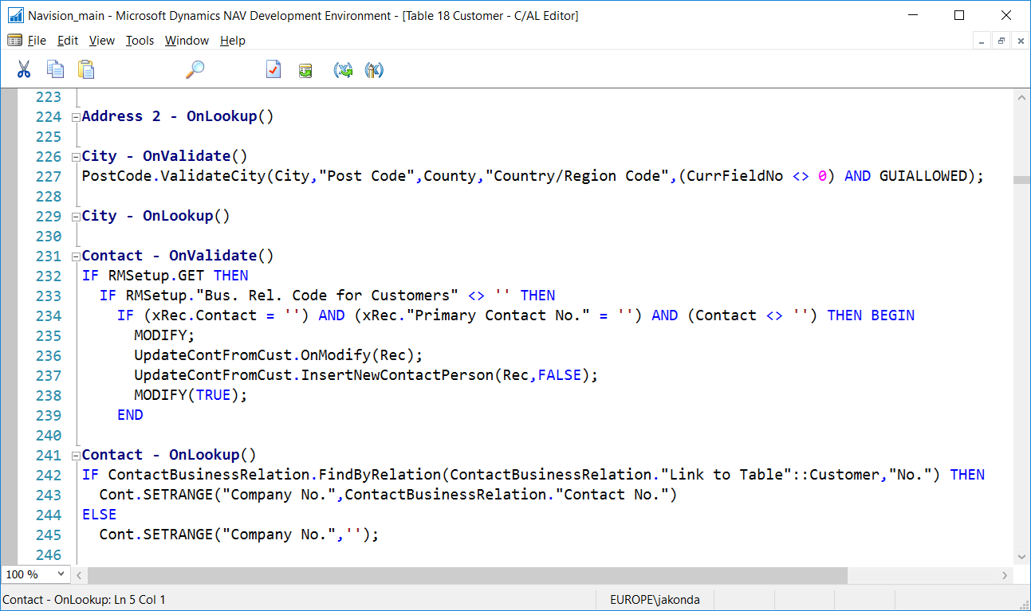

Slide 9
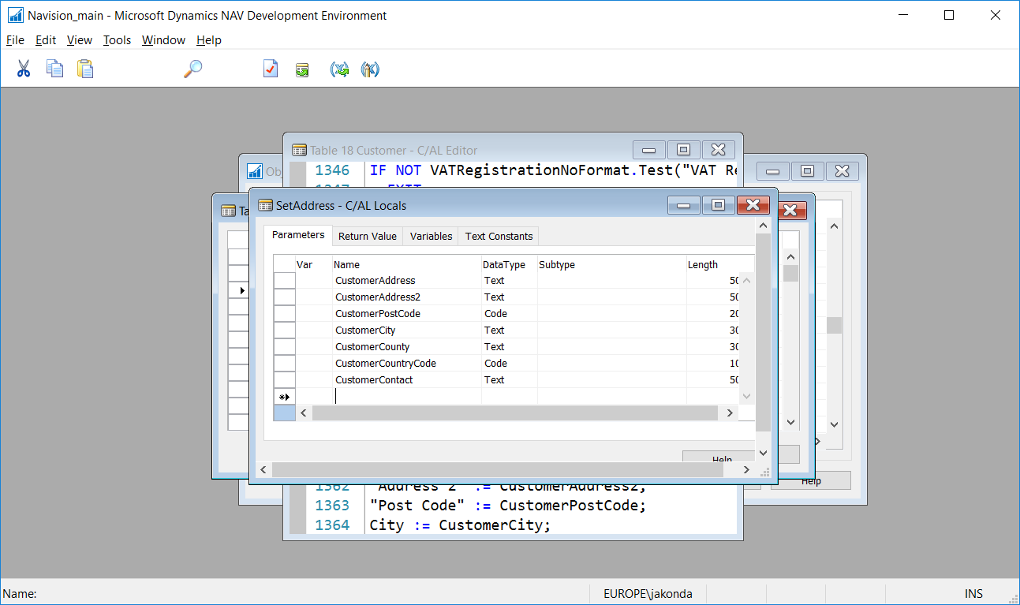

Slide 10
Reasons for moving on
Old – lack of features
Code Level modifications problems
Fast upgrades (check-in/production)

Slide 11
ModernDev

Slide 12
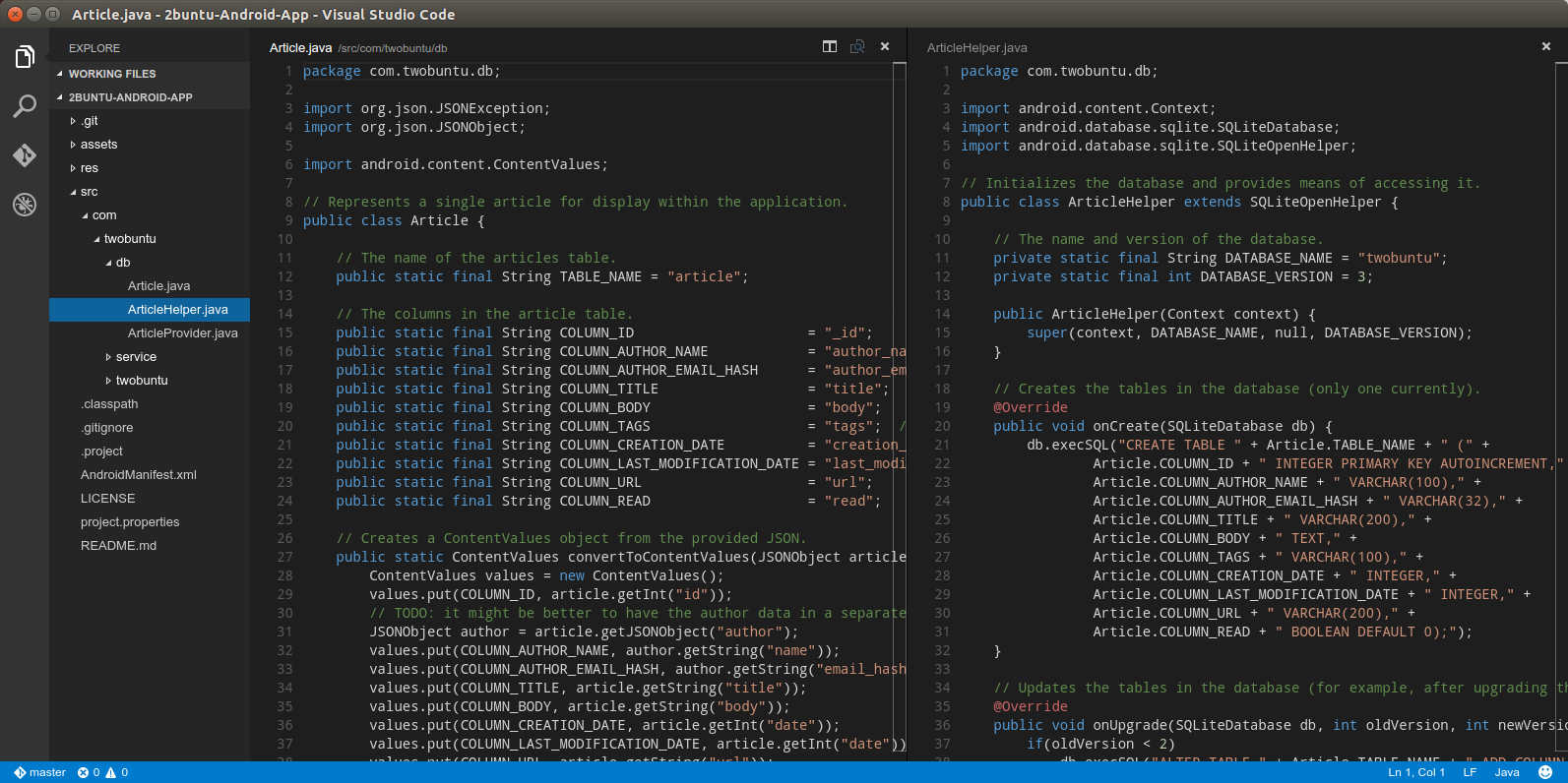
VS Code – more details
Free
Not Visual Studio
Code optimized (rename, find usages…)
Debugger
Native git support
Updates
Apple OSX and Linux platforms
Extensions
Community

Slide 13
Demo: Create new extension
AL:Go!

Slide 14
What’s supported and what’s not in Extensions
Page & Page Extensions
Table & Table Extensions
Codeunits & TBD
Profiles
Web services
Report layouts
Tenant specific web services
Permissions
Table data
New safe methods for .NET
Query Object
Menusuite
.NET Interop
Client Add-ins
Files
Local resources

Slide 15
Future plans & Other
In browser
In-Client designer
Integrated
Txt2al
Get it: http://aka.ms/navdeveloperpreview

Slide 16
When you leave…
Start to build code into extensions where possible
Start to refactor code
  Remove code from modified objects where possible
  Good: Use “Hook” pattern
  Better: Use events

Slide 17
Q&A
Jaka.Konda@Microsoft.com

