Slide 1
PowerApps in MS Flow
Robi Vončina

Slide 2
About…
Graduated at Faculty of economics in Ljubljana
Working at Kompas Xnet
Started as MS Office instructor
System admin
MCT for 10 years
Worked for European games in Baku, Azerbaijan
Worked for Asian games in Ashgabat, Turkmenistan
SharePoint MVP from 2013
Diving, pool player, snooker

Slide 3
Agenda
Intro
SharePoint Online
PowerApps
  Pricing
  SharePoint (Screens, cascading dropdowns,
  Mobile
Flow
  Pricing
  SharePoint (Approval flow,…)
  Mobile

Slide 4
Intro
What are PowerApps
  Working towards InfoPath replacement
  Standalone apps
  Not made exclusively for SharePoint
What is MS Flow
  Automate business processes
  Integrates in O365
    „Create automated workflows between your favorite apps and services to get notifications, synchronize files, collect data, and more“
  Automate processes + tasks | Microsoft Flow
  https://flow.microsoft.com/en-us/

Slide 5
PowerApps

Slide 6
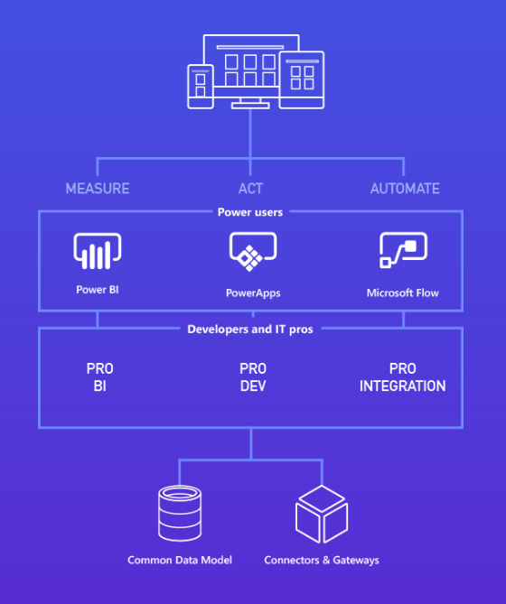
Intro
Tools
  PowerApps Portal
  https://web.powerapps.com/home
  PowerApps Studio
  https://powerapps.microsoft.com/en-us/downloads/
  On premise gateway to connect to SQL data
Connections

Slide 7
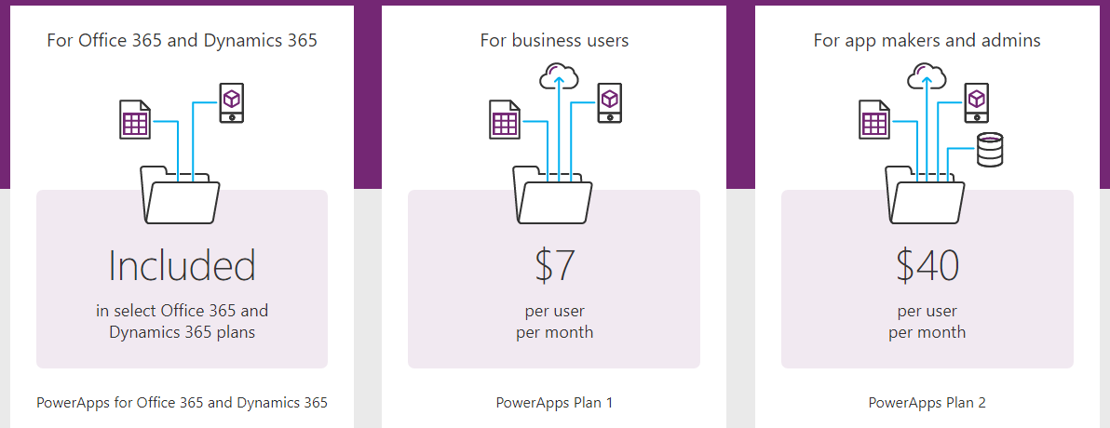
Pricing - PowerApps
https://powerapps.microsoft.com/en-us/pricing/

Slide 8
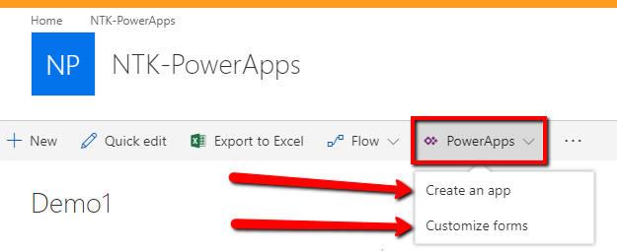
SharePoint integration
Modern list experience
Create new form from list

Slide 9
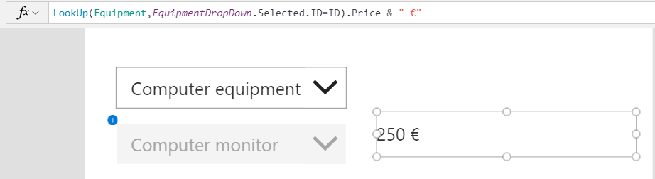
Formulas
Perform calculations (like Excel)
Change appearance – Yep. Conditional formatting
Navigation
Validation
Saving and updating data
Note: Can do more than one action
Notes:
This is where the power really is in building the apps…
This is also where the learning curve is

Slide 10
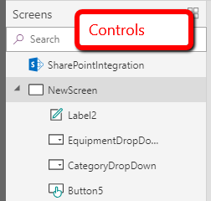
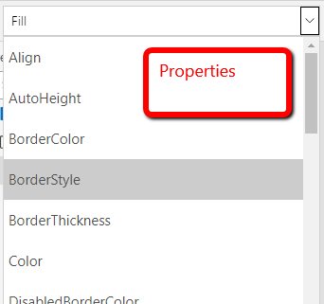
Controls and Properties
Very InfoPath-like feel when dragging and dropping controls on a screen
Advanced view: More Dev-like view of properties
Will the formulas hold up to the business rules like they did in InfoPath?

Slide 11
Sharing apps
Publishing an app will make it available in home.dynamics.com
  Users with Read access
Users with contribute access will see it in the PowerApps apps list

Slide 12
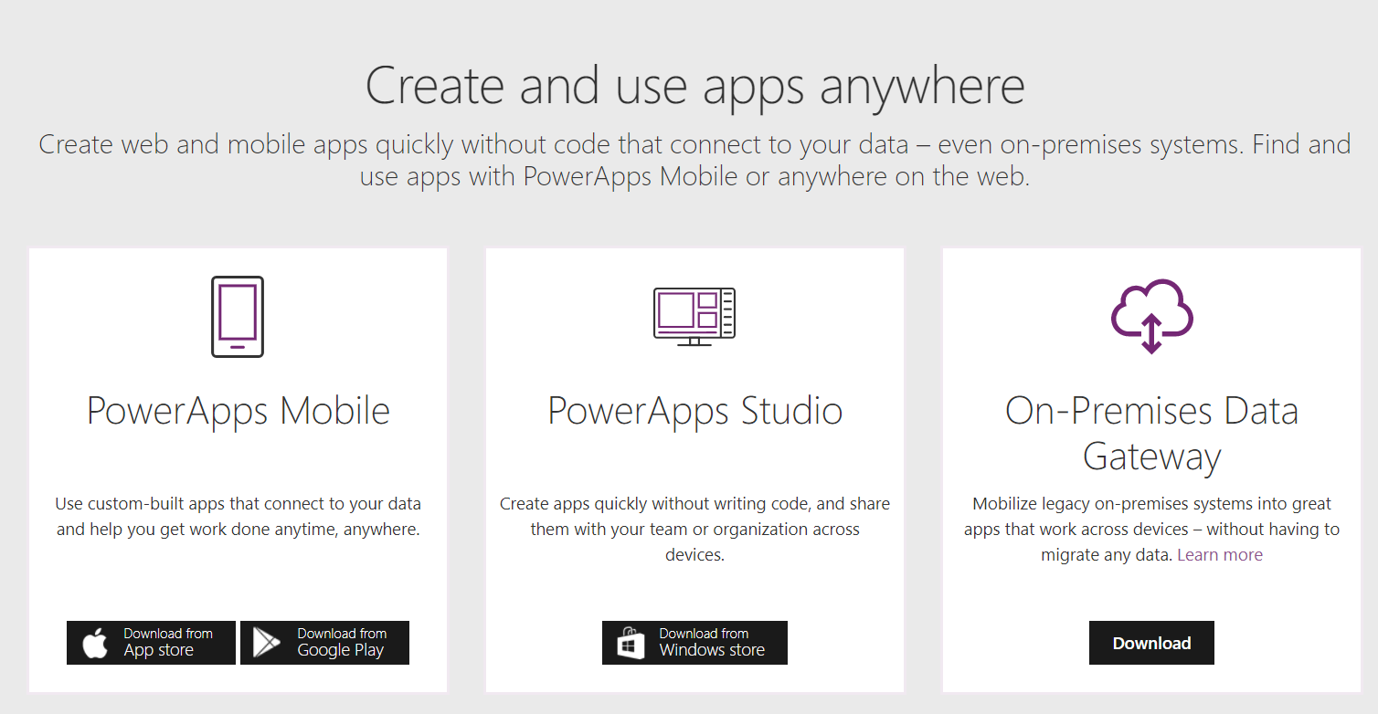
Mobile
Mobile app
Tenant wide app catalog
Downloads | Microsoft PowerApps
https://powerapps.microsoft.com/en-us/downloads/

Slide 13
PowerApps DEMO
Controls
Formulas
Conditions
Cascading dropdowns
Collections
Related lists
Patching
Notes:
SubmitForm(NewForm);Set(PurchaseRequestId,NewForm.LastSubmit.ID);ForAll(ItemsList,Patch('PI-1',Defaults('PI-1'),{Title:Equipment,Item_x0020_Category:Category,Item_x0020_price:Price,Purchase_x0020_request_x0020_ID:PurchaseRequestId}))

Slide 14
Flow

Slide 15
Intro
Workflow tool
  Think SharePoint designer but next generation
Connectors
  Many connectors and counting
Templates
  Start from template or from scratch

Slide 16
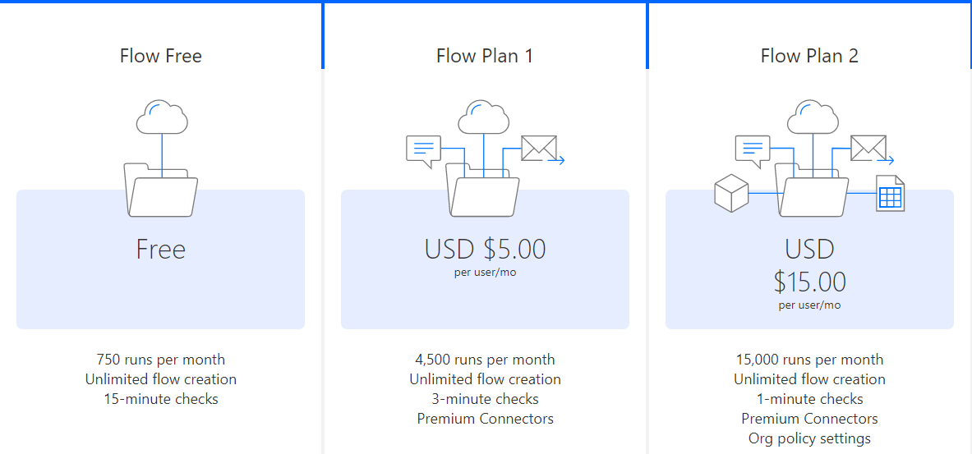
Pricing
Plans | Microsoft Flow
https://flow.microsoft.com/en-us/pricing/

Slide 17
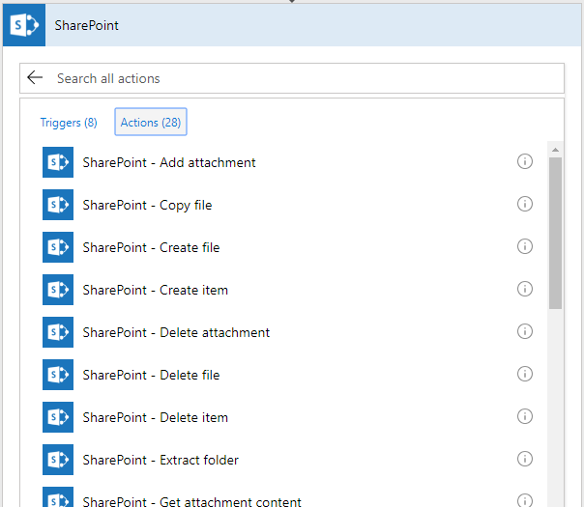
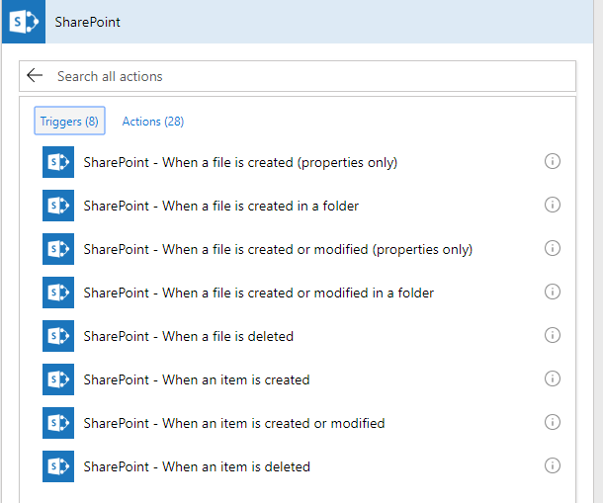
SharePoint integration
Triggers
Conditions
Actions
Scheduling

Slide 18
Approvals
Work with approvals - Microsoft Flow | Microsoft Docs
https://docs.microsoft.com/en-us/flow/guided-learning/work-with-approvals?tutorial-step=1

Slide 19
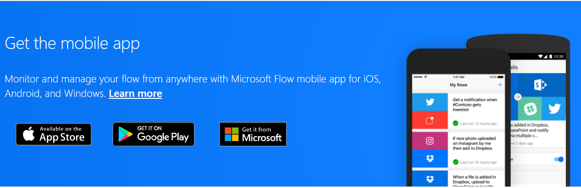
Mobile
Mobile app
Push notifications

Slide 20
Flow DEMO
Creating workflow
Getting items
Create HTML table
Send email

Slide 21
Questions?
Thank you

