Slide 2
Nameščanje Windows 10 – kako to narediti pravilno
Tomaž Čebul, Microsoft services

Slide 3

US Department of Defense to deploy 4 million seats of Windows 10 https://blogs.microsoft.com/firehose/2016/02/17/us-department-of-defense-to-deploy-4-million-seats-of-windows-10/#sm.0000ypu7eb7eifr611eg75l34tyiy https://blogs.windows.com/windowsexperience/2016/02/17/us-department-of-defense-commits-to-upgrade-4-million-seats-to-windows-10/

Slide 4
Windows 10 security

Slide 5


Typical Attack Timeline & Observations
  First Host Compromised
  Domain Admin Compromised
  Attack Discovered
Research & Preparation
Attacker Undetected (Data Exfiltration)
  24-48 Hours
  More than 200 days (varies by industry)
Attack Sophistication
Attack operators exploit any weakness
Target information on any device or service
Target AD & Identities
Active Directory controls access to business assets
Attackers commonly target AD and IT Admins
Attacks not detected
Current detection tools miss most attacks
You may be under attack (or compromised)
Response and Recovery
Response requires advanced expertise and tools
Expensive and challenging to successfully recover

Slide 6
The Windows 10 Defense Stack
PROTECT, DETECT & RESPOND
PRE-BREACH
POST-BREACH
Device protection
Device protection
Threat resistance
Threat resistance
Identity protection
Identity protection
Information protection
Information protection
Breach detection investigation & response
Breach detection investigation & response
Device Health attestation
Device Guard
Device Control
Security policies
Device integrity
Device control
SmartScreen
AppLocker
Device Guard
Windows Defender
Network/Firewall
SmartScreen
Windows Firewall
Microsoft Edge
Device Guard
Windows Defender
Built-in 2FA
Account lockdown
Credential Guard Microsoft Passport
Windows Hello ;)
Windows Hello ;)
Windows Hello for Business
Credential Guard
Device protection / Drive encryption
Enterprise Data Protection
Conditional access
BitLocker and BitLocker to Go
Windows Information Protection
Windows Defender ATP
Conditional Access
Windows Defender ATP

Slide 7
What are the hardware prerequisites?
To enable advanced Windows 10 security we need the following:
  Updated computer BIOS
  UEFI boot
  Secure Boot
  Virtualization support
  TPM enabled

Slide 8
But we are running Windows 7/8/x in legacy BIOS mode ☹…

Slide 9
What would be an old way to upgrade
Capture user state&data using USMT and backup to network server
Suspend BitLocker
Configure computer BIOS to UEFI boot + extras
Reformat the drive to GPT
Clean install Windows 10
Restore user state&data using USMT from network server
Configure BitLocker
Reinstall all applications

Slide 10
What is the modern way to upgrade
Suspend BitLocker
Upgrade Windows 7/8/x to Windows 10
Configure computer BIOS to UEFI boot + extras
Convert disk layout from MBR to GPT
Configure Bitlocker

Slide 11
Task Sequence componenets

Slide 12
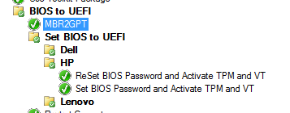
BIOS to UEFI
First run disk conversion
Second convert the Bios to UEFI
  Different tools for different vendors (different prameters for different models)
Restart
Group filter
  _SMSTSBootUEFI = False
  and HW models

Slide 13
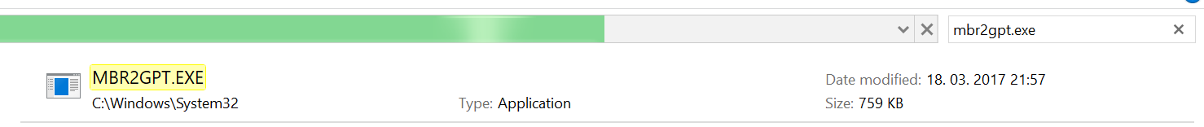
MBR2GPT
Converts a disk from Master Boot Record (MBR) to GUID Partition Table (GPT) partition style without modifying or deleting data on the disk
Part of Windows 10 Creators Update (1703)
Can run on WinPE or full OS if 1703
Mbr2gpt /convert /disk:0
https://docs.microsoft.com/en-us/windows/deployment/mbr-to-gpt

Slide 14
BIOS Configuration Tools
The computer manufacturer must provide a tool for BIOS configuration
  HP: https://ftp.hp.com/pub/caps-softpaq/cmit/HP_BCU.html
  Lenovo: https://support.lenovo.com/ca/en/solutions/ht100612
  Dell: http://en.community.dell.com/techcenter/enterprise-client/w/wiki/7534.dell-command-update

Slide 15
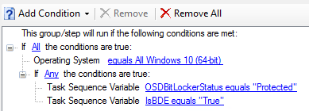
Bitlocker
We need to disable Bitlocker before upgrade and disk manipulation
Embeded Disable Bitlocker task disables Bitlocker for one restart only
We need to disable Bitlocker indefinitelly until we finish with upgrade taks
  Win10: cmd.exe /c "manage-bde -protectors -disable C: -RC 0"
  Win 7: cmd.exe /c "manage-bde -protectors -disable C:"
After upgrade is finished we need to reenable Bitlocker protectors
  cmd.exe /c "manage-bde -protectors -enable C:"

Slide 16
Language packs

Slide 17
How to install language packs to Windows 10
If we want to have multilanguage image, we need to add all required language packs into the basic en-US image.
Language pack versions has to match basic en-US image version.
At deploy time we select default language pack
  Proper procedure described here: https://rzander.azurewebsites.net/how-to-change-the-welcome-screen-language-in-win10/

Slide 18
Resources
https://blogs.technet.microsoft.com/mniehaus/2017/04/14/moving-from-bios-to-uefi-with-mdt-8443/
https://docs.microsoft.com/en-us/windows/deployment/mbr-to-gpt
https://miketerrill.net/tag/mbr2gpt/
https://rzander.azurewebsites.net/how-to-change-the-welcome-screen-language-in-win10/

Slide 19
Vprašanja? tomaz.cebul@microsoft.com

