Slide 1
Upravljanje naprav z Microsoft Intune
Jernej Pangeršič
Solution Specialist for Modern Work
Southeast Europe
Microsoft

Slide 2
Technology needs are evolving in the modern workplace
Fragmented
Integrated
Closed Perimeter
Cloud
Less Regulated
More Regulated
Manual
Automated
Insourced
Managed

Slide 3


Transform IT delivery and device management
Zero-touch IT provisioning for all devices using Windows Autopilot, Apple Business Manager, or Android Enterprise
App lifecycle management for
in-house (LOB) apps, public store apps, and traditional Win32 apps
Depth of configuration and security controls across any device

Slide 4
Microsoft simplifies mobile and PC management
Modernize device and OS provisioning
Complete
Management
Platform
Simplify app lifecycle management
Consolidate security policies and settings

Slide 5
Modern desktop provisioning with Windows Autopilot
Register devices
Autopilot profile sync
Existing PC estate
Autopilot Service
Intune and Azure AD
IT Admin
Register devices,
configure profiles
Self-deploy
New PC vendor
New Devices
User
Deliver direct to Employee
Provision new devices direct to employees, ready for use
Upgrade existing devices, reimaged with Autopilot
Lower IT effort and cost; user gets productive faster

Slide 6
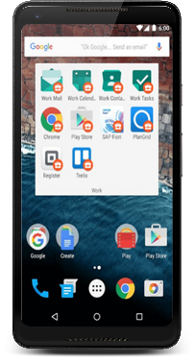



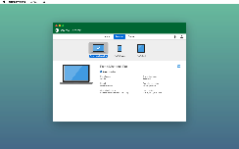


Modern device provisioning for iOS, macOS, Android
EMS +
Apple iOS
macOS
macOS
(with Jamf)
Android
Device Enrollment Program
Apple School Manager
Apple Business Manager
Supervised Mode
Intune APP managed
Deploying cert and settings
Zero-touch (DEP)
Conditional access
Device wipe, encryption
Intune MDM features +
Extensive inventory
Scripting support
Depth of security controls
Self-service controls
Android Enterprise (ZTE)
Samsung Knox (KME)
Kiosk mode
Work Profiles
Intune APP managed

Slide 7

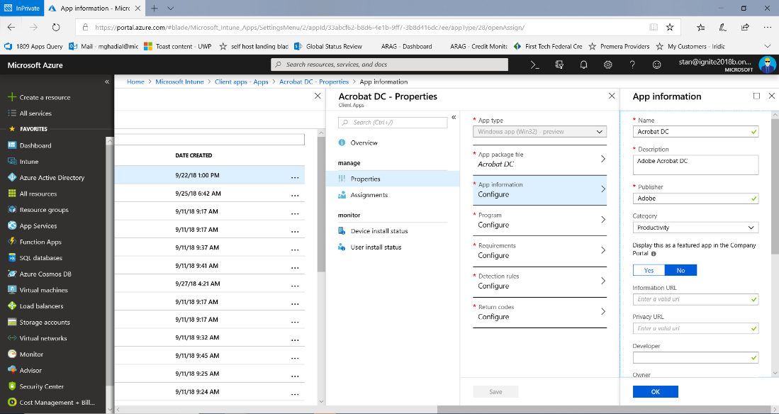
Simplify Windows application lifecycle management
Deploy Win32 apps, line-of-business (LOB) apps, and Microsoft store apps from the cloud
Application compatibility assurance using desktop analytics
Intune leverages Windows 10/11 cloud management capabilities

Slide 8






















On managed devices, Intune can manage hundreds of 3rd party apps

Slide 9






Protect your data on virtually any device with Intune
Mobile Device Management (MDM)
Enroll devices for management
Provision settings, certs, profiles
Conditional Access:
Restrict access to managed and compliant devices
Report & measure device compliance
Remove corporate
data from devices
Mobile Application Management (MAM)
Publish mobile
apps to users
Configure and
update apps
Conditional Access:
Restrict which apps can be used to access email or files
Report app
inventory & usage
Secure & remove corporate data within mobile apps

Slide 10










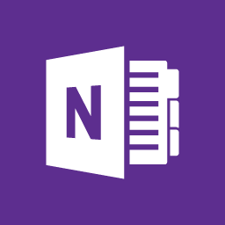





App protection policies for personal devices
Multi-identity
policy
Corporate data
Personal data
2
Enables bring-your-own (BYO) and personal devices at work where users may be reluctant to “enroll” their device
Ensures corporate data cannot be copied and pasted to personal apps within the device
Intune App Protection policies are useful to protect Office 365 apps where devices are unmanaged or managed by 3rd party
Managed apps
Personal apps
Notes:
“Traditional security management simply cannot keep up with the speed and evolution of today’s threats.”
Key points to land
Traditional security management isn’t adequate in today’s threat landscape
Traditional security management can’t keep up with the speed and evolution of security threats

Slide 11

















Control what happens after data has been accessed
Multi-identity
policy
Email
attachment
2
Corporate
data
Personal
data
Copy
Paste
Save
Paste to
personal app
Save to
personal storage
Azure Information Protection (AIP) empowers you to control how data is accessed from employee devices
Separate company managed apps from personal apps, and set policies on how data is accessed from managed apps
Intune APP ensure corporate data can’t be copied and pasted to personal apps within the device

Slide 12
















Intune threat protection for device risk-based conditional access
Threat protection partner detects:
Malicious Apps
Device manipulation
Network exploits
Data privacy violations
2
EMS role:
Intune evaluates compliance
Azure AD enforces Conditional Access
Allow
Enforce MFA
Enroll device
Microsoft Azure
Block access
Wipe device
Intune
Azure AD
Microsoft Defender ATP integration
Mobile threat defense (MTD) partners on iOS and Android

Slide 13
FastTrack for all Microsoft 365 customers
Team of engineers to help plan your deployment, included with every subscription
Deploy
new cloud capabilities
Light up Microsoft 365 services, migrate email and content
Enable intelligent communications and chat-based collaboration
Deploy and securely manage devices
Access
engineering expertise
End-to-end guidance built by Microsoft engineering
Access self-serve tools and resources
Guidance delivered remotely by Microsoft engineers or approved partners
Gain user
adoption
Create a holistic plan to accelerate user adoption
Proven methodologies for a successful implementation
Resources to increase capacity for change management

Slide 14
This is not school, but we
love to get grades.
Please fill out our
questoineers and leave
us your feedback.
You may even win some
cool rewards.

