Slide 2
Asinhroni
tokovi v C#
Damir Arh, Razum d.o.o.
Microsoft MVP

Slide 3


O meni
Razum d.o.o.
Microsoft MVP
https://damirscorner.com
https://www.dotnetcurry.com/csharpbook
@DamirArh

Slide 4
Agenda
Zakaj potrebujemo asinhrone tokove?
Asinhroni tokovi v .NET API-jih
Kako implementirati asinhrone tokove?
Kaj bo zdaj z IObservable?

Slide 5
Kdaj so asinhroni tokovi uporabni?
Zaporedje elementov
Počasen dostop
Asinhrona uporaba

Slide 6
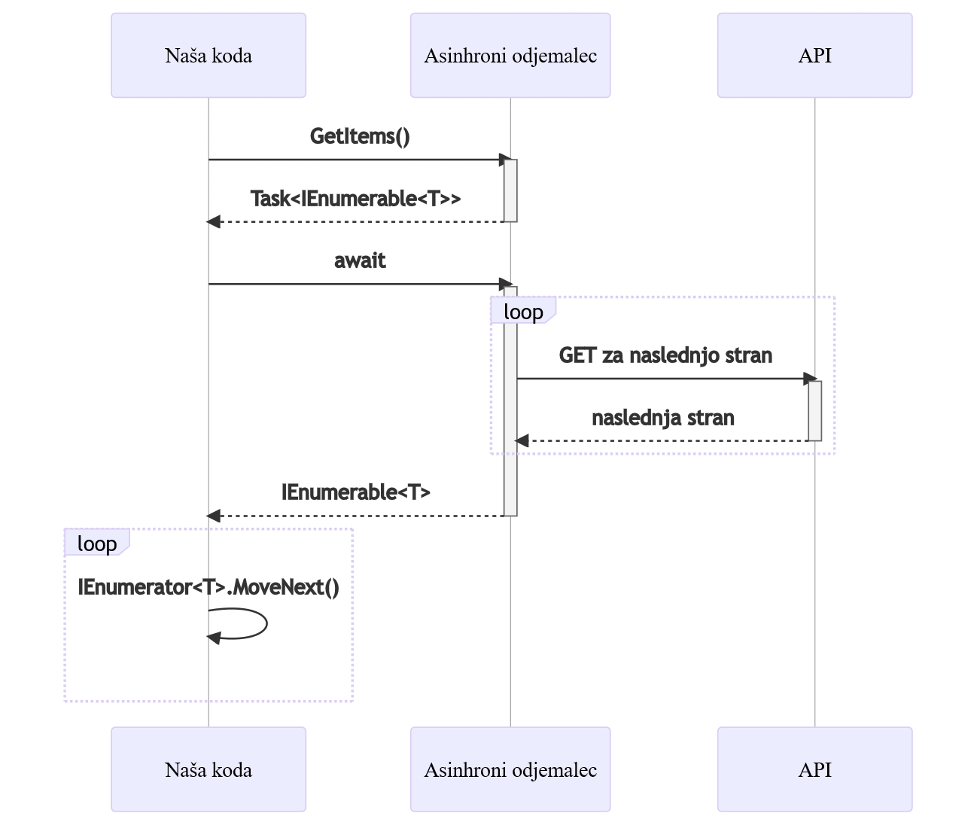
Task<IEnumerable<T>>
foreach (var item in await GetItems())
{
// use the item
}

Slide 7
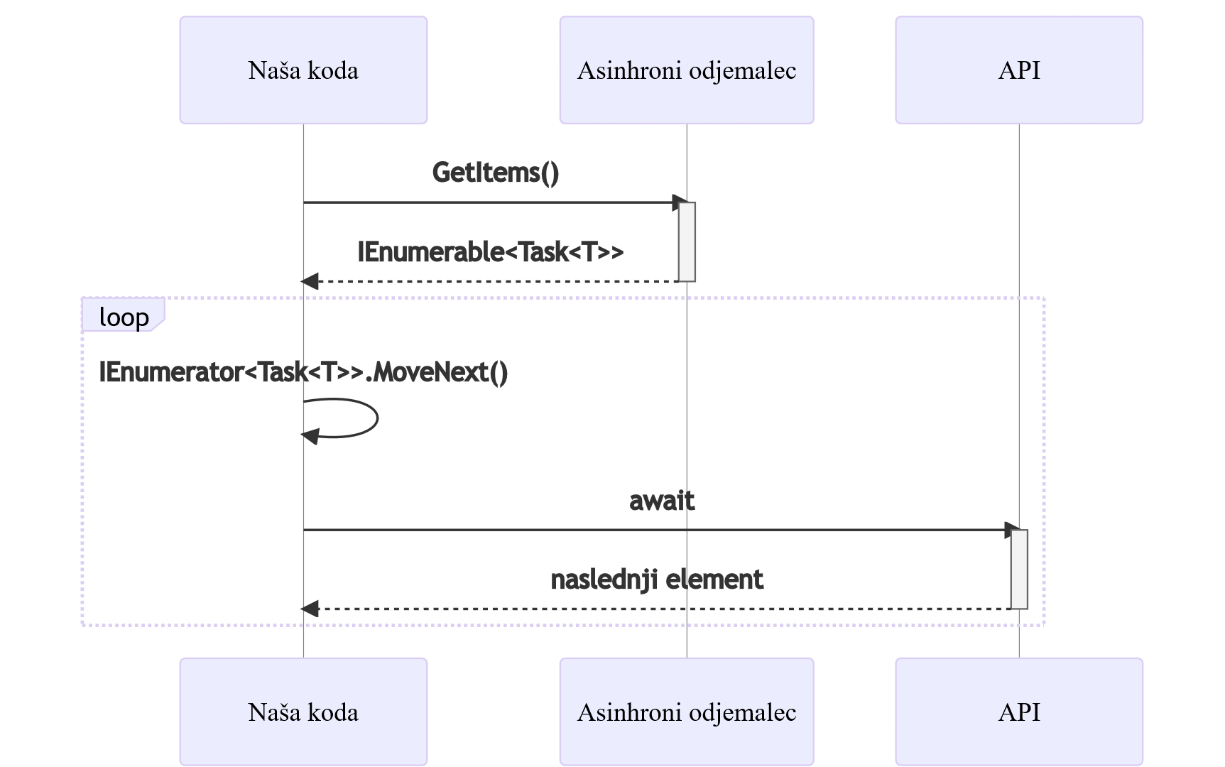
IEnumerable<Task<T>>
foreach (var task in GetItems())
{
var item = await task;
// use the item
}

Slide 8
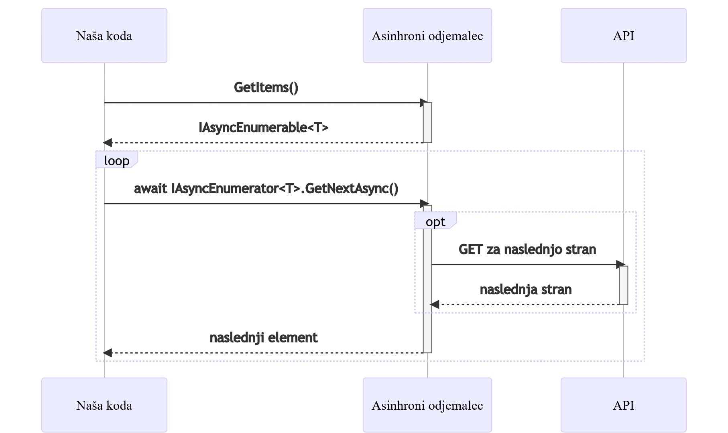
IAsyncEnumerable<T>
await foreach (var value in GetItems())
{
// use the item
}

Slide 9
IAsyncEnumerable<T> v .NET knjižnicah
System.Linq.Async
  var singleItem = await GetItems().Skip(5).FirstAsync();
Entity Framework Core
  var persons = context.Persons
  .Where(person => person.LastName == "Doe")
  .AsAsyncEnumerable();
ASP.NET Core web API
  public IAsyncEnumerable<Person> GetAllPersons()
  {
  return context.Persons.AsAsyncEnumerable();
  }

Slide 10
Asinhroni tokovi v EF Core
Branje zapisov na zahtevo

Slide 11
Implementacija IEnumerable<T>
public IEnumerable<T> GetIEnumerable<T>(int count)
{
for (var index = 0; index < count; index++)
{
yield return GetItem<T>(index);
}
}

Slide 12
Implementacija IAsyncEnumerable<T>
public async IAsyncEnumerable<T> GetIAsyncEnumerable<T>(int count)
{
for (var index = 0; index < count; index++)
{
yield return await GetItem<T>(index);
}
}

Slide 13
Implementacija asinhronega toka
Odjemalec za GitHub API

Slide 14
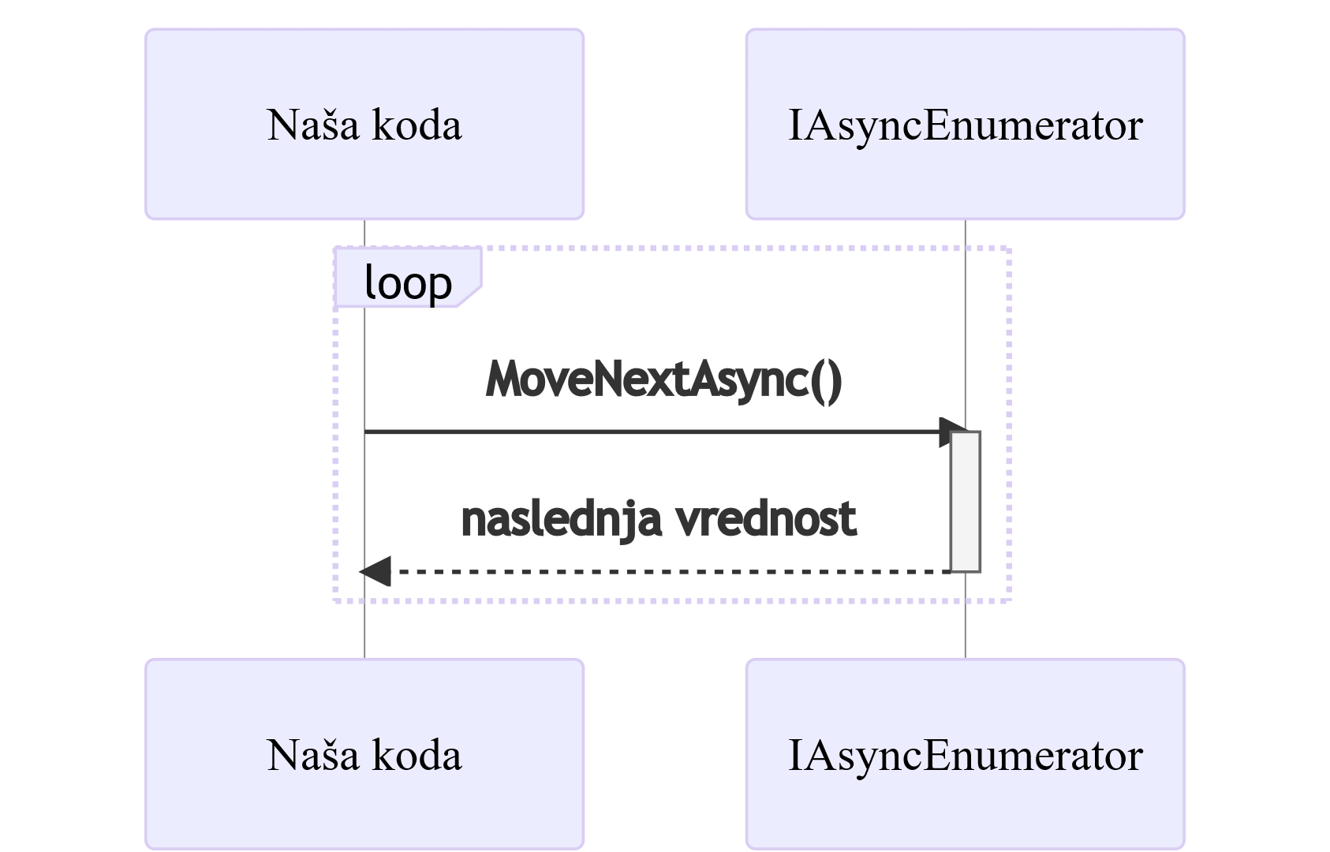
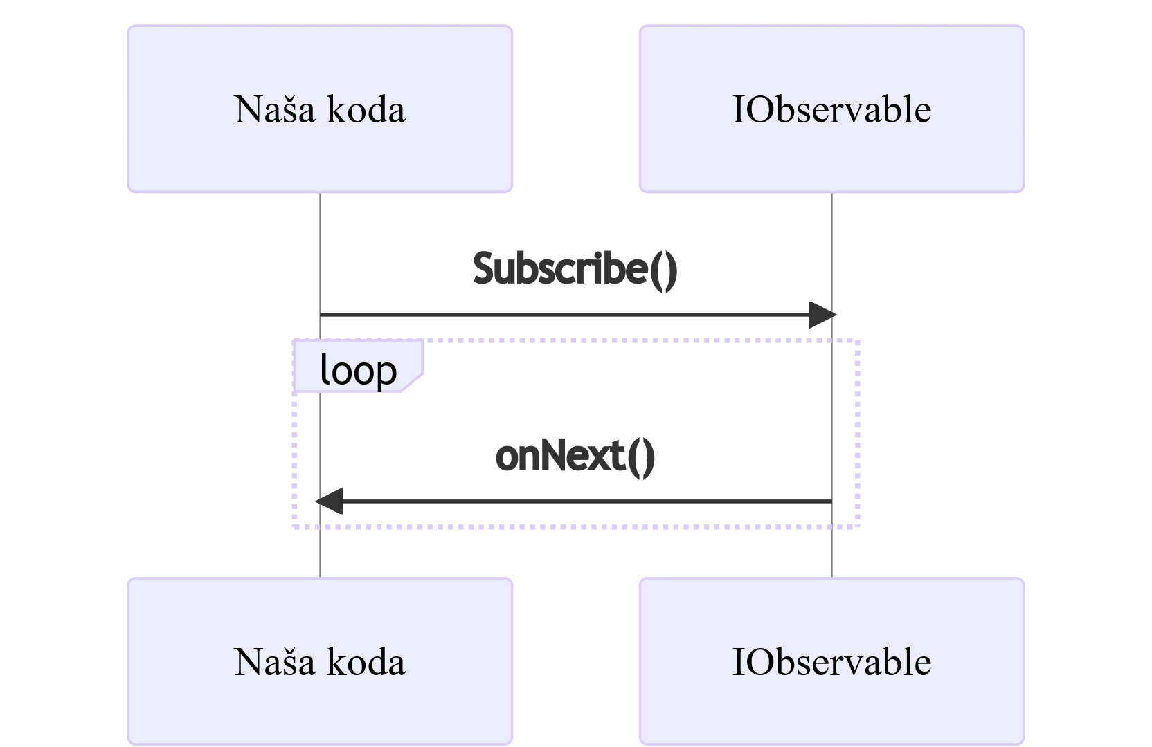
IAsyncEnumerable<T> : IObservable<T>

Slide 15
Kdaj je uporaben IObservable?
Observable.FromEventPattern
<TextChangedEventHandler, TextChangedEventArgs>(
handler => this.input.TextChanged += handler,
handler => this.input.TextChanged -= handler)
.Throttle(TimeSpan.FromMilliseconds(500))
.Subscribe(_ => this.PerformSearch());

Slide 16
Implementacija IObservable<T>
Odjemalec za GitHub API

Slide 17
Uporaba IObservable<T>
var subscription = client.GetIssues("dotnet", "runtime").Subscribe(
value =>
{
// process the issue
});
subscription.Dispose();

Slide 18
IObservable<T> <> IAsyncEnumerable<T>
public static IAsyncEnumerable<TSource> ToAsyncEnumerable<TSource>(
this IObservable<TSource> source);
public static IObservable<TSource> ToObservable<TSource>(
this IAsyncEnumerable<TSource> source);

Slide 19
Ključni poudarki
Asinhrona uporaba zaporedij
Podpora v EF Core in ASP.NET Core web API
Podpora asinhronim tokovom v C# prevajalniku
Potisni IAsyncEnumerable<T> : vlečni IObservable<T>

Slide 20
Viri
https://github.com/damirarh/async-streams
https://bit.ly/AsyncStreamMsdnMag
https://github.com/dotnet/reactive
https://www.nuget.org/packages/System.Linq.Async/

Slide 21
Vprašanja?

