Slide 1
Power BI – The Circle is Complete
Gašper Kamenšek

Slide 2










Gašper Kamenšek
gasper@excelolympics.com
http://excelolympics.com
http://excelunplugged.com

Slide 3
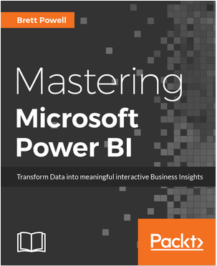
Power BI Projects
Gašper Kamenšek
Power BI Projects

Slide 4
Power BI is what?

Slide 5
Data Model
Reports
???
Data
Import & Transform

Slide 6
WriteBack!!!!!!
The Circle is complete!

Slide 7
Data Model
Reports
Add/Change Data
Data
Import & Transform

Slide 8
But How?
Power Apps

Slide 9
Demo
Power BI, Power Apps & SharePoint Online List

