Slide 2


Deja Vu:
Virtual Databases for SQL Server
Urh Srečnik <urh.srecnik@abakus.si>

Slide 3
Abakus Plus d.o.o.
History
  From 1992
  ~20 employees
Applications
  Special
    Document Management System
    Newspaper Distribution
    Flight Information System
  Oracle Database:
    ARBITER - the ultimate audit trail tool
    APPM – Abakus Plus Performance and Monitoring Tool
Services
  OS & Network Administration
  DBA, Programming
Hardware
  Servers, SAN Storage, firewalls
  Backup Server
Infrastructure
  > 20 years of experience with High Availability on GNU/Linux.

Slide 4




































Reference

Slide 5
Problem #1
Production Size and Growth
Notes:
Deduplication!

Slide 6
The Problem
Beyond every production environment...
  There is test, development and other project-specific environments
production
acceptance
test
devel

Slide 7
The Problem
Trying to migrate the problem by copying subsets of production.
... But, it is difficult and time-consuming
production
acceptance
test
devel

Slide 8
Time Consuming?
How long does it take to copy 5 TB of data?
MB/S | Time Required | Comment
55 | 26:28:45 | Notebook, 1x HDD, 5400 RPM
250 | 5:49:32 | Notebook, 1x SSD
280 | 5:12:05 | SAN1, 10x 600 GB 15k, FC
455 | 3:12:03 | SAN2, 30x 146 GB 15k, FC
1727 | 0:50:36 | SAN3, 16x SSD, Infiniband 40G
300 | 4:51:16 | LTO-7, tape drive

Slide 9
The Problem
So, most give up and the environments become stale.
production
devel
acceptance
test

Slide 10
Possible Solution – in a perfect world
devel
Developer #1 - Tom
production
devel
Developer #2 - Sally
test
Developer #3 - Harry

Slide 11
Possible Solution – in the real world
production
devel
Developer #1 – Tom
Developer #2 – Sally
Developer #3 – Harry

Slide 12
Attempting to Solve the Problem
It is not easy for developers or testers to share environments simultaneously.
  Changes made by each user conflict with one another.
Serialize access to the limited number of environments.
  Each user queues at the resource – their project takes more time.
  Each user destructively changes the resource.
We need a way and time to reset or cleanup environment between each use.
  Reset or clean up takes time and resources.

Slide 13
Problem #2
Debug on production?
Notes:
Point-in-time virtual databases

Slide 14
Test Environments
The best place to test is on production.
  Right data, right stats, right hardware.
  End-users may disagree.
  Competition for resources is a threat.
  Cannot test code on »history« data.
Next best is a »good« copy of production.
  How good, how often, how quickly?
  How do you supply a terabyte sized database to five different developer teams without 5TB of disk space for each copy?

Slide 15
The Problem
> ----- Original Message -----
> From: xxxxxxxxxxxxxxxxxxxxx
> To: "Urh Srecnik" <urh.srecnik@abakus.si>
> Sent: Tuesday, 8. March 2016 11:43:55
> Subject: The database from Friday
>
> Urh,
> a procedure that ran over the weekend went wrong. Can you restore the
> Friday's database somewhere where we could repeat the procedure
> and debug it?

Slide 16
The Problem
Last night report took 30 minutes instead of 2!
Developer: I believe I can make this part of the job run many times faster - where can I test it?
Different versions in PROD and DEV or TEST databases

Slide 17
Possible Solution
Test on actual data
Mon | Tue | Wed | Thu | Fri | Sat | Sun
1 | 2 | 3 | 4 | 5 | 6 | 7
8 | 9 | 10 | 11 | 12 | 13 | 14
15 | 16 | 17 | 18 | 19 | 20 | 21
22 | 23 | 24 | 25 | 26 | 27 | 28
29 | 30 | 31
debug
test
debug
production

Slide 18
The Problem
„Last night report took 30 minutes instead of 2. Why? Make sure it doesn't do it again tonight.“
data change,
statistics might change,
is execution plan the same as yesterday?

Slide 19
Possible Solution
Last night report took 30 minutes instead of 2!
Virtual database from production backup
Run new and old report and compare results.
debug
@last_night
run „slow“ report
production
backups
compare
results
debug
@last_week
run „fast“ report

Slide 20
Possible Solution
Developer: „I believe I can make this part of the job run many times faster - where can I test it?“
debug
@ -1 day
Compare „new“ and „old“ report
debug
@ -5 days
production
backups
Compare „new“ and „old“ report
debug
@ -2 months
Compare „new“ and „old“ report
debug
@ -6 months
Compare „new“ and „old“ report

Slide 21
Problem #3
Environment versions
Notes:
On-the-fly virtual databases

Slide 22
The Problem
Different versions on different environments.
Devel
V 3.0
Test
V 2.8-p1
Acceptance
V 2.8
Production
V 2.7

Slide 23
Possible Solution
Production
Clone
V 2.7
Debug V 2.7 on Production or
on it‘s clone?
Devel
V 3.0
Test
V 2.8-p1
Acceptance
V 2.8
Production
V 2.7

Slide 24
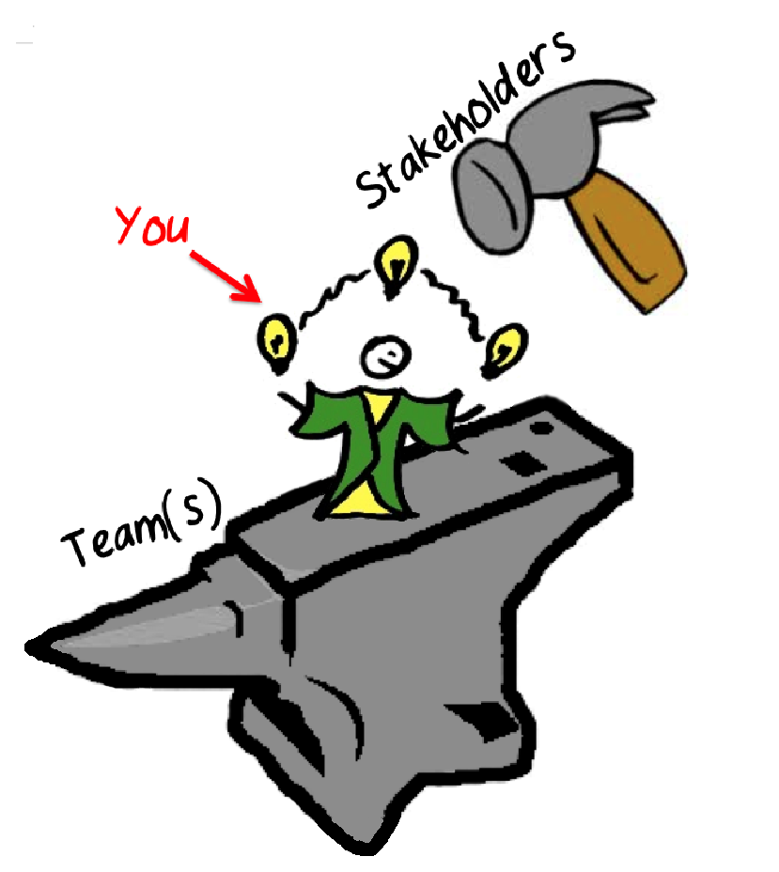
DBA
management
developers & testers

Slide 25
Problem #4
Solution(s) requirements
Notes:
On-the-fly virtual databases

Slide 26
Solution Requirements and Cost
Server to run the instance
Disk space to host the database
Time to find appropriate backups / prepare restore script
Time to restore backup
Time to apply transaction logs
Standby databases? Snapshots?

Slide 27
Could we use...
Single server,
Minimal disk space by means of block-level deduplication
Let automation decide which backup to use
Apply at most 4 hours of transaction logs to get to...
... Any point in time in last 6 months?
Without touching the production server

Slide 28
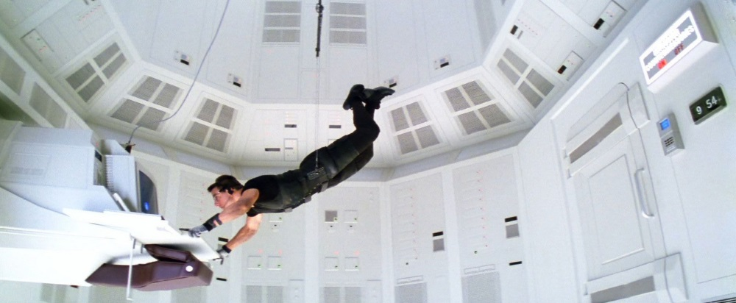
Mission: Impossible

Slide 29
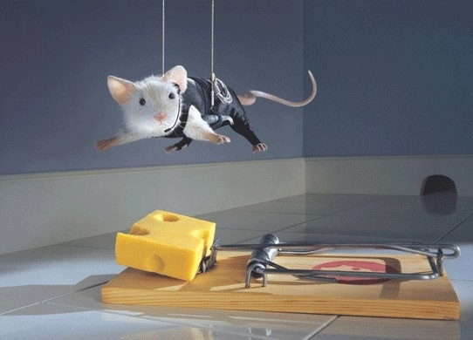
Mission: Impossible

Slide 30
Deja Vu
Connect to Deja Vu
Open the database in required point-in-time.

Slide 31
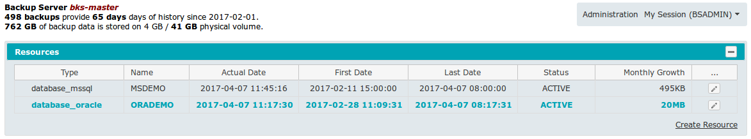
Deja Vu: Resources

Slide 32
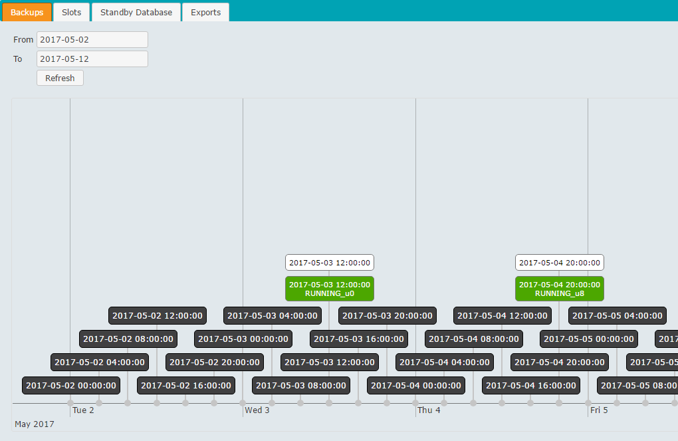
Deja Vu: Backups Timeline

Slide 33
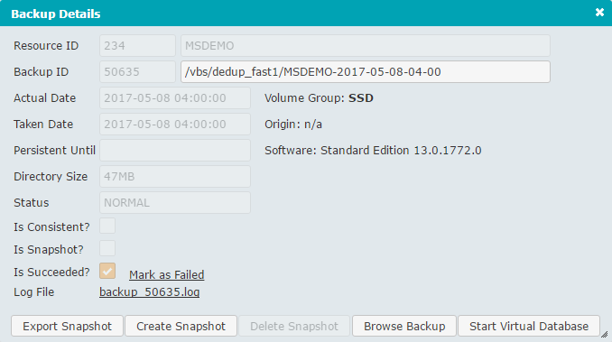
Deja Vu: Backup Details

Slide 34
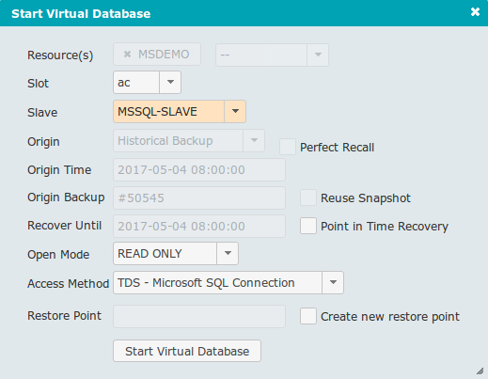
Deja Vu: Open Virtual Database

Slide 35
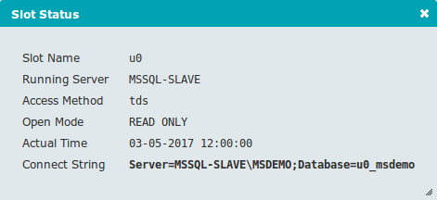
Deja Vu: Database Status

Slide 36
Log Shipping (Physical Standby)
primary
database
secondary
database
transaction
log backups
backup log
restore log

Slide 37
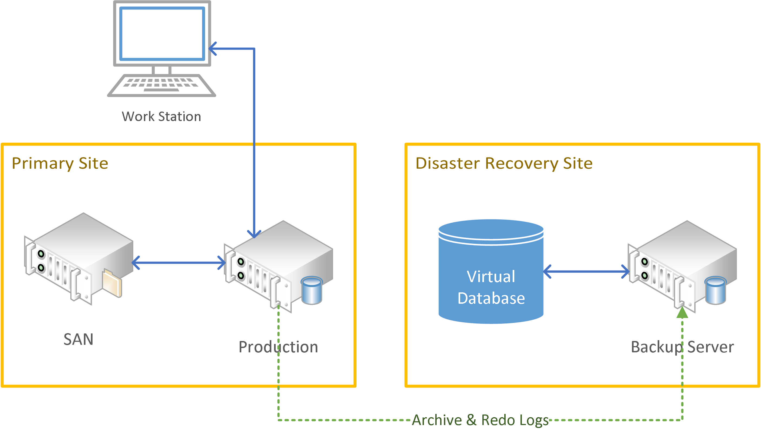
Deja Vu: Implementation Details

Slide 38


Deduplication
20.3 12:00
5.17 TB
21.3 12:00
5.19 TB
19.3 12:00
5.08 TB
18.3. 12:00
5.00 TB

Slide 39

Compression
Transaction logs should not be deduplicated
But they are well compressed
  About 5% - 30% of their original size

Slide 40
Tiered Storage
Fast Storage (e. g. SSD)
  more expensive
  less capacity
  less history
  deduplicated areas
Slow Storage (e. g. HDD)
  less expensive
  more capacity
  more history
  deduplicated areas
  compression areas
8 TB SSD
16 TB HDD
*.trn
4 TB HDD

Slide 41
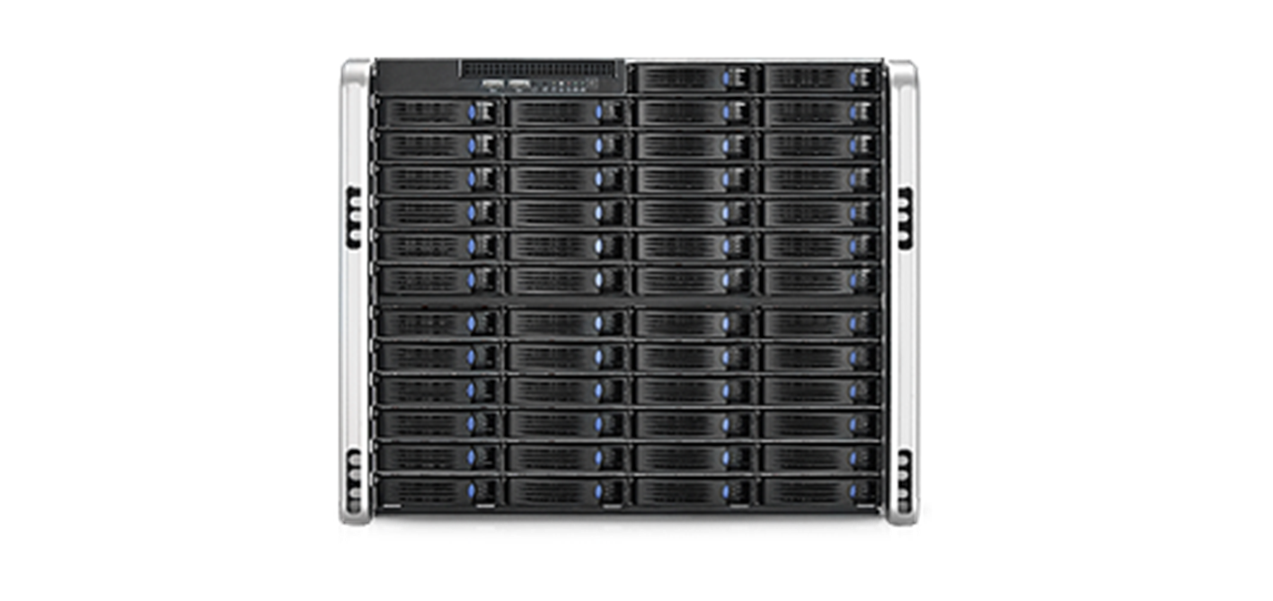
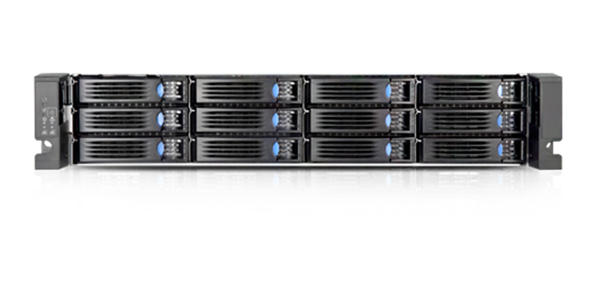
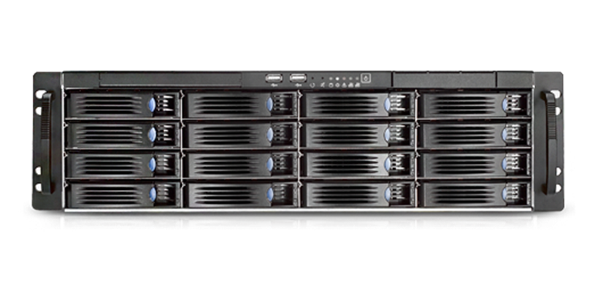
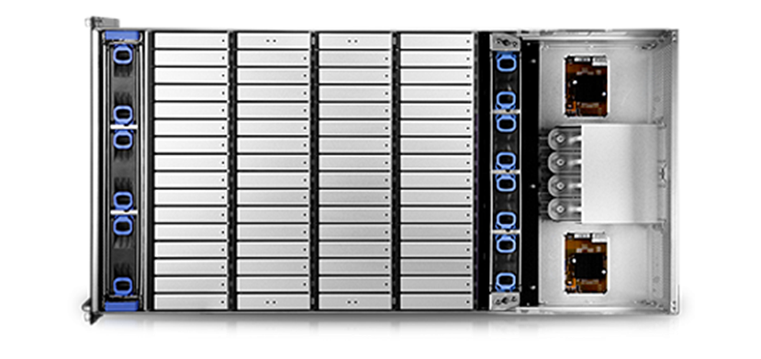
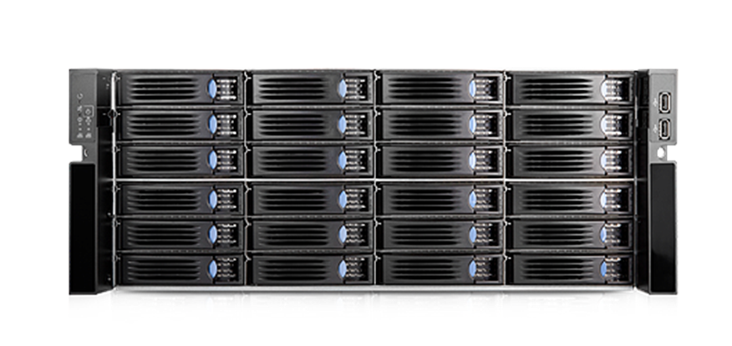
Deja Vu: Hardware

Slide 42
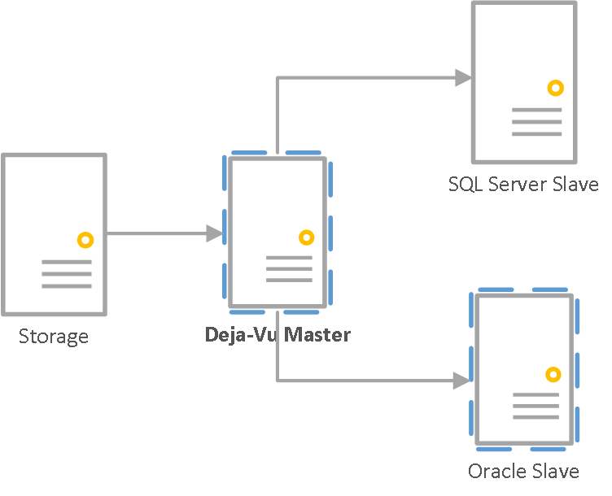
Deja Vu Deployment Options

