Slide 2
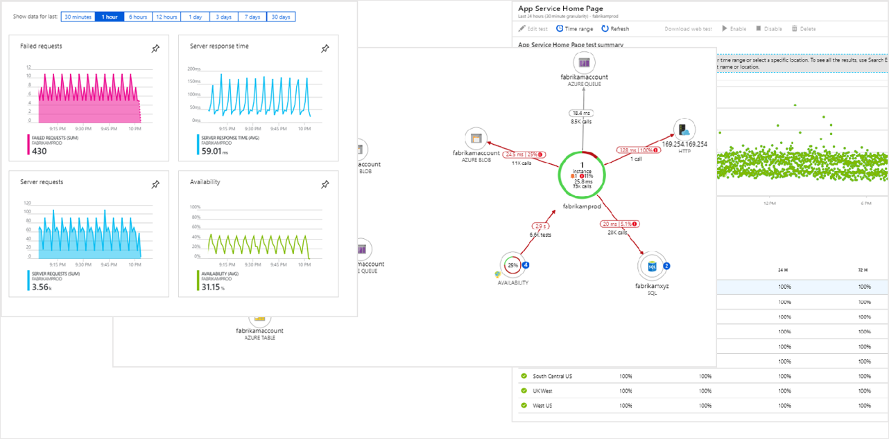

Azure Monitor za razvijalce
Bojan Vrhovnik
Cloud Solution Architect
Microsoft Slovenija
bojan.vrhovnik@microsoft.com
@bvrhovnik
@AzureMonitor

Slide 3
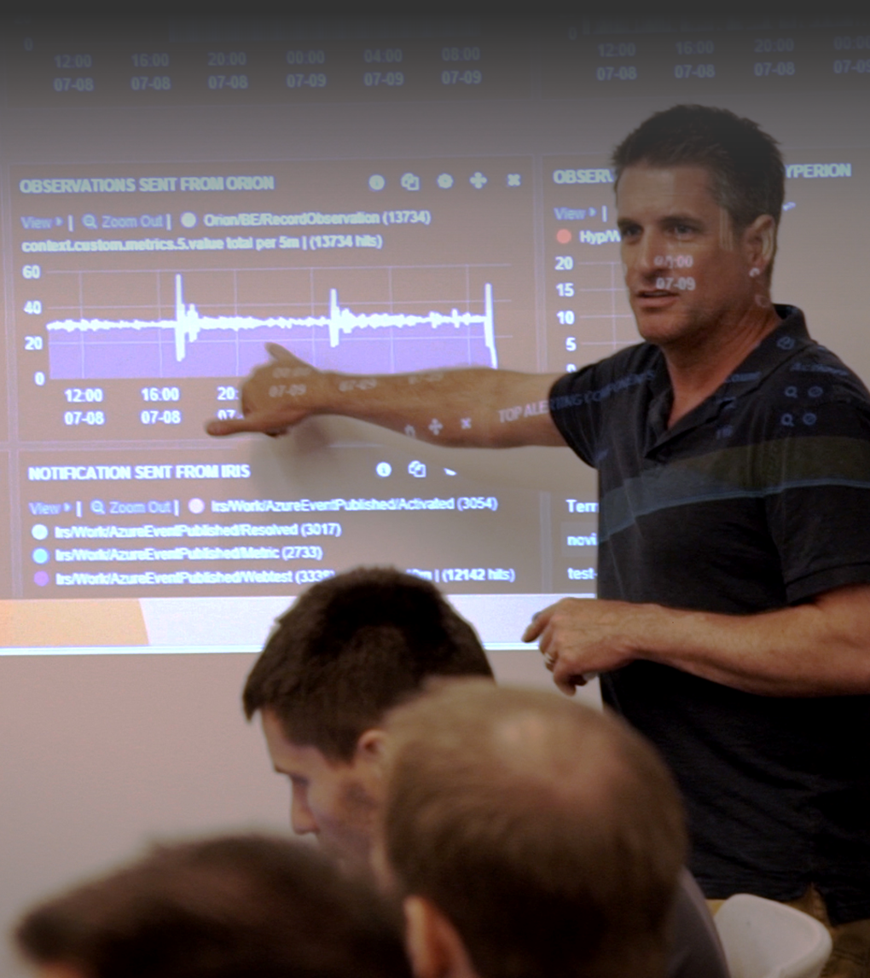
Odgovori na klasična vprašanja…
AlAli se moja aplikacija sesuva?
Kaj se je zgodilo z aplikacijo?
Ali je moja aplikacija zadovoljivo hitra?
Ali moj strežnik prenaša obremenitve s strani uporabnikov?
Moja aplikacija je hitra. Kaj pa 3rd party koda?
Ali je moja aplikacija živa ali neodzivna?
Kaj je ključni razlog za neodzivnost aplikacije?
Koliko uporabnikov ne more več uporabljati aplikacije?

Slide 4

Agenda
Pregled storitve Azure Monitor
Uporaba storitve Azure monitor in pregled razširjenih metrik
Uporaba REST api-jev in razširitve za Azure Monitor
Reakcija na različne ključne sprožilce
Notes:
With Azure Monitor, our goal is to provide end to end monitoring for your application. To accomplish that, we provide a common backend and analytics platform that is built into Azure and all Azure services uses. What it means is out of the box near real time monitoring data all collected and consolidated in a single platform.
What we can then do with the data is to provide you end to end insights. Whether you have a problem with your application code, or a VM that is deployed to or the underlying network – you get a birds eye view and drill downs that help you isolate and quickly fix issues with a modern cloud application.
You may be thinking about your own monitoring tools. We understand that monitoring is not done in isolation. You have your DevOps, incident management, SIEM tools that you currently use – and want to continue using. Azure Monitor provides tight integration with popular tools. In addition, we provide API’s, SDK’s and webhooks to build your own custom integration.

Slide 5

















Azure Monitor
Vpogled
Aplikacija
Kontajner
VM
Monitoring rešitve
Aplikacije
Operacijski sistemi
Vizualizacija
Metrike
Nadzorna plošča
Vpogledi
Power BI
Delovni zvezki
Azure viri
Azure naročnina
Analiza
Logi
Raziskovalec metrik
Analiza log-ov
Azure Tenant
Reakcija
Prilagojeni viri (custom)
Alerti
Autoscale
Integracija
Event Hubs
Logic Apps
Uvoz & Izvoz APIs
Notes:
Platform metrics are created by Azure resources and give you visibility into their health and performance. Each type of resource creates a distinct set of metrics without any configuration required.
Application metrics are created by Application Insights for your monitored applications and help you detect performance issues and track trends in how your application is being used. This includes such values as Server response time and Browser exceptions.
Custom metrics are metrics that you define in addition to the standard metric that are automatically available. Custom metrics must be created against a single resource in the same region as that resource. You can create custom metrics using the following methods:
Define custom metrics in your application that's monitored by Application Insights. These are in addition to the standard set of application metrics.
Publish custom metrics from your Windows virtual machines using Windows Diagnostic Extension (WAD).
Publish custom metrics from your Linux virtual machines using InfluxData Telegraf Agent.
Write custom metrics from an Azure service using the custom metrics API.

Slide 6
DEMO: Pregled Azure Monitor
Pregled Azure Monitor, nastavljanje virov za pridobivanje podatkov, prikaz povezave z virtualnim okoljem, “out of the box” merjenje informacij

Slide 7
Azure Monitor Metrike & Logi
Aplikacije
Application Insights
SDK usmerjen
Podpora multi prog. jezikom
Azure Monitor
Operacijski sistem
Diag. razširitve + Agenti
Podpora Windows + Linux
Workload Agnostic
Metrike
Azure viri
Azure naročnina
Logi
Logi & Metrike s strani platforme Azure
Azure Tenant
Prilagojeni viri (custom)
Za vse ostalo
Notes:
93 days – for longer brevity you need to archive it
https://docs.microsoft.com/en-us/azure/azure-monitor/platform/data-collection
Examples:
Resource - Logs and Metrics emitted by Azure – The number of queries against your CosmosDB, or the utilized capacity of your storage account
Agents – Collect docker stats about your containers, or logs your app is emitting into syslog
App Insights – track user transaction failures, or measure latencies as microservices communicate with one another
Custom – You may have a physical network device, like a router that you have logs collected for. Using our APIs you can send those logs, and metrics to Azure Monitor
Use Log Analytics in the Azure portal to write queries analyzing log data. Pin results rendered as tables or charts to an Azure dashboard.
Configure a log alert rule that sends a notification or takes automated action when the results of the query match a particular result.
Build a workflow based on log data using Logic Apps.
Export the results of a query to Power BI to use different visualizations and share with users outside of Azure.
Access metric values from a command line or custom application using PowerShell cmdlets or REST API.

Slide 8
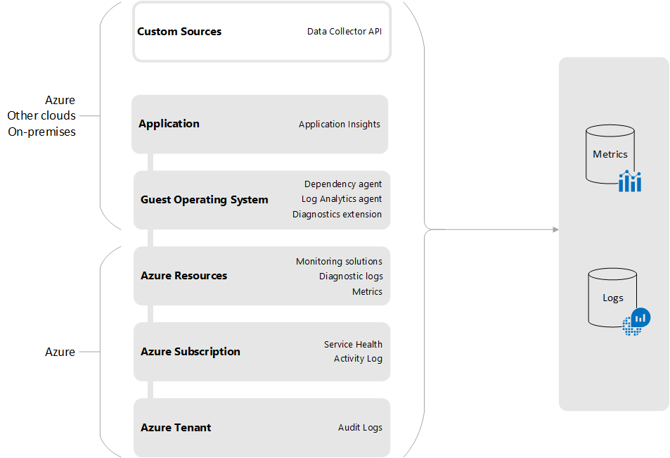
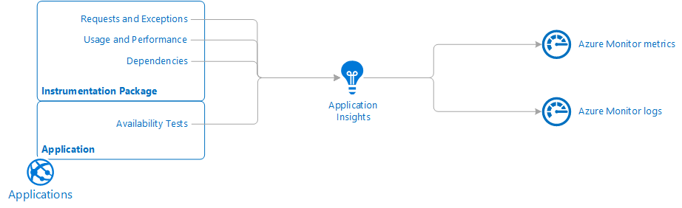
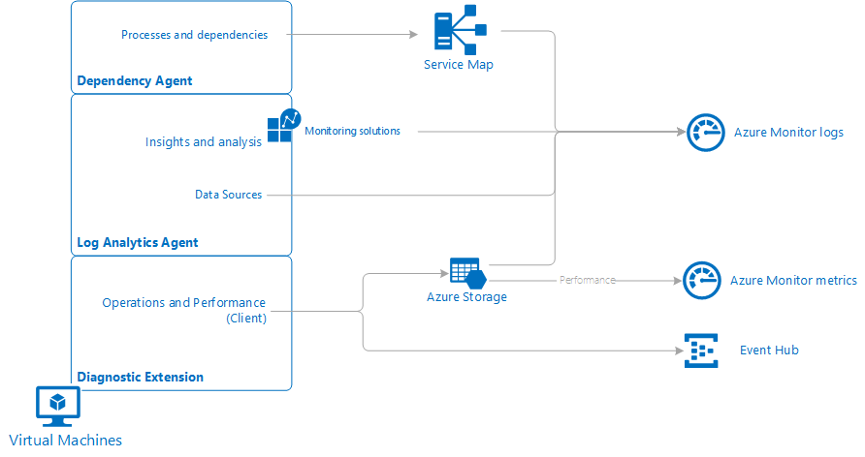
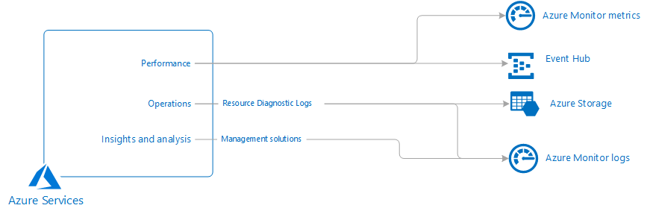
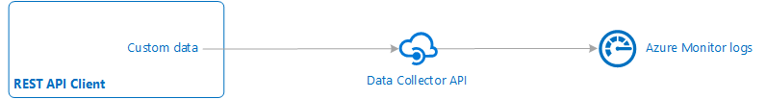
Izvori podatkov
Notes:
Programmatic approach - https://docs.microsoft.com/en-us/azure/azure-monitor/platform/data-sources-reference

Slide 9

Pošiljanje podatkov
Pošiljanje podatkov od 2 – 5 minut (https://docs.microsoft.com/en-gb/azure/azure-monitor/platform/data-ingestion-time#checking-ingestion-time )
Odvisno od agenta in indeksiranja podatkov za dostop
Azure doda dodaten čas za procesiranje:
  Podatki diagnostic logs 2 - 15 minut
  Metrike Azure platforme 3 minute za pošiljanje v Log Analytics
  Activity log podatki 10 - 15 minut za pošiljanje v Log Analytics
  Ko je na voljo v Log Analyticsu, potrebuje še približno 2 - 5 minut za pregled poizvedb
Notes:
https://docs.microsoft.com/en-gb/azure/azure-monitor/platform/data-ingestion-time#checking-ingestion-time

Slide 10
DEMO: Razširitev metrik v Azure Monitor in ustvarjanje svojega log okolja
Dodajanje svojih metrik in pregled the metrik v okolju Azure Monitor ter ustvarjanje svojega log okolja

Slide 11
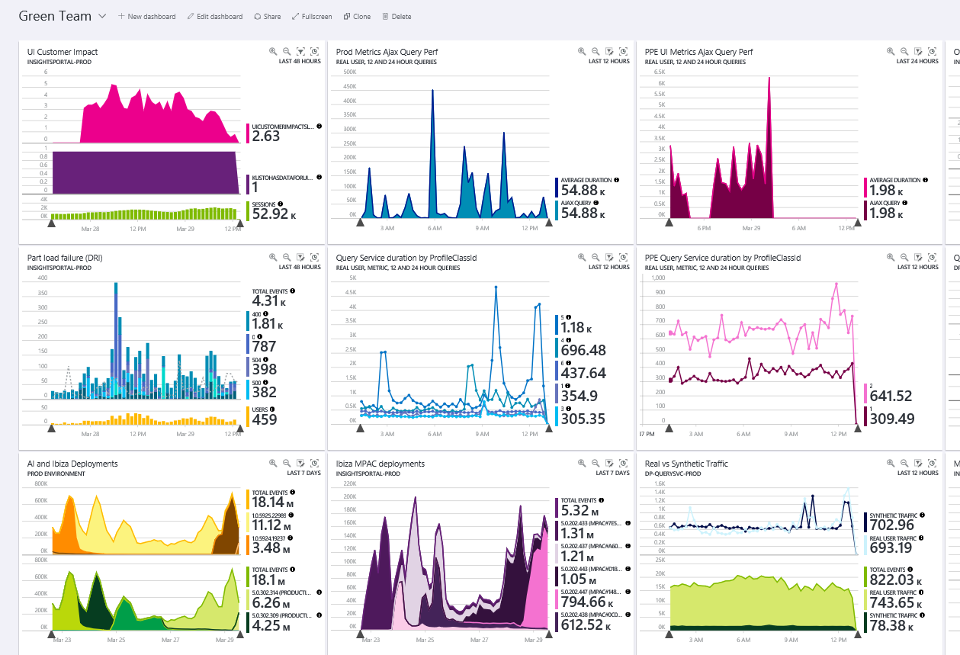
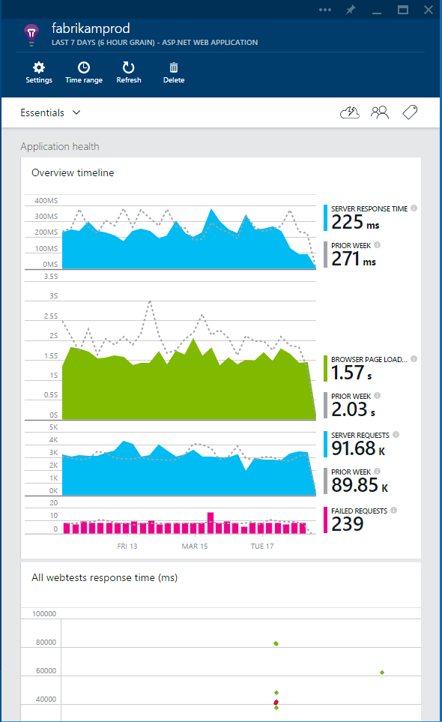
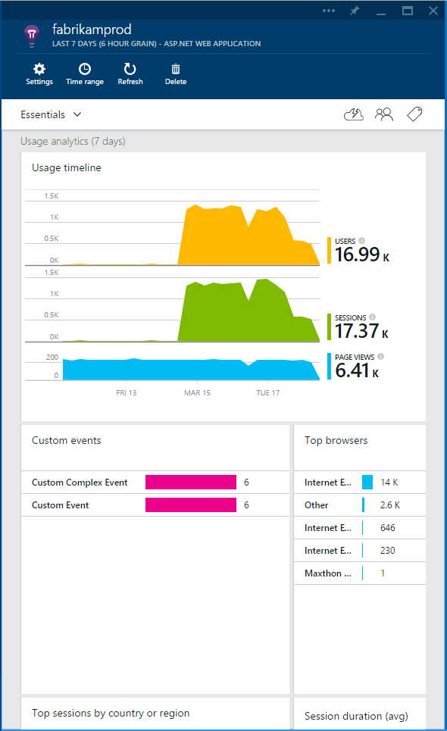
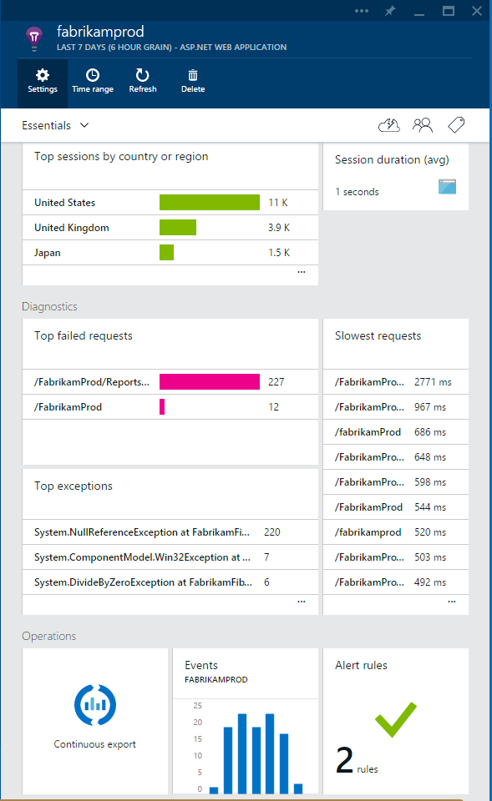
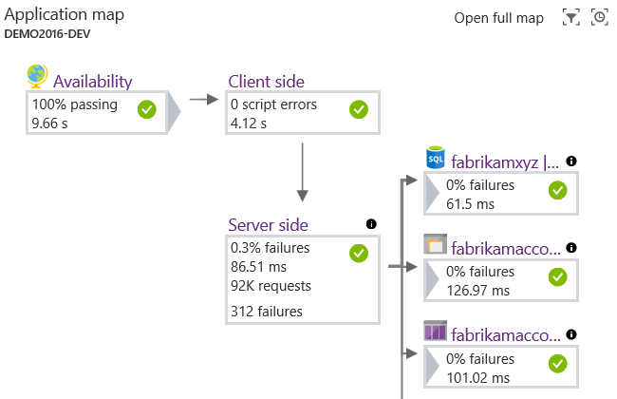
Application Insights
Zaznavanje
  Obvestila, “live stream” metrike, nadzorne plošče
Omeji izvore
  Application map, aktivnost uporabnikov
Diagnostika
  Exceptions, napake v kodi, ki ni naša
Operativa
  Aktivacija dodatnih opcij za reakcijo in obvestil glede na potrebe aplikacije

Slide 12
DEMO: Pregled Application Insights
Pregled application insights in razširitev application insights

Slide 13

Razširitve
Včasih “out of the box” rešitve niso dovolj
Imate na voljo več opcij
  Log analytics (dev.loganalytics.io)
  Application Insights (dev.applicationinsights.com)
  Azure Monitor REST API
  Managed Azure Libraries ali REST vmesnik (resources.azure.com)
…..in cel oblak ☺ (serveless, PaaS, CaaS, EaaS,…)

Slide 14
DEMO: Razširitev
Razširitev Azure Monitor in uporaba Azure Managed libraries, Signalr in Event Grid za aktivacijo ter pregled podatkov – uporaba Grafana

Slide 15
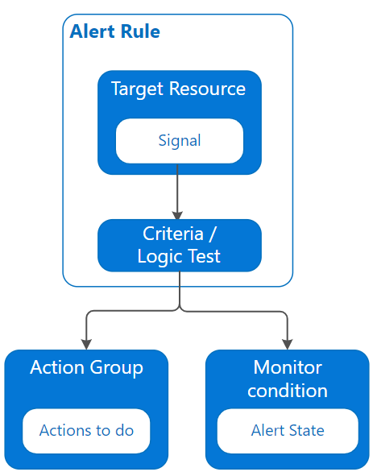
Obveščanje
Proaktivno obveščanje, ko se zgodi nekaj z vašimi aplikacijami
Kaj lahko spremljate:
  Metrike
  Iskanje po Log-ih
  Dogodki v Activity Log
  Splošno “zdravje” platforme Azure
  Teste za dosegljivost spletnih aplikacij
Notes:
https://docs.microsoft.com/en-gb/azure/azure-monitor/platform/data-sources-reference

Slide 16
DEMO: Obveščanje
Uporaba Azure Alerts z klasičnimi “out of the box” rešitvami in prirejen del z uporabo SignalR in EventGrid

Slide 17

Viri
Azure Monitor dokumentacija (https://aka.ms/MonitoringDocs)
Tutorials, kaj je novega, dodatni viri (https://aka.ms/AzMonOverview)
Kusto Query Language video tutorial (https://aka.ms/KQLPluralsight)
API REST access (https://dev.loganalytics.io/, https://dev.applicationinsights.io/)

