Slide 4
Text layout (without bullet points)
Main topic: Segoe UI Semilight, size 28pt
  Segoe UI, size 20pt for second level
    Segoe UI, size 16pt for third level

Slide 5
Text layout with bulleted text
Main topic: Segoe UI Semilight, size 28pt
  Segoe UI, size 20pt for second level
    Segoe UI, size 16pt for third level

Slide 6
Square photo with title
Smaller text

Slide 9
TABLE
 | Column 1 | Column 2 | Column 3 | Column 4 | Column 5 | Column 6 | Column 7
Row 1 | 17% | 12% | 11% | 19% | 11% | 14% | 15%
Row 2 | 78% | 61% | 36% | 25% | 15% | 12% | 2%
Row 3 | 24% | 18% | 18% | 21% | 9% | 15% | 8%
Row 4 | 64% | 46% | 41% | 47% | 26% | 26% | 14%
Row 5 | 63% | 46% | 44% | 50% | 28% | 39% | 35%
Row 6 | 4% | 2% | 2% | 4% | 1% | 2% | 1%
Row 7 | 11% | 5% | 5% | 9% | 3% | 4% | 2%
Row 8 | 11% | 5% | 5% | 9% | 3% | 6% | 5%

Slide 10
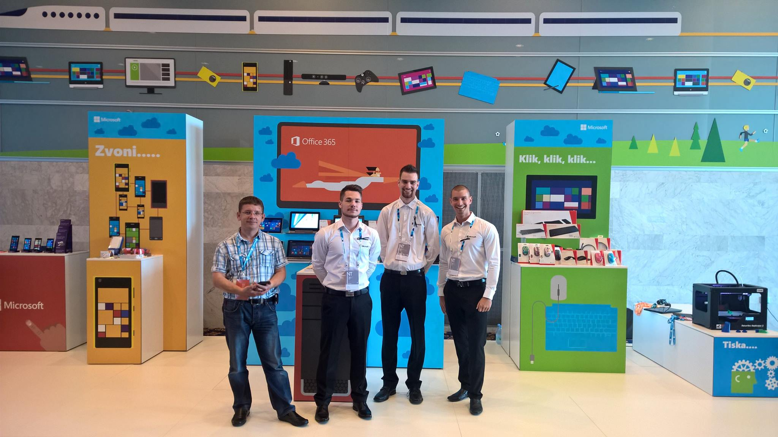
CLEAN AND MODERN
80 want to try it again
89 would purchase it
68 are indifferent
77 totally love it

Slide 11
PIE CHART
YOU CAN WRITE HERE
YOU CAN
WRITE YOUR
TITLE ABOUT
THIS GRAPHIC

Slide 15
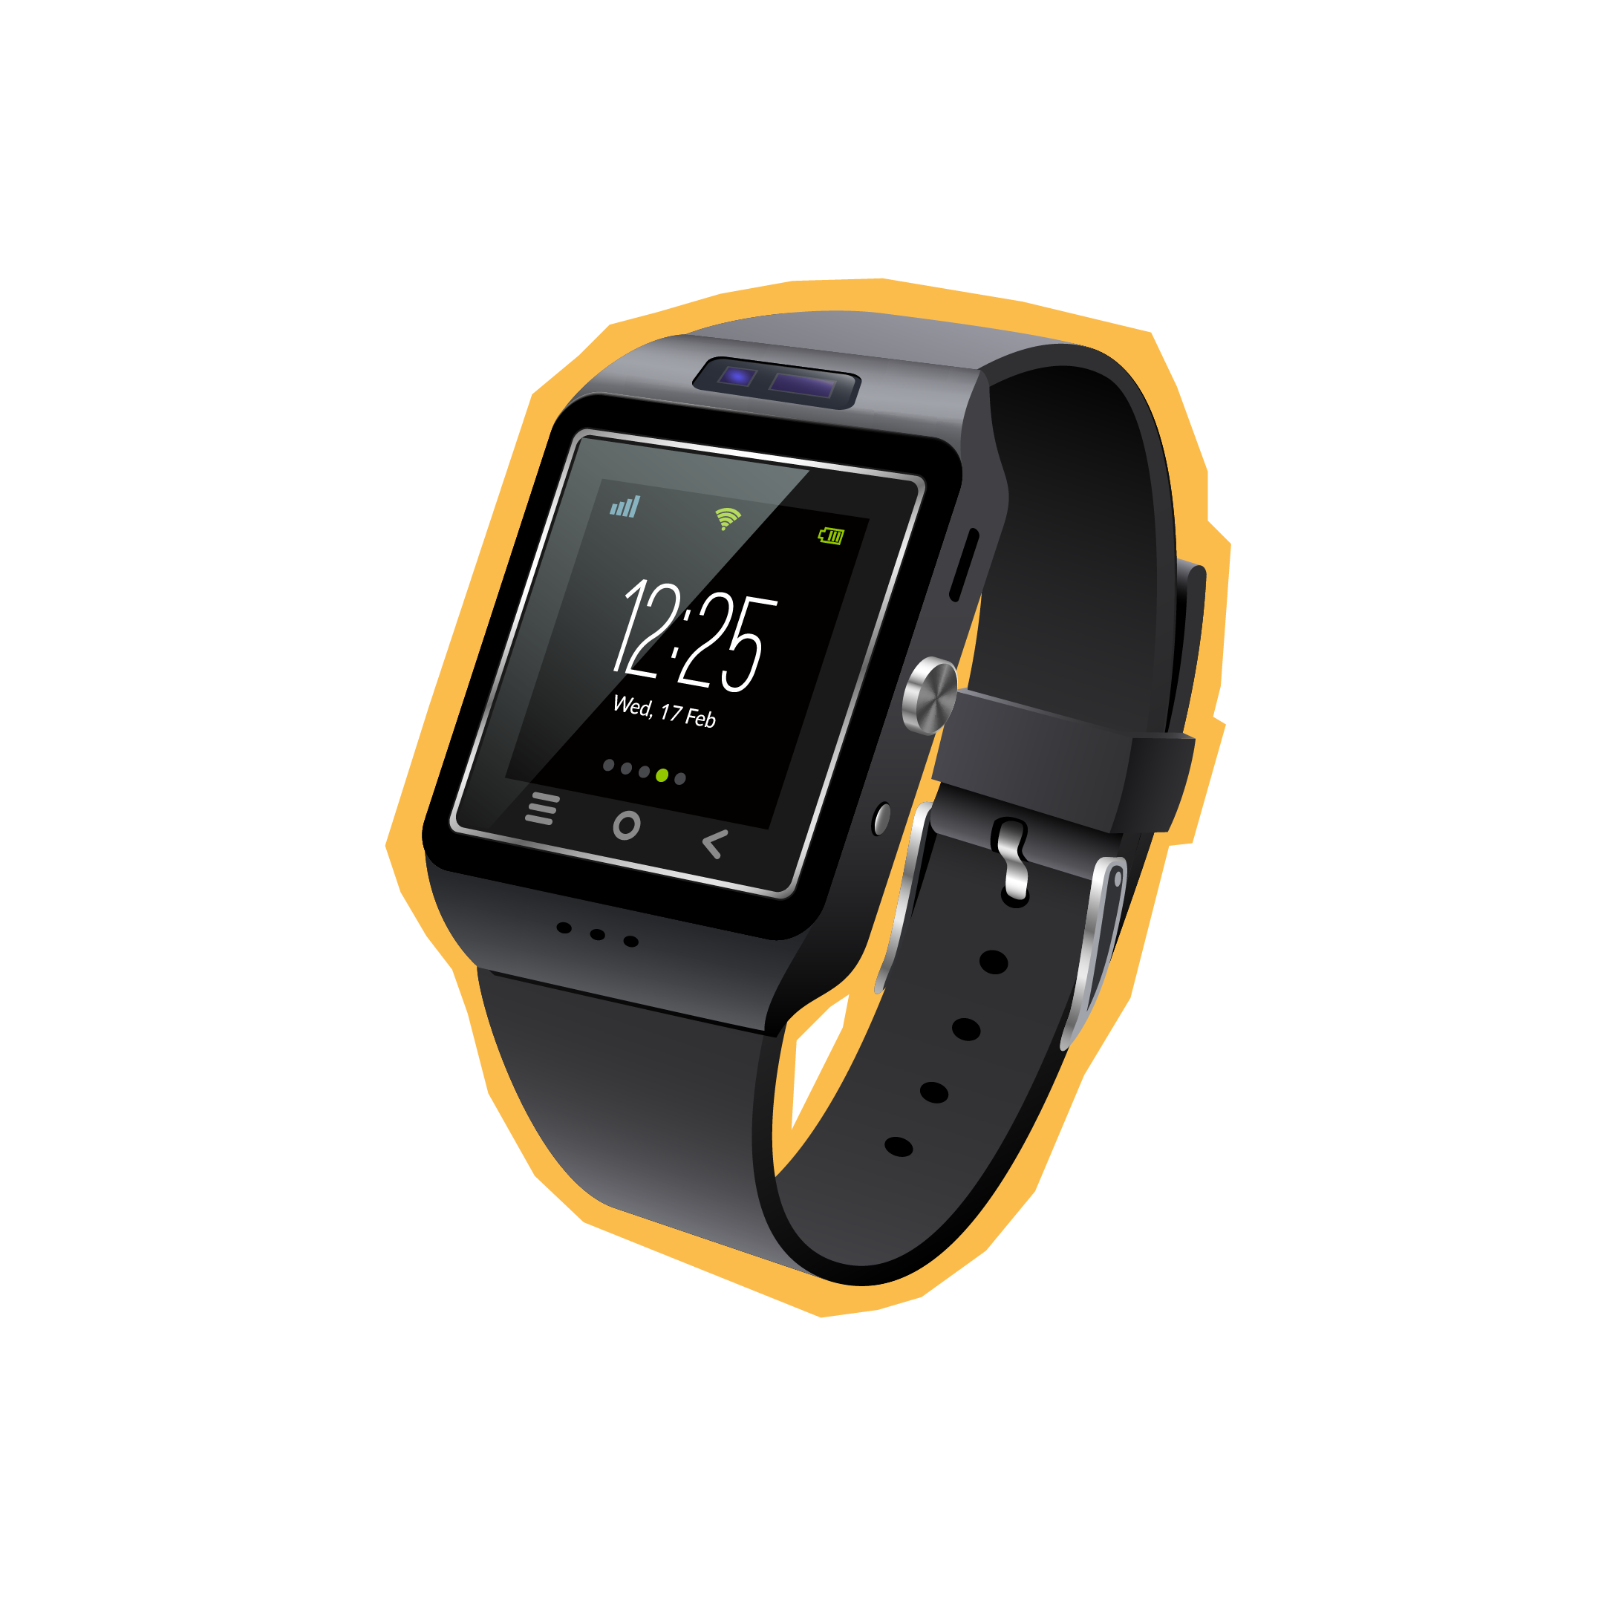



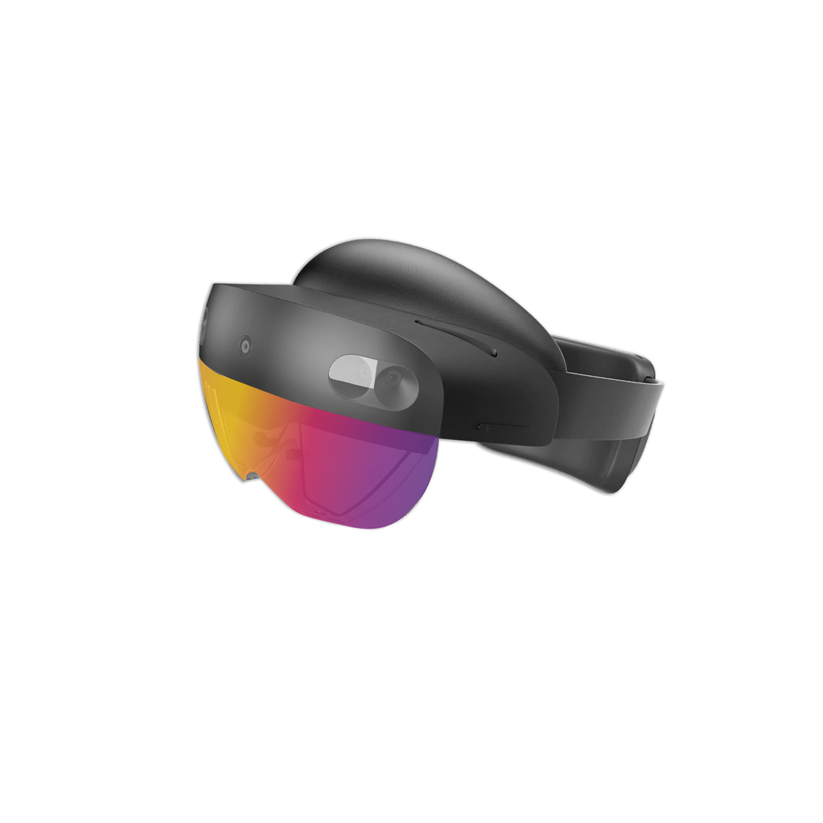

Few design elements for you to use.

Slide 16
This is not school, but we
love to get grades.
Please fill out our
questoineers and leave
us your feedback.
You may even win some
cool rewards.

Slide 19
Reporting capabilities for Dynamics 365 Business Central
Milan Milinčević, Factorial
Renato Fajdiga, Derecjun

Slide 20




Renato Fajdiga
Milan Milinčević
Dynamics 365 F&O, BC, and Power Platform consultant @ Derecjun
MVP & MCT
Dynamics 365 Business Central Developer @ Factorial

Slide 21
Agenda
Reporting capabilities in Dynamics 365 Business Central
From idea to the report
What and how can I start?
Report layouts
Power BI
Analyze in Business Central
Telemetry

Slide 22
Reporting capabilities in Dynamics 365 Business Central
RDLC
Excel and Word layouts
Data analysis mode in Dynamics 365 Business Central
Power BI

Slide 23
From idea to the report
Idea & Requirement
Developing dataset
Developing layout
Configure layouts

Slide 24
What and how can I start
Report
Report Description
Report Layout
Dataset
Request page
Labels
RDLC
Word
Excel

Slide 25
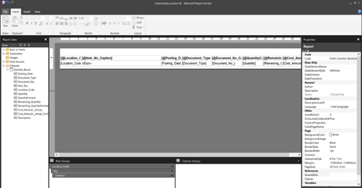
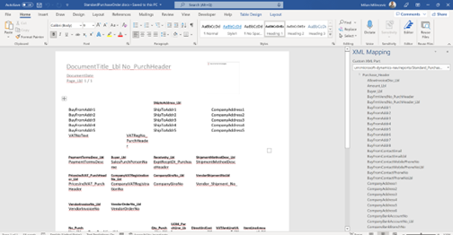
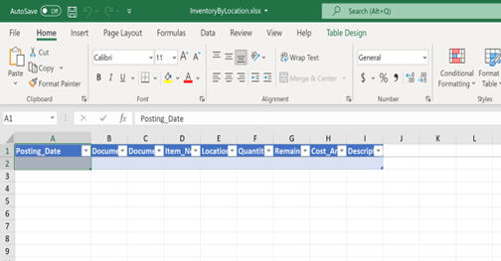
Report Layouts
RDLC
WORD
Excel

Slide 26
Demo
Get started with developing and extending reports

Slide 27
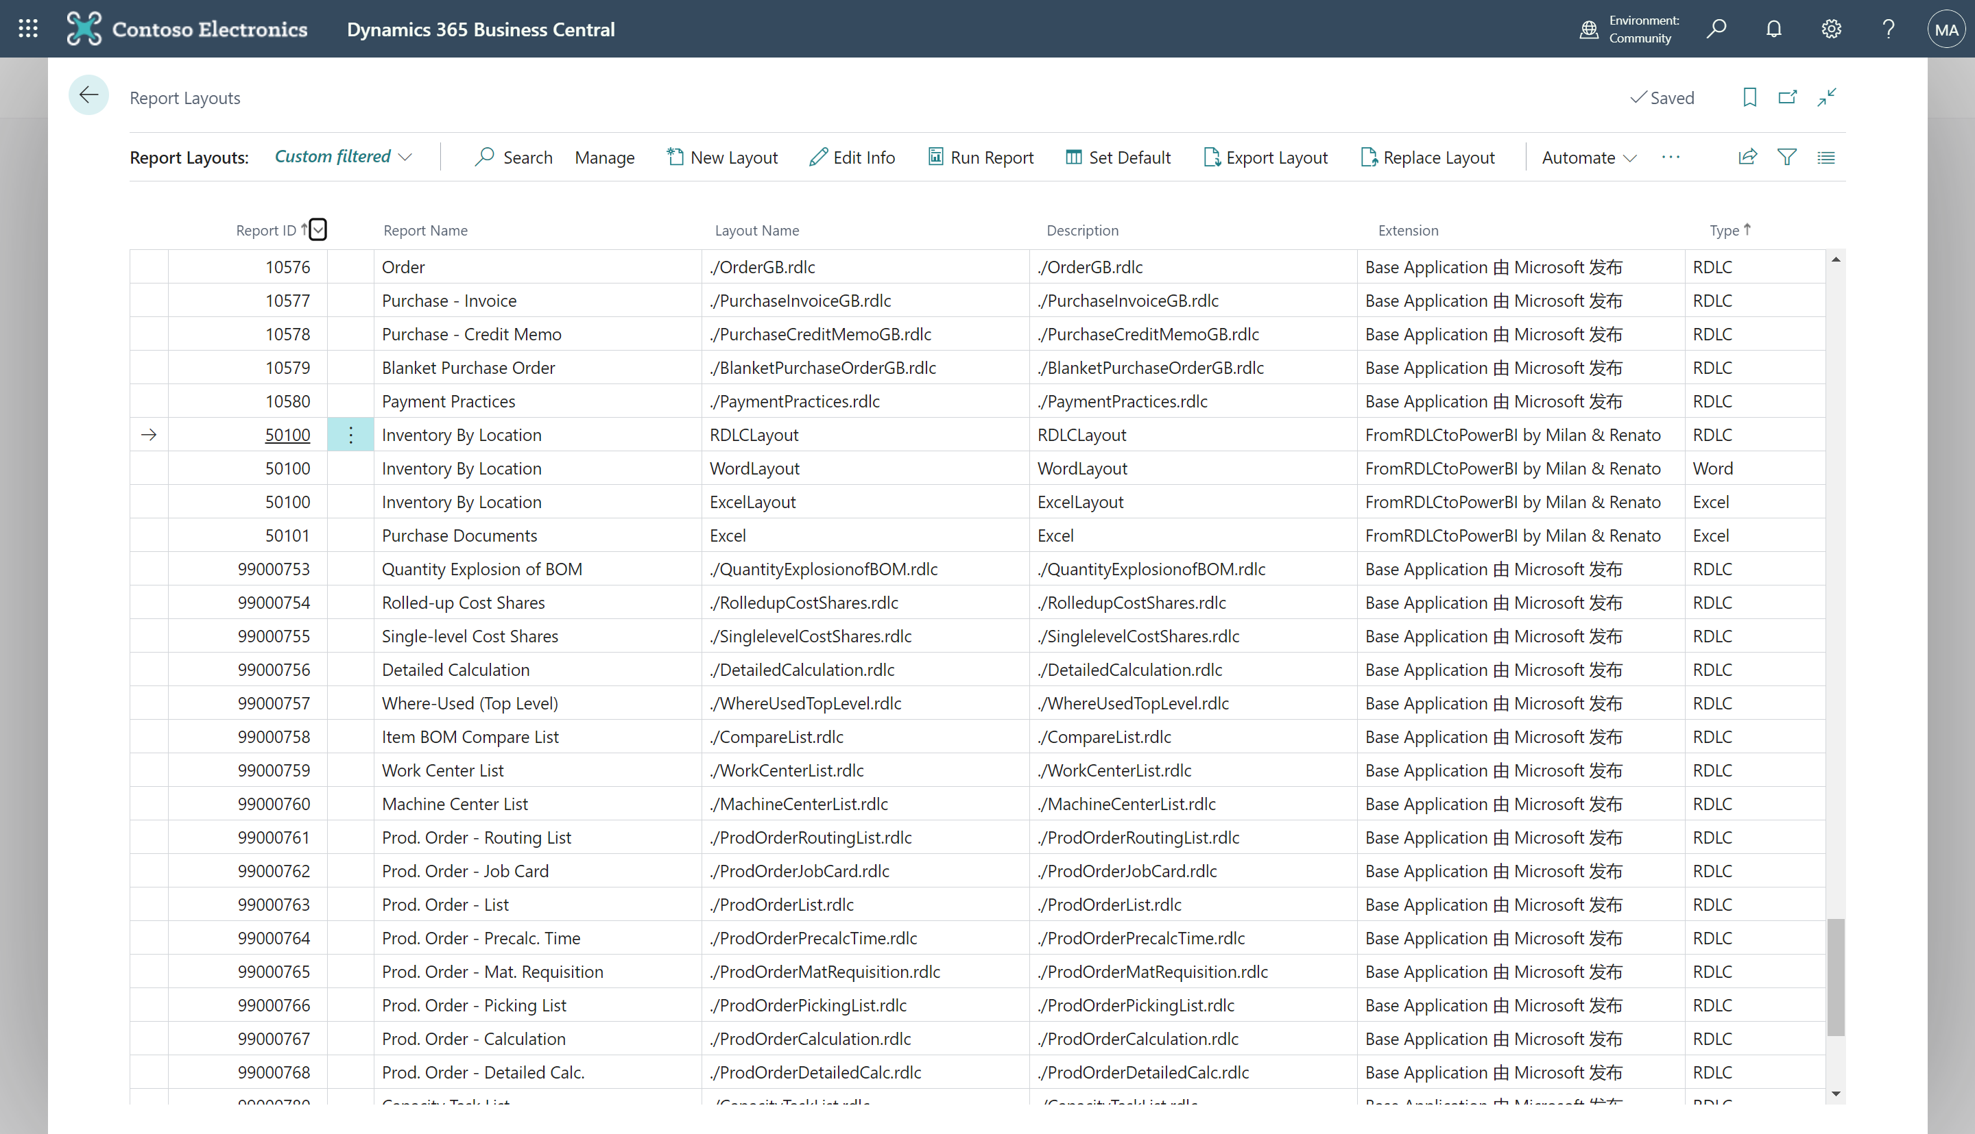
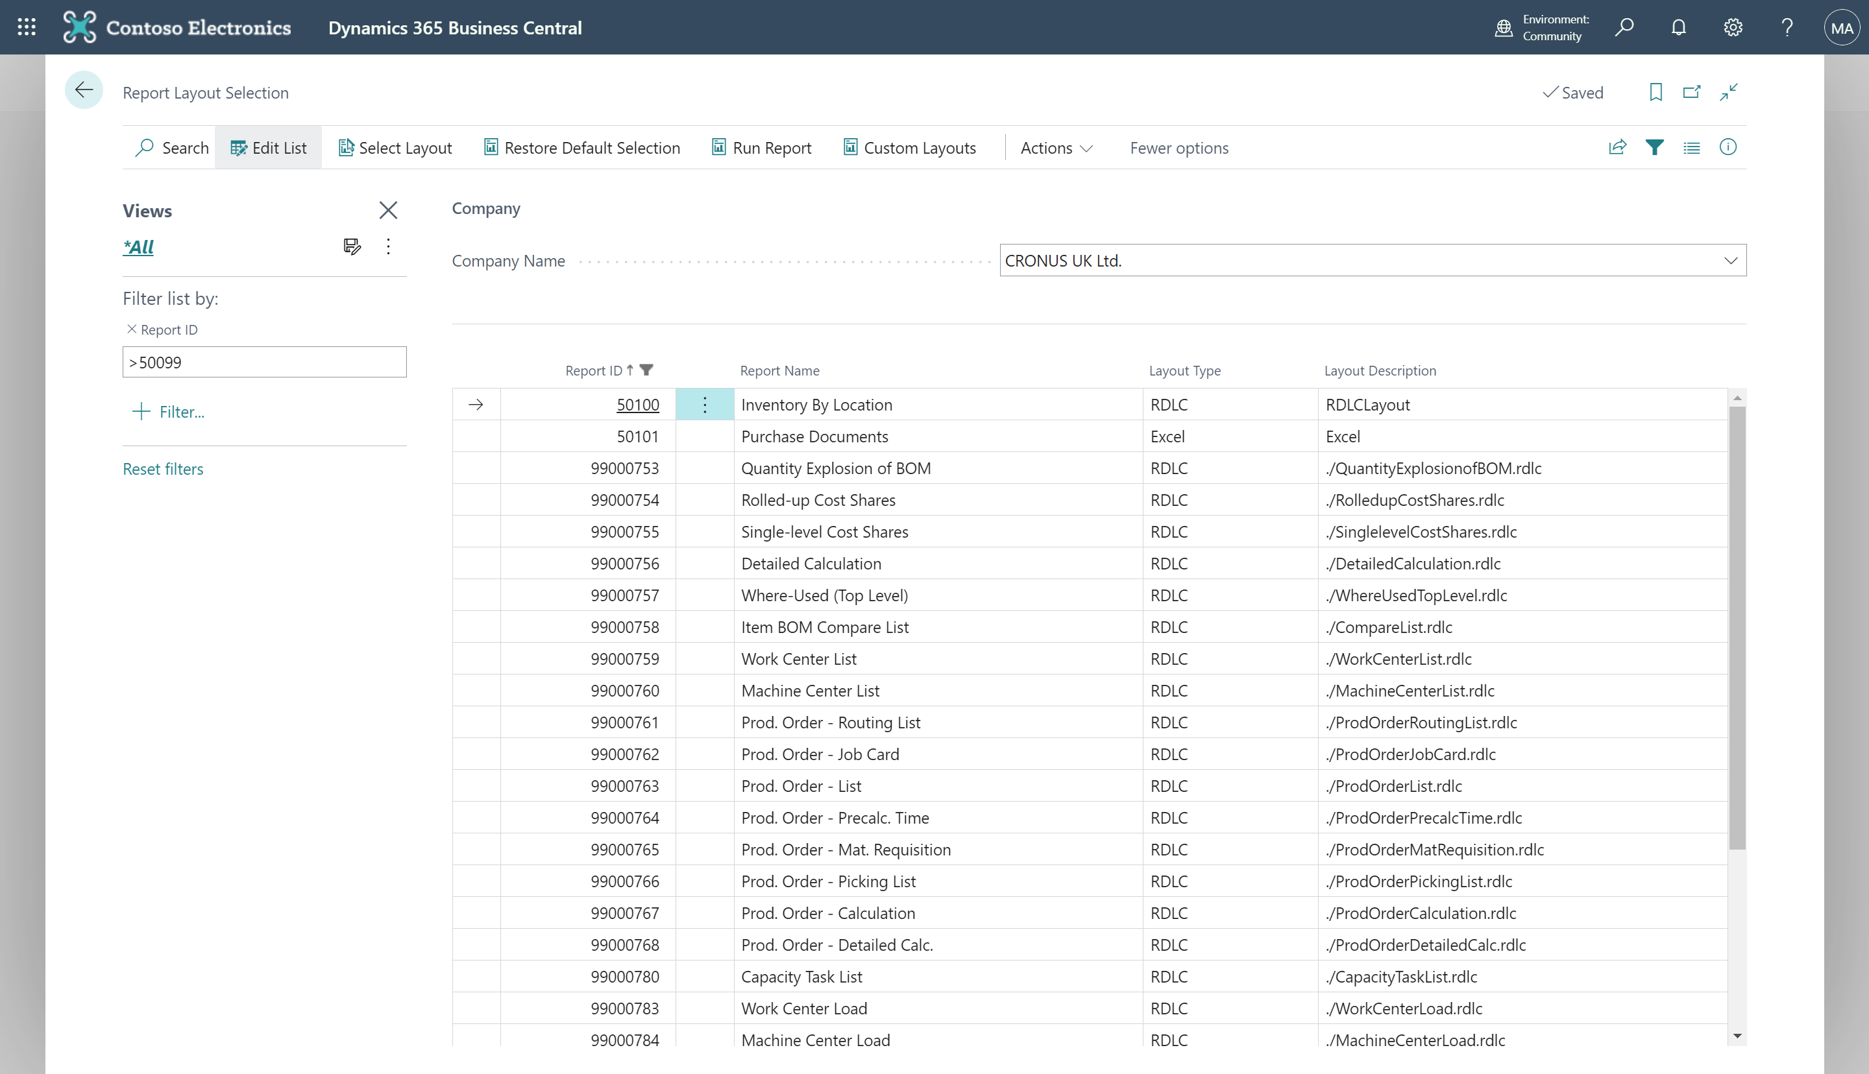
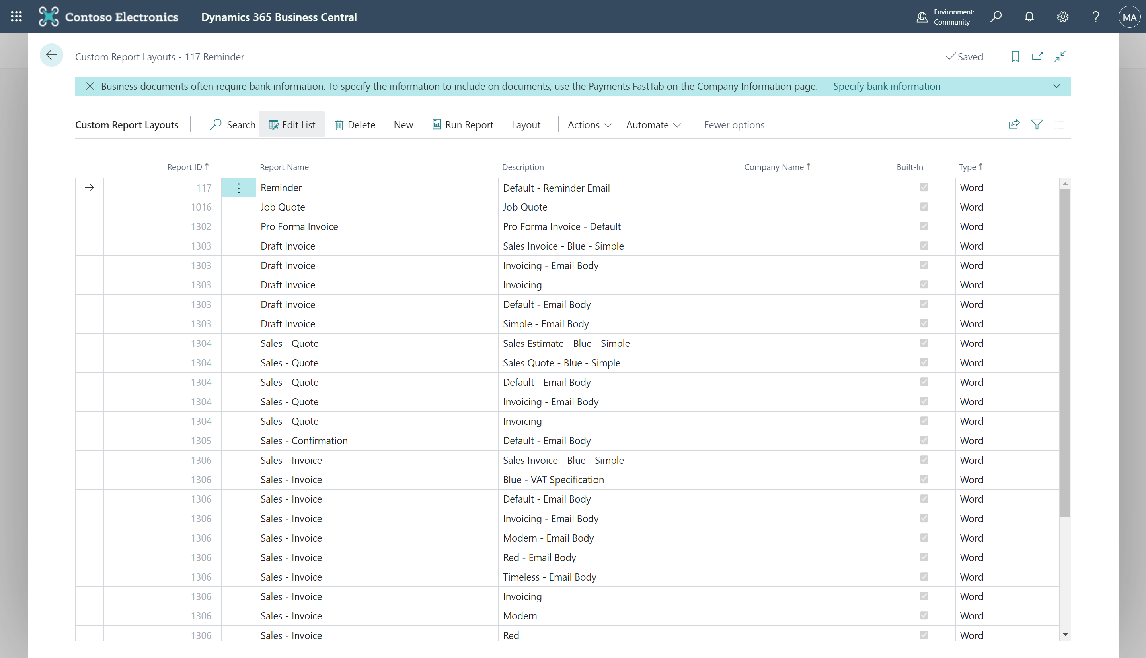
Document layouts & Report layouts
Define report layout for company reports.
Predefined layouts per customer, vendor.
Custom configuration for printing.

Slide 28
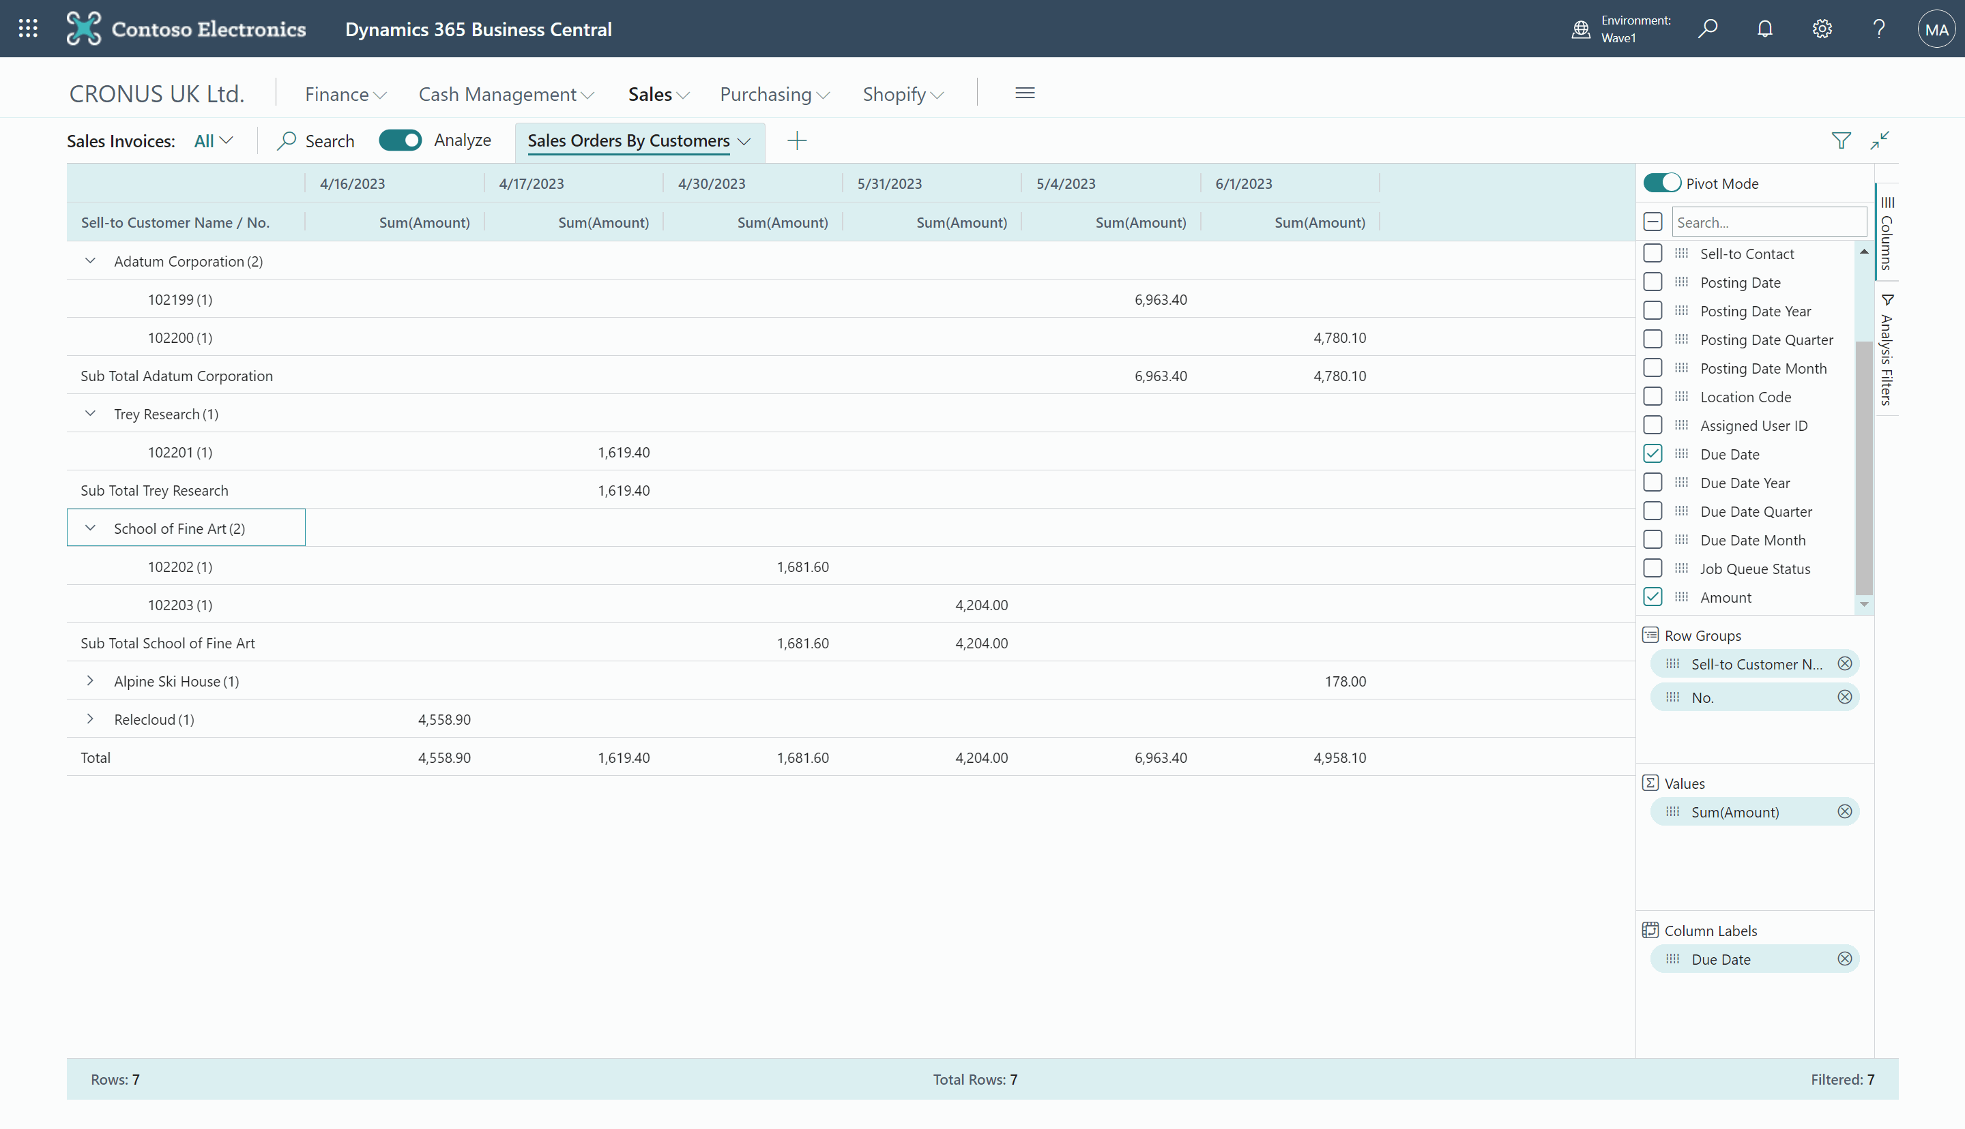
Data analysis
Bringing pivot table capabilities into BC Lists
Enable it in Feature Management*
Up to 100k rows*
Save views for future reuse
Integer and decimals are defined as values
Drag & Drop analysis
Export to a file
Use filters
Enable/Disable in code or with permissions*

Slide 29
Demo 1 & Demo 2
Document and report layouts
Data analysis mode

Slide 30
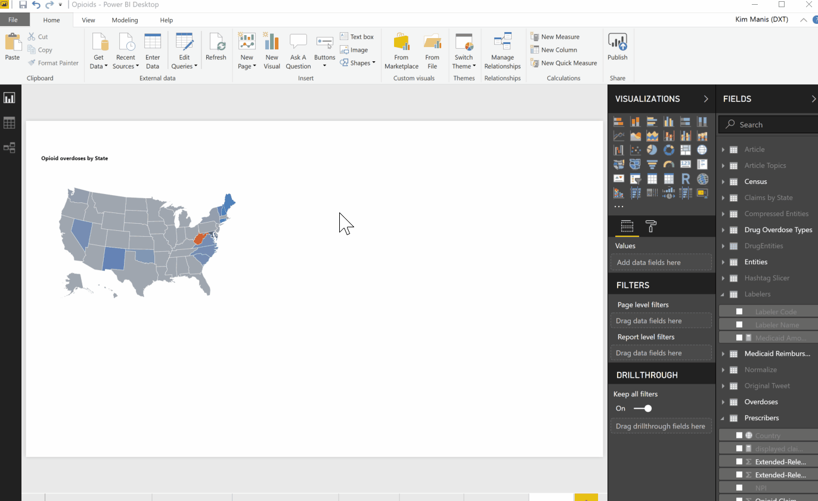
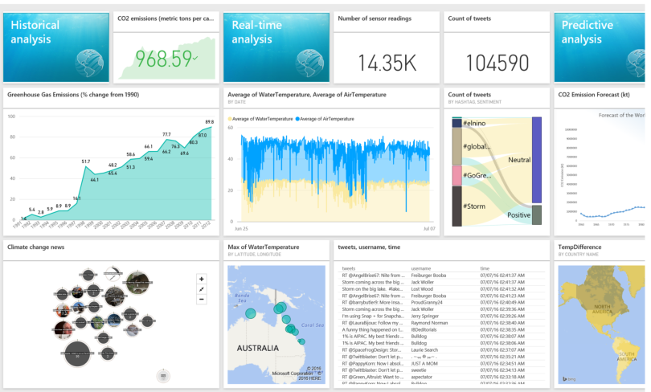



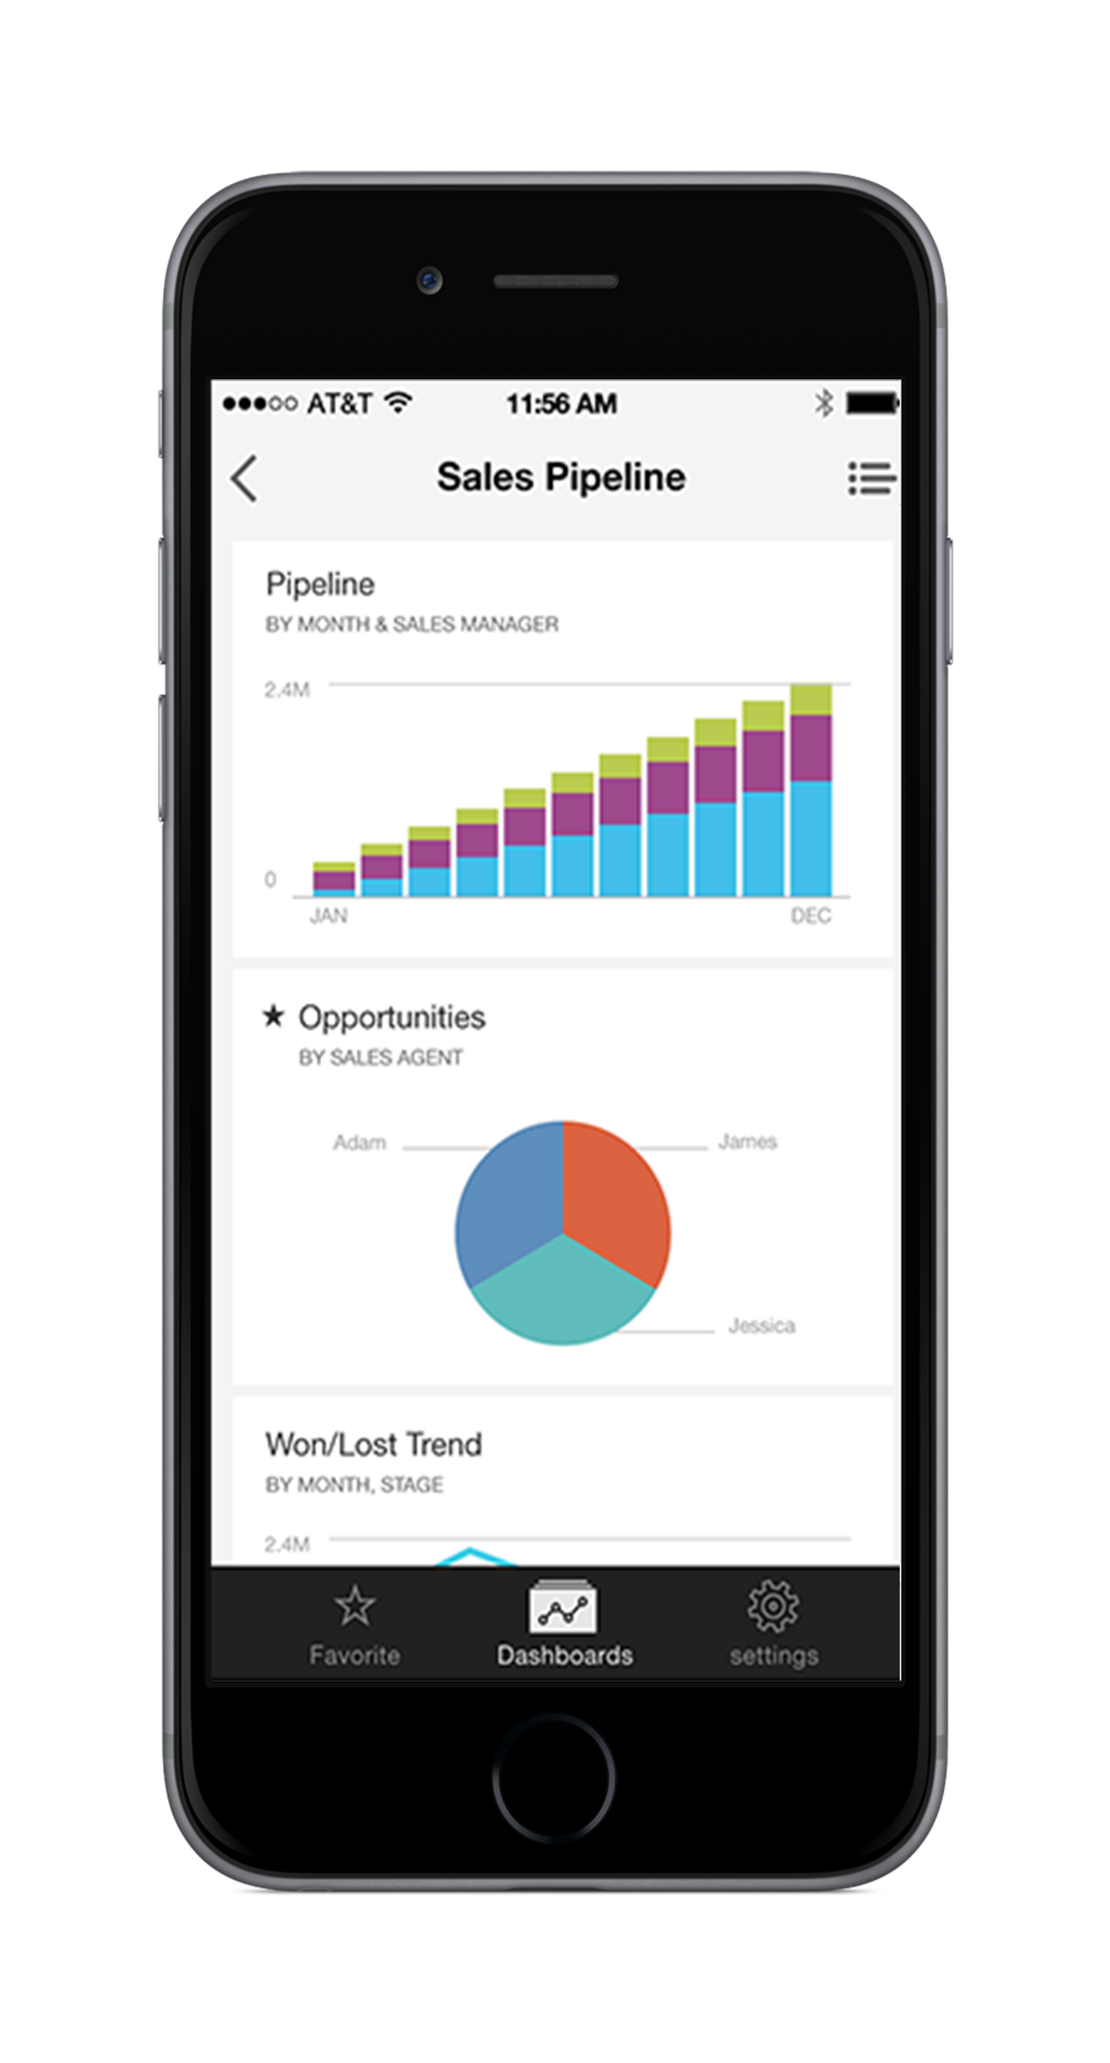
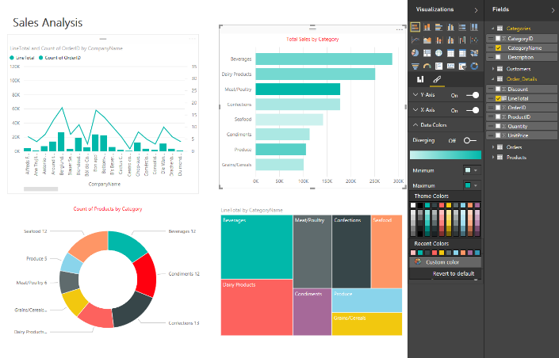

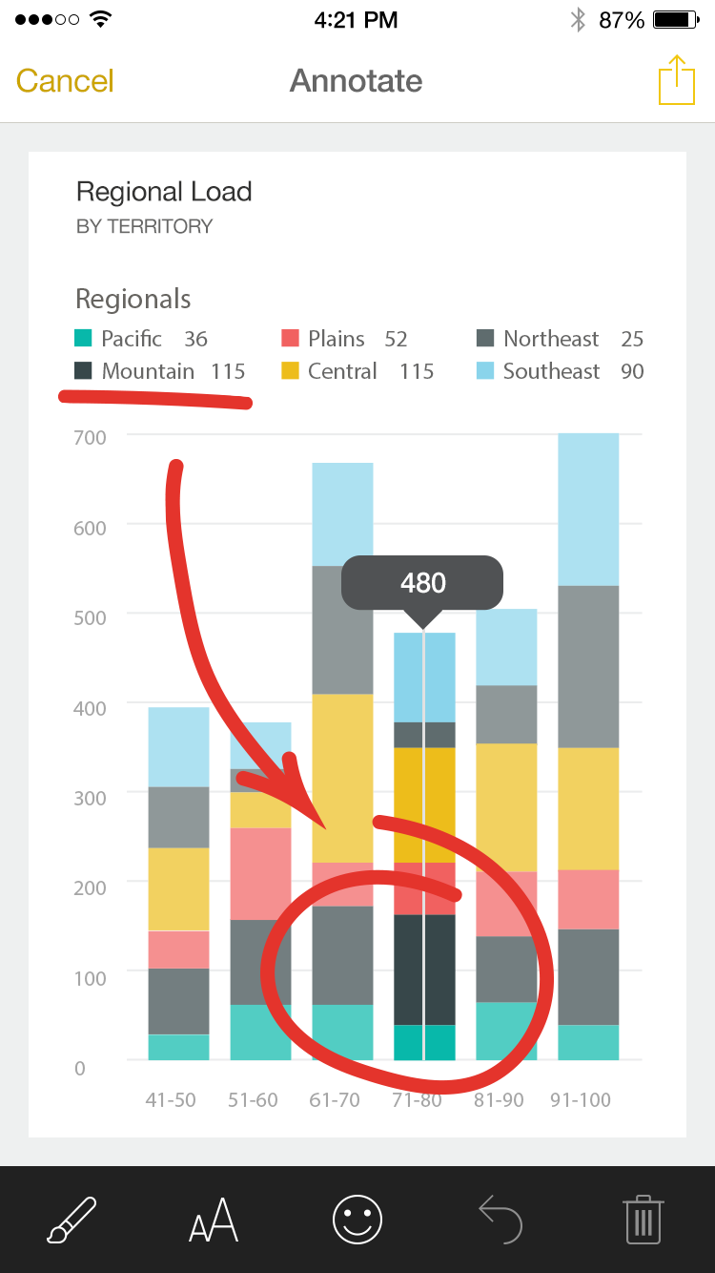
Power BI
Web
Mobile
Connectors
Publish reports
Excel
Data in the cloud
Embedded
HoloLens
Power BI Desktop
Power BI Service
On-Prem Data
Business Central

Slide 31
Demo
Power BI

Slide 32
Telemetry
Monitoring
Analyzing
KQL
Successful report generation
Failed
report generation
Cancelled report generation
Commit on cancelled report

Slide 33
Demo
Telemetry

Slide 34
Thank you for your attention!
Renato Fajdiga
renato@derecjun.com
Milan Milinčević
Milan.Milincevic@factorial.hr

Slide 35
This is not school, but we
love to get grades.
Please fill out our
questoineers and leave
us your feedback.
You may even win some
cool rewards.

