Slide 1
Instruction notes:
Cover slide v3
(design theme).
You can choose between four different versions of the cover (three with illustrations or a plain one).
When copying text from other sources, first clear the formatting to plain text, so it doesn't override Google Slides styles.
If you need to manually break the line in the subtitle, use soft enter (shift+enter) not to break the design.
The Journey to Secure Code Development
Jernej Porenta
Staff infrastructure engineer
25. SEPTEMBER 2023
NTK

Slide 2
About me
Staff infrastructure engineer @ 3fs
helping customers transitioning IT workloads to the cloud, explaining security and automating everything.
25 years of experience
Linux, cloud, DevSecOps
Prefer development over meetings
Passionate about CI/CD, k8s, security, LockedShields …

Slide 3
Instruction notes:
A basic slide with a title and placeholder for text. Remember to keep it short!
Edit the (you’ll have to do it on every slide). If you don’t need it, you can delete these text boxes.
When copying text from other sources, first clear the formatting to plain text, so it doesn't override Google Slides styles.
About 3fs
As engineers and consultants, we develop world-class digital products in highly regulated industries and help our customers capture the value of IoT .
‍
Partnering with organisations looking to leap-frog in the area of cloud and digital innovation, our approach utilises bleeding-edge technologies, DevSecOps methodology, and our own CI/CD pipeline and home-brewed tools to deliver efficiency.
‍

Slide 4
Where do I begin

Slide 5
Instruction notes:
A basic slide with a title and placeholder for text. Remember to keep it short!
Edit the (you’ll have to do it on every slide). If you don’t need it, you can delete these text boxes.
When copying text from other sources, first clear the formatting to plain text, so it doesn't override Google Slides styles.
About the customer
Customer is a leading energy storage developer, specializing in the development and manufacturing of advanced lithium-ion batteries and energy storage solutions.
‍

Slide 6







About the project
Anti Theft
Delay, Detect, Track
Device Management
Connectivity
management
Config
OTA
Provisioning
VPP
Virtual Power Plant
Data Management
Asset Management /
Device registry
ERP
MES
Asset Management
Relation
Time
series
Grid
API
PLM
Security
Data
Analytics
CPQ
Lifecycle +
ML models for extended life
PKI
Access
Control
Black/White listing
Connectivity
Gatewy

Slide 7
About the team
Project Manager, Product manager, Product designer
handling the project
Backend / frontend developers
A scrum team of contract developers with different backgrounds and different seniority
Infrastructure developers
Two developers with different backgrounds handling security as a side gig

Slide 8
About the tech stack
cloud native - AWS
gitlab - git, GitLab CI
containers - kubernetes
serverless - AWS Lambda
microservices - RabbitMQ, SQS, SNS
Python - Django, FastAPI
IaaC - terraform

Slide 9
About the state of the code
less than 10% code coverage
number of tests in frontend code: 0 .
10+ critical vulnerabilities in software dependencies
50+ high vulnerabilities in software dependencies
without any standarised development workflow
random code reviews .
manual end to end tests
flaky CI/CD system
missing common code style definitions
…

Slide 10
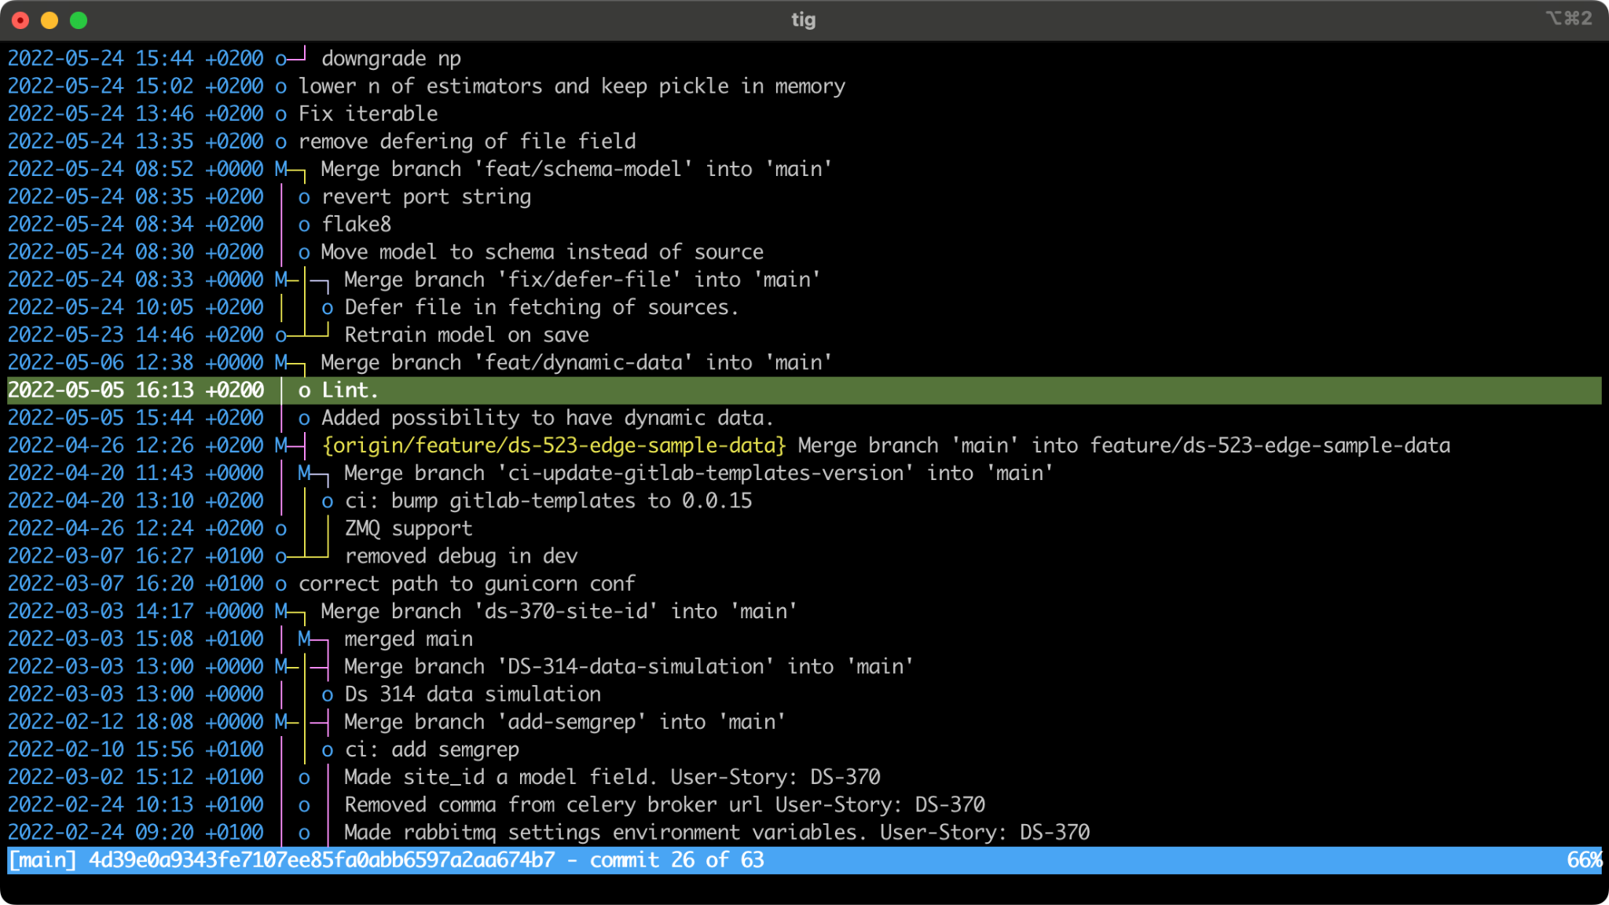

Instruction notes:
Slide for larger images/videos of wider proportions. The media placeholder demonstrates the maximum size, but you can adjust its aspect ratio to your file.
If you are importing an image, select the media placeholder and replace it with your image.
If you are importing a video, go to Insert > Video and replace the media placeholder with the video poster frame.
Write image/video caption here.

Slide 11
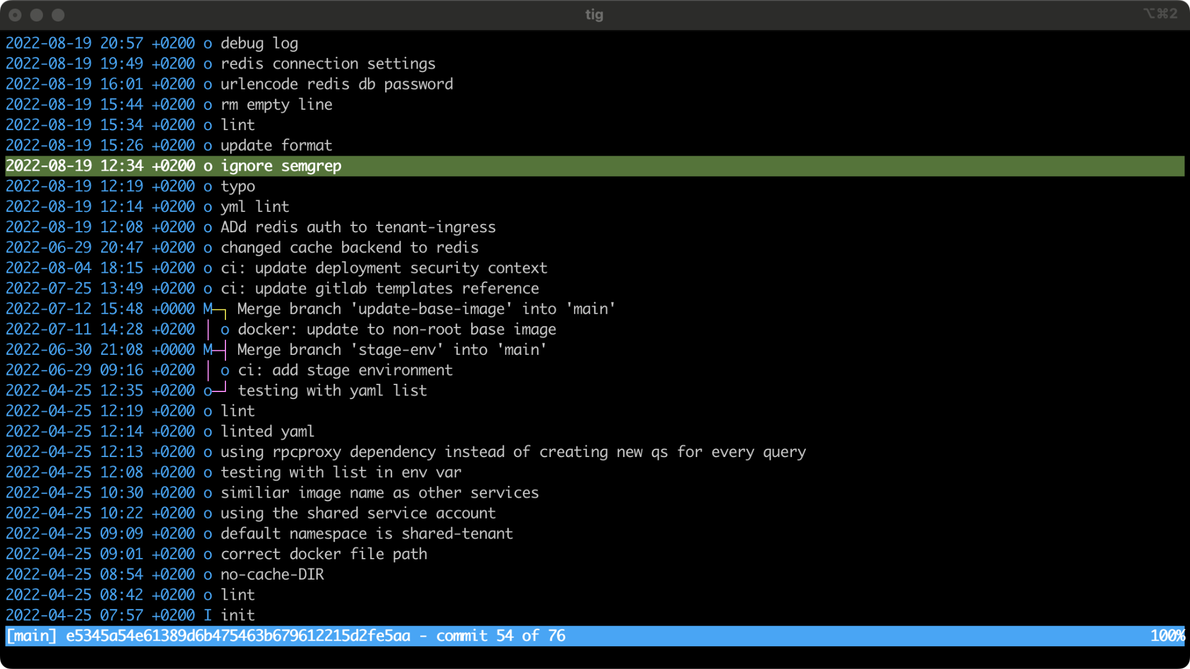
Instruction notes:
Slide for larger images/videos of wider proportions. The media placeholder demonstrates the maximum size, but you can adjust its aspect ratio to your file.
If you are importing an image, select the media placeholder and replace it with your image.
If you are importing a video, go to Insert > Video and replace the media placeholder with the video poster frame.
Write image/video caption here.

Slide 12
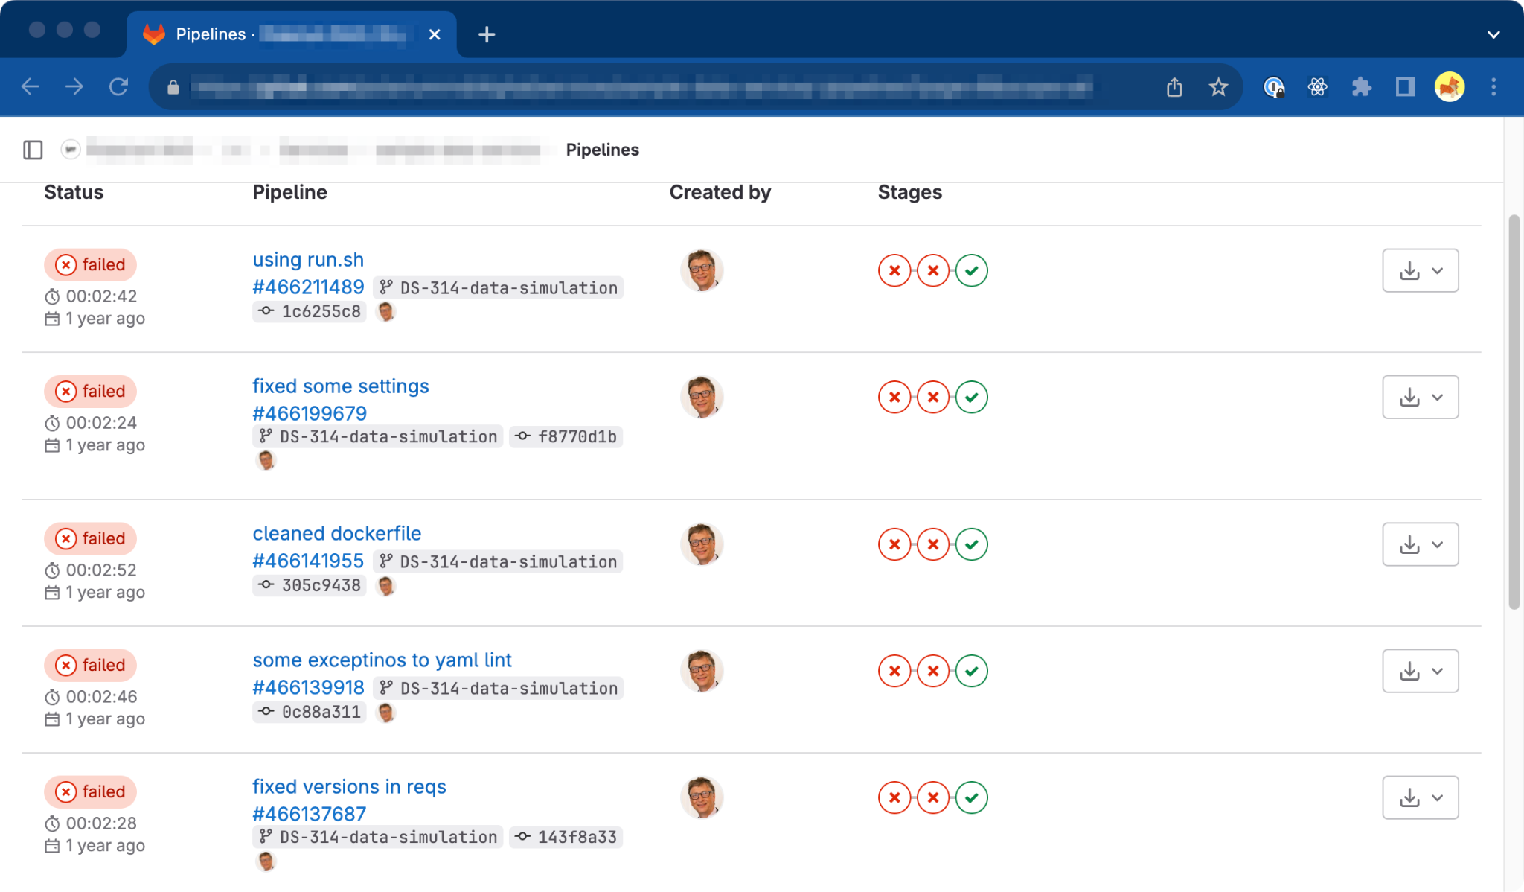
Instruction notes:
Slide for larger images/videos of wider proportions. The media placeholder demonstrates the maximum size, but you can adjust its aspect ratio to your file.
If you are importing an image, select the media placeholder and replace it with your image.
If you are importing a video, go to Insert > Video and replace the media placeholder with the video poster frame.
Write image/video caption here.

Slide 13
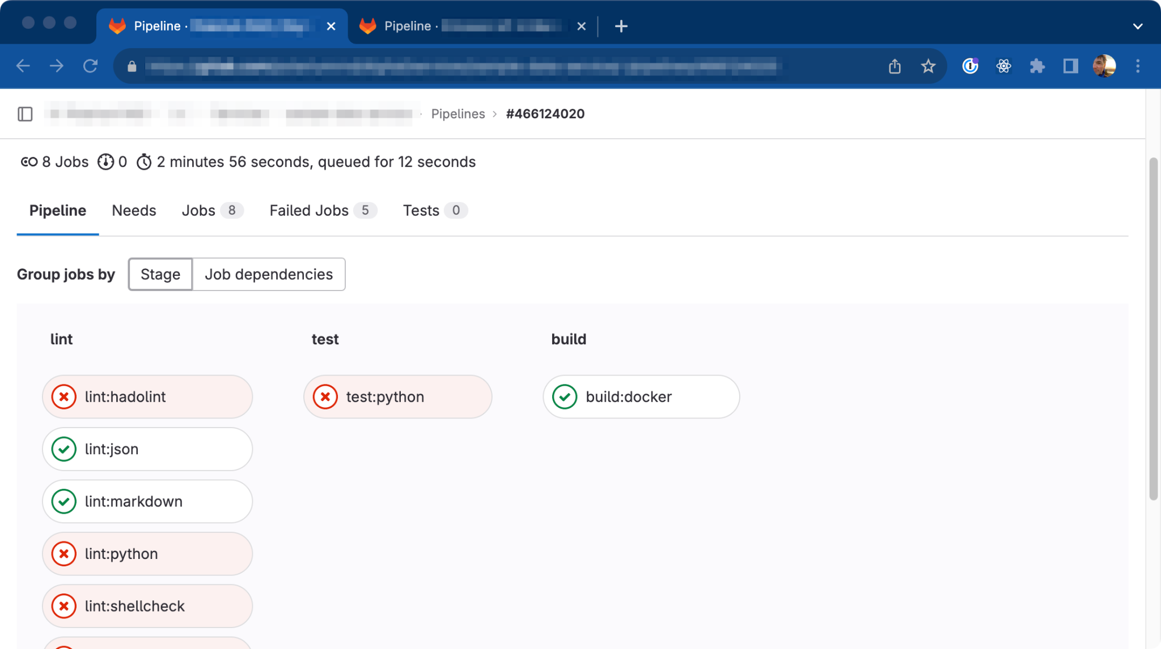
Instruction notes:
Slide for larger images/videos of wider proportions. The media placeholder demonstrates the maximum size, but you can adjust its aspect ratio to your file.
If you are importing an image, select the media placeholder and replace it with your image.
If you are importing a video, go to Insert > Video and replace the media placeholder with the video poster frame.
Write image/video caption here.

Slide 14
“
Any organization that designs a system (defined broadly) will produce a design whose structure is a copy of the organization's communication structure.”
— Melvin E. Conway

Slide 15
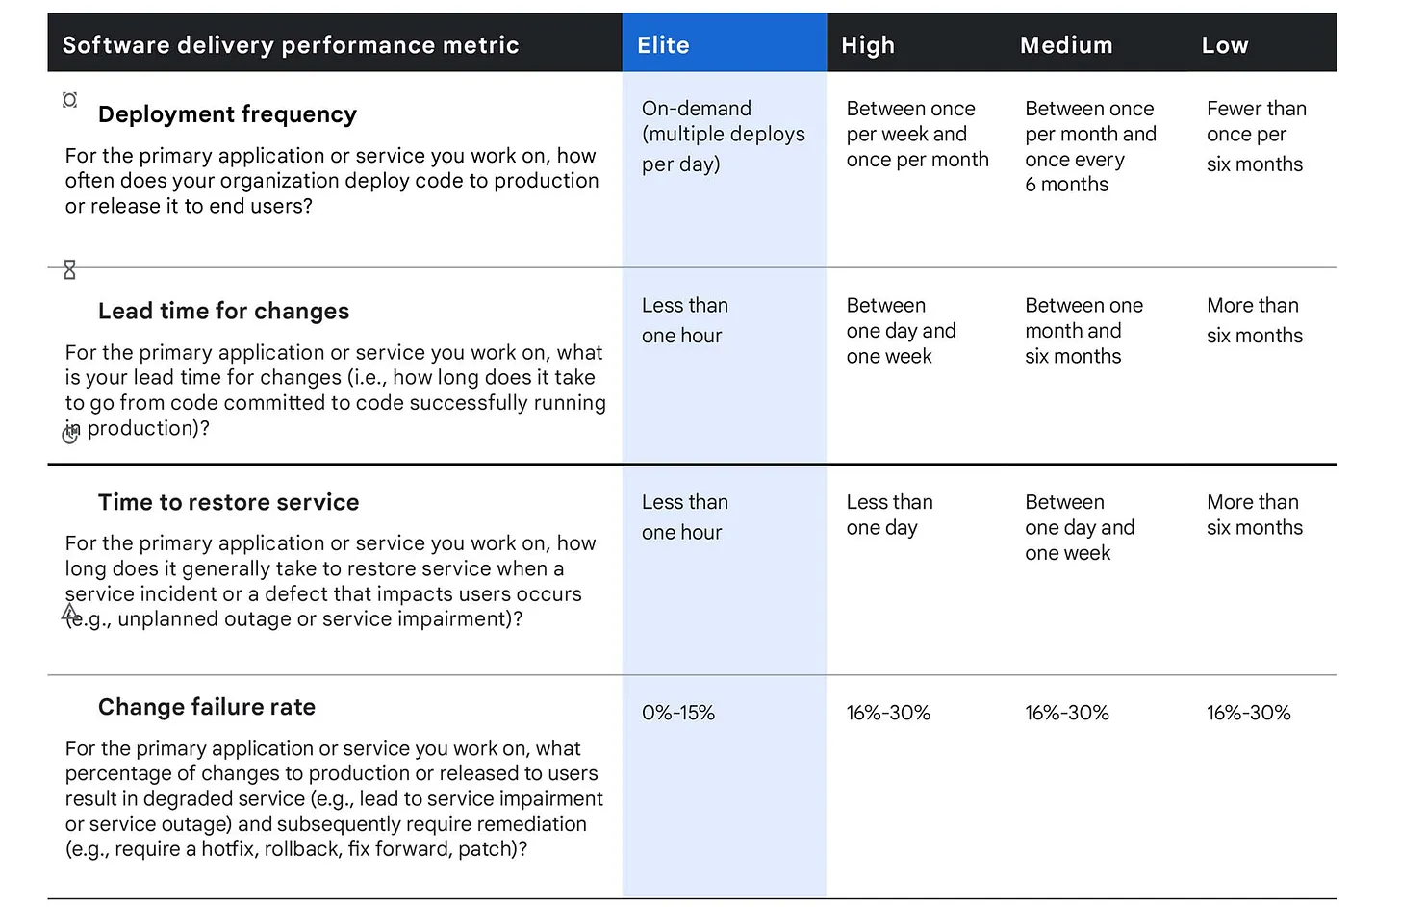
Instruction notes:
Slide for larger images/videos of narrower proportions. The media placeholder demonstrates the maximum size, but you can adjust its aspect ratio to your file.
If you are importing an image, select the media placeholder and replace it with your image.
If you are importing a video, go to Insert > Video and replace the media placeholder with the video poster frame.
DevOps Research and Assesment (DORA) metrics (2014-2022)

Slide 16
3fs approach

Slide 17
Ways of working
Process
disciplined agile, scrum teams, process: planning / design / grooming / implementation / deploy / release, “you build it, you run it”
Source code
git, main branch, short TTL topic branches, rebase, fast forward merges
Commits
small changes, non-breakable, conventional commits, GPG signed

Slide 18
Ways of working
Code reviews
everyone, objective, merge requests, approval rules, preview environments
CI/CD
static code analysis, application security testing, code tests, dependency updates, dependency vulnerability testing, builds, signing, deploy, reports, licensing, all within 10 minutes
Deploys
fully automated, git tags, artifacts promotion, signed and verified artifacts, feature flags

Slide 19
Ways of working
Code security
signed commits, code owners, library vendoring, load testing
Environments security
least privilege principle, continuous drift detection, endpoint protection, vulnerability assessments, secrets management
Compliance
PII / GDPR / Privacy guidelines, external audits, licenses, SBOM, service readiness lists

Slide 20
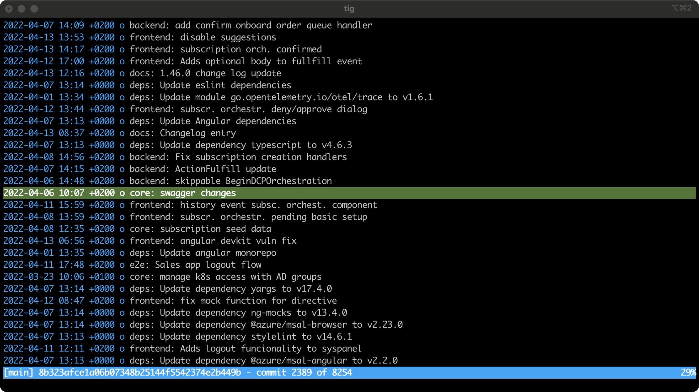
Instruction notes:
Slide for larger images/videos of wider proportions. The media placeholder demonstrates the maximum size, but you can adjust its aspect ratio to your file.
If you are importing an image, select the media placeholder and replace it with your image.
If you are importing a video, go to Insert > Video and replace the media placeholder with the video poster frame.
Write image/video caption here.

Slide 21
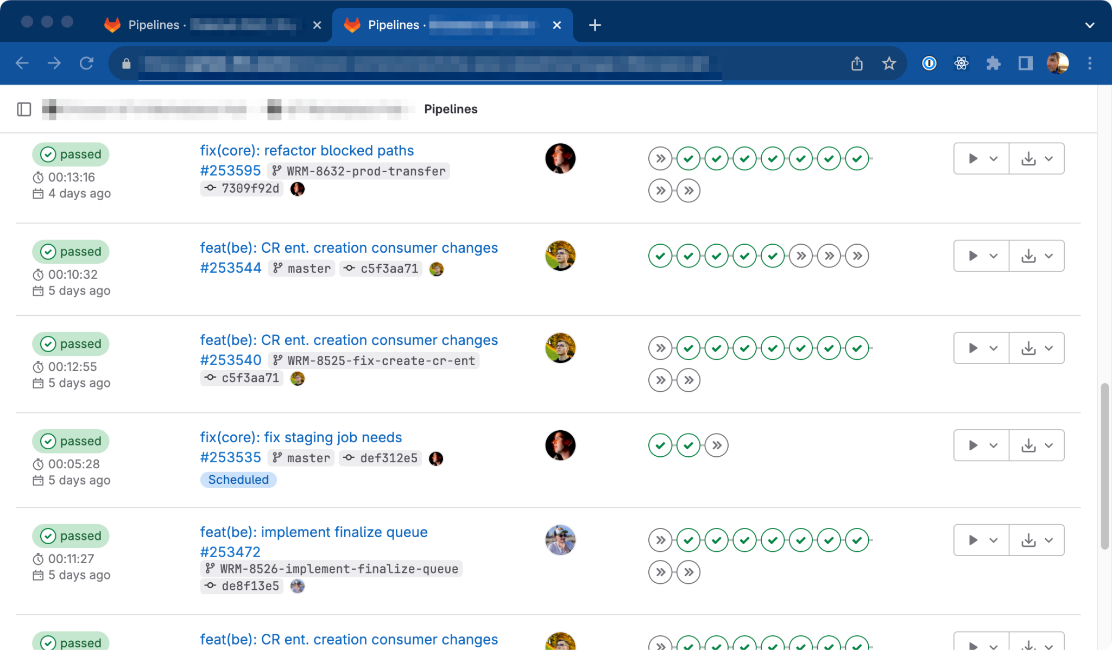
Instruction notes:
Slide for larger images/videos of wider proportions. The media placeholder demonstrates the maximum size, but you can adjust its aspect ratio to your file.
If you are importing an image, select the media placeholder and replace it with your image.
If you are importing a video, go to Insert > Video and replace the media placeholder with the video poster frame.
Write image/video caption here.

Slide 22
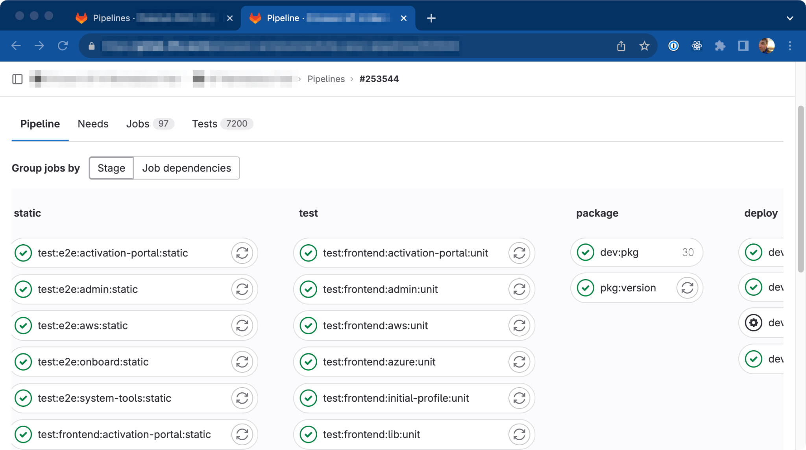
Instruction notes:
Slide for larger images/videos of wider proportions. The media placeholder demonstrates the maximum size, but you can adjust its aspect ratio to your file.
If you are importing an image, select the media placeholder and replace it with your image.
If you are importing a video, go to Insert > Video and replace the media placeholder with the video poster frame.
Write image/video caption here.

Slide 23
“
The Japanese word kaizen means 'change for better' (from 改 kai - change, revision; and 善 zen - virtue, goodness) with the inherent meaning of either 'continuous' or 'philosophy' in Japanese dictionaries and in everyday use.”

Slide 24
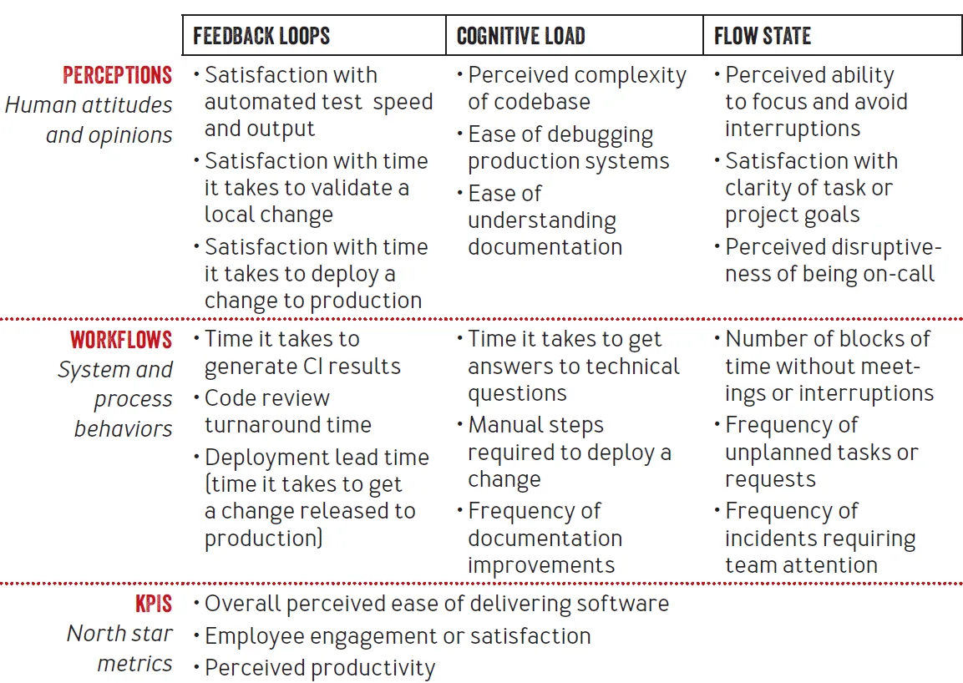
Instruction notes:
Slide for larger images/videos of narrower proportions. The media placeholder demonstrates the maximum size, but you can adjust its aspect ratio to your file.
If you are importing an image, select the media placeholder and replace it with your image.
If you are importing a video, go to Insert > Video and replace the media placeholder with the video poster frame.
DevEx metrics (2023)

Slide 25
When the two worlds collide

Slide 26
Initial steps
Getting to know each other
identify people personalities, skills, ways of working, culture
Getting the grip of the project
get the full understanding of the problem domain , get to know stakeholders, project workflow …
Getting around the project source code
code style, CI/CD, libraries used, release process, secrets handling

Slide 27
Make a plan
Separation of duties
split into two teams handling different microservices, API approach
Follow the good practices
follow the good practices in new microservices, backport them to existing ones
Create building blocks
create reusable building blocks, which can be used across all microservices

Slide 28
Make a plan
Community of practice
share the knowledge , present solutions, raise security awareness .
Document everything
document everything: ways of working, diagrams, feature documentation, implementation proposals
Simplify onboarding
address new developer experience : local development environment

Slide 29
Instruction notes:
Comparison slide of pros and cons.
When copying text from other sources, first clear the formatting to plain text, so it doesn't override Google Slides styles.
Execute a plan
Successes
Failures
Separation of duties
Create building blocks
Document everything
Follow the good practices
Simplify onboarding
Community of practice

Slide 30
Back to the drawing board
Post mortem
what could we do better: start small .
Change communication style
adapt to company culture, project maturity and personalities
Kaizen
actively participate in project management: take ownership, challenge, improve solutions

Slide 31
Hail Mary
External security audit
identified large amount of security issues in development workflow
Work recognition
developers identified our previous work as the way forward
Start small
start using building blocks in all microservices

Slide 32
Security audit aftermath
Work recognition
developers identified our previous work as the way forward, project stakeholders realised the importance of security
Team engagement
start using previously developed building blocks in all microservices
Team effort
realization security is important factor in software development

Slide 33
Where did we go from here

Slide 34
“
In technology and engineering, building blocks are the fundamental components or modules that make up a larger system or product.”

Slide 35
CI/CD templates
By building reusable CI/CD templates we have gained easier adoption, common practices and integrated security in the development.
code style : black
lint: hadolint, js, json, flake8, openapi, opa, shell, terraform, yaml, markdown …
test stage: tox
streamlined build flow: kaniko
automated release procedures with semantic release versioning: helm, terragrunt

Slide 36
CI/CD templates
Software Composition Analysis - SCA : osv-scanner, jake
Software Application Security Testing - SAST : semgrep
automatic dependency upgrades: renovate
Software Bill of Materials - SBOM : osv-scanner, syft

Slide 37
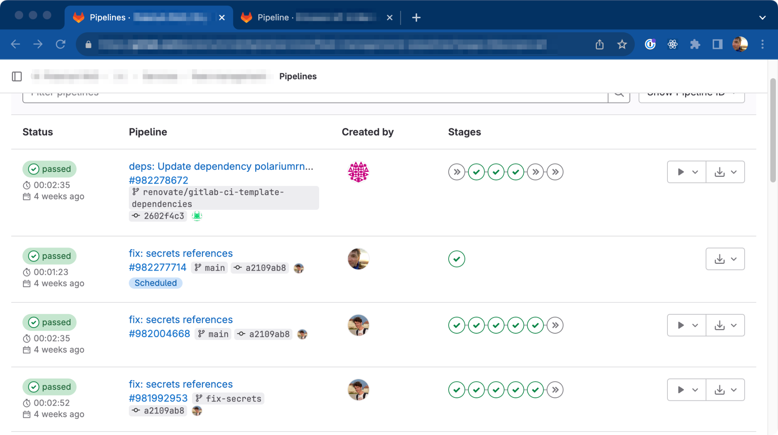
Instruction notes:
Slide for larger images/videos of wider proportions. The media placeholder demonstrates the maximum size, but you can adjust its aspect ratio to your file.
If you are importing an image, select the media placeholder and replace it with your image.
If you are importing a video, go to Insert > Video and replace the media placeholder with the video poster frame.
Write image/video caption here.

Slide 38
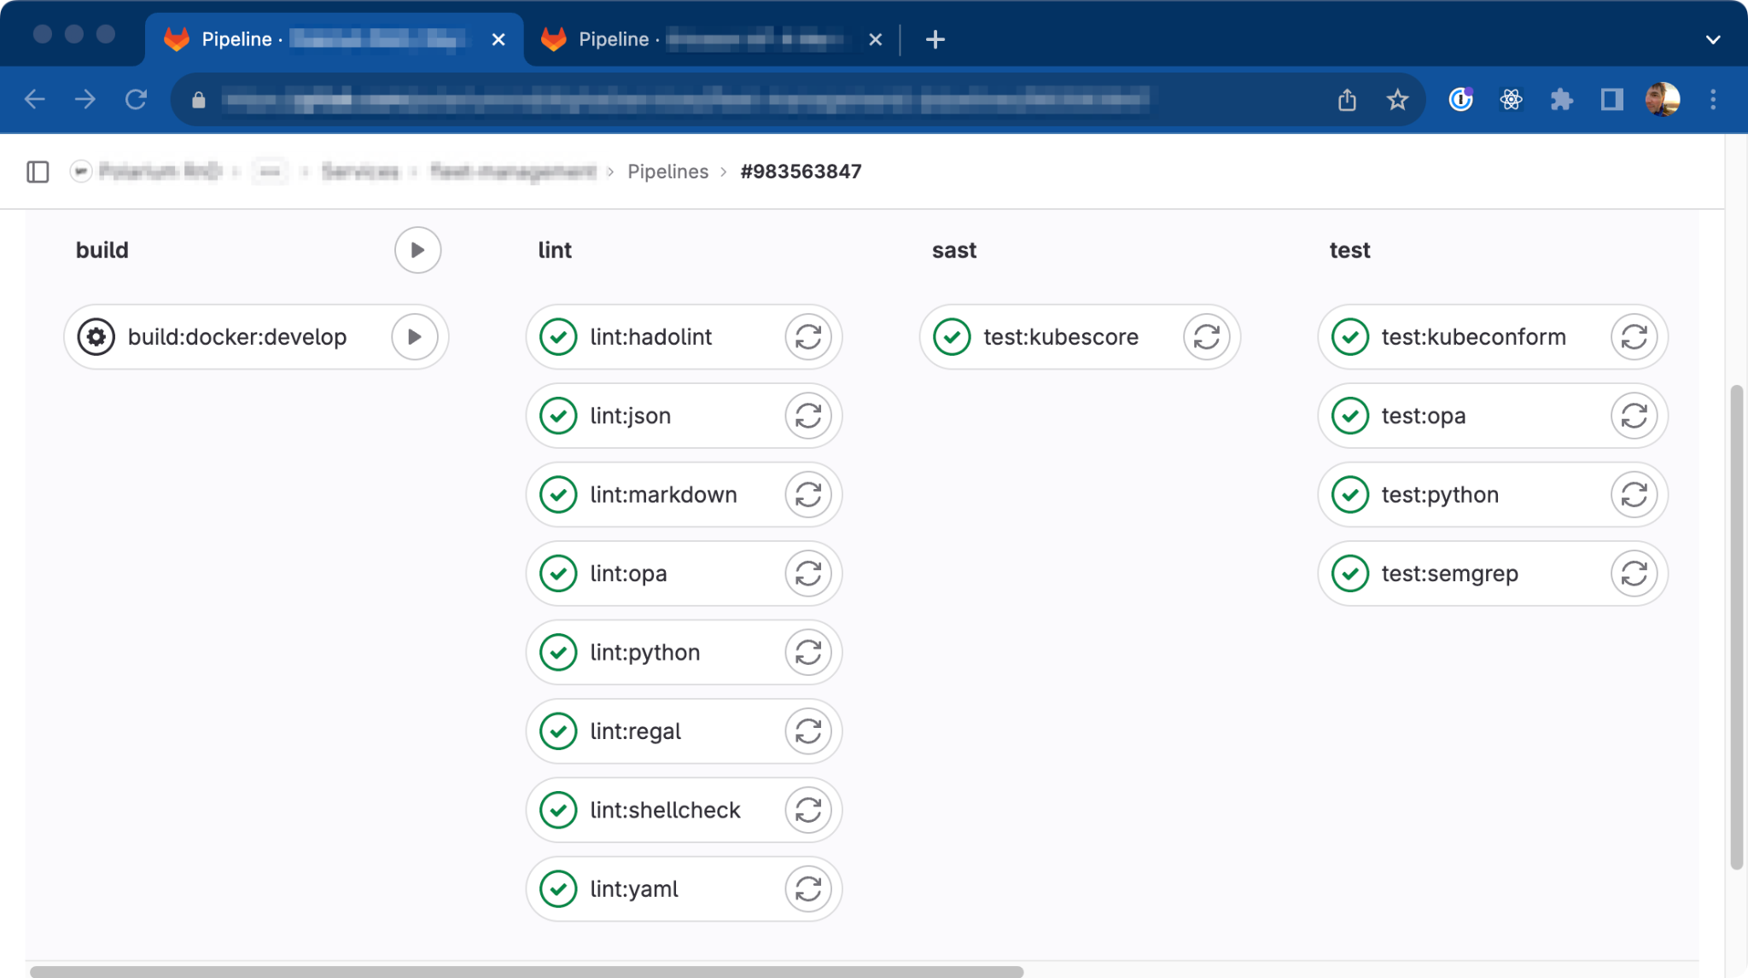
Instruction notes:
Slide for larger images/videos of wider proportions. The media placeholder demonstrates the maximum size, but you can adjust its aspect ratio to your file.
If you are importing an image, select the media placeholder and replace it with your image.
If you are importing a video, go to Insert > Video and replace the media placeholder with the video poster frame.
Write image/video caption here.

Slide 39
Developer experience
By using common development environments we are able to onboard new developers faster than before.
unified python development environment: direnv .
simplified cross service setup: tilt
RBAC environment access : AWS IAM Identity Center utilizing Azure AD
automated deploys
By continuously improving documentation onboarding a new developer does not require full day workshops any more.

Slide 40
Community of practice
Sharing knowledge is one of the core values within 3fs and we strongly believe in sharing it with our customers will improve their project significantly.
bi-weekly half hour long meetings
dedicated Slack channels .

Slide 41
Instruction notes:
Comparison slide.
Use it to compare two different concepts, before and after, what-you-bring and what-we-bring…
When copying text from other sources, first clear the formatting to plain text, so it doesn't override Google Slides styles.
Retrofitting security
Rip off the bandage
Rewrite
takes time
improves tests
requires domain knowledge
takes more time
results in better code

Slide 42
“
Shift Left Security is a software development and security approach that emphasizes the early integration of security practices and considerations into the software development lifecycle (SDLC).”

Slide 43
Where do we go now

Slide 44
Internal security audits
utilise open source tooling to continuously execute security audits and report on degradation of security posture
validate level 2 SLSA
improve security practices with continuous security monitoring
formalize incident response and recovery plans
continuous internal security audits

Slide 45
SLSA Level 3
currently compliant with level 2 SLSA
improve security practices with continuous security monitoring
formalize incident response and recovery plans

Slide 46
Kaizen
follow security trends .
monitor engineering metrics .
improve developer experience
automate even more

Slide 47
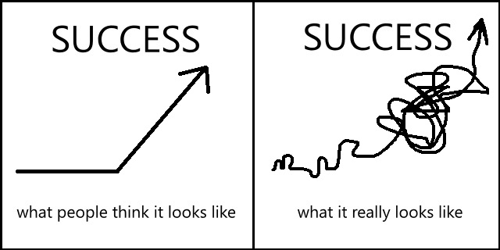
256th attempt (Kaizen at its best)
47
Notes:
Kaizen to the rescue!

Slide 48
Key takeaways

Slide 49
Key takeaways
communication is the key
start small .
security does not slow down the development
automation will take away the fear of security

Slide 50
Instruction notes:
Ending slide. Feel free to change the closing sentence depending on the context of your presentation.
QUESTIONS?
Jernej Porenta
JERNEJ.PORENTA@3FS.SI
@3fs

Slide 51







CI/CD evolution
Reusable pipeline building blocks
Pipeline-as-code
CI/CD adoption
Travis CI
GHA
Azure
Pipelines
Dagger
Jenkins
3rd wave
2nd wave
1st wave
2005
2013
2019
a typical customer CI/CD system
3fs CI/CD system

Slide 52
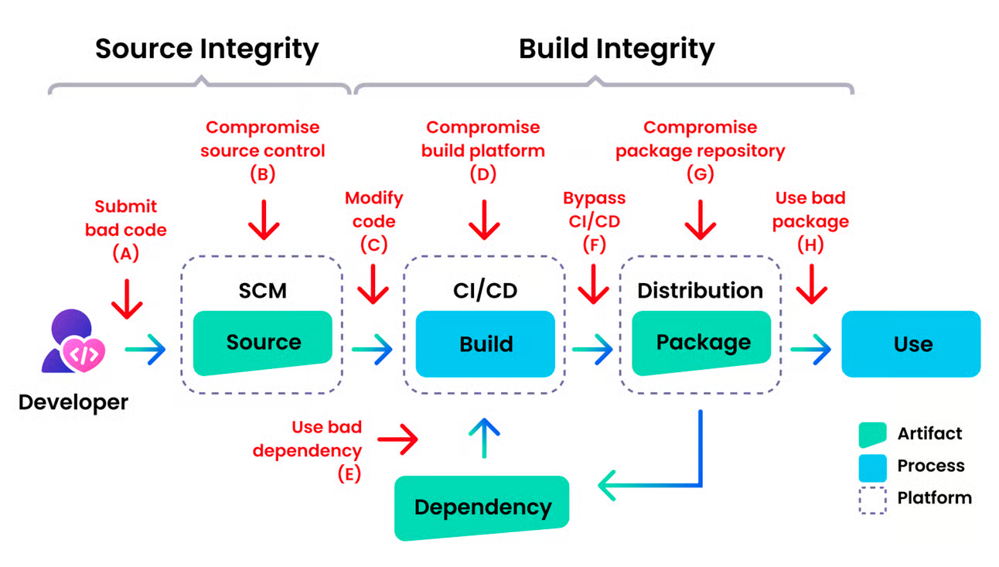

Slide 53
DX focus: Fast feedback loop KPI
<15 min
pipeline
execution
time
continuous improvements

Slide 54

Our DevOps Toolbox today
Foundation
Open-source components
deployed to cloud
CI
Linters
hadolint (Dockerfiles)
Go ling, json-lint
yaml-lint, openapi-lint
markdown-lint
kubescore
Checkov AWS IaaC
Checkov Azure IaaC
Security
Nancy/Sonatype Nexus (go)
AuditJS node, yarn-sca,
Kicks (IaaC scanner)
tfsec,
Grype vulnerability scan
OWASP zap testing
3pp lifecycle management
Renovate
licensefinder
Syft SBOM generation
CI/CD pipeline
Open-source components embedded as reusable components
Inner source
custom components that
solve shared shared problems
common libraries for logging, API development (Swagger OpenAPI), deployment to kubernetes, cloud infrastructure setup, container building and packaging

