Slide 1

ASP.NET Core and Enterprise Security
Admir Tuzović
@woisttuza

Slide 2





/graph.microsoft.com/v1.0/me
Chief Technology Officer
Author
Former Tech Evangelist
The Art of Speaking

Slide 3
Agenda
Migrating to ASP.NET Core
Basics of OAuth 2.0/OpenID Connect
OpenID Connect Middleware
Graph API
Microsoft Authentication Library (MSAL)
ASP.NET Identity

Slide 4
Major changes
Full .NET Framework:
FormsAuthenticationModule
WindowsAuthenticationModule
WSFederationAuthenticationModule
SessionAuthenticationModule
... Custom auth module
IHttpModule
HttpContext.Current
OwinContext
HttpContext is injected by IOC Container
IPrincipal
ClaimsPrincipal.Current
User is of type ClaimsPrincipal
ClaimsPrincipal.Current is null
New API: HttpContext.Authentication

Slide 5
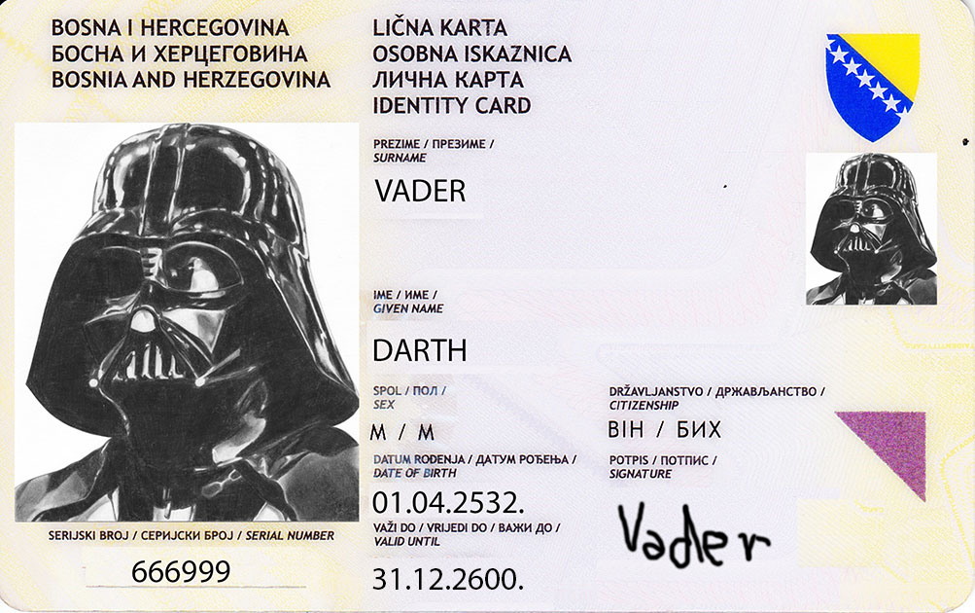
What are claims?

Slide 6
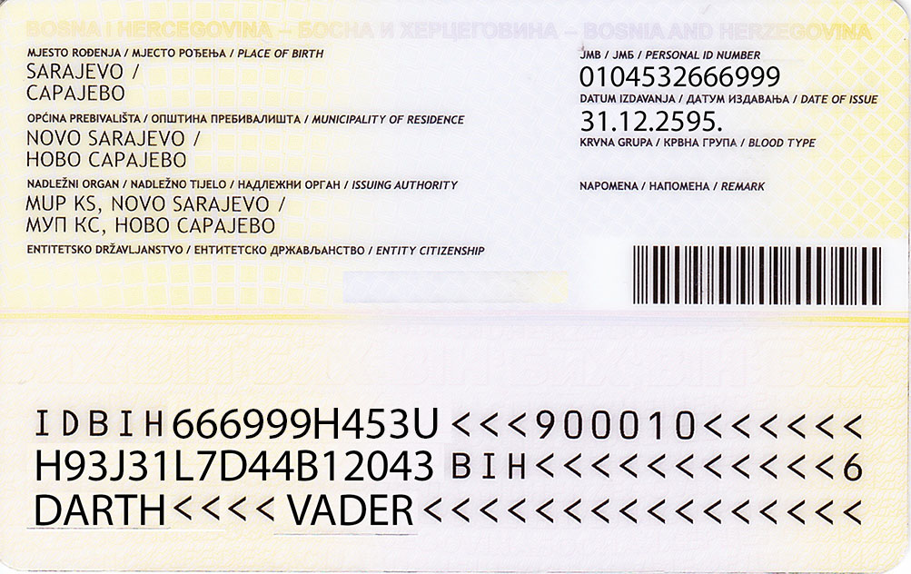
What are claims?

Slide 7
What are claims?
A claim is a statement that one subject (issuer) makes about itself or another subject.
{
"surname" : "Vader",
"given_name" : "Darth",
"sex" : "M",
"date_of_birth" : "01.04.2532.",
"citizenship" : "BIH",
"place_of_birth" : "Sarajevo",
"municipality" : "Novo Sarajevo",
"id_number" : "0104532666999"
}

Slide 8
ASP.NET Core Request Pipeline
Host (Console App, IIS, ...)
.NET Core
ASP.NET Core
REQUEST
Middleware
(static files)
Middleware
(session)
Middleware
(auth)
MVC
RESPONSE

Slide 9
ASP.NET Core Authentication Middleware
Microsoft.AspNetCore
.Authentication
.JwtBearer
Microsoft.AspNetCore
.Authentication
.Cookies
Microsoft.AspNetCore
.Authentication
.Twitter
Microsoft.AspNetCore
.Authentication
.MicrosoftAccount
Microsoft
.AspNetCore
.Authentication
Microsoft.AspNetCore
.Authentication
.Facebook
Microsoft.AspNetCore
.Authentication
.OpenIdConnect
Microsoft.AspNetCore
.Authentication
.OAuth
Microsoft.AspNetCore
.Authentication
.Google

Slide 10

OAuth 2 vs OpenID Connect
OAuth2 – Authorization, not Authentication framework
Authorization is done for Scope of resources:
scope=contacts timeline images
Grants Access Token and optionally Refresh Token
OpenID Connect – built on top of OAuth2 for Authentication only
Scope is predefined and narrowed to user’s profile (identity):
scope=openid profile
scope=openid email
Grants ID Token and Access Token and optionally Refresh Token
Based on claims and tokens

Slide 11
Json Web Token (JWT)
Anatomy of a token: header.body.signature
{
  "typ" : "JWT",
  "alg" : "HS256"
}
Header is JSON object base64 encoded and defines token type and algorithm used for signature.
{
  "iss" : "http://myidsr.com",
  "exp" : 1300889380,
  "sub" : "darthvader",
  "scope" : "profile"
}
Body is JSON object base64 encoded and contains collection of claims representing a subject.
h29324jkasjv8asdf234klkl234
Signature protects JWT contents from tampering and is validated on server.

Slide 12
OpenID Connect Flows
 | AuthZ Code | Implicit | Hybrid
All tokens returned from Authorization Endpoint |  | 
All tokens returned from Token Endpoint | 
Tokens not revealed to User Agent | 
Client can be authenticated |  |  | 
Refresh Token possible |  |  | 
Communication in one round trip |  | 
Most communication server-to-server |  |  | ?

Slide 13
DEMO
Bearer Token Authentication

Slide 14
Cloud Based Identity Services
Benefits of Azure AD:
SSO with AD, Office 365, Outlook.com, and more
Enhanced control with Conditional Access
Enhanced security with Identity Protection
Use SDK of your choice supporting OAuth 2.0 or OpenID Connect standards
More than just sign-in – access Microsoft Graph
Used by Microsoft cloud services – high scale, performance, availability
Azure
AD
Client
Service
cloud
on-premises
Active
Directory
Client
Service

Slide 15
What is the Azure AD v2 Endpoint?
v1
Microsoft
account
Unified endpoint for:
  Microsoft Personal Accounts (@outlook.com, @live.com, @msn.com, @hotmail.com,...)
  Work and School Accounts (Office 365)
Allows dynamic and incremental consents
Single Client ID/Secret pair for multiple apps
v2
v1
Azure
AD
AD
AD
AD

Slide 16
When to Use v1 Versus v2 (currently)
  For v1 : Azure Active Directory Authentication Libraries (ADAL - released)
  For v2: Microsoft Authentication Library (MSAL – in preview)
  If you need to sign in both Azure AD and MS accounts, use v2 and MSAL Otherwise, use v1 and ADAL
  Including if you are already using v1 and ADAL (migrate)

Slide 17
What is Coming Next in v2
Feature | v1 Endpoint (Azure AD only) | v2 Endpoint (Azure AD + MSA)
OpenID Connect 1.0 | GA | GA
OAuth 2.0: authorization code grant – used by native and web apps | GA | GA
OAuth 2.0: client credentials grant (secret or certificate) – used by daemon apps | GA | GA
OAuth 2.0: implicit grant – used by single page apps | GA | GA
OAuth 2.0: On Behalf Of exchange – used by web APIs calling other web APIs | GA | GA
Admin consent and admin-only scopes | GA | GA
Conditional Access including device health rules | GA | GA
Register scopes for your own web API | GA | Soon
Get access tokens to Azure AD-only scopes e.g. Azure ARM | GA | Soon
Group claims, role claims, email claim | GA | Later
Sovereign cloud endpoints | GA | Later
OAuth 2.0: device profile – used with limited UI devices | GA | Later
Preserve user session state from ADAL to MSAL | N/A | Later
Update Azure AD-only app registration to Azure AD+MSA | N/A | Later

Slide 18
DEMO
Azure AD v2 Endpoint

Slide 19
Microsoft Graph

Slide 20





State of the world before Microsoft Graph
Work and school
Personal
Many different APIs to access data
Separate auth stacks for work and personal

Slide 21
Diverse API styles and endpoints
Azure Active Directory Graph API
https://graph.windows.net/contoso.com/users
https://graph.windows.net/contoso.com/groups
Windows Live profile API
https://apis.live.net/v5.0/me
SharePoint User Profile API
https://contoso.sharepoint.com/_api/SP.UserProfiles.PeopleManager/GetMyProperties
Exchange HD Picture API
https://graph.microsoft.com/v1.0/me/photo
Outlook REST API
https://outlook.office.com/api/v2.0/me/Messages
https://outlook.office.com/api/v2.0/me/Events
Office Graph in SharePoint Online
https://contoso.sharepoint.com/_api/search/query?Querytext='*'&Properties='GraphQuery:actor(ME,action\:1020,or(action\:1020\,action\:1003,action\:1001,action\:1024,action\:1005,action\:1037,action\:1039,action\:1036)'&SelectProperties='Docid,Title
OneDrive for Business API
https://contoso-my.sharepoint.com/personal
/yina_contoso_com/_api/v2.0/drive
https://contoso.sharepoint.com/sites
/designCouncil/_api/v2./drive
OneDrive API
https://api.onedrive.com/v1.0/drive

Slide 22
Today’s world with Microsoft Graph
Microsoft Graph
https://graph.microsoft.com
Work and school
Personal
…

Slide 23
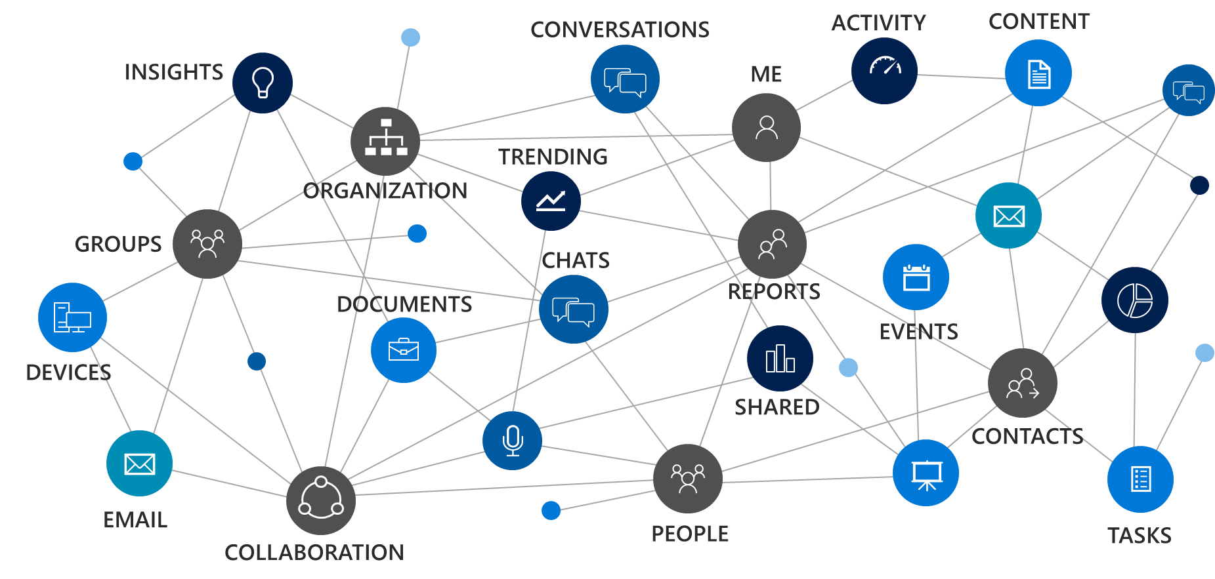








Microsoft Graph
CONVERSATIONS
ACTIVITY
CONTENT
INSIGHTS
ME
TRENDING
ORGANIZATION
GROUPS
CHATS
DOCUMENTS
REPORTS
EVENTS
DEVICES
SHARED
CONTACTS
EMAIL
PEOPLE
TASKS
COLLABORATION

Slide 24
- User, group and organizational
Data
Microsoft Teams API - preview
Project Rome API - preview
SharePoint Sites API – GA
OneNote API – GA
Planner API – GA
One endpoint
One token
All users
Your app
https://graph.microsoft.com
Users
Groups
Excel
Outlook
Calendar
OneNote
Teams
Planner
Intune
Azure AD
SharePoint

Slide 25

With Microsoft Graph
GET: /users/yina
{
"displayName": "Yina",
"jobTitle": "PRINCIPAL PM MANAGER",
}
GET: /users/yina/photo/…
{}
GET: /users/yina/manager
{"displayName": "Tristan", …}
GET: /users/yina/directReports
"value" : [
{"displayName": "Matt", …},
{"displayName": "Dmitry", …},
]
GET: /me/memberOf/…
"value" : [
{"displayName": "Office engineering", …},
{"displayName": "Women in tech", …},
]
Get the user profile
Tristan
manager
Groups
memberOf
Yina
directReports
Dmitry
Matt
Sudhi

Slide 26
With Microsoft Graph
GET /me/drive/root/…
"value" : [
{"name": "proposal.pptx",… },
{"name": "forecast.xlsx",… }
]
GET /drives/items/{id}/workbook
GET /me/messages
GET /me/events
GET /me/contacts
GET /me/onenote/notebooks
GET /me/planner/tasks
GET /me/devices
GET /sites:/teams/opg:/
GET /sites:/teams/opg:/lists
GET /groups/{id}/conversations
`
Get content for email, calendar, files, tasks, sites, notes & more
Documents
Calendar
Sites
Tasks
Email
Meetings
Contacts

Slide 27

With Microsoft Graph
GET /me/insights/trending
"value" : [
{"name": "presentation.pptx", …},
{"name": "forecast.xlsx", …}
]
GET /me/drive/recent
"value" : [
{"name": "guidelines.pptx", …},
{"name": "budget.xlsx", …}
]
GET people/?$search="topic: planning"
"value" : [
{"displayName": "Dan", …},
{"displayName": "Sean", …},
]
POST: /me/findMeetingTimes
{
"attendees": [
{
"type": "required",
"emailAddress": {
"address": "ana@contoso.com"
}
],
"meetingDuration": "2h"
}
Get insights based on activities
Out of office
Trending
Documents
Find me the best time to meet Ana
Search people
based on topics
People I’m working with
Recent
Documents

Slide 28
Calling the API
  HTTP verbs dictate the request intent: GET | POST | PATCH | PUT | DELETE
  Version: /v1.0 or /beta
  Resource: /users, /groups, /sites, /drives, /devices, more…
  Member from collection: /users/AAA
  Property: /users/AAA/department
  Traverse to related resources via navigations: /users/AAA/events
  Query parameters: /users/AAA/events?$top=5
    Format results: $select | $orderby
    Control results: $filter | $expand
    Paging: $top | $skip | $skiptoken
  https://graph.microsoft.com
  /{version}
  /{resource}
  /{id}
  /{property}
  ?{query-parameters}

Slide 29
Common queries
Scenario | API - https://graph.microsoft.com/
GET my profile | /v1.0/me
GET my files | /v1.0/me/drive/root/children
GET my photo | /v1.0/me/photo/$value
GET my high importance email | /v1.0/me/messages?$filter=importance eq 'high'
GET my calendar | /v1.0/me/calendar
GET my manager | /v1.0/me/manager
GET last user to modify foo.txt | /v1.0/me/drive/root/children/foo.txt/lastModifiedByUser
GET my recent files | /v1.0/me/drive/recent
GET Office 365 groups I’m member of | /v1.0/me/memberOf/$/?$filter=groupTypes/any(a:a eq 'unified')
GET users in my organization | /v1.0/users
GET group conversations | /v1.0/groups/<id>/conversations
GET people relevant to me | /beta/me/people
GET files trending around me | /beta/me/insights/trending
GET the root SharePoint site | /beta/sharepoint/sites/root
GET my Planner tasks | /beta/me/planner/tasks
GET my notes | /beta/me/onenote/notebooks
https://developer.microsoft.com/en-us/graph/graph-explorer

Slide 30
Auth
Microsoft
Identity
id_token
access_token
refresh_token
YOUR APP
MSAL
Microsoft
Graph
access_token
  Register your app at https://apps.dev.microsoft.com

Slide 31
Microsoft Authentication Library (MSAL)
https://www.nuget.org/packages/Microsoft.Identity.Client (Preview)
Supported frameworks:
  Xamarin
  .NET Framework
  .NET Core
Two types of clients:
  Public client (native / JS apps)
  Confidential client (ASP.NET MVC / Web API / Core)
Maintained and supported by the Microsoft

Slide 32
DEMO
Accessing e-mails with MSAL

Slide 33
What about ASP.NET Identity?

Slide 34
Dependency hell
Your Data Access Layer project - AppDbContext
AppDbContext : IdentityDbContext<AppUser>
Microsoft.AspNetCore.Identity.EntityFrameworkCore
Microsoft.AspNetCore.Identity
Microsoft.AspNetCore.Authentication.Cookies
What are cookie related assemblies and other HTTP related stuff doing in your data access layer ?

Slide 35
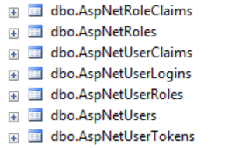
Leaky abstraction
Role = Claim of Type:
http://schemas.microsoft.com/ws/2008/06/identity/claims/role
Million dollar question:
Which table should I use to store roles?

Slide 36
When to use it?
Creating a solution prototype
You are too new to ASP.NET world to build security model of your own
You are migrating existing solution that targets full .NET framework and uses ASP.NET Identity 2.x

Slide 37
Thank you!

