Slide 2
Zgradite Virtualni podatkovni center v Azure
Andrej Kašnik, Microsoft

Slide 3
Agenda
Overview of datacenter components with latest updates
Connectivity and capabilities of virtual networks
Deployment options (Infrastructure as a code)
Reference architectures

Slide 4
Scenario
We want to host simple app in Azure
We need to apply organizational security policies
  Backend VMs with no internet access
  Frontend VMs internet access only through CheckPoint
  Treat Azure just as another Branch office
We need:
  Highly available Domain Controller (2 x VM WS2016)
  FrontEnd - App server (1 x VM WS2016)
  BackEnd - SQL server (1 x VM WS2016 + SQL2016)
  Connection with existing environment
  Network segmentation in Azure (DMZ, Frontend, Backend)

Slide 8
Azure Networking
Notes:
Let’s start out by diving into virtual machine endpoints.

Slide 9

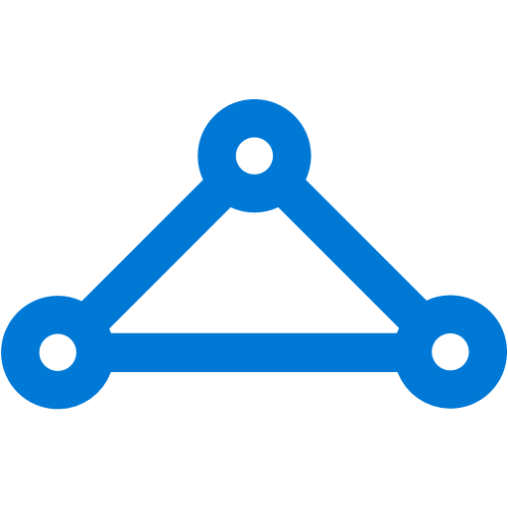
The Big (Network) Picture
Virtual Network
“Bring Your Own Network”
Segment with subnets and security groups
Control traffic flow with User Defined Routes
Azure
Virtual Network
Users
Internet
Front-End Access
Dynamic/Reserved Public IP addresses
Direct VM access, ACLs for security
Load balancing
DNS services: hosting, traffic management
DDoS protection
Backend Connectivity
Point-to-site for dev / test
VPN Gateways for secure site-to-site connectivity
ExpressRoute for private enterprise grade connectivity
Backend Connectivity
ExpressRoute
VPN Gateways

Slide 10


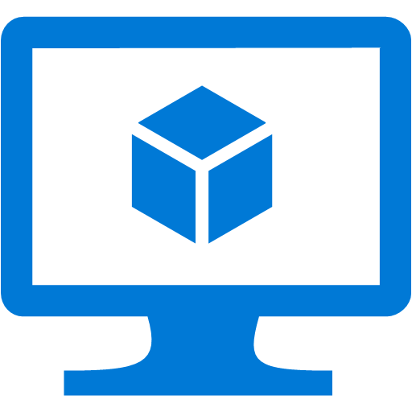

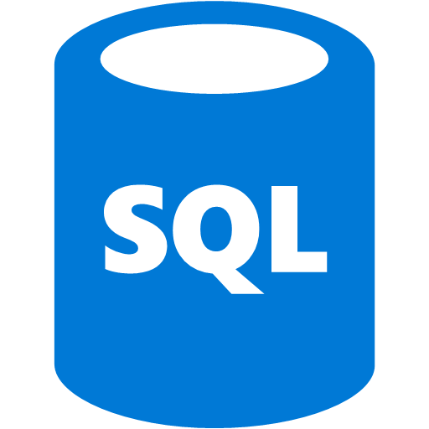

Azure Virtual Networks
10.1.1.0/24
Internet
Virtual Networks are the primary building block for Azure networking
Create subnets with your private or public IP addresses
Bring your own DNS or use Azure-provided DNS
Connect to on premises or the Internet
Control traffic flow with
User Defined Routes and Network Security Groups
10.1.1.0/25
10.1.1.128/25
Front end subnet
Back end subnet
Traffic stays within MS network
Traffic to on-premises and other VNets
Storage
SQL DB

Slide 11
Components of a Virtual Network
Address Spaces (IP Prefixes)
  The range of IP addresses available in your virtual network
Subnets
  Named ranges of addresses assignable to virtual machines and cloud service instances.
DNS Servers
  References to DNS servers that will be assigned to virtual machines or cloud service instances in the virtual network.
Local Network Configuration
  Configuration of an remote network connected by a site-to-site VPN connection or ExpressRoute.
Notes:
Address Space
IP range that is dedicated to this network. This should sized appropriately to the network scale that will be used over a long period of time. In general practice this should be a Private address space that doesn’t overlap rest of the company’s network.
Subnets
The smaller networks that have been “carved” out of the IP address space. Typically these might be for the Web, Data, or Management tiers. Each of these have a purpose and by subnetting you can direct only the traffic that should be accessing those machines to have access.
DNS
Azure by default provides Name services to Azure VNETs, but this can be configured to use the DNS servers of the company.
Local Network Configuration
This is the address range of the network onsite that will be connecting to the Vnet via VPN.

Slide 12

VMs and NIC
NIC connects a VM to network
VM can have one or more NICs
NIC can have:
1 Private IP – Static or Dynamic
1 Public IP – Static or Dynamic
1 LB VIP – Static or Dynamic
All NICs belong to same VNet
NICs can be in different subnets
Private IP
Private IP
primary
Public IP
LB

Slide 13

Connectivity within VNet
System routes
Direct VM to VM connectivity
Every other VM is just one hop away (logically)
Infinite scale within a region
Azure Region
Network Infrastructure
Customer VNet

Slide 14

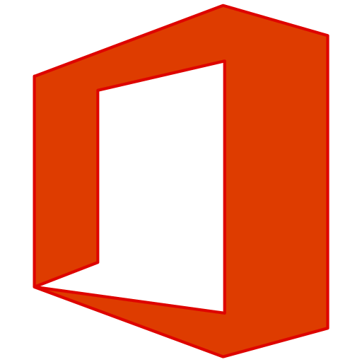

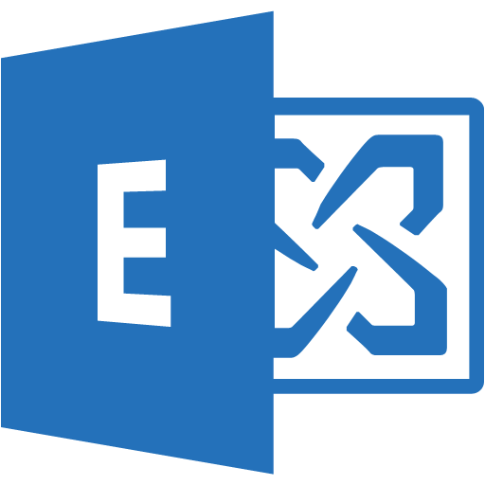
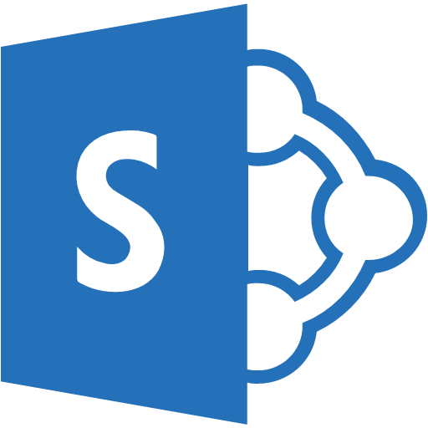


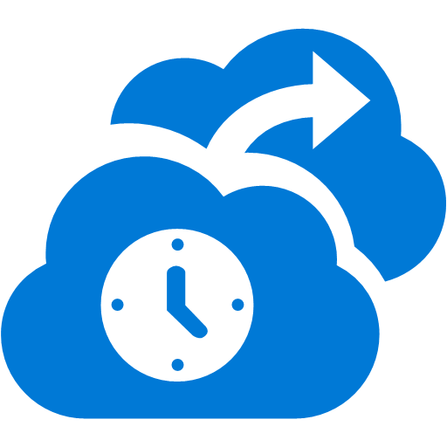




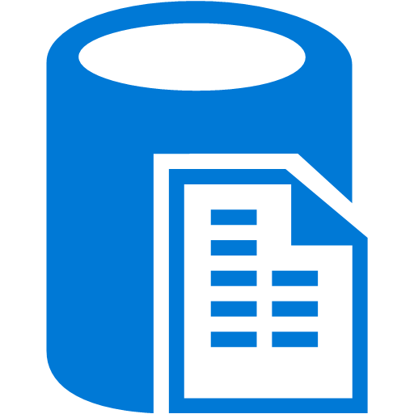
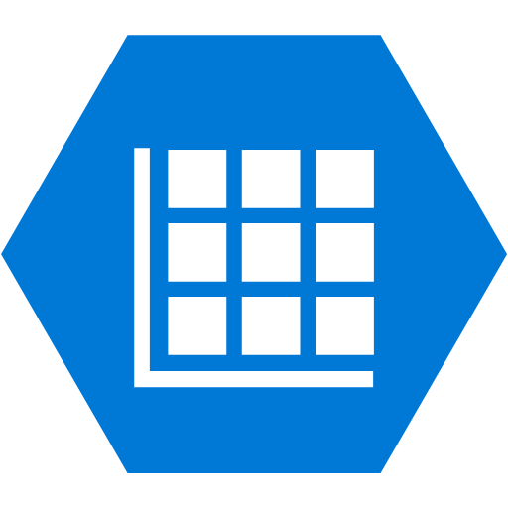
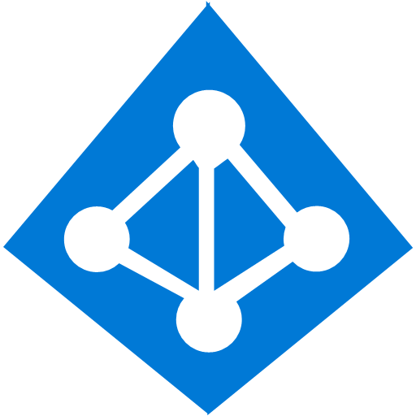
Cross premises connectivity overview
Azure
Azure
P2S SSTP tunnels
Virtual Network
Internet
Backend
Mid-tier
Frontend
IPsec S2S VPN tunnels
Private WAN
ExpressRoute

Slide 15
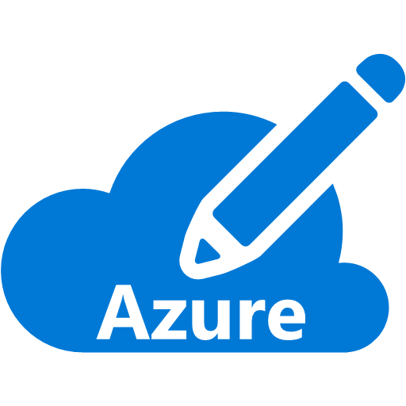
ExpressRoute connectivity
Partner Edge
Microsoft Edge
Customer’s
network
Customer’s
connection
Traffic to Office 365 Services and soon CRM Online
Traffic to public IP addresses in Azure
Traffic to Virtual Networks
Notes:
Mention recommendation update on MSFT peering!
2 physical lines, one logical connection

Slide 16
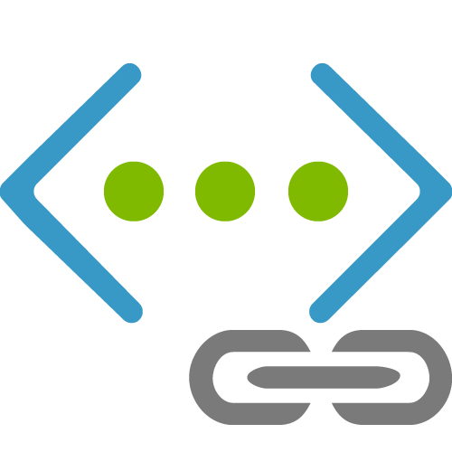
VNet to VNet peering
Azure Region
10.0.0.0/16
Private connectivity from VM to VM in different VNets
Connection through the gateway
NEW
VNet Peering GA
Direct full mesh connectivity
Latency and throughput at par as single VNet!
PEER
IPSec VPN Tunnel
10.0.1.0/16

Slide 17
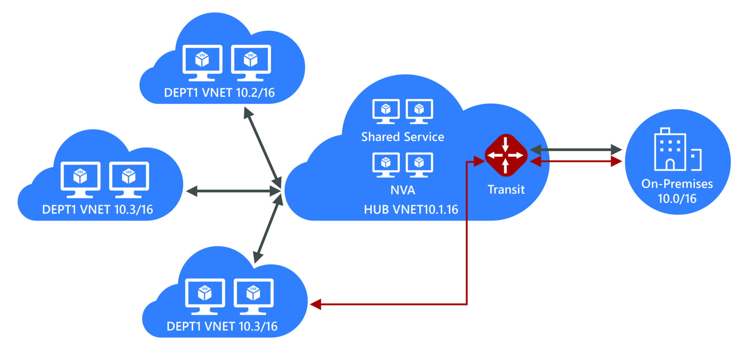
VNet Peering Hub and spoke
Central VNet (Hub) peers with spoke Vnets
Gateway and NVA Transit
UDR next hop IP in central VNet
Consolidate shared services
Virtual DMZ

Slide 18
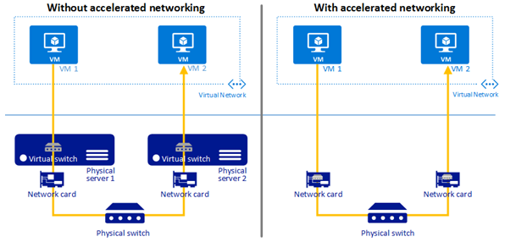
Accelerated Networking
  Provides SRIOV to the VM
  10x latency improvement
  Increased packets per second (PPS)
  Up to 25 Gbps throughput

Slide 19
Security - Network Security Group (NSG)
Prioritized set of rules
Applied at the NIC and/
or Subnet
Default Tags: Virtual
Network, Internet, AzureLoadBalancer
Default rules: 65000 and above
VM2
VM1
NSG 1
Pri | Access | Src | Port | Dst | Port | Protocol
Virtual Subnet
NSG 2
Pri | Access | Src | Port | Dst | Port | Protocol

Slide 20
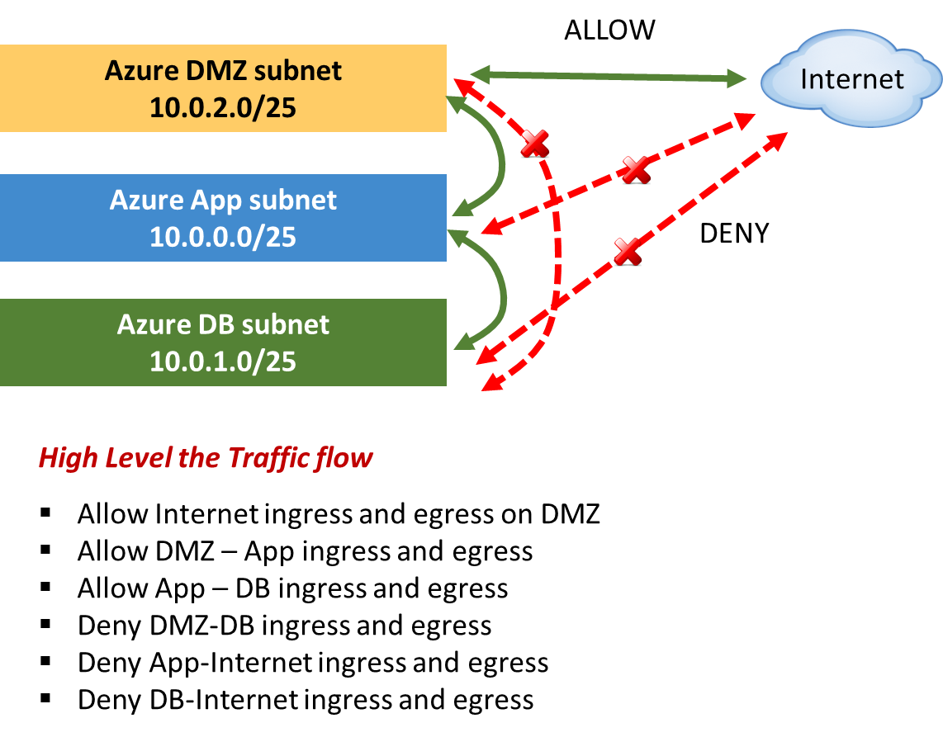
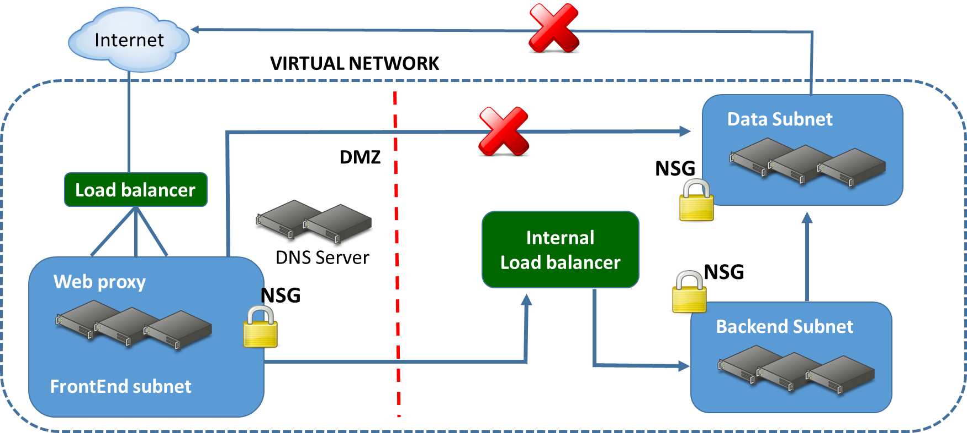
NSGs in a multitier topology

Slide 21
Default rules
Inbound
Name | Priority | Source IP | Source Port | Destination IP | Destination Port | Protocol | Access
ALLOW VNET INBOUND | 65000 | VIRTUAL_NETWORK | * | VIRTUAL_NETWORK | * | * | ALLOW
ALLOW AZURE LOAD BALANCER INBOUND | 65001 | AZURE_LOADBALANCER | * | * | * | * | ALLOW
DENY ALL INBOUND | 65500 | * | * | * | * | * | DENY
Outbound
Name | Priority | Source IP | Source Port | Destination IP | Destination Port | Protocol | Access
ALLOW VNET OUTBOUND | 65000 | VIRTUAL_NETWORK | * | VIRTUAL_NETWORK | * | * | ALLOW
ALLOW INTERNET OUTBOUND | 65001 | * | * | INTERNET | * | * | ALLOW
DENY ALL OUTBOUND | 65500 | * | * | * | * | * | DENY
Example
Name | Priority | Source IP | Source Port | Destination IP | Destination Port | Protocol | Access
WEB | 100 | INTERNET | * | * | 80 | TCP | ALLOW

Slide 22
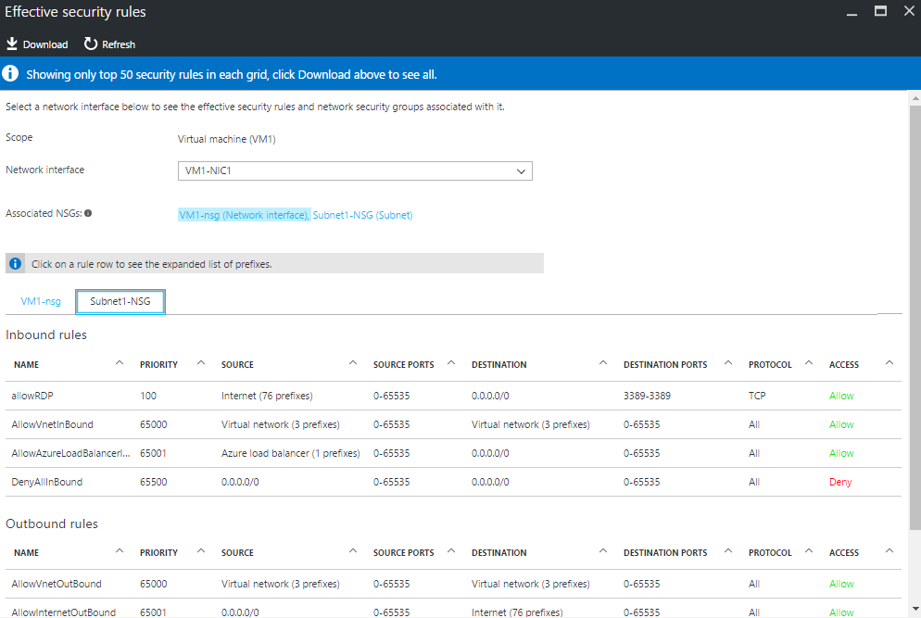
Who is blocking me - Trouble shooting NSG rules
Effective rules applied on the NIC
Consolidated view of NIC and Subnet NSGs
Expanded System tags

Slide 23
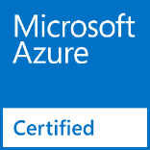
Network Virtual Appliances
Overview
  VMs that perform specific network functions
  Focus: Security (Firewall, IDS , IPS), Router/VPN, ADC (Application
  Delivery Controller), WAN optimization
  Typically Linux or FreeBSD-based platforms
Scenarios
  IT Policy and compliance—consistency between on-premises and Azure
  Supplement/complement Azure capabilities
Azure marketplace
  Available through Azure Certified Program to ensure quality
  and simplify deployment
Notes:
NVA & UDR for HA
NVA per VNet

Slide 24



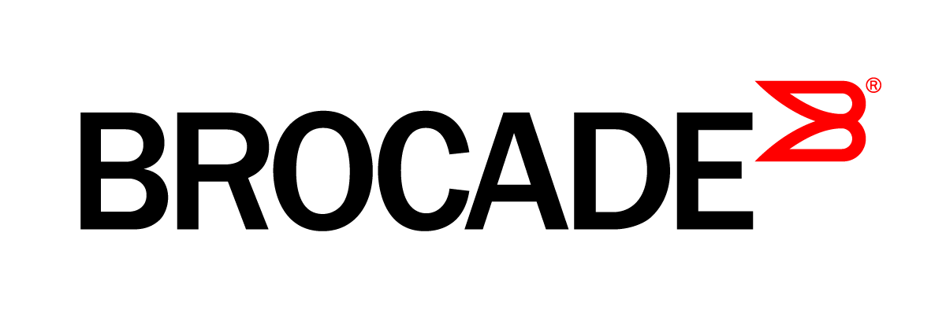
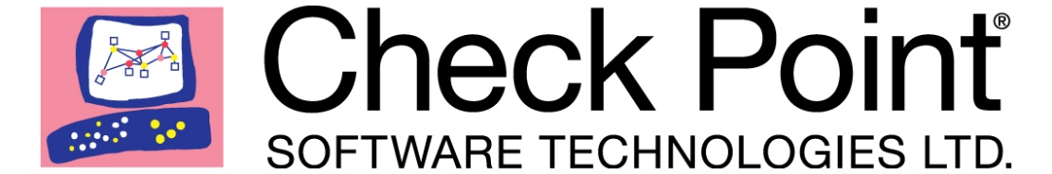






Network Virtual Appliance ecosystem

Slide 25
Internal and External load balancing
Enables load balancing among VMs with private IP addresses
Accessible only from
  Within customer’s cloud service
  Customer’s Vnets
  Customer's on-premises Vnets
Multi-tier applications with internal facing tiers require ILB
  HA LOB apps
  SQL Always On
Internet
Microsoft Azure
Public VIP
Customer Virtual Network
External load balancer
Customer
on-premises
Internal VIP
Internal
load balancer
Back end
Front end

Slide 26




MultiTier application
Internet
Virtual Network
Frontend Subnet
DMZ
Network Virtual Appliance
Application Subnet
APP
Backend Subnet
Load Balancer
DB

Slide 27
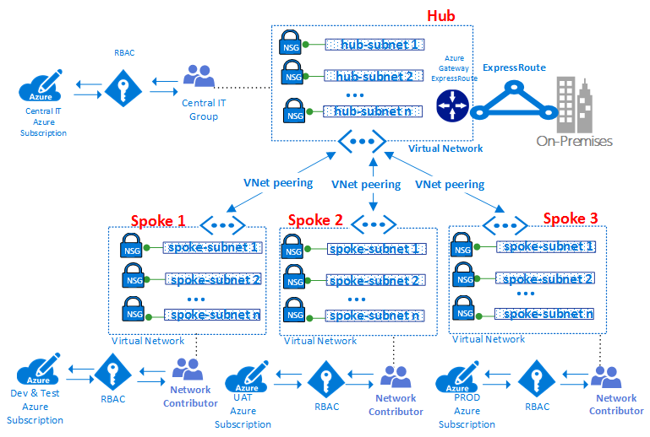
Hub and Spoke
Management & billing segregation
Compliance

Slide 28
VNet deployment demo

Slide 29
Azure Virtual Machines

Slide 30
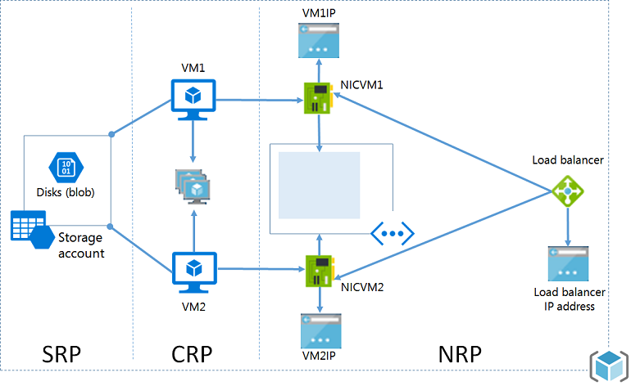

Overview of Virtual Machine Services
Compute resources
  Virtual machines
  VM extensions
Storage resources
  Storage accounts (blobs)
  Managed Disks
Networking resources
  Virtual networks
  Network interface cards (NICs)
  Load balancers
  IP addresses
  Network Security Groups

Slide 31
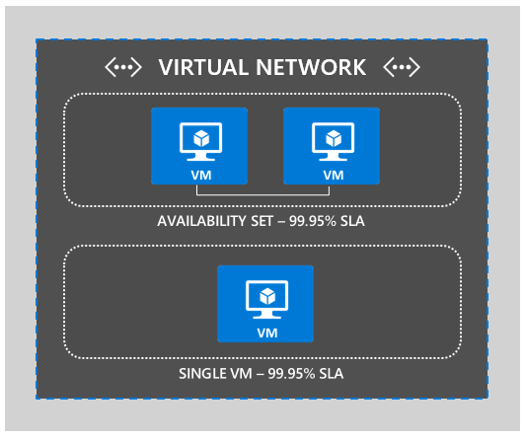
Single Instance SLA for VMs
First in the industry to offer single instance SLA for VMs.
Requires VMs to use Premium Storage for all disks.
99.9% SLA guarantee.
https://azure.microsoft.com/en-us/support/legal/sla/virtual-machines/v1_4/

Slide 32

Availability Sets
Availability set
SLA High Availability
Hardware and Software
Windows and Linux
Virtual Machine
Virtual Machine
SQL Server
Primary
SQL Server
Secondary
SLA 99.95
Notes:
So when you’re creating and deploying your application, you want to consider High Availability.
SQL is the example but it works on Linux as well

Slide 33


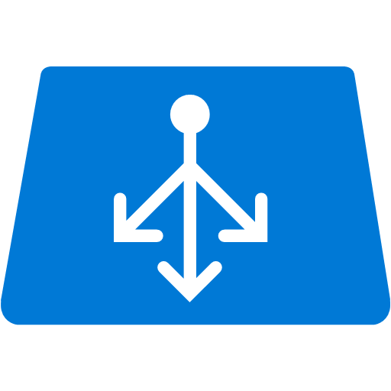
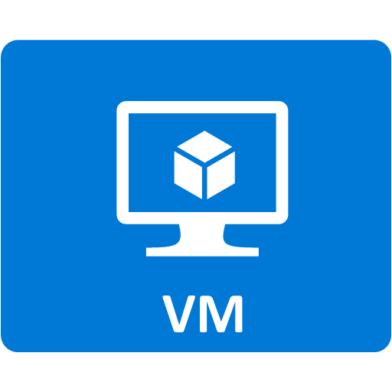

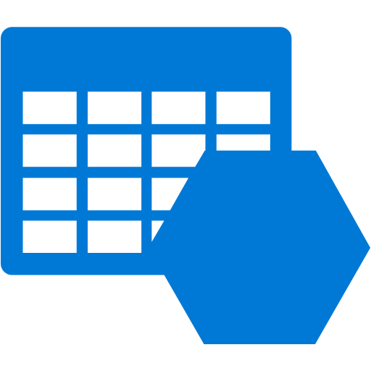

Azure Virtual Machines
Virtual Network
Public IP
Azure Load Balancer (external)
Subnet
Network Security
Group
Scale Set
Azure Load Balancer (internal)
Subnet
Network Security
Group
Availability Set
Azure Storage: Premium (SSD) or Standard
Disk Format: Fixed VHD – Max 1 TB per disk
Span disks for larger volumes (up to 64 T

Slide 34

Compute families
A
D
F
G
Entry
Level
General Purpose VMs
Compute
Optimized VMs
Large Memory
VMs
>80,000 IOPs
Premium Storage
Dev/Test and
entry-level workloads
Earliest generation, HDD
100 ACU/core
Good combination of memory, SSD for most common production applications
Memory-intensive variants
210 ACU/core
Compute-intensive apps like Gaming, Analytics
More CPU to
memory ratio
210 ACU/core
Large VMs for large databases requiring fast Storage
Intel Haswell processor with 0.5TB RAM
180 ACU/core
Highest Value
Largest Scale-up
Notes:
Azure offers a broad set of compute family that customers can take advantage from dev test to large database workloads

Slide 35
DC in Azure

Slide 36
Extend Active Directory to Azure IaaS
Extending Active Directory Domain Services to Azure is the first step to support line-of-business applications in Azure IaaS.
Supports cloud-based solutions that require NTLM or Kerberos authentication, or domain-joined virtual machines.
Adds additional integration potential for cloud services and applications and can be added at any time.

Slide 37
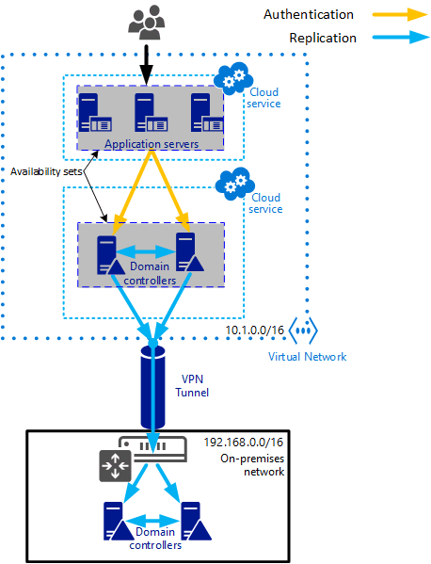
Scenario – Replica domain controller in Azure
Steps:
Create an Active Directory site for the Azure virtual network
Create an Azure virtual network
Provide connectivity to on-prem DCs
Create Azure VMs for the DC roles in Availability Set
Install AD DS on Azure VMs
Reconfigure DNS server for the virtual network

Slide 38
Domain Controllers In Azure
Consider the use of the Tier 0 subscription reference model depending on the subscription design = a separate subscription
Limit endpoint exposure to AD DS VMs
Protect VHDs
Active Directory database is not encrypted
Encrypt AD DS VHDs using first or third-party tools
Create a separate Storage Account for Domain Controller VHDs
Limit access to the Azure Management Portal to administrators which require access to the service
https://docs.microsoft.com/en-us/azure/active-directory/active-directory-install-replica-active-directory-domain-controller
Notes:
Key resources in any informed conversation about this should include:
The use of the Tier 0 subscription in the reference model in this document carefully as it allows you to manage who has explicit control over the domain controllers (and their security equivalents in Tier 0).
The logical flow of choosing security controls in AZRA including the “do no harm” approach to security controls.

Slide 39
Azure VM Storage

Slide 40
Introduction to Disks and Images
OS Images
Microsoft
Partner
User
Base OS image for new VMs
Sysprepped/Generalized/Read-only
Created by uploading or by capture
Disks
OS Disks
Data Disks
Writable disks for VMs
Created during VM creation or during upload of existing Virtual Hard Disks (VHDs)
Notes:
Slide Objective
Explain the workflow for creating a custom image in the cloud.
Notes
This use case is about using the Capture feature of IaaS to create OS images. You start with a base Virtual Hard Disk (VHD) and then customize it with software binaries, registry settings etc. Next, you run sysprep.exe and generalize/shutdown the OS. You can then upload it, if the image is being coming from on-premises, or click the capture button if you created the VM in the cloud.
Capture allows you to take a generalized VM and save the underlying VHD as a new image in your Image library.
Disks and Images
The idea of disks and images are key concepts related to VMs
The difference is between OS images provided by Microsoft, users or partners.
The difference is the fact that those images have been sysprepped and generalized
They can be uploaded, or captured
You can create them, add whatever you need, then capture for repeated use
We are seeing customers who want to install SharePoint in one of these images, save it, and use it
For disks, this represents a .vhd machine that you have already booted up somewhere and that is running sysprep on, may ruin something in its environment. Also, it is a little more risky because if you do not already have remote desktop set up on the image, you would not be able to turn it on in the Cloud like Microsoft does for the OS images. Otherwise, the process is the same as how it works in Microsoft Azure, where an ISO is created, an unattended.xml file and storage is used

Slide 41
Azure Storage Capabilities
Scalability
Per storage account: 500TB of data , 20,000 tps, 10Gbps ingress/20Gbps egress
Availability
99.9% for reads/writes, 99.99% for reads with RA-GRS. Backed by SLA.
Access Control
Symmetric shared key (AuthN)
Shared Access Signatures (SAS) - Delegated AuthZ
Public (blob service only)
Analytics
Rich perf-counter like metrics and detailed logs
Notes:
Each Storage account has hard limits in terms of scalability. The Size, IOPS and data volumes.
Access Control is important to mention here. There are three different ways to access data in the Storage account:
Keys: There are complex keys that are essentially secure passwords.
Share Access Signatures: which can be created dynamically using a Programming API
Public: which allows to set permissions on a file or container in Azure granting rights

Slide 42
Standard Storage Capacity Planning
IOPS Per Disk
  300 for Basic Tier
  500 for Standard Tier (60 Mbps)
IOPS Per Storage Account: 20,000
  Supports up to 40 data disks using maximum IOPS per disk
  Group disks into striped sets to for more IOPS
  Example: 4-disk X 500 IOPS = 2000 IOPS
~40xDisks
per
Storage Account
Notes:
Basic Tier Disks are limited to 300 IOPS while Standard are 500 IOPS.
There is a cap of the concurrent IOPS for each storage account at 20,000
You can use disks with different storage accounts on the same VM.

Slide 43
Azure Premium Storage Disks
For high-performance IO-intensive workloads (databases, etc.)
Consistent low latency and predictable high IO throughput
Durable - 3 strongly consistent copies in SSD storage
New class of VMs – Ds Series
    Supports up to 1 TB blob/disk size
    Up to 32TB per VM and up to 64,000 IOPS per VM
Flexible Pricing – VMs and disks by the hour
Disk Types | P10 | P20 | P30
Disk Size | 128 GB | 512 GB | 1024 GB
IOPS Per Disk | 500 | 2,300 | 5,000
Throughput per Disk | 100 MB/Sec | 150 MB/Sec | 200 MB/Sec
Price per month | €16.63 per month | €61.75 per month | €113.99 per month

Slide 44

Managed disks
Simplified management for
performance and scale
Overview
  Simplifies management to avoid capacity
  planning mistakes and easier to scale
  Integrates directly with virtual machine
  scale sets
  Managed disks do not allow direct access to the VHD but instead allow common operations through Azure. Managed disks are a top level entity which allows fine grained permission management through role based access control
WHAT THE
ADMINISTRATOR SEES
BEHIND THE SCENES
500 IOPS PER DISK
MANAGED DISK (2000 IOPS)
STORAGE ACCOUNT
Notes:
Key talking points:
Managed disks is a new feature that is cross cutting. You will see different aspects of it when we discuss security and flexibility improvements later in the presentation.
Managed disks simplifies scale by taking away the need for the administrator to know about service limits of storage accounts and ensure that IOPS and throughput capabilities are easy to understand.
Managed disks also integrate directly with virtual machine scale sets to automatically scale the front end compute and the backend storage.

Slide 45
Virtual Machine Storage Architecture
Azure Virtual Machine
C:\
OS Disk
D:\
Temporary Disk
E:\, F:\, etc.
Standard Data Disks
E:\, F:\, etc.
Premium Data Disks
Y:\, Z:\, etc.
SMB Share
Disk Cache
SSD Read Cache
Azure Page Blob
Azure Page Blobs (Premium Storage)
Azure Files

Slide 46
Azure Storage Durability
Locally Redundant Storage
  Stores 3 replicas of the data within a single zone (facility) in a single region
  Provides data durability for disk, node and rack failures
Geo Redundant Storage
  Stores 6 replicas of the data across two regions (3 in each region)
  Provides additional durability to protect data against major regional natural disasters
  Updates across regions are performed asynchronously
Geo Redundant Storage with Read Access
  Stores 6 replicas of the data across two regions (3 in each region)
  Provides additional durability to protect data against major regional natural disasters
  Updates across regions are performed asynchronously
Notes:
All data in Azure is relocated locally 3 times inside of the region where the storage account is located
That data can be replicated to another region using the Geo Redundant Storage which then means that data has been replicated 6 times.
Geo Redundant Storage with Read Access has 6 replicas, but allows the replicated data to be accessed as “read-only”

Slide 47
Azure Disk Encryption ^{Preview}
  Disk encryption for Windows and Linux IaaS VM’s
  Key management integrated in customer key vault using HSM
Value Proposition:
VM’s are secured at rest using industry standard encryption technology to address organizational security and compliance requirements
VM’s boot under customer controlled keys and policies, and they can audit their usage in Key Vault

Slide 48
Backup of Azure IaaS VMs
Microsoft Azure
Virtual machines
Cloud Data Backup
Value proposition:
Application consistent backup for MS workloads File System Consistent for Linux workloads
Fabric level protection
No additional customer resources required

Slide 49
VM deployment demo

Slide 50
CheckPoint deployment demo https://supportcenter.checkpoint.com/supportcenter/portal?eventSubmit_doGoviewsolutiondetails=&solutionid=sk110194

Slide 51
Deployment

Slide 52
Deployment Options
Manual
Not easily repeatable
Not easy to copy the deployment to a second region or subscription
Client Driven Automation (PowerShell Script)
Solves a lot of the manual deployment issues
Burden of deployment logic and dependencies in the script execution and order
Hard to parallelize

Slide 53
Deployment Options
ARM Templates
Cloud based orchestration engine
Fully declarative
Automatically optimizes the deployment based on dependency graph
Compliments and integrates PowerShell automation for deployment tasks

Slide 54
ARM template deployment demo

Slide 55
Power of Repeatability
Azure Templates can:
Ensure Idempotency
Simplify Orchestration
Simplify Roll-back
Provide Cross-Resource Configuration and Update Support
Azure Templates are:
Source file, checked-in
Specifies resources and dependencies (VMs, WebSites, DBs) and connections (config, LB sets)
Parametized input/output
Instantiation of repeatable config.
Configuration → Resource Group
SQL-A
Website
[SQL CONFIG] VM (2x)
DEPENDS ON SQL
DEPENDS ON SQL
SQL - A
Website
Virtual
Machines
SQL
C
ONFIG

Slide 56
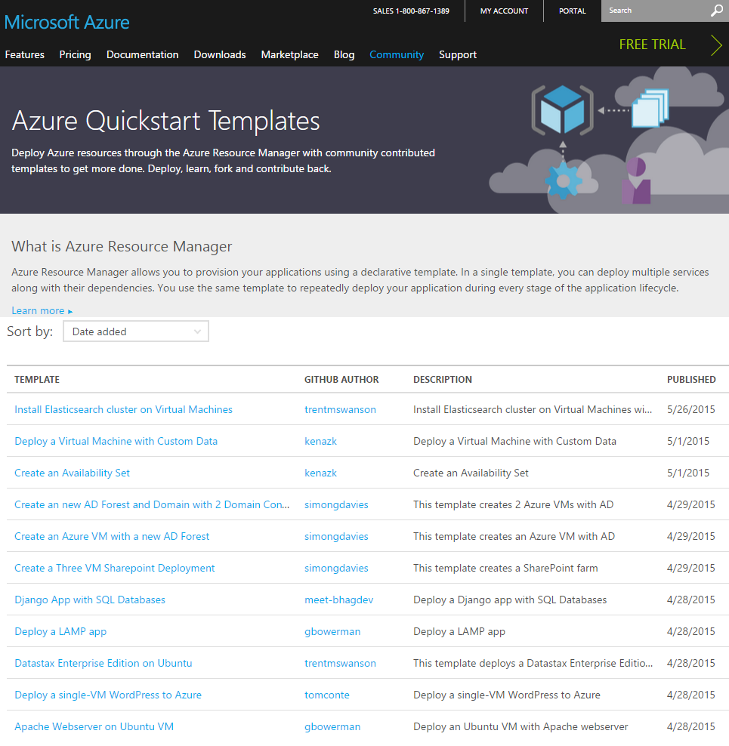
Getting Started with Azure Templates
  Wide range of Quickstart Templates
    Indexed on Azure.com
    Github Repo
    Community & Microsoft contributed
  Integration of IaaS with Azure Services
  Azure Resource Explorer
    https://resources.azure.com/

Slide 57
Reference Architectures

Slide 58
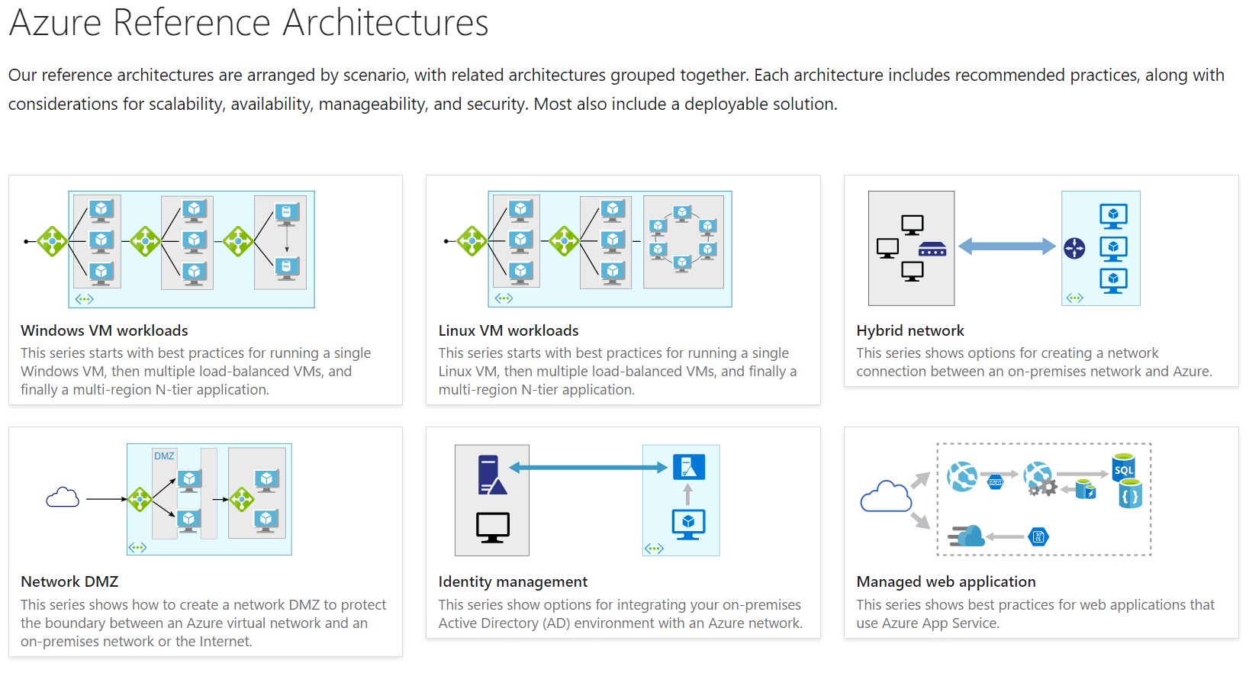
Azure Reference Architectures
https://docs.microsoft.com/en-us/azure/architecture/reference-architectures/

Slide 59
Q & A

Slide 60
H.V.A.L.A. :-)

