Slide 1
Razvoj Debugger Extension-a za
Visual Studio Code
Damjan Cvetko, Monotek d.o.o.

Slide 2
Developer environments
IDE
  Visual Studio
  IntelliJ
  Eclipse
Source Code Editors
  Notepad++
  Sublime Text
  vim

Slide 3

Visual Studio Code

Slide 4

Visual Studio Code
Release 2016
Freeware
Cross-Platform
Support for
JavaScript
TypeScript
HTML
Node.js
git
Extensons

Slide 5
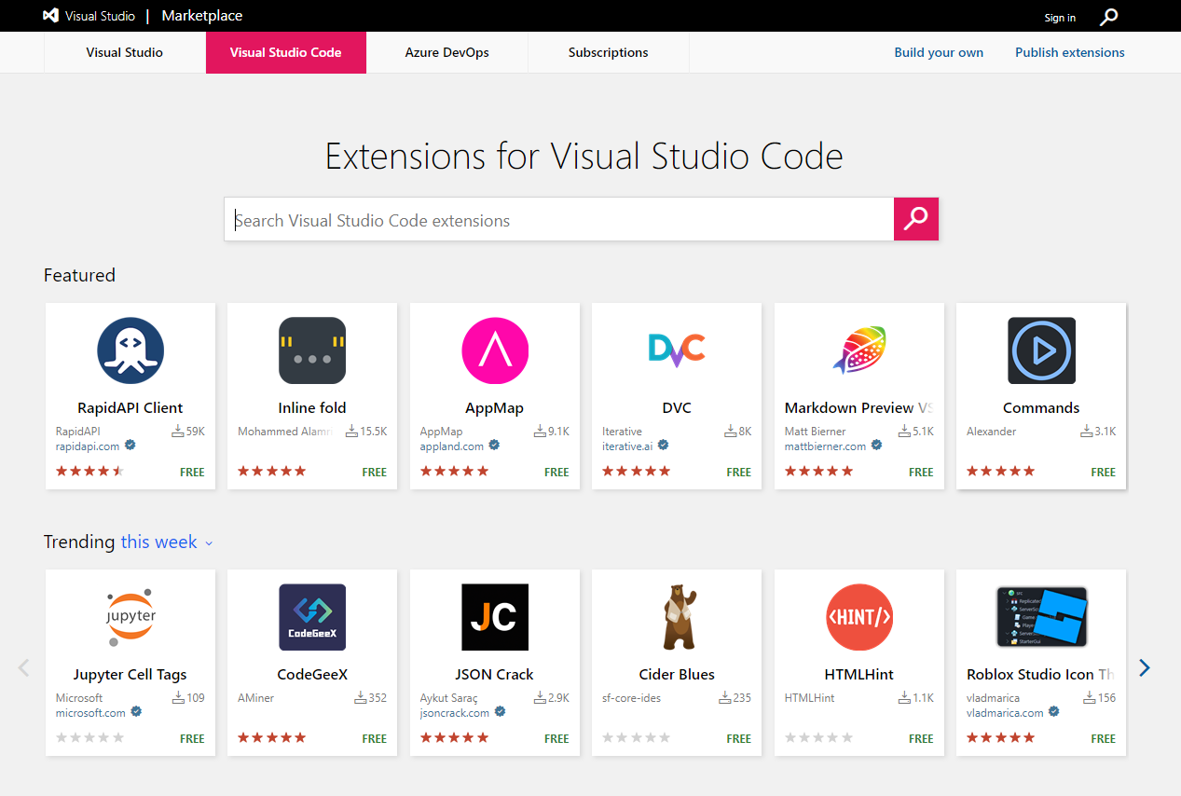
Visual Studio Code Marketplace
Color themes
Programming languages
Source control
Testing tools
Code formatters

Slide 6
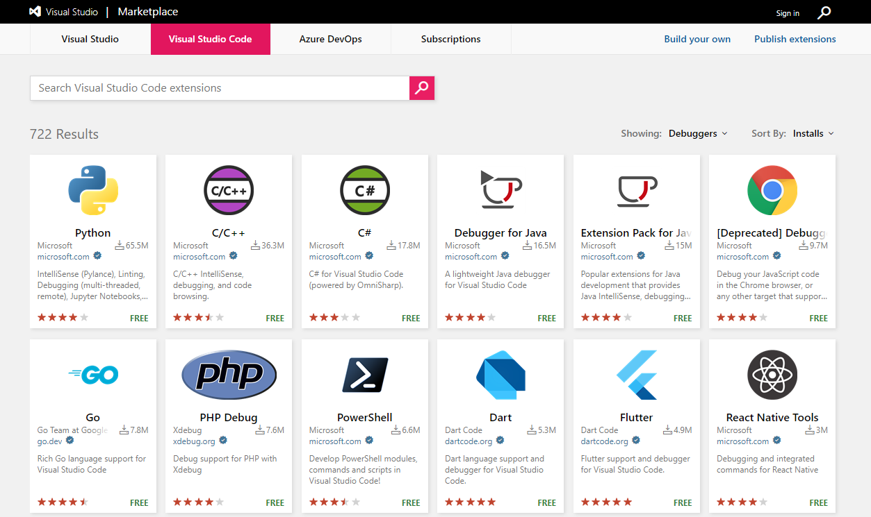
Visual Studio Code Marketplace
Debuggers

Slide 7
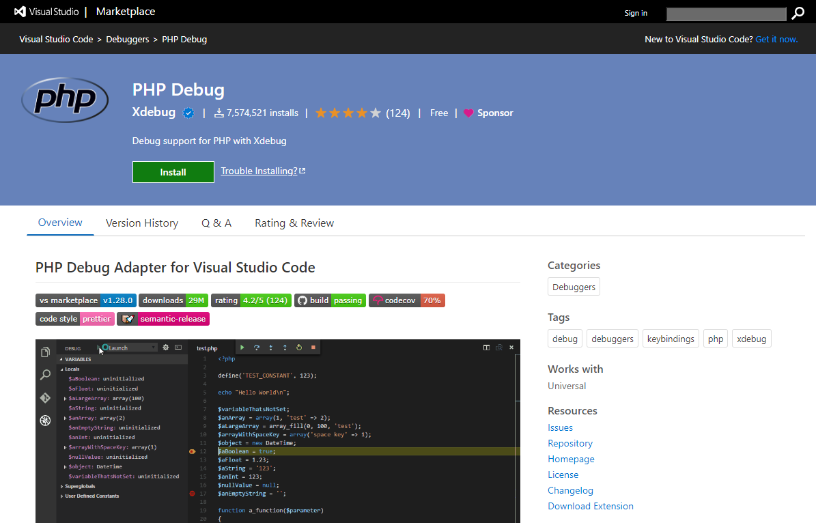
VS Code PHP Debug

Slide 8



Visual Studio Code Stack
Electron
TypeScript
GitHub
https://github.com/microsoft/vscode
MIT license

Slide 9
Anatomy of a VS Code extension
VSIX
  zip
  extension.vsixmanifest
  [Content_Types].xml
  extension

Slide 10
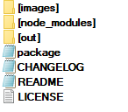
Anatomy of a VS Code extension
VSIX
  zip
  extension.vsixmanifest
  [Content_Types].xml
  extension
Extension
  node_modules
  JavaScrip files
  package.json (Extension Manifest)

Slide 11
Extension Manifest
General data
  Name, version, published, description…
Contribution points
  configuration, commands, breakpoints, menus, themes, views...
Activation events
  onCommand, onDebug, onView...
https://code.visualstudio.com/api/references/extension-manifest
https://code.visualstudio.com/api/references/contribution-points
https://code.visualstudio.com/api/references/activation-events

Slide 12
Extension Manifest
General data
  Name, version, published, description…
Contribution points
  configuration, commands, breakpoints, menus, themes, views...
Activation events
  onCommand, onDebug, onView...
https://code.visualstudio.com/api/references/extension-manifest
https://code.visualstudio.com/api/references/contribution-points
https://code.visualstudio.com/api/references/activation-events
VS Code API
  window
  workspace
  debug
  command
  …
https://code.visualstudio.com/api/references/vscode-api

Slide 13
Demo
https://code.visualstudio.com/api/get-started/your-first-extension
Notes:
yo code
package.json
.vscode directory
source of extension
debug demo

Slide 14
Visual Studio Code
Debuggers

Slide 15
Debuggers in general
A debugger or debugging tool is a computer program used to test and debug other programs (the "target" program).
https://en.wikipedia.org/wiki/Debugger

Slide 16
Debuggers in general
General actions
  Breakpoints
  Conditional breakpoints
  Step operations
  Variable inspection
  Stack inspection
  Evaluation
  Start and stop target program
Debugger backends
  Node.js
  Go/Delve
  GDB
  LLDB
  Python
  .NET/Mono
  PHP/Xdebug

Slide 17
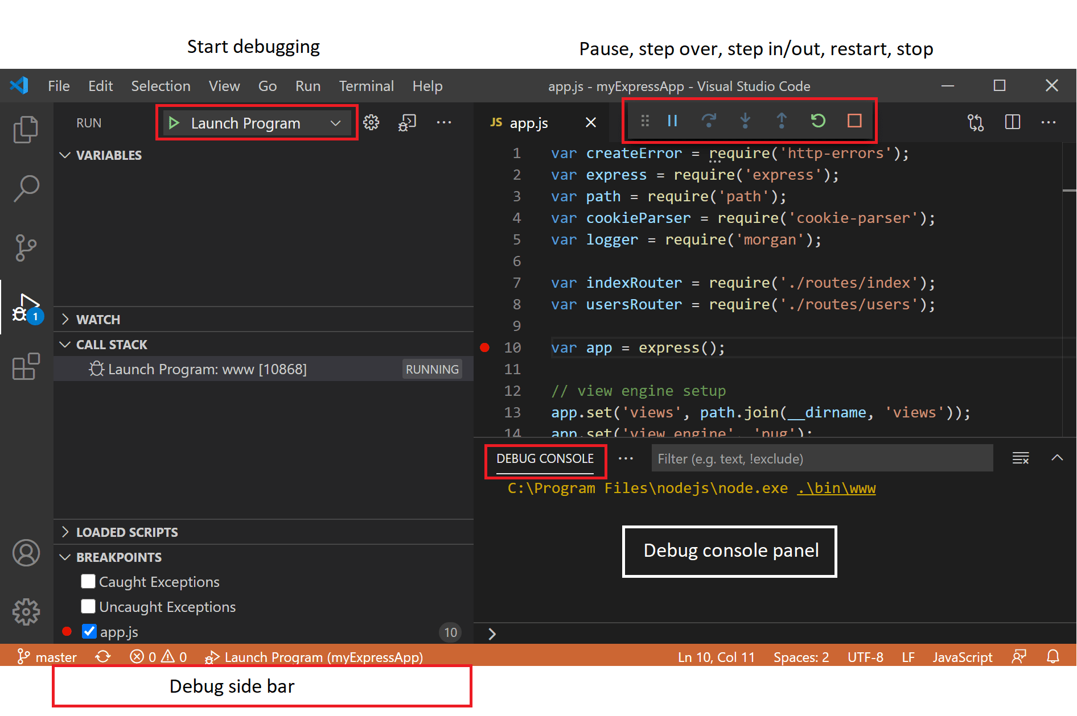
Visual Studio Code Debuggers
Debugger UI
  Run menu
  Launch configuration
  Debug actions
  Breakpoints
  Logpoints
  Data inspection
https://code.visualstudio.com/api/references/vscode-api

Slide 18
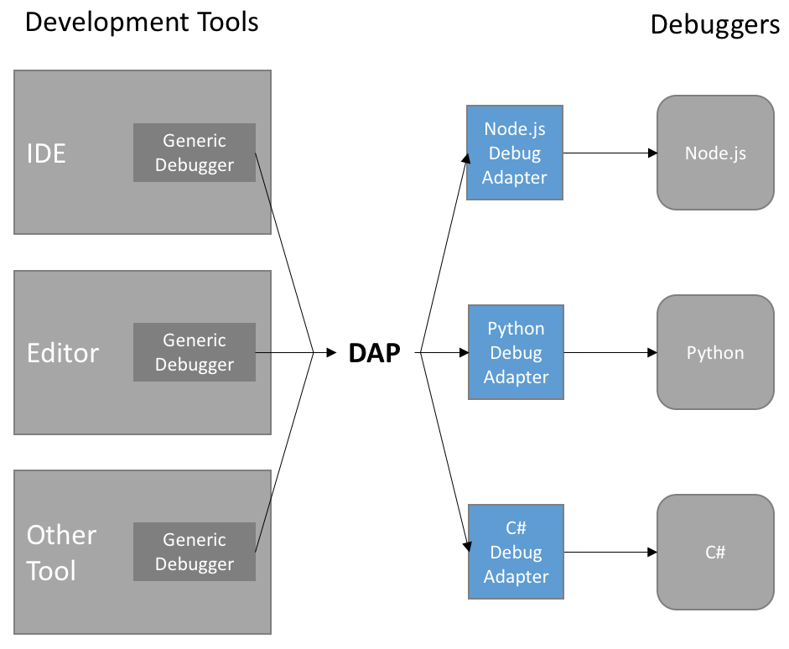
Debug Adapter Protocol
Separate UI from debugger
  Actions from IDE
  Events from Debuggers
Language agnostic
  JSON wire protocol
https://code.visualstudio.com/api/extension-guides/debugger-extension
https://microsoft.github.io/debug-adapter-protocol/

Slide 19
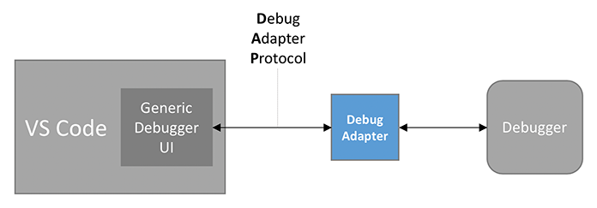
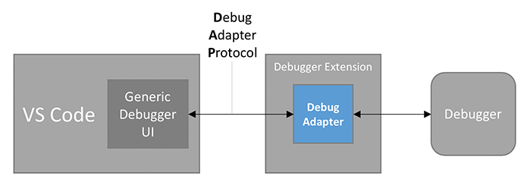
Anatomy of a Debugger Extension
Extension Manifest
Contribution points
contributes.breakpoints
contributes.debuggers
  program
  configuration
https://code.visualstudio.com/api/extension-guides/debugger-extension

Slide 20
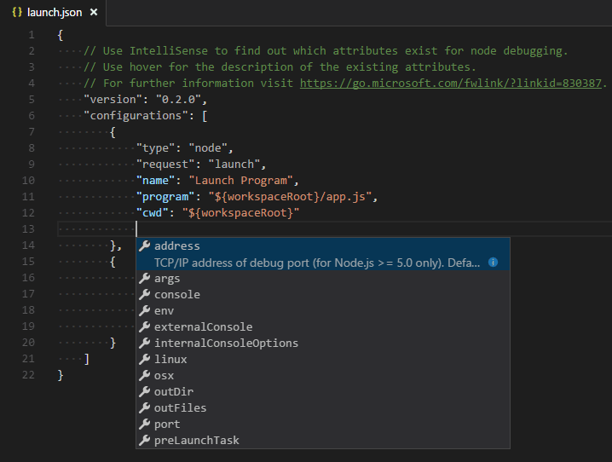
Debugger launch configuration
Workspace configuration
  .vscode/launch.json
  Can contain multiple configurations
  Extension specific
  Structure defined by exetension
https://code.visualstudio.com/docs/editor/debugging#_launchjson-attributes

Slide 21
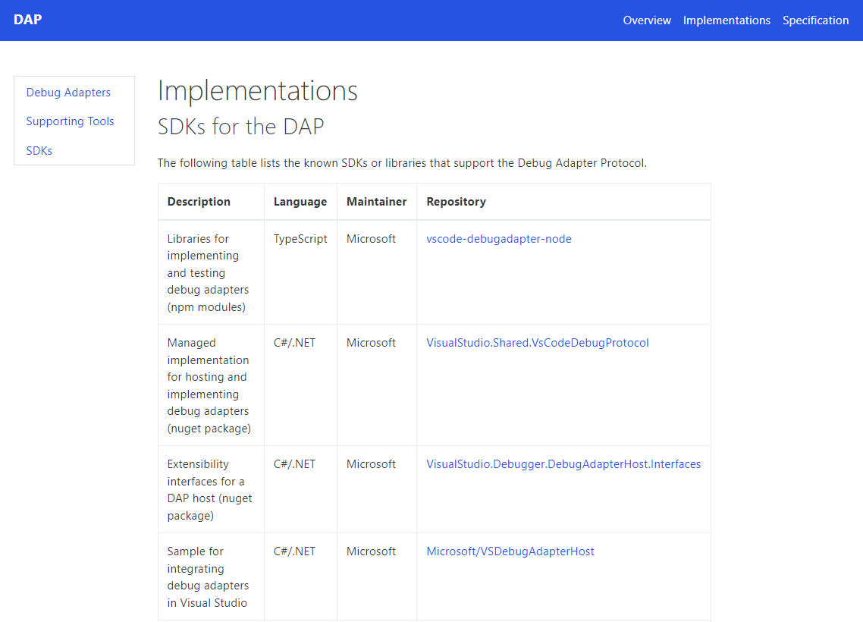
Implementing Debug Adapter
SDKs for DAP implementation
  Different SDKs
  TypeScript
https://microsoft.github.io/debug-adapter-protocol/implementors/sdks/

Slide 22
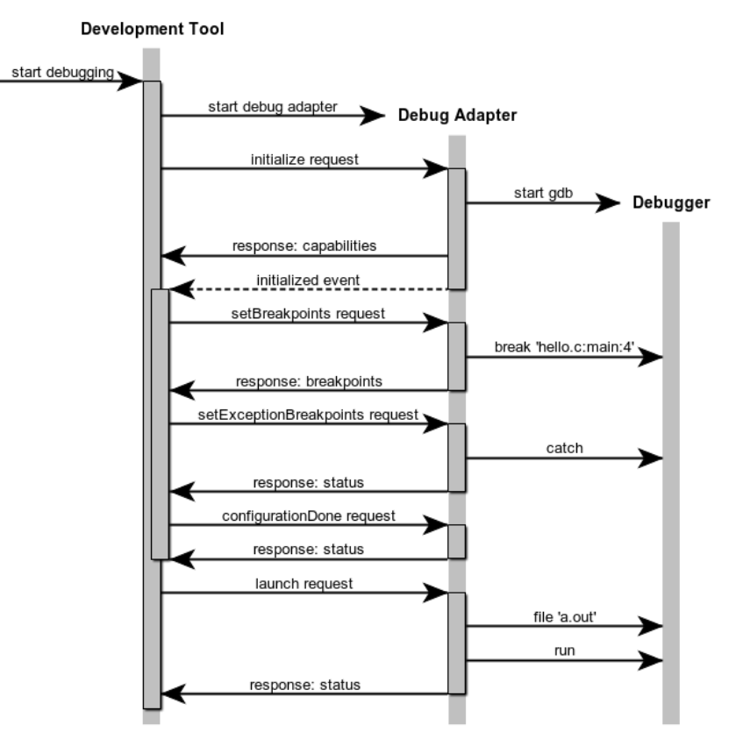
Debug Adapter Workflow
Protocol exchange
  Initialize
  SetBreakpoints
  ConfigurationDone
  Launch
While running
  StepIn, Next, StepOut, Continue
  Variables, StackTrace
  Terminate
https://microsoft.github.io/debug-adapter-protocol/specification

Slide 23


PHP Debug
PHP
  Script language
  ZendVM
  No interactive debugging support
Xdebug
  Provides step debugging
  DBGp protocol
  Cloud
https://xdebug.org/
https://xdebug.cloud/

Slide 24
Demo
https://github.com/xdebug/vscode-php-debug

Slide 25
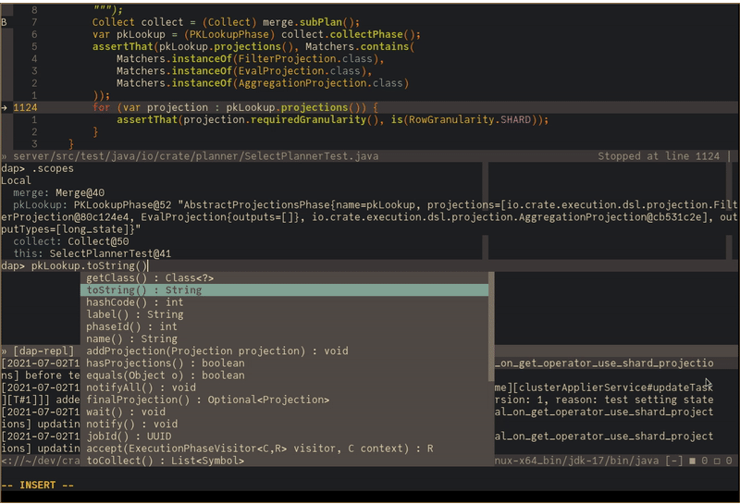
Debug Adapter Protocol clients
Alternative DAP clients
  VSCodium
  Visual Studio
  vim
  Neovim
  Emacs
https://microsoft.github.io/debug-adapter-protocol/implementors/tools/

Slide 26
Development process
PHP Debug
  GitHub
  Issues for support
  Documentation
  Roadmap
  Pull requests with tests and checks
  Automatic dep upgrades
  Semantic-Release
  GH Actions
  Release via VSCE
VS Code
  GitHub
  Microsoft very active towards extension authors
  Improvements are suggested and discussed with the community

Slide 27
Visual Studio Code
Remote Development

Slide 28
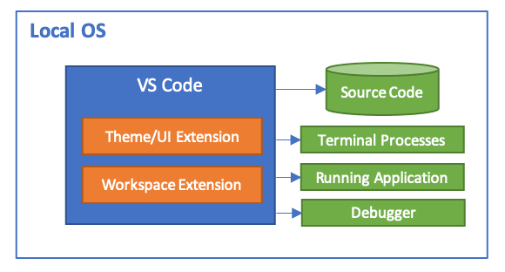
Local setup
Local filesystem
Local network
Local processes
  Debugger can execute target
  Target „sees“ same filesystem as IDE

Slide 29
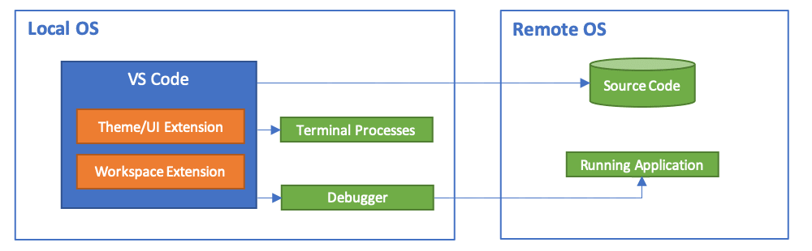
Remote server
Remote filesystem (SMB,NFS)
Remote network
Remote processes
  Debugger can‘t execute target
  Target „sees“ different filesystem as IDE

Slide 30
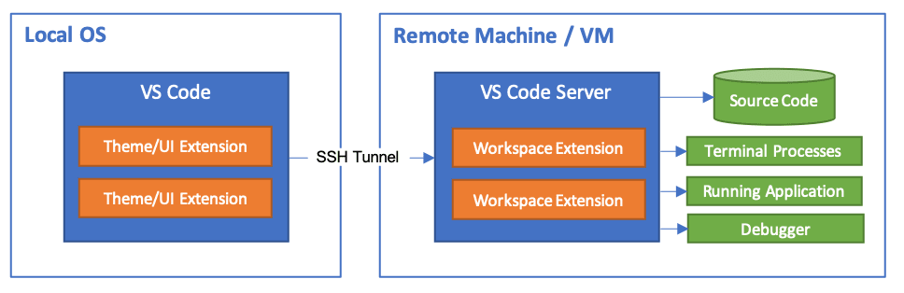
VS Code Remote Development (SSH)
Local UI / Remote IDE
„Local“ filesystem
„Local“ processes
  Debugger can execute target
  Target „sees“ same filesystem as IDE
SSH tunnel
  Port forwarding
Flutter on Mac
https://code.visualstudio.com/docs/remote/ssh

Slide 31
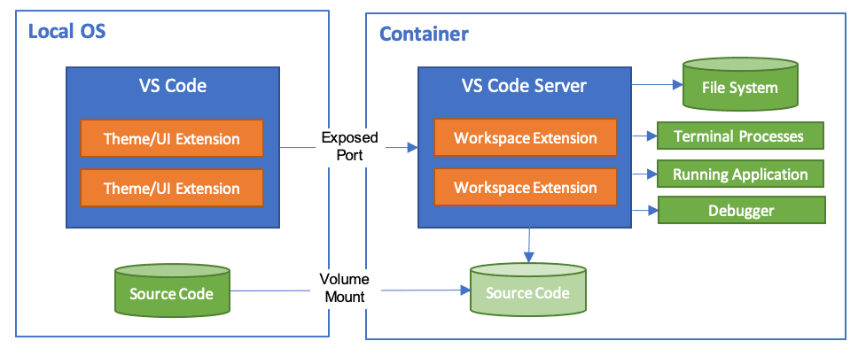
VS Code Remote Development (Container)
Local UI / Containerized IDE
„Local“ filesystem and processes
SSH tunnel
  Port forwarding
https://code.visualstudio.com/docs/remote/containers

Slide 32
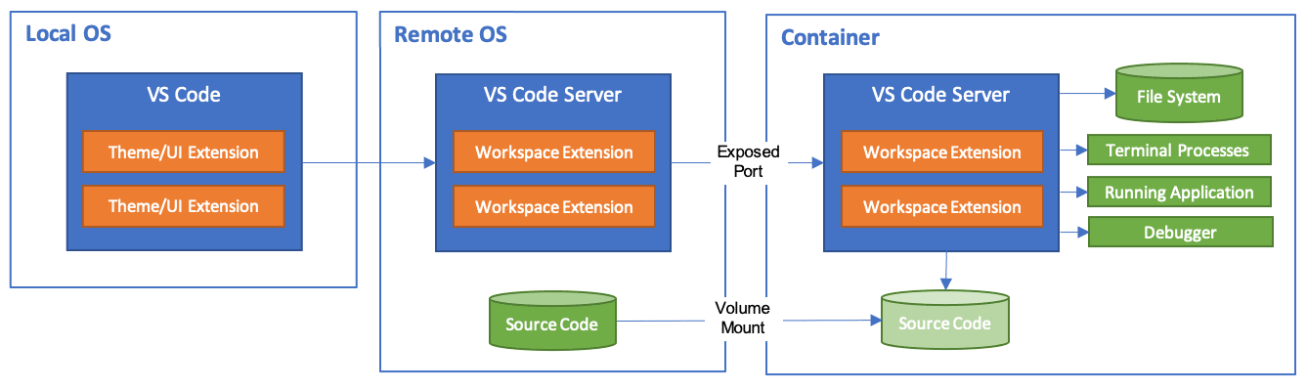
VS Code Remote Development (SSH+Container)
Local UI
SSH tunnel
Containerized IDE

Slide 33
VS Code Remote Development (Other)
Windows Subsytem for Linux
GitHub Codespaces
VS Code Server
Live Share
https://vscode.dev/
https://github.dev/org/repo
https://code.visualstudio.com/docs/editor/vscode-web

Slide 34
Povezave
https://github.dev/xdebug/vscode-php-debug
https://xdebug.org https://xdebug.cloud
https://github.com/microsoft/vscode
https://marketplace.visualstudio.com/vscode
https://code.visualstudio.com/docs/
https://code.visualstudio.com/api/get-started/your-first-extension
https://code.visualstudio.com/api/references/vscode-api
https://damjan.cvetko.org
https://github.com/zobo
@damjancvetko

Slide 35
Thank you, Q&A!

