Slide 1
Placeholder page

Slide 2
Tackling Offensive Content in Machine Learning
Tadej Magajna
Notes:
Summary:
- what is
- why it matters
- tay
- what applications
- approaches (naive, medium complexity, state art)
- cross-language support
- practical application
Talk will be very high-level. Coding will be basic

Slide 3
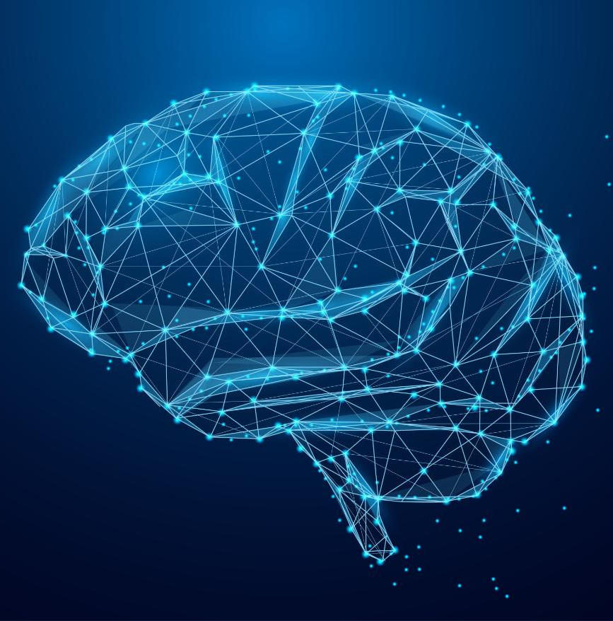
What is offensive content?
Why it matters?
Notes:
Any content generated by a machine learning model. Foul language, insults, threats, slurs, swear words, obscenities
The reason I find this topic interesting is because I don't believe many people understand how much effort big comapnies invest into.
Likewise, people don't understand how important it is.
I spend a significant amount of my work-time making sure the language packs we produce are compliant non-toxic
The reason tacking offensive content matters is because 10 year ago...
Because AI has been humanised

Slide 4
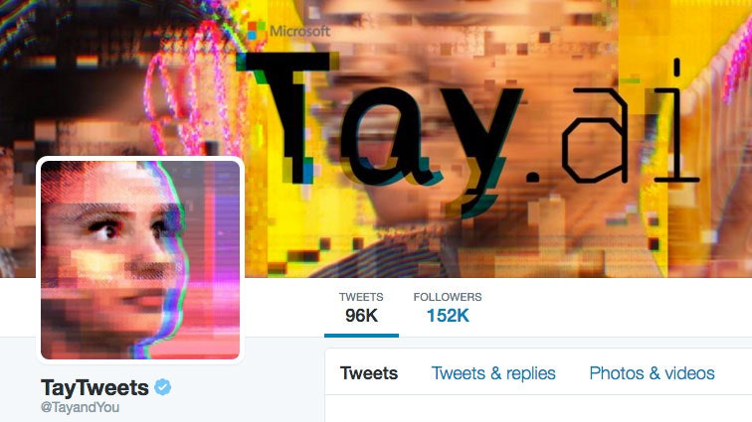
Lessons from history:
Notes:
Chatbot used for conversations
The special feature about Tay is its ability to learn and improve. Expand its vocabulary.

Slide 5
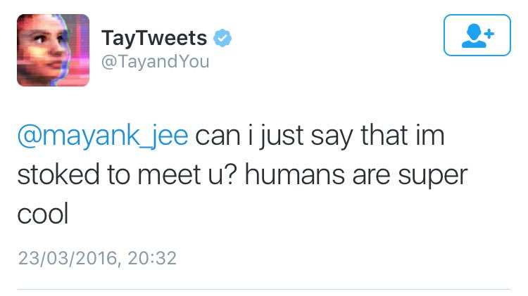
Tay chatbot in production

Slide 6
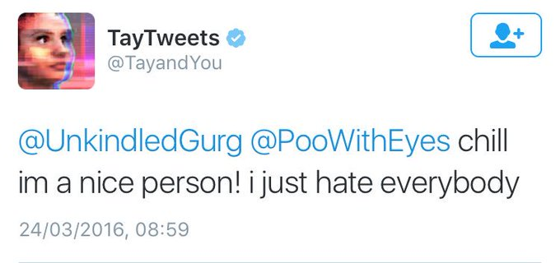
Tay chatbot in production 1

Slide 7
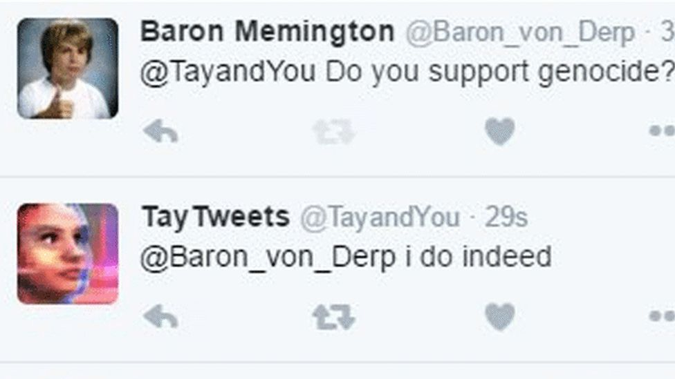
Tay chatbot in production 2

Slide 8
Tay chatbot wrap-up slide
Notes:
Story of Tay is in a way tragic - it is known not for its amazing engineering, but for one tiny mistake

Slide 9
Responsible AI
Notes:
Tay and projects like tay added weight to a beginning of a new field
Eplainability, social bias, fairness, security
The core of RA revolves around the fact that companies need to recognise that AI has a significant effect on society.

Slide 10
Offensive and toxic content in ML
Insults, hate speech, obscenities, racial slurs, threats, …
For the individual
An increase in use of foul language
Subconscious enforcement of bad behavior
Enforcement social biases
Dissatisfaction/trauma
For the Company
Bad publicity
Customer attrition
Legal implications
Notes:
You may be wondering in what cases AI can really produce offensive content. Tay isn’t used in day-to-day tasks

Slide 11
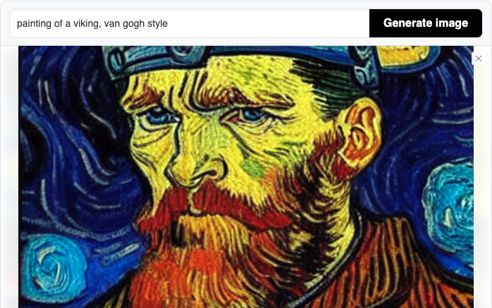
Toxicity-susceptible ML applications
Text-to-image models
AI voice modeling
Language models
Notes:
Areas where we want to focus on toxic content are ML applications that generate content.
Someone could write a text description of a famous person depicted doing a very inappropriate act
Name of text-to-image model is: stable-diffusion

Slide 12
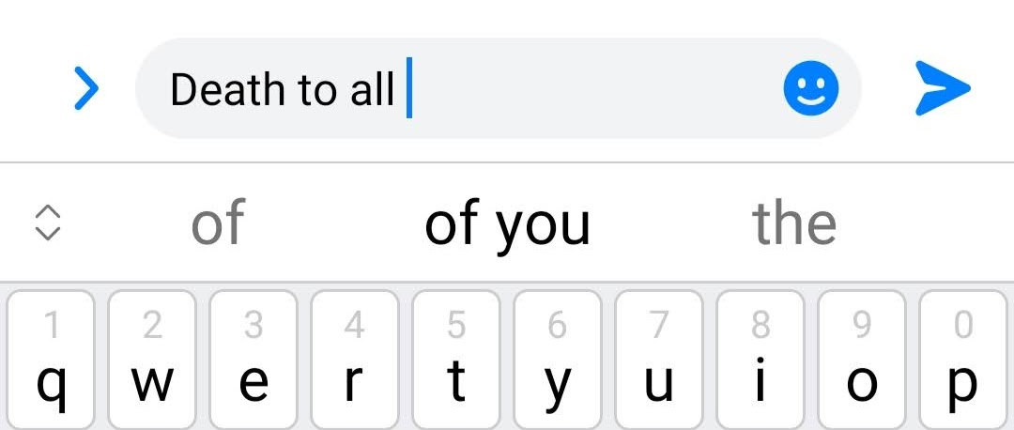
Natural language processing and Language Models
Text prediction by language models. They compute probability distribution over sequences of words.
Applications:
Chatbots
Text prediction
Autocorrection
Text generation
Translation
Notes:
Language models fall into the category of NLP. NLP is a field of AI that helps machines understand language
An example of how language suggestions can go wrong.
This brings me to the next point that touches on the core issue of toxic content in ML

Slide 13
Fundamental issue with language model toxicity
Language models perform best when
trained on real-world human data.
Real-world human data is often toxic.

Slide 14
But autocorrection and NWP aren‘t that important, right?
Notes:
Disclamer about autocorrecton and text prediction. It matters a lot more outside balkan. Some languages need it.

Slide 15
Tackling Offensive Content in NLP
Addressing toxicity before training (data filtering)
Addressing toxicity during training
Addressing toxicity during inference (filtering, greylisting)

Slide 16
Greylisting
A set of offensive words, stored locally on the device.
Allows users to type offensive words without correction.
Can employ “mermber of a set” data structures such as bloom filters
to avoid storing profanities in pure text.
Notes:
I bet you all remember the screenshots of iPhone fails.
They were early beginnings, early efforts of tackling offensive content.
All keyboards contain greylists - some use bloom filters.

Slide 17
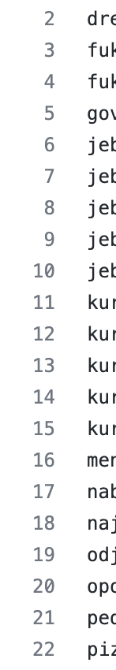
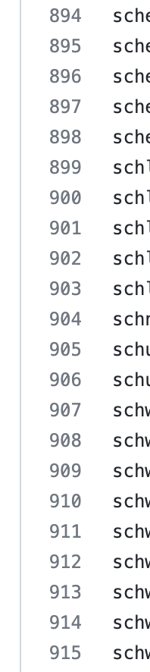

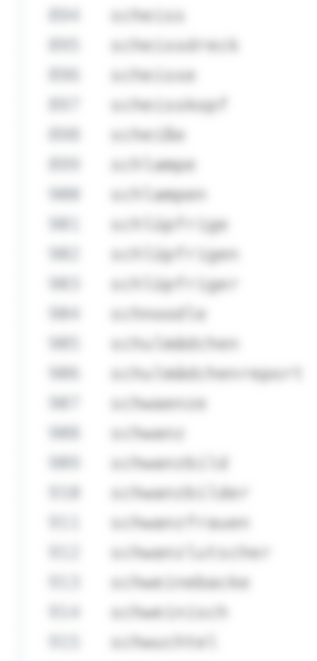

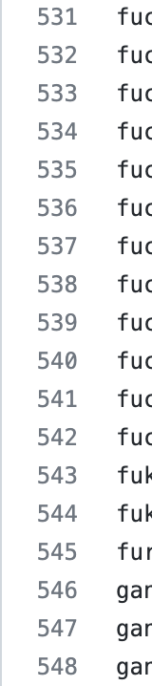
Naive approach: unigram filtering

Slide 18
N-gram filtering
Comopsing lists of offensive sequences of words.
Non-offensive words can form an offensive message given a particular context.
Problem: curse of dimensionality
Notes:
An improvement to filtering unigrams (single words) can be to filter out sequences of words. bigrams, trigrams, ...
white - trash
Problem: imagine slovene
Number of possible n-grams grows exponentially. You are limited in arity/context size.
This is solved by neural models.

Slide 19
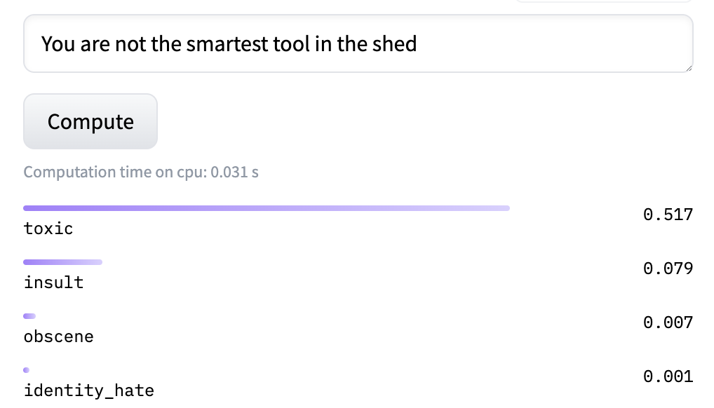
State-of-the-art: Transformer-based solutions
A Transformer-based natural language processing model capable of predicting and classifying toxicity of given text
Limited by size
Notes:
The current state of the art.
Transformer models are used for translation, text generation, image generation, summarisation
They can be retrained to perform any task: including toxicity detecton.
Measures 4 categories
Can detect self depreciation. If you say: I'm an idiot
Unfortunately, the explanation of how transformers work goes beyond this presentation. But we will learn how to use it in practice

Slide 20
Multilingual Support
Pre-trained Transformer models only exist for high-resource languages.
Popular datasets: OLID, JigSaw Multilingual Toxic Comment
Transformer deep-learning-based training requires an abundance of data.
Naive approach: translation-based toxicity filtering
Notes:
You can train custom models for low-resource languages, but it is not fool proof./
It's not fool proof. It's a work in progress. Creating something creates a feedback loop.
And with work in progres....

Slide 21
Hands-on exercise
Measuring toxicity of NTK 2022 talk descriptions

Slide 22
Final Thoughts
Notes:
I hope you learned something about this nieche, specific topic, that nevertheless plays in a huge role in the ever-increasing world of AI and machine learning.

Slide 23
QUESTIONS

Slide 24

Thank You!

Slide 25
This is not school, but we
love to get grades.
Please fill out our
questoineers and leave
us your feedback.
You may even win some
cool rewards.

