Slide 2
SharePoint Subscription Edition
Robi Vončina

Slide 3
Agenda
Looking back
What could be better
Goals for vNext
What‘s new
What‘s gone
Prerequisites
Upgrade methods
Design Goals for 2019 Upgrades
Modernization
Farm Upgrade Overview
  Planning
  Preparing
  Executing
  Finishing
Tools, Tips and Tricks

Slide 4
Looking back at SP2019/2016
What went well
On-premise inherits SPO features
Modernized end user experience (kind of)
Reliable syncing with OneDrive Sync app

Slide 5
What could be better
To hard to stay current with on-prem version
On-prem-only experiences not prioritized

Slide 6
Goals for vNext
Get current and stay current
Focus on unique on-prem needs
Evergreen
Lower TCO
Usabitility
Cloud enablement

Slide 7
Evergreen
Continous update model
  No major releases after vNext
  Features and functionality delivered via monthly updates
  No version to version upgrades
  Split on-prem base code from SPO
Dependancy management
  Legacy code removed
  Manage remaining dependecies
Feature Updates
Latest 23H2 – September CU

Slide 8
Lower cost of Ownership
N-2 upgrades
Full administration in PowerShell
Faster and cheaper storage
Modern security
  Windows Server Core
  SSL cert management
  TLS 1.3 support

Slide 9
Usability
Collaboration
  Modern UX for document sets
  Better rich video support
  Refresh modern UX in vNext
Improve anonymous in modern UX
Document thumbnails

Slide 10
Cloud Enablement
Integration of PowerApps and PowerAutomate
Newer version of SPFx
Hybrid web parts
OpenIDConnect
BCS support for Odata 4.0

Slide 11
What‘s new

Slide 12
OS Support
Windows Server 2022
Windows Server 2019
Windows Server Core

Slide 13
New and improved
  Web templates
  Modern teams sites → STS#3
  Communication sites → SITEPAGEPUBLISHING#0
  OneDrive personal site → SPSPERS#10
  Fast site creation
  Modern lists and libraries
Large file support
  Increased from 10GB to 15GB (same as 2019 version)
Modern search experience
  Retrieves list content as well

Slide 14
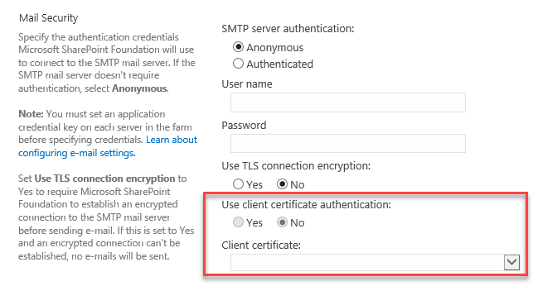
New and improved - SMTP
SMTP Connection encryption and SMTP ports
SMTP username and password
$CentralAdmin = Get-SPWebApplication -IncludeCentralAdministration | ? { $_.IsAdministrationWebApplication -eq $true }
$SmtpServer = "mail.dev.local"
$SmtpServerPort = 21
$FromAddress = "SP2019@dev.loc"
$ReplyToAddress = "robi@dev.loc"
$Credentials = Get-Credential
Set-SPWebApplication -Identity $CentralAdmin -SMTPServer $SmtpServer -SMTPServerPort $SmtpServerPort -OutgoingEmailAddress $FromAddress -ReplyToEmailAddress $ReplyToAddress #-SMTPCredentials $Credentials

Slide 15
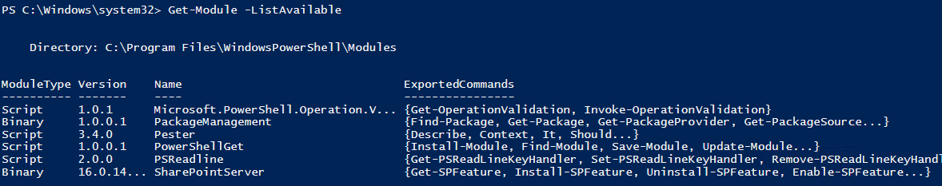
New and improved - PowerShell
No more PowerShell Snap-in
Loaded as module on demand
cmdlets will not be compatible with PowerShell Core 6.x or PowerShell 7.x

Slide 16
New and improved
Health rules
  People picker
  SMTP authentication
File path limit → 400 charachters
Recycle bin
  With edit permissions you can restore items that were deleted by other users
Sync files with OneDrive Sync client
  Deploy OD4B sync client
  https://docs.microsoft.com/en-us/onedrive/deploy-on-windows

Slide 17
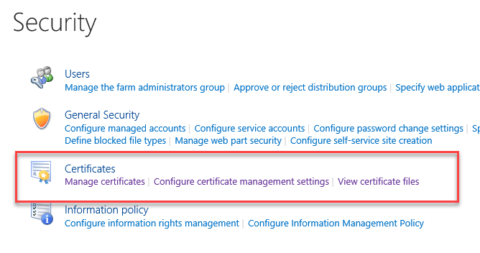
Security
Certificate management built in
TLS 1.3 by default with Windows Server 2022

Slide 18
Demo security
Certificate management

Slide 19
Still Not available
Hub sites
Site designs and site scripts

Slide 20
MIN role

Slide 21
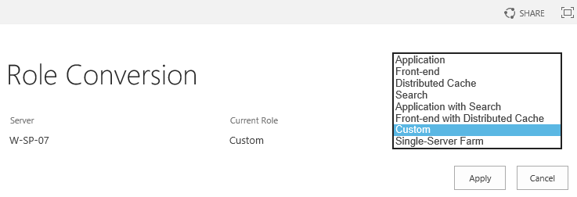
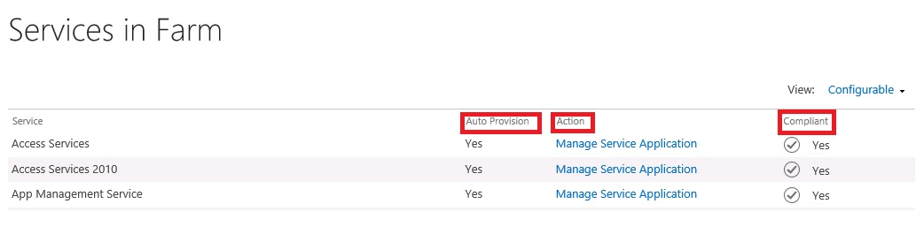
MIN Role overview
Installs only required services
Min role
  Web Front end
  DistributedCache
  Search
  Application server
  Custom
  Application with search
  Front-end with distributed cache
Compliance check

Slide 22
What‘s deprecated

Slide 23
What‘s deprecated
Definition „Deprecated“ vs „Removed“
Access services 2010 and 2013
Agregated newsfeed
InfoPath
  Support for InfoPath 2013 till 2026
Machine translations
PerformancePoint
  Silverlight dependency
  PowerBI as alternative
SharePoint Designer

Slide 24
What‘s gone

Slide 25
What‘s gone
Code based sandbox
PowerPivot Gallery and refresh
  PowerBI
Incoming email automatic mode
  Removing dependency on IIS 6
  Incoming email 2 options to configure, Foreign connector or SMTP smart host
Visio services
  Silverlight based rendering

Slide 26
Introduction

Slide 27
Server Prerequisites
HW
  16GB (it depends)
  4xCPU
Windows Server 2019 or Windows Server 2022
Windows Server Core is now supported
  .NET 4.6
SQL 2019 or newer
  Version that support db compatibility level 150
MAXDOP=1

Slide 28
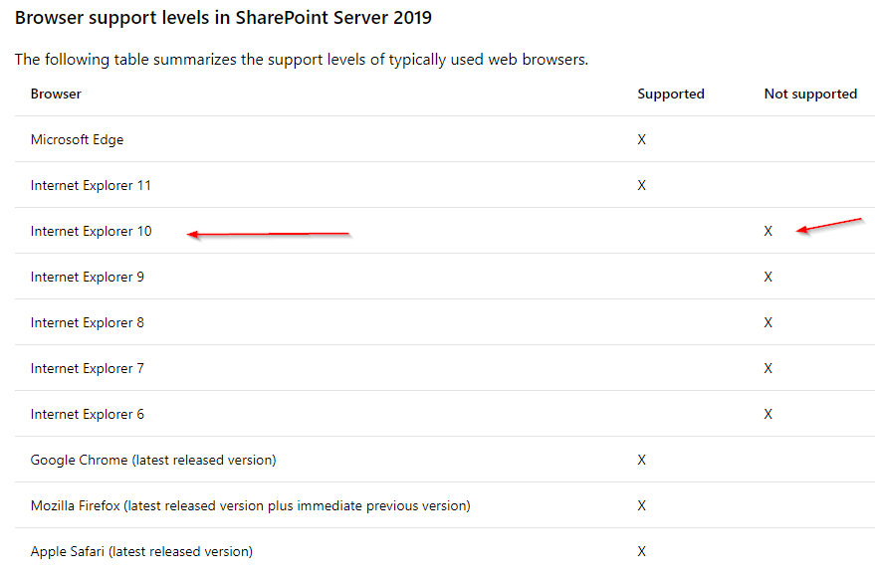
Client Minimum Software Requirements
Mobile browser support
Internet Explorer and Microsoft Edge on Windows Phone 8.1 or later.
Latest version of Chrome on Android 4.4 or later.
Latest versions of Safari and Chrome on iOS 8 or later.

Slide 29
Upgrade Methods
SharePoint Server 2022 supports an upgrade from a RTM version of SharePoint Server 2019 or SharePoint Server 2016.
N-2 upgrades now supported
Database Attach Upgrade
  Only available method for version to version (V2V) upgrades
  Works for both version to version (V2V) and build to build (B2B) upgrades
  Works for content and services databases
  Option to manually or automatically upgrade site collections
In-Place Farm Upgrade
  Only available for build to build (B2B) upgrades

Slide 30
Databases Supporting Database Attach Upgrade
Content databases
Project databases
Search admin database
Search analytics reporting
Profile database
Social database
Managed Metadata database
Secure Store database
  Note: Passphrase required to retain passwords in store

Slide 31
Databases Not Supporting Database Attach Upgrade
Configuration database
  Unsupported for both V2V and B2B upgrades
  Has never been supported in prior versions
Search index databases
  Unsupported for V2V upgrades only
Word automation
Machine translation

Slide 32
Authentication Mode Support & Upgrade
Windows Classic Support (Legacy)
Windows Claims Support
  Migration before upgrade recommended
Forms Auth Support
  No changes from 2010
  Ensure provider installed with same name before database attachment
Database to Web Application authentication mode mismatches
  Database attach in SP2022 detects mismatched auth support
  Test-SPContentDatabase in SP2022 also detects this
  Fix before attaching is best advice

Slide 33
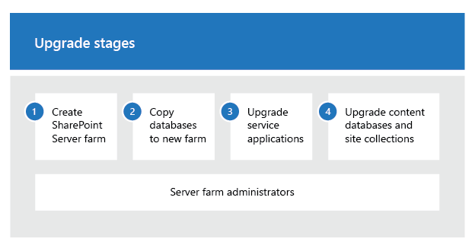
Upgrade process
Backup content db on a SP2016/2019 farm
  Claims
  Classic Windows Authentication on SP2016/2019
Restore content db on SQL for SP2022
Mount and Upgrade content db
Site collection upgrade*
  May be upgraded automatically

Slide 34
Demo
Create web app
Test, Mount SPContentdatabase

Slide 35
Miscellaneous Upgrade Items

Slide 36
Upgrade Log Improvements
ULS Logging
  TSV format with headers, easily imported into Excel
  Separate Site Collection level upgrade logs (SiteUpgrade_DateTime.log)
Correlation Ids
  Helps track specific upgrade sessions into ULS
  Also helpful tracking unique sessions from merged parallel upgrade logs
Error Codes
  Can help determine error cause/location/fix in debugging (Binging for answers)
  Some progress at RTM, more codes will follow
Categorization of Operations
  Better detail to track when entering/exiting sequences and actions
  Planned for future update

Slide 37
Maintenance Log
Gallery added during any upgrade
  Only added if it doesn’t exist
  Will add during both version to version and build to build upgrades
Contains site collection upgrade logs
  Only contains local site collection’s reduced logging level upgrade log
  Full site collection and database logs still on file system for farm admin access
Logging level is separate from file system upgrade logs
  Less detail than file system logs, not configurable

Slide 38
Farm Upgrade Overview

Slide 39
Planning Farm Upgrades
Learn about upgrade (how it works, what to plan for)
  Documentation/posters
  Training
  Try it out on a test environment
Gather data on existing farms (i.e. farm surveys)
  Collect all settings within the farm
  Get report on farm state including services, databases, and sites
  Collect all customizations with installation/configuration documents
  SPDocKit (www.spdockit.com)
  Get-SPFarmInfo
Plan business continuity
  Outage length planning and mitigation methods

Slide 40
Preparing Farm Upgrades
Remove orphaned items
  Customizations you can’t move forward (e.g. incompatible with SP SE)
Build-out new 2022 farm(s)
  If using federated services on different farms, target the services farm first
  If possible leave old farms running while upgrading to new ones (for outage reduction)
  Set farm CompatibilityRange as appropriate
  Install customizations onto new farm
    Ensure you install customizations for both 15 and 16 mode as appropriate

Slide 41
Executing Farm Upgrades
Backup everything
Upgrade services first
    Search Administration database
    Profile, Social, and Sync databases
    Managed Metadata/Taxonomy database
    Secure Store database
      Remember to have Secure Store passphrase or you will lose all existing passwords
Upgrade content databases
  Site collection upgrade part of database upgrade except if explicitly excluded
Mount-SPContentDatabase "SP2022_Content_Upgrade" -WebApplication http://2022portal -SkipSiteUpgrade
  Upgrade site collections at your leisure

Slide 42
Finishing Up Farm Upgrades
Confirm successful upgrade state
  Verify services and content rendering
  Fix issues if necessary
Re-index existing content
  Search Crawls
  !! Query string parameter: !!
  ?contents=1

Slide 43
Workflow manager??
2 Scenarios
1.Connect to existing WF manager farm
2.Set up new WF manager farm

Slide 44
Upgrade WF manager
2.Set up new WF manager farm
Restore:
Workflow Manager Instance DB
Workflow Manager Resource Manager DB
Service Bus Message Container DB
Service Bus Gateway DB
Reconnect SharePoint and run:
$credential = [System.Net.CredentialCache]::DefaultNetworkCredentials
$site = Get-SPSite <siteurl>
$proxy = Get-SPWorkflowServiceApplicationProxy
$svcAddress = $proxy.GetWorkflowServiceAddress($site)
Copy-SPActivitiesToWorkflowService -WorkflowServiceAddress $svcAddress -Credential $credential -Force $true

Slide 45
Post upgrade steps
Page modernization

Slide 46
Disable modern??
#Site Collection Level
Add-PSSnapin microsoft.sharepoint.powershell -ea 0
$site = Get-SPSite http://spwfe
#Disable modern Lists and libraies at the Site Collection Level
$site.Features.Add([guid]"E3540C7D-6BEA-403C-A224-1A12EAFEE4C4")
#Re-enable the moden expirence at the site collection Level.
$site.Features.Remove([guid]"E3540C7D-6BEA-403C-A224-1A12EAFEE4C4")

Slide 47
Post upgrade fixes
There is known issue with Search service application if upgrading from SharePoint 2013
  Usage analytics does not work
  Needed to be fixed. Contact me if you need help. I was told not to blog about it…
Some language pack have bugs with UI. We have several cases opened for UI bugs in Slovenian language

Slide 48
Tools, tips and tricks

Slide 49
Tools, tips and tricks
Feature admin
  SharePoint Feature Administration and Clean Up Tool - Home
  http://www.featureadmin.com/
SPDocKit
SharePoint Manager
Scripts
  www.Get-spscripts.com

Slide 50
Tools, tips and tricks

Slide 51
Izobraževanja
SharePoint Online Power User; 19.12 - 22.12.2023
SharePoint Online for Administrators, 27.11 - 29.11.2023

Slide 52
Questions?

Slide 53
Thank you
Questions?

Slide 54
This is not school, but we
love to get grades.
Please fill out our
questoineers and leave
us your feedback.
You may even win some
cool rewards.

