Slide 2

HOW IS AI TRANSFORMING THE
CUSTOMER-BASED BUSSINES:
HOSPITALITY USE-CASE
Božidara Cvetković, PhD
Data Science Team @Adacta

Slide 3

WHAT IS
CUSTOMER-BASED BUSINESS
Effective customer-based business does not only enhance customer service, but also changes the way how it thinks about its customers and their feedback
UNDERSTAND YOUR
CUSTOMER
PROVIDE VALUE
REWARD LOYALTY
Analyse their past behaviour, what the customer likes and dislikes. Segment your customers.
-
Efficient customer profile increases the success of any offer
Provide relevant information and services so the customer can make intelligent decisions.
-
Empower your customers to make the right decisions themselves
Identify loyal costumer and make them feel extra special.
-
Nothing works better than word of mouth publicity

Slide 4
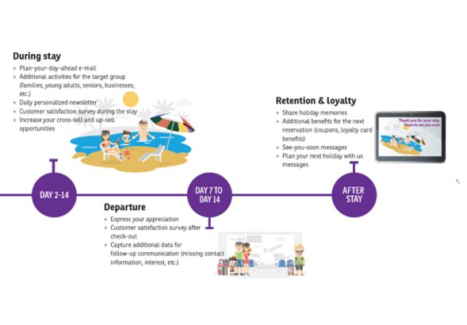
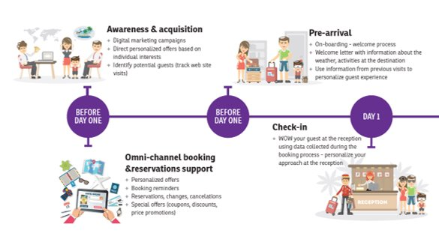
CUSTOMER-BASED BUSINESS
HOSPITALITY
HIGHLY COMPETITIVE BUSINESS
Accommodation arrangements are done in the palm of your hand which makes any destination easily reachable

Slide 5
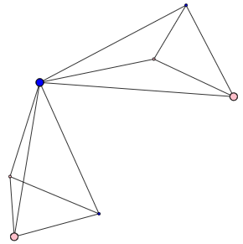
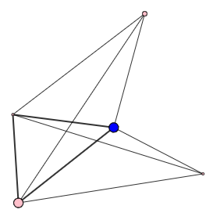
LEARN ABOUT OUR CUSTOMERS
Learn repetitive patterns
Segment your costumer (various dimensions)
Learn preferences (likes/dislikes)
Monitor real-time consumption
Detect (monitor) customers‘ feedback per service
@ RIGHT TIME
THROUGH RIGHT CHANNEL
PROVIDE RELEVANT INFORMATION
Booking reminder in time of reservation
  Time, location & property, personalised list of events, …
Timely events & service recommendations during stay
Environment recommendations (ambient)
System generated
Email, mobile app
On demand
Mobile app enhanced with a virtual assistant
Virtual assistant with audio interface
For business
CRM interface
Save customers time used for searching – Increase customer satisfaction with timely recommended services Avoid hard-sale impression by recommending relevant services – Engage the customer
Build loyal customers – Increase revenue
…

Slide 6
DATA-DRIVEN BUSINESS
HOW DO WE DO IT
DATA FUSION
Collect and fuse internal and external data sources
Historic customer-related data
Properties data
Destination data
Weather data
External events and services datasets
Social media and metadata from websites
IoT data
MACHINE LEARNING
Use state-of-the-art machine-learning algorithms for:
Prediction and anticipation models
Detection and recognition models
User profiling
Segmentation models
Recommendation systems
Decision support systems
Natural language processing
AUTOMATISATION
Use the machine-learning models for automated:
Marketing campaigns
Real-time customer insights
Offers with personalised services in real-time
Optimisation of events through season
Optimisation of capacities
Q&A through virtual assistant
Smart room and smart resort

Slide 7




DECISION SUPPORT SYSTEM
HOW DOES THE SYSTEM LOOK LIKE
CRM
CORE DATA
THIRD- PARTY DATA
Data fusion
Use in production
Evaluate
(Re)-Train
Prediction of the reservation and arrival time
Personalised marketing offers
Next best offer
Cross-sell and up-sell
Customer assistance
DSS

Slide 8
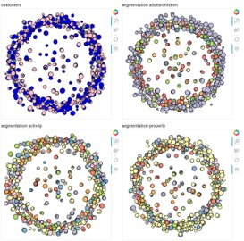
DRILL DOWN
DECISION SUPPORT SYSTEM
USER PROFILER
RECOMMENDER SYSTEM
Expert
knowledge
Segments, historic data,
third-party data
Customer ID
Events, services, next best offer, up-sell/cross-sell recommendations
OFFLINE RECOMMENDER
ONLINE RECOMMENDER
Bulids rich user profile
Generates marketing strategy and schedule
Detects the need for interaction
Generates strategy and interacts with a user

Slide 9

USE
CASE

Slide 10
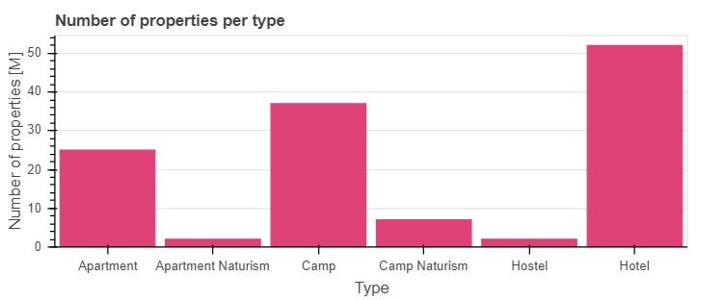
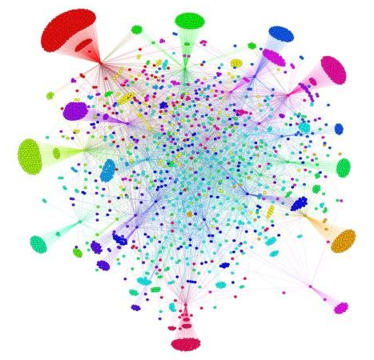
LARGE HOTEL-CHAIN DATASET
HOSPITALITY
DATASET
Large hotel-chain with more then 100 properties
  6 types of properties
  9 locations
1milion average number of stays per year
GOALS
Develop an AI enhanced tool for hospitality employees to:
  Better understand their guest (online and offline)
  Identify who are the „Best“ customers
  Generate automatic personalised marketing campaigns and increase revenue
Develop an AI enhanced tool for customers to:
  Improve the experience by assisting the customer throughout the journey

Slide 11
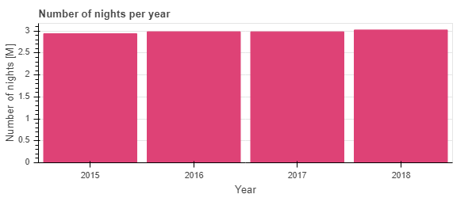
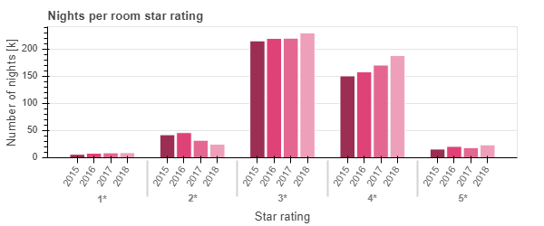
LARGE HOTEL-CHAIN DATASET
HOSPITALITY
Data insights – number of stays

Slide 12
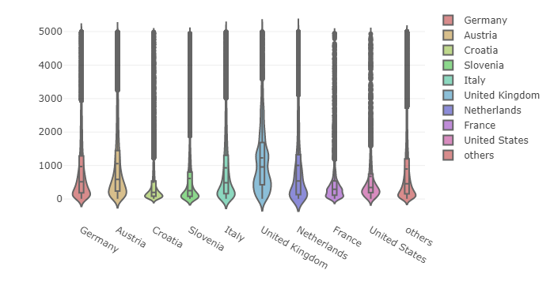
LARGE HOTEL-CHAIN DATASET
HOSPITALITY
Data insights – revenue per customer per country

Slide 13
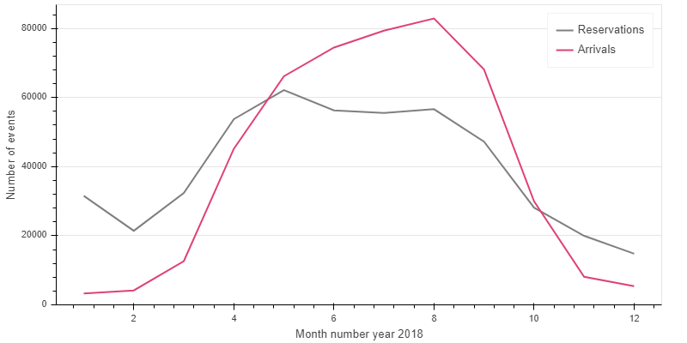
LARGE HOTEL-CHAIN DATASET
HOSPITALITY
Data insights – reservation and arrival dates

Slide 14
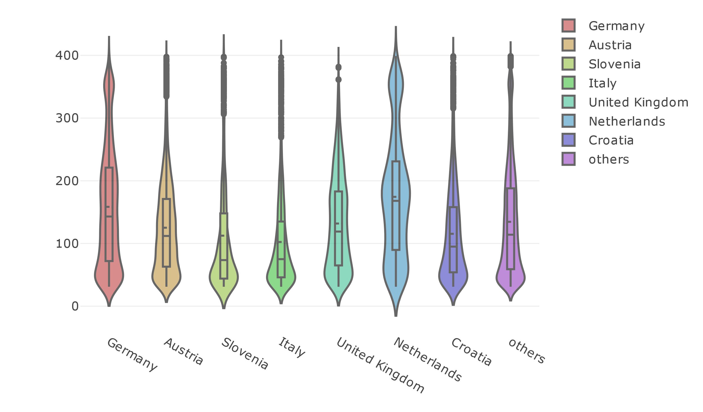
LARGE HOTEL-CHAIN DATASET
HOSPITALITY
Data insights – difference between reservation and arrival time

Slide 15

MODULE
NEXT STAY PREDICTION
GOAL
For each individual customer estimate:
  The time of check-in and duration of the stay
  The usual time of reservation / channel of reservation
RESULTS
Campaign conversion rate growth
DATA REQUIREMENTS
Demographic data (to model a basic user profile)
Historical data per customer (reservation, check-in and check-out dates)
RESERVATION INTERVAL
STAY INTERVAL

Slide 16
MODULE
NEXT STAY PREDICTION
PROCEDURE
Predict arrival month and use it as a feature for prediction of reservation month
Features: country, historic arrival and reservation months, number of stays per year
Algorithm: Random Forest
RESULTS
Training dataset: data from 2015 to 2017
Test dataset: year 2018
Accuracy: timely sent marketing materials for 90% of customers
RESERVATION INTERVAL
STAY INTERVAL

Slide 17
USER PROFILING
SEGMENTATION
Large hotel-chain business dataset
Utilise historical data (and real-time) of customer interaction with a company for advanced segmentation and customer profiling
Segmentation is done over various parameters (interest, budget, social, property, etc.)
Intelligent fusion of fine-grained segments constructs the customers‘ profile
HOSPITALITY SPECIFICS
Social component
  Customers can come as individuals or in groups
  Customers company varies
  The interests may frequently change
Personalised
Recommendations
Improve targeted
Marketing
&
Increase customer
satisfaction

Slide 18
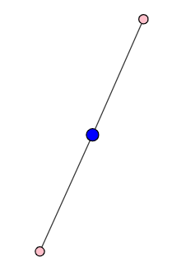
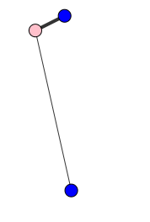
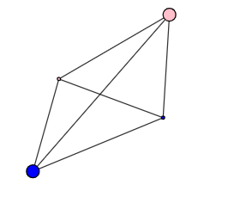
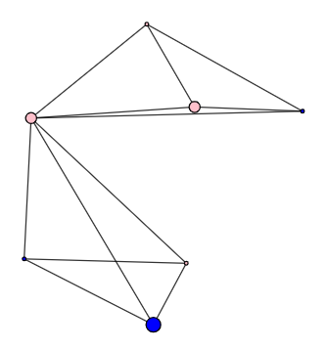
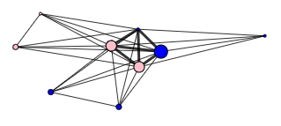
USER PROFILING
SEGMENTATION
Large hotel-chain business dataset
Utilise historical data (and real-time) of customer interaction with a company for advanced segmentation and customer profiling
Segmentation is done over various parameters (interest, budget, social, property, etc.)
Intelligent fusion of fine-grained segments constructs the customers‘ profile
HOSPITALITY SPECIFICS
Social component
  Customers can come as individuals or in groups
  Customers company may vary
  The interests may frequently change
ML APPROACH
  The customers are modelled as a network and their historic data clustered and interpreted using ML

Slide 19
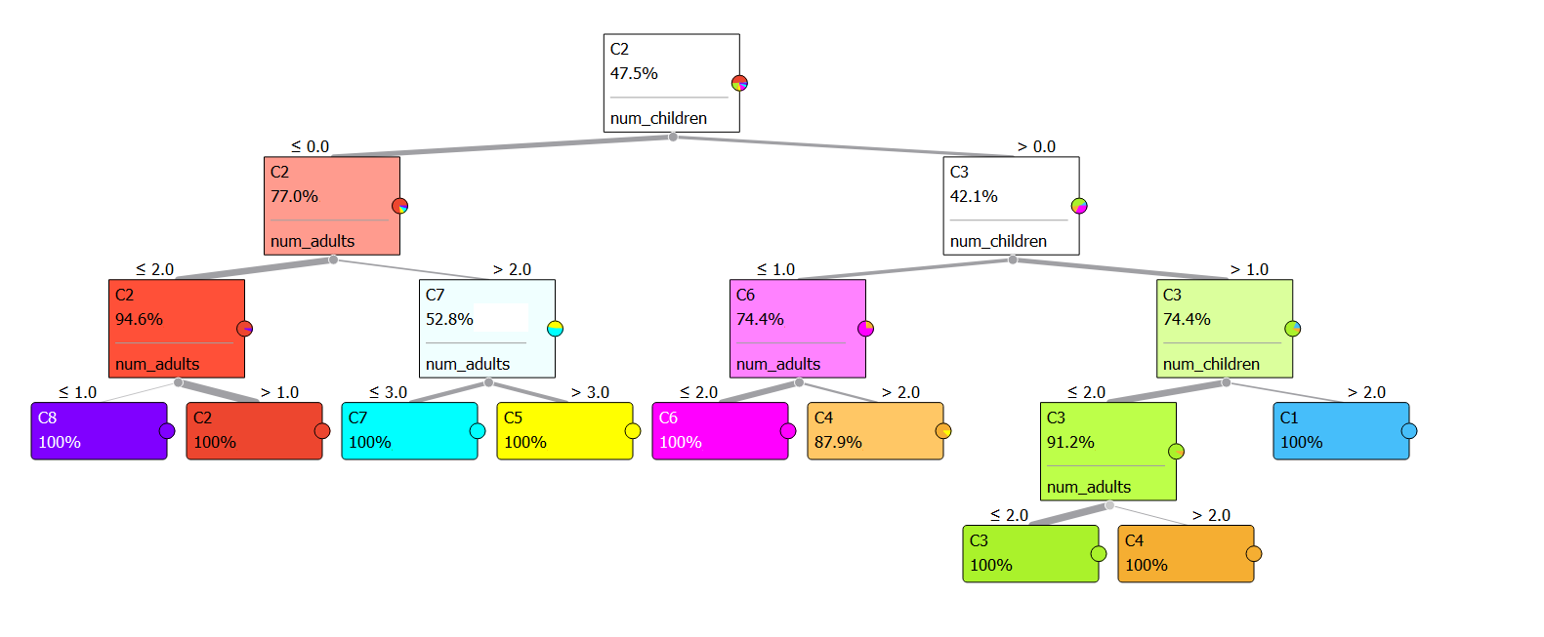
USER PROFILING
SEGMENTATION
Social-component
Historic data of the customers‘ stays and companions
Procedure: Feature selection → PCA → Clustering → Decision tree for interpretation
C8: no children, 1 adult → singles
C2: no children, 2 adults → couples/friends
C7: no children, 3 adults → small group of friends
C5: no children, more then 3 adults → larger group of friends
C6: single child, not more then 2 adults → family with a child
C4: up to two children, more then 2 adults → family & friends with a child/children
C3: two children, two adults → family with children
C1: more children → family & friends with children

Slide 20
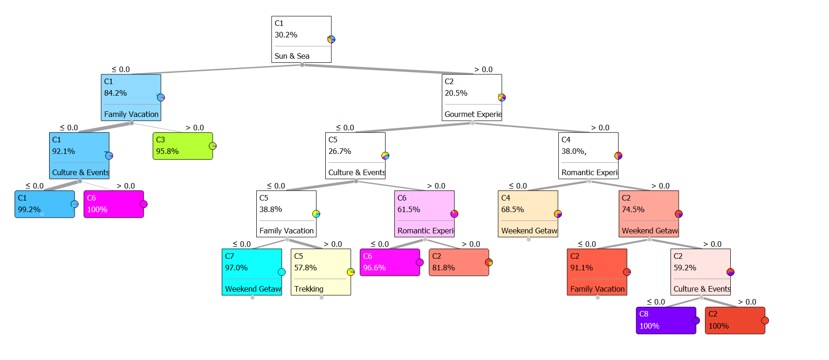
USER PROFILING
SEGMENTATION
Interests component
Historic data of the customers‘ stays, activities & purchases
Procedure: Feature selection → PCA → Clustering → Decision tree for interpretation
C1: no preferences
C3: family vacation
C6: culture & event & sun & sea
C7: sun & sea & weekend getaway
C5: sun & sea & sports (tennis, cycling, trekking, diving)
C2: sun & sea & culture & romantic (& family & gourmet)
C4: sun & sea gourmet & weekend getaway
C8: sun & sea & romantic & family & gourmet

Slide 21
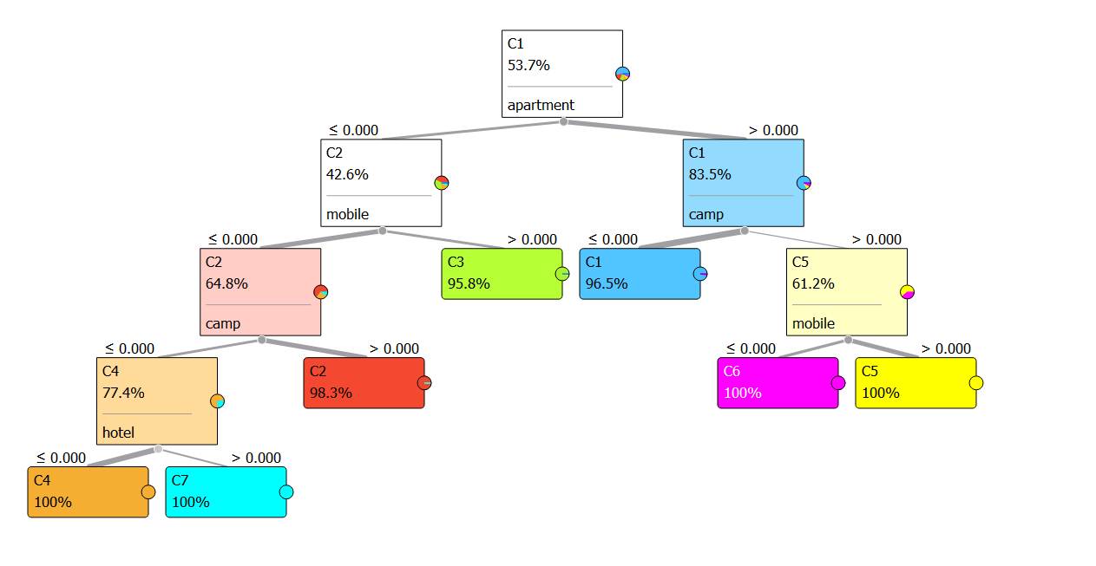
USER PROFILING
SEGMENTATION
Property component
Historic data of the customers‘ stays
Procedure: Feature selection → PCA → Clustering → Decision tree for interpretation
C4: no preferences
C7: hotel
C2: camp
C3: mobile house
C1: apartments
C6: apartments & camp & no mobile
C5: apartments & camp & mobile

Slide 22
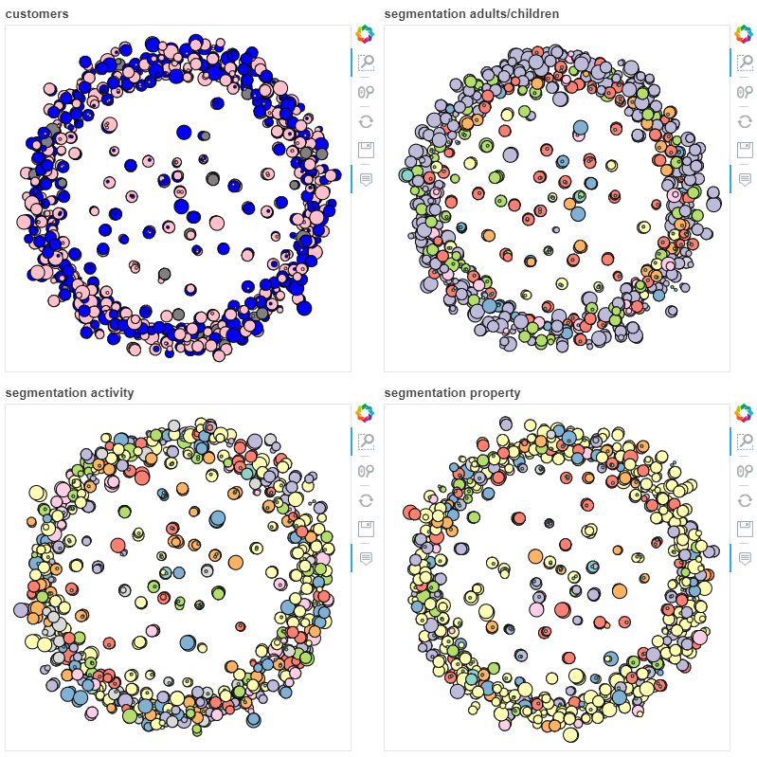
USER PROFILING
SEGMENTATION
Module

Slide 23
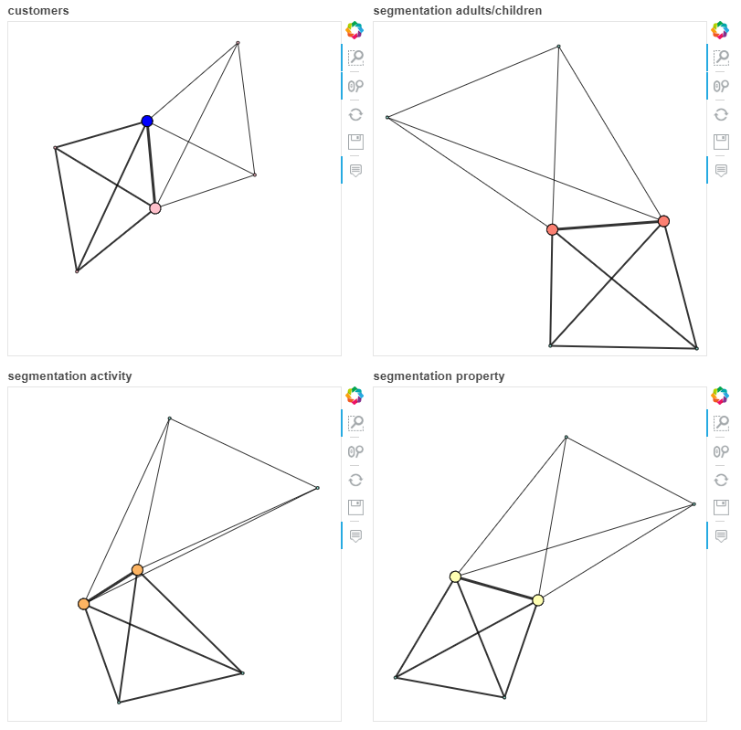
USER PROFILING
SEGMENTATION
Module
Social: C3 – 2 adults & 2 children
Interest: C5 – sun & sea & sports
Property: C1 - apartments
Input for the recommendation system
Offline
Online

Slide 24
RECOMMENDATIONS
RECOMMENDATION SYSTEM
COLLABORATIVE FILTERING
Similar customers will like similar services (e.g., find similar customers and use their rates to calculate the final rate)
CONTENT-BASED
Customer will like similar services (e.g., if person liked local food event, then he/she may also other food events)
EXPERT KNOWLEDGE
Expert experience (e.g., people from certain country like specific services)
 |  | Services |  |  |  |  |  |  |  |  |  | Segments
 |  | 1 | 2 | 3 | 4 | 5 | 6 | 7 | 8 | Age | Country | S1 | S2
Person | A | 3 | ? | ? | 2 | 5 | ? | ? | ? | 32 | UK | C4 | C2
 | B | ? | ? | ? | ? | 5 | 3 | 5 | ? | 45 | Germany | C3 | C3
 | C | ? | 1 | 5 | ? | 1 | ? | ? | 5 | 34 | Slovenia | C3 | C4
 | D | 4 | 1 | ? | ? | ? | ? | ? | 4 | 20 | Croatia | C1 | C5

Slide 25
RECOMMENDATIONS
RECOMMENDATION SYSTEM
Hybrid recommendation system: collaborative filtering + content based filtering + expert knowledge
Data: customers preferences, customers segments and historic ratings or purchases (per service)
Personalised recommendations for services (products)
Recommend services (products) that are usually bought together – association rules
+
+
Expert
knowledge
= rating
$α∗Collaborative_{rate}+β∗Content_{rate}$ + $γ∗Expert_{rate}=rate$

Slide 26
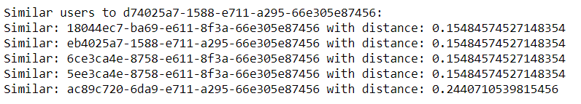
RECOMMENDATIONS
RECOMMENDATION SYSTEM
+
+
Expert
knowledge
= rating
$α∗Collaborative_{rate}+β∗Content_{rate}$ + $γ∗Expert_{rate}=rate$

Slide 27
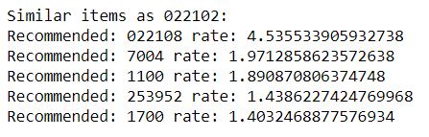
RECOMMENDATIONS
RECOMMENDATION SYSTEM
+
+
Expert
knowledge
= rating
$α∗Collaborative_{rate}+β∗Content_{rate}$ + $γ∗Expert_{rate}=rate$

Slide 28
RECOMMENDATIONS
RECOMMENDATION SYSTEM
+
+
Expert
knowledge
= rating -> 0.75
$α∗Collaborative_{rate}+β∗Content_{rate}$ + $γ∗Expert_{rate}=rate$

Slide 29
CONCLUSION
We have presented intelligent modules composing the decision support system in hospitality
The segmentation utilising ML methods generate more detailed segments; combined with network analysis gives instant past behaviour explanation of the customer
WHAT‘S NEXT
The presented segmentations and recommendations are being piloted this season (from 1.6. 2019)
Full system (automatic marketing) with additional segmentation and other enhancements is planned to go-live by the end of 2019

