Slide 1
SQL Server 2012-2017
Columnar Storage
Dejan Sarka

Slide 2
Module Overview
Analytical queries problems
Columnstore indices
Batch processing
Other BI features
  Bitmap filtered hash joins
  Table partitioning
  Filtered indexes and indexed views
  Data compression
  Window functions

Slide 3
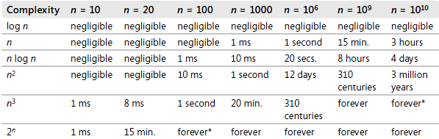
Algorithms Complexity
Forever* = about 40 billion billion years!

Slide 4
RDBMS Joins
Merge: complexity ~ O(n)
  Needs sorted inputs, equijoin
Hash: complexity ~ O(n) / ~O(n²)
  Needs equijoin
  Good parallelization possible
Nested Loops: complexity ~ O(n) (indexed), ~ O(n²) (not indexed)
  Works always, can become quadratic
Non-equijoins are frequently quadratic
  E.g., running totals

Slide 5
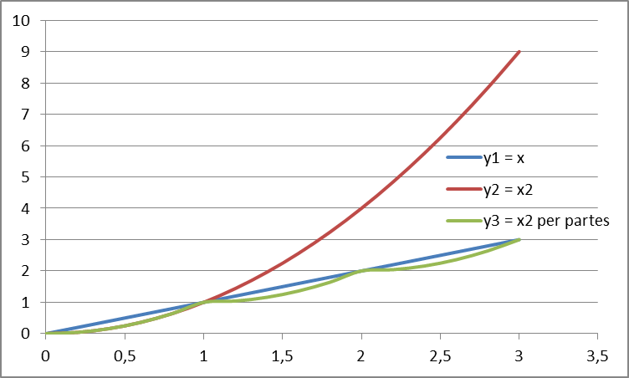
Linearize Joins
x | y₁ = x | y₂ = x² | y₃ = x² per partes
0 | 0 | 0 | 0
0,2 | 0,2 | 0,04 | 0,04
0,4 | 0,4 | 0,16 | 0,16
0,6 | 0,6 | 0,36 | 0,36
0,8 | 0,8 | 0,64 | 0,64
1 | 1 | 1 | 1
1,2 | 1,2 | 1,44 | 1,04
1,4 | 1,4 | 1,96 | 1,16
1,6 | 1,6 | 2,56 | 1,36
1,8 | 1,8 | 3,24 | 1,64
2 | 2 | 4 | 2
2,2 | 2,2 | 4,84 | 2,04
2,4 | 2,4 | 5,76 | 2,16
2,6 | 2,6 | 6,76 | 2,36
2,8 | 2,8 | 7,84 | 2,64
3 | 3 | 9 | 3

Slide 6
Bitmap Filtered Star Join
Optimized bitmap filtering for star schema joins
  Bitmap representation of a set of values from a dimension table to pre-filter rows to join from a fact table
  Enables filtering rows early in the plan, allowing subsequent operators to operate on fewer rows
  Introduced with SQL Server 2008

Slide 7
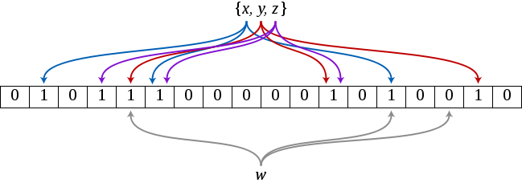
Bloom Filter
To test whether and element it is in the set, feed it to each of the k hash functions to get k array positions
  If any of the bits at these positions are 0, the element is not in the set
  If all are 1, then either the element is in the set, or the bits have been set to 1 during the insertion of other elements

Slide 8
Data Compression
Pre-SQL 2005: variable-length data types
SQL 2005: vardecimal data type
SQL 2008
  Row compression - fixed-width data type values stored in variable format
  Page compression
SQL 2008 R2
  Unicode compression
Might be useful in OLTP scenarios as well
  Take care about the update overhead

Slide 9
Page Compression
Page Header
aaabb | aaaab | abcd
aaabcc | bbbb | abcd
aaaccc | aaaacc | bbbb
Prefix (value) compression
Page Header
aaabcc | aaaacc | abcd
4b | 4b | [empty]
[empty] | 0bbbb | [empty]
3ccc | [empty] | 0bbbb
Page Header
aaabcc | aaaacc | abcd
4b | 0bbbb
0 | 0 | [empty]
[empty] | 1 | [empty]
3ccc | [empty] | 1
Dictionary compression

Slide 10
Unicode Compression
Works on nchar(n) and nvarchar(n)
Automatically with row or page compression
Savings depends on language
  Up to 50% in English, German
  Only 15% in Japanese
Very low performance penalty

Slide 11
LZ77 Compression
Input stream
Position 1 2 3 4 5 6 7 8 9
Byte A A B C B B A B C
Step | Position | Match | Byte | Output
1. | 1 | ~ | A | (0, 0) A
2. | 2 | A | ~ | (1, 1)
3. | 3 | ~ | B | (0, 0) B
4. | 4 | A | C | (0, 0) C
5. | 5 | B | ~ | (2, 1)
6. | 6 | B | ~ | (1, 1)
7. | 7 | A B C | ~ | (5, 3)

Slide 12
Trans-Relational Model
Not “beyond” relational
  Transformation between logical and physical layer
Steve Tarin, Required Technologies Inc. (1999)
All columns stored in sorted order
  All joins become merge joins
  Can condense storage
  Of course, updates suffer
Logically, this is a pure relational model
SQL Server uses own variant
  Order of columns not preserved – optimized for compression
  Leverages parallel hash joins rather than merge joins

Slide 13
Columnar Storage (1)
Row / Col | 1 | 2 | 3
 | Name | Color | City
1 | Nut | Red | London
2 | Bolt | Green | Paris
3 | Screw | Blue | Oslo
4 | Screw | Red | London
5 | Cam | Blue | Paris
6 | Cog | Red | London
Row / Col | 1 | 2 | 3
 | Name | Color | City
1 | Bolt | Blue | London
2 | Cam | Blue | London
3 | Cog | Green | London
4 | Nut | Red | Oslo
5 | Screw | Red | Paris
6 | Screw | Red | Paris

Slide 14
Columnar Storage (2)
Row / Col | 1 | 2 | 3
 | Name | Color | City
1 | Bolt | Blue | London
2 | Cam | Blue | London
3 | Cog | Green | London
4 | Nut | Red | Oslo
5 | Screw | Red | Paris
6 | Screw | Red | Paris
Row / Col | 1 | 2 | 3
 | Name | Color | City
1 | Bolt [1:1] | Blue [1:2] | London [1:3]
2 | Cam [2:2] | Green [3:3] | Oslo [4:4]
3 | Cog [3:3] | Red [4:6] | Paris [5:6]
4 | Nut [4:4]
5 | Screw [5:6]
6

Slide 15
Row Reconstruction Table
Row / Col | 1 | 2 | 3
 | Name | Color | City
1 | 3 | 6 | 4
2 | 1 | 4 | 6
3 | 6 | 5 | 3
4 | 4 | 1 | 5
5 | 2 | 2 | 1
6 | 5 | 3 | 2
Row / Col | 1 | 2 | 3
 | Name | Color | City
1 | Bolt [1:1] | Blue [1:2] | London [1:3]
2 | Cam [2:2] | Green [3:3] | Oslo [4:4]
3 | Cog [3:3] | Red [4:6] | Paris [5:6]
4 | Nut [4:4]
5 | Screw [5:6]
6

Slide 16
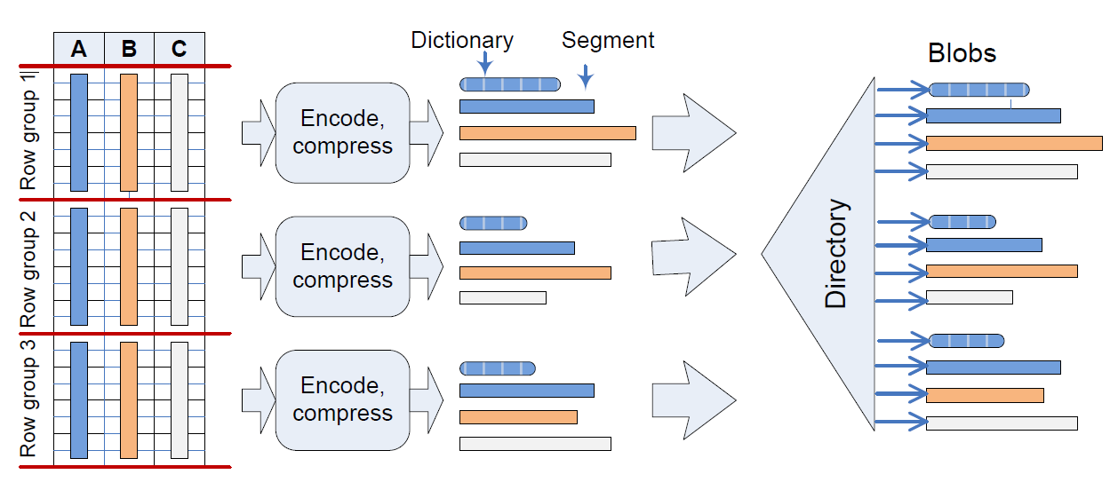
Columnstore Indexes
Row groups (about 1,000,000) converted to segments of columns

Slide 17
Columnstore Compression (1)
Bit-Packing – use min number of bits for a value
Encoding values to 32-bit or 64-bit integer
  Value-based (prefix) encoding
  Dictionary-based encoding
  The more cases included in building a dictionary, the better compression
Run-Length Encoding (RLE)
  Optimal row ordering for RLE with VertiPaq™ algorithm to rearrange rows
  Not absolute sorting
  Leverages Bloom filters and parallel hash joins

Slide 18
Columnstore Compression (2)
Two forms of dictionaries
  A global dictionary associated with the entire column
  A local dictionary associated with a row group
SQL 2012 fills in the entries in the global dictionary as it builds the index
SQL 2014 builds the index in two steps
  Sample the data for each column and pick the values to include in the global dictionary
  Build the index using the global dictionary

Slide 19
Columnstore Compression (3)
SQL Server 2014 adds Archival Compression
  LZ77 algorithm, 64KB sliding window
  Implemented on table or partition level
Two different samplings in SQL 2014
  Cluster sampling: a set of row groups is first randomly selected, followed by a random sample of rows within each group – for dictionary creation
  Random row sampling – histograms for query optimization

Slide 20
Reduced I/O
SELECT region,
SUM (sales) …
Fetches only needed columns from disk
Columns are compressed
Less IO
Better buffer hit rates
C2
C3
C1
C4
C5
C6

Slide 21
Reading Segments
Column segment contains values from one column for a set of about 1M rows
Column segment is unit of transfer from disk
Storage engine can eliminate segments early in the process
  Because of additional column segment metadata
C1
C2
C3
C4
C5
C6
Set of about 1M rows
Column Segment

Slide 22
SQL Server 2012 NCCI
Columnstore index:
  Nonclustered
  One per table
  Must be partition-aligned
  Table becomes read-only (partition switching allowed)
Unsupported types
  Decimal > 18 digits
  Binary, Image, CLR (including Spatial, HierarchyId)
  (n)varchar(max), XML, Text, Ntext
  Uniqueidentifier, Rowversion, SQL_Variant
  Date/time types > 8 bytes

Slide 23
SQL Server 2014 CCI
Clustered Columnstore Index (CCI)
  No heap or balanced tree table
Must be able to identify each row
  Bookmark – unique tuple id within a row group – simple sequence number
The CCI is fully updatable
  Delete bitmap
  Delta store

Slide 24
SQL Server 2014 NCCI and CCI
Unsupported data types
  Varbinary(MAX), Image, CLR (including Spatial, HierarchyId)
  (N)Varchar(max), XML, Text, Ntext
  Rowversion, SQL_Variant
Memory-optimized index build
  Multi-threaded, each thread needs enough memory for a full row group, estimated in advance
  In SQL 2012, DOP is static
  SQL 2014 checks the memory while building and dynamically calculates optimal number of threads

Slide 25
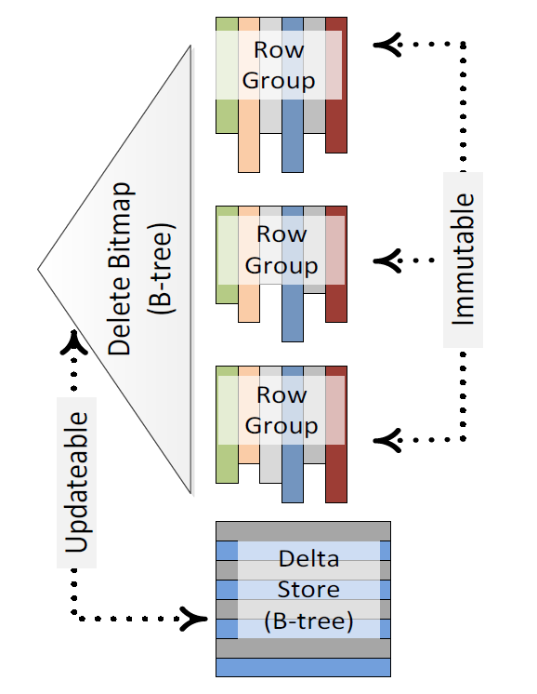
CCI Updates (1)
Insert: The new rows are inserted into a delta store
Delete: If the row to be deleted is in a column store row group, a record containing its row ID is inserted into the B-tree storing the delete bitmap; if it is in a delta store, the row is simply deleted
Update: Split into a delete and an insert
Merge: Split into a delete, an insert and an update

Slide 26
CCI Updates (2)
A delta store is either open or closed
  Closed after 1M rows
Tuple Mover converts closed delta stores to column segments
  Background process, starts every 5 min
  Run manually with ALTER INDEX … REORGANIZE
Non-bulk (trickle) inserts go to an open delta store
Bulk inserts up to 100K rows go to an open delta store, and larger than 100K go directly to column segments
More delta stores mean less compression
  Use ~1M bulk insert batches
  Rebuild index occasionally

Slide 27
SQL Server 2016 CCI and NCCI
CCI supports additional NCI (B-tree) indexes
  NCI indexes can be filtered
CCI supports through NCIs primary and foreign key constraints
CCI supports snapshot and read committed snapshot isolation levels
NCCI on a heap or B-tree updateable and filtered
Columnstore indices on in-memory tables
  Defined when you create the table
  Must include all columns and all rows (not filtered)

Slide 28
SQL Server 2017 Columnstore
Online non-clustered columnstore index build and rebuild support added
Database Tuning Advisor (DTA) supports recommendations of columnstore indexes
Clustered columnstore indexes support LOB columns (nvarchar(max), varchar(max), varbinary(max))

Slide 29
SQL 2016 Operational Analytics
NCI
Filtered NCI
Row table
Updateable NCCI
Warm data
Hot

Slide 30
SQL 2016 In-Memory Analytics
Range index
Hash index
Row table
Updateable NCCI
Warm data
Hot

Slide 31
Reducing CPU Usage
Columnstore indexes reduce disk IO
Bitmap-filtered hash joins can be executed in parallel
Problem: CPU becomes a bottleneck
Solution: reduce CPU usage by processing large numbers of rows
  Iterators that do not process row-at-a-time
  Process batch-at-a-time

Slide 32
Batch Processing
Orthogonal to columnstore indices
  Can support other storage
However, best results with columnstore indices
  Sometimes can perform batch operations directly on compressed data
Can mix batch and row operators
  Can dynamically switch from batch to row mode
Batch ~1,000 rows

Slide 33
Batch Operators in SQL 2012
The following operators support batch mode processing in SQL Server 2012:
  Filter
  Project
  Scan
  Local hash (partial) aggregation
  Hash inner join
  Batch hash table build
  No spilling
  Bitmap filters limited to a single column, data types represented with a 64-bit integer

Slide 34
Batch Operators in SQL 2014
Batch processing supported also for:
  All join types
  Union All
  Scalar aggregation
  Spilling support
  Complex Bloom filters, all data types supported
  However, they can be pushed down to the storage engine only for previously supported data types, unless all key columns are integer

Slide 35
Batch Operators in SQL 2016
Batch processing improvements:
  Single-threaded queries
  Sort operator
  Multiple distinct count operations
  Left anti-semi join operators
  Window aggregate functions
  Window analytical functions
  String predicate and aggregate pushdown to the storage engine
  Row-level locking on index seeks against a nonclustered index and rowgroup-level locking on full table scans against the columnstore

Slide 36
Batch Operators in SQL 2017
Batch mode adaptive joins
Batch mode memory grant feedback

Slide 37
CS 2012-2017 Summary
Columnstore Index Feature | SQL 2012 | SQL 2014 | SQL 2016 | SQL 2017
Batch execution for multi-threaded queries | yes | yes | yes | yes
Batch execution single-threaded queries |  |  | yes | yes
Batch mode adaptive joins |  |  |  | yes
Archival compression |  | yes | yes | yes
Snapshot isolation levels |  |  | yes | yes
Specify CI when creating a table |  |  | yes | yes
AlwaysOn supports CIs | yes | yes | yes | yes
AlwaysOn readable 2nd read-only NCCI | yes | yes | yes | yes
AlwaysOn readable 2nd updateable CIs |  |  | yes | yes
Read-only NCCI on heap or B-tree | yes | yes | yes | yes
Updateable NCCI on heap or B-tree |  |  | yes | yes
B-tree indexes together with a NCCI | yes | yes | yes | yes
Updateable CCI |  | yes | yes | yes
B-tree index on a CCI |  |  | yes | yes
CI on a memory-optimized table |  |  | yes | yes
Filtered NCCI |  |  | yes | yes
NCCI online build and rebuild |  |  |  | yes

