Slide 1
Do you PAW?
And why you should. And how to do it.
Jure Jereb, NIL d.o.o.

Slide 2
About
Jure Jereb, Cloud tech lead @ NIL
- jjereb@nil.com
- LinkedIN
Microsoft @ NIL:
- Microsoft Azure,
- Microsoft 365,
- Identity and Security
Security Operations Center (SOC)

Slide 3
PAWs - The WHAT?

Slide 4
Security basics
Up to date hardware and software inventory (Patching!)
Data encryption (Bitlocker)
Principle of Least Privilege („admin rights“)
Active Directory Tier model
Using PAW model
Allow-listing (AppLocker, WDAC)
MFA and strong authentication
Hardware / Phsyical control (USBs)
Usage of IPsec
*Based on The 18 CIS Critical Security Controls
https://www.cisecurity.org/controls/cis-controls-list
Notes:
The Center for Internet Security, Inc. (CIS®) is a community-driven nonprofit organisation, responsible for the CIS Controls® and CIS Benchmarks™, globally recognized best practices for securing IT systems and data. We lead a global community of IT professionals to continuously evolve these standards and provide products and services to proactively safeguard against emerging threats.
Allow-listing – better than deny-listing, better to allow what you need, than block everyhing that is bad.
MFA – good job so far… 2022 first year that the phishing is not the number one entry point for attackers. Its unpatched vulnerabilities now. Before, numbers said use MFA, now numbers say patch more and faster! :-)
IPsec – basically modern Microsegmentation, but instead on IP address level, on Identity level. Instead of limiting access based on „numbers“ - IP addresses, subnets, VLANs, limit access on „names“ - grops of users/computers
Source for stats: Truesec Threat Intelligence report. Fortinet report,…

Slide 5
PAW? PAWs? PAW model?
PAW = Privileged Access Workstation
  Security concept and practice used to enhance security by isolating and protecting sensitive administrative tasks and privileged accounts within an organization's network.
Security concept, not a fixed set of instructions
  There is no ultimate recipe for PAWs. The concept needs to be adapted to each individual environment.
Used to reduce the attack surface
  The device that can take down the company, should not be able to access facebook, youtube, dropbox… (internet -> malware, phishing).
Don‘t let the perfect be the enemy of good!
  Start slow, and keep things simple - whatever extra layer of security you manage to implement, makes your environment more secure than it was before, and harder to breach,
  You cannot stop attackers, but maybe you can slow them down just enough that they get caught.
Notes:
Test your environment with this example:
1. Go to receptionists PC
2. Lists DC servers: Net group „domain controllers“ /domain
3. Mstsc -> DC
4. You‘re F****

Slide 6
General „rules“ of PAW model
Dedicated Workstation: A PAW is a dedicated and separate computer or workstation used exclusively for performing privileged administrative tasks. It should not be used for regular day-to-day activities or general internet browsing.
Isolation: The PAW is isolated from the standard network and is often connected to a separate, highly controlled network segment. This isolation minimizes the risk of malware or malicious actors compromising the privileged workstation.
Secure Configuration: The PAW is configured with security best practices, including regular patching and hardening to reduce vulnerabilities.
Strict Access Control: Access to the PAW is restricted to authorized personnel who require elevated privileges for managing critical systems and security configurations. Multi-factor authentication (MFA) and strong access controls are often used.
Limited Software: Only essential software and tools needed for administrative tasks are installed on the PAW. Unnecessary software, especially internet-facing applications, are typically not allowed to reduce potential attack surfaces.
Regular Monitoring: PAWs are subject to continuous monitoring and auditing to detect any unusual or suspicious activities that could indicate a security breach.

Slide 7
Active Directory Tiering
Split Active Directory environment into (three) layers
Never allow higher layer administrators
to logon to lower layer devices
Not enough to have two accounts –
you have to prevent logins!
Notes:
There is no need to EVER login to servers with DA account!
If attacker gains access to DA account, its GAME OVER!

Slide 8
Active Directory Tiering
PAW(s)
T0 admins
T0
Identity
T1
Data
Member servers
T1 admins
T2 admins
T2
Access
Workstations

Slide 9
Maybe even more important than AD Tiering
PAW
(V)LAN1
Domain
Admins
Active
Directory
Domain
PAW
(V)LAN2
Fabric
Admins
Fabric
PAW
(V)LAN3
Bacup
Admins
Backup

Slide 10
Hypervisor
Dedicated PAW
Prevent AD priviliged accounts from logins to Hypervisor!
In bigger environment: Dedicated AD forest (NOT domain!)
Fabric PAW
Fabric AD?

Slide 11
Backup
Dedicated PAW
Prevent AD priviliged accounts from logins to Backup systems!
In bigger environment: Dedicated AD forest (NOT domain!)
Backup PAW
Backup AD?

Slide 12
PAWs - The WHY?

Slide 13
The WHY – Incident statistics
According the recently published 2023 Trends in Securing Digital Identities report (July 2023) from the Identity Defined Security Alliance (IDSA), 90% of organizations experienced at least one identity-related breach in the past year. This represents a 7.1% increase YoY (84% of organizations reported an identity-related breach in 2022). Moreover, 68% of the organizations that incurred an Identity-based breach over the past year suffered a direct business impact as a result, the most significant of which being the cost associated with recovering from the breach. Other impacts ranged from distracting from core business to the tarnishing of the business’s reputation.
IDSA’s breakdown of the different types of identity-related incidents organizations reported having last year:
Phishing (… the percentage of breaches caused by phishing in 2023 was (62%), cited as the top cause of identity-related breaches for organizations…)
Inadequate Management of Privileges / Privileged Identities (…37% of the organizations surveyed by the IDSA reported that inadequately managed privileges resulted in a breach, making poorly managed privileged identities the second-leading cause of breaches in 2023...)
...
Source: https://www.beyondtrust.com/blog/entry/the-state-of-identity-security-identity-based-threats-breaches-security-best-practices

Slide 14
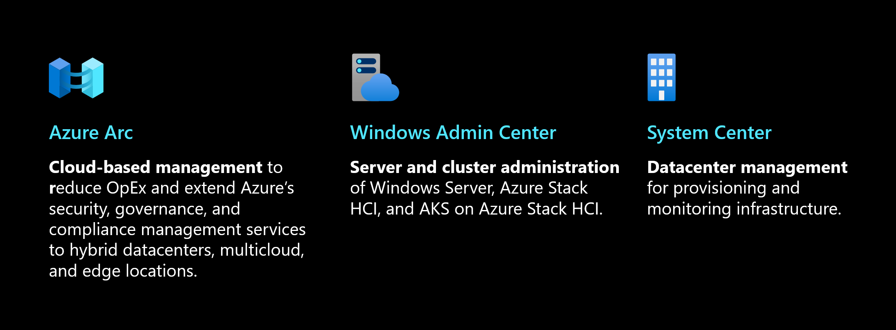
The WHY – Server administration
Management tools were not meant to be used on servers (RSAT)
Windows Admin Center / Powershell (5985, 5986)
RDP is an emergency / break-glass console with only two licenses (3389)
Windows Servers have no GUI by default, with reason
High privileged user accounts should not, and MUST NOT be just used „where ever“
https://learn.microsoft.com/en-us/windows-server/administration/overview

Slide 15
PAWs - The HOW?

Slide 16
Platforms
Platform level 1
  A workstation is either normal or a priviliged one
Platform level 2
  Admins have a VM
    Running the priviliged tasks on the Host
    Running the priviliged tasks on the VM
Platform level 3
  Admins have separate computers for normal and priviliged use
Notes:
Keylogger protection on platform level 2 physical host:
Its a IT machine, and should have high level of protection anyway
WDAV will block most of the „user level“ keyloggers
Require trusted path for credential entry (computer configuration – administrative templates – windows components – credential user interface)
No admin rights – for any sw/driver installation or „kernel/driver level“ keyloggers, admin rights are required

Slide 17
PAW workstation configuration
Windows 11 22H2 Enterprise (VBS, Credential Guard enabled by default)
Always up to date with security updates!
UEFI, Secure Boot
Bitlocker + TPM + PIN
Block DMA for Thunderbolt, FireWire/PCCard slots
Disable internet access (or limit and strictly monitor + MDAG)
Enable Windows Firewall via GPO, enable logging and disable local rules merging
Block higher tier admins, separate local admins, only allow specific people to login
Notes:
Unpatched vulnerabilities are number 1 entry point in the environment. Identity issues/phishing is number 2.

Slide 18
PAW workstation additional configuration
Block RDP, Fast user switching
Force Bitlocker recovery when password lockout
MFA – Windows Hello for Business, Duo, FIDO2 keys
Security Baselines – Microsoft, CIS
Allow-listing – AppLocker (Win10Pro 2004 ->), Windows Defender Application Control
IPsec – AH and ESP ON
Block or limit USB devices
Sysmon
Shielded VMs
But again: Don‘t let the perfect, be the enemy of good!

Slide 19
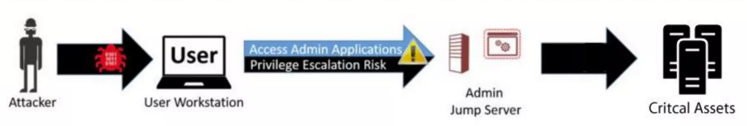
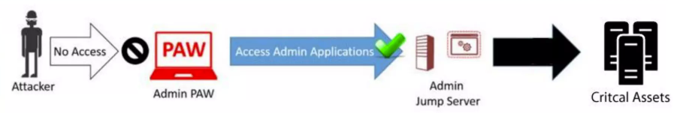
Jump servers
Frequently proposed solution to mitigate risk to administration,
Provides some security assurances,
But it violates the „Clean Source“ principle (http://aka.ms/cleansource),
Often used in MSP scenarios in combination with PAWs
Notes:
The clean source principle requires all security dependencies to be as trustworthy as the object being secured.
Clean source issues: hosted on hypervisor, accessed from a unsecure workstation
The administrative session on the jump server relies on the integrity of the local computer accessing it. If this computer is a user workstation subject to phishing attacks and other internet-based attack vectors, then the administrative session is also subject to those risks.

Slide 20
Internet
Standard PC
Standard ports
Servers / Services
Management ports
Standard ports
Management ports
PAWs
IPsec:
Request IN and OUT for management ports
More Secure: Require IN, request OUT
NO requirements for standard ports
IPsec:
Request IN and OUT
More secure: Require IN request out

Slide 21
Administrators group members
Standard PC
Servers / Services
Administrators
Domain Admins | YES
Server Admins | NO
Workstation Admins | YES
Builtin Administrator (via LAPS) | YES
PAWs
Administrators
Domain Admins | YES
Server Admins | YES
Workstation Admins | NO
Builtin Administrator (via LAPS) | YES
Administrators
Domain Admins | NO
Server Admins | NO
Workstation Admins | NO
Builtin Administrator (via LAPS) | YES

Slide 22
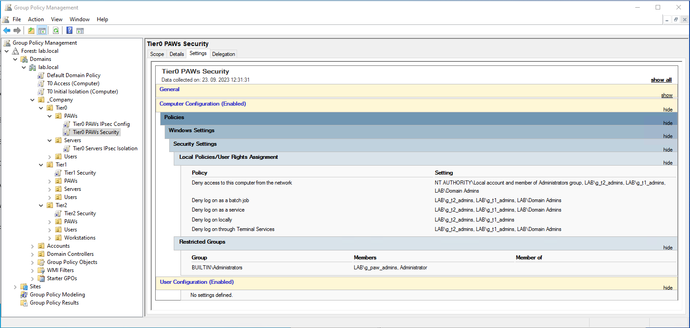
Tier0 PAW security

Slide 23
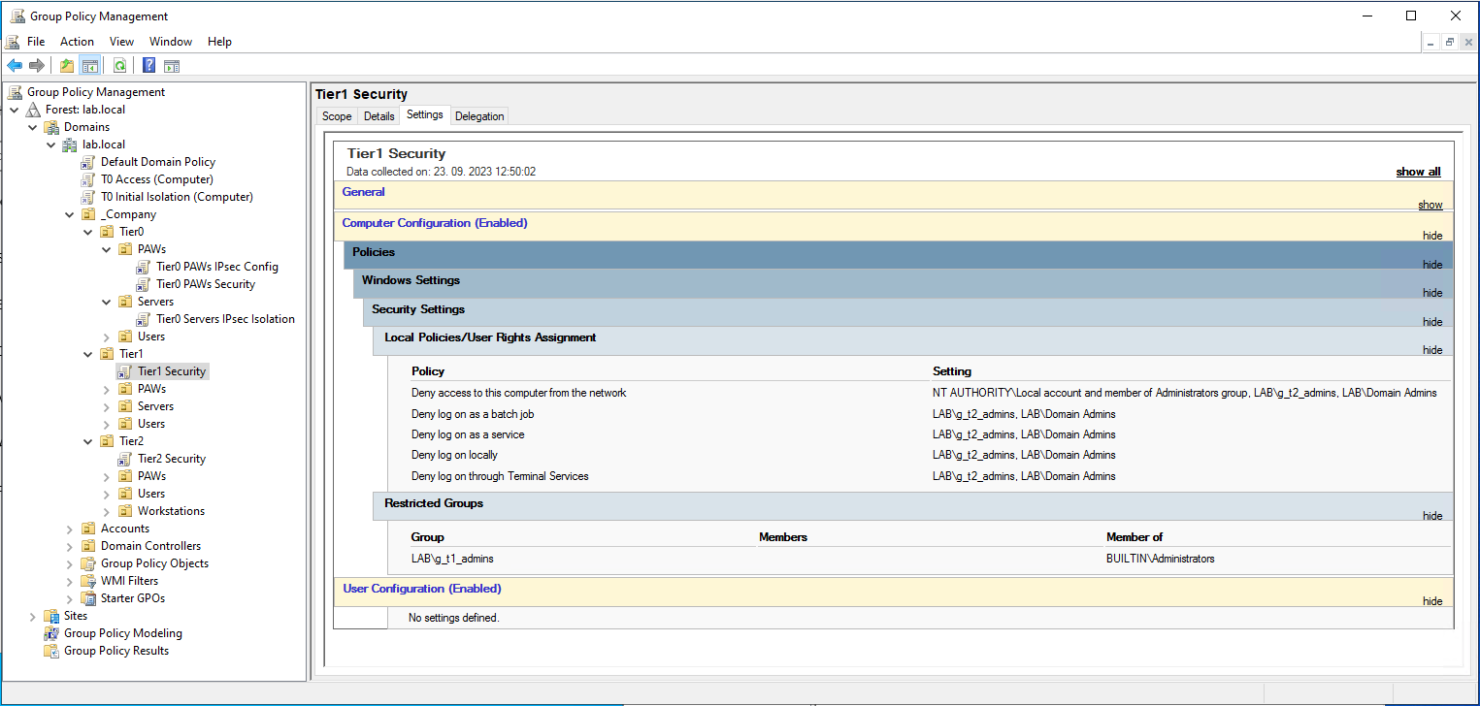
Tier1 Server security

Slide 24

Tier2 Workstation security

Slide 25
Basic Tier0 asset isolation
Goals:
  Prevent exposure of highly privileged domain admin accounts on lower privileged systems
  Enforce the use of dedicated administrative workstations at least for domain controller access
Benefits:
  Only 2 global security AD groups and 2 GPOs required
  No need to create new structure of Organizational Units
Source / more information:
  https://techcommunity.microsoft.com/t5/core-infrastructure-and-security/initially-isolate-tier-0-assets-with-group-policy-to-start/ba-p/1184934

Slide 26
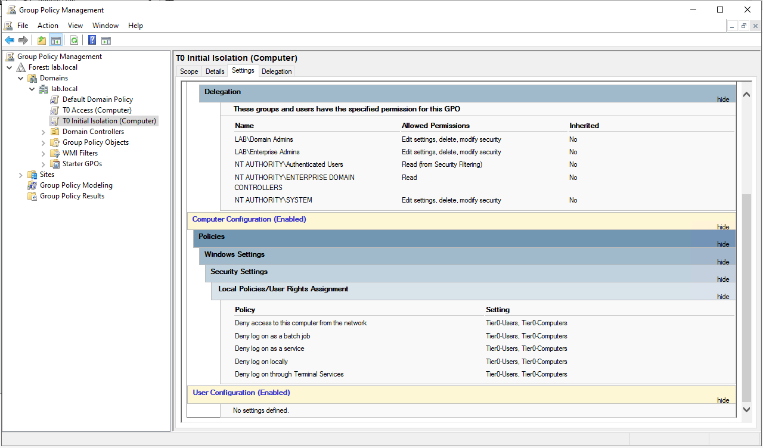
Basic Tier0 asset isolation

Slide 27
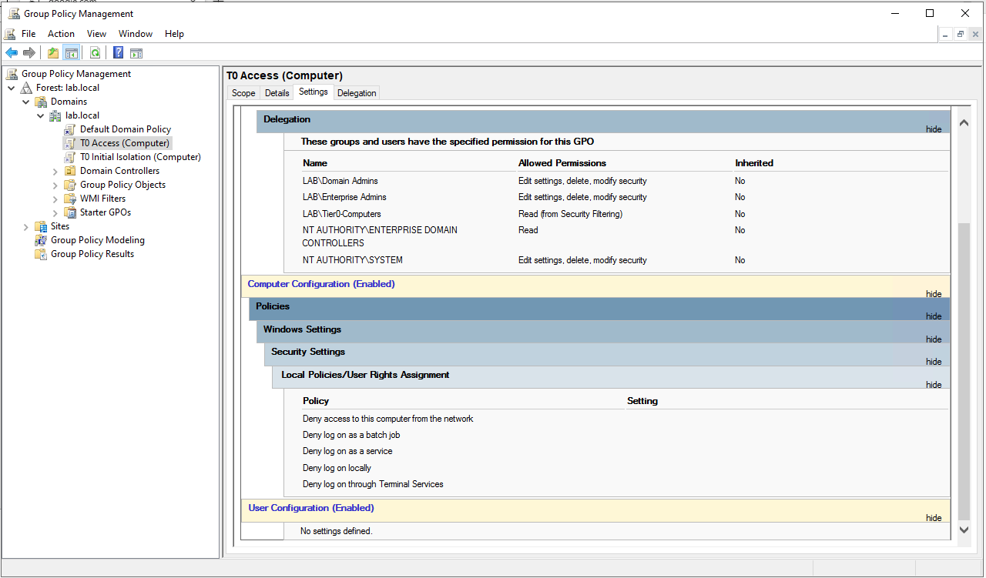
Basic Tier0 asset isolation

Slide 28
Basic Tier0 asset isolation - considerations
Computers: „Big-Bang“ approach– we need to add all DCs at once (replication)
Users can be added gradually
GPO ordering is EXTREMELY IMPORTANT!
Create new domain admins? Existing credentials might be exposed
Printers?
Patching – SCCM, WSUS?
PKI?
Backup?

Slide 29
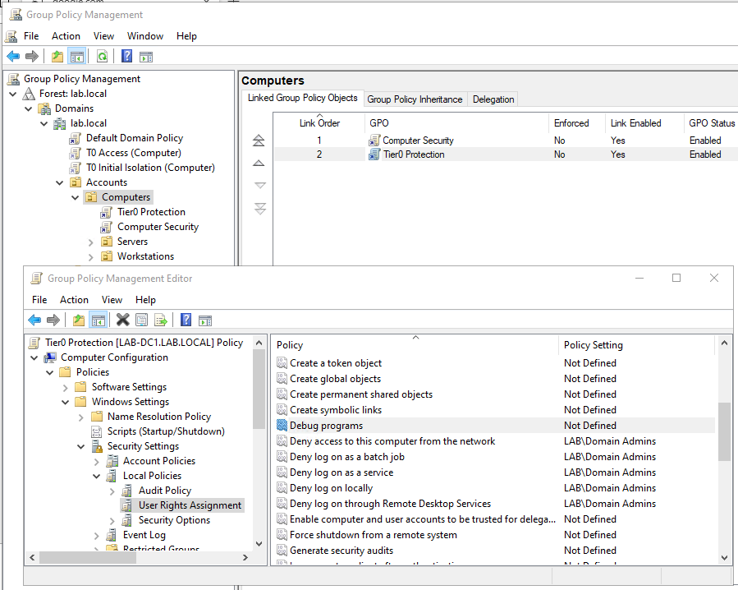
If nothing else, do THIS!
Notes:
+ LAPS

Slide 30
Secure PAWs with IPsec
Internet Protocol Security (IPsec) is a secure network protocol implemented as an add-on in IPv4 to protect communication. It provides data confidentiality, data integrity, and data authentication between participating peers at the IP layer, which prevents impersonation, data tampering, eavesdropping, and replay attacks.
It consists of two protocols: Authentication Header (AH), Encapsulating Security Payload (ESP)
It is integrated into the Windows Defender Firewall.
It enables us, to configure secure management sessions (RDP, WinRM,…) from PAWs to critical assets in such a way, that the destination host will only accept connections from PAWs.
Additionally it can protect the connections between the hosts with encryption

Slide 31
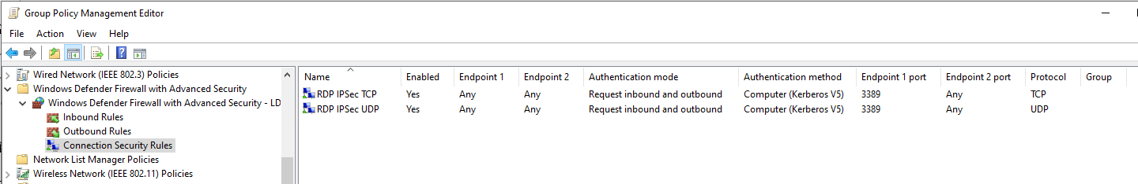
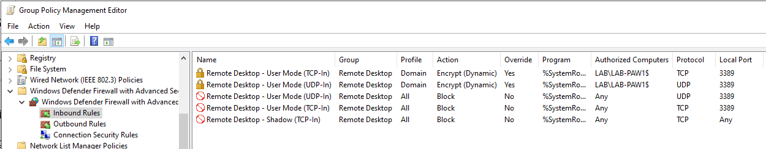
Secure PAWs with IPsec

Slide 32
Tip: Move default AD user and computer locations
Redirusr
https://learn.microsoft.com/en-us/previous-versions/windows/it-pro/windows-server-2012-r2-and-2012/cc771655(v=ws.11)
Redircmp
https://learn.microsoft.com/en-us/previous-versions/windows/it-pro/windows-server-2012-r2-and-2012/cc770619(v=ws.11)

Slide 33
Tip: Block PAW internet access with exceptions
No need for proxy server
GPO for proxy settings:
Computer Configuration -> Administrative templates -> Microsoft Edge -> Proxy server -> Proxy settings
  {"ProxyMode": "fixed_servers","ProxyServer": "127.0.0.1:8080","ProxyBypassList": "*.azure.com;*.microsoft.com;*.windowsupdate.com ... etc ...}

Slide 34
Will you PAW? ☺
Thank you

