Slide 1
Azure Information Protection
Gregor Šuster
Microsoft Slovenija

Slide 2
Agenda
An overview of Azure Information Protection
  Why it should be used?
  How it fits into GDPR scenarios?
  What to expect from Azure Information Protection solution? How to implement and integrate.

Slide 3
Providing clarity and consistency for the protection of personal data
The General Data Protection Regulation (GDPR) imposes new rules on organizations that offer goods and services to people in the European Union (EU), or that collect and analyze data tied to EU residents, no matter where they are located.
Enhanced personal privacy rights
Increased duty for protecting data
Mandatory breach reporting
Significant penalties for non-compliance
Notes:
Presenter guidance:
Use this slide to define the GDPR and introduce why it is such a big a change.
Key takeaways:
In May 2018, a European privacy law is due to take effect that will require big changes, and potentially significant investments, by organizations all over the world – including Microsoft and our customers.
And there is an opportunity for Microsoft to support its customers with products and services that simplify their GDPR compliance.
The General Data Protection Regulation (GDPR) applies to organizations located in the EU. And it applies to organizations – wherever they are located – that offer goods and services to people in the EU or monitor the behavior of people in the EU.
Microsoft believes the GDPR represents an important step forward for individual privacy rights. It gives EU residents more control over their “personal data” (which is precisely defined by the GDPR). The GDPR replaces the 20 year old Data Protection Directive.
When you think about the change in the technology landscape over the past 20 years and the implications for the privacy of individuals, and you can appreciate why it was important to modernize the law. And the importance of privacy has been amplified with the prospect of significant fines for non-compliance.
The GDPR is a complex regulation that may require significant changes in how you collect, process, and manage data. Microsoft has a long history of helping our customers comply with complex regulations. When it comes to preparing for the GDPR, we’ve got your back.
Supporting points:
Enhanced personal privacy rights—The GDPR strengthens and unifies data protection for individuals within the European Union (EU) by ensuring they have the right to have access to data, to correct inaccuracies, to erase data, to object to processing of their information, and to have the ability to move their data. Additionally, data controllers and processors have increased security requirements to ensure data is more secure.
Increased duty for protecting data—The GDPR contains rule changes that reinforce the accountability of companies and public organizations that process personal data, providing increased clarity of responsibility in ensuring compliance.
Mandatory Breach Reporting—the GDPR requires companies to report data breaches to their supervisory authorities without undue delay, and generally no later than 72 hours.
Significant penalties for non-compliance—The regulation features steep administrative sanctions, including substantial fines that are applicable whether an organization has intentionally or inadvertently failed to comply.
10 000 000 EUR or 2% of the total worldwide annual turnover of the preceding financial year (whichever is higher)
20 000 000 EUR or 4% of the total worldwide annual turnover of the preceding financial year (whichever is higher)

Slide 4
What are the key changes with the GDPR?
Personal
privacy
Controls and notifications
Transparent policies
IT and training
Individuals have the right to:
Access their personal data
Correct errors in their personal data
Erase their personal data
Object to processing of their personal data
Export personal data
Processors will need to:
Protect personal data using appropriate security practices
Notify authorities within 72 hours of breaches
Receive consent before processing personal data
Keep records detailing data processing
Processors are required to:
Provide clear notice of data collection
Outline processing purposes and use cases
Define data retention and deletion policies
Processors will need:
Train privacy personnel & employee
Audit and update data policies
Employ a Data Protection Officer (for larger organizations)
Create & manage processor/vendor contracts
Notes:
Presenter guidance:
Use this slide to dive deeper into the changes being introduce with GDPR and the potential impact organizations are going to face.
Key takeaways:
The GDPR contains many requirements about how you collect, store, and use personal information. This means not only how you identify and secure the personal data in your systems but also how you accommodate new transparency requirements, how you detect and report personal data breaches, and how you train privacy personnel and employees.
Personal privacy:
The GDPR strengthens data protection for individuals within the European Union (EU) by ensuring they have the right to have access to their personal data, correct inaccuracies, erase data, object to processing of their data, and have the ability to move their data, such as in the case of moving from one vendor to another.
Access their personal data—The GDPR gives individuals rights to a copy of their personal data, an explanation of the categories of data being processed (e.g., location data, browsing history, demographic data, voice data, biometric data, etc), the purpose of the data processing, and any third parties that might receive that data.
Correct errors in their personal data (rectification)—Individuals can require corrections to their personal data.
Right to erasure—Individuals can require deletion of their personal data where it is no longer needed for the purpose for which it was initially collected or in the event consent is withdrawn. For enterprises, this means an indivudual’s data needs to be removed not just from production databases, but all backups, archives, and more.
Object to the processing of their personal data—In cases where data cannot be deleted because it is necessary for other legitimate purposes (such as a legal hold, protection of another’s rights, etc...) an individual can require that the data not be processed and that it is simply stored.
Move their information (also known as Data Portability)—An individual should be able to get a copy of his or her personal data in a structured interoperable format to share with another data controller.
Controls and notifications:
Strict security requirements—The regulation requires organizations to protect personal data in order to “prevent any unlawful forms of processing, in particular any unauthorized disclosure, dissemination or access, or alteration of personal data.” This means data controllers and processors need to ensure:
Sensitive personal data is encrypted/pseudonymized
Processing systems and services maintain data confidentiality, integrity, and availability
Deleted/lost personal data can be restored in a timely manner in the event of a physical or technical incident
Security measures are routinely tested for competency
Breach detection and prevention tools are in place
Breach notification obligation—A new requirement not in the existing DPD is that data controllers must notify supervisory authorities (generally, the applicale data protection authority) of data breaches without undue delay and in any event within 72 hours after discovery. Data subjects will also have to notified without undue delay if the leaked data poses a “high risk to their rights and freedoms.”
Appropriate consents for data processing—Consent for processing must also be “freely given, specific, informed, and unambiguous.”
Confidentiality—Ensure those that process personal data are committed to confidentiality.
Recordkeeping—Companies must maintain robust records on how they comply with the GDPR and their processing activities.
Transparent policies:
Transparent and easily accessible policies—In keeping with the view that individuals should understand how their data is being used, the GDPR requires transparency to individuals with regard to how their personal data is collected, used, and processed. This information should be easily accessible and in clear and plain language. It should explicitly describe the specific purposes for which personal data are processed and it should be provided at the time of collection.
IT and Training:
Companies will need to ensure their employees understand the GDPR and that their data policies are updated to ensure alignment with GDPR and its broader “personal data” definition.
Larger organizations will need to appoint a Data Protection Officer to monitor compliance with GDPR.
Lastly, companies will need to enter into contracts with data processors, such as Microsoft, to jointly commit to the data processing requirements of the GDPR.

Slide 5



What does this mean for my data?
Stricter control on where personal data is stored and how it is used
Better data governance
tools for better transparency, recordkeeping and reporting
Protecting customer privacy with GDPR
Improved data policies to provide control to data subjects and ensure lawful processing
Notes:
Presenter guidance:
Use this slide to translate how those key changes are going to affect how organization’s store, use and manage personal data.
Key takeaways:
With the GDPR, organizations will need to have tighter controls on how they manage and collect personal. Systems and processes will need to be updated or put in place to prevent unlawful use of data (primarily around processing data without the data subject’s content) and to ensure the way it is stored and used is compliant. Additionally, because data subjects now have the legal right to correct, withdraw consent, request deletion or ask for a copy of their data, organizations will need to have the proper tools and systems in place to accommodate these new requirements.
Organizations will also need implement more advanced data policies that not only need to ensure that organizations are being compliant with their use of personal data, but also enable them to accommodate the new transparency, recordkeeping and reporting requirements. Organizations that take a privacy by design approach to improve their data policies will be better prepared to prevent data breaches, report on their GDPR compliance, and perform data impact risk assessments.
With the GDPR’s high penalties for non-compliance, data governance tools will be extremely important to ensure organizations can provide an audit trail to prove compliance, expose areas of risk before they become a problem, and effectively and legally respond to data breaches.

Slide 6

The evolution of Information Protection
CLASSIFICATION
LABELING
ENCRYPTION
ACCESS CONTROL
POLICY ENFORCEMENT
DOCUMENT TRACKING
DOCUMENT REVOCATION
Classify & Label
Protect
Monitor & Respond

Slide 7




What is Azure Information Protection ?
Optional
Leverage a common identity across Active Directory and Azure Active Directory
Azure AD
Azure Information Protection
Azure Key Management
Authentication & collaboration
BYO Key
RMS connector
Connect to on-premises Exchange, SharePoint and for the simplest way to get Rights Management running in your organization
AAD Connect
RMS SDKs on popular mobile platforms including Windows, iOS, Android, Windows Phone and Mac OS

Slide 8
Deployment phases for AIP
Phase 1: Deployment of basic classification
Phase 2: Advanced classification
Phase 3: Protection
Phase 4: Monitoring
Phase 5: Secure collaboration
Phase 6: Integration with other systems
* All phases except Phase 1 are optional

Slide 9
Phase 1: Basic Classification
The “foundation” of Azure Information Protection
User-driven, focused on complementing DLP
Majority of planning exercises will involve this step
Can be done VERY quickly once customer agrees on a taxonomy
Notes:
https://blogs.microsoft.com/blog/2015/11/09/microsoft-to-acquire-secure-islands-a-leader-in-data-protection-technology

Slide 10
Basic Classification - Considerations
Does a classification taxonomy exist today?
What can be done with this data?
With whom can it be shared?
Do we care where the data goes?
Default vs. mandatory

Slide 11
Demo: Klasifikacija dokumentov

Slide 12
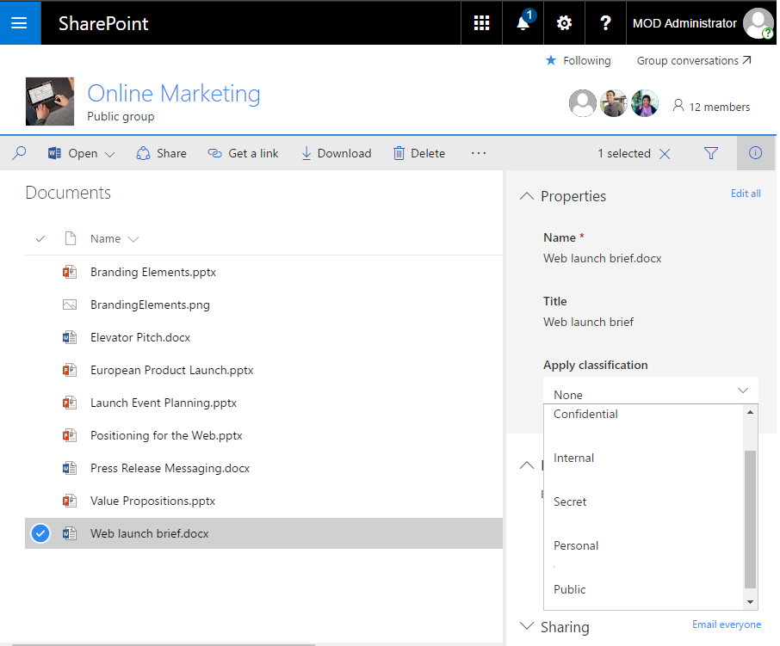
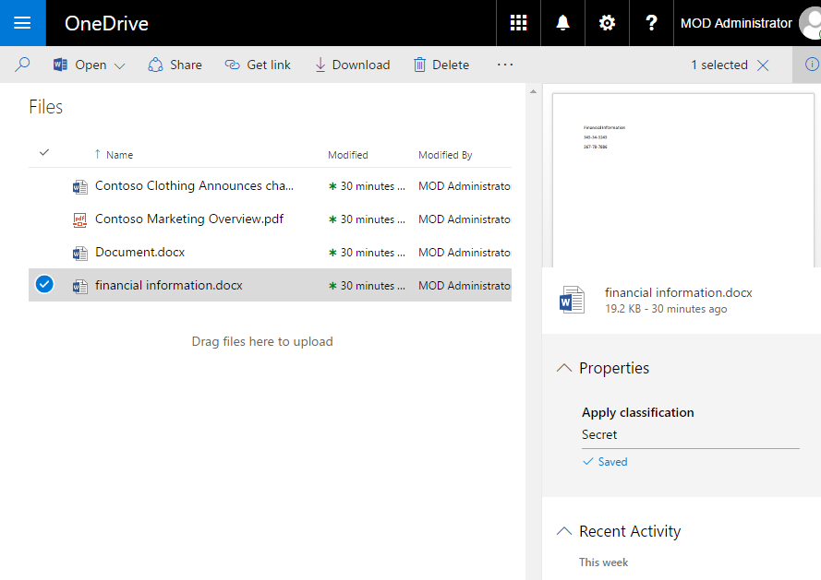
Classification Capabilities
Documents and emails can be classified by users
SharePoint and OneDrive can display and apply classification labels
  Via forward/back sync of document properties with AIP labels*
Exchange 2016 and Exchange Online can display and apply labels
  Via conversion between mail headers and the legacy Exchange Message Classification feature*
* Note: these are temporary, native integration planned for upcoming updates

Slide 13
Designing a classification taxonomy
Start with the defaults and keep them if possible!
The defaults have been validated in multiple companies, markets and geographies, and they work!
Adapt to your business as needed
We can provide examples of taxonomies used in specific industries

Slide 14
Classification Best Practices
Keep labels simple and limited in number
Align terminology that matches the users mental model
Consider external sharing needs
Define a default label for documents (maximizes adoption)
Always allow reclassification

Slide 15
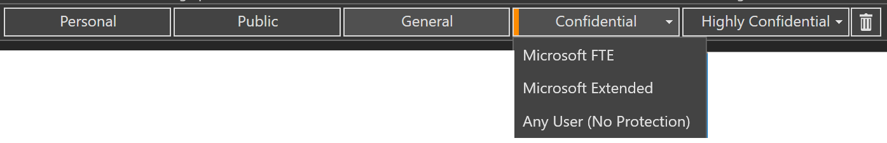
Phase 2: Advanced Classification
Start with Basic, then add:
  Sublabels
  Departmental/Scoped classifications
  Automatic classification based on rules
  Provide team specific templates

Slide 16
Scoped labels
You can create scopes and assign labels to them
Then you associate these scopes to groups of users (roles, departments, etc.)
Scoped labels best practices:
  Align label names and meanings in different departments
  Apply narrower protection for different divisions

Slide 17
+Automation
Builds on classification to apply DLP-like rules to information.
Automatic vs. Recommended Considerations:
  What must be protected, regardless of trust?
  Leverage existing tags/watermarks
  Tuning/feedback – reclassification
  EMS E5 or Azure Information Protection P2 required

Slide 18
Phase 3: Protection
Familiar encryption and rights management – RMS
  Mature, well-known service
Label to Template mapping
Key management
Define protection objectives
For new deployments
Label to Template mapping
Key management
For ADRMS migration

Slide 19
Define protection objectives
What do you want to achieve?
Aim for flexibility first, restrictions next
Label to Template mapping
Drive protection via labelling
Intent → protection!
Key Management
Start with MS managed key
Choose HYOK wisely
Keep it simple
Moving to BYOK
Especially Office apps

Slide 20
Key Management
BYOK vs. Microsoft Managed
  BYOK = Azure KeyVault
  Key activity heavily audited by KeyVault
Dual Server (Migration Enabler)
  Enabled consumption from AD RMS, protection/consumption via Azure RMS
HYOK (= Hold Your Own Key)?

Slide 21
Protection – Some advanced scenarios
Bulk Protection: use FCI with PowerShell to protect vast caches of documents
  ALWAYS grant full control access to file owner, and be VERY generous with the rights you grant
  Bulk labeling also available, combine the two
Enable IRM in SharePoint or OneDrive
  Limited scenarios today, but improvements are coming.
Protect automatically in Exchange via Transport Rules

Slide 22
Phase 4: Reporting/Monitoring
Two primary scenarios:
  End-user (or auditor) uses Document Tracking
  Business creates reports analyzing logs
Both focused on documents (tracking of emails is limited today)

Slide 23
End-user doc tracking
Easy to use. You can track ALL documents protected by users
  If the document was protected from the Sharing App, go to the portal, select it from there
  If the document was protected by Office or via classification, open the document (or right click on it) and select the track option
Exception: documents protected by SharePoint or by DLP systems where the user may not be owner of the document or not have a copy

Slide 24
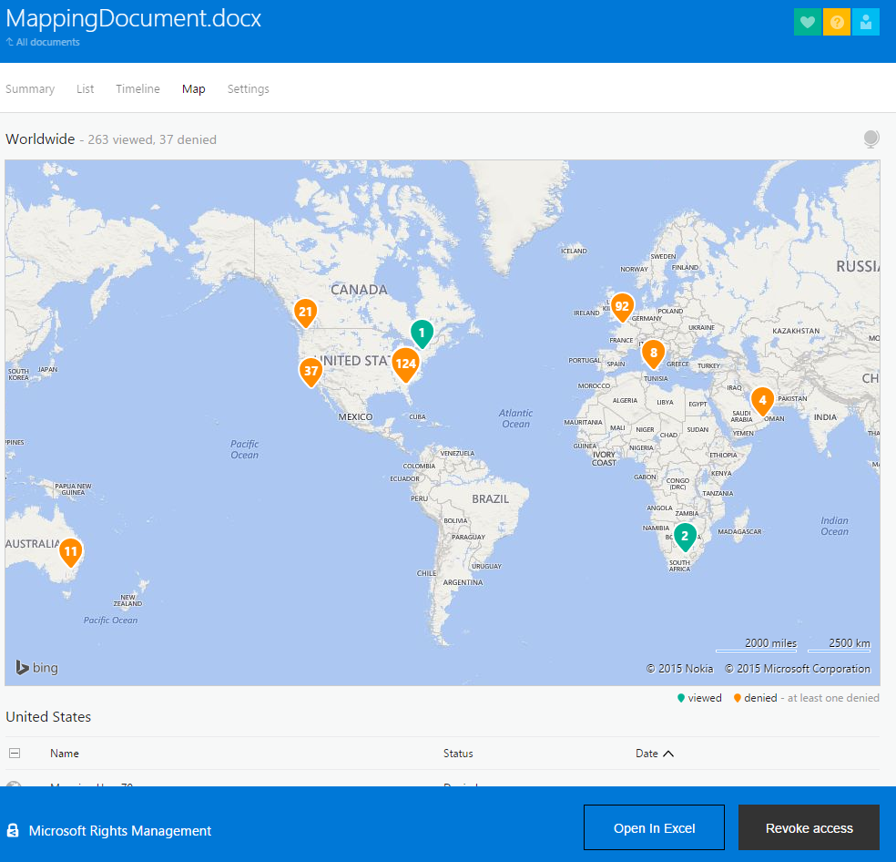
Admins can also do tracking!
Beware of legal, political implications with tracking (e.g. “workers unions” demands)
You can disable tracking if in trouble, but fight it if possible as it adds tons of value

Slide 25
Log-based reporting
Azure RMS logs available today
KeyVault logging for BYOK
Local event logs for classification actions
Import to SIEM from service logs and query away!

Slide 26
Phase 5: Secure Collaboration
Available today:
  External sharing via Azure RMS Sharing App
  External sharing via contacts/internal groups
  External sharing via Azure AD B2B
  External sharing via Office 365 Message Encryption triggered by label
What‘s next?

Slide 27
Phase 6: Integration with other systems
Integration possible with ANY system
Some exists today natively, some involve partners
Some involve the customer asking the ISV to work with Microsoft
  One large, committed customer has more pull-through than all of Microsoft

Slide 28
Demo in 15 minutes…
https://www.microsoft.com/en-us/cloud-platform/enterprise-mobility-security-trial
Registracija in aktivacija licenc
Testiranje… ☺

Slide 29
Additional questions?

Slide 30
Resources
Global Data Protection Regulation – https://www.microsoft.com/gdpr
Azure Information Protection – https://aka.ms/aip
Azure Information Protection Samples - https://azure.microsoft.com/en-us/resources/samples/azure-information-protection-samples/

