Slide 1
Windows without windows...
First steps
By Matjaž Žnidar

Slide 2

What is Windows server CORE
“The Server Core option is a minimal installation option that is available when you are deploying the Standard or Datacenter edition of Windows Server. Server Core includes most but not all server roles. Server Core has a smaller disk footprint, and therefore a smaller attack surface due to a smaller code base.”
*curtesy of Microsoft documentation
CORE
Desktop Experience

Slide 3
Few historic facts
February 2008 → CORE as installation option of Windows Server 2008
August 2012 → Switch between Server CORE and normal server w/o reinstallation in Windows Server 2012
September 2016 → CORE is standard installation of Windows Server 2016
October 2017 → CORE is the only option for Windows Server 1709 (Semi- Annual Channel) for HW
Notes:
2008 - Reinstall needed
2012 - Switch between> Server Core>Minimal server Interface>Windows Shell
2016 - Only Server (CORE) and DesktopExperience
Reinstall needed
Long Time Servicing Channel will have GUI
1709 - SemiAnnual only CORE and Nano for containers

Slide 4
Demo
Installation

Slide 5
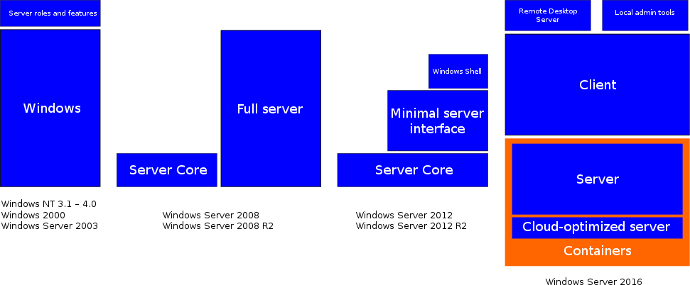
Installation “bricks”

Slide 6

What can you run on CORE?

Slide 7
Demo
What can you run on CORE?

Slide 8
You can run on CORE
Command prompt
PowerShell
RegEdit
Fsutil
DiskPart
TaskMgr
Notepad
iSCSIcpl (control /name Microsoft.iSCSIInitiator)
Intl.cpl
TimeDate.cpl
MSInfo32
RoboCopy
xCopy
TotalCommander

Slide 9
Some basic functions, you can do with PowerShell & co
Driver manipulation
Check-HotFix
Network configuration
Disk Operations
Keyboard configuration
Add and remove roles and features

Slide 10
Demo
Some basic functions, you can do with PowerShell & co

Slide 11
Main benefits of server CORE
Faster cadence → 2 a year vs. 2-3 years
Smaller footprint → 6GB (Clean installed 1709)
Fewer services running → 123 vs. 204
Smaller footprint → smaller number of vulnerabilities/patches
No IE, Flash and GUI → Admins CANNOT browse internet
Supports containers
Supports WSL (Windows subsystem for Linux)
Pokazal Robert Potočnik včeraj v Azure Track

Slide 12
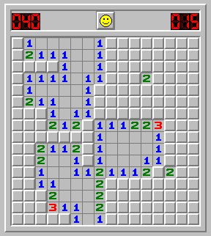
Main disadvantages of server CORE
(only)18 months of support
Majority of management need to be done remotely
You can no longer avoid to learn PowerShell
No GUI
→ No Minesweeper ;)

Slide 13
Basic management
Installation of drivers
With help of Server Config tool
A lot of PowerShell commands
Replacement for popular Commands
RSAT
Manage from Web Browser → Honolulu (now Windows Admin Center)
This is topic for my sessions tomorrow

Slide 14
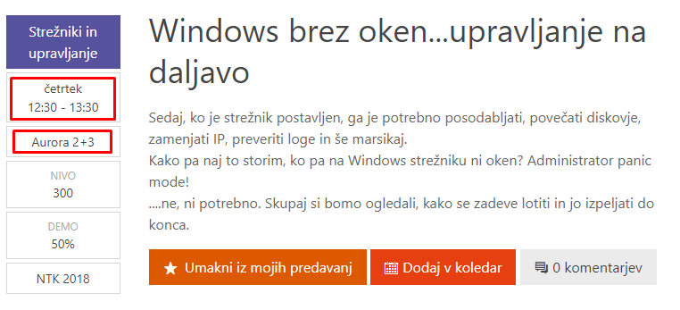
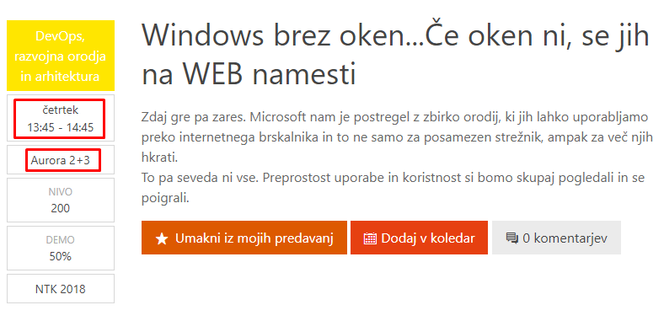
And what now?
Story continues here at NTK 2018

Slide 15
How to proceed with Windows Server CORE
Go and start using PowerShell (e.g. mva.ms )
Implement your first Windows Server Core (you can use aka.ms/WSLab )
Learn some more PowerShell
Get info from several servers at once
Stop loosing time
Invest gained time to learn something new
There are several conferences and community events available, where you can learn new and interesting “stuff” (e.g. ExpertsLive.eu, SloWug.si...)

Slide 16
Few words about me
Follow me on Twitter → @MatjazZnidar
Visit my blog → https://m-12.net
Mail me → matjaz@m-12.net
Stay curious and never stop learning!!
Thank you

