Slide 2
Trening in uporaba računalniškega vida in večmodalnih modelov
Marko Kokol

Slide 3
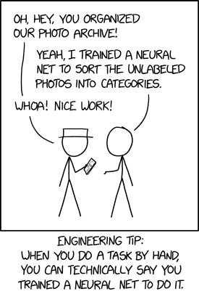
Content
Getting on the same page regarding terminology
Shallow dive into deep neural networks
Computer vision architectures
Vision transformers
Overview of open-source models
Fine-tuning a model
source: xkcd.com

Slide 4
The Fundametnals

Slide 5
AI Model Types by learning mechanism
Discriminative Models: These models are designed to distinguish between different types of data points. They predict a label given an input.
Linear Models, i.e.:
  Logistic Regression
  Support Vector Machines
Non-linear Models:
  Decision Trees
  Random Forest
  Gradient Boosting Machines (e.g., XGBoost, LightGBM)
Deep Learning Models:
  Convolutional Neural Networks (CNN)
  Recurrent Neural Networks (RNN)
  Transformer-based models (e.g., BERT, GPT, T5)
  RetNet based models
Ensemble Methods:
  Bagging (e.g., Bagged Decision Trees)
  Boosting (e.g., AdaBoost)
  Discriminative AI has been successfully used for more than a decade on a wide range of problems in medicine, natural language processing, and other fields.

Slide 6
AI Model Types by learning mechanism
Generative Models: These models are designed to generate new data points that are similar to some given set of input data.
Probabilistic Graphical Models:
  Bayesian Networks
  Hidden Markov Models (HMM)
Generative Adversarial Networks (GANs)
  Deep Convolutional GANs (DCGAN)
  Conditional GANs (cGAN)
  CycleGANs
Variational Autoencoders (VAEs)
Autoregressive Models:
  PixelRNN, PixelCNN
  Transformer-based models (e.g., GPT-3, GPT-4)
  Generative AI came into spotlight with the release of ChatGPT, but has been successfully used for limited problems before that.
  Large Language Models were known to be able to solve a wide set of problems before the release of ChatGPT (such as the Google Palm model).

Slide 7
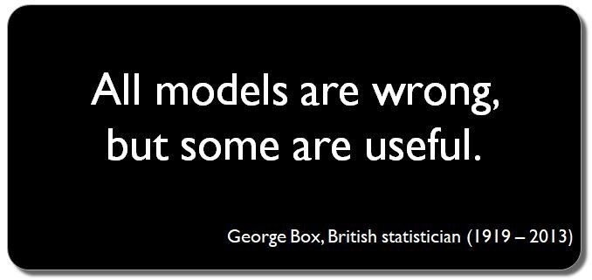
Recurring Themes
AI is often defined as machine behaviour mimicking human intelligence
Turing Test
Different approaches to learning: supervised, semi-supervised and unsupervised
Model: A model, in the context of artificial intelligence and machine learning, refers to a mathematical representation of a real-world process or system, designed to capture patterns or make predictions based on data. It serves as an abstraction that generalizes from observed data to make inferences on unseen data.

Slide 8
Major milestones
  Alan Turing's "Computing Machinery and Intelligence" (1950)
  The Dartmouth Workshop (1956)
  Eliza (1966)
  Backpropagation (1980s)
  Deep Blue Beats Garry Kasparov (1997)
  ImageNet Large Scale Visual Recognition Challenge (2012)
  AlphaGo Beats Lee Sedol (2016)
  ChatGPT (2022)

Slide 9
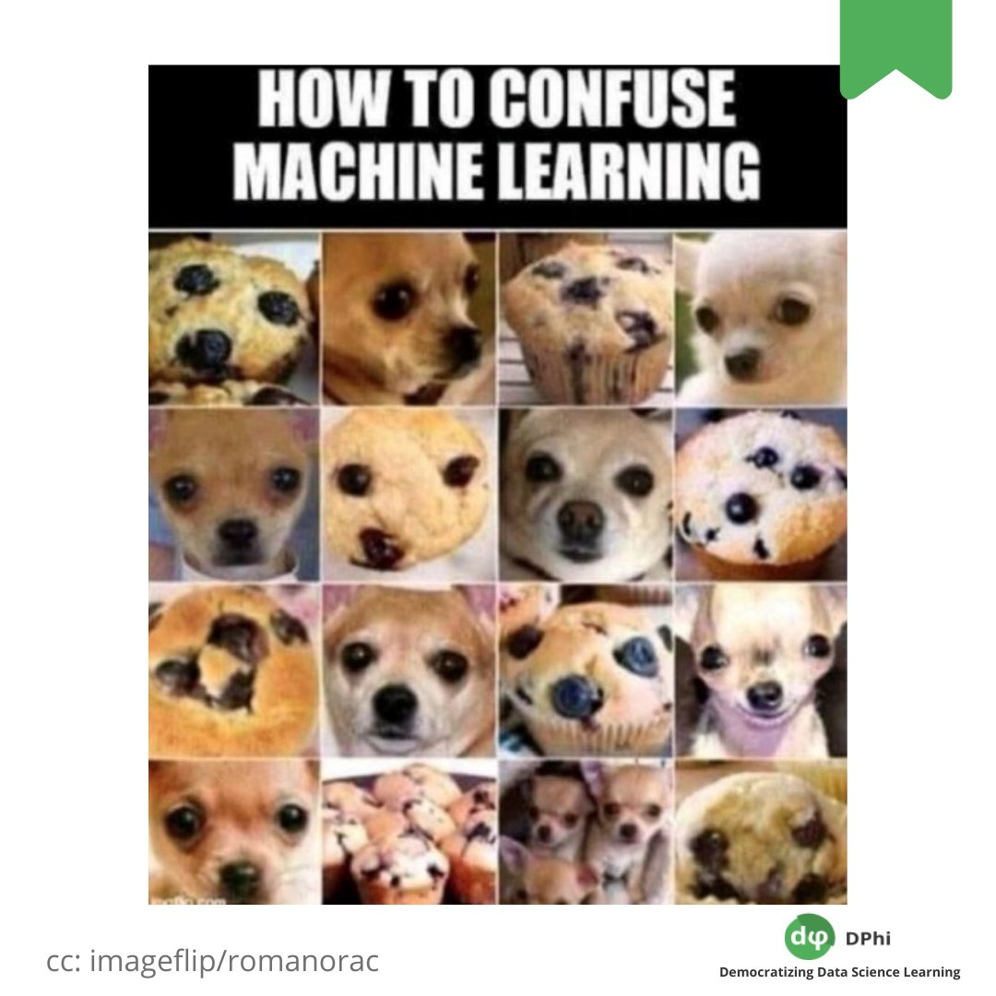
How to use Models?
Use as-is on our own data
Fine-tune on our data that is mostly similar (fine tuning)
Fine-tune on our data that to solve the same fundamental problem on different data (recognize dog breed on model trained to find dogs on pictures)
Reuse existing architecture and train from scratch
Design a completely new architecture
Design a completely new approach

Slide 10
Computer Vision & Multimodal
  Computer vision is a field of artificial intelligence (AI) that enables computers and systems to derive meaningful information from digital images, videos and other visual inputs
  It uses machine learning and neural networks to teach computers how to see and understand visual data.
  Multimodal learning is a type of deep learning that uses a combination of various modalities of data, such as images, text, audio, video and more, to create a more comprehensive understanding of a particular object, concept or task.
  Multimodal learning models have various applications, such as visual search and question answering, structuring unstructured data, facilitating robots' manipulation of their surroundings based on natural language instructions, and more.
  Multimodal learning models commonly use contrastive learning to integrate the representations of similar data pairs while separating the representations of dissimilar data pairs. This is done by defining a similarity metric that measures the distance between data pairs in the model's latent space (such as marginal loss).

Slide 11
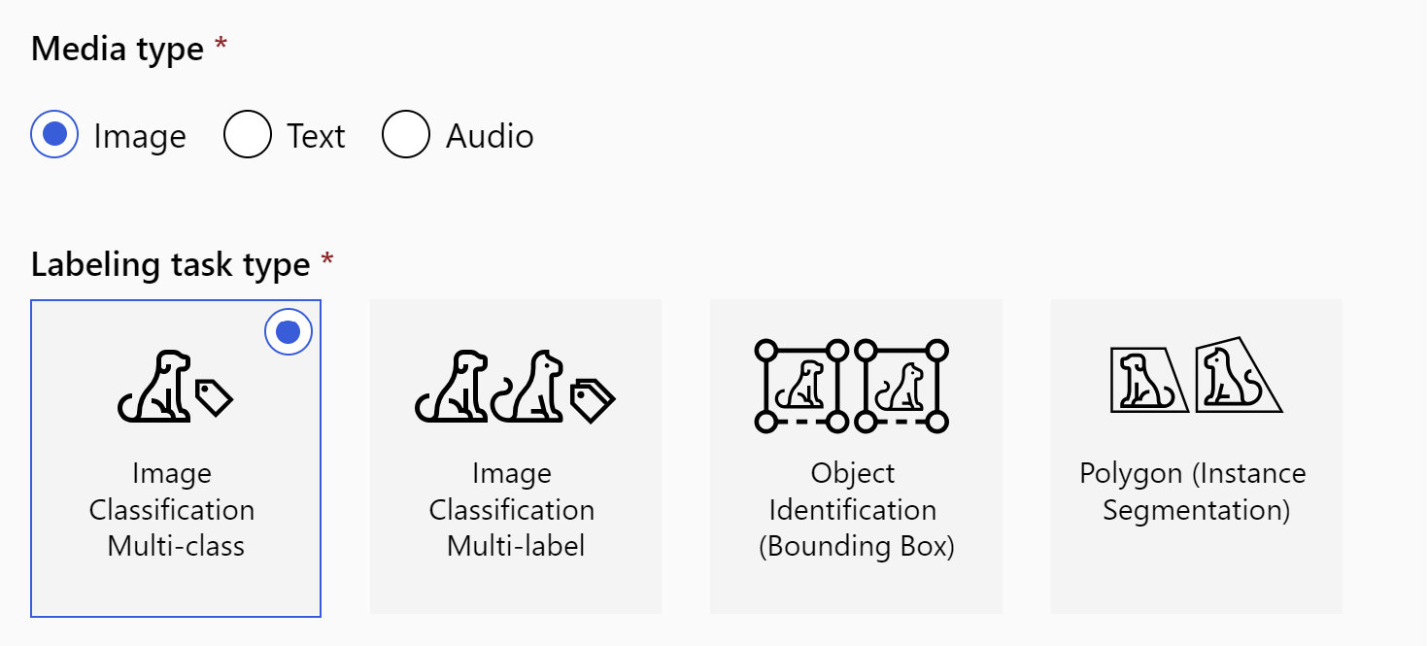
CV Use Cases

Slide 12
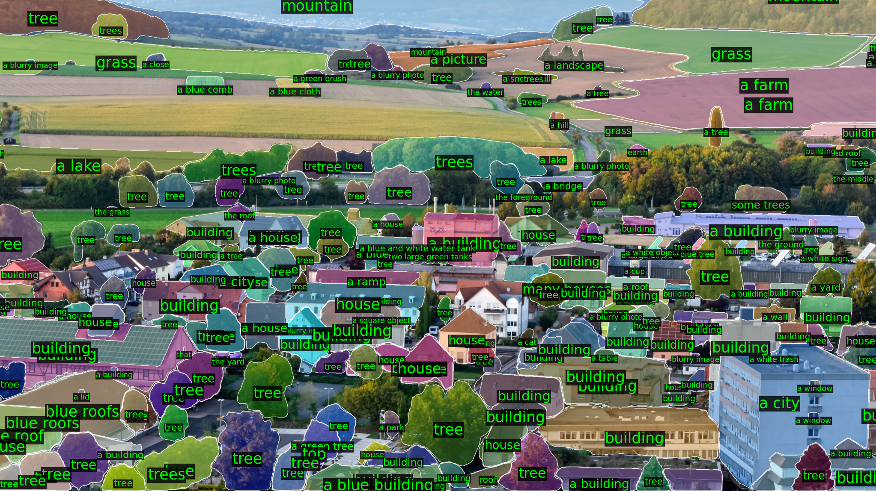
The Challenge

Slide 13
Shallow Dive
Into Deep Neural Networks & Transformers

Slide 14
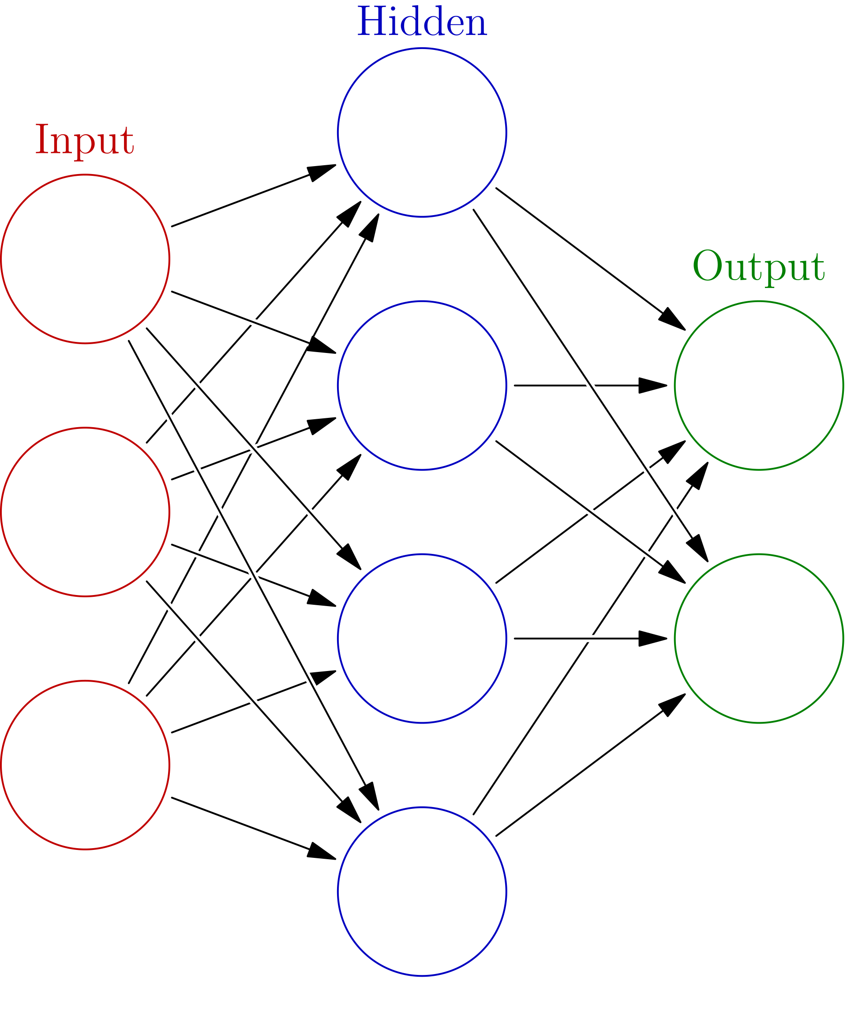
Artificial Neural Networks
  ANNs are computing systems inspired by the structure and functioning of biological neural networks in the human brain.
  The fundamental building blocks of ANNs are "neurons" or "nodes," which process information and transmit it to subsequent layers.
  Composed of multiple layers, including an input layer, one or more hidden layers, and an output layer. Each layer can have numerous neurons.
  Neurons are interconnected, and each connection has a weight, which adjusts during training to optimize the network's output.
  Each neuron processes its input using an activation function (e.g., ReLU, sigmoid, tanh) to introduce non-linearity into the model.
  ANNs learn by adjusting their weights based on a loss function through algorithms like backpropagation and optimization methods such as gradient descent.
source: Wikipedia (Glosser.ca)

Slide 15
Convolutional Nets I
  Convolutional layer: The first and most important layer of a CNN, where the input image is processed by applying filters (or kernels) that extract features such as edges, shapes, and colors. The output of this layer is a feature map that represents the spatial information of the image.
  Pooling layer: A layer that follows the convolutional layer and reduces the dimensionality of the feature map by applying a pooling operation, such as max, average, or sum. This layer helps to reduce the computational cost and avoid overfitting by discarding some information.
  Fully-connected layer: The final layer of a CNN, where the flattened feature map is fed into a standard neural network that performs the classification or regression task. This layer learns the high-level features and patterns from the previous layers and outputs the final prediction.
  Activation function: A function that introduces non-linearity into the CNN and determines whether a neuron should be activated or not based on its input. Common activation functions include sigmoid, tanh, ReLU, and softmax. Activation functions help to improve the learning ability and performance of the CNN.

Slide 16
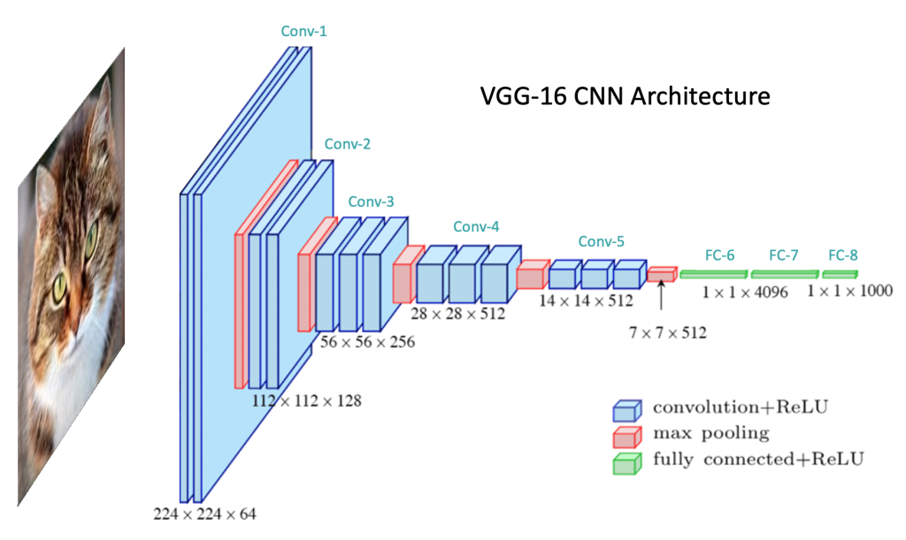
Convolutional Nets II
Source: https://learnopencv.com/understanding-convolutional-neural-networks-cnn/

Slide 17
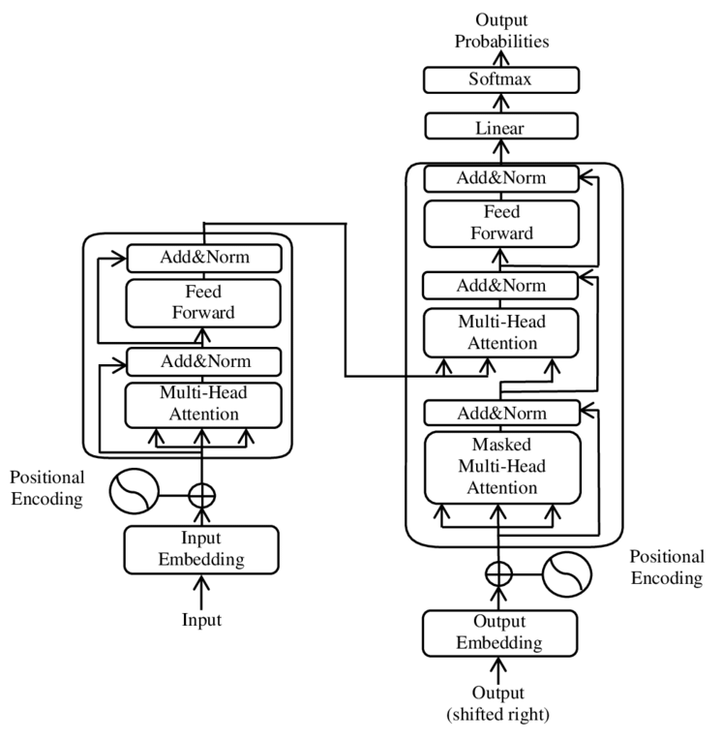
Transformers
  Self-Attention Mechanism from the Google paper: “Attention is all you need”
  Learn which parts of the input are the most important parts to focus on
  A more in-depth review will be provideda as part of the LLM presentation later today
source: DOI:10.1088/1742-6596/1314/1/012186

Slide 18
Generative Models
  Mostly based on Transformer architecture
  During pre-training, LLMs aim to predict the next word in a sequence given all the previous words, which is often termed autoregression. The model learns from vast amounts of text to capture patterns, relations, and knowledge present in the data.
  Before processing, text data is tokenized into chunks (could be words, subwords, or characters). This ensures the model can handle varied vocabularies and even learn meaningful representations for parts of words.
  Within transformers, the self-attention mechanism allows each token in the input sequence to focus on different parts of the sequence, capturing long-range dependencies and relations between tokens. This is pivotal for understanding context in a given text.
  While generative LLMs can generate text out-of-the-box after pre-training, they can be further fine-tuned on specific tasks or datasets to generate more task-specific or coherent outputs. This involves training the model on a narrower task with specific data and objectives.

Slide 19
Anatomy of a Typical Multimodal Model
  Usually a combination of a discriminative and a generative model
  Image Segmentation Network: the network takes the input image and calculates the segmentation mask + object classification, basically identifying regions of the image representing different objects
  Output Transformation: Takes the output of the segmentation layer (and possibly other outputs of the image recognition network) and feeds them into a generative model
  Segment Captioning Network: a generative model that provides captions for the image segments

Slide 20
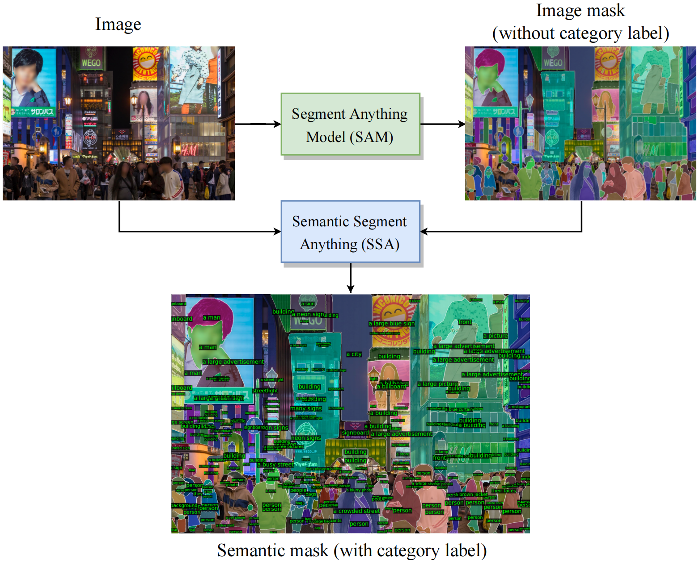
Anatomy of a Typical Multimodal Model II
  Source: https://github.com/fudan-zvg/Semantic-Segment-Anything

Slide 21
What is out there?
Existing Architectures, Models, and Datasets

Slide 22
Open-source Models
A large number of open-source models is available, good starting points:
  Meta Segment-anything model for segmentation
  LLAMA2 for captioning
  Existing engines combining the models: https://github.com/fudan-zvg/Semantic-Segment-Anything
  Example: https://replicate.com/cjwbw/semantic-segment-anything
  Good overview: https://github.com/steven2358/awesome-generative-ai
  LICENSING: be careful, some models do not allow commercial use

Slide 23
Typical use cases

Slide 24
How do I?
Tools, Starting Points and Common Challenges

Slide 25
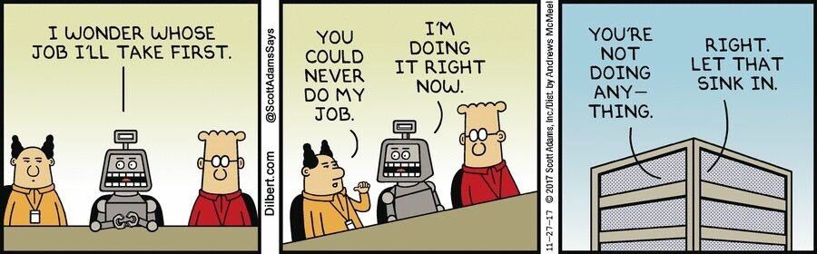
So, How do I?
  Frameworks: PyTorch, TensorFlow, Keras, MXNet, ML.NET
    Additional Frameworks: CUDA (Nvidia), oneAPI (Intel)
  Huggingface:
    Dataset
    Model
  Appropriate Hardware

Slide 26
Hardware
  Main limiting factor is usually the GPU Memory
  Nvidia 4090 vs H100 (3090 vs A100) is in the range of 2k vs 500k
  What you can do, depends on your hardware
  Two common tricks:
    Quantization
    LORA

Slide 27
How to use Models?
Use as-is on our own data
Fine-tune on our data that is mostly similar (fine tuning)
Fine-tune on our data that to solve the same fundamental problem on different data (recognize dog breed on model trained to find dogs on pictures)
Reuse existing architecture and train from scratch
Design a completely new architecture
Design a completely new approach

Slide 28
Use Existing model
  Take a model already trained for multimodality such as LLAVA LLaVA (llava-vl.github.io)
  or:
  Take a large generic segmentation model, i.e. SegmentAnything from Meta
  Take a pretrained large language model, i.e. LLAMA2
  Combine them using a similar technique to: https://github.com/feizc/Visual-LLaMA

Slide 29
Training & Fine-tuninG
  Tokenizer
  Model
  Dataset
  Training loop
  Training and fine tuning have the same basic requirements
  NOTE: Be sure to read the model documentation. For example some GPT models from Huggingface perform model shifting internally and therefore input=output

Slide 30
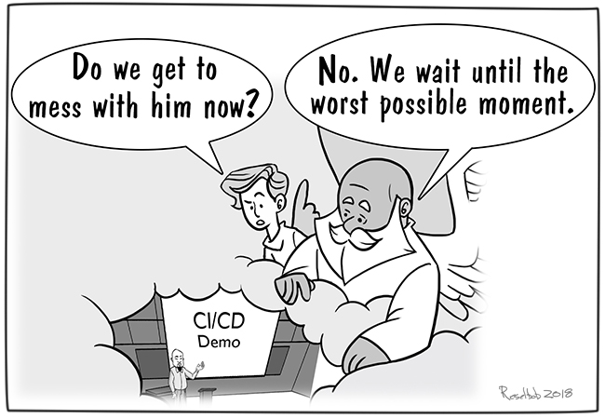
DEMO
Vir slike: In the Hands of the Demo Gods - DevOps.com

Slide 31
Questions?
github.com/klokedm
github.com/klokedm/ntk23_mm

