Slide 1
Azure Track v2.0
DevOps in Infrastructure as code
Andrej Kašnik
Microsoft

Slide 2
Azure Track v2.0
Azure Track v2.0 – Moj Drugi PC je Azure
Azure Track v2.0 – Azure Stack in »hiperkonvergirana« infrastruktura (HCI)
Azure Track v2.0 – Cloud-native pristopi s kontejnerji
Azure Track v2.0 – Migracija v Azure – kaj, kako, zakaj?
Azure Track v2.0 – DevOps in Infrastructure as code
Azure Track v2.0 – Cloud management in governance

Slide 3


Culture Shift
Dev: Shared Live Site Responsibility
Dev: Owns deployments
Ops: Learns and deploys
Infrastructure as code

Slide 4
What is DevOps?
People. Process. Products.
Build
& Test
Deploy
DevOps is the union of people, process, and technology to enable continuous delivery of value to your end users.
“
Continuous
delivery
Develop
Operate
”
Plan
& Track
Monitor
& Learn
Notes:
DevOps is the union of people, process and tools to enable the continuous delivery of value to your end customers

Slide 5
Infrastructure as code (IaC) is the process of managing and provisioning computer data centers through machine-readable definition files, rather than physical hardware configuration or interactive configuration tools. The definitions may be in a version control system. It can use either scripts or declarative definitions, rather than manual processes, but the term is more often used to promote declarative approaches.
Git is a distributed version-control system for tracking changes in source code during software development. It is designed for coordinating work among programmers, but it can be used to track changes in any set of files. Its goals include speed, data integrity, and support for distributed, non-linear workflows. [repository, git init, git clone, git commit, git add, git push, git pull]
In software engineering, continuous integration (CI) is the practice of merging all developer working copies to a shared mainline several times a day.
Continuous deployment (CD) is a software engineering approach in which software functionalities are delivered frequently through automated deployments.
Source: Wikipedia

Slide 6


Infrastructure (and Configuration) as Code
DEV
Value
Agile to Ops
Accelerated, automated Delivery
Consistency, Repeatability
Version history
Optimized Resources
CODE
STAGE
DEV
OPS
PRODUCTION
Measure
Deployment Rate
MTTR
Notes:
Agilne metode iz sveta razvojnikov v infrastrukturo - IaC
Kako deployamo na Azure -> želimo avtomatizacijo –> potrebujemo skripte/predloge –> kje bomo imeli shranjene?
Kdo naredil spremembo konfiguracije, kdaj in zakaj?-

Slide 7






Azure DevOps… the evolution of Visual Studio Team Services
Azure DevOps
Visual Studio Team Services
Azure Boards
Azure Repos
Azure Artifacts
Azure Pipelines
Azure
Test Plans
Plan & Track
Develop
Build & Test
Deploy
Operate
Monitor & Learn

Slide 8









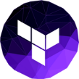
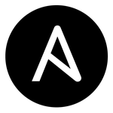
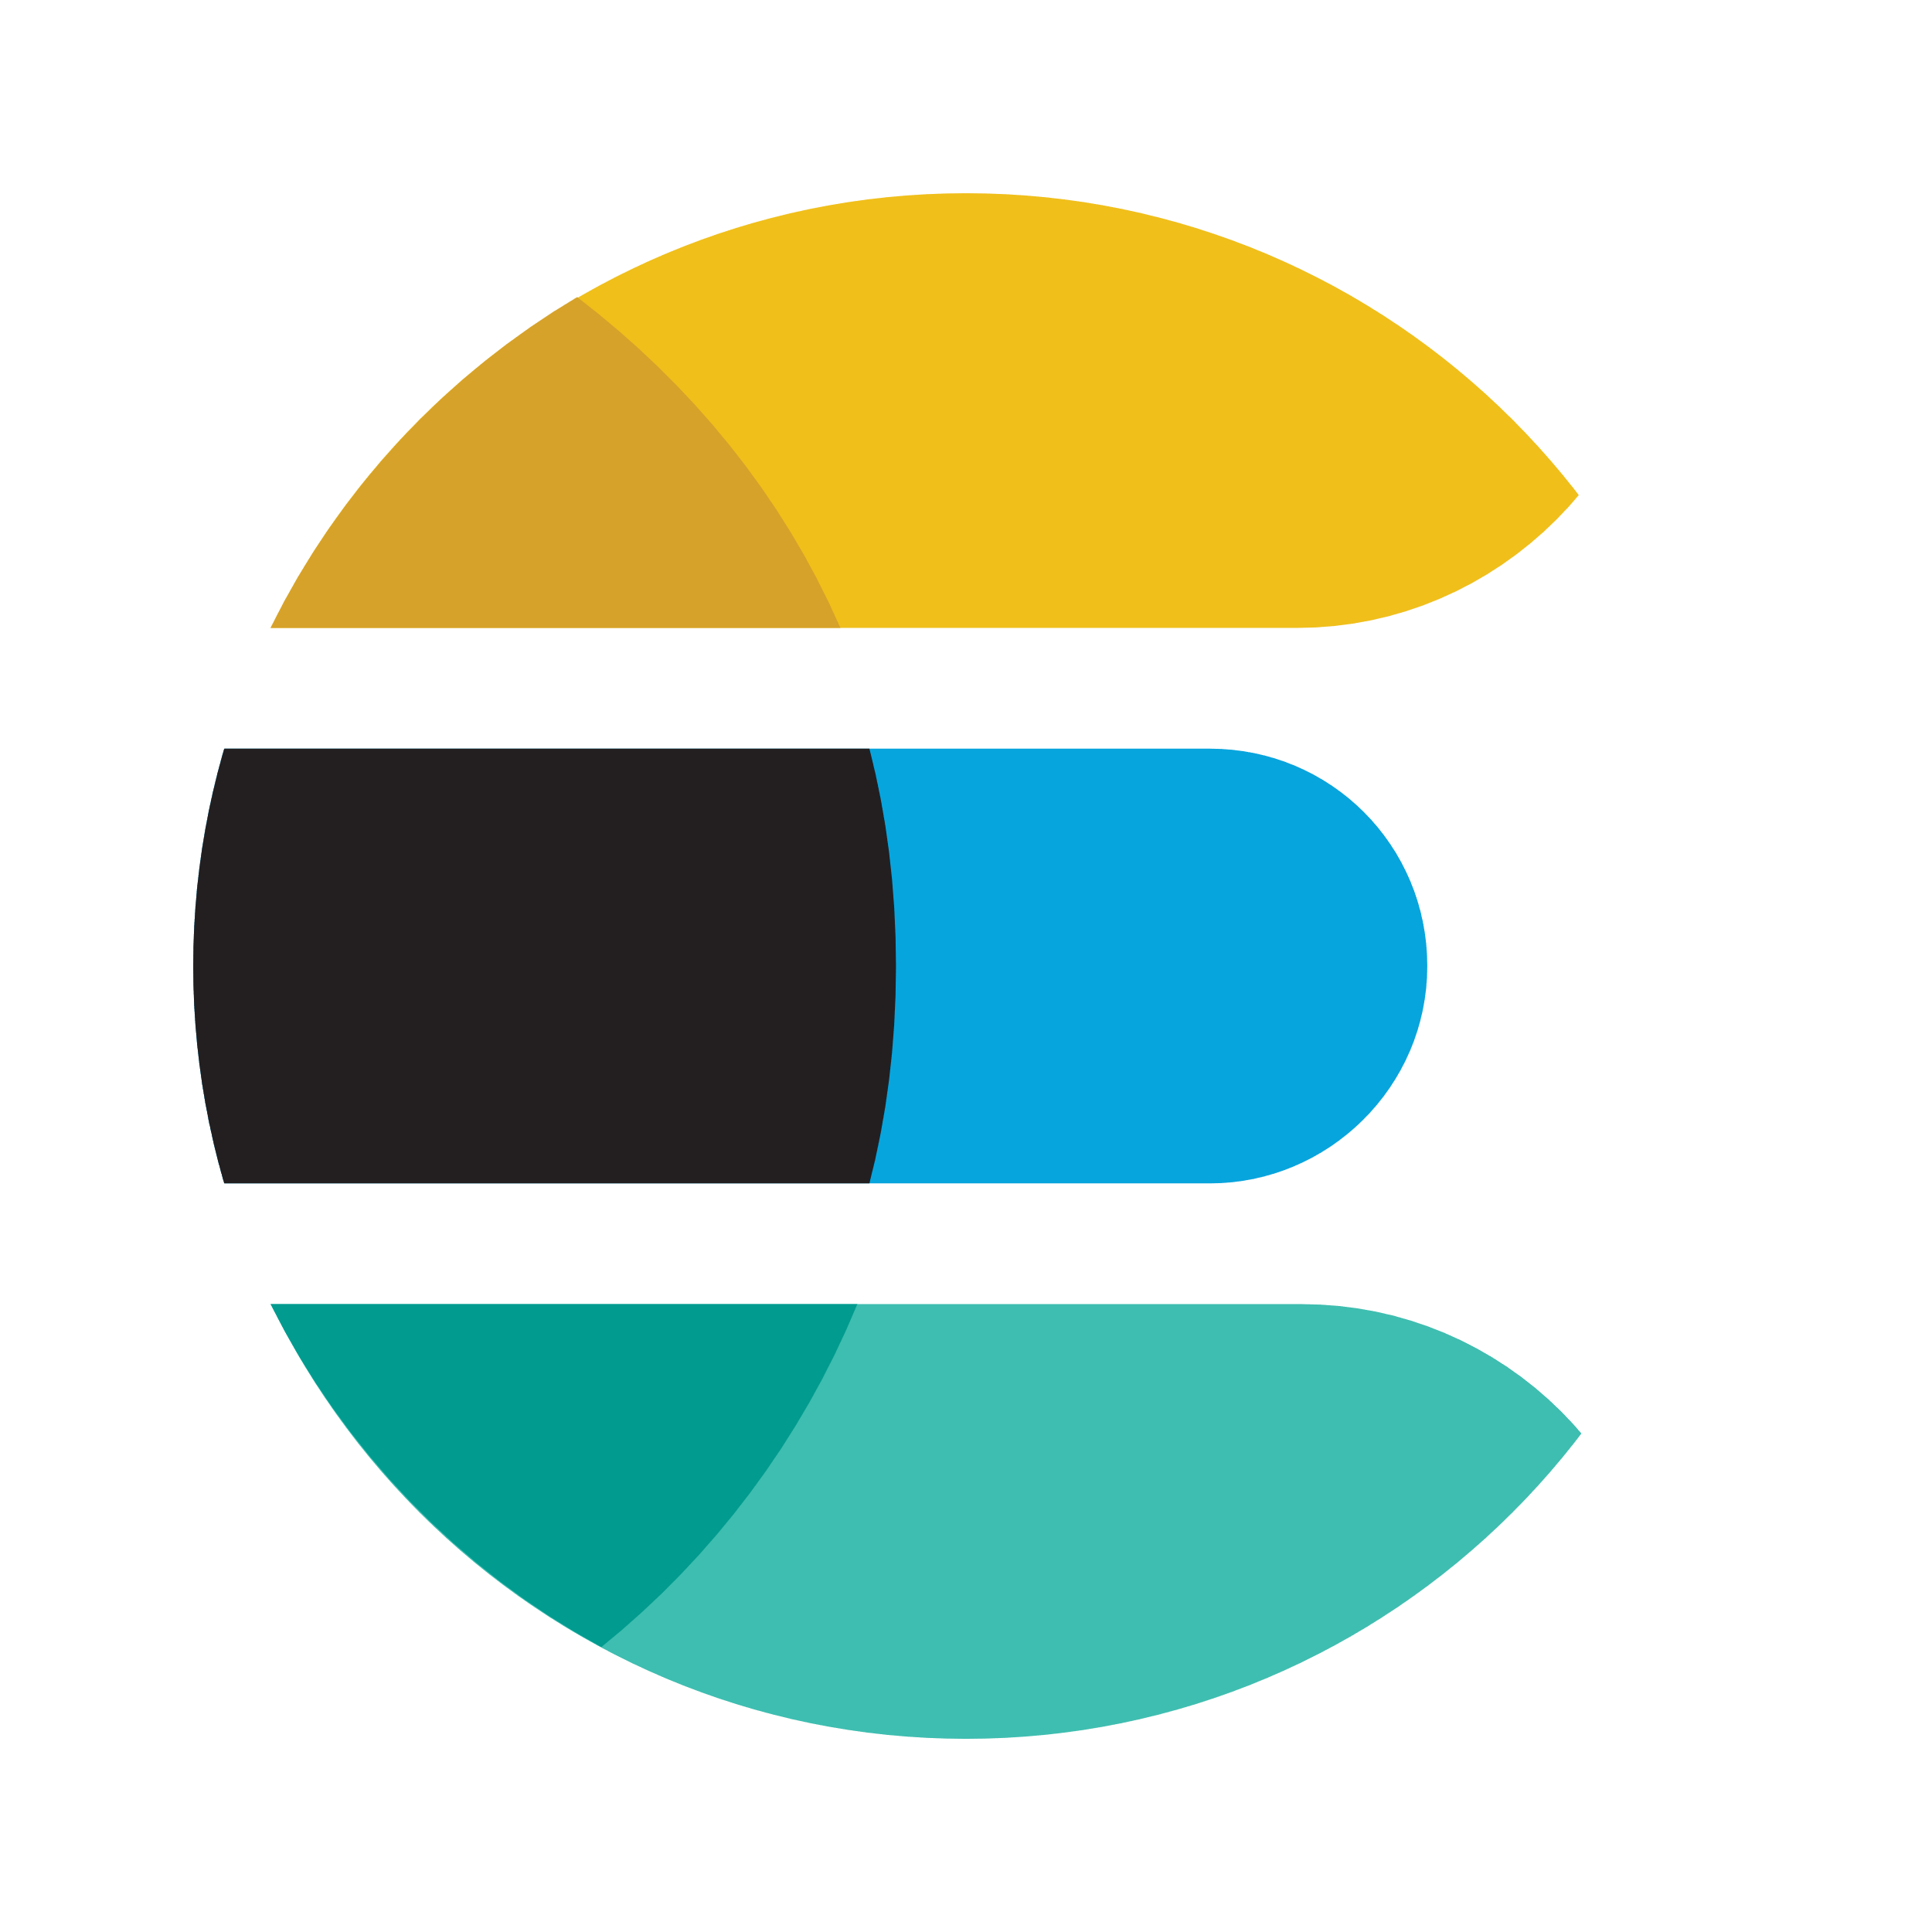

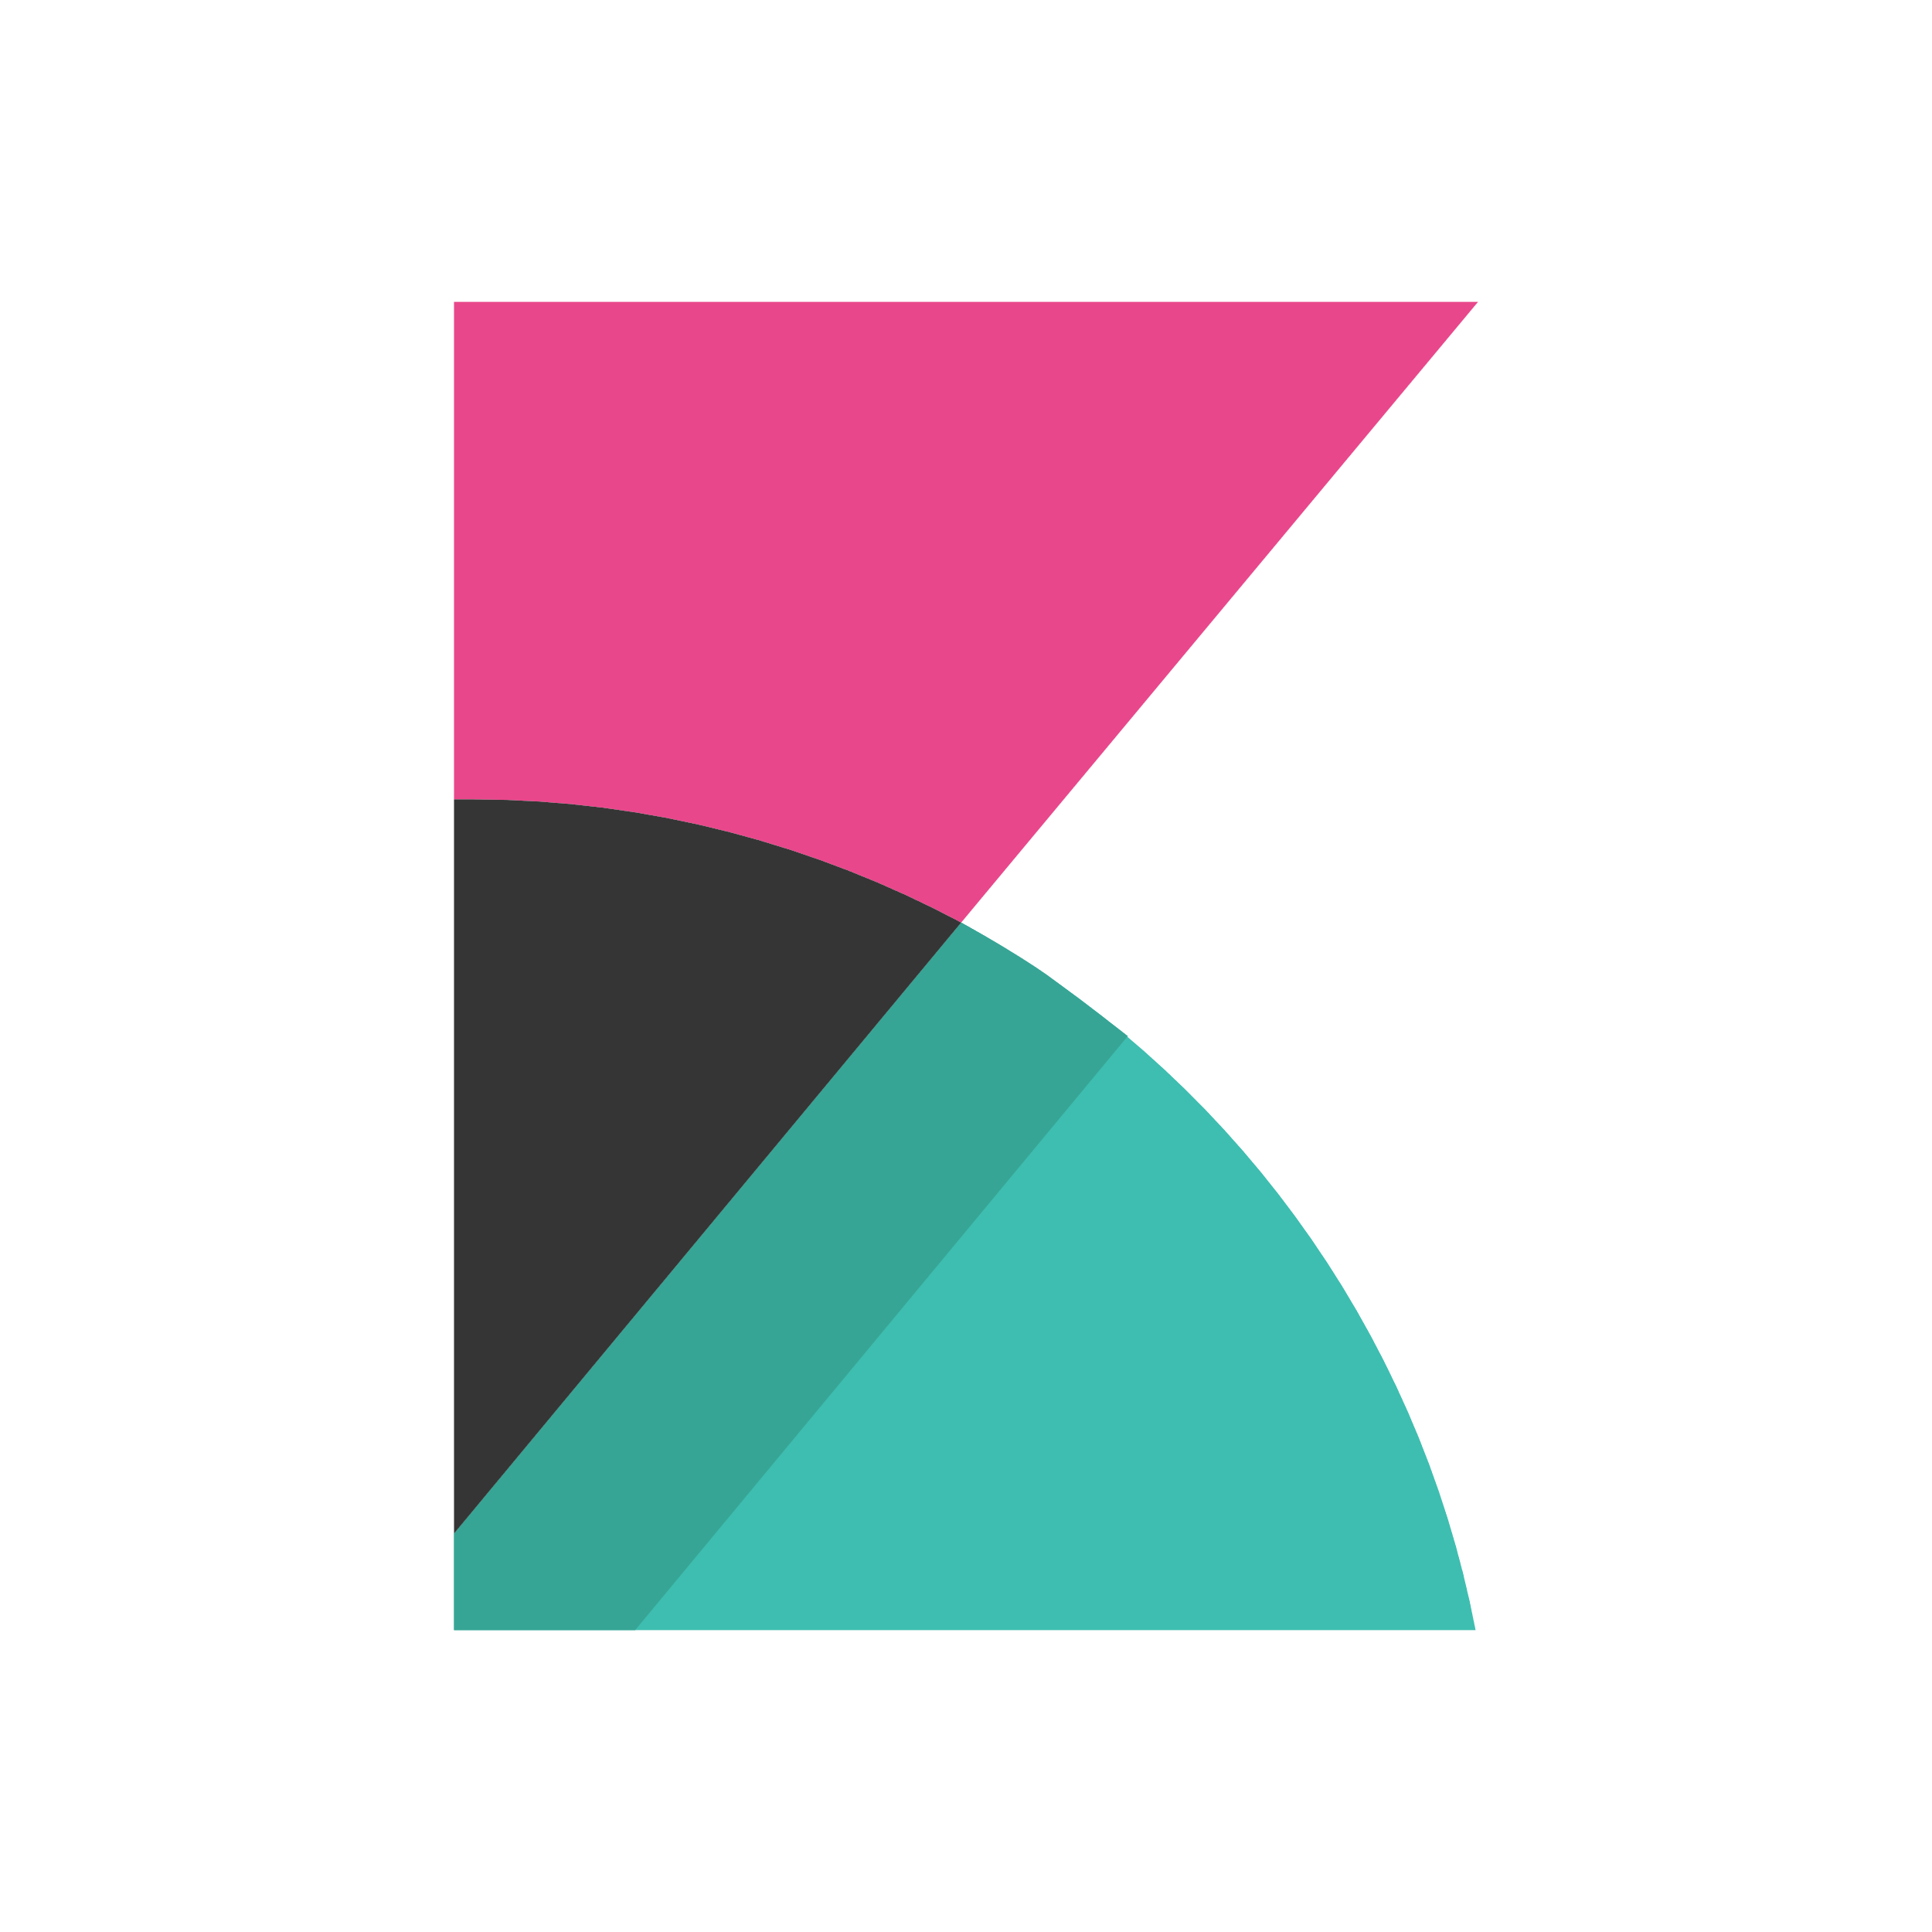
DevOps on Azure framework
Plan and track
Code
Build and test
Deploy
Operate
Monitor
Boards
(Azure DevOps)
Repos
(Azure DevOps)
Pipelines & Test Plans
(Azure DevOps)
Artifacts & Pipelines
(Azure DevOps)
Policy
Application
Insights
GitHub
Trello
GitHub
Jenkins
Terraform
Ansible
ELK Stack
Notes:
Deliver continuous innovation faster and more reliably with DevOps and Microsoft Azure.
Azure DevOps provides a fully integrated set of enterprise DevOps services covering the entire DevOps lifecycle. You can use all the Azure DevOps services, or choose just what you need to complement your existing workflows. Azure DevOps is comprised of:
Azure Boards allows you to track work with configurable Kanban boards, interactive backlogs, and powerful planning tools. Combined with the Azure DevOps suite of services, it provides traceability through the entire pipeline, from work item tracking, to code commit, builds and right through deployments.
Azure Repos provide flexible and powerful Git hosting with effective code reviews, start free and scale to unlimited git repositories for all your ideas.
Azure Pipelines allows you to build, test and deploy in any language, to any cloud – or on-premises. Run builds and tests in parallel on Linux, macOS, or Windows, and deploy containers to individual hosts or Kubernetes
Azure Test Plans enables you to improve your overall code quality with manual and exploratory testing tools for your apps.
Azure Artifacts allows you to share Maven, npm, and NuGet packages from public and private sources with your entire team. Integrate package sharing into your CI/CD pipelines in a way that's simple and scalable.
You can also use GitHub Enterprise or GitHub Business cloud for the management of source code, with direct integration into Azure Pipelines to provide an end-to-end solution that leverages the power and familiarity of GitHub, the largest open source community in the world. GitHub is also an open platform supporting a large ecosystem of integrations beyond Azure, that are easily available from the GitHub marketplace.
Azure is open – so If you've already made tooling choices such as Jenkins, Terraform, Ansible or Chef, we provide clear guidance and documentation to help you get started on Azure, fast.
If you’ve made choices in some areas, but have gaps in others, you can take advantage of Azure Pipelines to orchestrate and supplement your end-to-end DevOps toolchain.
Regardless of your toolchain choice, take advantage of the reliable and integrated security, monitoring & management capabilities of the Azure platform such as Azure Policy, Azure Monitor and Application Insights – spend less time fighting fires and more time meeting business requirements

Slide 9
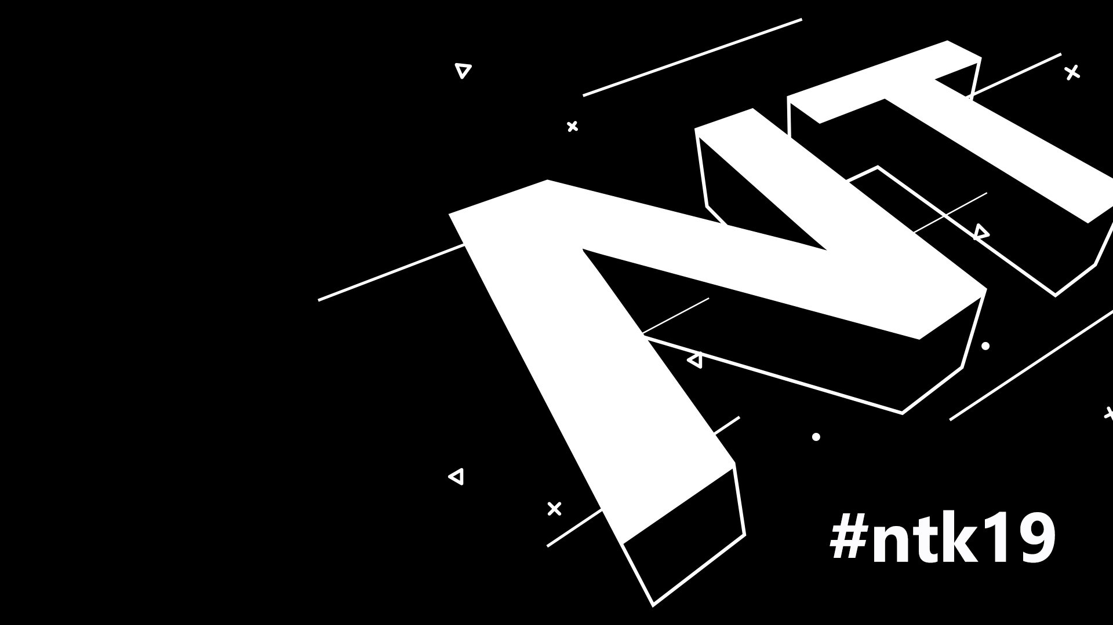
DevOps in action

Slide 10
Vprašanja ?

