Slide 1
Azure Active Directory
Identity Protection
Luka Obersnu
Microsoft PFE

Slide 2
Why Identity Security Matters?

Slide 3
Why Identity Security Matters?
It’s our responsibility to keep the bad guys out
If we fail at that job, bad things can happen

Slide 4
Why identity is important?
81%
73%
80%
of breaches are caused by credential theft
of passwords are duplicates
of employees use non-approved apps for work

Slide 5
Successful attacks
Disrupt businesses
Disrupt governments
Disrupt
lives

Slide 6
Bad guys need a password to get in
They can guess it
Common passwords
Easily guessable passwords
Reused passwords
Try all the passwords
They can know it
Third-party breach
Network breach
Phishing
Malware
Black market

Slide 7
Common attack types
Indiscriminate attacks
Brute forcing
Password spray
Some list cleaning
Easier to see
Easier to defend
Targeted attacks
Some list cleaning
Individual attacks
Harder to see
Harder to defend

Slide 8
Microsoft identity security at a glance
>1.4 billion auths every day on Azure AD
+ 13 billion auths from the consumer space (MSA)
Identify 30K potentially compromised users per day
Every day the Identity ML system processes >10 TB of data
Automatically deflect 1.5 million attacks per day in the consumer space

Slide 9
Identity Protection at scale
For MSA
For Azure AD
9.8M
users marked as compromised monthly
115.5M
blocked login attempts or 15.8M credentials daily
1.7M
users protected by real-time detection and challenges each day
1M
users marked as Med/High risk monthly over 50K tenants
2.4M
users marked as at risk monthly over 100K tenants
10K
users confirmed to be compromised each month

Slide 10
We need your help to protect our customers
2.4M risk events detected but…
  Less than 1 percent of tenants have enabled policies
Customers need to enable risk based policies so we can protect them in real-time!

Slide 11
Defenses in Azure AD
MFA
Identity Protection
Smart
Lockout
IP Lockout
Banned
PWs
Leaked Creds
Core protections

Slide 12
Defenses in Azure AD
Core protections
Generally available for all accounts, all the time
Multi-factor authentication
Available for basic, Premium P1, and Premium P2 accounts
Azure AD conditional access
Available Premium P1 users
Identity Protection
  Part of Premium P2

Slide 13
Core protection: Smart Lockout
Applies to all accounts always
Protects each account individually
  Too many failed sign-in attempts and the account locks temporarily
  Threshold: 10 failures & each subsequent failure
  Duration: 60 seconds per lock
  Prevents brute force attacks and some password spray
  Bad guys prevented from trying lots of passwords
  Doesn’t stop all attempts, but most of them
  Passwords still need to be not terrible

Slide 14
Core protection: IP Lockout
Applies to all accounts always
Protects accounts across the system
  Too many failed sign-in attempts and requests from the IP address are blocked for some duration of time
  The threshold is dynamic to prevent false positives
  Prevents brute force and password spray attacks
  Bad guys prevented from trying lots of sign-ins across many accounts
  Doesn’t stop all attempts, but most of them
  Passwords still need to be not terrible

Slide 15
Core protection: Banned Passwords
Applies to password changes for all accounts
Users prevented from using known-bad passwords
  Words on the list can’t be substrings of the password
  Words on the list can’t fuzzy match the password
  Applied at the time of password change or reset
  Two lists: Global & Tenant
  Global is applied to all accounts, prevents worst of the worst passwords
  Tenant is a Premium P2 feature, allows tenants to create a custom list
  In Private Preview now

Slide 16
Core protection: Leaked Credentials
Applies to all accounts always
Partnership with Azure Security
We find credentials in the wild
  Pastebin & other paste sites
  Dark web
  Trusted partners and researchers
  Law enforcement
  We check those creds against users’ current creds in AAD
  Use AAD to hash the password and compare to user’s current hash
  If a match: the password is compromised

Slide 17
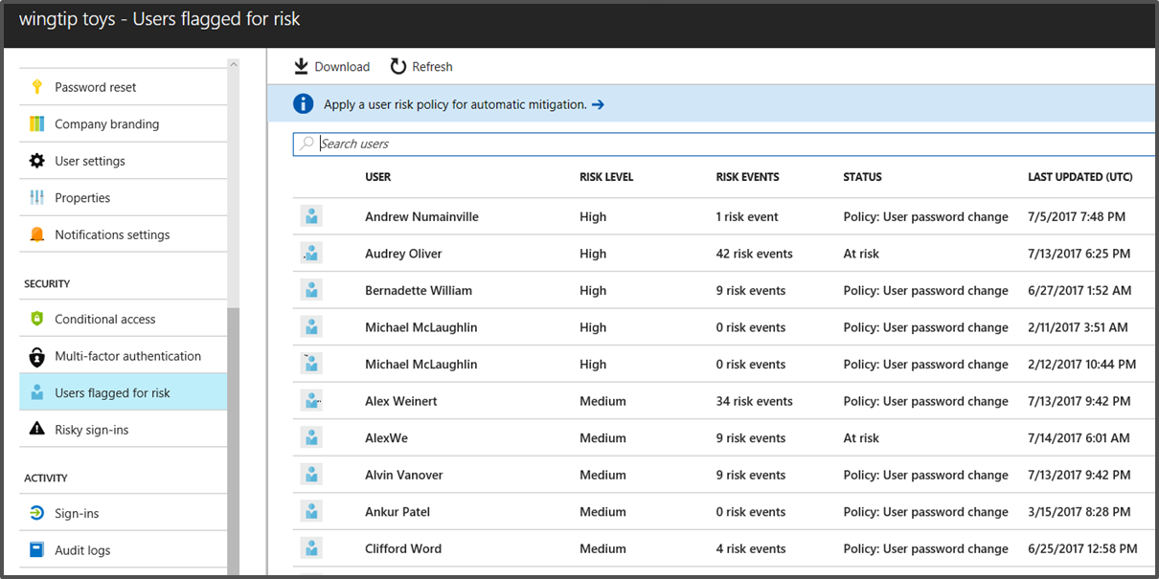
Core protection: Leaked Credentials
If we find an account with current creds in the wild:
  Account goes to High risk
  This is viewable as “Users at risk” or “Users flagged for risk” in:
  Azure AD Portal (all accounts:
  free, basic, P1, P2)
  Identity Protection (P2 only)

Slide 18
Core protection: Leaked Credentials
For managed accounts, it just works
For hybrid accounts, requires Password Hash Sync

Slide 19
Defenses in Azure AD
Core protections
Generally available for all accounts, all the time
Multi-factor authentication
Available for basic, Premium P1, and Premium P2 accounts
Azure AD conditional access
Available Premium P1 users
Identity Protection
  Part of Premium P2

Slide 20
Multi-factor authentication
Require >1 authentication method to sign in a user
Pro: way more secure than single factor
Con: more friction on users, and friction is bad

Slide 21
Multi-factor authentication
Four types currently available in Azure MFA:
Phone-based:
Call to phone
Text message to phone
App-based:
Notification through mobile app
Verification code from mobile app
More common
More secure

Slide 22
Defenses in Azure AD
Core protections
Generally available for all accounts, all the time
Multi-factor authentication
Available for basic, Premium P1, and Premium P2 accounts
Azure AD conditional access
Available Premium P1 users
Identity Protection
  Part of Premium P2

Slide 23
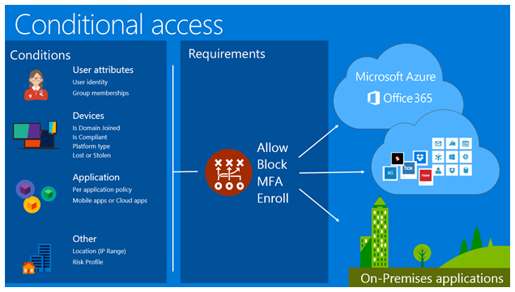
Azure AD conditional access

Slide 24
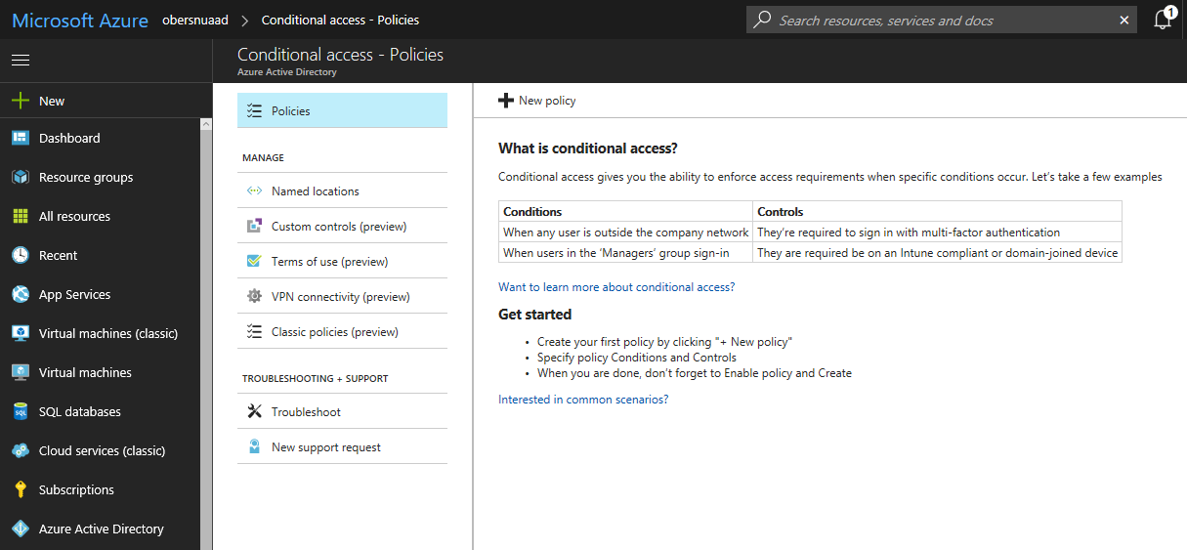
Azure AD conditional access

Slide 25
Defenses in Azure AD
Core protections
Generally available for all accounts, all the time
Multi-factor authentication
Available for basic, Premium P1, and Premium P2 accounts
Azure AD conditional access
Available Premium P1 users
Identity Protection
  Part of Premium P2

Slide 26
Azure Active Directory
Identity Protection

Slide 27
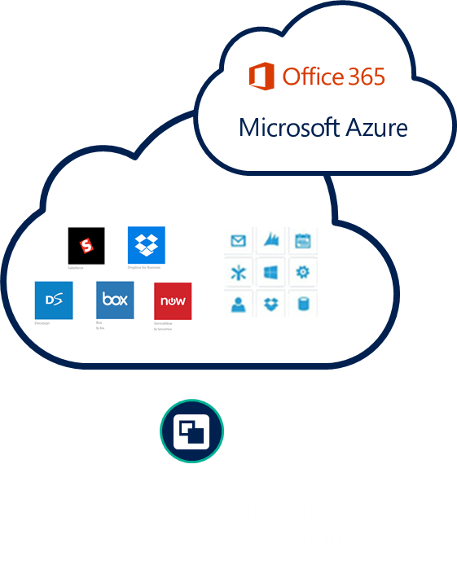
Identity-driven security
Actions
Conditions
Location (IP range)
Allow access
Or
Device state
User
Enforce MFA per user/per app
User group
Risk
MFA
Block access
NOTIFICATIONS, ANALYSIS, REMEDIATION, RISK-BASED POLICIES
CLOUD APP DISCOVERY
PRIVILEGED IDENTITY MANAGEMENT
IDENTITY PROTECTION

Slide 28
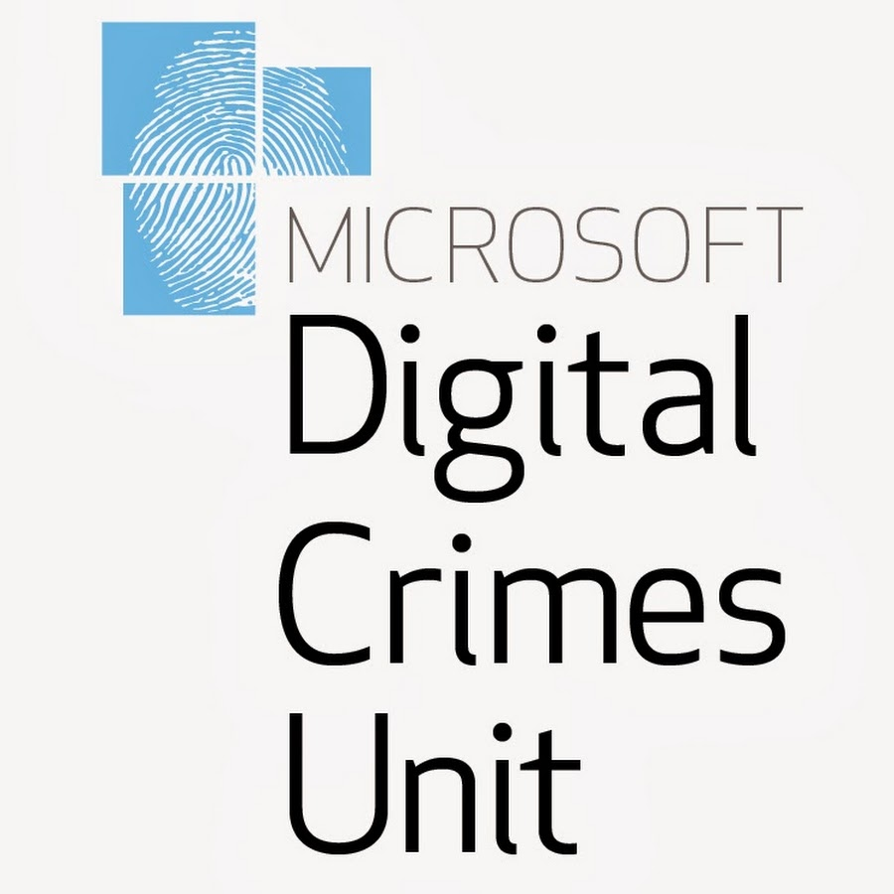


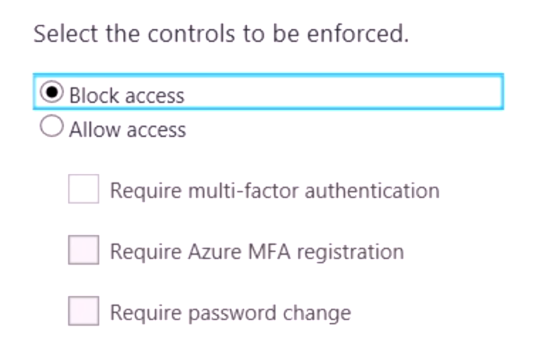
Azure Active Directory Identity Protection
Threat Intelligence
14B
User behavior data from
14B logons each day
Attacker behavior data from millions of attacks each day
Threat data from applications, industry partners, researchers, and law enforcement
Botnet data from Microsoft’s Digital Crimes Unit
Malware data from the Windows Defender team
Microsoft Azure
Active Directory
logons /day
10 TB
High
Medium
per day
Low
Law
Enforcement
Machine learning
Risk score
Security
Researchers
Alerts and risk-based, policy-driven remediation
MICROSOFT CONFIDENTIAL – FOR DISCUSSION PURPOSES ONLY

Slide 29
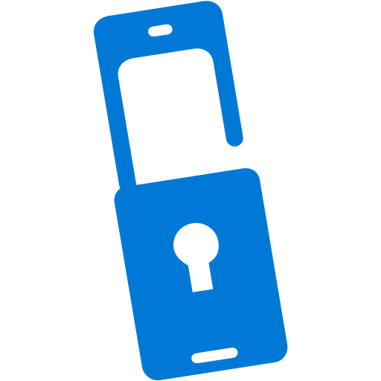
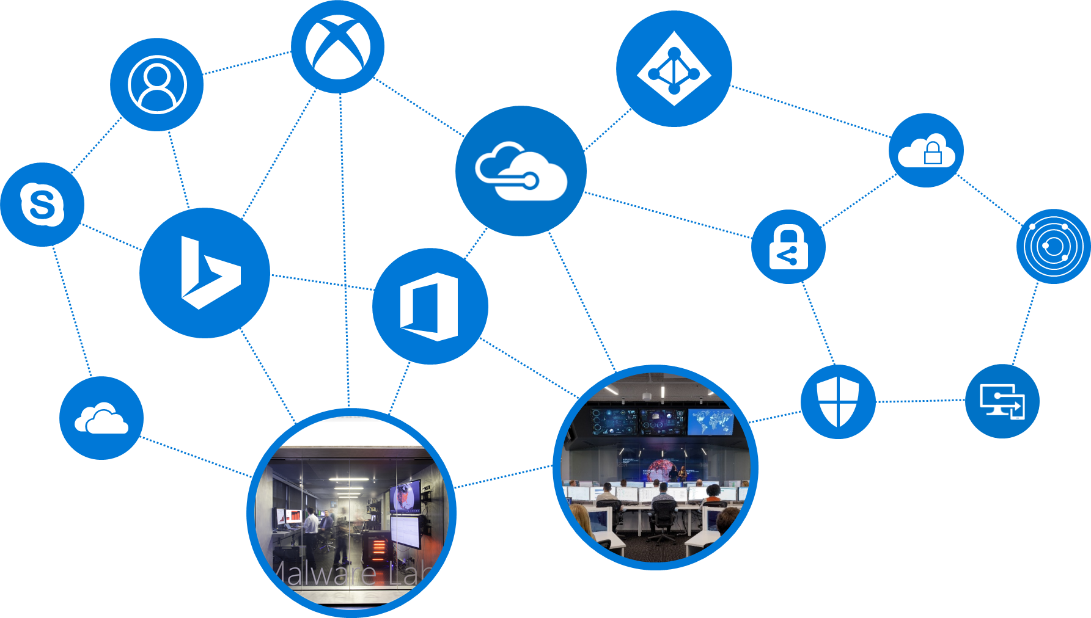
Azure Active Directory Identity Protection
CONDITIONS
CONTROLS
Allow access
User risk
Privileged user?
Credentials found in public?
Accessing sensitive app?
Unmanaged device?
Malware detected?
IP detected in Botnet?
Impossible travel?
Anonymous client?
High
Medium
Require MFA
10 TB
Low
Force password reset
******
per day
Session risk
High
Deny access
Medium
Low
Limit access

Slide 30
Azure Active Directory Identity Protection
For when a bad actor already has a user’s password
Premium P2
Detects anomalies in individual sign-ins
Sign-ins from unfamiliar locations
Impossible travel from unfamiliar locations
Sign-ins from malware-infected devices
Sign-ins from anonymous IP addresses
Sign-ins from suspicious IP addresses
More coming soon...

Slide 31
Azure Active Directory Identity Protection
Calculates two types of risk:
Sign-in risk – risk of a sign-in at a point in time
User risk state – the current risk state of a user
User risk state is calculated from that user’s risky sign-ins
jdoe@contoso.com...
Medium risk – unfamiliar location
Medium risk – impossible travel
Low risk – malware
Medium risk – impossible travel
High risk – leaked credential
jdoe@contoso.com
has High risk

Slide 32
Azure Active Directory Identity Protection
What if you don’t have Premium P2?
In Azure AD Portal, you can see:
  Users flagged for risk (i.e. list of users with High and Medium risk)
  Risky sessions (i.e. sign-ins that were flagged by AADIP algorithms)
No details or policies but you can see users who need remediation and related sign-ins
P2 tenants see all data and all details, and…

Slide 33
Demo
Azure AD Users flagged for risk, Risky sign-ins

Slide 34
Azure Active Directory Identity Protection
The real key to AADIP: Real-time protection
Risk policies:
  Session risk policy:
    If a session looks risky:
      require MFA in real-time to assure identity
  User risk policy:
    If a user is at risk:
      on next login, require MFA to assure identity and
      require password change
Set risk levels (H,M,L) reflect tolerance for risk vs friction

Slide 35
Azure Active Directory
Identity Protection -
Deployment journey

Slide 36
AADIP - Deployment journey
Don’t have the license to use Identity Protection?
Requires Azure AD Premium P2 or Enterprise Mobility Security E5
Easily setup trial in 1-click and pay only if you see value: Https://aka.ms/AADP2Trial

Slide 37
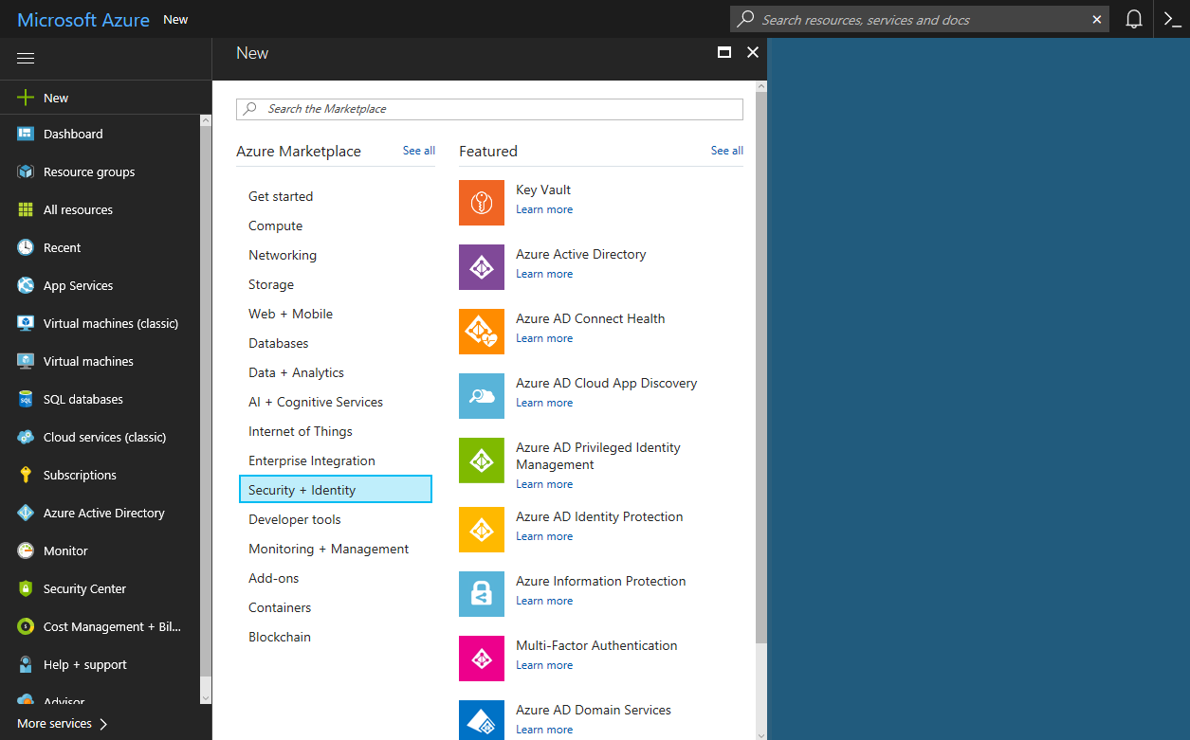
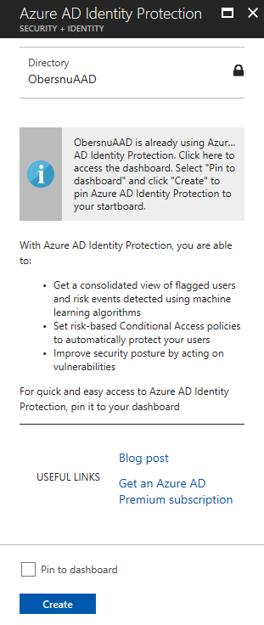
AADIP - Deployment journey
“Just Turn On the Feature!”
Go to https://portal.azure.com
2. In Marketplace, click on Security + identity
3. Select Azure AD Identity Protection
Or simply, go to
https://aka.ms/IPSignUp
(1-click option)

Slide 38
Demo
Onboard Azure AD Identity Protection

Slide 39
AADIP - Deployment journey
Roll out Multi-Factor Authentication registration policy
Goal
  Verify user’s identity
Recommendation
  Enable registration for all users
Things to know
  Only works with Azure MFA

Slide 40
AADIP - Deployment journey
Roll out sign-in risk policy
Goal
  Prevent bad actors from signing in
Two options
  MFA
  Block
Recommendation
  MFA on medium risk
Things to know
  MFA can be performed on-prem or cloud

Slide 41
AADIP - Deployment journey
Roll out user risk policy
Goal
  Remediate accounts that might be compromised
Two options
  Password change (Secure)
  Block
Recommendation
  Password change on high risk
Things to know
  Require password writeback

Slide 42
Demo
Configure policies

Slide 43
AADIP - Deployment journey
Key takeaways
Customers need to enable policies so we can help protect them
  MFA registration for all users
  MFA for medium or above risk sign-ins
  Password change for high risk users
Enable password hash sync for leaked credentials
Enable writeback for user risk policy to work

Slide 44
AADIP - Deployment journey
Some deployment recommendations
When setting the policy:
Exclude users who do not/cannot have multi-factor authentication
Exclude users in locales where enabling the policy is not practical (for example no access to helpdesk)
Exclude users who are likely to generate a lot of false-positives (developers, security analysts)
Use a High threshold during initial policy roll out, or if you must minimize challenges seen by end users.
Use a Low threshold if your organization requires greater security. Selecting a Low threshold introduces additional user sign-in challenges, but increased security.
The recommended default for most organizations is to configure a rule for a Medium threshold to strike a balance between usability and security.
Choosing a High threshold reduces the number of times a policy is triggered and minimizes the impact to users.
However, it excludes Low and Medium sign-ins flagged for risk from the policy, which may not block an attacker from exploiting a compromised identity.

Slide 45
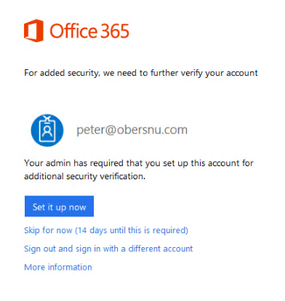
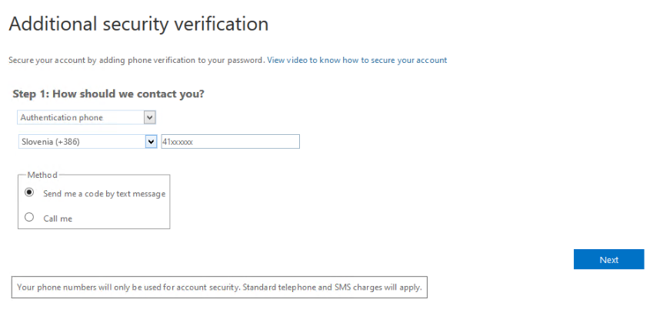
AADIP - Deployment journey
What about users?
Crucial point is also to educate users:
how to register for MFA
what to do in case they are unable to sign in
how to use MFA to sign in

Slide 46
Azure Active Directory
Identity Protection -
Ongoing management

Slide 47
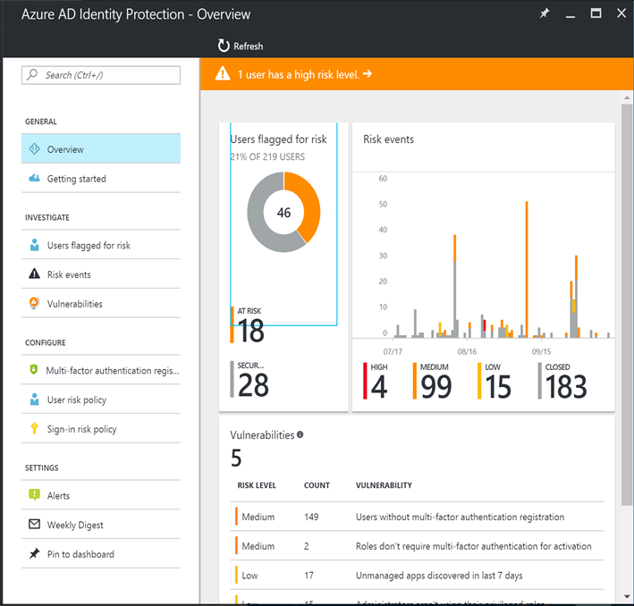
AADIP - Ongoing management
Data fatigue
Prioritize investigation
Start with high risk levels
Choose the high value users from medium or simply the ones with most risk events

Slide 48
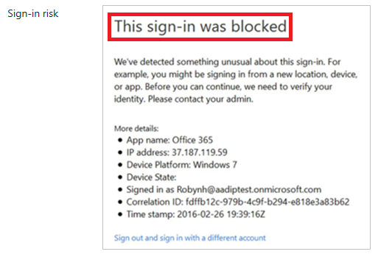
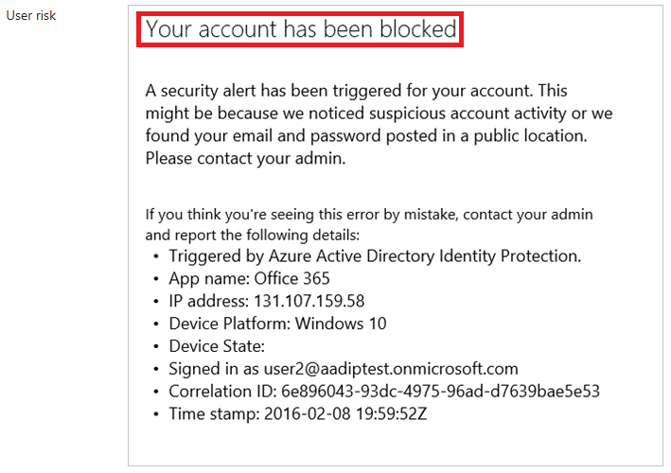
AADIP - Ongoing management
Determine the reason for blocking
A user that is blocked by:
A sign-in risk policy is also known as suspicious sign-in
A user risk policy is also known as an account at risk

Slide 49
AADIP - Ongoing management
Unblocking suspicious sign-ins
To unblock a suspicious sign-in, you have the following options:
  Sign-in from a familiar location or device - A common reason for blocked suspicious sign-ins are sign-in attempts from unfamiliar locations or devices. Your users can quickly determine whether this is the blocking reason by trying to sign-in from a familiar location or device.
  Exclude from policy - If you think that the current configuration of your sign-in policy is causing issues for specific users, you can exclude the users from it.
  Disable policy - If you think that your policy configuration is causing issues for all your users, you can disable the policy.

Slide 50
AADIP - Ongoing management
Unblocking accounts at risk
To unblock an account at risk, you have the following options:
  Reset password - You can reset the user's password.
  Dismiss all risk events - The user risk policy blocks a user if the configured user risk level for blocking access has been reached. You can reduce a user's risk level by manually closing reported risk events.
  Exclude from policy - If you think that the current configuration of your sign-in policy is causing issues for specific users, you can exclude the users from it.
  Disable policy - If you think that your policy configuration is causing issues for all your users, you can disable the policy.

Slide 51
Demo
Ongoing Management

Slide 52
AADIP - Ongoing management
Key takeaways
Enable Password Hash Sync for leaked credentials
Configure named locations to reduce false positives
Provide feedback via product as well as reach out to PG

Slide 53
Azure Active Directory
Identity Protection -
Alerting & Weekly Digest

Slide 54
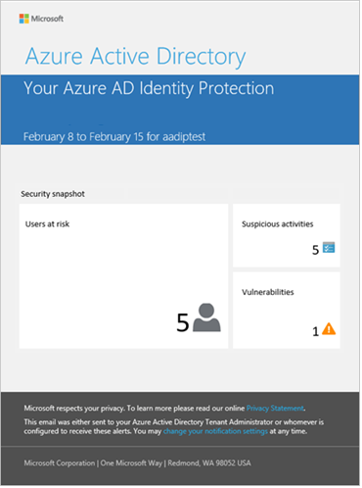
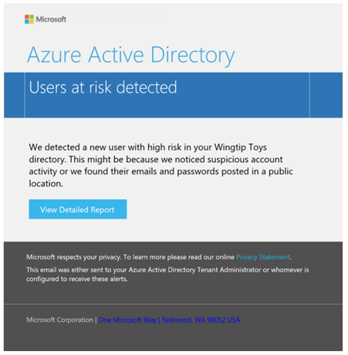
AADIP - Alerting & Weekly Digest

Slide 55
Demo
Setup Alerts and Weekly Digest

Slide 56
AADIP - Alerting & Weekly Digest
Key takeaways
Ensure the right individuals are receiving alerts & weekly digest

Slide 57
Azure Active Directory
Identity Protection -
How to Demo

Slide 58
AADIP - How to Demo
Onboard to Azure AD Identity Protection
Simulate risk events
  Sign-ins from anonymous IP addresses
  Sign-ins from unfamiliar locations
Set up risk-based conditional access policies
  Sign-in risk policy
  User risk policy
  MFA registration policy
End-user flows demos
  Sign-in from browser and go through MFA registration
  Sign-in from tor and show off risk based MFA
  Sign-in with a user account at risk and show off user password change
DEMO playbook: https://docs.microsoft.com/en-us/azure/active-directory/active-directory-identityprotection-playbook

Slide 59
Demo
How to Demo

Slide 60
Azure Active Directory
Identity Protection -
Roadmap

Slide 61
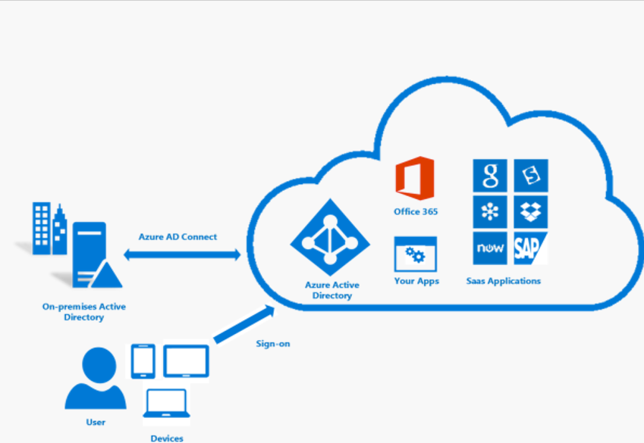
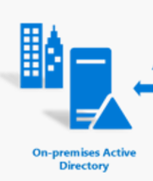

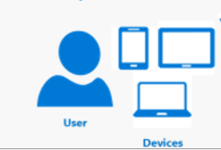


AADIP - Roadmap
Federation deep dive
Currently, risk-based conditional access only works for cloud resources (for both managed and federated users)
Coming soon: integrate with AD FS to do risk-based conditional access for all AD FS authentications, including to relying parties not configured with Azure AD
Azure Active Directory
Covered by Identity Protection
On-prem Active Directory
User
Protection coming Soon
On-prem Relying Parties

Slide 62
AADIP - Roadmap
Advanced detection
IP reputation
Brute force (smart lockout)
Anomalous user sign-in behavior
Signals from other Microsoft services
  Exchange
  Rights Management Services
  Advanced Threat Analytics
  Cloud App Security
  SharePoint etc.

Slide 63
Additional resources
  Public preview announcement
  Support for federated identities
  Azure AD Identity Protection Documentation
  Demo playbook
  End user experience
  Channel 9 Video
  APIs
  Security reader role
  Sign up
  Microsoft mechanics video

Slide 64
Q & A

Slide 65
Evaluate

