Slide 1


Slide 2

Windows Defender ATP
Robert Turnšek, NIL
IT Architect
Microsoft p-seller

Slide 3
“There are two kinds of big companies, those who’ve been hacked, and those who don’t know they’ve been hacked.”
James Comey
200+
80
$3Trillion
$3.5Million
Median number of days attackers are present on a victims network before detection
Days after detection to full recovery
Impact of lost productivity and growth
Average cost of a data breach (15% YoY increase)
Notes:
We’re used to attackers directly targeting fortune 500s but now we’re seeing attacks on any vulnerable target.
Those numbers are scary: It takes an enterprise more than 200 days to detect a security breach and, once you finally found them, it often takes a very long time to completely recover from that breach, often up to 80 days. Attackers can wreak havoc on a corporate network, stealing data, breaching privacy, and destroying the trust of customers.
These attacks are incredibly expensive, and often come with a broader impact to a company’s reputation
And there’s also enough data today quantify what the cost of breaches is.
Note:
Source 1 (HEADING): Cyber security is a CEO issue: http://www.mckinsey.com/insights/business_technology/why_senior_leaders_are_the_front_line_against_cyberattacks
Siource 2: 243 days for attacker to be present: http://www.fireeye.com/news-events/press-releases/read/fireeye-releases-annual-mandiant-threat-report-on-advanced-targeted-attacks
Source 3: 140 countries developing cyber weapons: Infosec Institue, “The Rise of Cyber Weapons and Relative Impact on Cyberspace”
Source 4: $3 trillion in lost productivity: http://www.mckinsey.com/insights/business_technology/why_senior_leaders_are_the_front_line_against_cyberattacks
Source 5: $3.5 million cost: http://www.ponemon.org/blog/ponemon-institute-releases-2014-cost-of-data-breach-global-analysis

Slide 4
YOUR
IT ENVIRONMENT

Slide 5
YOUR
YOUR
IT ENVIRONMENT
OPPORTUNITY

Slide 6




Smart cities
Sensors
Vehicles
Partners
Energy systems
Cloud
Equipment
On-premises
YOUR
YOUR
IT ENVIRONMENT
O
P
P
O
R
T
U
N
I
T
Y
Mobile devices
Manufacturers
Marketplaces
Citizens
Supply Chains
Customers

Slide 7




YOUR
IT ENVIRONMENT

Slide 8
Attacks are more sophisticated
  Highly Skilled
  Well funded
  New attack surface
  Collaborate
  Carbanak, a malicious banking campaign by organized group stole $300 million to $1 billion in total from more than 100 banks.
$
$
$
$
$
$
$

Slide 9
The security team
  Protecting against attacks is more challenging than ever
  Security talent is at short
  Bigger attack surface
  Increased amount of data
  Cost- cyber-insurance policies are becoming a new operating expense

Slide 10
MICROSOFT UNIQUE APPROACH
PLATFORM
INTELLIGENCE
PARTNERS

Slide 11
MICROSOFT UNIQUE APPROACH
Identity
PLATFORM
Device
Apps & Data
Infrastructure

Slide 12



MICROSOFT UNIQUE APPROACH
Identity
MICROSOFT SECURITY PLATFORM
PLATFORM
Device
Advanced Threat Analytics
Cloud App Security
Intune
Windows Server 2016
SQL Server 2016
Windows Trust Boot
Privileged Identity Management
Credential Guard
Microsoft Passport
Windows Hello
Windows Defender ATP
Windows Update for Business
Windows Information Protection
Azure Active Directory
Azure Security Center
Azure Storage Service Encryption
Azure Key Vault
Azure Information Protection
Advanced Threat Protection
Anti-Spam / Anti-Malware
Message Encryption
Data Loss Prevention
Threat Intelligence
Advanced Security Management
Apps & Data
Infrastructure

Slide 13
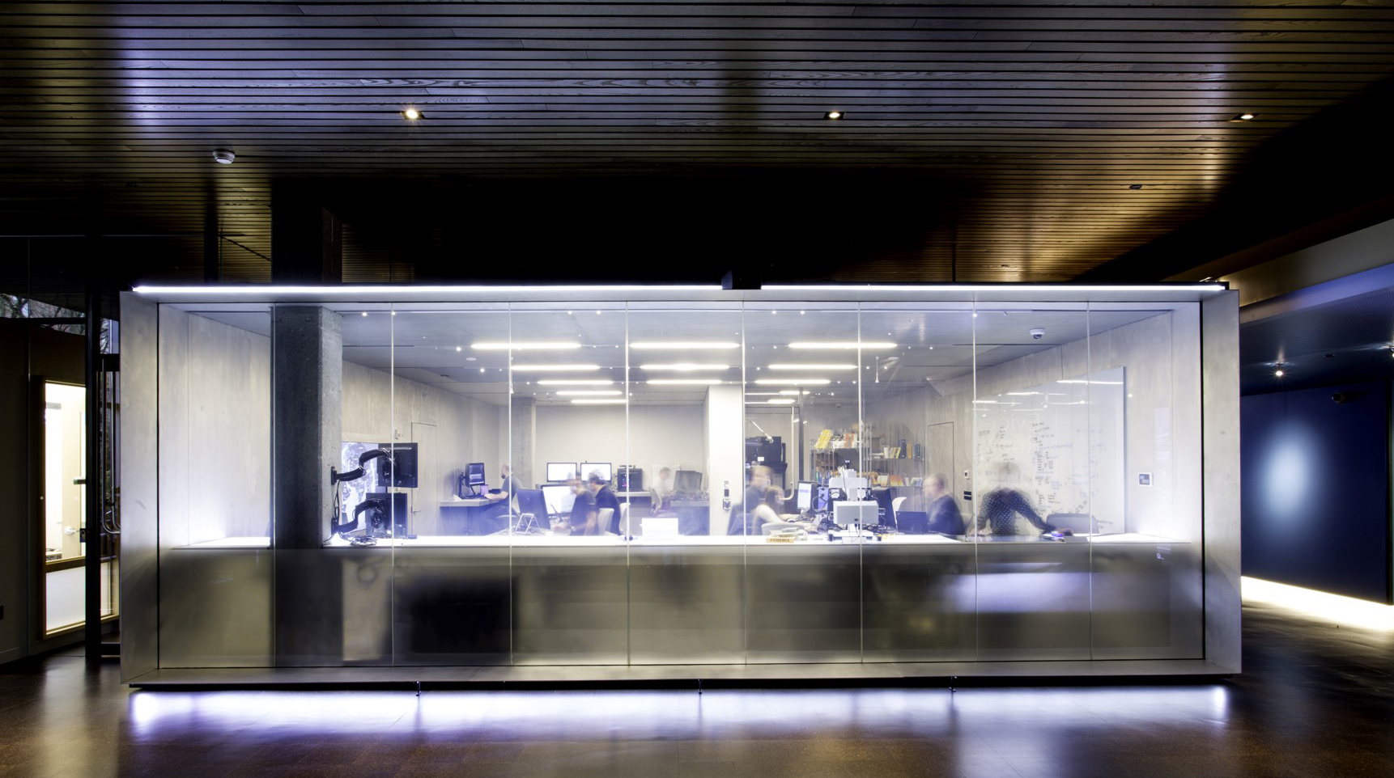


Cyber Defense Operations Center,
Digital Crimes Unit
Attorneys, investigators, data analysts and business professionals
INTELLIGENCE
100 people in 30 countries
Committed to fighting cybercrime
Experts in data analytics, cyberforensics

Slide 14
MICROSOFT PARTNERSHIP APPROACH
OUR UNIQUE APPROACH
Active Directory Premium
Advanced Threat Analytics
Identity
Partner with peers
PLATFORM
PLATFORM
INTELLIGENCE
PARTNERS
Windows 10 Intune
Device
Work with industry alliances
Cloud App Security
Intune
Apps & infrastructure
Work with government
Information Protection
Data

Slide 15
So What is
Windows Defender ATP?

Slide 16

Not Anti-Virus

Slide 17

Nearly 1 Million new Malware threats released every day

Slide 18
Malware is not the only vector
46%
of compromised systems had no malware on them

Slide 19

“APT” – Advanced Persistent Threat

Slide 20
Attackers are hard to detect
200+ days
Median number of days attackers are present on a victims network before detection

Slide 21
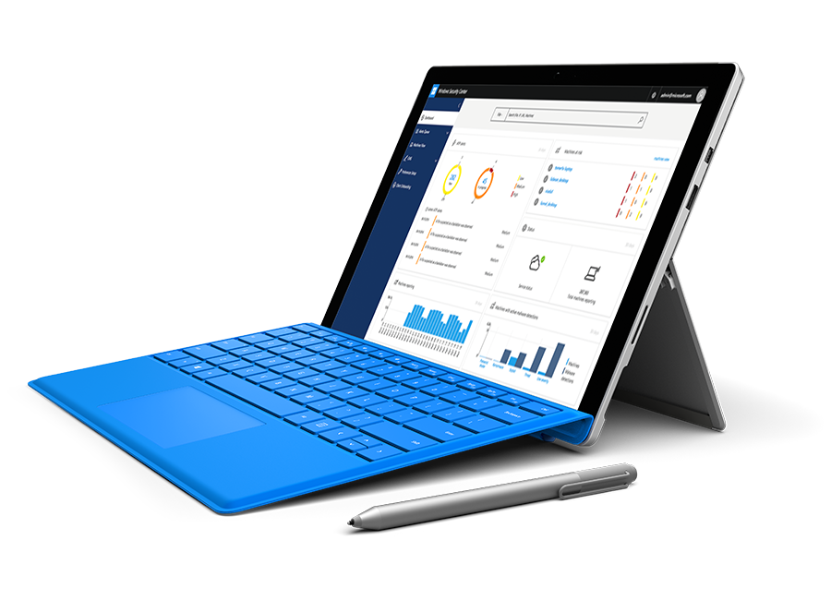
Windows Defender
Advanced Threat Protection
Detect advanced attacks and remediate breaches
Built in to Windows 10
No additional deployment & infrastructure.
Continuously up-to-date, lower costs.
Behavior-based, cloud-powered breach detection
Actionable, correlated alerts for known and unknown adversaries.
Real-time and historical data.
Rich timeline for investigation
Easily understand scope of breach. Data pivoting across endpoints. Deep file and URL analysis.
Unique threat intelligence knowledge base
Unparalleled threat optics provide detailed actor profiles
1st and 3rd party threat intelligence data.
Notes:
Windows Defender ATP uses a combination of client technology built into Windows 10 and our robust cloud service.
Windows Defender ATP is composed of 3 parts:
The Client – an agent built into the OS (Windows 10 Anniversary update and later)
responsible to log everything that happens on the client machine and send it over to the cloud
Cloud analytics service– leverage huge dictionary of IOAs and signals collected across it’s eco-system of Windows customers, enterprise cloud products and online assets.
It runs on a scalable Big Data, a processing service to draw fast insights, identifying attacks and use many ML algorithms that were created in the last years by
AND
Microsoft and community intelligence, our Hunters and researchers that are investigating the data and finding and creating new behavioral patterns and correlating it with existing knowledge from the security community
Windows Defender ATP brings you the following values
Endpoint APT protection built into Windows
It’s simple, native part of Windows 10 code, no additional deployment required, switch on through configuration. Continuously up-to-date, lowers costs.
Behavior based, cloud powered, advanced attack detection
Finds the attacks that made it past all other defenses (Post breach detection), provides actionable, correlated alerts for known and unknown adversaries trying to hide their activities on endpoints.
Rich timeline for forensic investigation and mitigation
Easily investigate scope of breach or suspect behaviors on any machine through a rich machine timeline. File, URLs and network connection inventory across the network. Gain additional insights using deep collection and analysis (“detonation”) for any file or URLs.
Built in threat intel knowledge base
Unparalleled threat optics provides actor details and intent context for every
threat intel-based detection – combining 1st and 3rd party intelligence sources

Slide 22
Threat Intelligence from partnerships
Always-on endpoint behavioral sensors
Security analytics
Forensic collection
Behavioral IOAs Dictionary
Threat Intelligence by Microsoft hunters
Known adversaries
unknown
SecOps console
Exploration
Files and URLs detonation
Alerts
Response
Customers' Windows Defender ATP tenant
SIEM
SIEM / central UX
Windows APT Hunters,
MCS Cyber
Notes:
The Windows Defender ATP agent is embedded into Windows 10, which mean no additional deployment is required and also no additional infrastructure on-prem is required. All the logic happens in the cloud. The agent is responsible to log everything that happens on the client machine and send it over to the cloud. The agent is also responsible for collecting other forensic data, such as PE files, and will have remediation capabilities at a la later point. The agent knows where to send the data to, because of an Organization certificate, which gets installed during the onboarding process.
The cloud backend is based on Azure services, designed for scale (endpoints, Organizations, users, data) and gets built for compliance. Each customer has its own Windows Defender ATP tenant, where its data gets stored and any access to the data is limited to authorized SecOps only and fully audited. The portal is also hosted in this tenant and uses Microsoft Azure AD accounts to authenticate. During the onboarding process, the customer has to provide an Azure Active Directory account and additional accounts can be added to grand access. Each tenant also has its own detonation chamber, which mean files will not even leave the tenant for deep file analyses. Before cyber data leaves the customer tenant (for instance to provide optics to our APT Hunters), all personal identifiable information (PII) data gets removed.
Every tenant gets enriched with a global threat intelligence knowledge base, which is combined of our own 1st party threat intelligence as well as with 3rd party intelligence sources (we will share more about our partners at a later point). We are working on providing SIEM connectors for the most popular SIEM vendors, starting with Splunk for GA. At this point we do not commit to customers what connector will be available at what time, as we are still developing the product as well as the SIEM connectors. If customers are using a different SIEM they can use our APIs to pull alerts into their SIEM system.

Slide 23

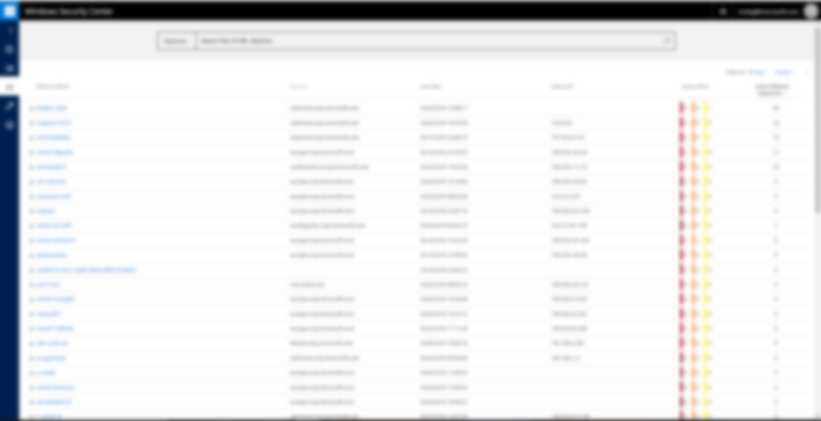
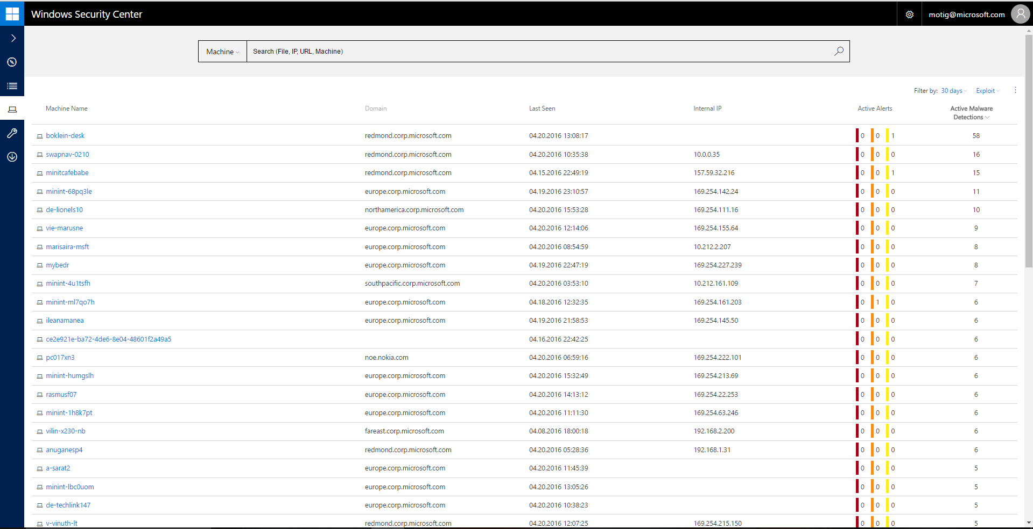
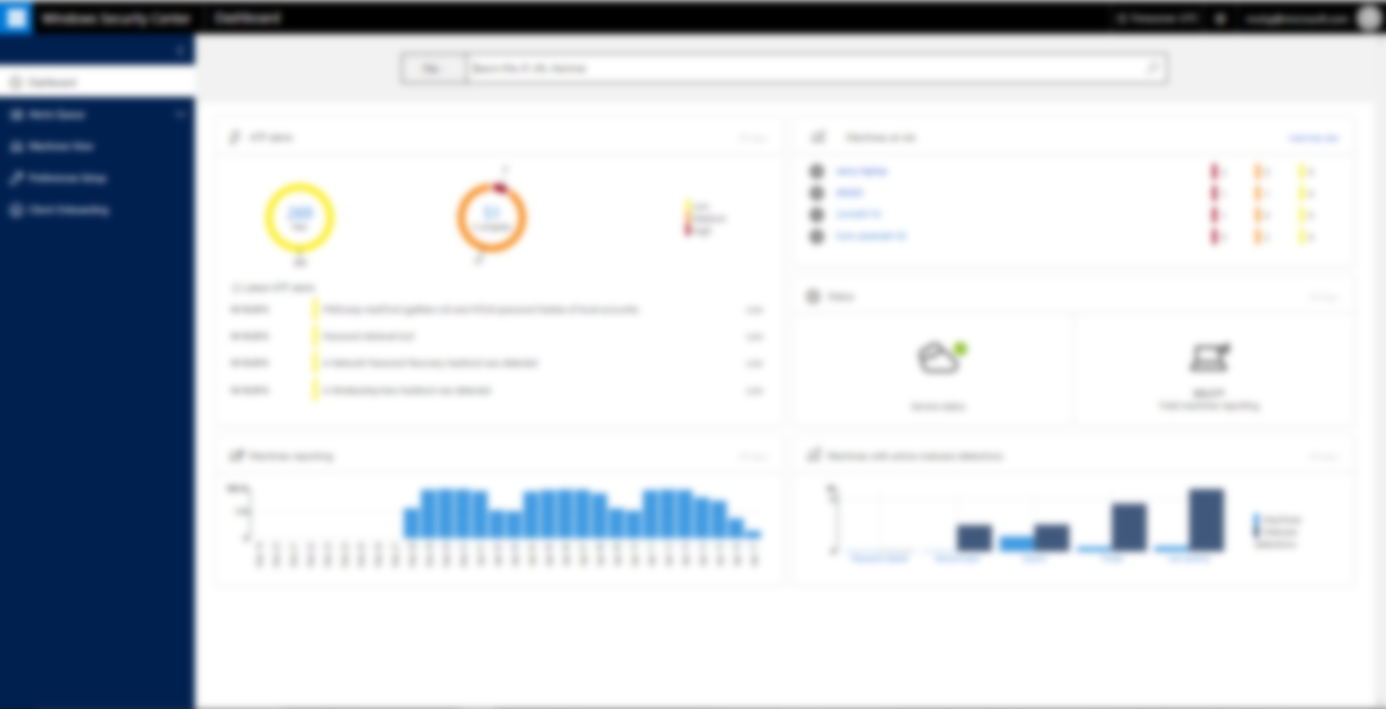
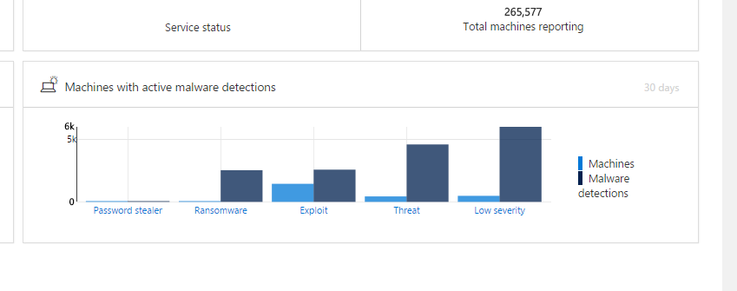
INTEGRATION WITH WINDOWS DEFENDER / SCEP
Notes:
If your organization is running Windows Defender / SCEP to protect your enterprise from Malware, then simply turn on Cloud Protection (if not already done) and Malware detections from your network will light up within the Security Center (WDATP Portal) as well. One place to investigate Malware threats and sophisticated advanced attacks.

Slide 24


Gartner Category:
Endpoint Detection and Response (EDR)

The endpoint detection and response (EDR) market is an emerging security technology created to continuously provide early identification of ongoing advanced attacks and to more rapidly respond to detected attacks.
Solutions that have the following capabilities:
Detect security incidents at the endpoint
Investigate security incidents
Contain the incident
Remediate endpoints to a pre-infection state


Slide 25
WINDOWS DEFENDER
ADVANCED THREAT PROTECTION
DETECT ADVANCED ATTACKS AND REMEDIATE BREACHES
Built into
End-point behavioral sensor (Sense)
Powered by cloud Machine Learning Analytics
Enhanced by the community of our hunters, researchers and threat intelligence

Slide 26
?
IOC
IOA

Slide 27

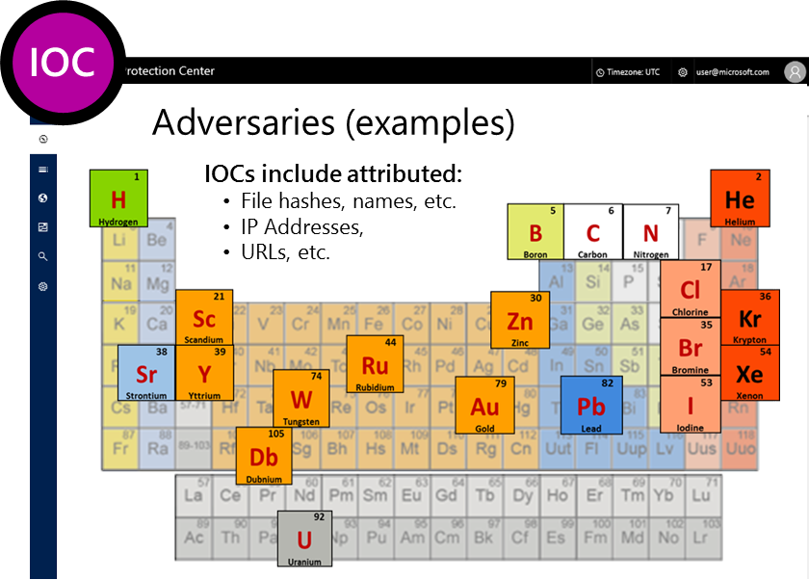
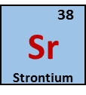
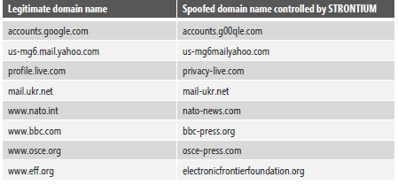
Indicators Of Compromise (IOC)
Monitoring “What (who) we know”
Threat Intelligence database of known adversary and campaign IOCs
Partnership with FireEye/iSight for additional integrated TI

Slide 28
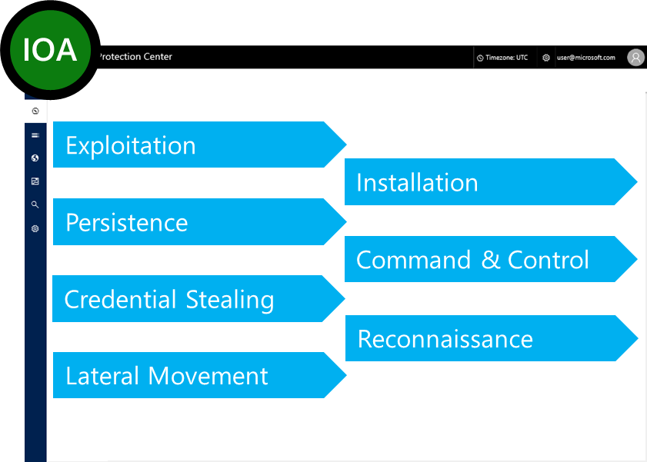
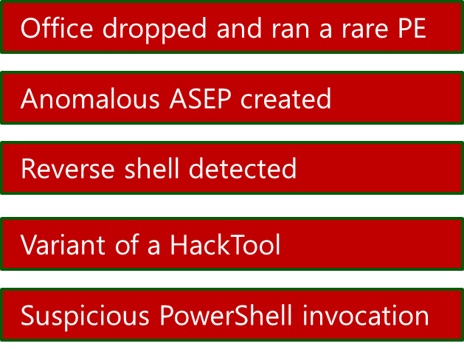
Indicators Of ATTACK (IOA)
Monitoring “What (whom) we don’t recognize – yet”
Generic IOA Dictionary of attack-stage behaviors, tools, and techniques

Slide 29
Why Microsoft?

Slide 30








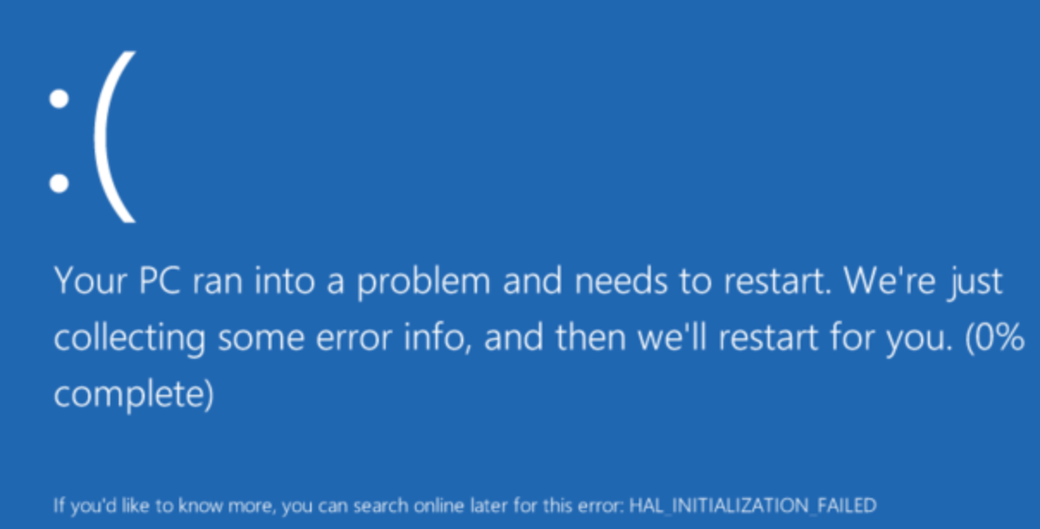



Built in
Not bolted on
Compatible with other security products
Kernel Sensor
High Performance

Slide 31









Best investigation experience
Watch Everything
Time Travel
Detonation

Slide 32
the Windows 10 defense stack
PRE-BREACH
Device protection
Device protection
Threat resistance
Identity protection
Identity protection
Information protection
Information protection
Threat resistance
Device Health attestation
Device Guard
Device Control
Security policies
SmartScreen
AppLocker
Device Guard
Windows Defender
Windows Defender Application Guard
Device Health Attestation
Device Guard
Device Control
Security policies
SmartScreen
AppLocker
Device Guard
Windows Defender
Network/Firewall
Built-in 2FA
Account lockdown
Credential Guard Microsoft Passport
Windows Hello :)
Built-in 2FA
Account lockdown
Credential Guard Microsoft Passport
Windows Hello ;)
Device protection / Drive encryption
Windows Information Protection
Conditional access
Device protection / Drive encryption
Enterprise Data Protection
Conditional access
Notes:
Windows 10 is the most secure enterprise platform today, with enterprise security capabilities, such as:
Device Guard, Credential Guard
Secure Boot, Measured Boot
Windows Hello, Microsoft Passport
<click>
We are talking about pre breach solutions.
And by pre-breach we mean all those solutions that are built for preventing an attack to happen
But cyber attacks are getting more sophisticated
<click>
Note: If you would like to discuss in more details the security features built into Windows
Secured Devices
Device attestation
Device guard – CCI, Configurable code integrity
Kernel Mode Code Integrity (KMCI)) protected by VBS (Virtualization based security)
ELAM Windows Defender trusted boot
Device control, HW turned off/on
Secured Identities
Passport, VSM
2FA
Account lockdown
Information Protection
Device protection (lost/stolen devices, BitLocker)
EDP
Data separation (BYOD, personal/corporate data) {remote wipe}
Leak protection (AAD, Azure RMS)
Sharing protection (Azure RMS, Office IRM, O365, on-prem & cloud)
Conditional access
Threat Resistance
Antimalware
Firewall
Application control (app-locker, device guard (UMCI))
Application privilege control (isolation, containment)
Web access filtering/protection

Slide 33
Adding a post-breach mindset
PRE-BREACH
POST-BREACH
Device protection
Device protection
Threat resistance
Identity protection
Identity protection
Information protection
Information protection
Threat resistance
Breach detection investigation & response
Breach detection investigation & response
Device Health attestation
Device Guard
Device Control
Security policies
SmartScreen
AppLocker
Device Guard
Windows Defender
Windows Defender Application Guard
Device Health Attestation
Device Guard
Device Control
Security policies
SmartScreen
AppLocker
Device Guard
Windows Defender
Network/Firewall
Built-in 2FA
Account lockdown
Credential Guard Microsoft Passport
Windows Hello :)
Built-in 2FA
Account lockdown
Credential Guard Microsoft Passport
Windows Hello ;)
Device protection / Drive encryption
Windows Information Protection
Conditional access
Device protection / Drive encryption
Enterprise Data Protection
Conditional access
Windows Defender Advanced Threat Protection (ATP)
Windows Defender ATP
Notes:
This is why we are developing Windows Defender ATP.
Building on the existing security features and services Windows 10 offers today (Pre-breach), Windows Defender ATP provides a new post-breach layer of protection to the Windows 10 security stack.
Windows Defender ATP gives you the ability to detect, investigate and remediate Advanced Attacks and data breaches on your networks
It will be a new service that will leverage what we know about cyber defense and offer it as a feature to our customers
Before we dig deeper into Windows Defender ATP, lets have a look at the advantage point of Microsoft.

Slide 34
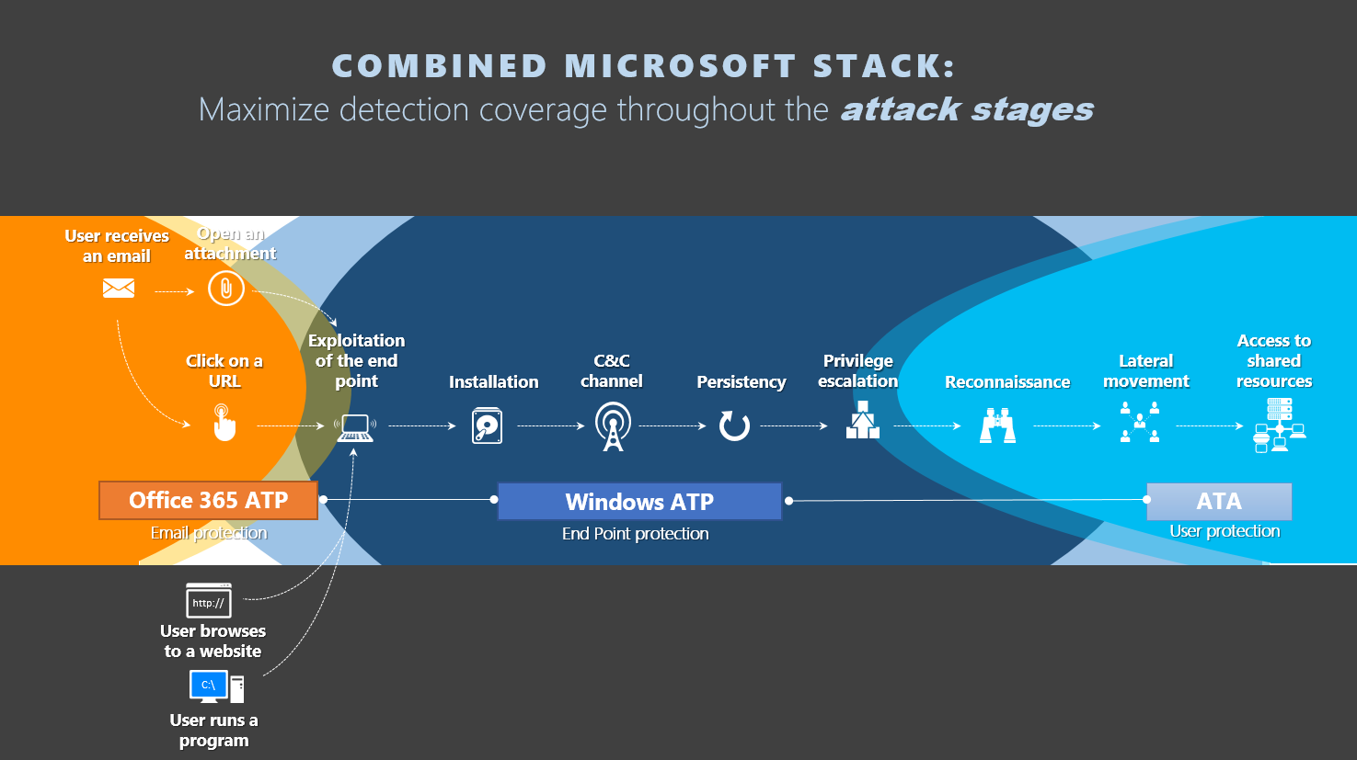
Integration

Slide 35




Unparalleled Detection
1 Billion
Behavioral Detection (0 Days)
Breadth of Optics
Depth of Optics
Industry Leading Hunters

Slide 36





Cloud Powered
Detection Service Cloud ( hidden from attacker)
Infinite Scale out
Non Domain Joined
Stream of new features ( outside Windows )

Slide 37
WDATP Demo

Slide 38

Remember
Built-In - No on premise infrastructure
Integration
Most Data

Slide 39
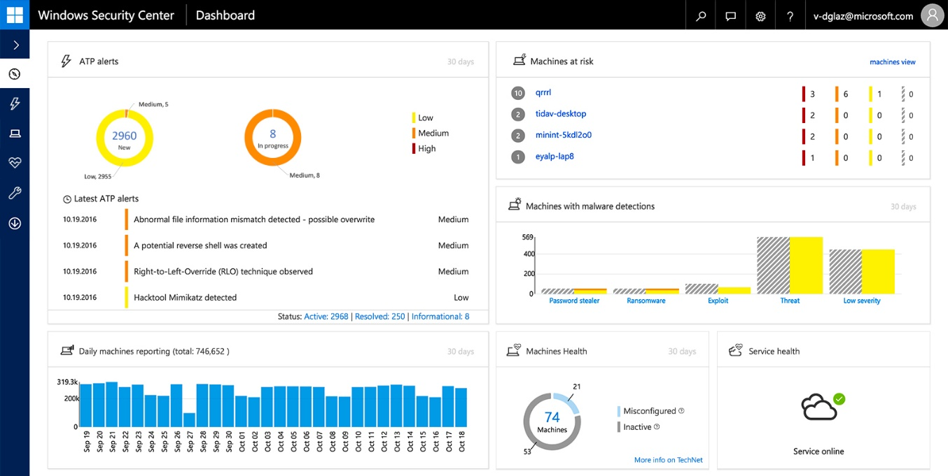
Trial @
More Information
Robert Turnšek @ rturnsek@nil.com
https://aka.ms/wdatp
TechNet resources @
https://aka.ms/technet-wdatp
Read MSFT Case Study @
https://t.co/paX7MQhezU
Notes:
Windows Defender Advanced Threat Protection requires one of the following Microsoft Volume Licensing offers:
- Windows 10 Enterprise E5
- Windows 10 Education E5
- Secure Productive Enterprise E5 (SPE E5) which includes Windows 10 Enterprise E5
The Windows Defender ATP agent only supports the following editions of Windows 10:
- Windows 10 Enterprise
- Windows 10 Education
- Windows 10 Pro
- Windows 10 Pro Education

