Slide 2
Introduction to
Azure SQL Data Warehouse
Dejan Pervulov
Technical Evangelist at Microsoft

Slide 3
Agenda
About speaker
What is Azure SQL Data Warehouse
Architecture
Designing your Data Warehouse in Azure
Loading data into your Azure SQL Data Warehouse
Using and monitoring your new Data Warehouse

Slide 4
About speaker
Proud dad of Jovana and Marko! ☺
Based in Belgrade, Serbia
Technical Evangelist – Microsoft DX from 02/2017
Until then, Microsoft Data Platform MVP from 10/2014
Microsoft Certified Trainer since 2003
Microsoft Certified Professional (MCSD, MCDBA, MCSE) since 2002
Technical consultant for ERP, CRM and DWH/BI implementations
Started as embedded systems developer in 1996 (in times when 4 KB of memory was something to good care about!)

Slide 5



What is Azure SQL Data Warehouse
A relational data warehouse-as-a-service, fully managed by Microsoft.
Industries first elastic cloud data warehouse with proven SQL Server capabilities.
Support your smallest to your largest data storage needs.
Elastic scale & performance
Market Leading Price & Performance
Powered by the Cloud
Azure
Azure
Get started in minutes
Integrated with Azure ML, PowerBI & ADF
Scales to petabytes of data
Massively Parallel Processing
Instant-on compute scales in seconds
Query Relational / Non-Relational
Saas
Simple billing compute & storage
Pay for what you need, when you need it with dynamic pause
Azure
Office 365
Office 365
Public
Cloud

Slide 6
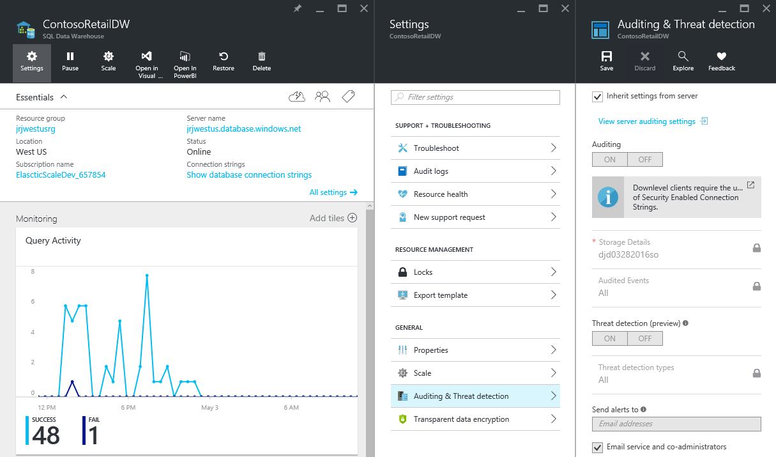
Platform-as-a-service
Azure cloud data warehouse service
Elastic scale
Separate storage and compute
Use existing tools and skills
Deploy and use in minutes!

Slide 7
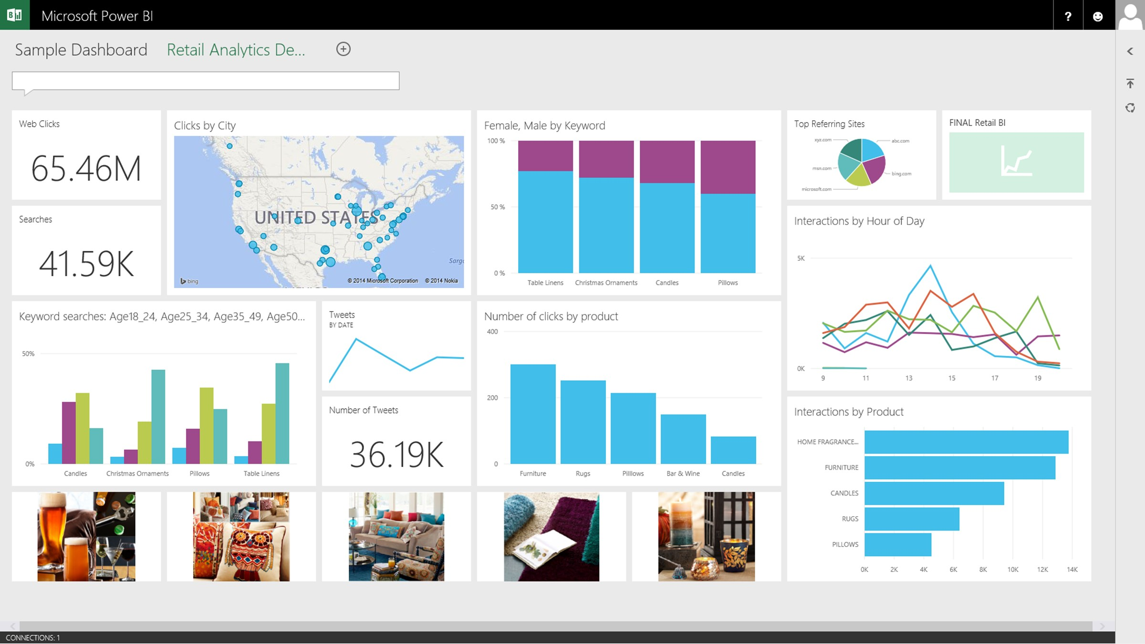
Integrates with existing processes
Analysis
Services
(ROLAP)
SQL Server
Data sources
Relational
Non-Relational
SSIS
Polybase
BCP
ADF
Event Hubs
Stream Analytics
Hadoop
Azure Blob
Storage
Azure Machine Learning
Stream Analytics
PaaS
IaaS
Analysis
Services
(MOLAP)
Azure SQL
Data
Warehouse

Slide 8


Architecture
Control
Compute
Storage

Slide 9
Architecture – distributed queries
Control
Compute
Storage

Slide 10
Demo
Azure portal
Creating Azure SQL Data Warehouse
Data Warehouse Units

Slide 11
Designing your Data Warehouse in Azure
Data distribution in general
Hash distribution
Round-Robin distribution
Different table types
Recommendations

Slide 12
Data distribution in general
Distribution keys determine the way that will be used to spread data across multiple nodes
There are 60 distributions that will get attached to nodes
Avoid having some overloaded and some underloaded distributions e.g. try to distribute data as evenly as possible in order to fully utilize parallel infrastructure

Slide 13
Hash distribution
Always hashing by specific column
This column must not be updated and should have more than 60 distinct values
Rows with the same hash key will be loaded to the same node
Should distribute as evenly as possible
Should be used for grouping
Should be used as join condition in order to avoid data movement as much as possible

Slide 14
Round-Robin distribution
No specific hash column
Rows will be distributed evenly across available nodes but that does not mean that it will provide the best possible performance because data from the same group could end in different distributions

Slide 15
Different table types
Heap – no specific row ordering, minimal overhead
  Mostly used for fast loading of data
  Can have other indexes
Clustered B-Tree index – similar to clustered index in SQL Server
  Can have other indexes
  Does not provide compression
Clustered Columnstore – same principles apply as in SQL Server
  Default for Azure SQL Data Warehouse
  Column oriented
  It is always compressed
  Organized in segments of 1 million rows
  Cannot have additional indexes

Slide 16
Recommendations
Use Clustered Columnstore for fact tables
  Try to distribute evenly using hash key
  Be careful with partitioning – do not use too many partitions as this can lead to inefficient segments
Use Clustered B-Tree index for dimension tables
  Consider using hash distribution if possible
  Round-Robin distribution can be sufficient in other cases
  Add other indexes to support your workload
Check for unsupported data types in documentation

Slide 17
Loading data into your Azure SQL Data Warehouse
Difference between SMP and MPP
Data readers and writers
Parallel and non-parallel data load
Parallel load with Polybase
Resource classes

Slide 18
Difference between SMP and MPP
There are no multiple nodes in Symmetric Multi Processing model
  So there is no true parallelism
Massively Parallel Processing introduces multiple nodes
  Parallel work is possible
Data and load methods should be aligned with parallel load logic
  Avoid Control node if possible
Consider using Azure SQL Data Warehouse migration utility

Slide 19
Data readers and writers
Readers read data in parallel
Transfer data to writers
Different DWU provide different number of readers and writers
DWU | Max External Readers | Max Writers
DW100 | 8 | 60
DW200 | 16 | 60
DW300 | 24 | 60
DW400 | 32 | 60
DW500 | 40 | 60
DW600 | 48 | 60
DW1000 | 80 | 80
DW1200 | 96 | 96
DW1500 | 120 | 120
DW2000 | 160 | 160
DW3000 | 240 | 240
DW6000 | 480 | 480

Slide 20
Parallel and non-parallel data load
Do not order data
  All data will be loaded in one distribution in case of hash distribution
Do not insert small number of rows
  Try to load data in big batches
Consider using Heaps for staging
Use CREATE TABLE AS SELECT to move data from staging into persistent storage
A compressed text file cannot be read
in parallel
Splitting data across multiple files maximises load performance

Slide 21
Parallel load with Polybase
Compute Node
Azure Storage Blob (ASB)
DMS
Bridge
Control Node
Compute Node
DMS
DMS
Bridge
Compute Node
DMS
Bridge

Slide 22
Resource class
Controls how many memory per distribution is dedicated to a query run by a user belonging to a resource class
There are four different classes
  smallrc
  mediumrc
  largerc
  xlargerc
Users can be moved between resource classes by assigning to different database role:
  EXEC sp_addrolemember ‘resource_class', ‘username'

Slide 23
Demo
Loading your Azure SQL Data Warehouse
Loading from SSIS (non-parallel)
Load using Polybase (parallel)

Slide 24
Using and monitoring your new Data Warehouse
Querying
  Extremely large queries can be queued
  There is a priority mechanism that takes into account:
    DWUs (Concurrency slots)
    Resource class
    Transaction size
    General limits (1024 connections and 32 concurrent queries)
  Can be monitored using DMVs
  Queries can be labeled OPTION (LABEL=‘some_label’)

Slide 25
Demo
Querying your Azure SQL Data Warehouse
Power BI Desktop
Power BI Service

Slide 26
Hvala / Thank you
a-deperv@microsoft.com

