Slide 2
Blocking async calls and thread starvation
Goran Šiška
Head of QA
Adacta d.o.o.

Slide 3
Agenda
Thread starvation
Threading in C#
Demo (problem and troubleshooting)
Blocking async calls
Sync-over-async anti-pattern
Notes:
© Microsoft Corporation. All rights reserved. MICROSOFT MAKES NO WARRANTIES, EXPRESS, IMPLIED OR STATUTORY, AS TO THE INFORMATION IN THIS PRESENTATION.
9/28/2022 9:17 PM
3

Slide 4
Thread Starvation
… thread is unable to gain regular access to shared resources and is unable to make progress.
Notes:
© Microsoft Corporation. All rights reserved. MICROSOFT MAKES NO WARRANTIES, EXPRESS, IMPLIED OR STATUTORY, AS TO THE INFORMATION IN THIS PRESENTATION.
9/28/2022 9:17 PM
4

Slide 5

Threading (appearance)
Notes:
© Microsoft Corporation. All rights reserved. MICROSOFT MAKES NO WARRANTIES, EXPRESS, IMPLIED OR STATUTORY, AS TO THE INFORMATION IN THIS PRESENTATION.
9/28/2022 9:17 PM
5

Slide 6
Threading (actual)
Notes:
© Microsoft Corporation. All rights reserved. MICROSOFT MAKES NO WARRANTIES, EXPRESS, IMPLIED OR STATUTORY, AS TO THE INFORMATION IN THIS PRESENTATION.
9/28/2022 9:17 PM
6

Slide 7

Threading (actual)
Notes:
© Microsoft Corporation. All rights reserved. MICROSOFT MAKES NO WARRANTIES, EXPRESS, IMPLIED OR STATUTORY, AS TO THE INFORMATION IN THIS PRESENTATION.
9/28/2022 9:17 PM
7

Slide 8
Thread Starvation vs Pool Exhaustion
Thread is waiting for available CPU time
Can be solved by reducing
number of threads
Process is waiting for a available thread
Can be solved by increasing
number of threads
Notes:
© Microsoft Corporation. All rights reserved. MICROSOFT MAKES NO WARRANTIES, EXPRESS, IMPLIED OR STATUTORY, AS TO THE INFORMATION IN THIS PRESENTATION.
9/28/2022 9:17 PM
8

Slide 9
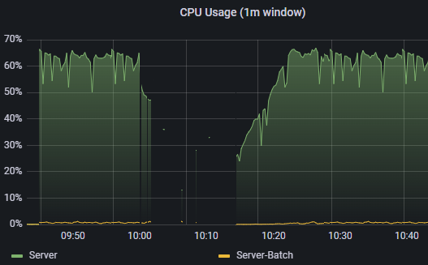
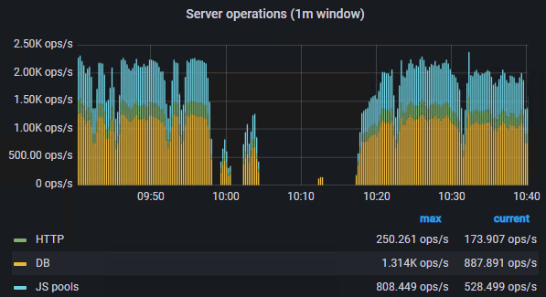
Detecting issue in production
Notes:
© Microsoft Corporation. All rights reserved. MICROSOFT MAKES NO WARRANTIES, EXPRESS, IMPLIED OR STATUTORY, AS TO THE INFORMATION IN THIS PRESENTATION.
9/28/2022 9:17 PM
9

Slide 10
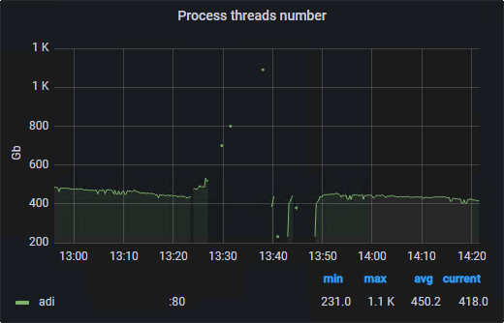
Detecting issue in production
Notes:
© Microsoft Corporation. All rights reserved. MICROSOFT MAKES NO WARRANTIES, EXPRESS, IMPLIED OR STATUTORY, AS TO THE INFORMATION IN THIS PRESENTATION.
9/28/2022 9:17 PM
10

Slide 11
Demo

Slide 12


Threading (pooling)
Work Item Queue
Thread Pool
Execution
Notes:
© Microsoft Corporation. All rights reserved. MICROSOFT MAKES NO WARRANTIES, EXPRESS, IMPLIED OR STATUTORY, AS TO THE INFORMATION IN THIS PRESENTATION.
9/28/2022 9:17 PM
12

Slide 13
Non blocking async
Thread (1) executes FooAsync
1
await FooAsync(input);
Thread (1) is returned to pool
1
Thread (n) continues execution
n
Notes:
© Microsoft Corporation. All rights reserved. MICROSOFT MAKES NO WARRANTIES, EXPRESS, IMPLIED OR STATUTORY, AS TO THE INFORMATION IN THIS PRESENTATION.
9/28/2022 9:17 PM
13

Slide 14
Blocking async
Thread (1) executes FooAsync
Thread (2) is spawned
1
2
FooAsync(input).Wait();
Thread (1) is blocked at Wait
1
Thread (1) continues execution
1
Notes:
© Microsoft Corporation. All rights reserved. MICROSOFT MAKES NO WARRANTIES, EXPRESS, IMPLIED OR STATUTORY, AS TO THE INFORMATION IN THIS PRESENTATION.
9/28/2022 9:17 PM
14

Slide 15
Blocking async
public async Task<TResult> FooAsync (TInput input)
{
//await something
}
FooAsync(input).Result
FooAsync(input).Wait()
FooAsync(input).GetAwaiter().GetResult()
Notes:
© Microsoft Corporation. All rights reserved. MICROSOFT MAKES NO WARRANTIES, EXPRESS, IMPLIED OR STATUTORY, AS TO THE INFORMATION IN THIS PRESENTATION.
9/28/2022 9:17 PM
15

Slide 16
Thread Starvation Scenario
Thread takes item from Global queue (web request)
Thread is blocked executing async operation
New thread is spawned with empty Local queue and takes item from Global queue (another web request)
With increasing threads serving new requests while threads performing operations are blocked – the system experiences thread starvation
* .NET 6 has updated ThreadPool heuristics that reduce the performance impact of the bad coding pattern
Notes:
© Microsoft Corporation. All rights reserved. MICROSOFT MAKES NO WARRANTIES, EXPRESS, IMPLIED OR STATUTORY, AS TO THE INFORMATION IN THIS PRESENTATION.
9/28/2022 9:17 PM
16

Slide 17
Sync over Async
public async Task<TResult> FooAsync (TInput input)
{
//await something
}
public TResult Foo (TInput input)
{
return FooAsync(input).Result;
}
Do Not Use
Notes:
© Microsoft Corporation. All rights reserved. MICROSOFT MAKES NO WARRANTIES, EXPRESS, IMPLIED OR STATUTORY, AS TO THE INFORMATION IN THIS PRESENTATION.
9/28/2022 9:17 PM
17

Slide 18
Resources
Code and slides
  NTK or https://github.com/GoranSiska/ThreadStarvationExample
Resources
  https://learn.microsoft.com/en-us/dotnet/core/diagnostics/debug-threadpool-starvation
  https://devblogs.microsoft.com/pfxteam/should-i-expose-synchronous-wrappers-for-asynchronous-methods/
Notes:
© Microsoft Corporation. All rights reserved. MICROSOFT MAKES NO WARRANTIES, EXPRESS, IMPLIED OR STATUTORY, AS TO THE INFORMATION IN THIS PRESENTATION.
9/28/2022 9:17 PM
18

Slide 19
This is not school, but we
love to get grades.
Please fill out our
questoineers and leave
us your feedback.
You may even win some
cool rewards.

