Slide 1
SharePoint 2016 in
MIM 2016
Robi Vončina
Kompas Xnet

Slide 2
Introduction
Kompas Xnet
MS Office
Sistemski administrator
SharePointom 2003
Speaker
  Collaboration Summit Zagreb
  SPS Monaco
SloSPUG
European games Bakuju 2015
  FIM 2010, O365, Lync Servers
Asian games Turkmenistan
  MS Infrastructure, including AD, GPO, SCCM, SCOM,….

Slide 3
Agenda
What‘s new in SharePoint 2016
MIM 2016
Connecting SharePoint and MIM
Extending with SQL data

Slide 4
SharePoint 2016

Slide 5
History
2007 – Active directory import
2010 – User profile sync (ForeFront Identity Manager)
2013 – User profile sync (ForeFront Identity Manager)
– Active directory import
2016 – Active directory import
– External identity manager

Slide 6
Importance of user profiles
User profiles are used for:
  Sending emails in workflows, alerts
  User profile filter
Each version of SharePoint increases dependency on User Profiles
Hybrid
  Managed Metadata service application
  User Profile Service application - User Principal Name property must be mapped to the userPrincipalName attribute
  My Sites

Slide 7
UPS provisioning
Central administration
PowerShell
Requires „Replicating directory changes“
Sync DB created, but empty – DO NOT DELETE

Slide 8
Difference between ADI and MIM
 | Microsoft Identity Management server | Active Directory Import
Pros | Flexibility allows for customized import. Can be customized for bidirectional flow. Imports user profile photos automatically. Supports non-Active Directory LDAP sources. Multi-forest scenarios are supported. | Very fast performance. Known to be reliable (used by Office 365). Configurable inside of Central Administration. (Less complex).
Cons | A separate MIM server is recommended for use with your SharePoint farm. The more customized the more complex the architecture, deployment, and management. | Import is unidirectional (changes go from Active Directory to SharePoint Server Profile). Import from a single Active Directory forest only. Does not import user photos. Supports Active Directory LDAP only. Multi-forest scenarios are supported.

Slide 9
Microsoft Identity Manager 2016

Slide 10
Why remove UPS
Embedded version of FIM
Old code
Issues integrating with SP
Legacy ECMAv1 MA

Slide 11
Why MIM
Best in class for IdM
UPS BCM outside SharePoint
Use existing expertise, environment

Slide 12
What is MIM used for
IdM - identity management product
Provides
  User management
  Group management
  Credential management

Slide 13
IdM considerations
Data ownership
Data quality
System quality
  AD health
Access control
  AuthN
  AuthZ

Slide 14
Introduction
Statefull
Strongly typed
Vocabulary
  MA
  Synchronization
  Joiner
  Anchor

Slide 15
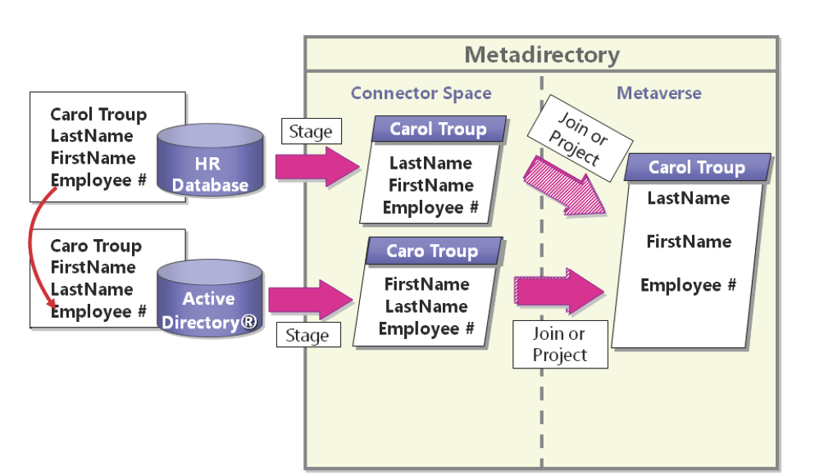
Data flow
Metaverse
Connector space
Import
Sync
Export

Slide 16
Connecting MIM with SP

Slide 17
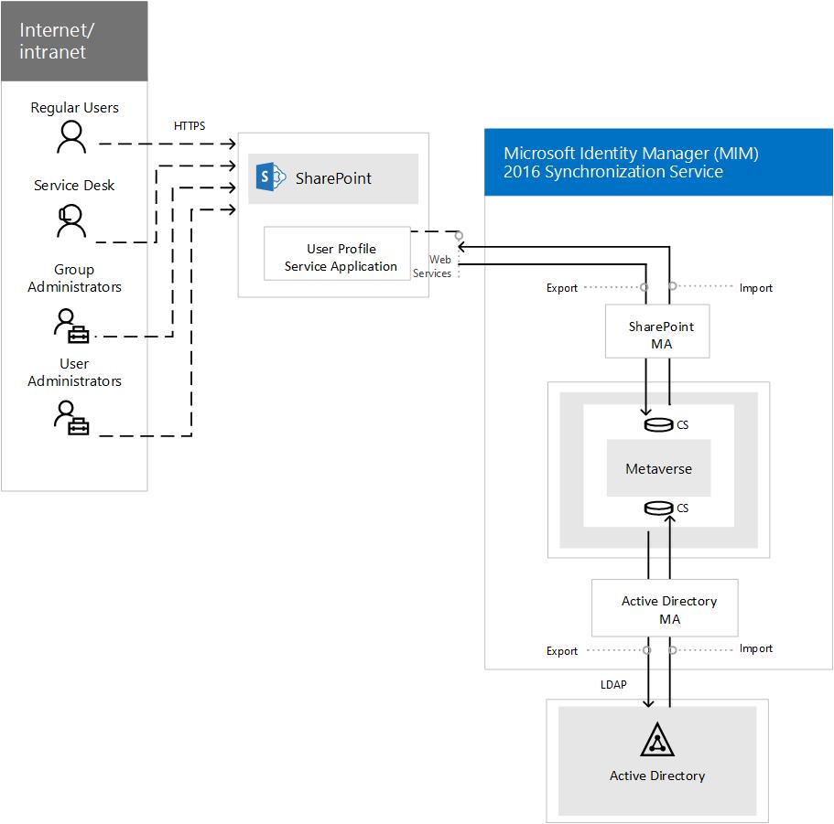
Synchronization topology
Overview of Microsoft Identity Manager Synchronization Service in SharePoint Server 2016
https://technet.microsoft.com/en-us/library/mt797545(v=office.16).aspx

Slide 18
GitHub - UserProfile
PnP-Tools/Solutions/UserProfile.MIMSync at master · SharePoint/PnP-Tools · GitHub
https://github.com/SharePoint/PnP-Tools/tree/master/Solutions/UserProfile.MIMSync
Enabling multiple OUs and avoiding credential touch up with the MIMSync “toolset” for SharePoint Server 2016
http://www.harbar.net/archive/2016/08/25/Enabling-multiple-OUs-and-avoiding-credential-touch-up-with-the.aspx

Slide 19
Create MAs
Create MA for Active Directory
Create MA for SharePoint 2016
Optional – create MAs for other data sources

Slide 20
Demo
Configuring MIM for SharePoint user profile Sync

Slide 21
Deployment considerations
Populate displayName attribute in metaverse for better search experience
Use search connector space to examine synced data
Clear management agent run history
High availability
  Sync service – warm stand by
  SQL

Slide 22
Modifying schema in SharePoint
Add additional columns
Bind columns to AD attributes or other sources

Slide 23
Demo
Add additional UPS properties, connect to AD properties

Slide 24
Connecting to SQL database - Extending
SQL MA
Import data
Join with AD data

Slide 25
Demo
Create SQL MA and connect object to AD object
Sync data to SharePoint

Slide 26
Questions?

