Slide 1
Najaktualnejši scenariji uporabe
(Workloads)
Tomaž Čebul, Microsoft
Robert Potočnik, Microsoft
Andrej Kašnik, Microsoft
Matjaž Perpar, Microsoft
Peter Zdovc, Span

Slide 2
AGENDA
Where to store data?
  Database SQL Server options
  MySQL and PostgreSQL
  NoSQL options
Where to run your apps?
  Disaster Recovery / HA
  SAP on Azure
  DevTest Labs
  AppService environment
Iot and Advanced Analytics

Slide 3
Where to store our data

Slide 4


Microsoft Azure Data Services
SQL Server
in a VM
SQL Database
Cosmos DB
Tables
Blobs
fully featured RDBMS
transactional processing
rich query
managed as a service
elastic scale
schema-free data model
Internet accessible http/rest
arbitrary data formats

Slide 5
DEMO:
SQL Server on
Azure IaaS

Slide 6
DATABASE AS A SERVICE OPTIONS
Azure SQL Database
Managed
Instance
Single
Elastic Pool
SQL
SQL
Instance-scoped programming model with high compatibility to SQL Server
Standalone managed database for predictable and stable workloads
Shared resource model for greater efficiency through multi-tenancy
Best for modernization at scale with low cost and effort

Slide 7
SQL Database Service
A relational database as a service, fully managed by Microsoft.
For cloud-designed apps when near-zero administration and enterprise-grade capabilities are key.
Perfect for cloud architects and developers looking for programmatic, DBA-like functionality.
Elastic scale and performance
Business continuity and data protection
Familiar and self-managed
Predictable performance levels
Programmatic scale-out
Dashboard views of database metrics
Self-service restore
Disaster recovery
Compliance-enabled
Familiar and compatible
Programmatic
Self-managed

Slide 8


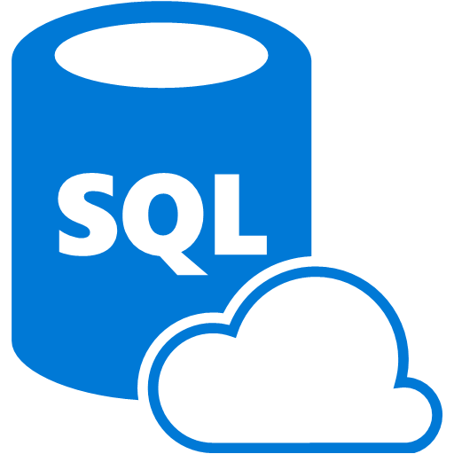
Elastic pool database model
An elastic database pool is a collection of DTUs and storage that is used by multiple databases
Elastic database jobs allow you to perform tasks across databases
in the pool
Scenarios include:
  Performing administrative tasks, such as
  deploying new schemas
  Updating reference data, such as making product information common across all databases
  Rebuilding indexes to improve query performance
Elastic database pool
Databases consume resources as needed
Customer
1
Customer
3
Customer
2
…
Customer
#N
Elastic database tools

Slide 9
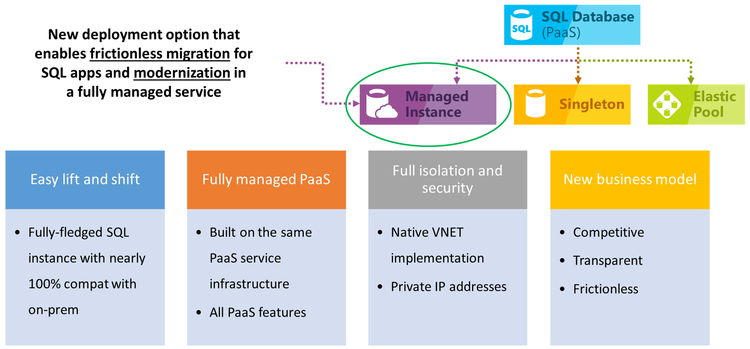
Azure SQL Managed Instance

Slide 10
Azure SQL Managed Instance
PaaS benefits | Business continuity
No hardware purchasing and management No management overhead for managing underlying infrastructure Quick provisioning and service scaling Automated patching and version upgrade Integration with other PaaS data services | 99.99% uptime SLA Built in high availability Data protected with automated backups Customer configurable backup retention period (fixed to 7 days in Public Preview) User-initiated backups Point in time database restore capability
Security and compliance | Management
Isolated environment (VNet integration, single-tenant service, dedicated compute and storage Encryption of the data in transit Azure AD authentication, single sign-on support Adheres to compliance standards same as Azure SQL database SQL auditing Threat detection | Azure Resource Manager API for automating service provisioning and scaling Azure portal functionality for manual service provisioning and scaling Data Migration Service

Slide 11
SQL
Managed Instance

Slide 12
OSS Databases as a Service
MySQL as a Service
PostgreSQL as a Service

Slide 13











AZURE DATABASE SERVICES FOR
MYSQL, POSTGRESQL, and MARIADB
More choices and full integration into Azure’s ecosystem and services
Managed community MySQL, PostgreSQL, and MariaDB
Languages and frameworks of your choice
Scale in seconds with built-in high availability
Secure and compliant
Industry-leading global reach
My
Easy Lift and Shift
Enterprise Ready

Slide 14
NoSQL options
Cosmos DB

Slide 15
Powering global solutions
Azure Cosmos DB was built to support modern app patterns and use cases.
It enables industry-leading organizations to unlock the value of data, and respond to global customers and changing business dynamics in real-time.
  Data distributed and available globally
  Build real-time customer experiences
  Ideal for gaming,
  IoT & eCommerce
  Simplified development with serverless architecture
  Run Spark analytics over operational data
  Lift and shift NoSQL data
  Puts data where your users are
  Enable latency-sensitive personalization, bidding, and fraud detection.
  Predictable and fast service, even during traffic spikes
  Fully-managed event-driven micro-services with elastic computing power
  Accelerate insights from fast, global data
  Lift and shift MongoDB and Cassandra workloads

Slide 16



What is Azure Cosmos DB
A globally distributed, massively scalable, multi-model database service
Table API
MongoDB
SQL
Key-value
Column-family
Document
Graph
Guaranteed low latency
at the 99th percentile
Elastic scale out
of storage & throughput
Five well-defined
consistency models
Turnkey global
distribution
Comprehensive
SLAs

Slide 17
GUARANTEED LOW LATENCY
PROVIDE USERS AROUND THE WORLD WITH FAST ACCESS TO DATA
Serve <10 ms read and <15 ms write requests at the 99th percentile from the region nearest to users, while delivering data globally.
Reads
(1KB)
Indexed writes
(1KB)
P50
<2ms
<6ms
P99
<10ms
<15ms
Notes:
Single digit latency -> SLA

Slide 18
COMPREHENSIVE SLAs
RUN YOUR APP ON WORLD-CLASS INFRASTRUCTURE
Azure Cosmos DB is the only service with financially-backed SLAs for millisecond latency at the 99th percentile, 99.999% HA and guaranteed throughput and consistency
Latency
HA
Throughput
Consistency
<10 ms
99.999%
Guaranteed
Guaranteed
99th percentile

Slide 19

Build Real-Time Customer experiences
Online Recommendations Service
HOT path
Offer latency-sensitive applications with personalization, bidding, and fraud-detection.
  Machine learning models generate real-time recommendations across product catalogues
  Product analysis in milliseconds
  Low-latency ensures high app performance worldwide
  Tunable consistency models for rapid insight
Azure Service Fabric
(Personalization Decision Engine)
Azure Cosmos DB
(distributed model store)
Azure Data Factory
(scheduled job to refresh persisted models)
Shoppers
.com
(Product Details Page)
Azure Event Hub
Azure Data Lake Storage
(offline raw data)
Apache Spark on Azure HDInsight
Offline Recommendations Engine
COLD path

Slide 20
Ideal for gaming and ecommerce
Maintain service quality during high-traffic periods requiring massive scale and performance.
  Instant, elastic scaling handles traffic bursts
  Uninterrupted global user experience
  Low-latency data access and processing for large and changing user bases
  High availability across multiple data centers
Azure CDN
Azure Storage (Game files)
Azure API Apps (Game backend)
Azure Cosmos DB (Game database)
Azure HDInsight (Game analytics)
Azure Functions
Azure Notification Hub (Push notifications)

Slide 21
simplified development with serverless architecture
Azure Functions
(E-commerce Checkout, API)
Azure Cosmos DB
(Order event score)
Experience decreased time-to-market, enhanced scalability, and freedom from framework management with event-driven micro-services.
  Real-time, resilient change feeds logged forever and always accessible
  Native integration with Azure Functions
Change feed
Azure Functions
(Microservice 1: Tax)
Azure Functions
(Microservice 2: Payment)
Azure Functions
(Microservice N: Fulfillment)

Slide 22
Where to run it?

Slide 23

Virtual Machine – Sizes and tiers
VM services recently introduced:
SAP HANA on Azure: new M-series VM certification.
Largest memory-optimized VM to date.
New E-series VMs to meet compliance and regulatory requirements
The new E64i_v3 and E64is_v3 VMs are isolated to hardware and dedicated to a single customer.
Continued expansion of the N-series VM portfolio
NCv3 VMs bring NVIDIA’s latest GPU to our best-in-class HPC, machine learning, and AI products.
Additional NVv2 (for graphic intensive applications) and NDv2 (to accelerate machine training and HPC) VMs are on the roadmap.
Entry level
Burstable
General Purpose
Compute Intensive
Storage Optimized
A
Av2
B
D
Dv2
Dv3
F
Fv2
L
Memory Optimized
Graphics Intensive
High Performance Computing
Purpose-built SAP HANA
G
Ev3
M
NC
NCv2
NV
ND
H
HANA
NCv3
NVv2
NDv2
(coming soon)
https://azure.microsoft.com/en-us/services/virtual-machines/

Slide 24
Azure Migrate and Disaster Recovery

Slide 25


Replicate and failover on-premises apps to Azure
Key features include:
Use Azure as your replication site
Automated VM protection and replication
Remote health monitoring
Customizable recovery plans
No-impact recovery plan testing
Orchestrated recovery of tiered applications
Support for heterogeneous environments
Azure Site Recovery
Orchestration
and replication
Microsoft System Center
Enterprise, SMB, and HSP primary site
Windows Server
Linux server
VMware/
Physical

Slide 26
Disaster Recovery for Hyper-V
Hyper-V Server
Azure Site Recovery
Source: Hyper-V
443 (HTTPS)
Data channel
Microsoft Azure
Microsoft Azure Recovery Services Agent
Replicates data to Azure
Public internet or ExpressRoute with public peering
Documentation: https://aka.ms/asr_hyperv
Videos: https://aka.ms/asr_videos

Slide 27



Replicate VMware virtual machines to Azure
443 (HTTPS)
Config
server
Azure Site Recovery
Process
server
443 (HTTPS)
9443 (HTTPS)
Data channel
Microsoft Azure
Source: VMware VMs and physical servers
Public internet or ExpressRoute with public peering

Slide 28
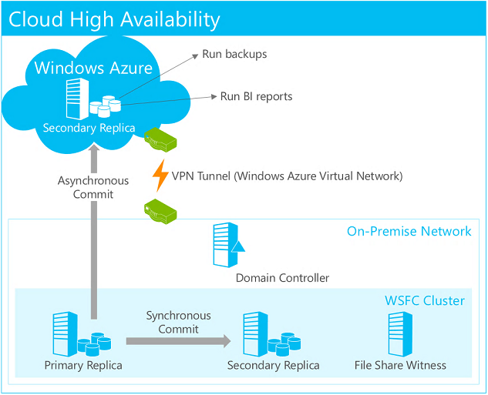
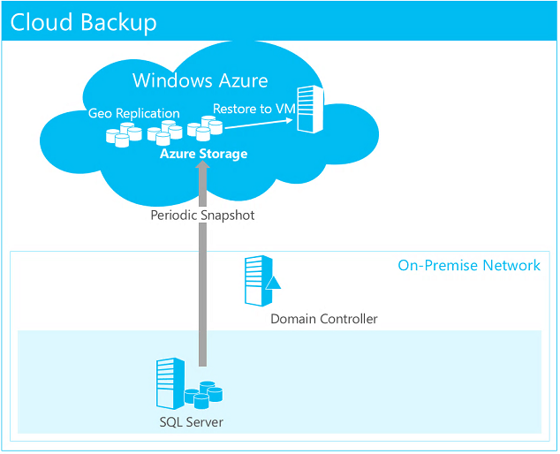
SQL to Azure HA/DR

Slide 29
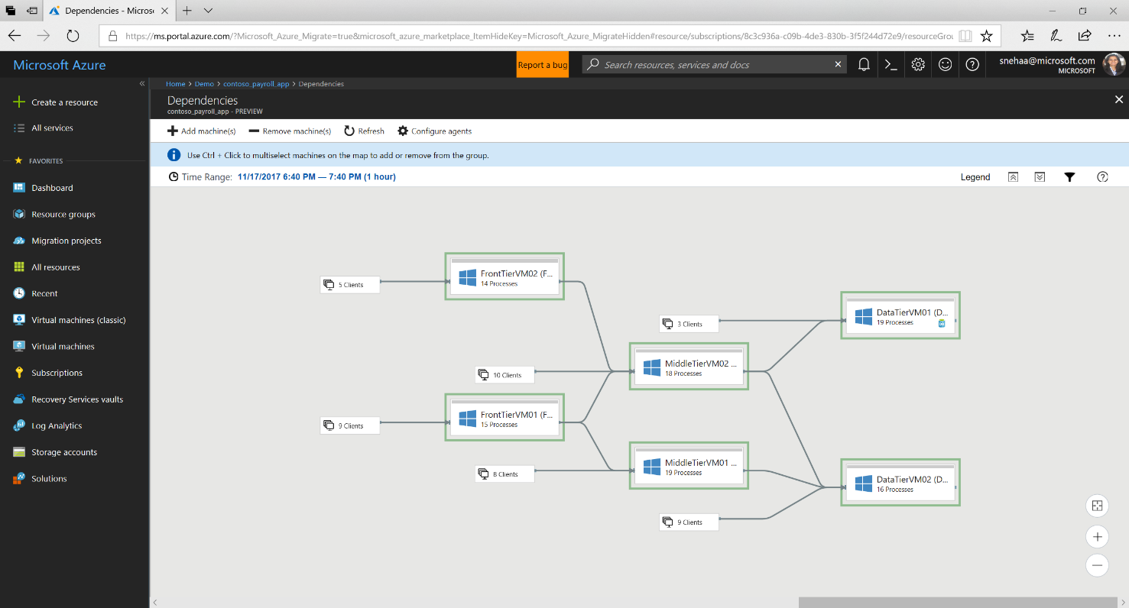
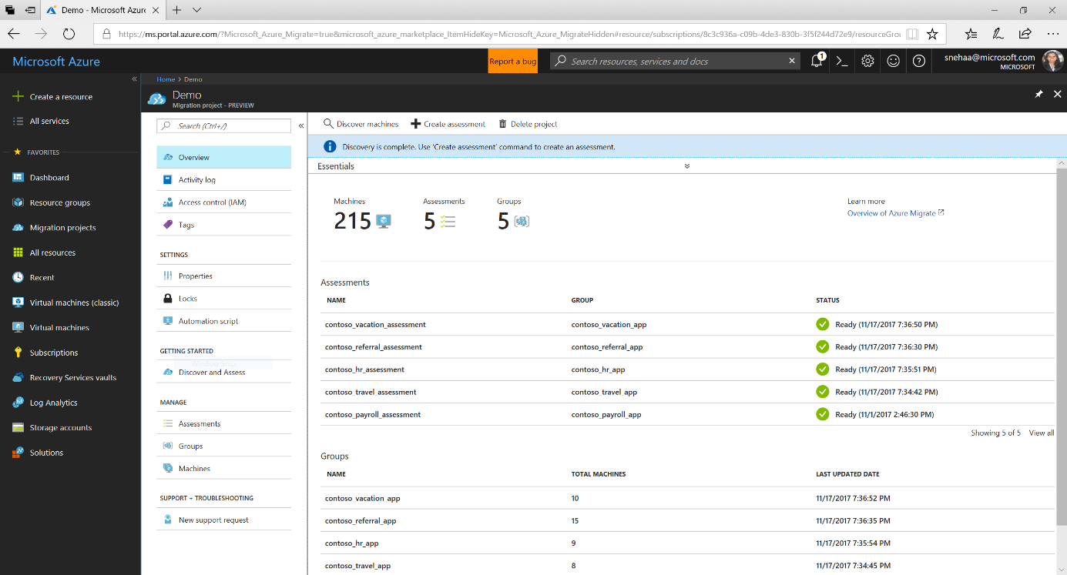
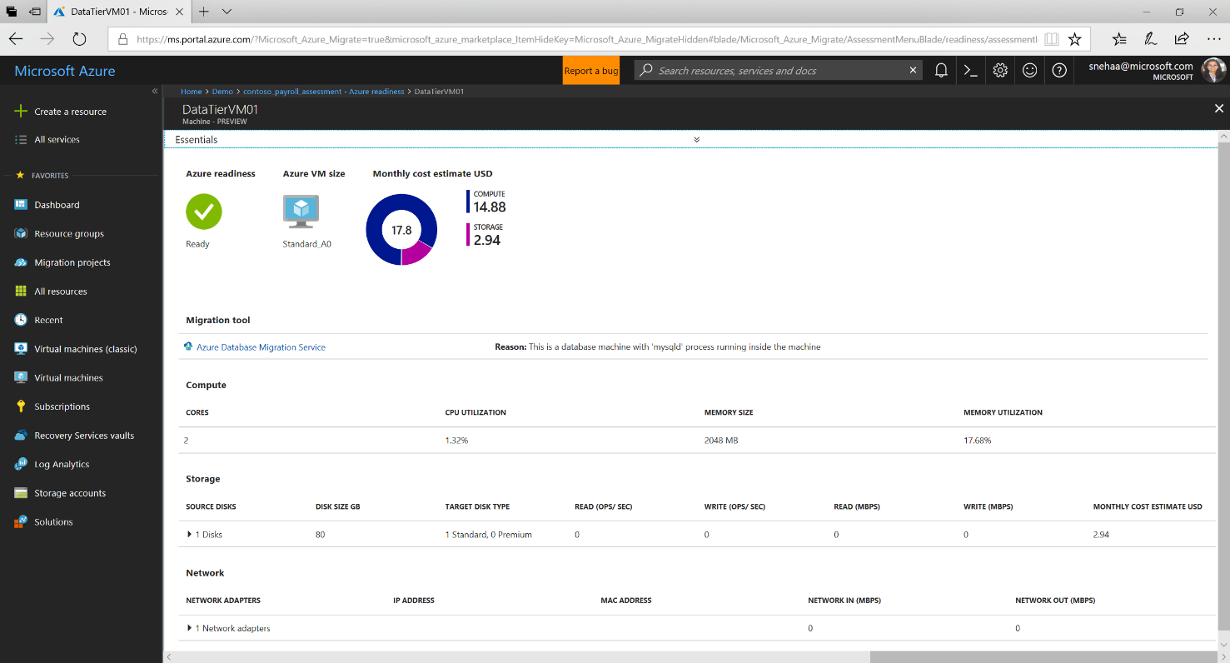
Azure Migrate
GA
Released
Feb ‘18
GA Released Feb ‘18
GA value proposition:
Easily discover on-premises VMware virtual machines, including rich app interdependency views
Assess your environment for a smooth cloud transition:
Right-size resources based on utilization history
Get estimated monthly run costs in Azure
Identify and mitigate migration risks
Free for all customers
Post-GA investments:
Discovery and assessment for Hyper-V and physical environments
Built-in migration experience in Azure Migrate
https://azure.microsoft.com/en-us/blog/confidently-plan-your-cloud-migration-azure-migrate-is-now-generally-available/

Slide 30
SAP on Azure

Slide 31

Potential scenarios and benefits for SAP on Azure
Development and Test
Software Licensing
Productive
Systems
Disaster Recovery
Archiving
Training
Scenarios
Quick and simple provision of development and test environments with the ability to stop the environments any time.
Use pre-licensed development and test environments enabling on demand licensing opposed to full licensed environments or development teams
“All in”. Deploy entire SAP system landscapes to Azure and deliver on cloud-first vision
Keep environments for recovery purposes without additional cost.
Archive data and the corresponding SAP systems audit-proof without running costs and always available
Use Azure to run SAP Training Systems only when they are needed.
Minutes instead
of days
Benefits
40-75%
Lower Costs
Higher Agility

Slide 32
Solution paths taken by a lot of customers
Move to public cloud with existing SAP platform and leverage public
cloud to have flexible and agile platform to move to S/4HANA
  Leverage agility in spinning up S/4HANA development, PoC and test systems
  Think about SaaS strategy
  Use public cloud native services
Move to public cloud and thereby move to SAP HANA for traditional
NetWeaver applications
  Use SAP DMO process to end up in public cloud with SAP driven NetWeaver applications
  Leverage agility in spinning up S/4HANA development, PoC and test systems
  Think about SaaS strategy
  Use public cloud native services
Greenfield implementations of S/4HANA or NetWeaver-based SAP applications
  Default for a lot of customers to start new implementations in public cloud

Slide 33
SAP HANA on Azure Offerings
HANA Large Instances
SAP HANA on HANA Large Instances
Bare metal HANA TDI-certified machines
(minimum commitment of 1 yr or 3 yrs,
fixed price per month)
S/4HANA and SuiteOnHANA:
From 768GB up to 20TB mem
SAP BW on HANA: 60TB (in scale-out)
HANA memory requirments
M-, G- and E-Series
SAP HANA on native Azure virtual machines
(per hour price, per minute billing)
S/4HANA and SuiteOnHANA:
From 128GB up to 3,8 TB mem
SAP BW on HANA: ++TB (in scale-out)
SAP on HANA
Highly dynamic More static

Slide 34
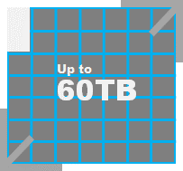




Your HANA Options on Azure
SCALE-UP
SCALE-OUT
432GB
128GB 256GB
768GB
1TB
1.5TB
1.7TB
2TB
2TB
3.8TB
4TB
6TB
8TB
12TB
16TB
20TB
OLAP/ OLTP
OLTP
OLAP
HANA Large Instance
HANA Virtual Machine
HANA Large Instances are not separately listed in the HANA hardware directly but are part of the hardware vendor HANA TDI certification (see SAP note 2316233).
HANA VM sizes are available between 64GB and 3.8TB (at this point in time, not all certified for production use).
https://azure.microsoft.com/en-au/services/virtual-machines/sap-hana/

Slide 35
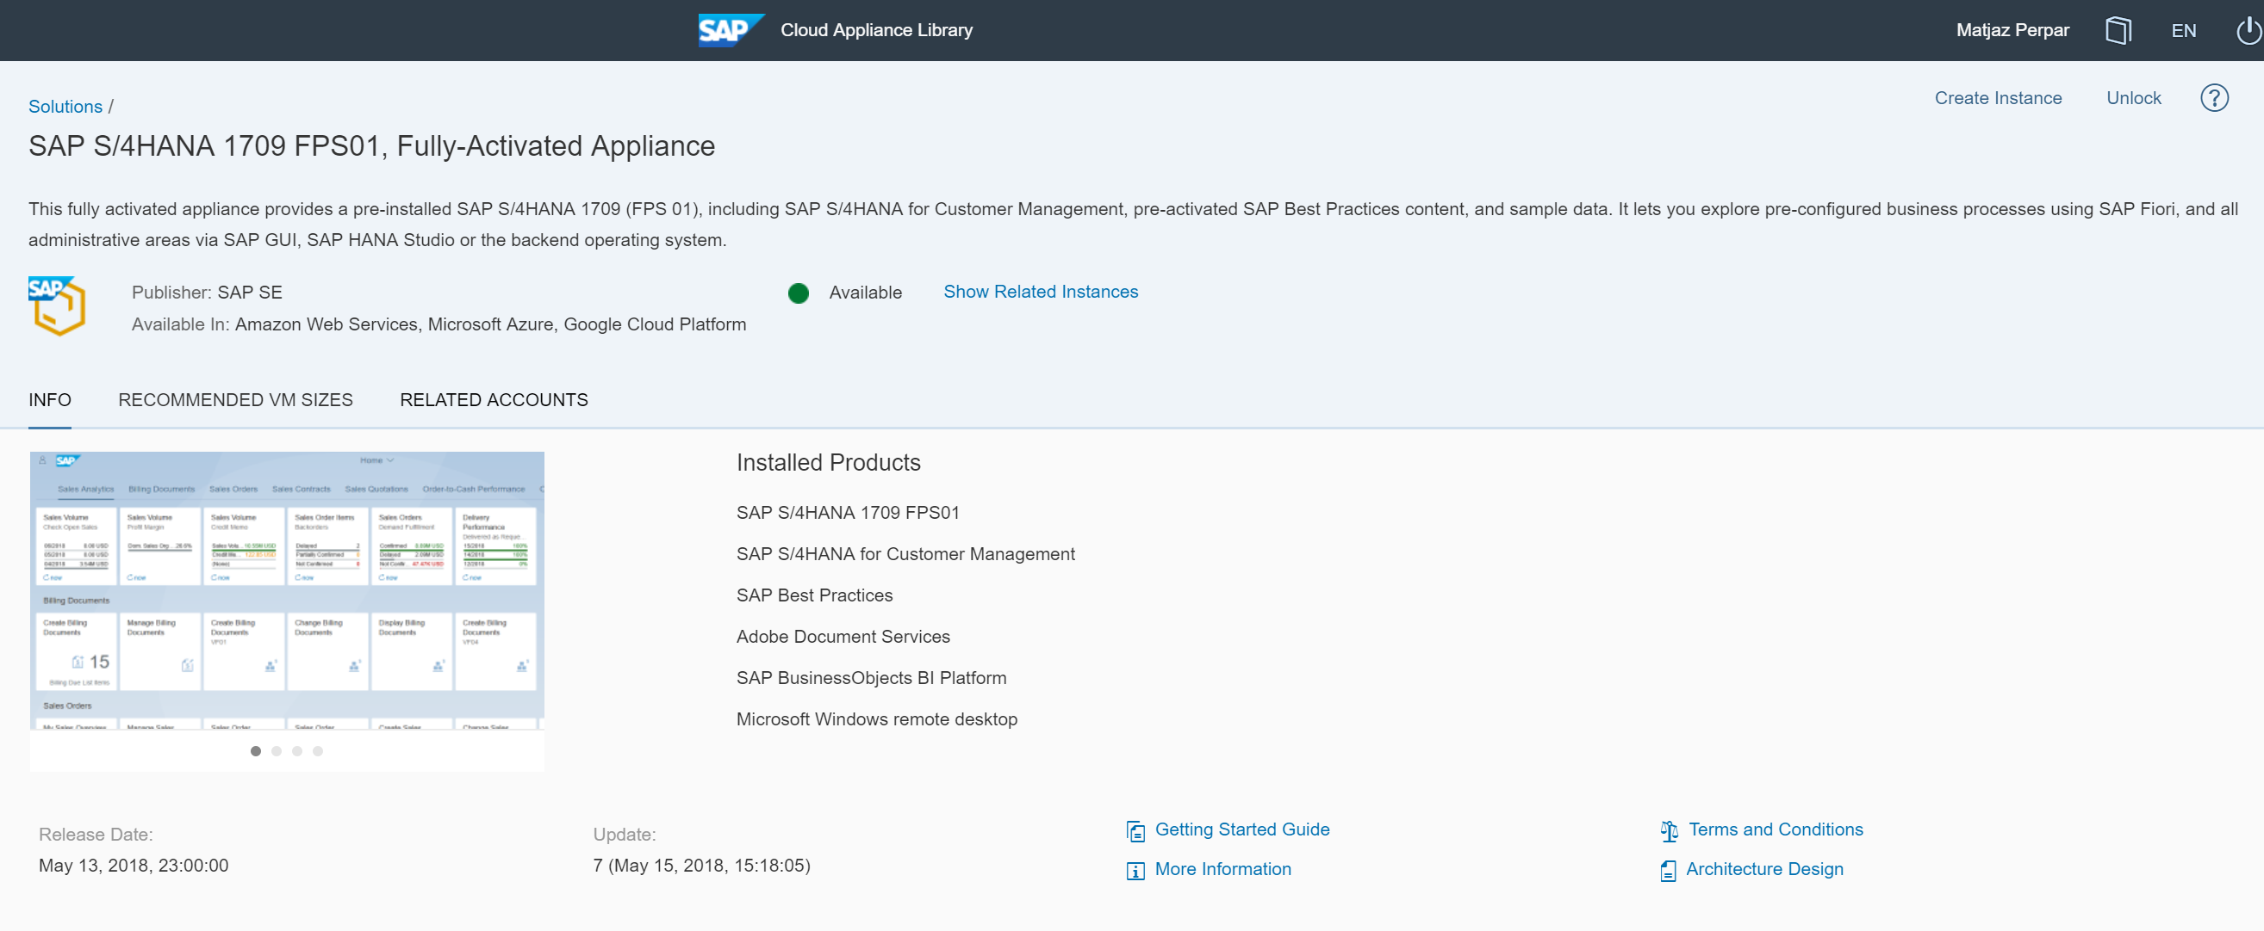
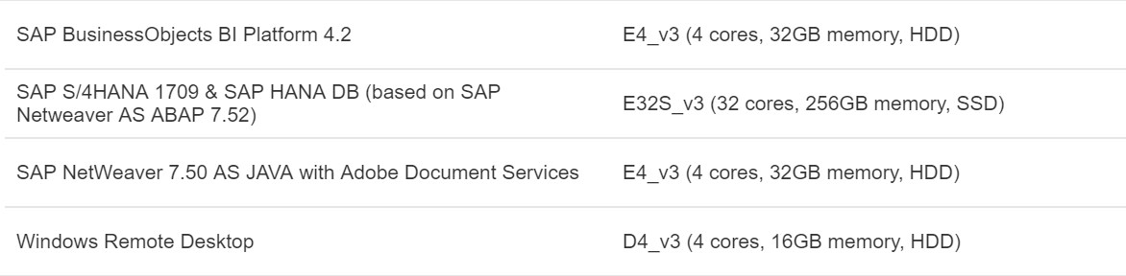
SAP Cloud Appliance Library

Slide 36


















S/4 HANA Production – Azure VMs, 3-tier
Petrol Corporate Network
Azure Datacenter
Azure Virtual Network #1
GW
Subnet
Subnet #1 – Prod
Subnet #2
Mgmt
Storage
Auto
mation
MPLS
WAN
or
Internet
HANA Database Server(s) Prod
Backup
OMS Log
Analytics
Site
Recovery
Security Center
1
Site to Site VPN or
ExpressRoute
SAP Application
Server(s) to scale out when needed
M64s (1TB RAM) uptime SLA : 99.9%
2,5TB SSD Storage
Domain
Controller,
Monitoring,
Backup Server,
SAP Router
in VM
4
2
3

Slide 37

S/4HANA – Azure VM with HA/DR
2 nodes x 1TB (RAM) HANA System Replication Cluster uptime SLA : 99.95%
2,5TB SSD Storage
4
Highly available SAP ASCS and NFS on Linux Clusters – VM uptime SLA : 99.95%
2
Azure Datacenter 1
Azure Virtual Network #1
GW
Subnet
Subnet #1 – AP Prod
Subnet #2 – DB Prod
Subnet #3
Mgmt
Storage
Auto
mation
Availability Set
SAP ASCS
Availability Set
HANA Database Server(s) Prod
Petrol Corporate Network
Availability Set
SAP AP
MSEE
Backup
OMS Log
Analytics
Express
Route
Availability Set
NFS Share
Express
Route
Gateway
Site
Recovery
Security Center
MPLS
WAN
HANA System Replication for async volume replica
3
Azure Datacenter 2
Azure Virtual Network #2
GW
Subnet
Subnet #4 – AP DR
Subnet #5 – DB DR
Subnet #6
Mgmt
Storage
Auto
mation
Availability Set
SAP ASCS
HANA Database Server(s) Prod
Availability Set
SAP AP
Express
Route
MSEE
Backup
OMS Log
Analytics
One ExpressRoute contract can connect to
all datacenters in
a geopolitical region
(All EU DCs)
Availability Set
NFS Share
1
Express
Route
Gateway
Shutdown VMs when unused (then no Compute charge)
Site
Recovery
Security Center
5

Slide 38
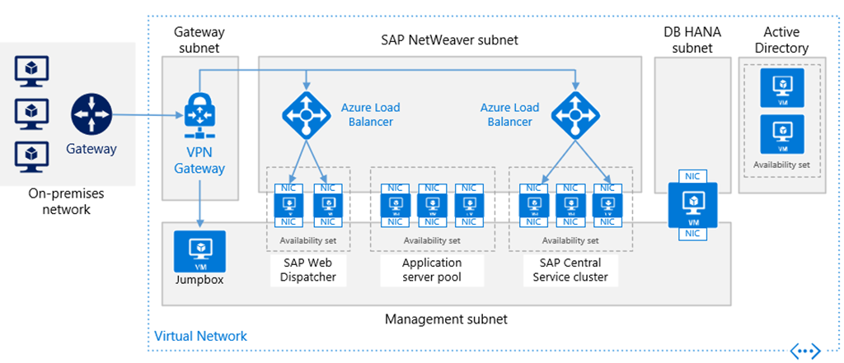
Reference Architecture for SAP NetWeaver and SAP HANA on Azure
https://azure.microsoft.com/en-gb/blog/reference-architecture-for-sap-netweaver-and-sap-hana-on-azure/

Slide 39
Azure DevTest Labs

Slide 40
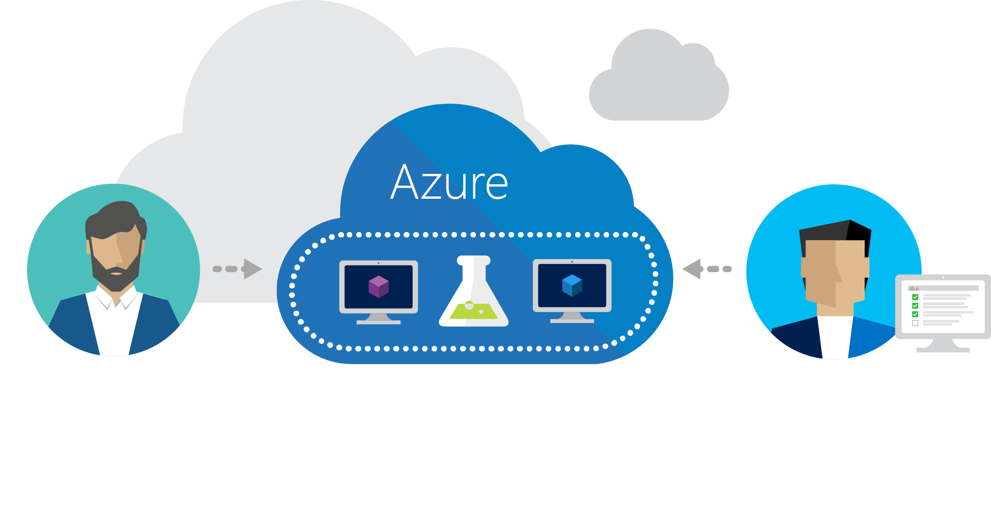
Azure DevTest Labs
Quick and easy to create DevTest environments in Azure.

Slide 41
Azure DevTest Labs DEMO

Slide 42
Azure AppService

Slide 43
Azure App Service
Quickly build, deploy and scale powerful cloud applications without worrying about infrastructure
✓
High productivity
Fully managed
Enterprise grade
Accelerate development using existing language skills, familiar frameworks, built-in CI/CD, and intelligent diagnostic capabilities
Focus on application logic and let Azure take care of mundane tasks like capacity provisioning, OS patching, scaling, load balancing and domain management
Meet rigorous performance, security and compliance requirements through a choice of hosting options, robust regulation support and MSI integration

Slide 44
Azure App Service
Quickly build, deploy and scale powerful cloud applications without worrying about infrastructure
High productivity
.NET, Node, Java, Docker,
PHP, Ruby, Python
Staging &
deployment
Testing in
production
App gallery
marketplace
Fully managed
Auto scale &
load balancing
High availability
w/ auto patching
Reduced
operations costs
Backup &
recovery
Enterprise grade
Global data
center footprint
Hybrid
support
AAD
integration
Secure &
compliance

Slide 45







VS code
GitHub repository
Azure Container Repository
Sample
architecture
Local Git repository
Kudu
Developers
Web App for Containers
MySQL database
Monitoring log aggregation
CDN
End users

Slide 46
Azure AppService DEMO

Slide 47






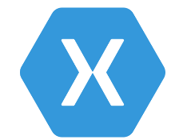




App Service
Media services
Structured
Document
database
Logging
Storage
Customer
browser
CDN
Branded
website
CMS
Functions
Power
BI
with personalized experience and mobile notifications
Xbox TV
integration
Twilio
Notification Hubs
Functions
Application insights
LUIS
Emotion
API
Bot
integration
App Service
Bot Service
Cognitive
Services
AD B2C
Customer
mobile
Weather
service
Xamarin
Test Cloud
Visual Studio
Team Services
Xamarin
Visual
Studio

Slide 48






Azure AD
API
Management
On-premises resources
Line of business
app
Tablet
Mobile Apps
CRM
ERP
with VPN and access to on-premises resources
API Apps
SQL
Server
Active
Directory
Mobile
App Service
Environment
SQL Azure
Legacy
APIs
Browser
Web Apps
Office 365
3rd Party
Notification Hubs
Service Bus
Storage
Express Routes

Slide 49
Advanced Analytics and Internet of Things

Slide 50


Azure IoT reference architecture
Device connectivity
Data processing, analytics, and management
Presentation & business connectivity
IP capable devices
Cloud gateway
Stream processing and analytics
Solution UX
IoT SDK
Personal mobile devices
Existing IoT devices
Application business logic
IoT SDK
Field Gateway
Business integration connectors and gateway(s)
Resource constrained devices
Business systems
IoT SDK
Device provisioning and management
Data Path
Optional solution component
IoT solution component

Slide 51
Simplify IoT with preconfigured solutions
Azure IoT Suite
Street sweepers
Buses
Cows
Vending
machines
Buildings
Device connectivity & management
Postboxes
Data ingestion and command & control
Auto
Oil
equipment
Stream processing & predictive analytics
Aircraft
Electric
charging
stations
Factory
floor
Workflow automation and integration
Power plant
IoT
Racing
Dogs
Dashboards and visualization
Medical
devices
Preconfigured solutions
Trucks
Power
tools
Mining
equipment
  Oil distribution
Remote monitoring
Elevators
Predictive maintenance
Smart meters
Surveillance
Smart
grids
Engines
Connected factory (new)

Slide 52
IoT Demo

Slide 53
The data warehousing portfolio from Microsoft
Relational
Beyond relational
Azure SQL Data Warehouse
SQL Server in Azure VMs
Azure Data Lake
Azure Marketplace
Hortonworks, Cloudera, MapR
Cloud
Insights
PolyBase
SQL Server
Analytics Platform System
3rd Party Hadoop Distributions
Hortonworks, Cloudera
On-premises
Choose flexibility

Slide 54
Cloud Data Warehouse
INGEST
STORE
PREP & TRAIN
MODEL & SERVE
Logs, files and media
(unstructured)
Azure Data Factory
Azure Blob Storage
Polybase
Business/custom apps
(Structured)
Operational Reports
&
Analytical Dashboards (PowerBI)
Azure Data Factory
Azure SQL Data Warehouse
Azure Analysis Services

Slide 55
Auto-scaling Data Warehouse
INGEST
STORE
MODEL & SERVE
Logs, files and media
(unstructured)
Polybase
Azure Data Factory
Azure Blob Storage
Azure SQL Data Warehouse
Azure Analysis Services
Operational Reports
&
Analytical Dashboards (PowerBI)
Business/custom apps
(Structured)
Azure Functions
Azure Monitoring

Slide 56

Advanced Analytics on Big Data
INGEST
STORE
PREP & TRAIN
MODEL & SERVE
Azure Machine Learning
SQL Machine Learning
Logs, files and media
(unstructured)
Azure Data Factory
Azure Databricks / HDInsight
Azure Blob Storage
Polybase
Business/custom apps
(Structured)
Operational Reports
&
Analytical Dashboards (PowerBI)
Azure Data Factory
Azure SQL Data Warehouse
Azure Analysis Services

Slide 57
Real time analytics
INGEST
STORE
PREP & TRAIN
MODEL & SERVE
Logs, files and media
(unstructured)
Azure IoT Hub
Azure HDInsight (Kafka)
Azure Databricks / HDInsight
Sensors and IoT
(unstructured)
Polybase
Business/custom apps
(Structured)
Operational Reports
&
Analytical Dashboards (PowerBI)
Azure Data Factory
Azure Blob Storage
Azure SQL Data Warehouse
Azure Analysis Services

Slide 58
Intelligent applications
INGEST
STORE
PREP & TRAIN
MODEL & SERVE
Cosmos DB
Logs, files and media
(unstructured)
Azure IoT Hub
SQL
SQL Database
Predictive apps
Azure HDInsight (Kafka)
Azure Databricks / HDInsight
Sensors and IoT
(unstructured)
Polybase
Business/custom apps
(Structured)
Operational Reports
&
Analytical Dashboards (PowerBI)
Azure Data Factory
Azure Blob Storage
Azure SQL Data Warehouse
Azure Analysis Services

Slide 59
Big Data has new data characteristics
Big Data
(schema agility)
Petabytes
Click stream
Wikis/blogs
Sensors/RFID/
devices
Social sentiment
Audio/video
Log files
Spatial &
GPS coordinates
Data market feeds
eGov feeds
Weather
Text/image
Terabytes
Advertising
Mobile
Collaboration
eCommerce
Web Logs
Digital Marketing
Search Marketing
Recommendations
Relational
(highly modeled schema)
Gigabytes
Payables
Payroll
Inventory
Contacts
Deal Tracking
Sales Pipeline
Megabytes
Data complexity: variety and velocity

Slide 60



Azure Data Lake Store
A cost-effective cloud repository for big data
Gather and store data indefinitely—analyze as needed
  Specifically designed to work with multiple analytics frameworks
  Seamlessly scales from a few KBs to several PBs
  Data is never lost or unavailable—even under failures
  Offers enterprise-grade security for even the most sensitive data
Devices
Social
ADL Analytics
LOB Applications
Video
Azure Data Lake Store
HDInsight
Web
Sensors
R
Spark
Relational
Clickstream
Azure Machine Learning

Slide 61
Bringing Big Data to everybody
Accelerate the pace of innovation through a state-of-the-art cloud platform
CONTROL
EASE OF USE
Specific apps in a multi-tenant form factor
Azure Data Lake Analytics
Workload optimized, managed clusters
User Adoption
Azure HDInsight
Any Hadoop technology
BIG DATA
ANALYTICS
Azure Marketplace
HDP | CDH | MapR
IaaS Hadoop
Managed Hadoop
Big Data as-a-service
Azure Data Lake Analytics
Azure Data Lake Store
BIG DATA STORAGE
Azure Storage

