Slide 2
Azure Stack v enterprise okoljih, da ali ne?
Tomaž Čebul, Microsoft services
Andrej Kreuh, ADD

Slide 3
Kaj je Azure Stack?

Slide 4
Microsoft’s hybrid cloud platform
Power of Azure in your datacenter
Portal | PowerShell | DevOps tools
Portal | PowerShell | DevOps tools
Portal | PowerShell | DevOps tools
Azure Resource Manager
Developers
Azure Resource Manager
Azure Resource Manager
One Azure ecosystem
Azure IaaS | Azure PaaS
Compute | Network | Storage
App Service | Service Fabric*
IaaS | PaaS
Azure IaaS | Azure PaaS
Compute | Network | Storage
App Service | Service Fabric*
Unified app development
Azure services in your datacenter
Cloud-inspired infrastructure
Cloud infrastructure
Cloud-inspired infrastructure
IT
Microsoft Azure Stack
Private | Hosted
Microsoft Azure
Public
Microsoft Azure Stack
Private | Hosted
Sealed hosts
Integrated Systems Hardware
Sealed hosts
Azure-designed Hardware

Slide 5

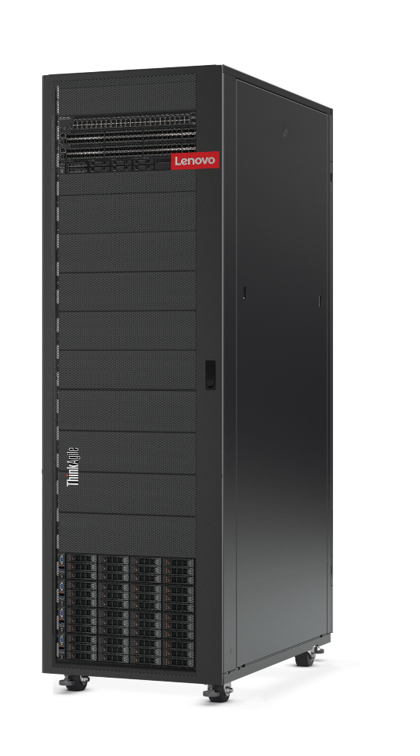
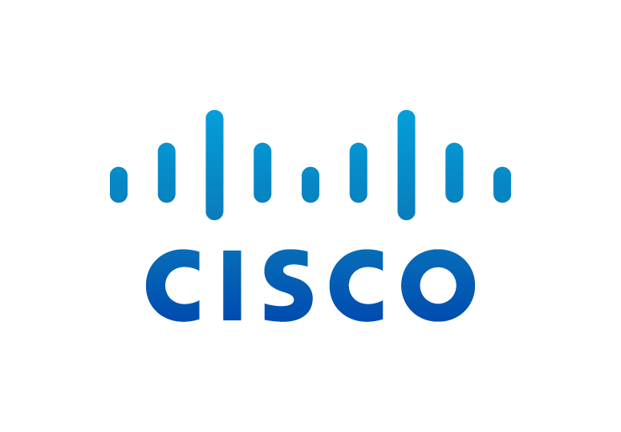

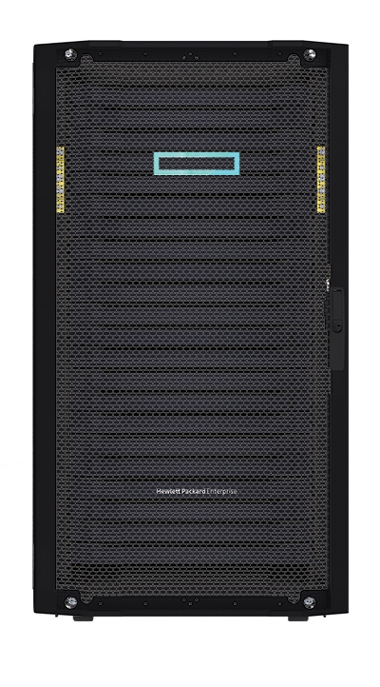
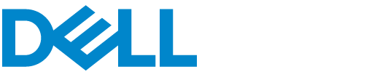

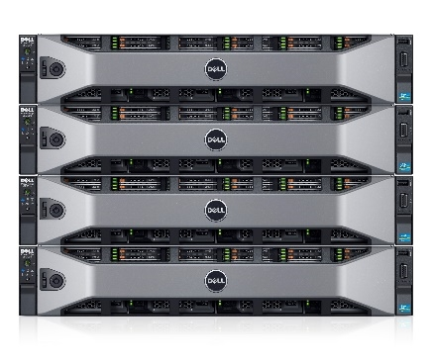
Azure Stack integrated systems
Joint design, continuous co-validation
Enables quick time to market and focus on business value
Purpose-built for innovation

Slide 6
Azure Stack: scale architecture
One Cloud “endpoint” (Portal URL)
Several Regions
Multiple scale units (SU) per region
  each scale unit can be different generation hardware
  Scale unit = fault domain = failover cluster
Smallest scale unit = 4 servers
Scale = #servers per SU x #SU’s per regions x #regions
GA scale: 1 x Region, with 1 x Scale unit with min 4 and max 12 servers
1
Example: Global enterprise or service provider
1
Portal /Azure Resource Manager
2
3
Resource management
2
Region 1
Region 2
Region 3
3
3
3

Slide 7

Azure Stack: security principles
Assume Breach
  Just Enough Administration, Network Access control to limit blast radius
Locked down infrastructure
  Examples: Application whitelisting, No domain admin credentials, no access to infrastructure components, network ACLs
Customized auditing
Hardened by default
  Examples: Data at rest encryption, Security OS baseline, Disabled legacy protocols (e.g. NTLM), Endpoint protection

Slide 8
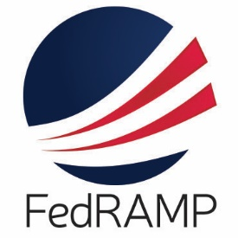

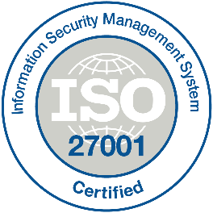

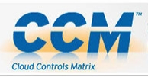
Azure Stack: compliance standards
Formal assessment of Azure Stack Infrastructure by independent third party
Precompiled documentation for applicable controls
  Technology
    Infrastructure
    Tenant Applications
  People
  Process

Slide 9
Licensing options: Consumption model
Consumption Model
Pay As You Use
Pay only for usage
No upfront licensing fees
Business model consistent with Azure
Simple bill management
  One invoice with public Azure
  EA deployments consume same monetary commit as public Azure
Available in EA and CSP channels

Slide 10
Licensing options: Capacity model
Capacity
Model
Fixed annual fee
Fixed fee, annual subscription – no perpetual L
  Pay for physical cores – with unlimited IaaS for licensed cores
  For customers needing predictability
  For disconnected scenarios
  Only available in EA; “lead status” SKU

Slide 11
Demo – Provisioning VM to Azure Stack and Azure
Andrej Kreuh

Slide 12
Azure stack v enterprise okoljih

Slide 13
Cloud Operating Model and Roles
operate
use
Azure Customers
Microsoft Engineers
DevOps
Cloud Architect
use
operate
Azure Stack Cloud
Your Customers
Your Engineers
Cloud Operator
Cloud Administrator

Slide 14
Design your Plans, Offers, and Subscriptions
Services
Quotas
Plan #1 - VMs
Offer #1 – IaaS only
Base
Plan #1
Account 1
user@ contoso. onmicrosoft.com
Subscription 1
Compute
Compute Quota - small
Compute
Compute Quota - large
Storage
Storage
Offer #2 – IaaS and Web
Network
Network
Base
Plan #1
Subscription 2
Storage Quota
Plan #2 – Increase Compute quota
Account 2
user@ fabrikam. onmicrosoft.com
AppService
Network Quota
Add On
Plan #2
Subscription 3
Compute
…..
AppService Quota
Plan #3 - Web
Add On
Plan #3
AppService
What services do you want to provide to your customers?
What are your envisioned customer quotas?
What things do you want to monetize for your customer base?
How do you want to present these as offers to customers?
How will your customers consume these offers?

Slide 15
Example: Base compute

Slide 16
One directory
Best practice
All organizational Azure subscriptions use the same Azure AD for access control.
I.e., don’t have each subscription in the organization relying on its own Default directory.
Benefits
Manageability
Compliance
Litware
Azure AD
Marketing Subscription
Resource Group 1
Resource
Resource
Resource Group 2
Resource
Resource
Finance Subscription
Resource Group A
Resource
Resource

Slide 17
Azure Stack with AAD – Single Tenanted
Azure Stack
Azure Active Directory
Admin Portal
Admin ARM
igaad1.onmicrosoft.com
Public Portal
Public ARM
Resource Providers
Use cases: Enterprises, Dedicated Hosting

Slide 18
Azure Stack with AD FS
Production Topology
Azure Stack
AD Graph
Portal
Stamp
ADFS
Customer
ADFS
ARM and RPs
Stamp AD
adfs.azurestack.local
Customer
AD
adfs.corp.contoso.com
Applications
Use cases: Enterprises
Dedicated Hosting

Slide 19
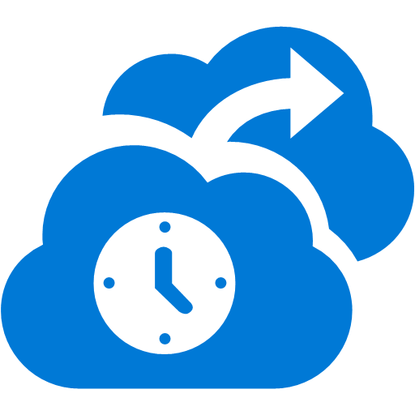

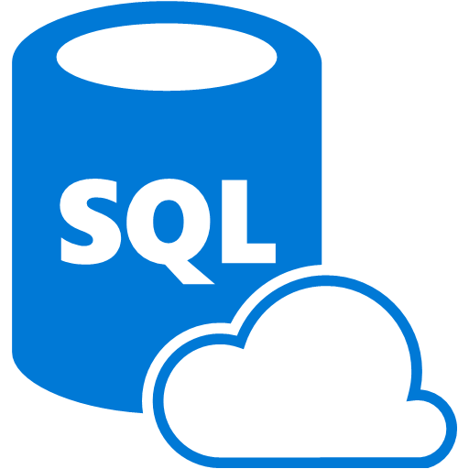
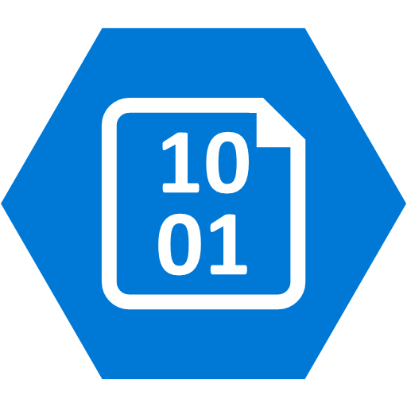

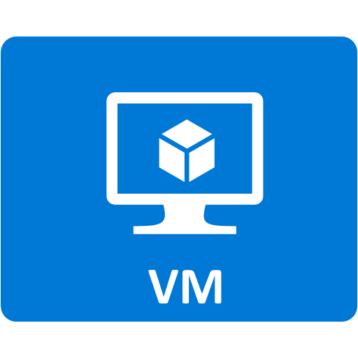


Azure Stack: backup and disaster recovery
Azure Backup
Azure Site Recovery
Replication to Azure
Blob snapshot, AzCopy blob: copy
AzCopy Table: export
Tenant
On-premises
Backup Target
IaaS
PaaS
Azure Stack infrastructure
External
File Share
Administrator

Slide 20
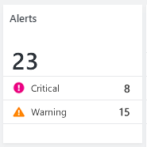
Azure Stack monitoring
Azure Stack Stamp
OEM Network Switches
Azure Stack software components internally monitored via
  Health Services
  Service Fabric Health
Metrics & Logs centrally collected
Hardware monitoring
  OEMs responsible for agentless HW device monitoring/validation through external systems
    Nodes
    Switches
  S2D storage monitored by Azure Stack components
REST API for 3rd party integration of alerts, metrics, and logs
  SCOM Azure Stack Fabric MP https://azure.microsoft.com/en-us/blog/management-pack-for-microsoft-azure-stack-now-available/
  Nagios integration
Azure Stack Software Components
Health & Alerts visible in Admin Portal
Alerts generated from:
  Internal Health Services
    WSHS
    Service Fabric
  Azure Stack components
Rest API available for 3rd Party System Integration
Monitoring via SNMP
External Monitoring Systems
Restful
Integration
Agentless device Monitoring
OEM HW Nodes

Slide 21
Demo – Priprava naročila, ponudbe in kvot
Andrej Kreuh

Slide 22
Azure stack in vsebina

Slide 23
















Azure Stack Extensible Architecture
Storage Blobs
Websites
(.NET, PHP, Python … )
Guest Workload Resources
(IaaS + PaaS)
Websites
(.NET, PHP, Python … )
Service Fabric Clusters
Virtual Machines
(Linux or Windows)
Virtual Networks
Service Fabric Clusters
End User Experiences
End User Experiences
Azure Portal | Developer Tools (MSFT & Open Source)
From Microsoft
Unified App Model
Unified Application Model
Azure Resource Manager
Marketplace
Core Services
Core Services
Subscriptions | RBAC | Marketplace | Metrics | Usage
Azure Stack Software
Extensible Service Framework
Additional Platform Services
Foundational Services
Compute | Storage | Networking | Platform Services
Foundational Services
From 3rd Parties
Cloud Infrastructure
Infrastructure Management
Cloud Infrastructure
Compute
Storage
Networking

Slide 24





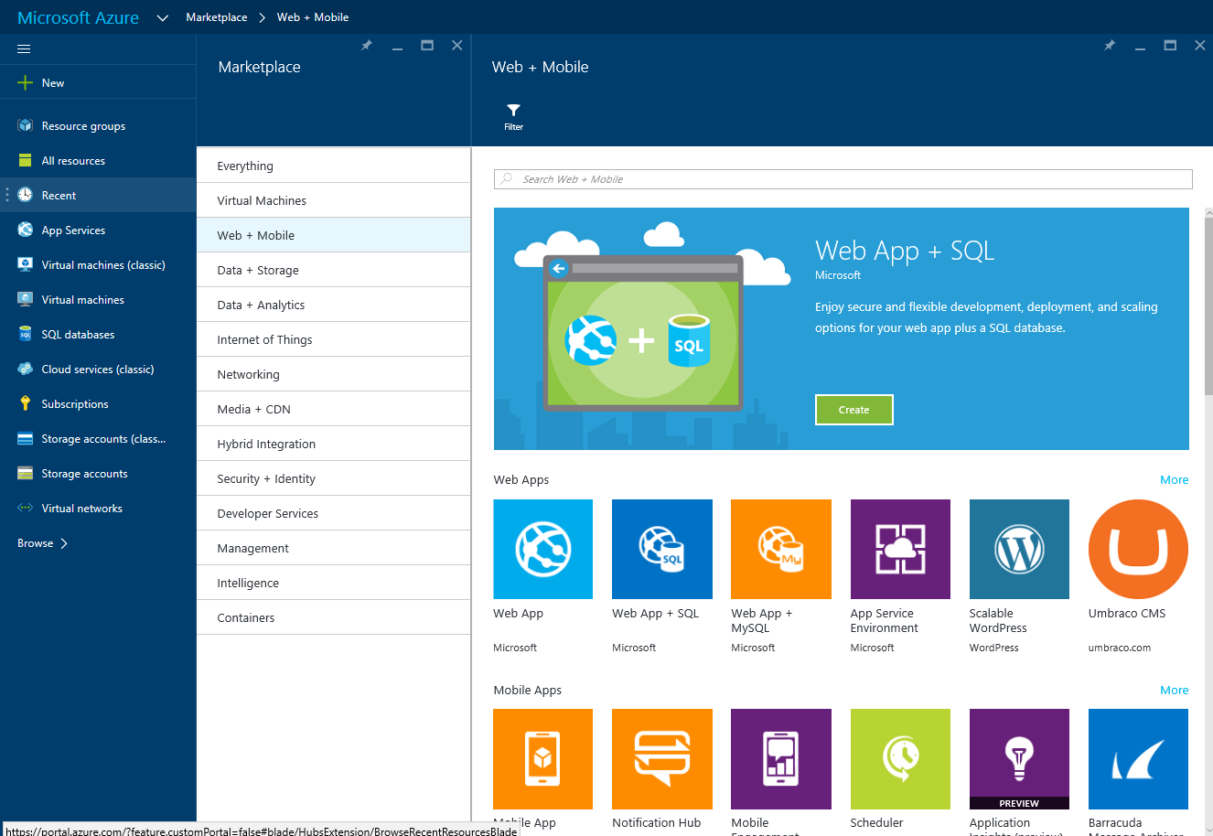



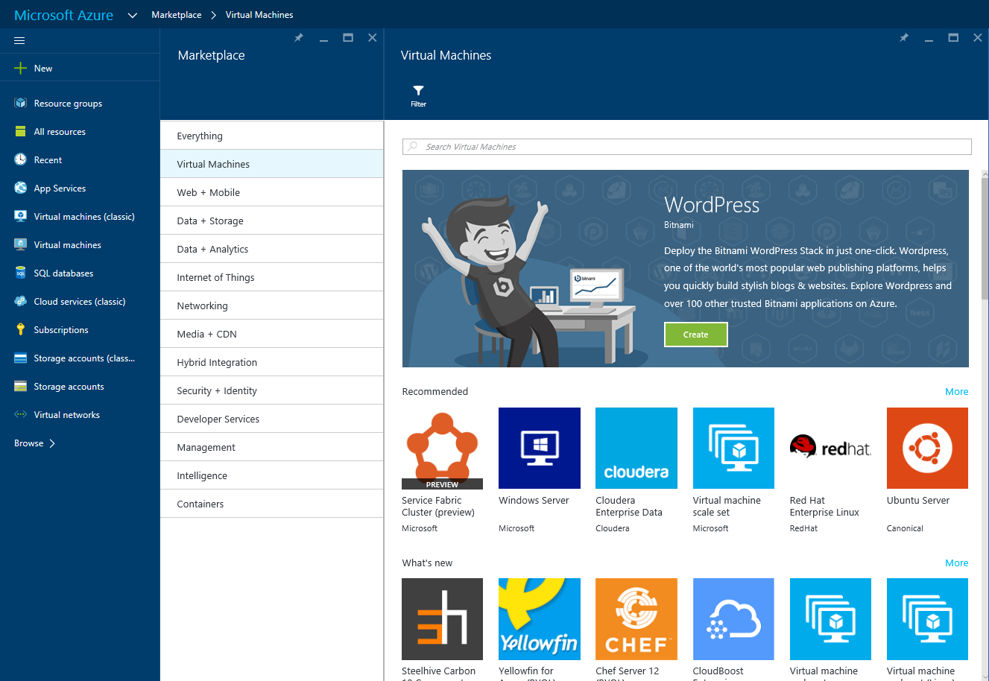




















































Developer Services
Visual Studio
DevTest Labs
VS Application Insights
HockeyApp
Developer Tools
Visual Studio
DevTest Labs
VS Application Insights
HockeyApp
Developer Tools
Add Developer Services that work with Azure Stack
Management & Security
Azure Portal
Automation
Key Vault
Azure Portal
Scheduler
Automation
Log Analytics
Key Vault
Security Center
Log Analytics
Compute
Web & Mobile
Data & Storage
Analytics
IoT & Intelligence
Media & CDN
Identity & Access Management
Web Apps
Data Lake Analytics
Virtual Machines
Web Apps
SQL Database
Virtual Machines
Media Services
Azure IoT Suite
Azure Active Directory
DocumentDB
Azure Active Directory
Mobile Apps
Mobile Apps
Azure Stack starts lighting UP!
Virtual Machines
Scale Sets
Data Lake Store
Virtual Machines
Scale Sets
Add Web & Mobile
Platform Services
“Preview at GA”
Foundational Services
basis for IaaS
Virtual Machines
Azure IoT Hub
Content Delivery Network
Logic Apps
Redis Cache
HDInsight
B2C
Blobs, Tables, Queues, Files, Disks
Cloud Services
API Apps
Blobs, Tables, Queues, Files, Disks
Event Hubs
API Apps
Machine Learning
Domain Services
API Management
Cortana Intelligence Suite
Batch
API Management
Multi-Factor Authentication
StorSimple
Multi-Factor Authentication
Stream Analytics
Add Container Services & Service Fabric for PaaS v2
“Preview at GA”
With Additional Azure Services that Interoperate with Azure Stack
Notification Hubs
Remote App
Notification Hubs
Search
Data Factory
Cognitive Services
Mobile Engagements
Mobile Engagements
SQL Data Warehouse
Data Catalog
Service Fabric
Service Fabric
Functions
Container Service
Functions
Container Service
SQL Server Stretch Database
Power BI Embedded
Hybrid Integration
Backup
Site Recover
BizTalk Services
Service Bus
Backup
Site Recover
Networking
Virtual Network
Express Route
Traffic Manager
Load Balancer
Azure DNS
VPN Gateway
Application Gateway
Virtual Network
Express Route
Traffic Manager
Load Balancer
Azure DNS
VPN Gateway

Slide 25
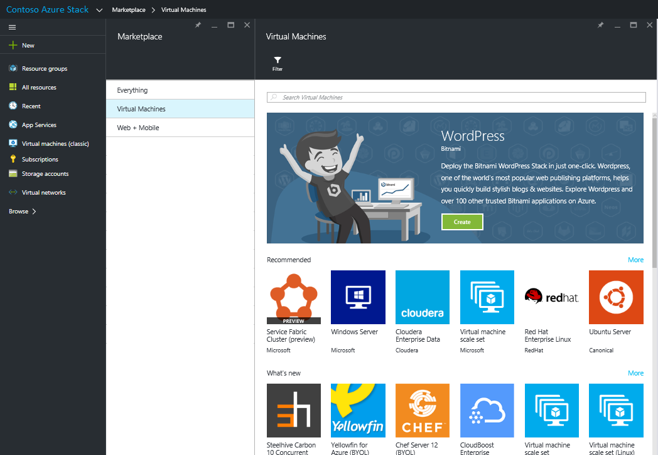
Azure Marketplace
Azure Marketplace is an online store that contains certified, open source, and community software applications, developer services, and data which are pre-configured to run in Microsoft Azure (and Azure Stack)
https://azure.microsoft.com/en-us/marketplace

Slide 26
Demo – Uvoz vsebine iz Azure marketplace
Andrej Kreuh

Slide 27
Priprava na Azure stack

Slide 28
Azure Stack Development Kit
Minimum Scale
  Similarity to final production deployment
  Repeatability of development experience prior to or alongside Azure Stack production deployments
Simplicity
  Ease and Speed of (re)Deployment, Management, Operations and the reuse of existing collateral
Flexibility, Low Cost, Low Overhead
  Minimum requirements that can easily be procured and adopted
  Multiple deployment options (from minimum requirements to large single host machines)
    https://docs.microsoft.com/en-us/azure/azure-stack/azure-stack-deploy

Slide 29
Strojne zahteve za Azure Stack Development kit
Component | Recommended
Disk drives: Operating System | 1 OS disk with minimum of 200 GB available for system partition (SSD or HDD)
Disk drives: General Azure Stack POC Data | 4 disks. Each disk provides a minimum of 250 GB of capacity (SSD or HDD). All available disks will be used. *
Compute: CPU | Dual-Socket: 16 Physical Cores (total)
Compute: Memory | 128 GB RAM ** (192 GB++)
Compute: BIOS | Hyper-V Enabled (with SLAT support)
Network: NIC | Windows Server 2012 R2 Certification required for NIC; no specialized features required
HW logo certification | Certified for Windows Server 2012 R2
* You will need more than this recommended capacity if you plan on adding many of the marketplace items from Azure
** Minimum memory to support PaaS resource providers

Slide 30
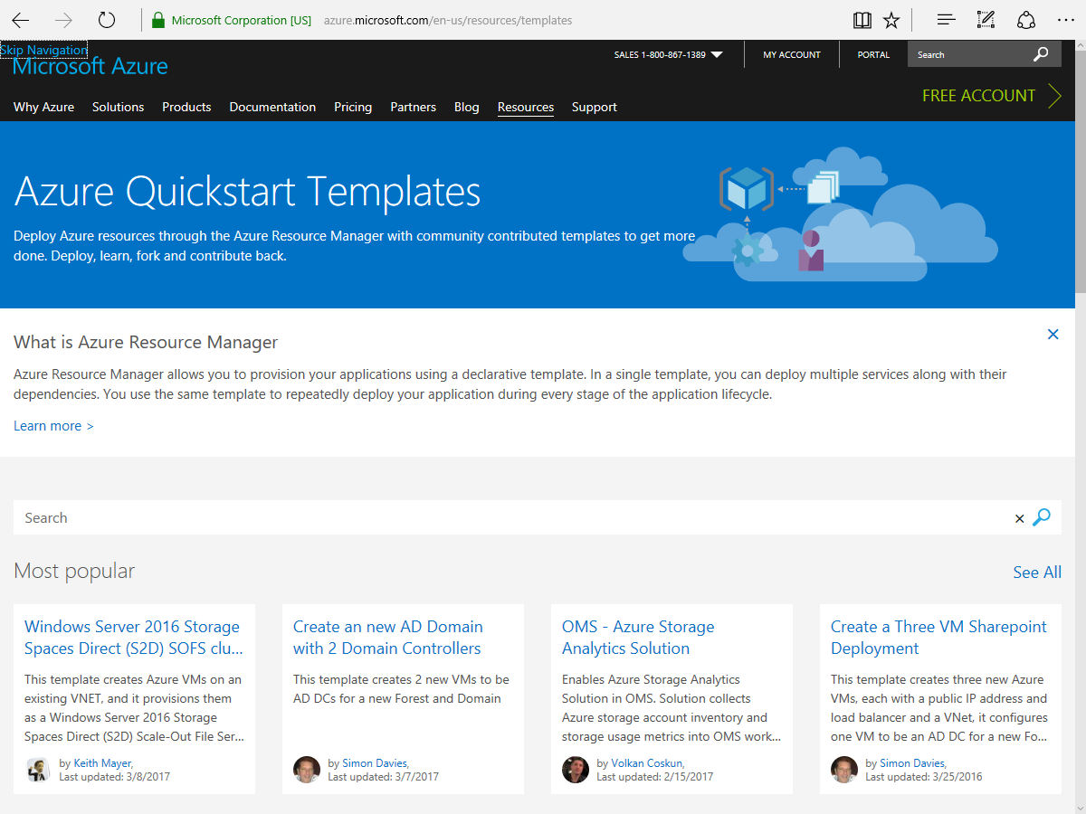
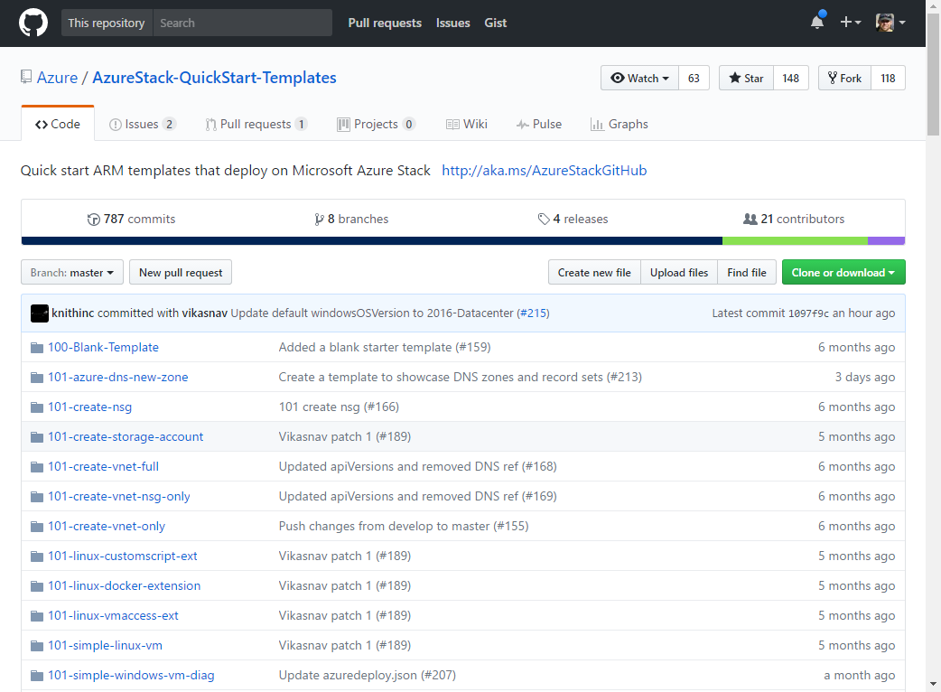
Azure templates
  Azure Quickstart Templates
    Community contributed ARM templates to accelerate learning and deployment of Azure Services
    Contains a contribution guide and best practices.
    https://azure.microsoft.com/en-us/resources/templates/
  Azure Stack support
    Contains deployment templates that have been tested on Microsoft Azure Stack Technical Preview
    https://github.com/Azure/AzureStack-QuickStart-Templates
Microsoft Confidential

Slide 31
Pomembni viri
http://aka.ms/AzureStack (Main Site)
http://aka.ms/AzureStackDocs (Documentation) http://aka.ms/azurestackwhatsnew
http://aka.ms/azurestacktroubleshooting
http://aka.ms/AzureStackakaGuide (Blog with guide to other resources)
https://channel9.msdn.com/Blogs/azurestack (Azure Stack Channel)
http://aka.ms/AzureStackForum
http://aka.ms/AzureStackUserVoice
https://github.com/Azure/AzureStack-Tools
#AzureStack on Twitter

