Slide 1
Pregled scenarijev uporabe storitve Azure Active Directory pri integraciji in nadzoru identitete uporabnika
Gregor Šuster
Microsoft Slovenija

Slide 2
Session objectives
What is Azure AD?
Why it is important in today‘s authentication scenarios?
Discuss about different Azure Active Directory authentication options – Federation, Password Hash Sync, Pass-through Authentication (PTA), Seamless SSO, etc.
Best practices and considerations using different authentication options.

Slide 3
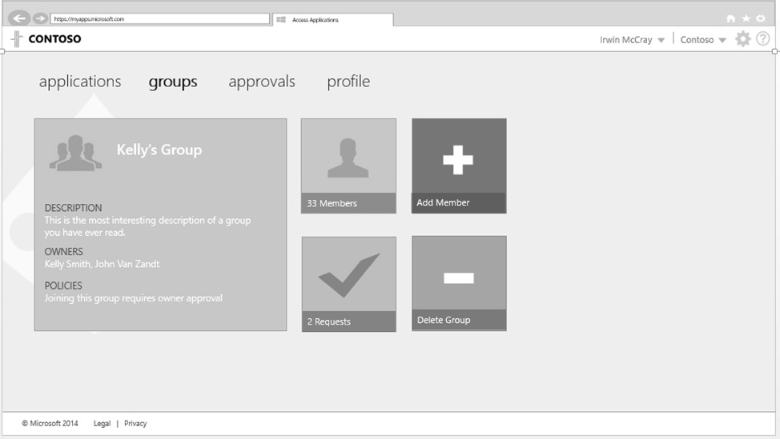
What is Azure Active Directory?
Simple connection
Self-service
Single
sign on
Windows Server
Active Directory
Username
•••••••••••
Other
Directories
SaaS
Azure
Public
cloud
Office 365
On-premises
Cloud
Microsoft Azure Active Directory

Slide 4



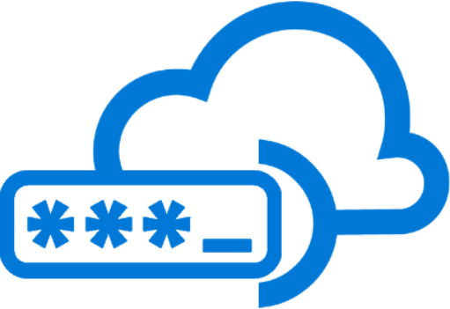











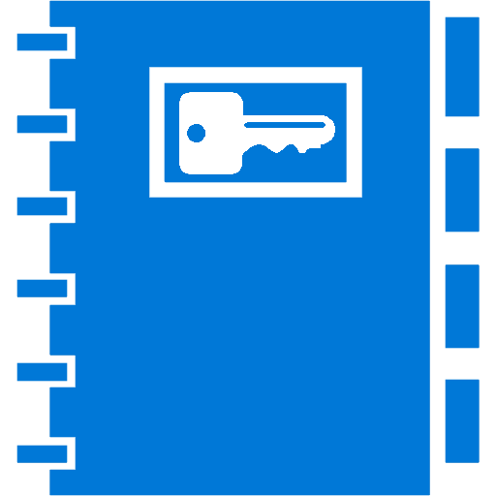



Azure Active Directory
Azure AD Connect
B2B collaboration
Provisioning-Deprovisioning
Conditional Access
SSO to SaaS
Self-Service capabilities
Connect Health
Multi-Factor Authentication
Addition of custom cloud apps
Access Panel/MyApps
Dynamic Groups
Identity Protection
Remote Access to on-premises apps
Azure AD
B2C
Group-Based Licensing
Privileged Identity Management
Microsoft Authenticator - Password-less Access
Azure AD Join
MDM-auto enrollment /
Enterprise State Roaming
Security Reporting
Azure AD DS
Office 365 App Launcher
HR App Integration
Access Reviews

Slide 5
What is Azure AD Connect?
In the past…
Now we have…
Tool which simplifies connecting on-premises identity infrastructure with Azure AD
Beyond synchronizing users from AD to Azure AD, provides various features for simplifying hybrid identity management
All future investments will only be available with AAD Connect
Azure AD Connect
DirSync
Azure AD Sync
Sync
FIM + Azure AD Connector
ADFS
ADFS
PTA/DSSO
Health

Slide 6
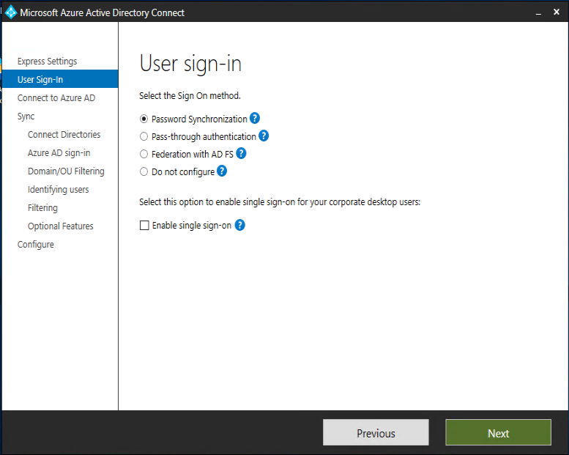
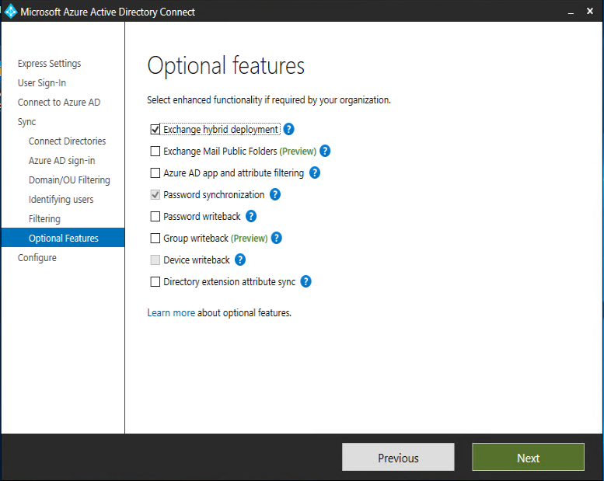
User sign-in options

Slide 7
Authentication options for Hybrid customers
Same Sign-on (Sync only)
  Passwords in Azure AD are different then in AD on premise
Authenticate with ADFS
  Keeps passwords on premise and the identity provider under the organization’s control
  Flexibility and third party interoperability
Authenticate with Azure AD by synchronizing password hashes to Azure AD (referred as PHS (Password Hash Sync))
  Recommended option for organizations who do not want any on-premises footprint
Authenticate with AD using Pass-through Authentication agent (referred to as PTA (Pass-through Authentication))
  Keeps passwords on premise, but with very little on-premises footprint (lightweight agent)

Slide 8
Same Sign-on (Sync only)
AD objects on premise are synced to Azure AD, but the password in Azure AD is different then in AD on premise
  Password management for Azure AD users is done in Azure AD and not synced back to AD on premise.
  Basically we have user objects that look the same (user name) but are different!

Slide 9
Authentication with ADFS
Pros:
  Keeps passwords on premise and the identity provider under the organization’s control.
  Numerous possibilities to connect/federate with different service/identity providers.
  Audit trail on premise.
  Third party interoperability (MFA etc).
Cons:
  ADFS environment could be complex (ADFS servers, WAP servers, firewall configuration, certificate management, etc.)

Slide 10
Authentication with ADFS

Slide 11

Authentication with ADFS
Azure AD
ADFS
Active
Directory
Application
Trust with
Azure AD
Federation
Access
Authenticated?
Redirect to STS
Realm Discovery
Redirect to „home“ AD FS
Authentication
Secuity Token 1
ST
Users Attributes
ST
Redirect to STS
Transformed Security Token 2
ST
Authentication Token 2
Cookie and Access

Slide 12
Authentication with Azure AD using PHS
With password hash synchronization, hashes of user passwords are synchronized from on-premises Active Directory to Azure AD.

Slide 13
PHS – Security Considerations
How secure is it?
  Every two minutes, the password hash synchronization agent on the AD Connect server requests stored password hashes (the unicodePwd attribute) from a DC.
  DC encrypts the MD4 password hash (again!) by using a key that is a MD5 hash of the RPC session key and a salt. DC also passes the salt to the synchronization agent. DC also passes the salt to the synchronization agent.
  Synchronization agent uses MD5CryptoServiceProvider and the salt to generate a key to decrypt the received data back to its original MD4 format.
  The password hash synchronization agent expands the 16-byte binary password hash to 64 bytes and adds a salt, consisting of a 10-byte length salt to the 64-byte binary to further protect the original hash.
  The password hash synchronization agent then combines the MD4 hash plus salt and inputs it into the PBKDF2 function. 1000 iterations of the HMAC-SHA256 keyed hashing algorithm is used.
  The password hash synchronization agent takes the resulting 32-byte hash, concatenates both the salt and the number of SHA256 iterations to it (for use by Azure AD), then transmits the string from Azure AD Connect to Azure AD over SSL.
Notes:
https://docs.microsoft.com/en-us/azure/active-directory/connect/active-directory-aadconnectsync-implement-password-hash-synchronization#how-password-hash-synchronization-works

Slide 14
Authentication with Azure AD using PTA
Enables customers to validate password on-premises without the need for ADFS
  Allows for on-premises policies to be evaluated such as account disabled, login hours restrictions etc.
  Simple deployment via AAD Connect, no complex DMZ requirements
  Works for single or multi-forest customers
Lightweight agent that is installed on premise
  Securely validates the user’s password against on-premises AD
  On-premises passwords are never stored in the cloud in any form
  The agent only makes outbound connections from within your network. Therefore, there is no requirement to install the agent in a perimeter network
  Customer can deploy multiple agents for HA
Bottom line – Similar benefits to federation without the deployment cost

Slide 15
PTA – Additional features
Sign-in usernames can be either the on-premises default username (userPrincipalName) or another attribute configured in Azure AD Connect (known as Alternate ID).
The feature works seamlessly with conditional access features such as Multi-Factor Authentication (MFA)
Integrated with cloud-based self-service password management, including password writeback to on-premises Active Directory and password protection by banning commonly used passwords.
Multi-forest environments are supported if there are forest trusts between your AD forests and if name suffix routing is correctly configured
It is a free feature and you don't need any paid editions of Azure AD to use it.

Slide 16
How does PTA work?
Polling
2
Username and password sent to the connector
User Name and password
Azure AD STS
Azure AD STS
1
2
8
7
Connector notified of request
Result returned back to AAD STS
Token returned to use or further proofs (MFA) are initiated
3
Connector returns result
6
Contoso Corpnet
Connector validates the credentials against AD
Connector
4
5
DC returns result
DC

Slide 17
PTA prerequisites
For PTA to work you need following:
  Server running Windows Server 2012 R2 or later to run Azure AD Connect. Needs to be domain joined.
  Latest Azure AD Connect build (at least 1.1.644.0 or later)
  Proxy and firewall configuration
    80/tcp outbound from Authentication Agent to check CRLs for SSL,
    443/tcp outbound from Authentication Agent to process the service Authentication queue
    Whitelist *.msappproxy.net and *.servicebus.windows.net on Proxy
    Whitelist login.windows.net and login.microsoftonline.com on Proxy for initial configuration.
  Prerequisites for high availability
    Additional Windows Servers 2012 R2 or later to run Authentication Agent. This agent is used for HA only.

Slide 18
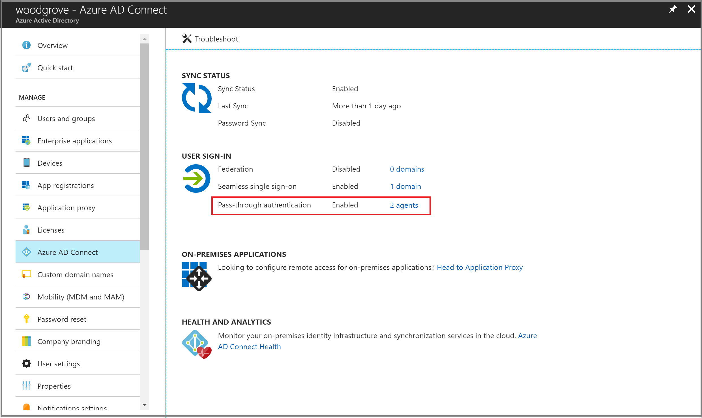
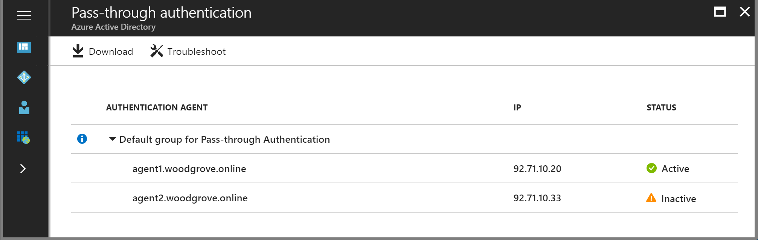
PTA prerequisites

Slide 19
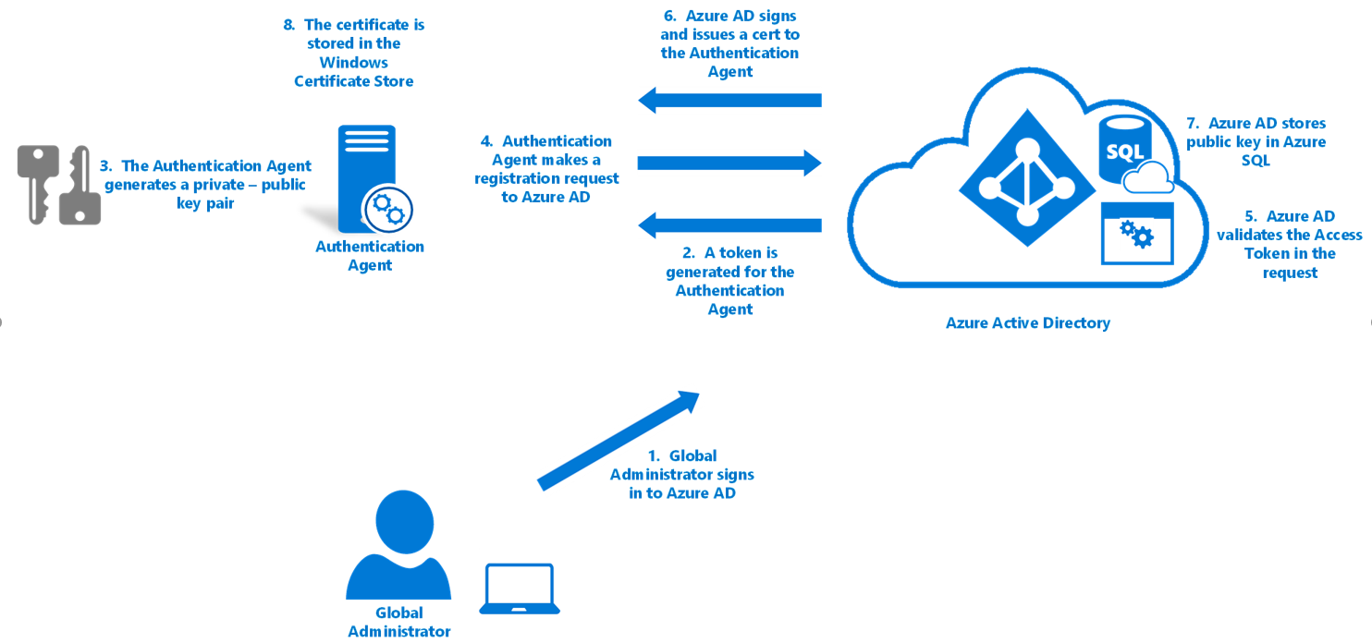
PTA - Authentication Agent registration
Notes:
https://docs.microsoft.com/en-us/azure/active-directory/connect/active-directory-aadconnect-pass-through-authentication-security-deep-dive

Slide 20
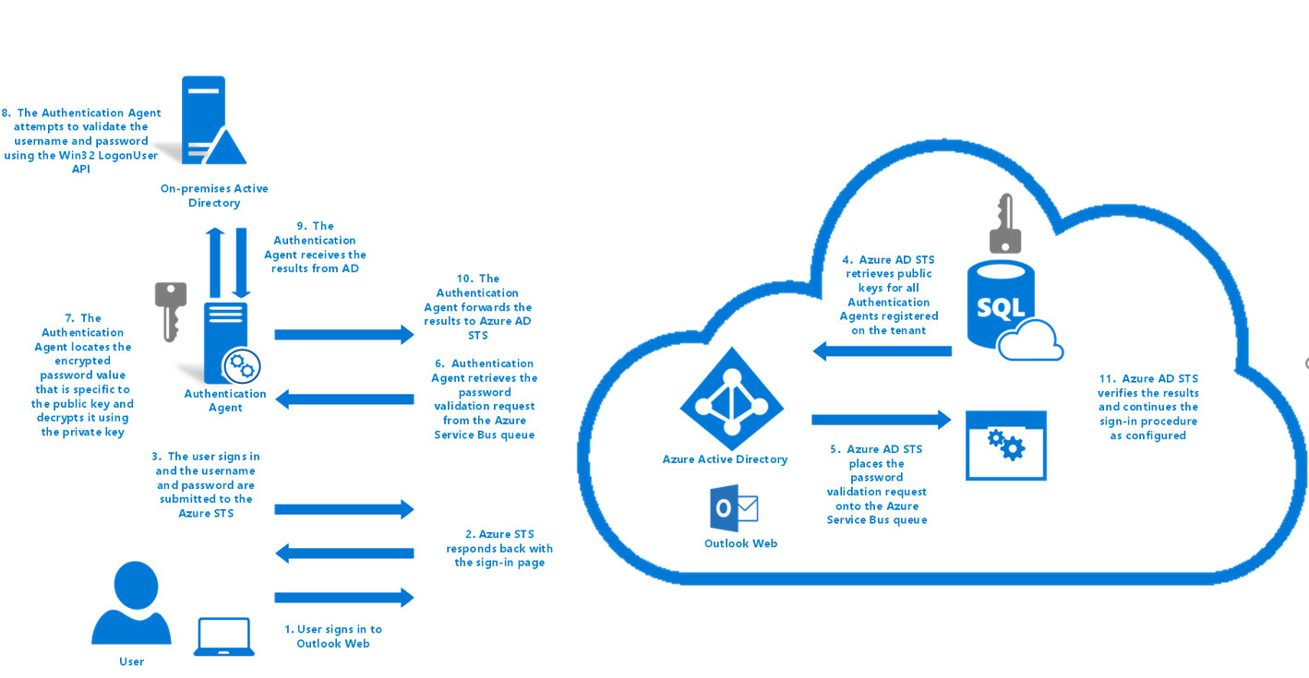
PTA - Process sign-in requests
Notes:
https://docs.microsoft.com/en-us/azure/active-directory/connect/active-directory-aadconnect-pass-through-authentication-security-deep-dive

Slide 21
PTA – supported scenarios
User sign-ins to all web browser-based applications.
User sign-ins to Office applications that support modern authentication (ADAL):
  Office 2016 and Office 2013 with modern authentication
User sign-ins to Skype for Business that support modern authentication
User sign-ins to Outlook clients using legacy protocols such as Exchange ActiveSync, SMTP, POP and IMAP.
Azure AD domain joins for Windows 10 devices.
What about unsupported scenarios?

Slide 22
PTA – Additional HA option
Enabling password hash synchronization gives you the option to failover authentication if your on-premises infrastructureis disrupted.
This is not automatic failover! You'll need to switch the sign-in method manually using Azure AD Connect.

Slide 23
PTA – Smart Lockout
What is Smart Lockout?
  Protects against brute-force password attacks and prevents genuine users from being locked out of their Office 365 and SaaS applications.
What does it do?
  After a certain lockout threshold, it starts a lockout duration.
  By default account treshold is set to 10 and lockout duration is 60 seconds. This could be changed in Azure AD Premium P2 subscription.
Additional customization:
  Set the values so that the Active Directory account lockout threshold is at least two or three times longer than the Azure AD lockout threshold.
  The Azure AD lockout duration (represented in seconds) is longer than the Active Directory reset account lockout counter after duration (represented in minutes).

Slide 24
Considerations for choosing authentication options
Consideration | Password Hash Synchronization (with SSO) - PHS | ADFS | Pass-through Authentication with SSO - PTA
Where does the authentication happen? | In the cloud | On-premises | On-premises
Where does the user enter the credentials? | In the cloud | On-premises (through proxy in DMZ) | In the cloud (transmitted securely to on-premises agent)
Is there any on-premises infrastructure needed beyond Azure AD Connect? | No | Yes – At least 2 ADFS servers and 2 proxies in DMZ | Yes – 1 or more lightweight agents that can be installed on any existing servers (including DCs) with no DMZ requirements
Do my users get single sign-on to cloud resources from domain-joined devices within company network? | Yes, with SSO feature or with AAD-join* | Yes | Yes, with SSO feature
*AAD-join is only supported on Windows 10

Slide 25
Considerations for choosing authentication options
Consideration | Password Hash Synchronization (with SSO) - PHS | ADFS | Pass-through Authentication with SSO - PTA
What login types does it support? | U/P, Win10/Hello | U/P, WIA, Cert-based auth, SmartCard, | U/P
What MFA options do I have? | Azure MFA | Azure MFA, Azure On-premises MFA, 3rd party MFA (RSA, Safenet, HID Global, Symantec,…) | Azure MFA
What Conditional Access options do I have? | Azure AD Conditional Access | Azure AD Conditional Access as well as additional on-premises | Azure AD Conditional Access
Does it support alternate login ID? | Yes | Yes | Yes
Does it support legacy application & EAS clients? | Yes | Yes | No

Slide 26
Desktop SSO
Single sign on without the cost of AD FS
  No additional servers or infrastructure required on premises
  Accelerated deployment
Utilizes existing AD infrastructure
  Support for multiple regions
  Support for finding the closest DC
  Based on Kerberos
Support for both PTA and PHS customers
  SSO is provide for all domain joined corporate machines with line of sight to a DC
Supports Alternate Login ID

Slide 27
Desktop SSO - How does it work - Setup
Azure AD
Kerberos key stored securely in Azure AD
2
GPO to set Intranet zone
3
1
DC
Machine Account created in on-prem AD
Company‘s Corpnet

Slide 28
Desktop SSO - How does it work - Runtime
AAD STS
AAD STS returns token to the user
User sends ticket to AAD STS
6
User enters their username
1
5
2
401 response to get a Kerberos ticket
AD returns Kerberos ticket
3
4
User requests a Kerberos ticket
Company‘s Corpnet
DC

Slide 29
To summarize -
There are multiple sign-in options to Azure AD in Hybrid scenarios
  Federated authentication (with ADFS on premise)
  Authentication to Azure AD with synced password (hashes)
  Pass-through Authentication (with passwords still stored on premise)
All scenarios have their Pros and Cons, but
  PTA or PHS are easy to implement and to manage. Security considerations should not be a problem.
  ADFS – sometimes required if additional 3rd party security solutions are used or specific integration with 3rd service/identity providers is established.

Slide 30
Resources and additional information
Getting started with Azure AD - https://docs.microsoft.com/en-us/azure/active-directory/get-started-azure-ad
Integrate your on-premises directories with Azure Active Directory - https://docs.microsoft.com/en-us/azure/active-directory/connect/active-directory-aadconnect
Azure AD Connect user sign-in options - https://docs.microsoft.com/en-us/azure/active-directory/connect/active-directory-aadconnect-user-signin
Azure Active Directory Seamless Single Sign-On - https://docs.microsoft.com/en-us/azure/active-directory/connect/active-directory-aadconnect-sso
Implement password hash synchronization with Azure AD Connect sync - https://docs.microsoft.com/en-us/azure/active-directory/connect/active-directory-aadconnectsync-implement-password-hash-synchronization
User sign-in with Azure Active Directory Pass-through Authentication -
https://docs.microsoft.com/en-us/azure/active-directory/connect/active-directory-aadconnect-pass-through-authentication

