Slide 1
Programmatic access to AKS
  Bojan Vrhovnik
  Cloud Solution Architect
  @bvrhovnik | bojan.Vrhovnik@microsoft.com

Slide 2
Kubernetes
Flow Reminder
Agent pools
User
Agent node
kubelet
kube-proxy
Internet
Kubernetes users communicate with API server and apply desired state
Control plane
Container runtime
Control plane actively enforces desired state on agent nodes
api-server
Pods
Pods
Containers
Containers
Agent nodes support communication between containers
controller-manager
scheduler
Agent node
kubelet
kube-proxy
Internet
Agent nodes support communication from the
Internet
replication, namespace, serviceaccounts, etc.
etcd
Container runtime
Pods
Pods
Agent pools keep multiple agent nodes organized
Containers
Containers
Notes:
The Kubernetes API server validates and configures data for the api objects which include pods, services, replicationcontrollers, and others. The API Server services REST operations and provides the frontend to the cluster's shared state through which all other components interact.
Organizing Cluster Access Using kubeconfig Files | Kubernetes

Slide 3
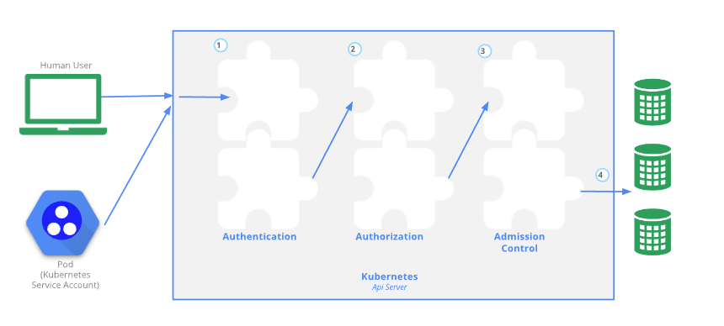
Picture from Controlling Access to the Kubernetes API | Kubernetes
Notes:
Authentication modules include client certificates (X509), password, and plain tokens, bootstrap tokens, and JSON Web Tokens (used for service accounts), OpenID Connect Tokens, Webhook Token Authentication, Service Account Tokens.
After the request is authenticated as coming from a specific user, the request must be authorized.
Admission Control modules are software modules that can modify or reject requests. In addition to the attributes available to Authorization modules, Admission Control modules can access the contents of the object that is being created or modified.

Slide 4
Demo Postman
Showcasing REST calls
Notes:
All resource types are either scoped by the cluster (/apis/GROUP/VERSION/*) or to a namespace (/apis/GROUP/VERSION/namespaces/NAMESPACE/*). A namespace-scoped resource type will be deleted when its namespace is deleted and access to that resource type is controlled by authorization checks on the namespace scope.
Kubernetes API Reference Docs

Slide 5
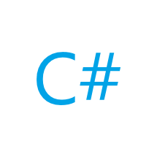
Kubernetes C# library
C# library to work with K8S API’s
Usage: dotnet add package KubernetesClient
Honorable mentions:
  Microsoft.ApplicationInsights.Kubernetes
  AspNetCore.HealthChecks.Kubernetes
  Microsoft.Orleans.Hosting.Kubernetes
  Dapr.io
Notes:
Configure Access to Multiple Clusters | Kubernetes

Slide 6

Demo Csharp library
Showcasing official C# library and how to work with most common scenarios

Slide 7
Recap
K8S is very configurable / extensible
Extend workloads programmatically with ease
Up to date client libraries with tons of community support (16.7 millions downloads)

Slide 8
Thank you for attending my session

Slide 9
This is not school, but we
love to get grades.
Please fill out our
questoineers and leave
us your feedback.
You may even win some
cool rewards.

