Slide 1
Microsoft Teams
Introduction

Slide 2
Who are we?
Robi Vončina (robi.voncina@kompas-xnet.si)
SharePoint MVP from 2013
Kompas Xnet
SharePoint and O365 Experts
Learning center for Microsoft Products from 1995

Slide 3
Agenda
Introduction
Microsoft Teams client
Organizing teams
Collaboration
  Meetings
  Planner
  OneNote
  Add-ons
    Bots
What‘s new and what is coming
Admin stuff

Slide 4
Introduction to Teams

Slide 5
Chat-based workspace in Office 365
Chat for today’s teams
Communicate in the moment and keep everyone in the know
A hub for teamwork
Give your team quick access to information they need right in
Office 365
Customizable for
each team
Tailor your workspace to include content and capabilities your team needs every day.
Security teams trust
Get the enterprise-level security and compliance features you expect from Office 365.

Slide 6
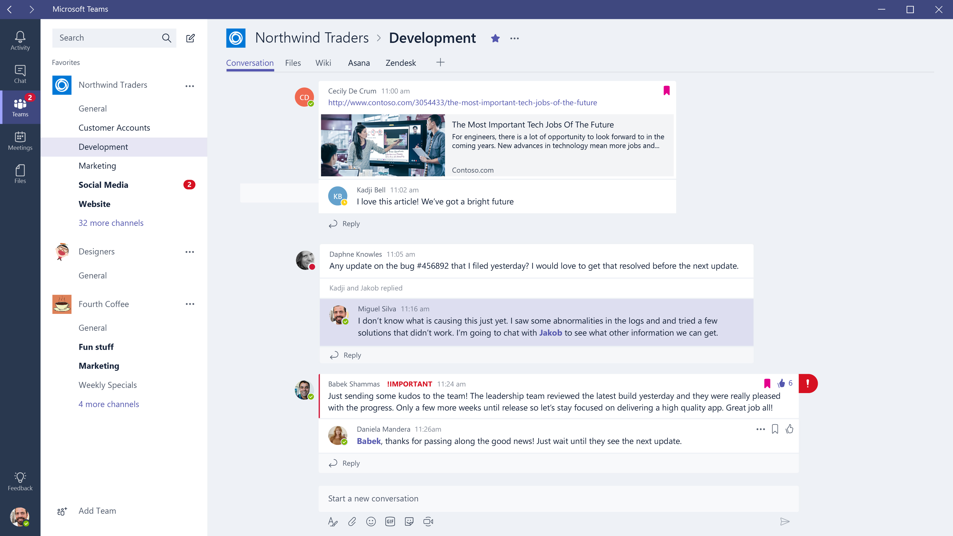
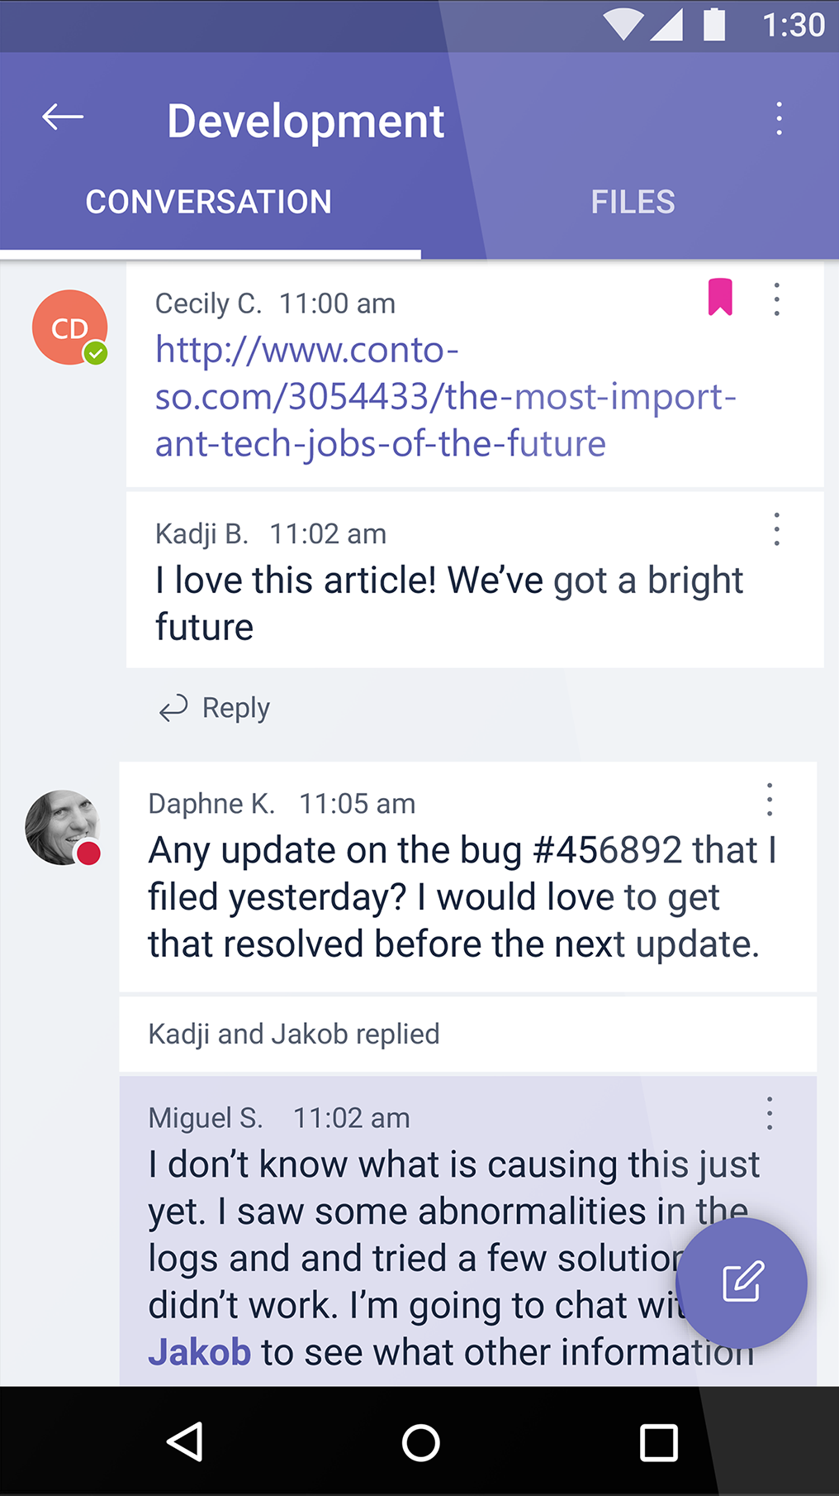
Chat for today’s teams
People can see content and chat history anytime
Team chats and activities are visible to the entire team
Use private chats for small group conversations
Mobile access on Android, iOS and Windows Phone

Slide 7
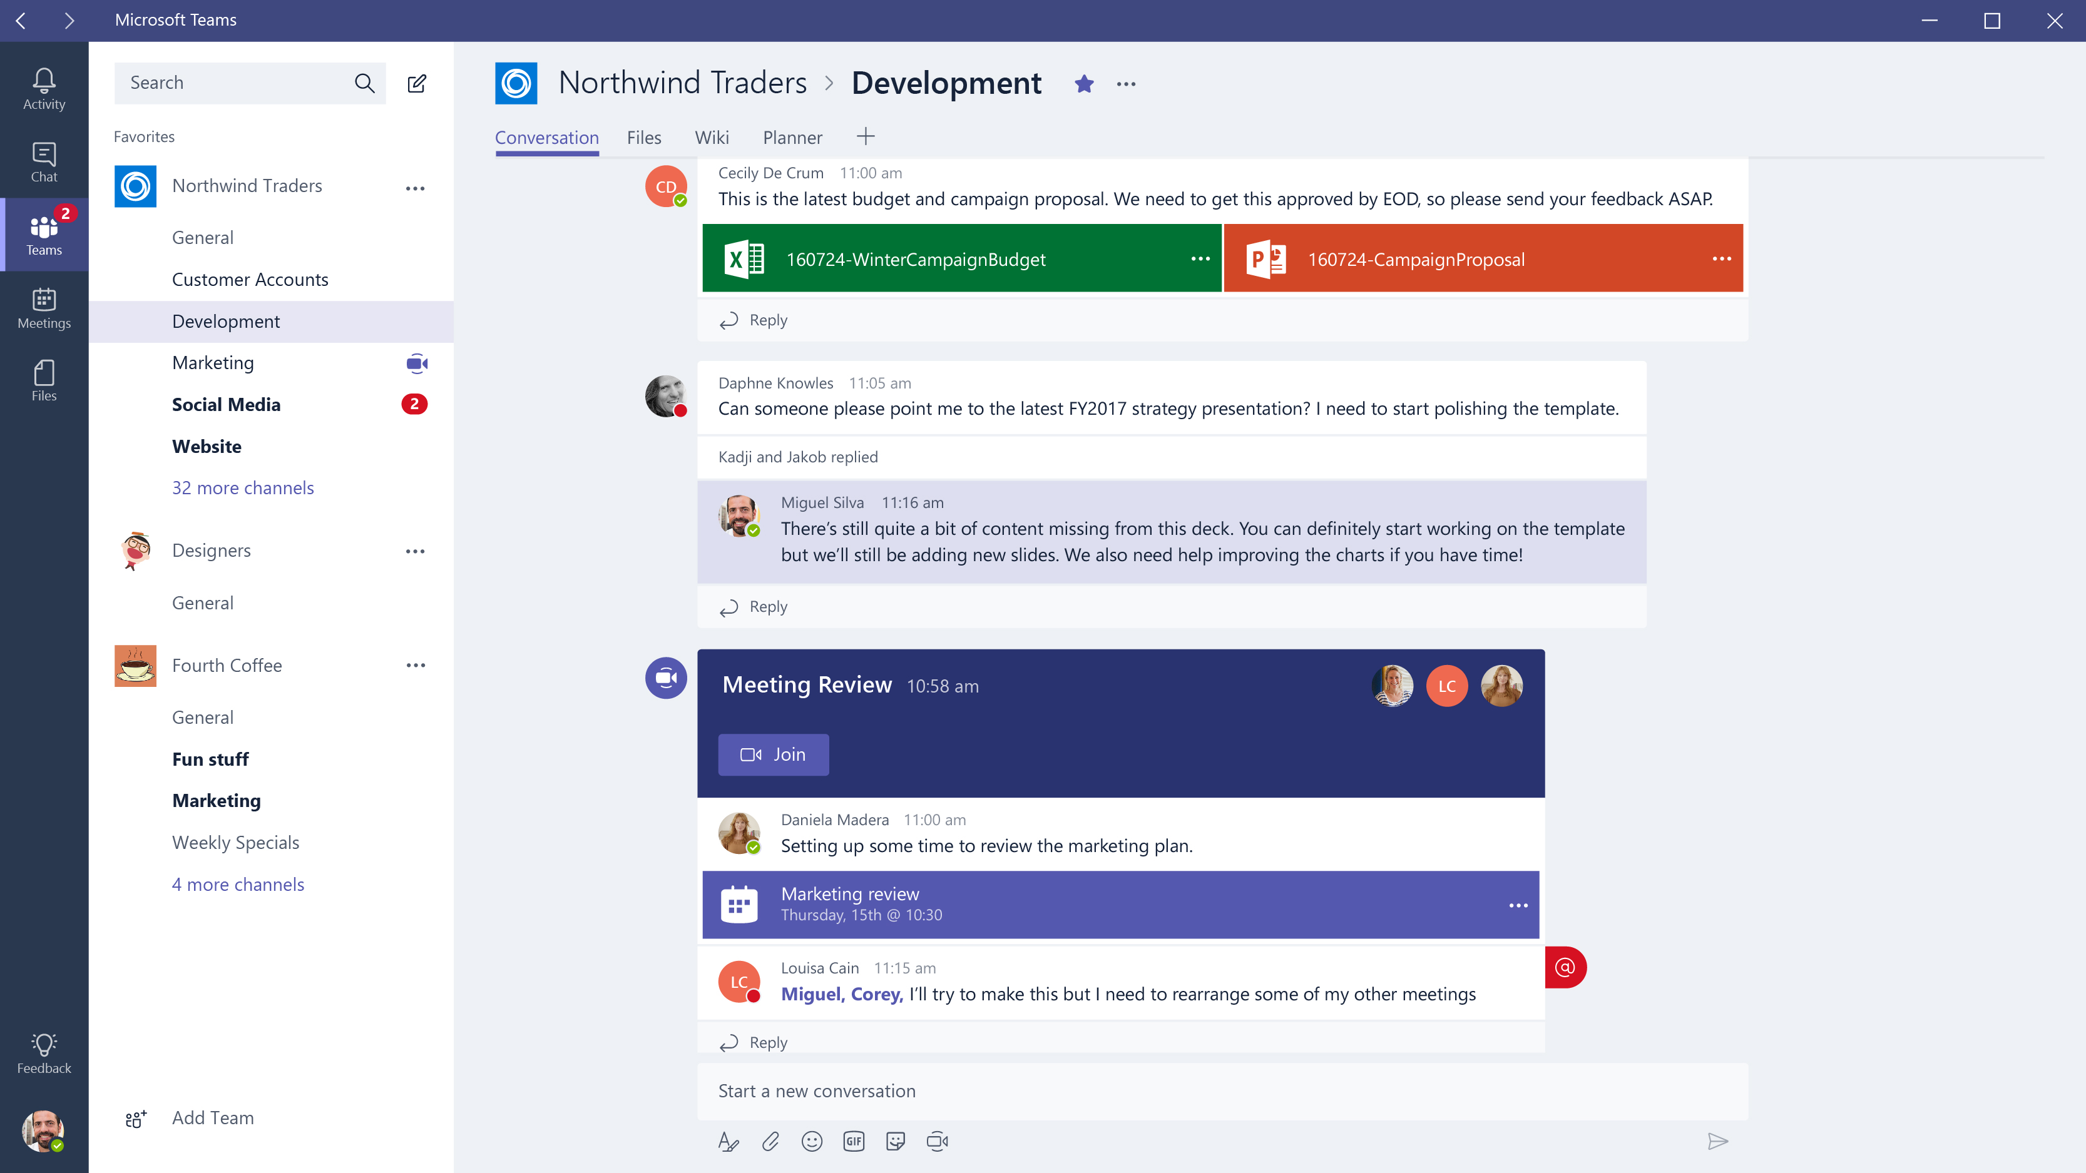
A hub for teamwork
Chat, content, people, and tools live in a team workspace
Voice and video meetings right within Teams
Built-in access to SharePoint, OneNote and Planner
Work with Office and other documents right in the app

Slide 8
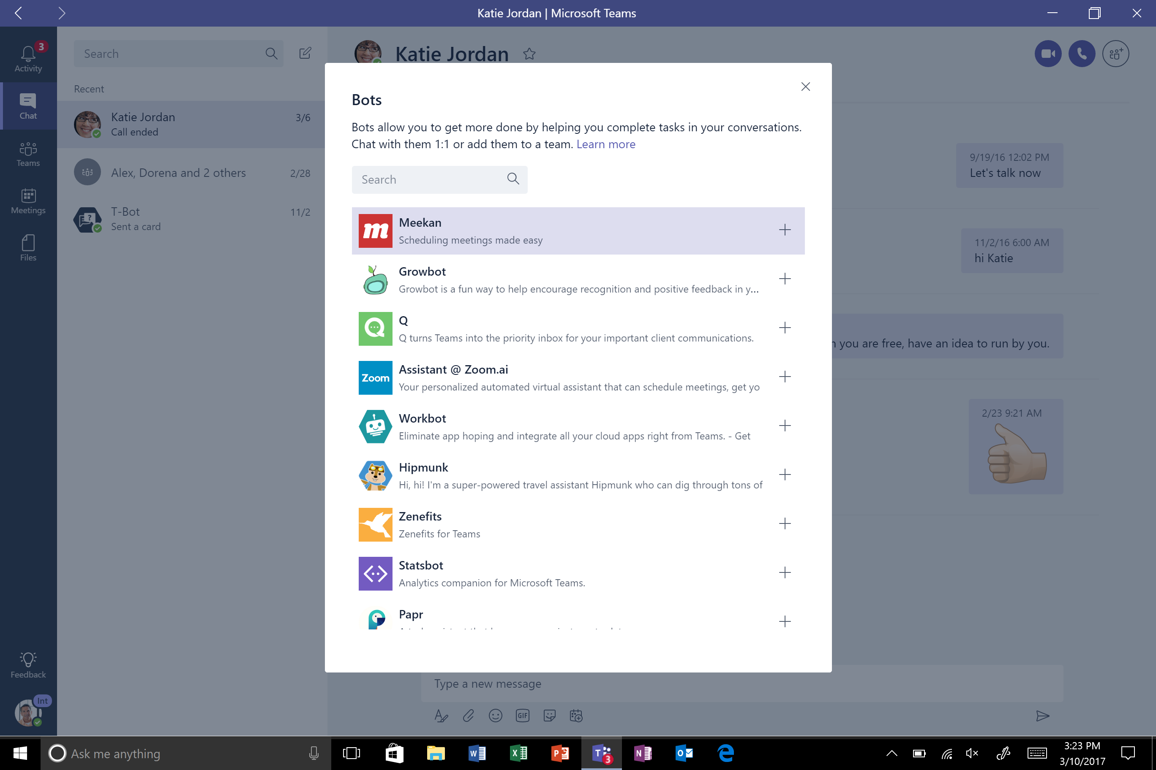
Customizable for each team
Create different channels for work streams and topics
Add tabs to frequently used files and cloud services
Get updates from the apps your team uses every day
Customize notifications so you don’t miss important info
Build integrations with developer preview APIs

Slide 9
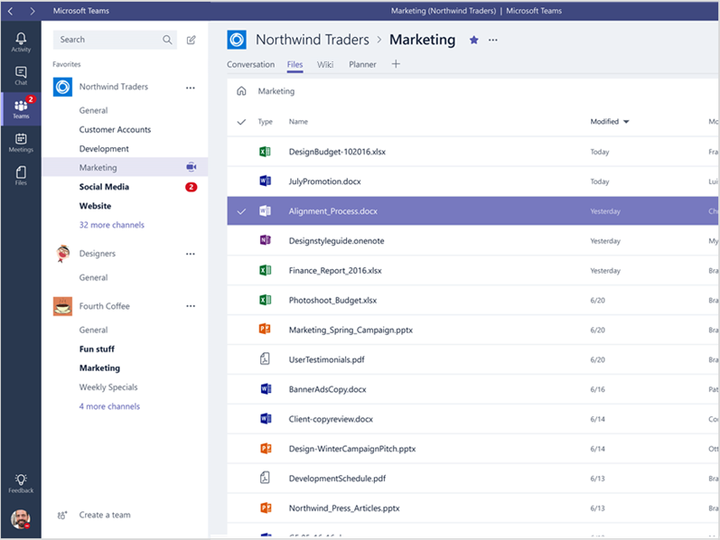
Security teams trust
Broad compliance standards support: Accessibility, ISO27018/01, SOC 1 and 2, HIPAA, EU Model Clauses & more
Information protection with Archive, eDiscovery, Legal Hold, Compliance Content Search, Auditing and Reporting¹
Tier-C Compliant
Data encryption at all times, at-rest and in-transit.
Multi-factor authentication for enhanced identity protection.
¹ Archive, eDiscovery, Legal Hold, Compliance Content Search, Auditing and Reporting are in E3 and above suites.

Slide 10

Meet Microsoft Teams

Slide 11
Office 365: Supporting the unique workstyle of every group
Chat-based Workspace
Teams
Mail &
Calendar
Outlook
Voice, Video
& Meetings
Skype
Sites & Content Management
SharePoint and OneDrive for Business
Enterprise
Social
Yammer
Office 365 Groups
Complete Collaboration Solution
Office 365 addresses the breadth of collaboration needs across organization
Integrated Experiences
Office 365 Groups and Graph enable integrated experiences that facilitate effective collaboration
Security and Compliance
Office 365 provides the security, compliance and manageability required in today’s workplace

Slide 12
Microsoft Teams Clients

Slide 13


Clients for Microsoft Teams
Web
Desktop
Mobile
Full-functioned chat client that can be used from a variety of browsers.
Doesn’t yet support conferencing.
Provides support for audio, video, and content sharing for team meetings, group calling, and private one-on-one or private multi-party calls.
Geared at users participating in chat-based conversations while on the go , and currently allows users to have peer-to-peer audio call.

Slide 14
Platform Requirements
Web
Desktop
Mobile
Edge: 12+
Internet Explorer: 11+
Chrome: 51.0+
Firefox: 47.0+
Safari (coming soon)
Windows 7+ (7, 8, 8.1, 10)
Both 32 & 64 bit available
Mac OSX 10.10+
Android 4.4+
iOS (iPhone and iPad) 10+
Windows Phone 10.0.10586+

Slide 15
Demo
Navigating arounD teams client

Slide 16
Organizing Teams
Notes:
Before going down the path of technical implementation details of Teams, let’s first understand how Teams are organized.

Slide 17
Structure
Teams
Collection of people, content, and tools surrounding different projects
Channels
Dedicated sections within a team to keep conversations organized
Places where everyone on the team can have open conversations
Can be extended with Tabs, Connectors and Bots
Lessons learned → less is more

Slide 18
Memberships and Roles
Team owners are able to invite anyone in the organization they work
Three roles in Teams:
Owner: person who creates the team or assigned the role.
Responsible for managing team-wide settings and membership, including invitations
Team member: the people that have been invited to join the team
Guests: Office 365 users who are outside of your tenant can be added to the team by team owners (more info @ aka.ms/guestaccesshelp)
Lessons learned → be patient

Slide 19
Collaboration

Slide 20


Content collaboration in the Microsoft cloud
Document collaboration
with Office apps
Shared content in
Teams and Outlook
Anywhere access to
files with OneDrive
Employee engagement with Yammer & Stream
Digital experiences with SharePoint portals & spaces
SharePoint
Security
AI
Extensibility

Slide 21
AND
SharePoint
OneDrive
or
?

Slide 22
OneDrive
AND
SharePoint
Where do I put files?
Private stuff in my files; team stuff in a shared library
Where do I go to use my files?
Wherever it’s most productive!
OneDrive is the files app for Office 365. It enables you to access, share, and collaborate on all your files.

Slide 23
AND
Microsoft Teams
SharePoint
?
or

Slide 24
SharePoint
AND
Microsoft Teams
When should I use SharePoint?
Every Team uses SharePoint!
Where do I go to work with my team?
Wherever it’s most productive!
SharePoint will be best for creating and managing lists, pages and composite apps that can be used by everyone in Teams.

Slide 25
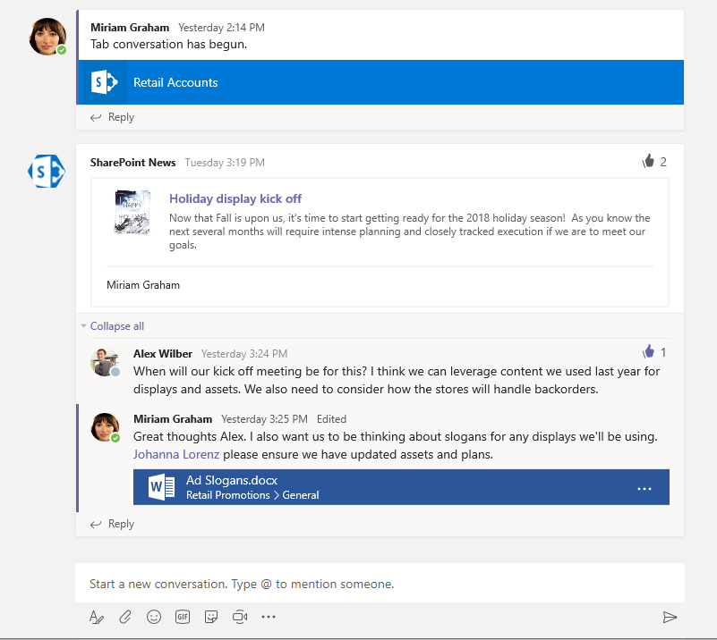
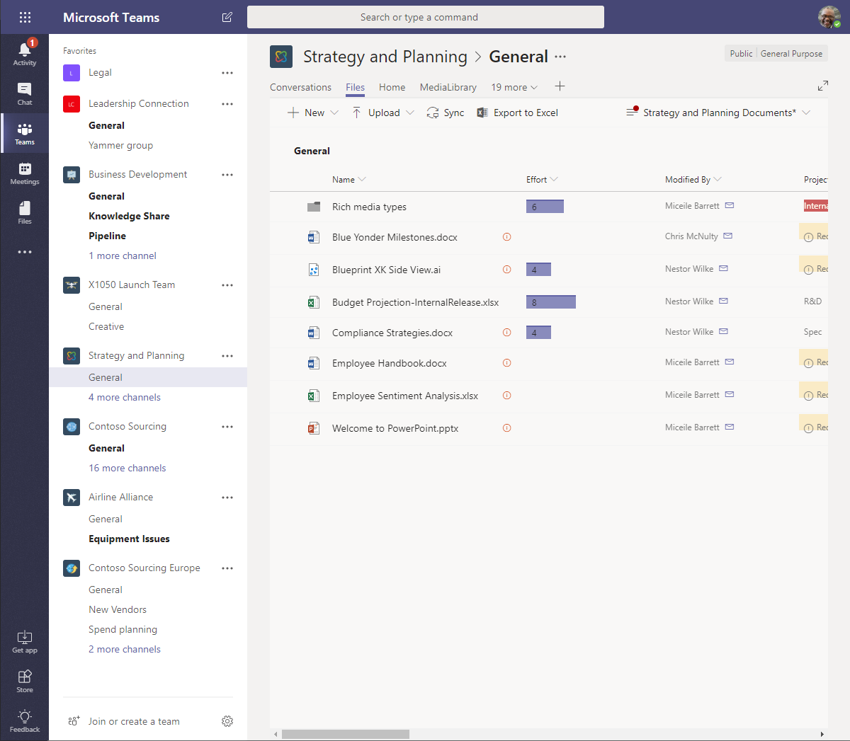
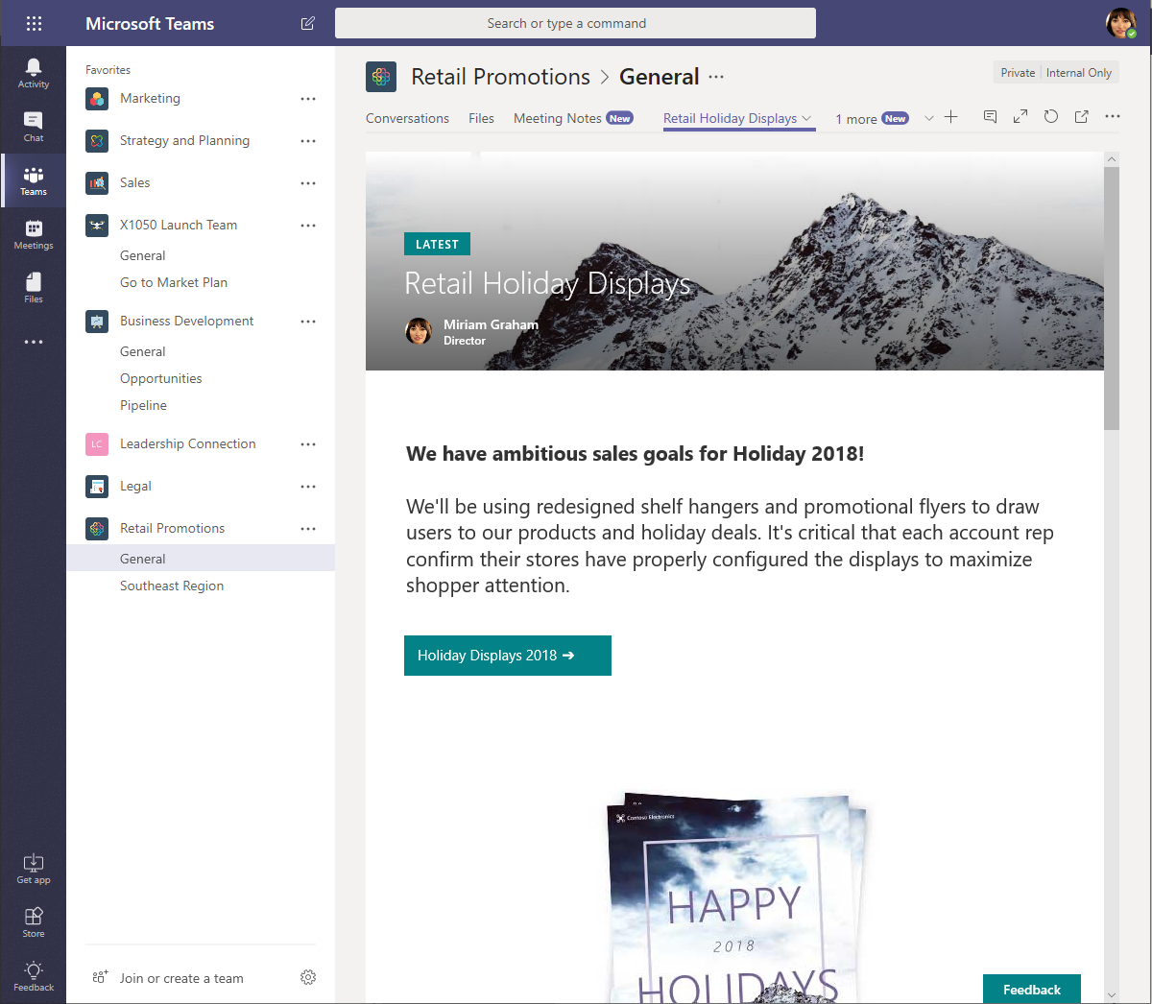
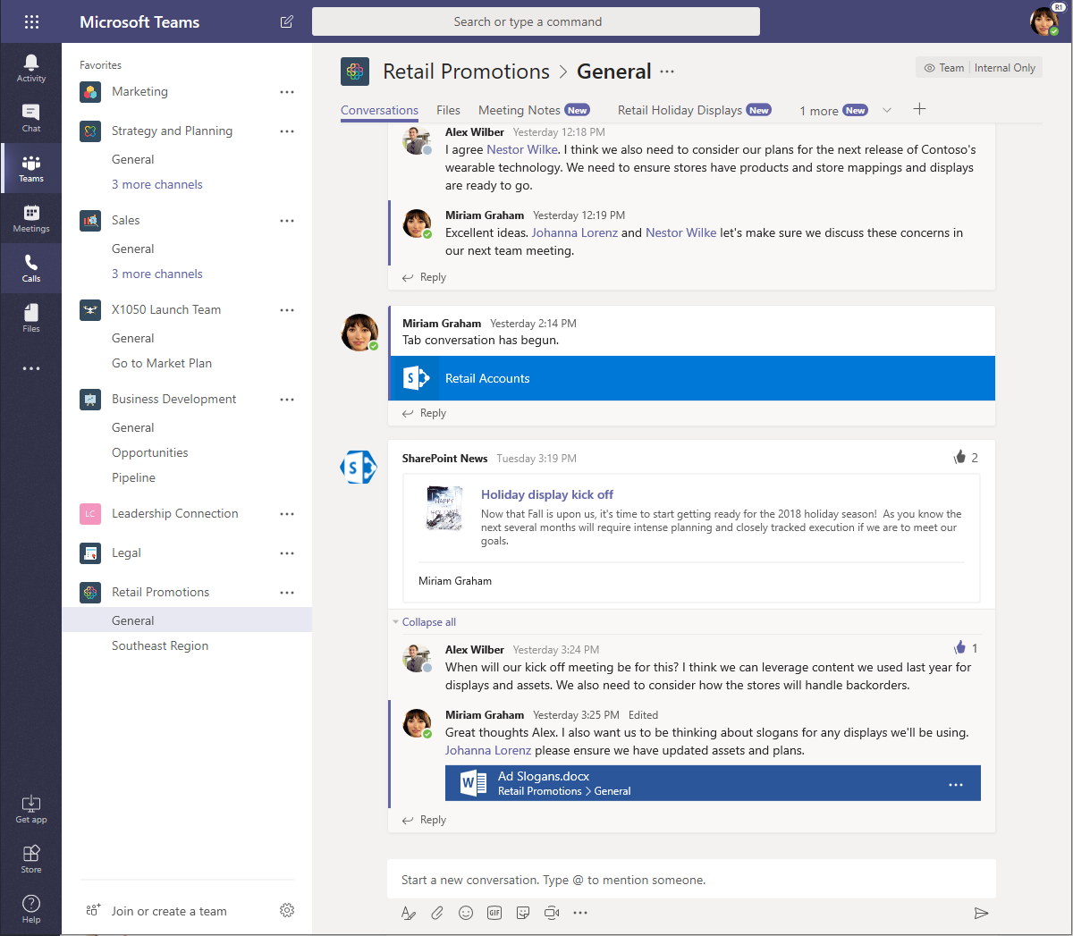
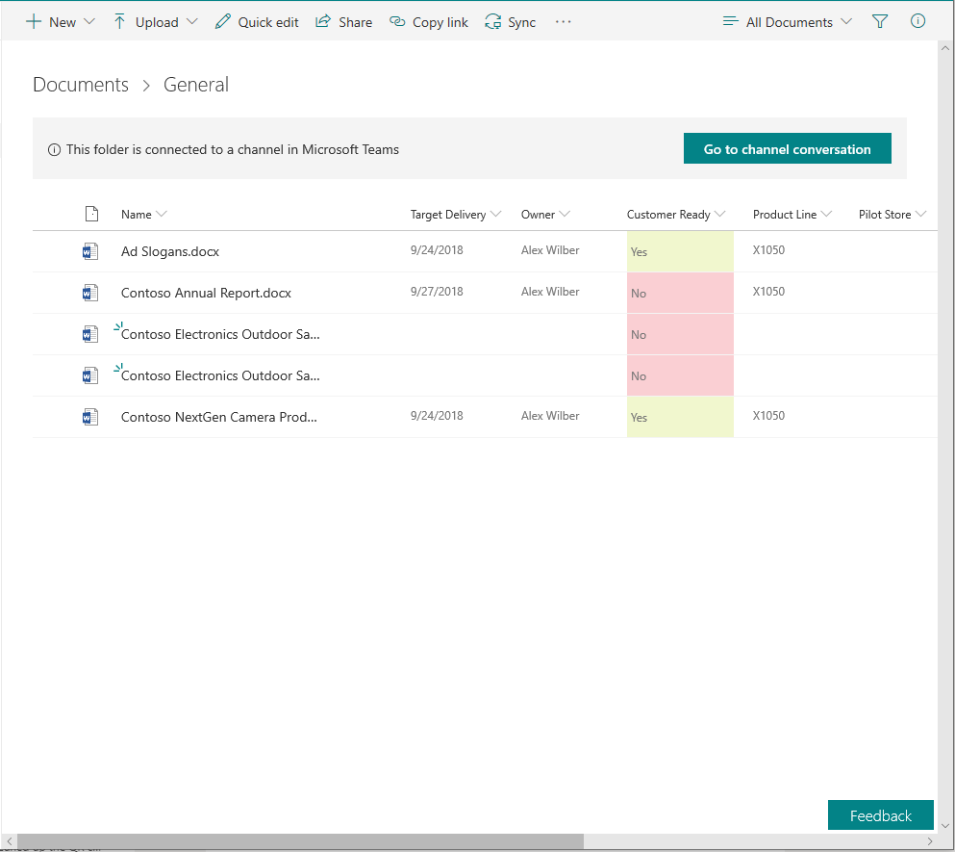
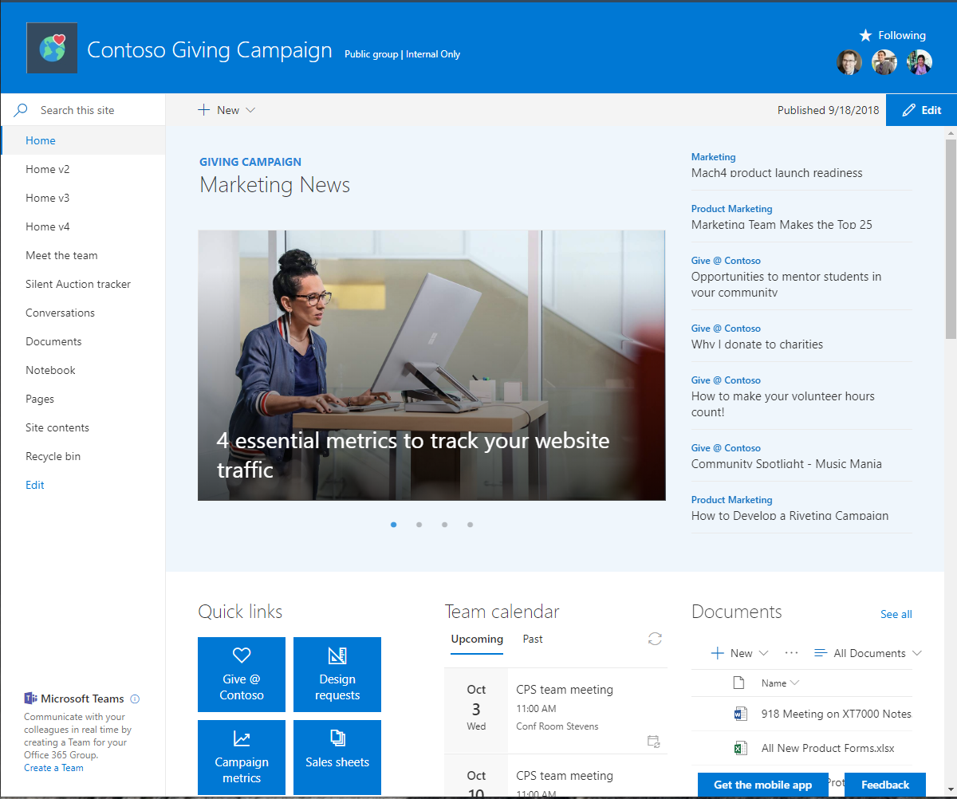
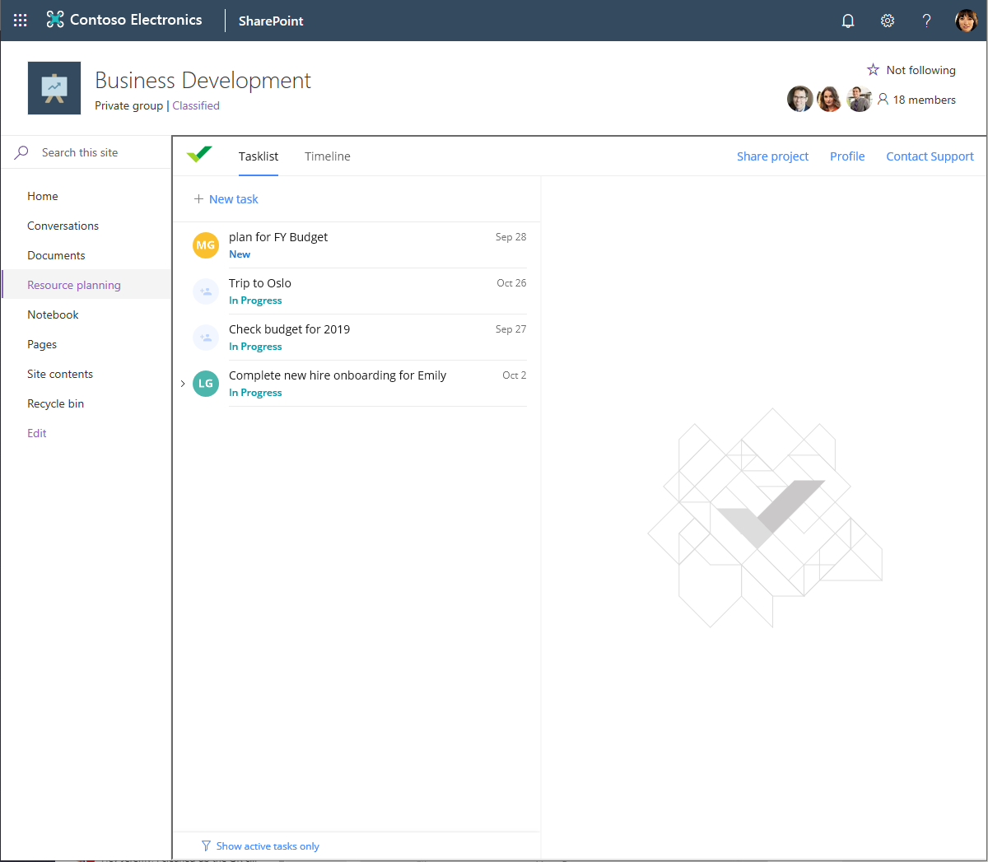
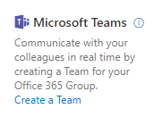
Integrated Experiences
News
Files
Lists, Pages and apps
Experience OneDrive and SharePoint in Microsoft Teams
Channel folders
Add a team
Tabs as pages
Experience Microsoft Teams in SharePoint

Slide 26
Content collaboration without barriers
Modern
Scalable
Experiences
Groupify
Teamify
Hubify
25TB site collection
15GB files
30M item lists and libraries
Desktop, Web, and mobile
OneDrive, SharePoint and Teams
Build your modern intranet on SharePoint in Office 365

Slide 27
Demo
Planner
Meetings
OneNote
SharePoint News
Bots
Collaboration

Slide 28
What‘s new and what is coming

Slide 29
What‘s new
  MS Teams as part of O365 ProPlus
  Show and hide teams to stay organized
  PowerShell 1.0 GA
Roadmap
  SharePoint and Microsoft Teams: new Files experience
    Currently Teams does not respect SharePoint library settings
  Microsoft Teams – Announcements
Update channel | Version | Date
Monthly Channel | Version 1902 | March 4, 2019
Semi-Annual Channel (Targeted) | Version 1902 | March 12, 2019
Semi-Annual Channel | Version 1902 | July 9, 2019

Slide 30
Admin stuff

Slide 31
Powershell
Install-Module -Name MicrosoftTeams
Get-Command -Module MicrosoftTeams

Slide 32
Upgrade s4b – Flip the switch
Step 1: Notify the users of the change (optional)
  In the Microsoft Teams admin center, select Org-wide settings > Teams upgrade.
  Under Coexistence mode, change the Notify Skype for Business users that an upgrade to Teams is available switch to On.
Step 2: Set the coexistence mode to TeamsOnly for the organization
  In the Microsoft Teams admin center, select Org-wide settings.
  Select Teams Only mode from the Coexistence mode drop-down list.

Slide 33
DEmo
Admin stuff

Slide 34
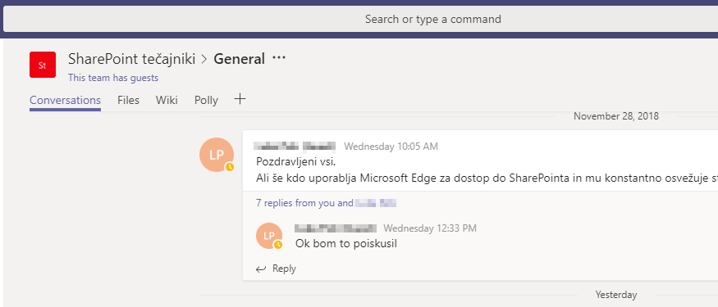
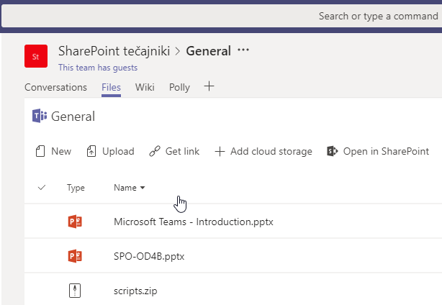
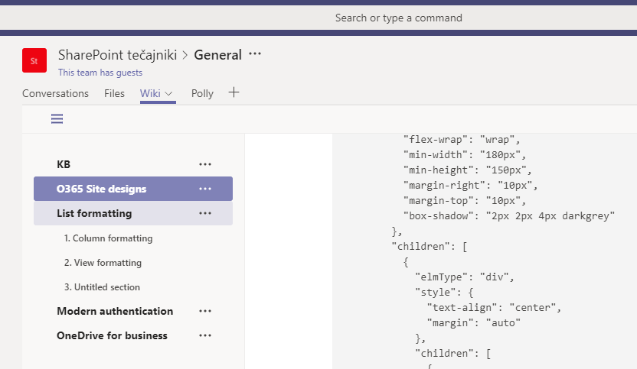
Xnet community on MS Teams
If you want to join, send us either your Live id or O365 account

Slide 35

Learning
MS300 Deploying Microsoft 365 Teamwork 7.-11.10. 2019
MS 301 Deploying SharePoint Server Hybrid 26.-30.8.2019
SharePoint Online Power User 26.-29.8.2019
SharePoint Online for Administrators 2.-4.9.2019
Več: www.kompas-xnet.si
10. Thrive konferenca
Termin: 12. - 13. november 2019
Lokacija: Hotel Jama - Postojnska Jama https://www.thriveconf.com

