Slide 2
About me…
Anton Šivic
@antonsivic
Anton.sivic@outlook.com

Slide 3
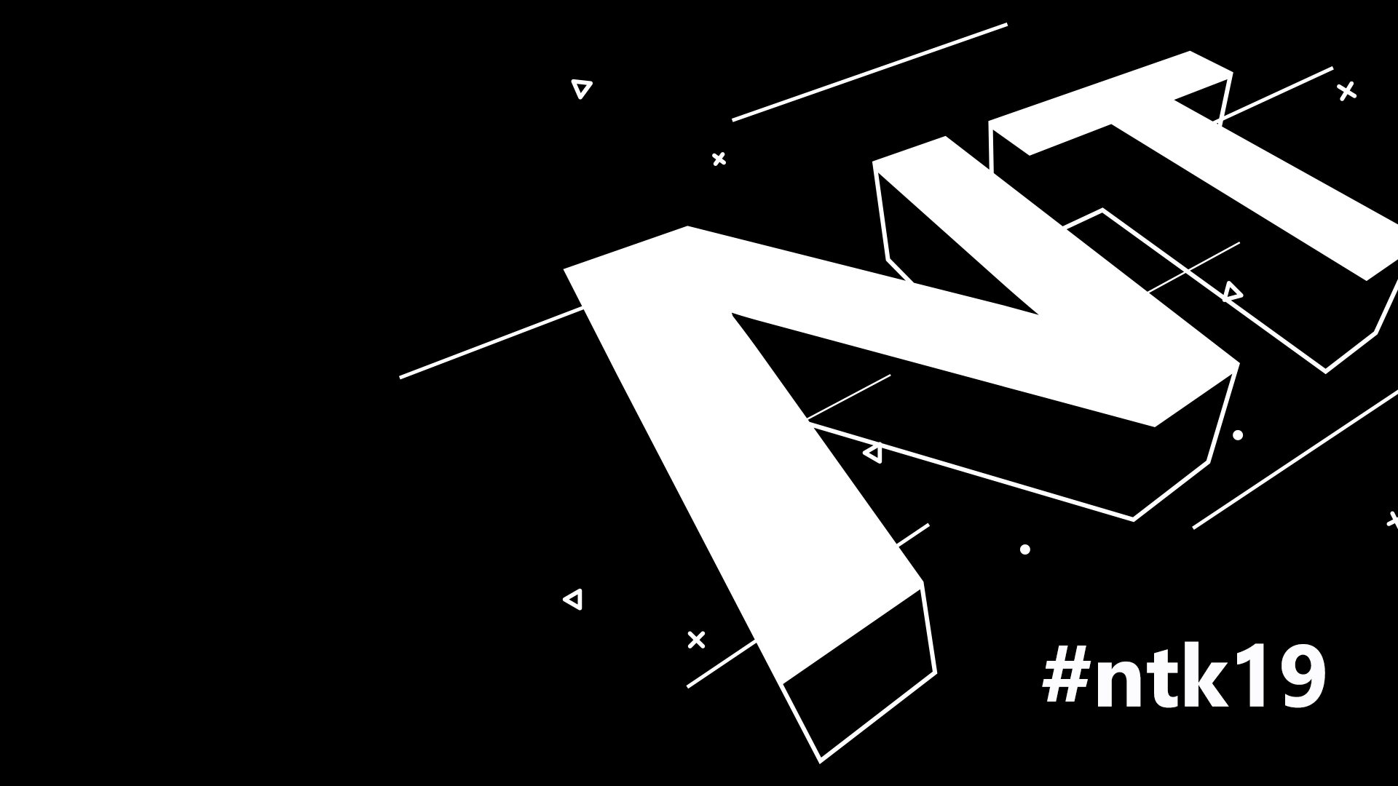
Bot's with current BotFramework, what and how

Slide 4
“It is better to fail in originality than to succeed in imitation.”
Herman Melville

Slide 5
Quick intro
Different buzz words fly arround...
AI
ML
DL
ANN

Slide 6
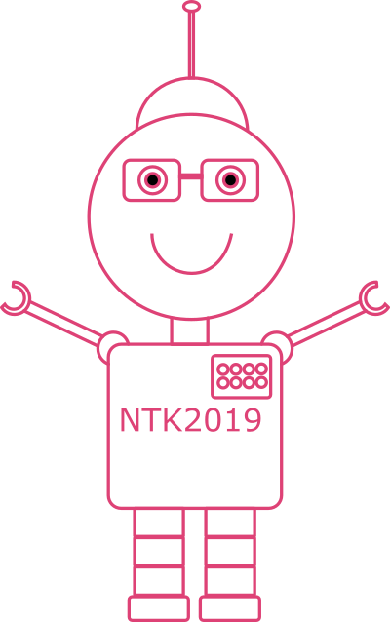
Bot's with current BotFramework, what and how
Quick Intro
Bots have now been arround for quite some time. Different companies are using „them“ as a „first line“ of support
Used to provide quick answers to most common issues/informations

Slide 7
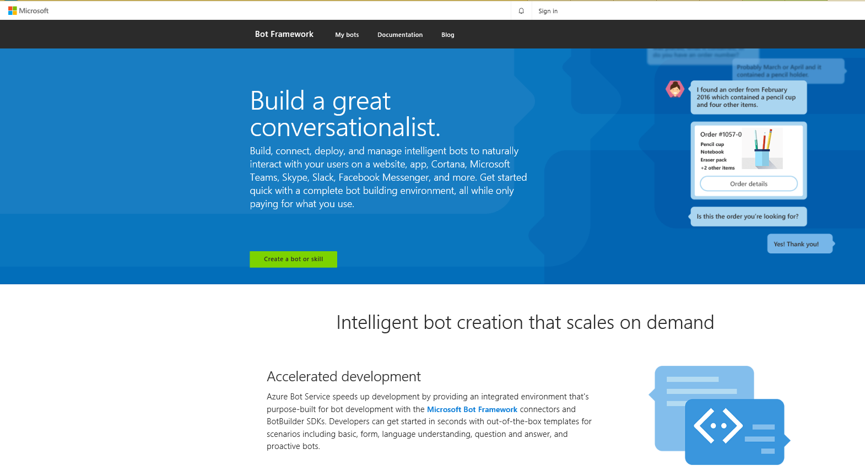
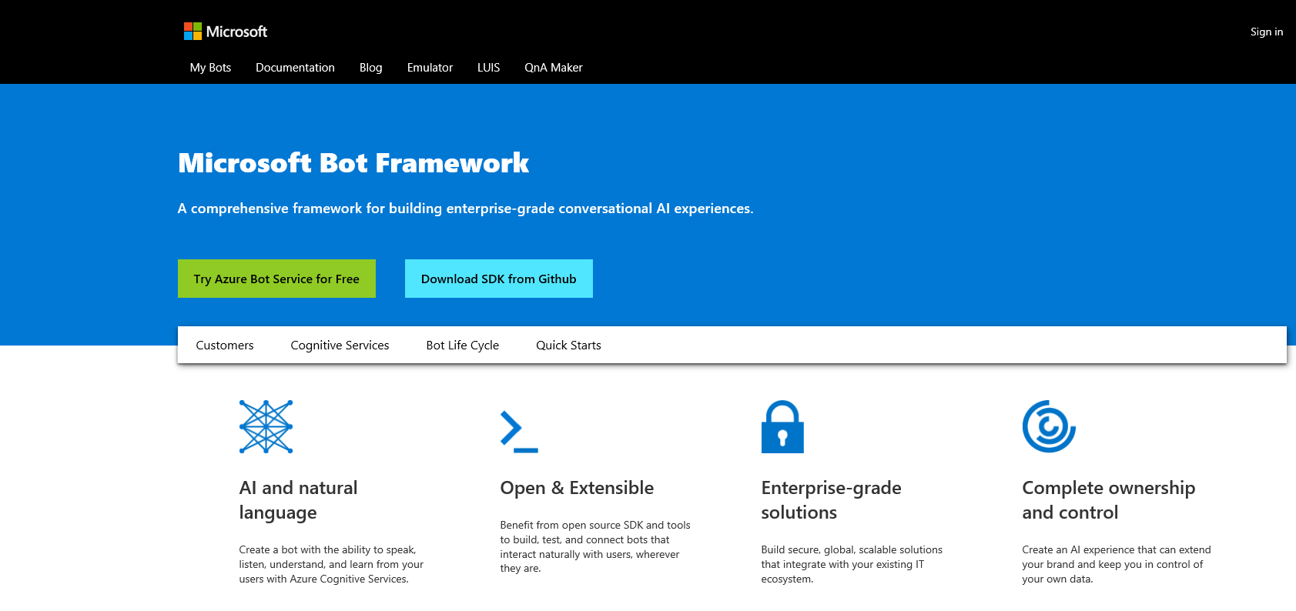
Bot's with current BotFramework, what and how
Microsoft Bot Framework
Has been arround since 2016
Provides you with everything you need to build (intelligent) agents
Those agents are know as Bots

Slide 8
Bot's with current BotFramework, what and how
Microsoft Bot Framework
Azure Bot Service*
Provides an integrated environment that is purpose-built for bot development.
Bot Framework Developer Portal
Users are able to login with their LiveId account and see what Bots are there and are registered with their name or have access to.
Bot Builder SDK – now Bot Framework SDK V3
In previous releases - Bot Builder v3 SDK has been migrated to the Bot Framework SDK V3 repository.
BotKit SDK
SDK included to Microsoft Bot Framework built with Bot Framework SDK V4.

Slide 9



Bot's with current BotFramework, what and how
Microsoft Bot Framework
Azure Bot Service*
Provides an integrated environment that is purpose-built for bot development.
Web App Bot
Bot Service deployed to Azure App Service.
Bot Channels Registration
Your own Bot, hosted where you want, registered with the Azure Bot Service.
Functions Bot
Azure Bot Service deployed to an Azure Functions App.
Microsoft Helthcare Bot*
Microsoft Helthcare Bot is a cloud service intended for helthcare organizations to build virtual health assistants.

Slide 10
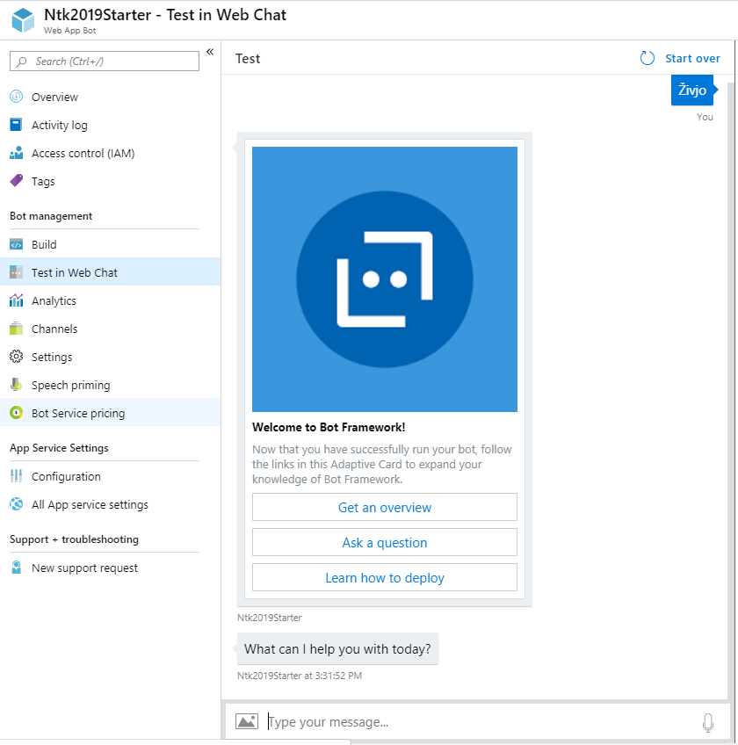
Bot's with current BotFramework, what and how
Microsoft Bot Framework
Web App Bot
Bot Service deployed to Azure App Service.

Slide 11
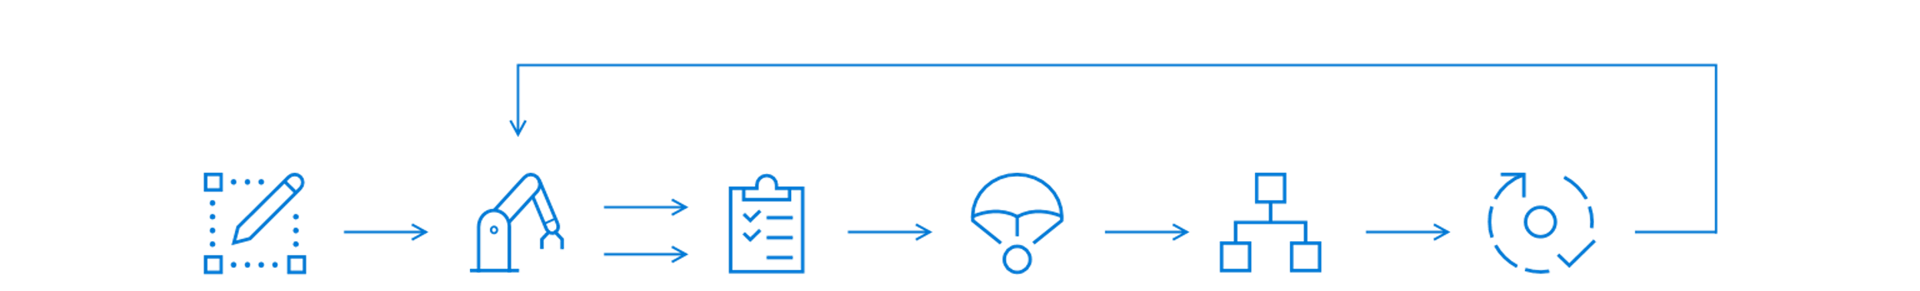
Bot's with current BotFramework, what and how
Microsoft Bot Framework
Bot‘s life cycle
Additional tools / resources available to cover complete Bot life cycle
Design
Build
Test
Publish
Connect
Evaluate
Design guidelines
For success
For success
Start with
Azure
.NET SDK
Node.JS
Bot Framework SDK
Cognitive services
LUIS
QnA Maker
Emulator
Web Chat
Azure Bot Service
Directly to Azure
CI / CD
Channels
Analytics

Slide 12





Bot's with current BotFramework, what and how
Microsoft Bot Framework
Adding „power“ to your bots – Cognitive Services
With utilization of Cognitive Services we can „bring our bots to life“
LUIS
QnA Maker
Speech
Search
Vision

Slide 13
Bot's with current BotFramework, what and how
Microsoft Bot Framework
The lifecycle of language model
Same as bot itself, language model can follow the same pattern.
Design
Build
Test
Publish
Connect
Evaluate
Identify Scenarios
Define Actions
Identify Data
Sources
Knowledge Base
Definte Intents
and Entities
Evaluate
Improve
Shared Runtime
Deployment
Publish KB
Container
Deployments
Deploy a bot
Using Bot
Framework
Integrate with
other Cognitive
Services
App Insights
Active Learing

Slide 14
Bot's with current BotFramework, what and how
Microsoft Bot Framework
Cognitive Services - QnA Maker
Simple question and answer bot based on FAQs.
Is a API service
Creates (simple) Q&A pairs
Creates a KB from different types of data (FAQ URLs, different documents, manually entered values)
  Extracts Q&A pairs
Enables easy build of conversational layer over our existing data
Manage, test and train QnA model in an easy-to-use UI
Added „Chit-Chat“ support – adds personality to our KB
  None (default)
  Professional
  Friendly
  Witty
  Caring
  Enthusiastic
Easy, No – code simple bot creation
Scalability

Slide 15
Bot's with current BotFramework, what and how
Microsoft Bot Framework
Cognitive Services - QnA Maker(New)
Simple question and answer bot based on FAQs.
Extraction
Intelligence
Conversation
Extraction of hierarchical info from different sources (URLs, documents – pdf & doc, Sharepoint*)
Contextual ranking model
Active learning suggestions
Create multi-turn conversations
Deploy a bot (custom dialog)

Slide 16
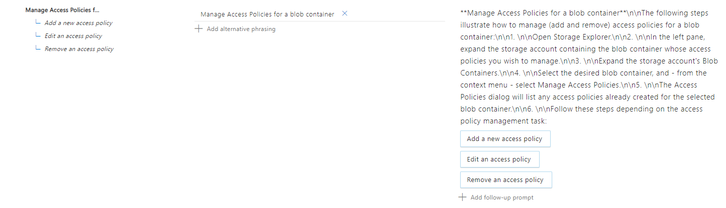
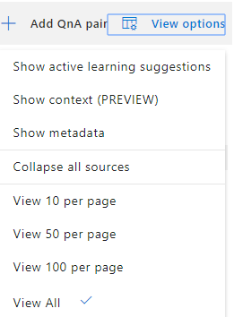
Bot's with current BotFramework, what and how
Microsoft Bot Framework
Cognitive Services - QnA Maker(New)
Simple question and answer bot based on FAQs.

Slide 17
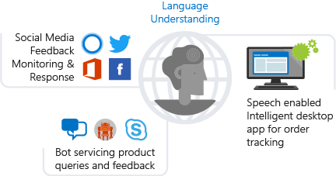
Bot's with current BotFramework, what and how
Microsoft Bot Framework
Cognitive Services - LUIS
A ML – Azure based service that is intended to be used to build natural language functionality into different applications, bots, IoT devices.
Is a API service
Applies ML to conversations with users
Uses natural text to predict overall meaning
Extracts relavant / detailed information
Used in apps that communicate with users in a natural way to complete a task.

Slide 18
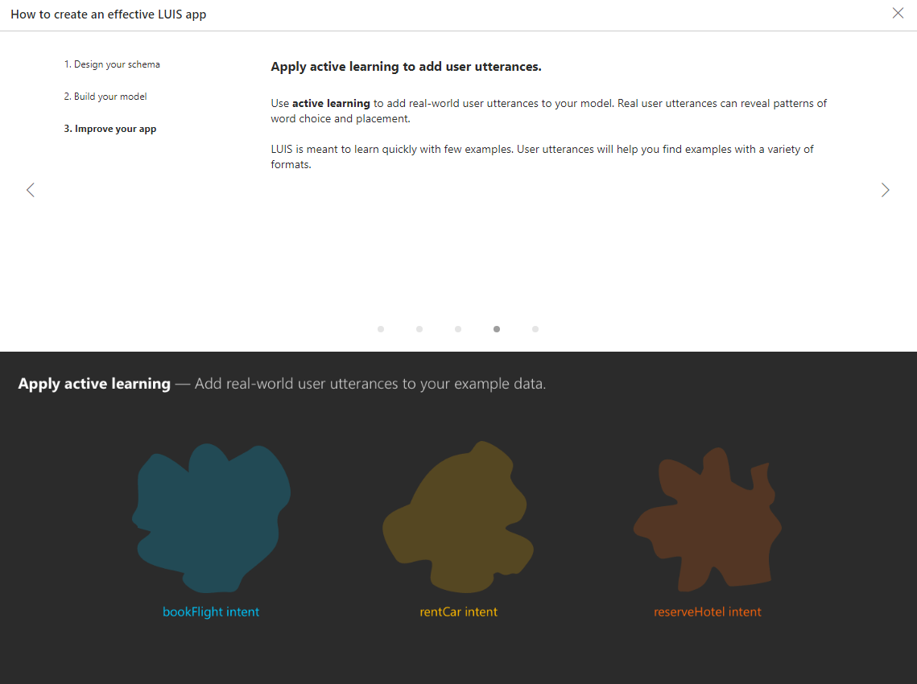
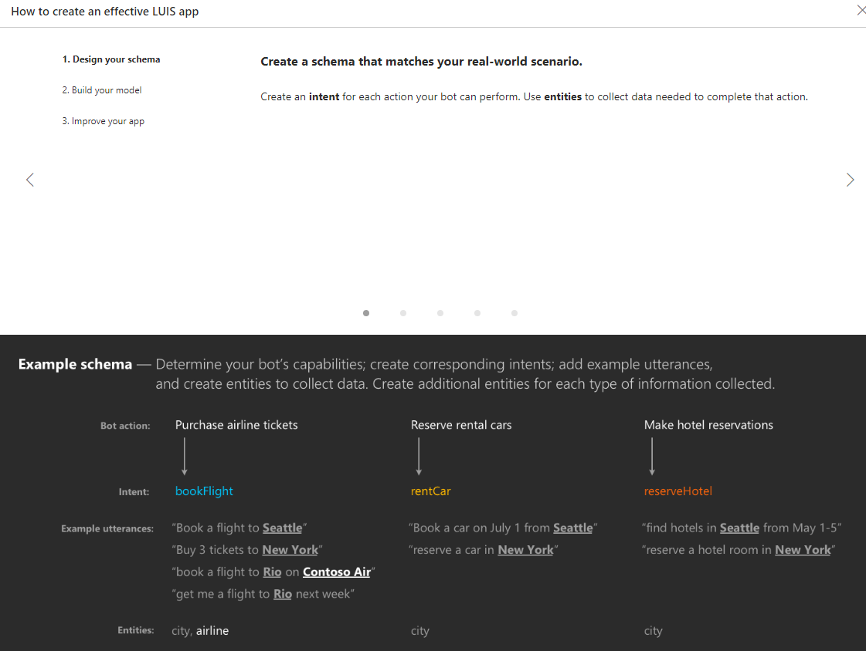
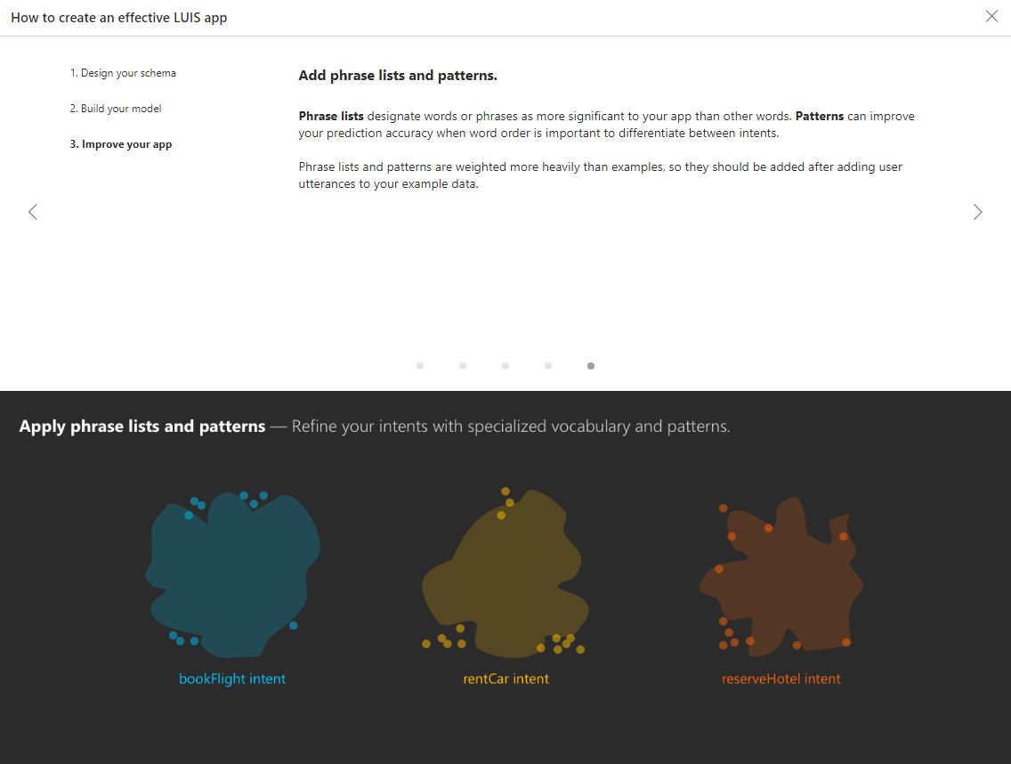
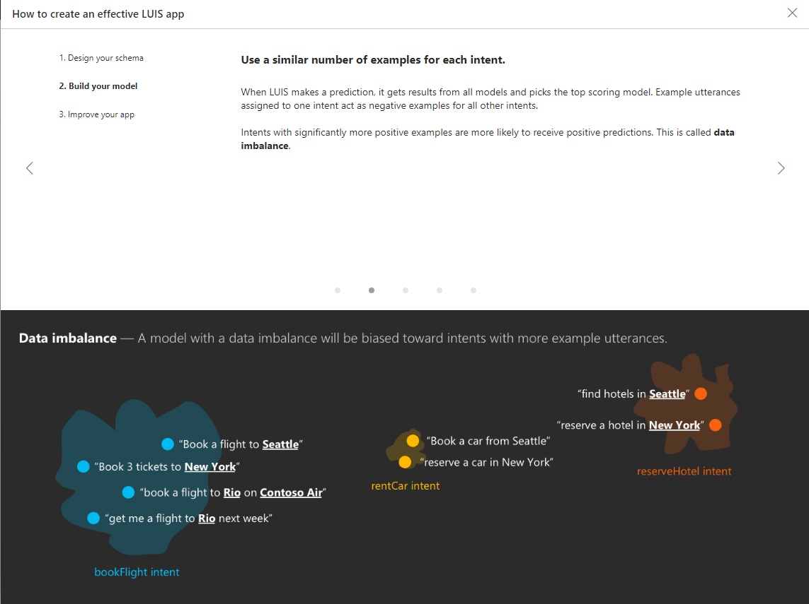
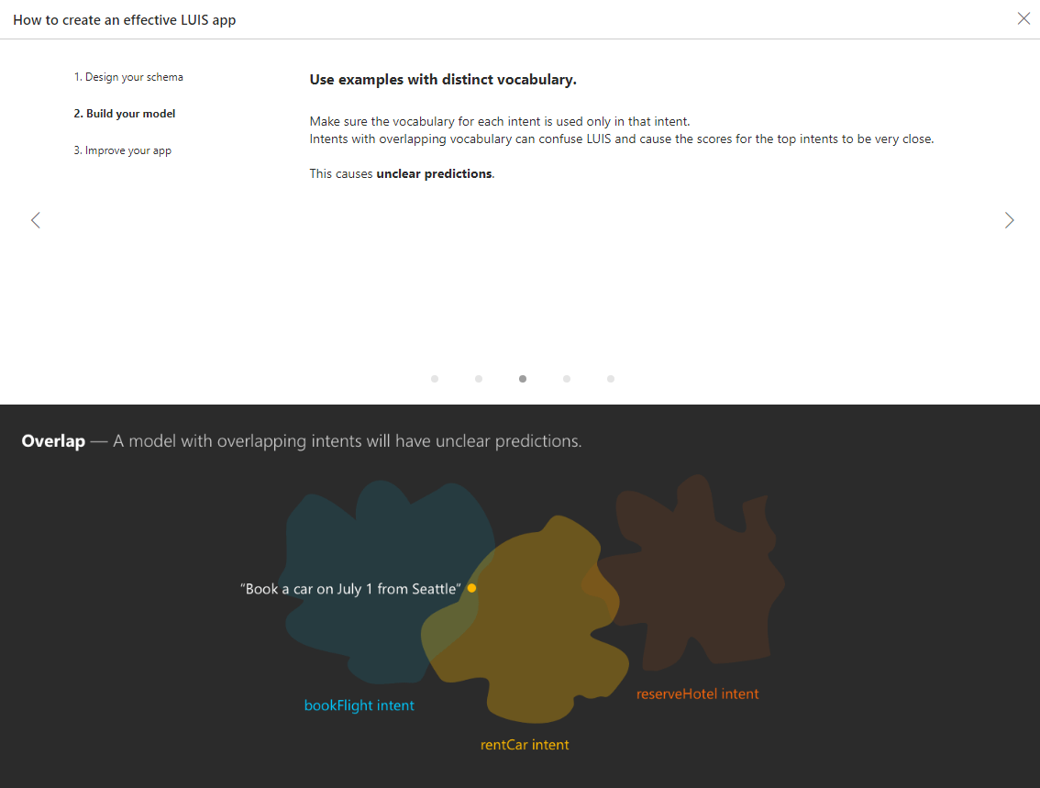
Bot's with current BotFramework, what and how
Microsoft Bot Framework
Cognitive Services - LUIS
A ML – Azure based service that is intended to be used to build natural language functionality into different applications, bots, IoT devices.

Slide 19
Bot's with current BotFramework, what and how
Microsoft Bot Framework
Cognitive – LUIS(New)
A ML – Azure based service that is intended to be used to build natural language functionality into different applications, bots, IoT devices.
Enhanced
Entities
Analytics
APIs
New analytics dashboard giving you insights on your models
Updated APIs that enables you more direct access to extracted informations
Advanced Entities types:
Roles
External Entities
Dynamic Lists

Slide 20
Bot's with current BotFramework, what and how
Microsoft Bot Framework
Different templates available*
SDK contains different templates available for usage. These tempal
SDK V3
SDK V4
Basic
Form
Language understanding
Question and Answer
Proactive
Echo Bot
Basic Bot
Enterprise Bot
Virtual Assistant
Language Understanding Bot
QnA Bot
Bot Framework SDK v3 lifetime support will end with 2019!

Slide 21
Bot's with current BotFramework, what and how
Microsoft Bot Framework
Quick overview of some differences
Refactoring of the previous version of the SDK.
Bot Adapter
Refactoring state management
A new Dialogs library
Support for ASP.NET Core
Underlying Bot Framework Service stayed the same as in SDK V3*

Slide 22
Bot's with current BotFramework, what and how
Microsoft Bot Framework
Bot Framework SDK v4
Version 4.5 Preview available.
Adaptive Dialog
Language Generation
Common Expression Language*
  Both Adaptive dialog and Language Generation rely on and use it
BotKit – develoer tool and SDK
  Intended for custom integrations
  Build with latest version of Bot Framework SDK.
  Includes additional adapters (Slack, Webex Teams, Google Hangouts,
  Facebook Messenger, Twilio, Web chat.

Slide 23
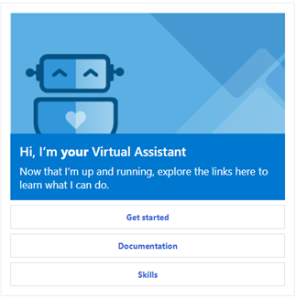
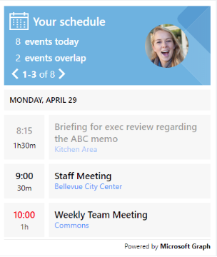
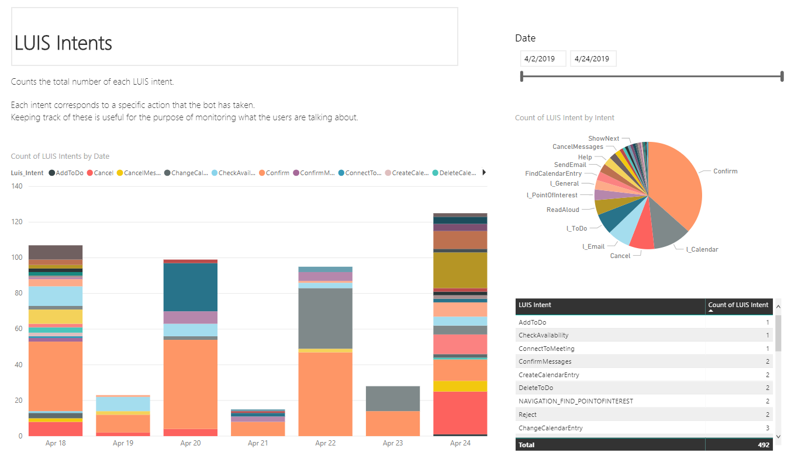
Bot's with current BotFramework, what and how
Microsoft Bot Framework
Bot Framework Solutions
Repository provides resources to easily get you started builidng simple or complex solutions.
Virtual Assistant
Skils
Analytics

Slide 24















Bot's with current BotFramework, what and how
Microsoft Bot Framework
Channels
Connection between the bot and communication application.
Web Chat*
Direct Line Speech
LINE
Cortana channel
Email
Skype for Business
Facebook
Direct Line channel*
Slack
Microsoft Team channel
GroupMe
Telegram
Skype channel
Kik
Twilio (SMS)

Slide 25
Bot's with current BotFramework, what and how
Microsoft Bot Framework
Azure Bot Service
Hosting of our bots, allowing complete ownership and control of your data.
Direct Line JS Client
Direct Line Speech Channel

Slide 26
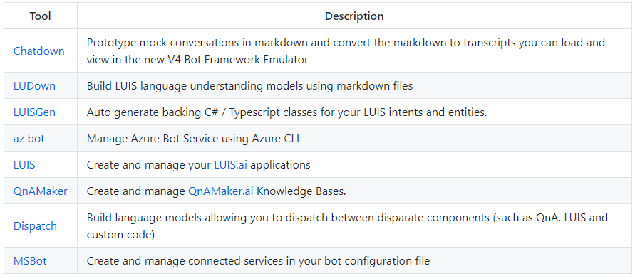
Bot's with current BotFramework, what and how
Microsoft Bot Framework
Tooling
A lot of toos in context of Microsoft Bot Framework has been modified to be on paar with annonunced changes.
Bot Framework Emulator
Bot Inspector
Bot Framework Web Chat
Some CLI tools

Slide 27
Demo a bit

Slide 28


















Bot's with current BotFramework, what and how
Microsoft Bot Framework
Channels
Bot Framework
Knowledge
General Knowledge
Manuals (PDF)
Cognitive Services
Data Sources
Skills
(Customizable)
Input
Your Assistant
Your Brand
Your Personality
Mail
Tasks
Tap
Adaptive Cards
Azure Bot
Service
Speech
Dispatch
Points of
Interest
Calendar
Type
Speak
Automotive
Other
Bots
QnA
Language Understanding
Vision
Custom
Devices
3P Assistants
APIs
Office Graph
Directory

Slide 29
Bot's with current BotFramework, what and how
Microsoft Bot Framework

