Slide 1


Ta močne aplikacije
Martin Pregl – Partner Tech Strategist, CEE region
Martin.pregl@microsoft.com

Slide 2
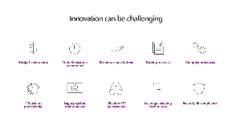




Agenda
1. Intro
Power Platform
What is Power Apps?
2. Rapid app development (citizen/every dev)
3. Admin and governance
(IT pro)
4. Extensibility
(pro developer)
5. Closing

Slide 3






Microsoft Power Platform
The low-code platform that spans Office 365, Azure, Dynamics 365, and standalone applications
Innovation anywhere. Unlocks value everywhere
Power BI
Business analytics
Power Apps
Application development
Power Automate
Process automation
Power Virtual Agents
Intelligent virtual agents
Data
connectors
Portals
AI Builder
Common
Data Service

Slide 4
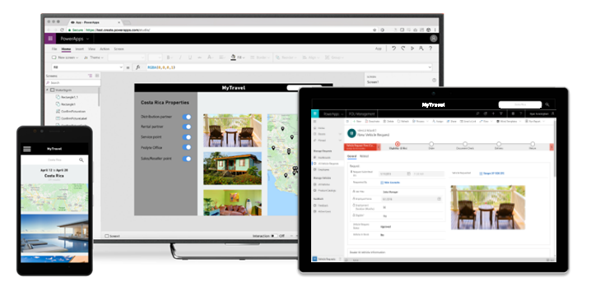
Power Apps: a low-code approach to building apps
Build standalone web and mobile apps, or customize existing apps in Office 365 and Dynamics 365
Connect to all your data with 350+ pre-built connectors and custom connectors
Add AI and intelligence with ease through built-in cognitive services
Provide IT guardrails with enterprise-grade governance and security controls
Pro-developer extensibility enables a “no limits” platform that spans business users to professional developers

Slide 5
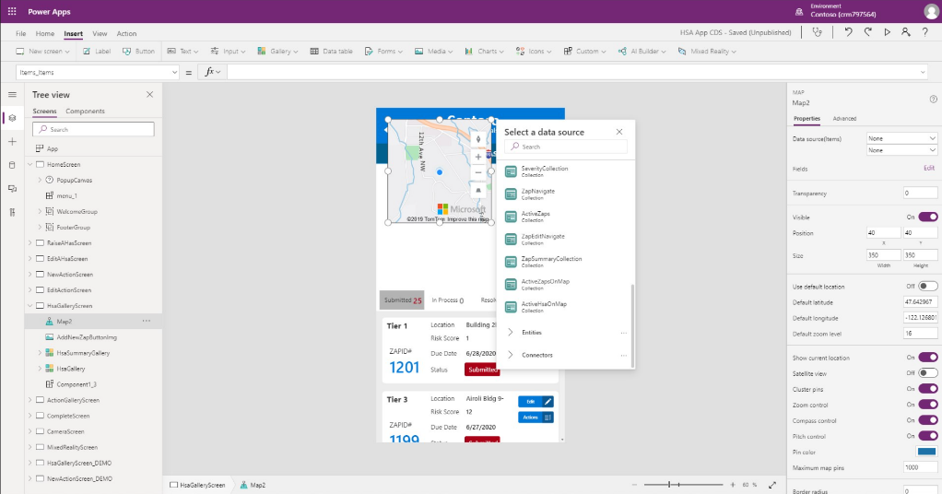
Demo 1
Fundamentals

Slide 6
A platform for all makers
Citizen Developer, IT Administrator, Professional Developer, App Wizard. We’ve got you
Basic
Complex
CITIZEN DEV
PRO DEV
Intuitive to use & easy to learn for Citizen Developers
Build apps fast with a point-and-click approach to app design. Choose from a large selection of templates or start from a blank canvas
Easily connect your app to data and use Excel-like expressions to easily
add logic
One admin center to rule them all for IT Administrators
No compromises on governance and security. One centralized view and management of all your 1 & 3rd party apps, eliminating shadow IT
GDPR compliance, and enterprise grade security, consistent with
the experience across O365 & D365
World class Pro Developer support and ALM
Experience the full range of development and ALM functionality with rich pro developer tools like Visual Studio and DevOps
Reuse your current IP and skills – Power Apps component framework, CLI and VS Code create instant value for the business

Slide 7

Rapid app development
Empowering everyone to build apps

Slide 8






Power Apps enables low-code development
Services
and data
Clients
UI and logic
Mobile
Apps
Common
Data Service
SQL
server
Dynamics 365
for operations
Office 365
users
User
Web
Flows
Connectors
SharePoint
Salesforce
Twitter

Slide 9
Demo 2
Canvas app

Slide 10
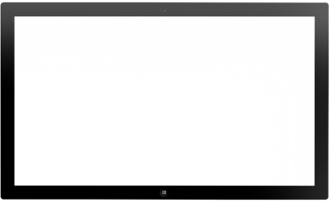
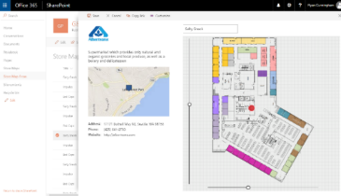
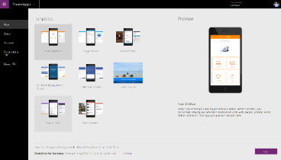
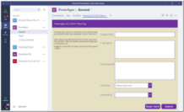
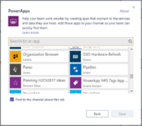
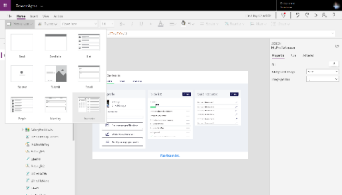
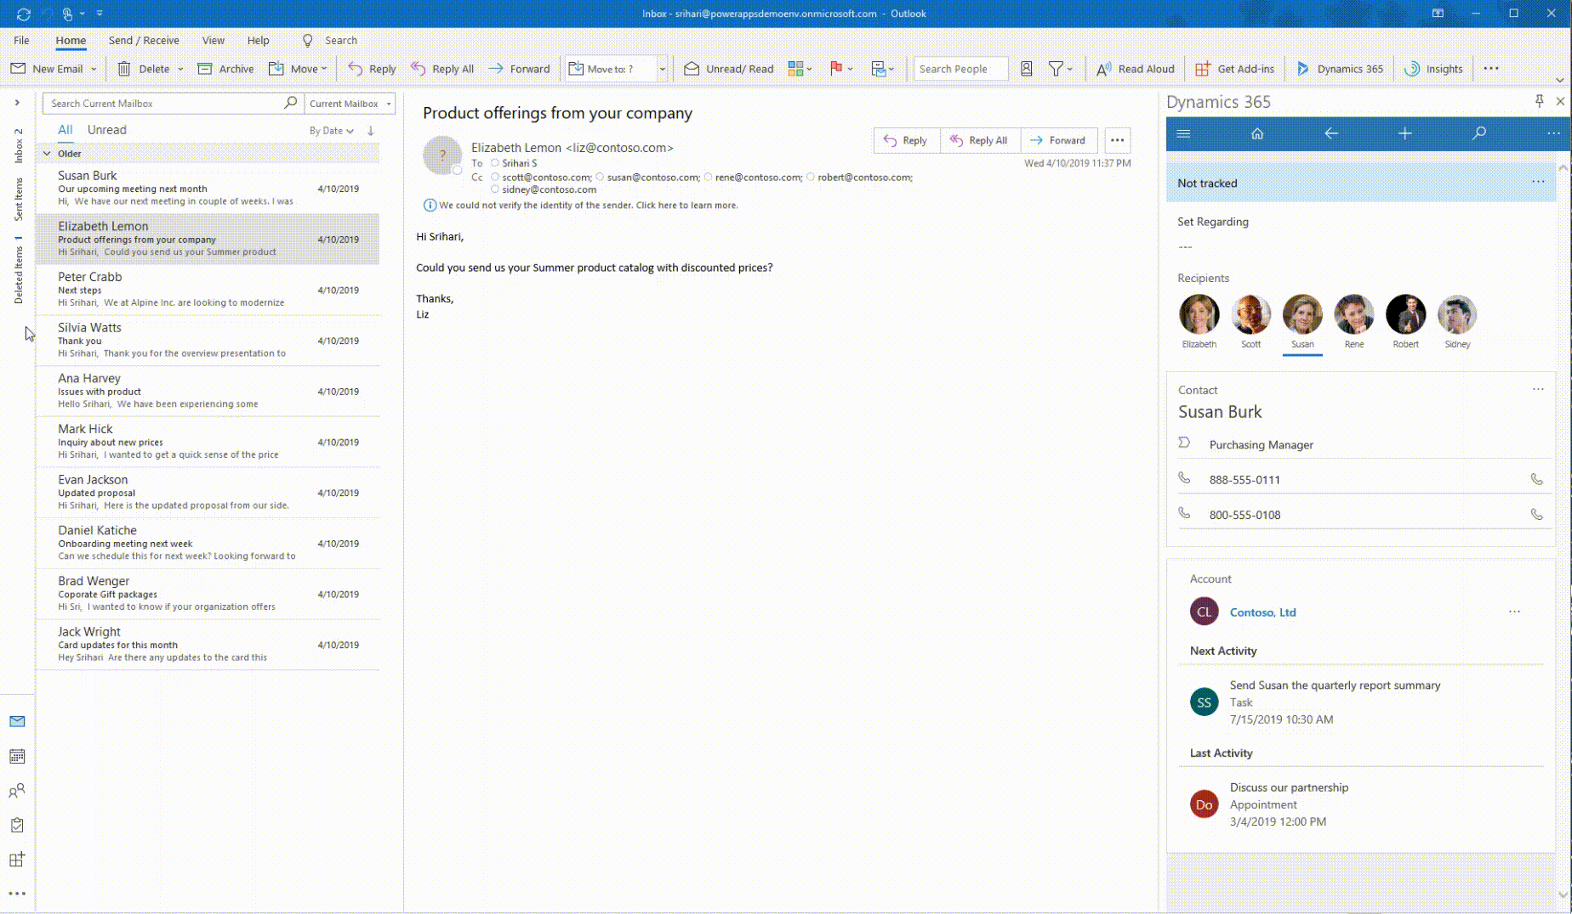
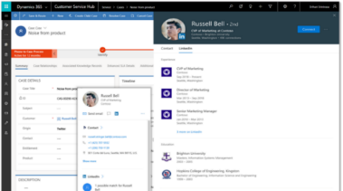
Integrated with Office 365
Publish Power Apps as a SharePoint web part or create a custom SharePoint list experience
Build a Power Apps app from an
Excel sheet on OneDrive
Customize a Microsoft Teams tab
with Power Apps
Use Office 365 data through built-in connectors and Office 365
screen templates
Bring data from Microsoft Dataverse and Power Apps UX to Outlook with the mail app (WIn32, OWA and mobile)
Office 365 people card in
Power Apps (incl. LinkedIn info)

Slide 11
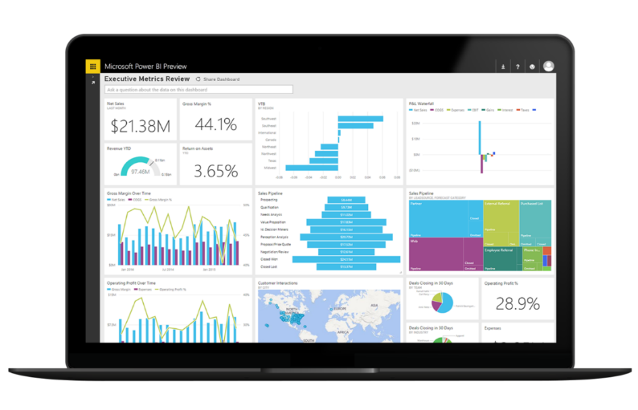
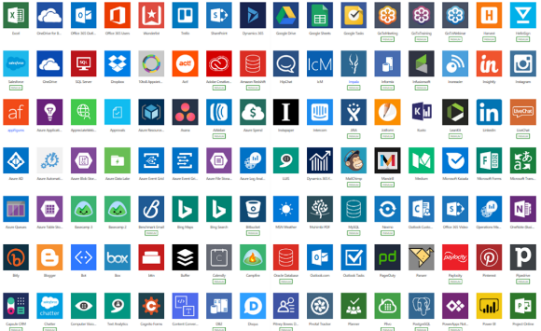
Cloud and on-premises connectivity
Built-in connectivity to 350+ cloud services, content services, databases, APIs, etc.
Seamless hybrid connectivity to on-premises systems via the on-premises data gateway
Develop and register custom connectors as a building block for citizen developers
Break down data silos by using multiple data sources in a single application

Slide 12












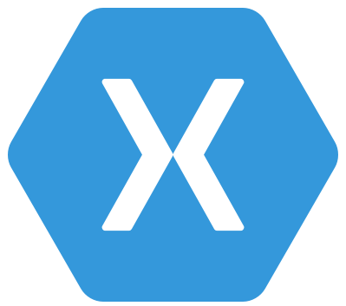














Microsoft Dataverse
Integration
Securely store and mange business data
Storage
Event to Event Hub
Relational
databases
Data
Event to Service Bus
Catalog
and discovery
Files and
blobs
Logic
Log files
Event to webhook
Jobs
Modelling
Reporting
Security
Semi-structured
data
Business
Rules
API
Calculated &
Rollup fields
Mobile
Offline
Export to SQL
Authentication
Duplicate
Detection
Data
validation
Search and
Find data
Authorization
Plugins
Common Data
Model
Export to Lake
Auditing
Data lake
Workflows

Slide 13
Demo 3
Data

Slide 14



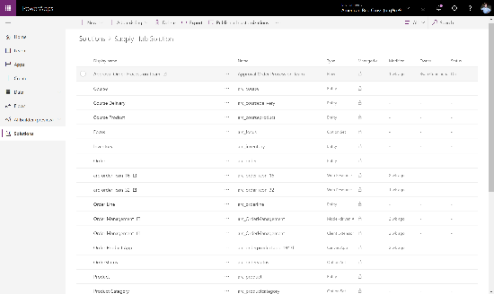
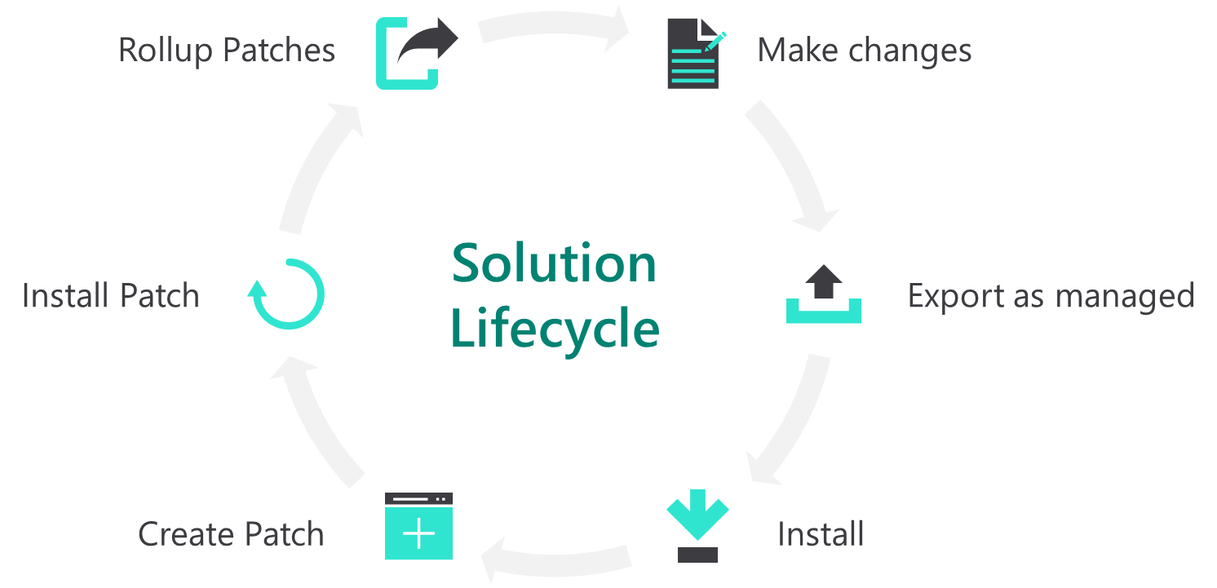
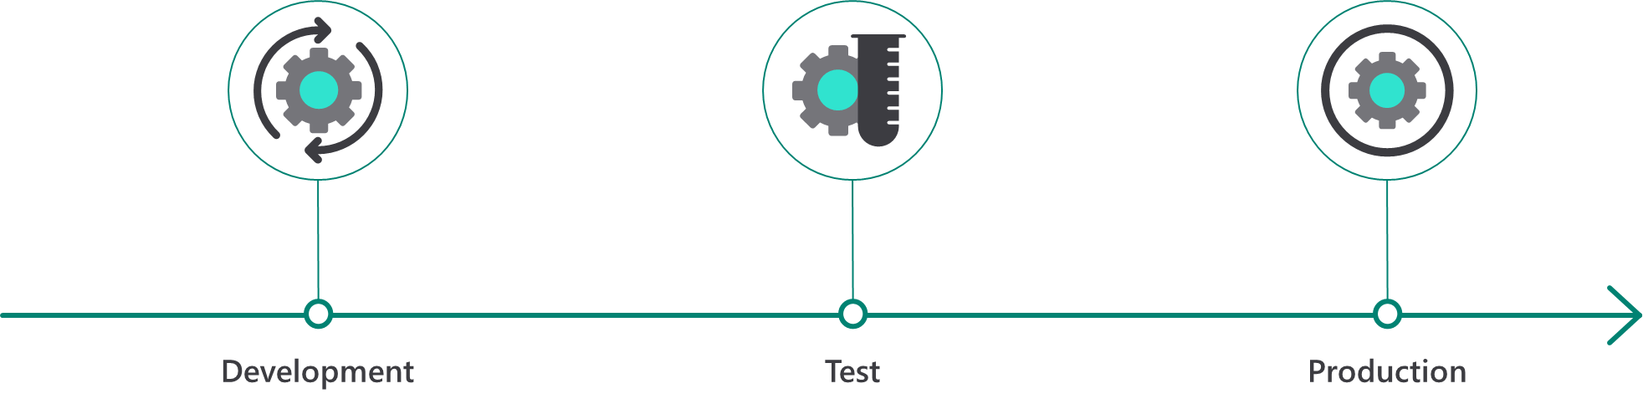
Solutions enable lifecycle management
Author solutions
Deploy solutions
Manage solution lifecycle
Solutions are containers to track the changes and customizations you make
  Solutions are how you transport and install changes to target environments
Solutions enable lifecycle management for your customizations and can be fully integrated into your DevOps processes

Slide 15


Admin and governance
Enabling low-code innovation
in your organization

Slide 16
IT must provide guardrails for all Power Apps developers
Business
Cloud
Create and use
All developers
Apps
Dataverse
IT
Monitor, control and support
Flows
Connectors
IT professionals
      IT retains control over low-code apps.

Slide 17
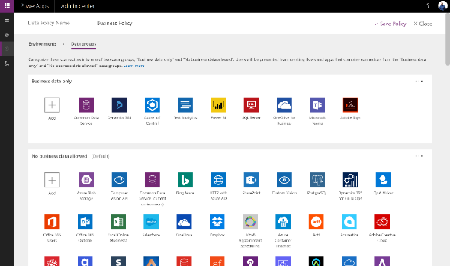
Enterprise-grade governance
Identity management and multi-factor authentication for enhanced identity protection and secure guest access
Built-in information protection and usage analytics with full audit logs, data loss prevention policies and more
Secure and control data on mobile devices with Intune mobile application management
Compliance leadership with 13+ standards including FedRAMP high, HIPAA, EU model clauses, SOC and GDPR
Manage all aspects – users, apps, usage
and settings – in a single admin experience

Slide 18







Data loss prevention (DLP) policies control which connectors can be used in the same app/flow
DLP policy
Business data only
This example policy would prevent creating an app that exposes salesforce data through Twitter
…
SQL Server
Dynamics 365 for Operations
Office 365 Users
SharePoint
Salesforce
No business data allowed
Using Power Apps
and Power Automate
doesn’t elevate a user’s permissions in any way
…
Adobe Creative Cloud
Twitter

Slide 19



To succeed with low-code development, IT infrastructure leaders must act
Set up monitoring of your
environments
IT maintains control of your organization’s low-code world.
Create appropriate
DLP policies for your organization
IT maintains control of data access.
Determine the level of support you want to provide
More is probably better.

Slide 20



Establishing a Power Platform Center of Excellence
Strategy and Vision
Admin and Governance
Nurture and Support

Slide 21
Roles and Responsibilities
Low Code
Strategy
Power Platform
Admin Team
Power Platform
Nurture Team
Power Platform
Re-Usable Assets
& Automation …
User
Support Team
Align Power Platform strategy with Digital Transformation strategy
Drive innovation
Key Decision makers
Business Value
Adoption and Change management
Empower new ways of working
Environment Strategy
DLP Policies
Data integration/ migration guidelines
Guardrails
License management
App-in-a-day/ Hackathons
Solution envisioning
Community of Practice
Evangelize Platform
Automation/Azure DevOps
Application & Architecture review
Library of common utilities, patterns and templates
App Catalog
Help Desk guidance/ FAQ
Ticketing process
Support Process & Resources

Slide 22
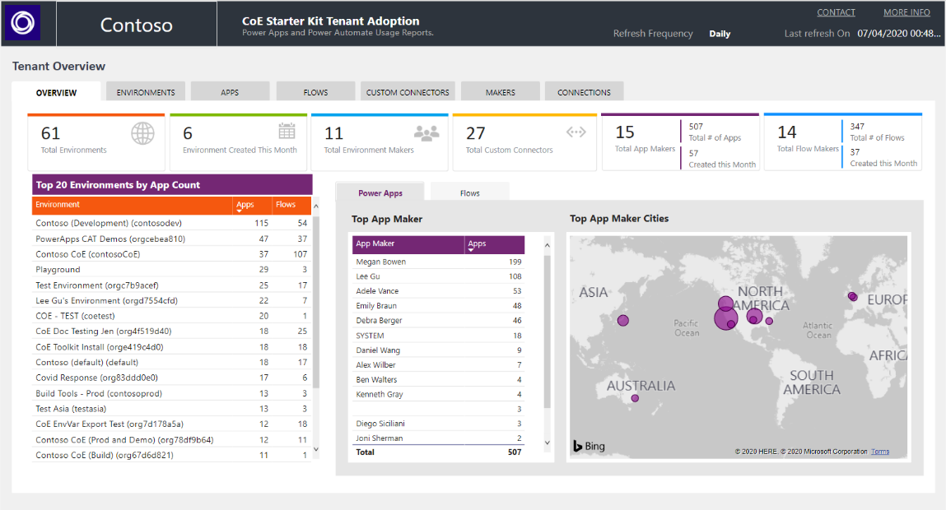
Enterprise Tooling – Center of Excellence Starter Kit
aka.ms/coestarterkit
Existing offering:
Admin Center capabilities
Extensibility via Connectors
Templates:
A templatized implementation of best practices
The CoE Starter Kit is a collection of components and tools designed to help you get started with developing a strategy for adopting and supporting the Power Platform.

Slide 23
Demo 4
Management

Slide 24

Extensibility
Develop faster than ever before

Slide 25
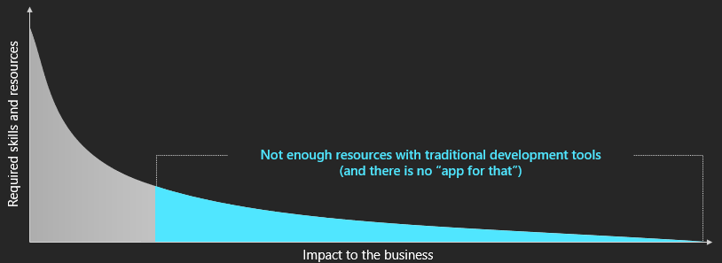
Accelerate App Modernization
500 million new apps will be built in the next 5 years – more than all apps built in the last 40 years!¹
Demand for mobile apps is growing 5x faster than IT departments can deliver ²
Over 85% of organizations struggle to analyze unstructured data⁴
86% of organizations struggle to find technical talent³
65%
of enterprise application development will be in the low-code category by 2024
1. Satya Nadella, Microsoft FY19 Q4 earnings call – Jul 2019
2. Gartner, How to Deliver Enterprise Mobile Apps Faster – 2017
3. Indeed.com Survey
4. IDG: Big Data Survey 2017

Slide 26






Azure + Power Apps = Rapid Application Development
Professional
developer
Custom controls and connectors
Citizen
developer
Power Apps
Power Automate
Power Virtual Agent
Azure DevOps
Power BI

Slide 27

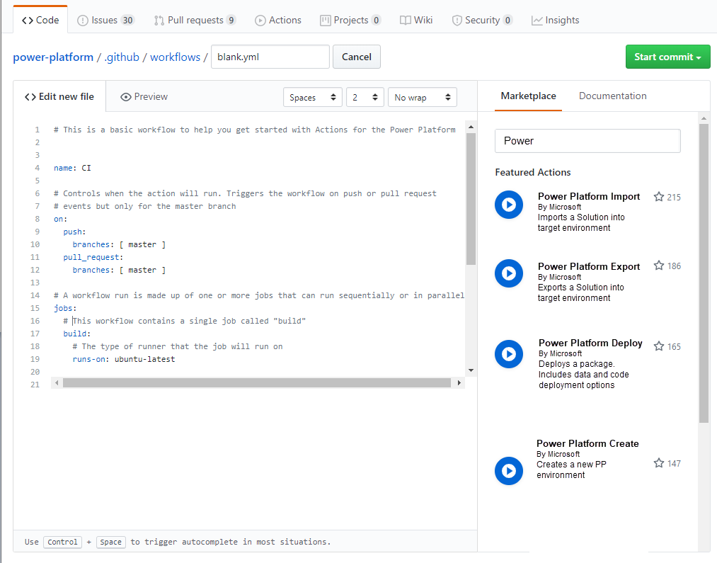
GitHub actions for Power Platform on GitHub Marketplace
Developers can create their own Software Development Lifecycle workflows using GitHub actions for Power Platform
Now available on the marketplace

Slide 28

Closing

Slide 29


A solid and future-proof foundation to digitize your organization
Start learning
Start innovating
Leverage expertise

Slide 30
Power Platform adoption & guidance
Overview
Power Apps
Power Automate
Power BI
Power Virtual Agents
Create your first app
Canvas App
Model-driven app
Flow
Dashboard
Chatbot
Training labs
App in a Day
Flow in a Day
Power Virtual Agents in a Day
More Power Platform labs
Browse documentation
Power Apps
Power Automate
Power Virtual Agents
Power BI
Microsoft Dataverse
Connectors
Power Apps Trial
Power Automate Trial
Power BI Trial
Power Virtual Agents Trial

Slide 31
Additional adoption & guidance
COE Starter Kit
Learn how to nurture the growth of Power Platform in your organization with the Power Platform Center of Excellence Starter kit
Whitepaper
Guidance for governing, securing, deploying, and supporting applications built with Power Apps and Power Automate
Learning Resources
Set of links to help novice, intermediate and advanced users learn Power Platform
Accelerate with Power BI
Attend a live virtual free one-day, hands-on workshop that covers the full capabilities of Power BI
Community Forum
Discuss ideas, share best practices, and get help from the community
Power Apps Trial
Power Automate Trial
Power BI Trial
Power Virtual Agents Trial

Slide 32
Thank you

