Slide 2
Povečanje varnosti Windows klientov
Jože Markič s.p.

Slide 3
Agenda
Kaj je malware?
The Windows 10 defense stack
Windows 10 & Windows Defender
Windows Defender AV – upravljanje
VMs & VDI: Configure endpoints for optimal performance
Microsoft Security Compliance Toolkit
Windows 10 1903

Slide 4
Agenda
PowerShell Automation
Windows Defender Security Center
Windows Defender Antivirus
Windows Defender Application Guard
Overview of Windows Defender Device Guard
Implementing Windows Defender Device Guard policies

Slide 5
Agenda
Windows Defender Exploit Guard
  Controlled Folder Access
Windows Defender SmartScreen
What is AppLocker?
AppLocker rules
Windows Defender ATP
Attack Surface Analyzer

Slide 6
Kaj je malware?
Computer viruses
Computer worms
Trojan horses
Ransomware
Spyware
Adware
Fileless malware
Notes:
#Computer Virus
Created to relentlessly self-replicate it infects programs and files. The malicious activities may be targeted at destroying valuable data or causing unrepairable damages.
#Spyware
The name says it all, the software is created to spy on the victim so, it is secretly implanted on the computing device by the hacker. The spyware gathers information and sends it to the hacker.
#Adware
The malicious program is devised to pop-up unwanted advertisements on the victim’s computer without their permission. The pop-ups are uncontrollable and tend to behave erratically, they usually appear numerous times on the screen and it becomes tedious to close them.
#Rootkit
Rootkit Virus assists a hacker in remotely accessing or controlling a computing device or network without being exposed. They are hard to detect due to the reason that they become active even before the system’s Operating System is booted up.
#Trojan Horse
The name “Trojan horse” arrives from the ancient Greek tale on Trojan War. Similar to the story, the malicious program sneaks into the victim’s computer disguised as a legitimate program that users will accept and want to use.
#Worm
The Worm Virus is a malicious code that copy’s itself and spreads to other computers. The Worm makes use of the network to spread to other devices. An infected network or system may slow down and face unexpected hiccups on the full-swing. While a Computer Virus attaches itself to different programs and executable codes, the Worm Virus spreads across the networks, this is the notable difference between the two.
#Ransomware
As the name interprets, the ransomware is a ransom malware. The ransom virus blocks the user from accessing the files or programs and the virus removal demands to pay the ransom through certain online payment methods. Once the amount is paid the user can resume using their system.
#Keylogger
The Keylogger records every keystroke that a user makes on their device by running in the background. It steals user credentials and confidential data and forwards it to the hacker for malicious purpose.
#Botnet
The cybercriminal blocks a user actions and takes full control of the system. The hacker creates a network of malware-infected computers which functions as a bot. The botnet virus is used to transmit malware, send spam emails, and execute other malicious tasks.

Slide 7
The Windows 10 defense stack
PRE-BREACH
POST-BREACH
Device protection
Threat resistance
Identity protection
Information protection
Breach detection investigation & response
Device protection
Threat resistance
Identity protection
Information protection
Breach detection investigation & response
Device Health attestation
Device Guard
Device Control
Security policies
SmartScreen
AppLocker
Device Guard
Windows Defender
Network/Firewall
Built-in 2FA
Account lockdown
Credential Guard Microsoft Passport
Windows Hello :)
Device protection / Drive encryption
Enterprise Data Protection
Conditional access
Windows Defender ATP
Device integrity
Device control
SmartScreen
Windows Firewall
Microsoft Edge
Device Guard
Windows Defender
Windows Hello :)
Credential Guard
BitLocker and BitLocker to Go
Windows Information Protection
Conditional Access
Windows Defender ATP

Slide 8
Windows 10 & Windows Defender
Feature | Windows 10 Pro | Windows 10 Ent & Edu
Windows Defender Credential Guard |  | YES
Windows Defender System Guard | YES | YES
Windows Defender Application Guard |  | YES
Windows Defender Application Control |  | YES
Windows Defender Exploit Guard | YES | YES
Windows Defender Antivirus | YES | YES
Windows Defender Advanced Threat Protection (ATP) |  | YES
AppLocker | AppLocker CSP (MDM) | YES
Notes:
https://www.microsoft.com/en-us/windowsforbusiness/compare
https://docs.microsoft.com/en-us/windows/client-management/mdm/applocker-csp
https://docs.microsoft.com/en-us/windows/security/threat-protection/windows-defender-application-control/applocker/requirements-to-use-applocker

Slide 9
Windows Defender AV - upravljanje
Windows Defender Security Center
PowerShell modul: Defender
Microsoft Intune
System Center Configuration Manager
Group Policy
Windows Management Instrumentation
Microsoft Azure
Notes:
https://docs.microsoft.com/en-us/windows/security/threat-protection/windows-defender-antivirus/deploy-manage-report-windows-defender-antivirus

Slide 10
VMs & VDI: Configure endpoints for optimal performance
Randomize scheduled scans
Use quick scans
Prevent notifications
Disable scans from occurring after every update
Scan out-of-date machines or machines that have been offline for a while
Notes:
https://docs.microsoft.com/en-us/windows/security/threat-protection/windows-defender-antivirus/deployment-vdi-windows-defender-antivirus#configure-endpoints-for-optimal-performance

Slide 11
Microsoft Security Compliance Toolkit
Windows & Office Security baselines
  Documentation
  GP Reports
  GPOs
  Local_Script
  Templates
Local GPO Utility
Policy Analyzer
Notes:
https://www.microsoft.com/en-us/download/details.aspx?id=55319

Slide 12

DEMO

Slide 13
Windows 10 1903
Windows Sandbox (Pro, Ent & Edu)
Protection history
Tamper Protection for Windows Defender Antivirus
Windows Defender Application Guard (Ent & Edu)
  manage access to camera and microphone while browsing

Slide 14
DEMO

Slide 15
PowerShell automation
SignatureDownloadCustomTask.ps1
WindowsDefender_InternalEvaluationSettings.ps1
Device Guard and Credential Guard hardware readiness tool
AaronLocker
Notes:
https://github.com/nsacyber/AppLocker-Guidance

Slide 16
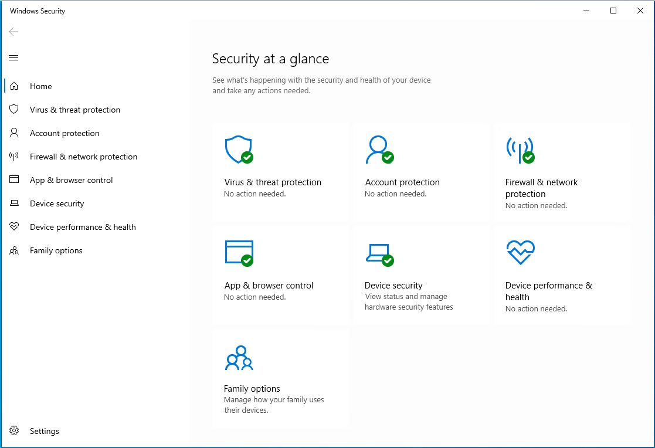
Windows Defender Security Center
Notes:
Discuss the Windows Defender Security Center app and how you can use it as a centralized location to review security information in Windows 10. Don’t provide too much detail about specific items in the app, because subsequent topics in this module will provide that information.
20744C
5: Mitigating malware and threats

Slide 17
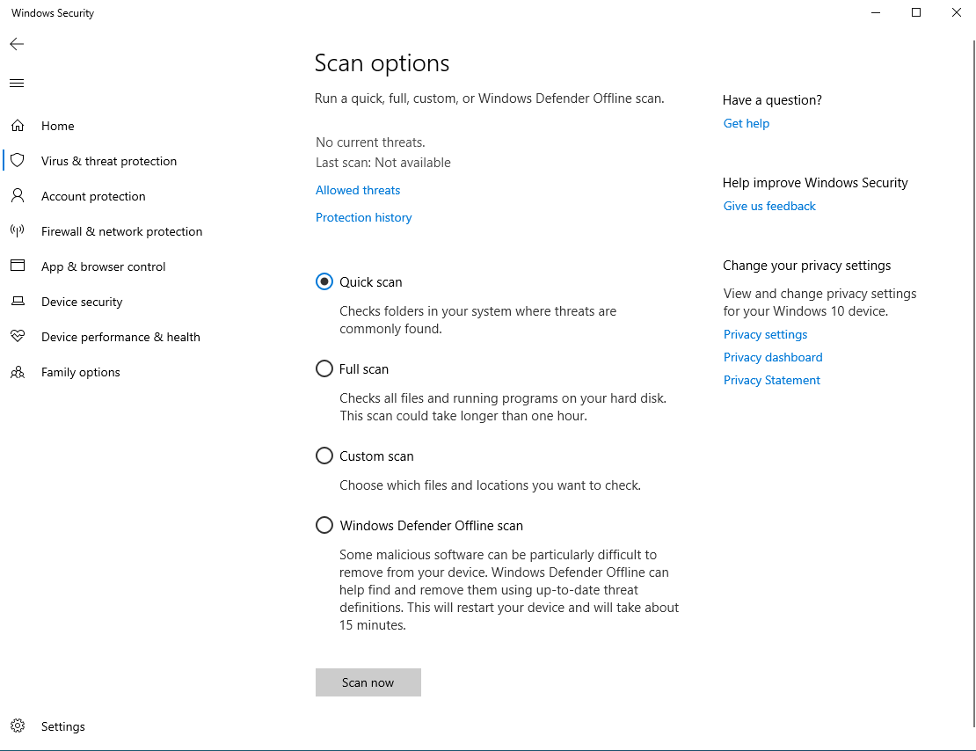
Windows Defender Antivirus
Notes:
Discuss scanning options.
20744C
5: Mitigating malware and threats

Slide 18
Windows Defender Application Guard
Application Guard in standalone mode
Application Guard in Enterprise-managed mode
Root certificate sharing options
Notes:
https://docs.microsoft.com/en-us/windows/security/threat-protection/windows-defender-application-guard/test-scenarios-wd-app-guard
Computer Configuration\Administrative Templates\Network\Network Isolation\Enterprise resource domains hosted in the cloud
Computer Configuration\Administrative Templates\Network\Network Isolation\Domains categorized as both work and personal
Computer Configuration\Administrative Templates\Windows Components\Windows Defender Application Guard\Turn on Windows Defender Application Guard in Enterprise Mode
Computer Configuration\Administrative Templates\Windows Components\Windows Defender Application Guard\Allow Windows Defender Application Guard to use Root Certificate Authorities from the user's device

Slide 19
Overview of Windows Defender Device Guard
Windows Defender Device Guard is a combination of hardware and software system integrity-hardening features that will lock down a device by ensuring that only trusted applications can execute
Windows Defender Device Guard is comprised of:
  Virtual Secure Mode
  Windows Defender Application Control
  Virtual Secure Mode Protected Code Integrity includes:
    Kernel mode code integrity
    User mode code integrity
  Platform and UEFI Secure Boot
Notes:
Note: This topic has one additional slide.
20744C
5: Mitigating malware and threats

Slide 20
Overview of Windows Defender Device Guard
To enable Virtual Secure Mode in Windows 10 or Windows Server 2016, perform the following steps:
Enable Secure Boot and UEFI in BIOS
Enable TPM
Install Microsoft Hyper-V hypervisor
Enable Isolated User Mode
Enable the Virtual Secure Mode policy named Enabled Credential Guard
Configure the BCD to start Virtual Secure Mode
Notes:
20744C
5: Mitigating malware and threats

Slide 21
Implementing Windows Defender Device Guard policies
You can configure Windows Defender Device Guard for audit mode or enforcement mode
Audit mode is the default, which you should use initially
Use Windows PowerShell cmdlets to create a policy from the audit log, and then merge it with your initial policy
Enable enforcement after you verify the audit mode
Notes:
20744C
5: Mitigating malware and threats

Slide 22
DEMO

Slide 23
Windows Defender Exploit Guard
Windows Defender Exploit Guard includes the following features:
  Exploit protection
  Attack surface reduction rules
  Network protection
  Controlled folder access
Notes:
20744C
5: Mitigating malware and threats

Slide 24
Controlled Folder Access
Protected folders
  User shell folders: Documents, Pictures, Videos, Music, Favorites, and Desktop
  Public shell folders: Documents, Pictures, Videos, and Desktop
  Custom network shares
  Custom mapped drives
PowerShell
  Set-MpPreference –EnableControlledFolderAccess [Enable/Disable]
  Add-MpPreference –ControlledFolderAccessProtectedFolders [path]
  Add-MpPreference –ControlledFolderAccessAllowedApplications [path]

Slide 25
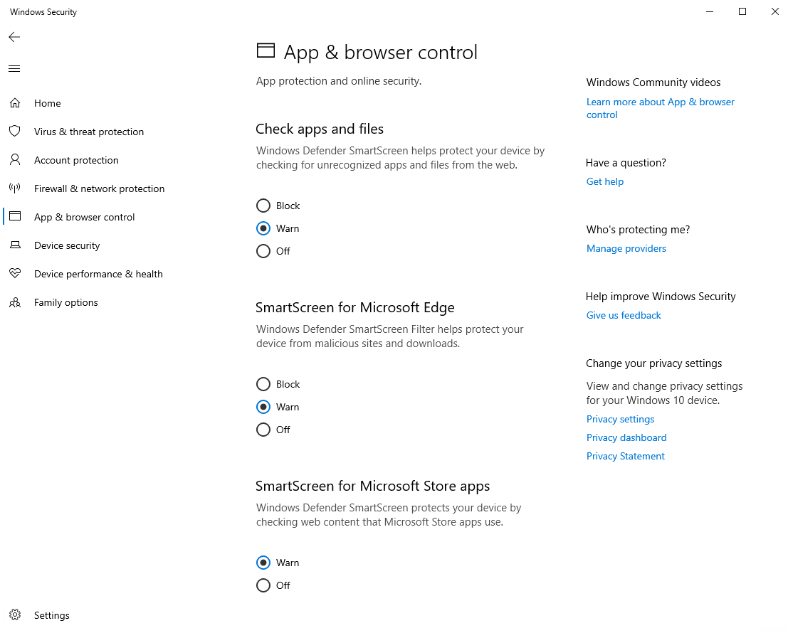
Windows Defender SmartScreen
Notes:
Discuss the functionality of the SmartScreen for Microsoft Edge and SmartScreen for Windows Store apps features, and explain that these technologies don’t work with third‑party browsers. Therefore, if a user visits a malicious site by using a third‑party browser, SmartScreen would not issue a warning.
20744C
5: Mitigating malware and threats

Slide 26
DEMO

Slide 27
What is AppLocker?
AppLocker contains capabilities and extensions that:
  Reduce administrative overhead
  Help administrators control how users access and use:
    .exe files
    scripts
    DLLs
    Windows Installer files
    Packaged apps
Notes:
Introduce AppLocker as the replacement for SRPs in Windows Server 2008 R2 and Windows 7. Mention that AppLocker has been available since Windows Server 2012 and Windows 8.
Introduce the benefits that AppLocker provides, and start a high-level discussion about how you can apply it in a Windows Server 2016 or a Windows 10 environment.
Highlight how you can use AppLocker to define specific sets of rules based on a user account or security group membership, and then explain that you can define application variables when you create rules.
20744C
5: Mitigating malware and threats

Slide 28
AppLocker rules
AppLocker defines rules based on file attributes such as:
    Publisher name
    Product name
    File name
    File version
Rule actions:
    Allow or Deny conditions
    Enforce or Audit Only policies
Notes:
Explain how AppLocker rules work and demonstrate them. Discuss an example of using AppLocker in which students can use a Deny action in AppLocker to configure software that their company does not use anymore. This means that users no longer can run the software. You should further explain that the next step is to remove the software.
Discuss an example of auditing policies, such as how you can use auditing policies to retrieve information about software that your employees are using.
Discuss several scenarios in which it is beneficial to implement AppLocker, such as for:
Licensing audits, software true-up procedures, software-license purchases, and enterprise agreements that must maintain compliance, and to ensure that an organization has the proper licenses.
Software that you don’t want used in your company. Mention an example of software that can disrupt employees’ business productivity, such as social networks, or software that streams video files or pictures that use significant network bandwidth.
Software that an enterprise doesn’t use. This is the software that the enterprise no longer needs, and which the enterprise doesn’t maintain or license.
Software that the enterprise does not support. If an enterprise no longer supports specific software, you typically don’t provide security updates for it, which can pose a security risk.
20744C
5: Mitigating malware and threats

Slide 29
DEMO

Slide 30
Windows Defender ATP
Windows Servers
  Windows Server 2016 & 2019
  Windows Server 2012 R2
Windows clients
  Windows 10
  Windows 8.1
  Windows 7 SP1
Other platforms (via partners)
  Android
  iOS
  macOS
  Linux
Notes:
https://www.microsoft.com/en-us/windowsforbusiness/windows-atp

Slide 31
Attack Surface Analyzer
Track changes in key areas, including:
  File System
  User Accounts
  System Services
  Network Ports (listeners)
  System Certificate Stores
  Windows Registry
Notes:
https://www.microsoft.com/security/blog/2019/05/15/announcing-new-attack-surface-analyzer-2-0/

Slide 32
“It is better to fail in originality than to succeed in imitation.”
Herman Melville

Slide 33

MOC tečaji - Kompas Xnet
Windows 10: Installing, Configuring, Protecting, Maintaining W10
  Termin: 10.6. - 14.6.2019
10982 Supporting and Troubleshooting Windows 10
  Termin: 29.7. - 2.8.2019
Securing Windows Server 2016
  Termin: 26.8. - 30.8.2019
Info: www.kompas-xnet.si

Slide 34
Q&A

Slide 35
Hvala

