Slide 1
Notes:
© Microsoft Corporation. All rights reserved. MICROSOFT MAKES NO WARRANTIES, EXPRESS, IMPLIED OR STATUTORY, AS TO THE INFORMATION IN THIS PRESENTATION.
5/14/2017 6:53 PM
1

Slide 2
HOLOLENS V KUHINJI
Introduction to Hololens development
Rok Bermež, Dušan Zupančič
Notes:
© Microsoft Corporation. All rights reserved. MICROSOFT MAKES NO WARRANTIES, EXPRESS, IMPLIED OR STATUTORY, AS TO THE INFORMATION IN THIS PRESENTATION.
5/14/2017 6:53 PM
2

Slide 3

Agenda
Overview
HoloToolkit
Spatial Mapping
Gestures &
Voice Commands
Enterprise Integration

Slide 4
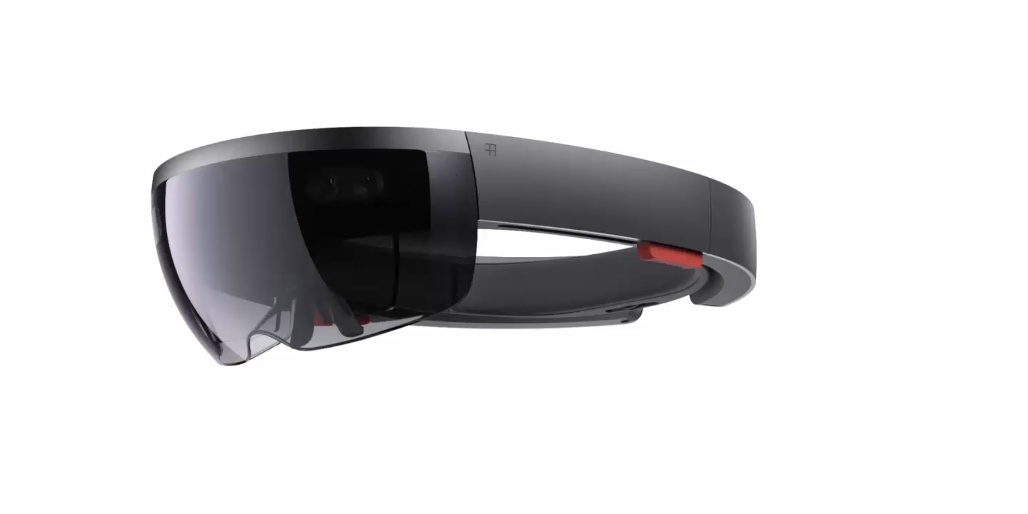
Quick Overview

Slide 5
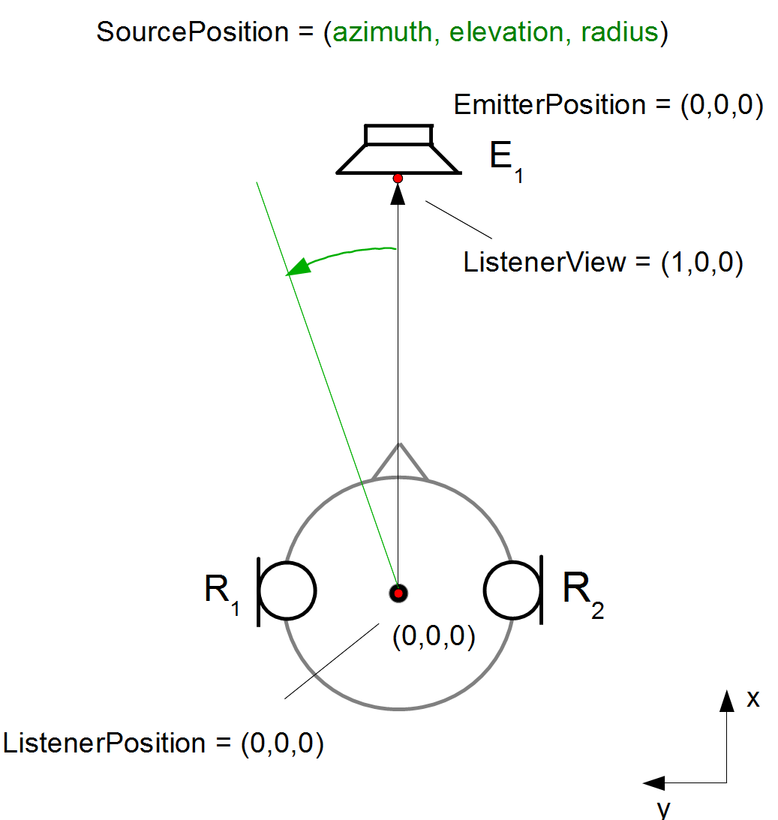
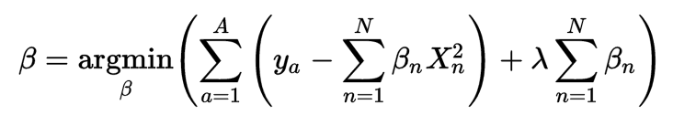
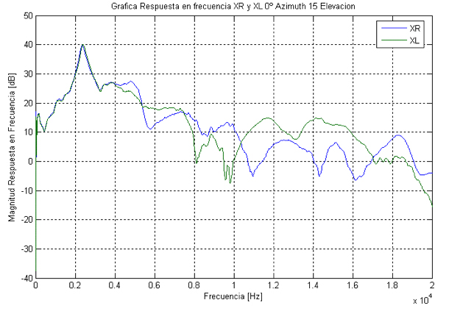
Head Related Transfer Function
Notes:
Microsoft Ignite 2016
© 2016 Microsoft Corporation. All rights reserved. MICROSOFT MAKES NO WARRANTIES, EXPRESS, IMPLIED OR STATUTORY, AS TO THE INFORMATION IN THIS PRESENTATION.
5/14/2017 6:53 PM
5

Slide 6
HoloToolkit
Notes:
© Microsoft Corporation. All rights reserved. MICROSOFT MAKES NO WARRANTIES, EXPRESS, IMPLIED OR STATUTORY, AS TO THE INFORMATION IN THIS PRESENTATION.
5/14/2017 6:53 PM
6

Slide 7
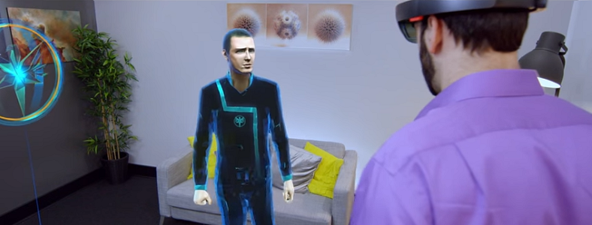

Fragments
Young Conker

Slide 8
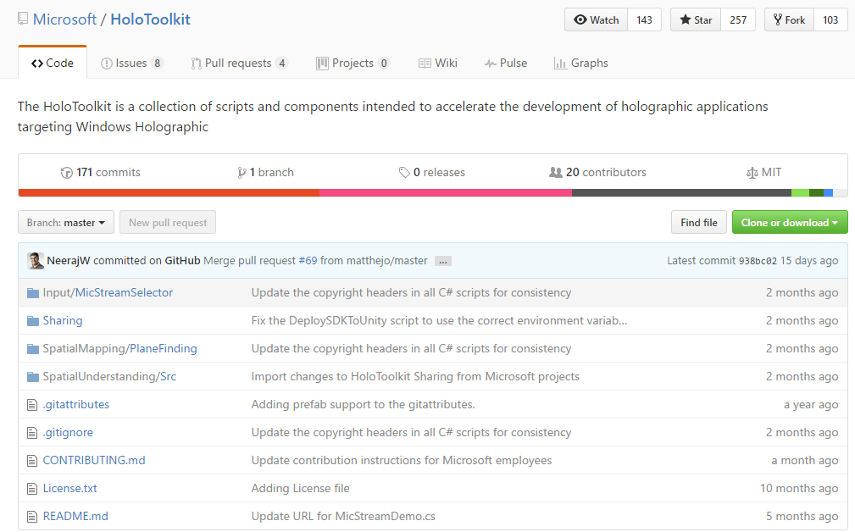
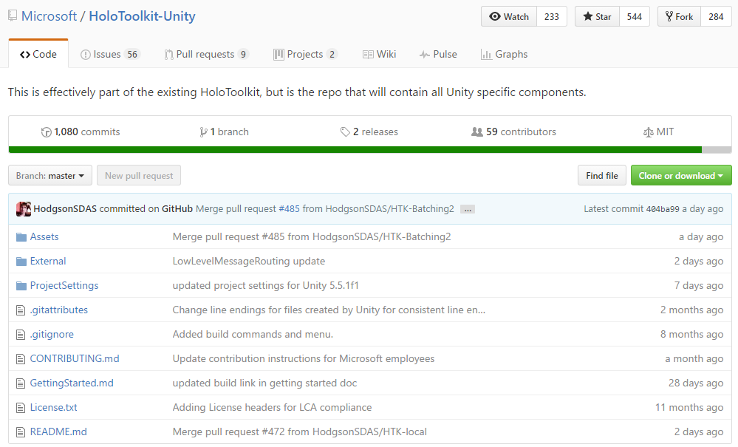
HoloToolkit – Making Life Easyer

Slide 9
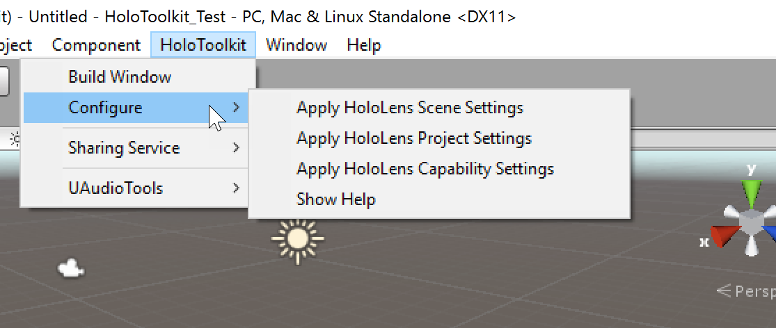
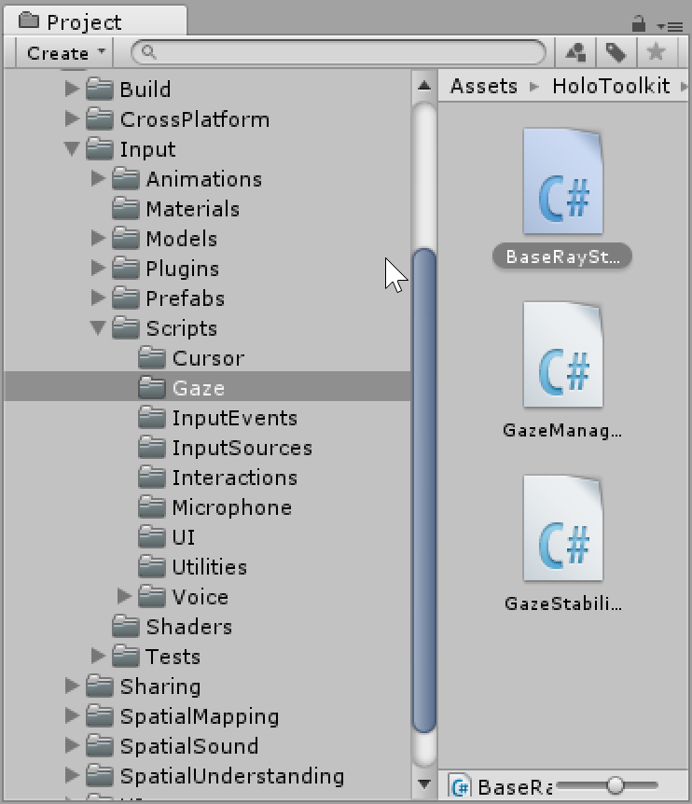
HoloToolkit Features
Project Setup
Spatial
Sharing
Scripts

Slide 10
Demo - HoloToolkit
Rok
Create a new project
Download and add HoloToolkit
Add 3D model we will use for the rest of the demos
Notes:
© Microsoft Corporation. All rights reserved. MICROSOFT MAKES NO WARRANTIES, EXPRESS, IMPLIED OR STATUTORY, AS TO THE INFORMATION IN THIS PRESENTATION.
5/14/2017 6:53 PM
10

Slide 11
Spatial Mapping
Notes:
© Microsoft Corporation. All rights reserved. MICROSOFT MAKES NO WARRANTIES, EXPRESS, IMPLIED OR STATUTORY, AS TO THE INFORMATION IN THIS PRESENTATION.
5/14/2017 6:53 PM
11

Slide 12
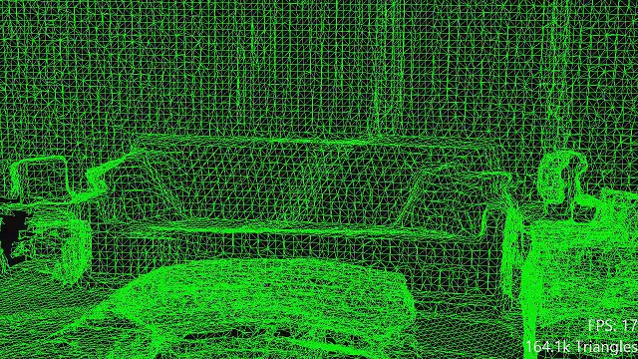
https://developer.microsoft.com/en-us/windows/holographic/spatial_mapping
Notes:
Microsoft Ignite 2016
© 2016 Microsoft Corporation. All rights reserved. MICROSOFT MAKES NO WARRANTIES, EXPRESS, IMPLIED OR STATUTORY, AS TO THE INFORMATION IN THIS PRESENTATION.
5/14/2017 6:53 PM
12

Slide 13
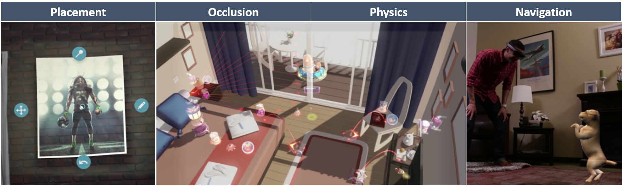
Spatial Mapping Usage

Slide 14
Demo – Placing the Hologram
Rok
Use Spatial Mapping to find floor
Place 3D model on the floor
Show on Hololenc through Holographic Remoting Player
Build & deploy to Hololens
Notes:
© Microsoft Corporation. All rights reserved. MICROSOFT MAKES NO WARRANTIES, EXPRESS, IMPLIED OR STATUTORY, AS TO THE INFORMATION IN THIS PRESENTATION.
5/14/2017 6:53 PM
14

Slide 15
Gestures & Voice Commands
Notes:
© Microsoft Corporation. All rights reserved. MICROSOFT MAKES NO WARRANTIES, EXPRESS, IMPLIED OR STATUTORY, AS TO THE INFORMATION IN THIS PRESENTATION.
5/14/2017 6:53 PM
15

Slide 16
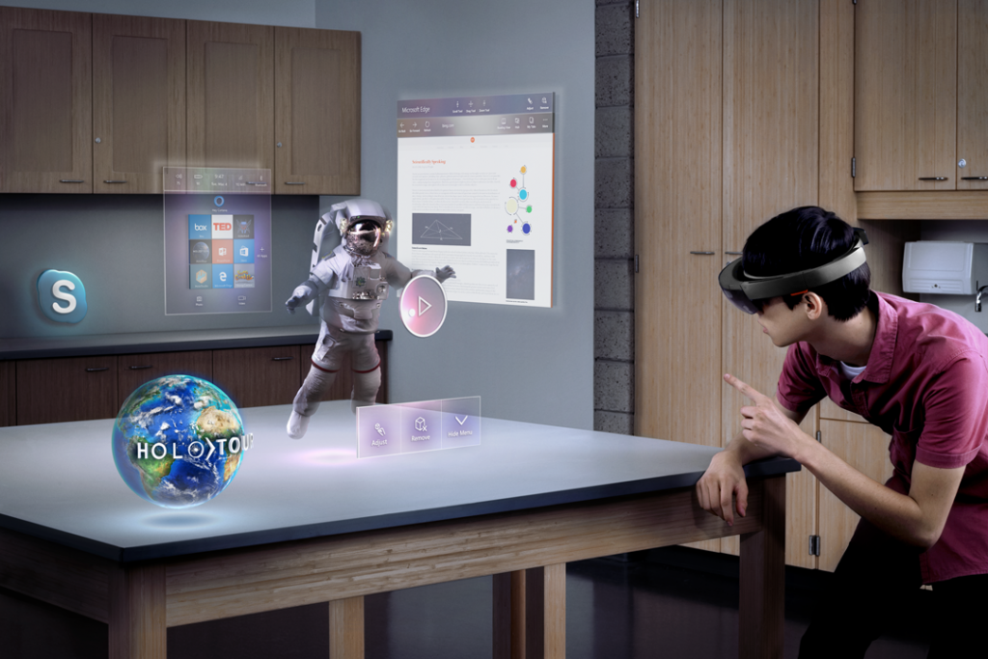
Notes:
Microsoft Ignite 2016
© 2016 Microsoft Corporation. All rights reserved. MICROSOFT MAKES NO WARRANTIES, EXPRESS, IMPLIED OR STATUTORY, AS TO THE INFORMATION IN THIS PRESENTATION.
5/14/2017 6:53 PM
16

Slide 17

Speech Design
What actions can be taken through speech?
Is speech input a good option for completing a task?
How does a user know when speech input is available?
Is the app always listening?
What phrases initiate an action or behavior?
What is the interaction dialog between app and user?
Is network connectivity required?

Slide 18
Demo – Interaction & Deployment
Rok
Create door open animation
Add gaze cursor
Use Airtap to start animation
Use „door open“ / „door close“ voice commands
Notes:
© Microsoft Corporation. All rights reserved. MICROSOFT MAKES NO WARRANTIES, EXPRESS, IMPLIED OR STATUTORY, AS TO THE INFORMATION IN THIS PRESENTATION.
5/14/2017 6:53 PM
18

Slide 19
Enterprise Integration
Notes:
© Microsoft Corporation. All rights reserved. MICROSOFT MAKES NO WARRANTIES, EXPRESS, IMPLIED OR STATUTORY, AS TO THE INFORMATION IN THIS PRESENTATION.
5/14/2017 6:53 PM
19

Slide 20


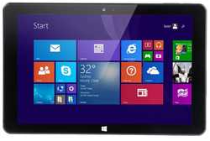

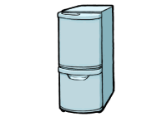
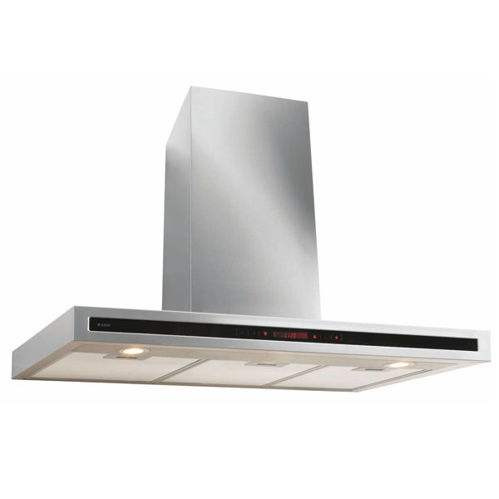
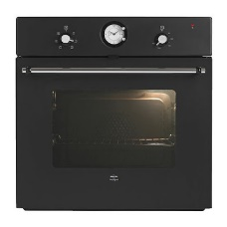
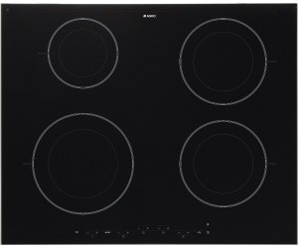
Connectlife
Hololens app
Connectlife
Web site
Connectlife
BOT
Connectlife
Smart device app
3rd party
applications
Presentation Layer
Service Layer
Connectlife API
Wizards API
CHP API
Business rules & wizards
Recipe & Menu
Food storage
Hob Guide
Refresh air
Etc.
Recipes, Menus, Ingredients storage info …
Database
Service agents
Oven
Refrigerator
Hob
Hood
Etc.
CHP
Connected Home Platform
Appliances

Slide 21
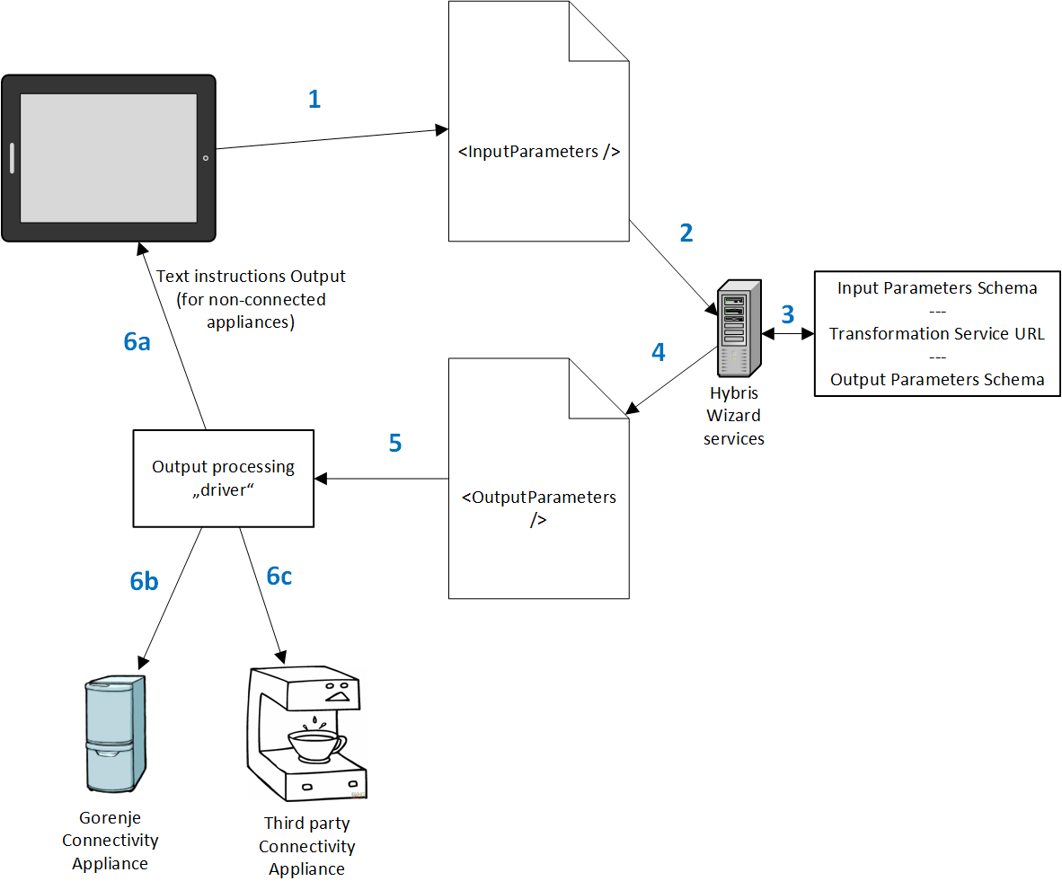
Generalised concept of a wizard
App
Backend (Connectlife Service)
21
Notes:
User enters required wizard parameters via application (or web site), together with target appliance model and packs it in wizard input structure.
Wizard input structure is send to Hybris wizard service.
Hybris wizard service has internal structure describing input parameters schema, URL to transformation service and Output Parameters Schema. Input parameters are first validated against the schema, then transformation service is called with input parameters which returns output parameters.
Output parameters are returned from Hybris Wizard Service.
Output parameters are transferred to initiating application, where wizard output processing driver takes the parameters
Output processing driver accepts the wizard output parameters and depending on appliance capabilities and user preferences of the output processes output that can be consumed by several channels:
Text instructions – for non-connected appliances → wizard output parameters are translated into text instructions of how to set the parameters on appliance manually.
Gorenje Connectivity enabled appliance – remote control command is assembled and send to appliance in order to automatically set parameters on appliance.
Third Party Connectivity enabled appliance – remote control command is assembled and appropriate third party remote service is called in order to remotely set parameters on appliance.
21

Slide 22
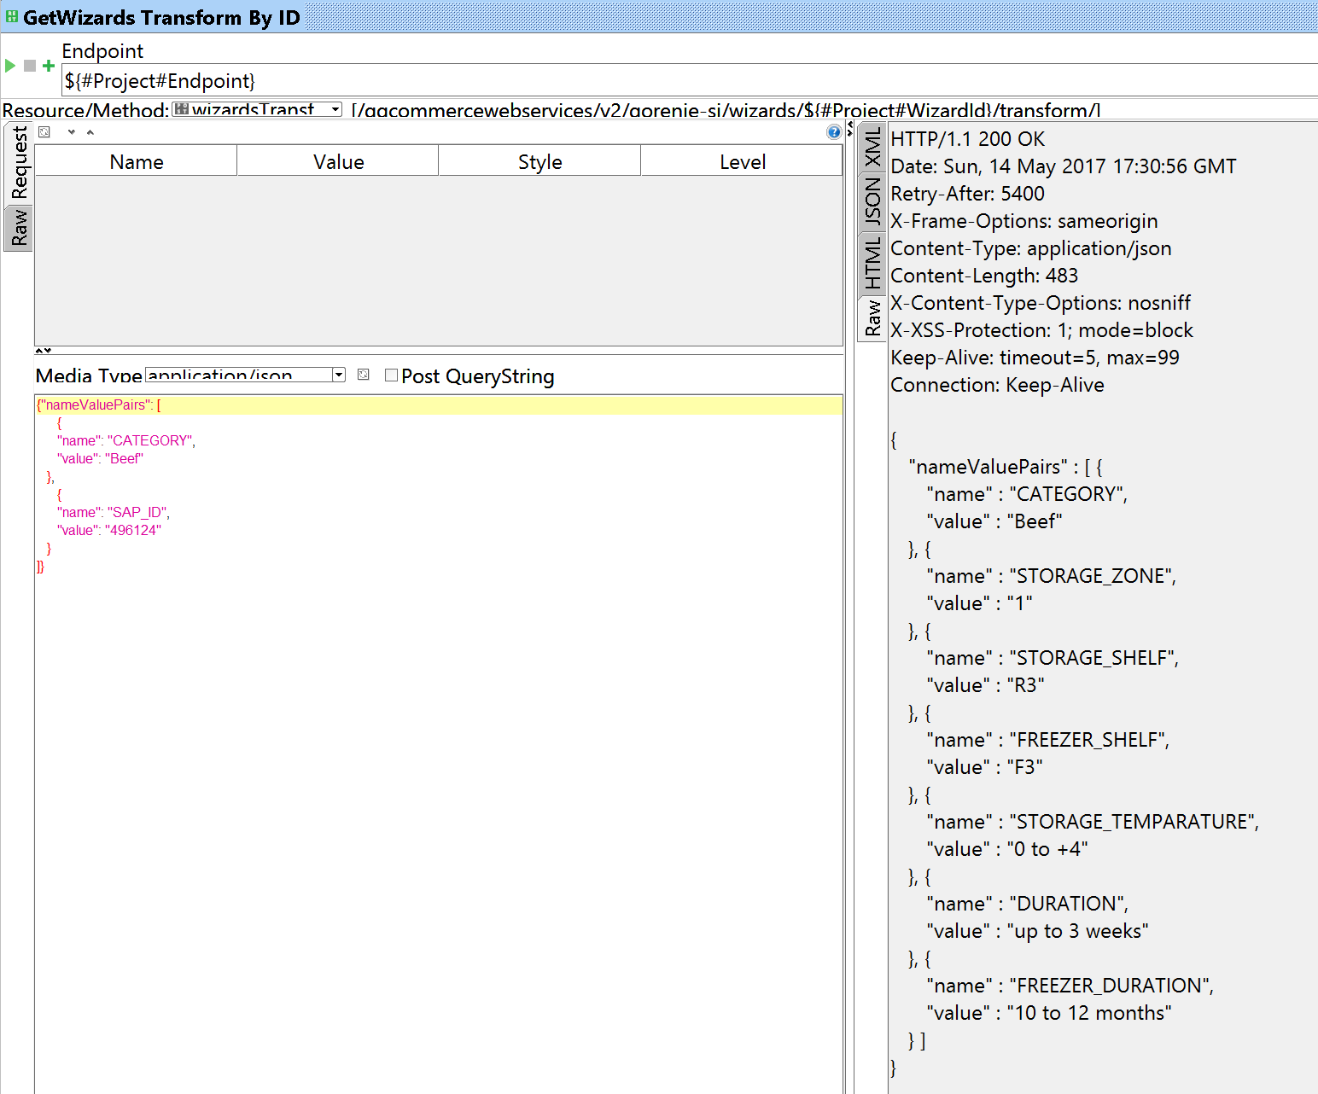
Connectlife Service Call (in SOAPUI)
Input parameters:
  Category: Beef
  SAP id: 496124
Output parameters:
  Refrigerator:
    Storage zone
    Shelf
    Temperature
    Duration
  Freezer:
    Storage zone
    Shelf
    Temperature
    Duration

Slide 23
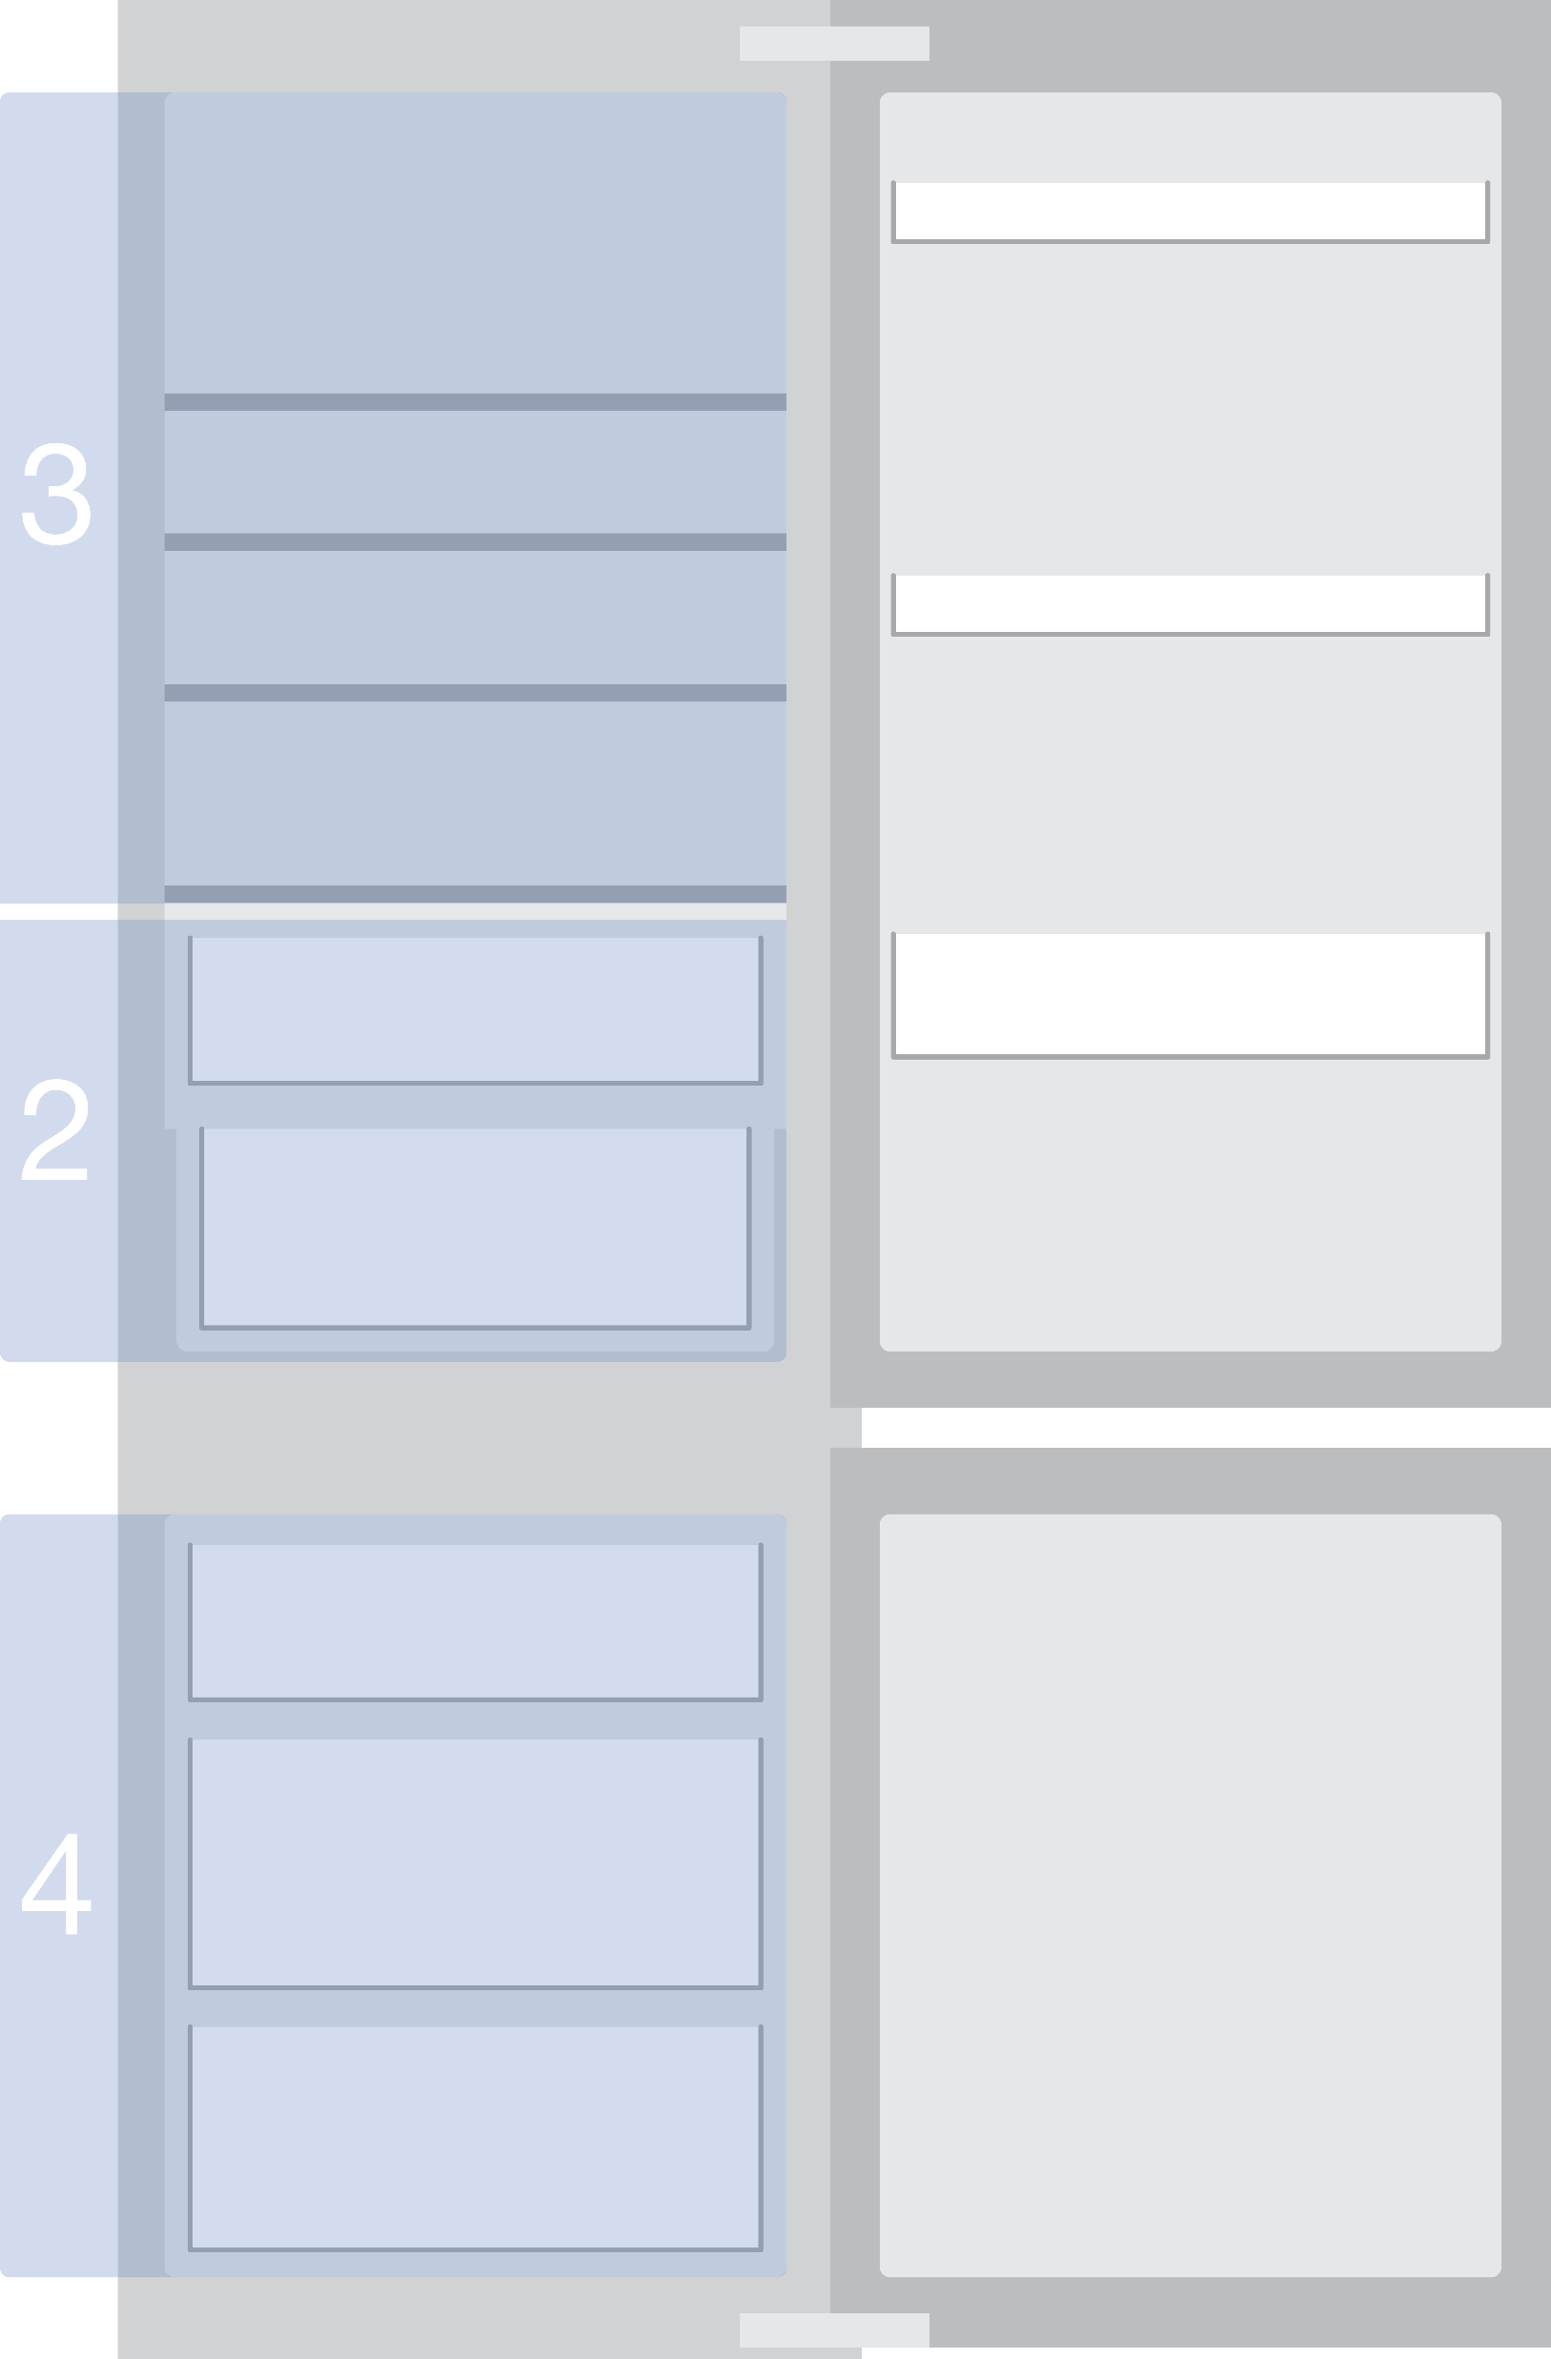
Storage zones schema

Slide 24
Demo – Enterprise Integration
Dušan
Notes:
© Microsoft Corporation. All rights reserved. MICROSOFT MAKES NO WARRANTIES, EXPRESS, IMPLIED OR STATUTORY, AS TO THE INFORMATION IN THIS PRESENTATION.
5/14/2017 6:53 PM
24

Slide 25
Where to next?
Ultimate resource list:
  http://chadcarter.net/ultimate-hololens-resource-list/
HoloToolkit packages:
  https://holotoolkit.download/
Perception simulation:
  https://developer.microsoft.com/en-us/windows/mixed-reality/perception_simulation
Simplygon:
  https://labs.simplygon.com/

Slide 26

Q&A
Notes:
26

Slide 27
Notes:
5/14/2017 6:53 PM
27
© Microsoft Corporation. All rights reserved. MICROSOFT MAKES NO WARRANTIES, EXPRESS, IMPLIED OR STATUTORY, AS TO THE INFORMATION IN THIS PRESENTATION.

