Slide 4
Text layout (without bullet points)
Main topic: Segoe UI Semilight, size 28pt
  Segoe UI, size 20pt for second level
    Segoe UI, size 16pt for third level

Slide 5
Text layout with bulleted text
Main topic: Segoe UI Semilight, size 28pt
  Segoe UI, size 20pt for second level
    Segoe UI, size 16pt for third level

Slide 6
Square photo with title
Smaller text

Slide 9
TABLE
 | Column 1 | Column 2 | Column 3 | Column 4 | Column 5 | Column 6 | Column 7
Row 1 | 17% | 12% | 11% | 19% | 11% | 14% | 15%
Row 2 | 78% | 61% | 36% | 25% | 15% | 12% | 2%
Row 3 | 24% | 18% | 18% | 21% | 9% | 15% | 8%
Row 4 | 64% | 46% | 41% | 47% | 26% | 26% | 14%
Row 5 | 63% | 46% | 44% | 50% | 28% | 39% | 35%
Row 6 | 4% | 2% | 2% | 4% | 1% | 2% | 1%
Row 7 | 11% | 5% | 5% | 9% | 3% | 4% | 2%
Row 8 | 11% | 5% | 5% | 9% | 3% | 6% | 5%

Slide 10
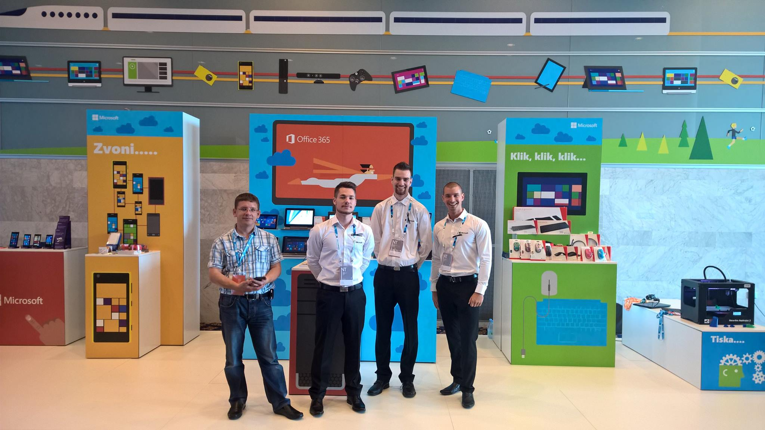
CLEAN AND MODERN
80 want to try it again
89 would purchase it
68 are indifferent
77 totally love it

Slide 11
PIE CHART
YOU CAN WRITE HERE
YOU CAN
WRITE YOUR
TITLE ABOUT
THIS GRAPHIC

Slide 15
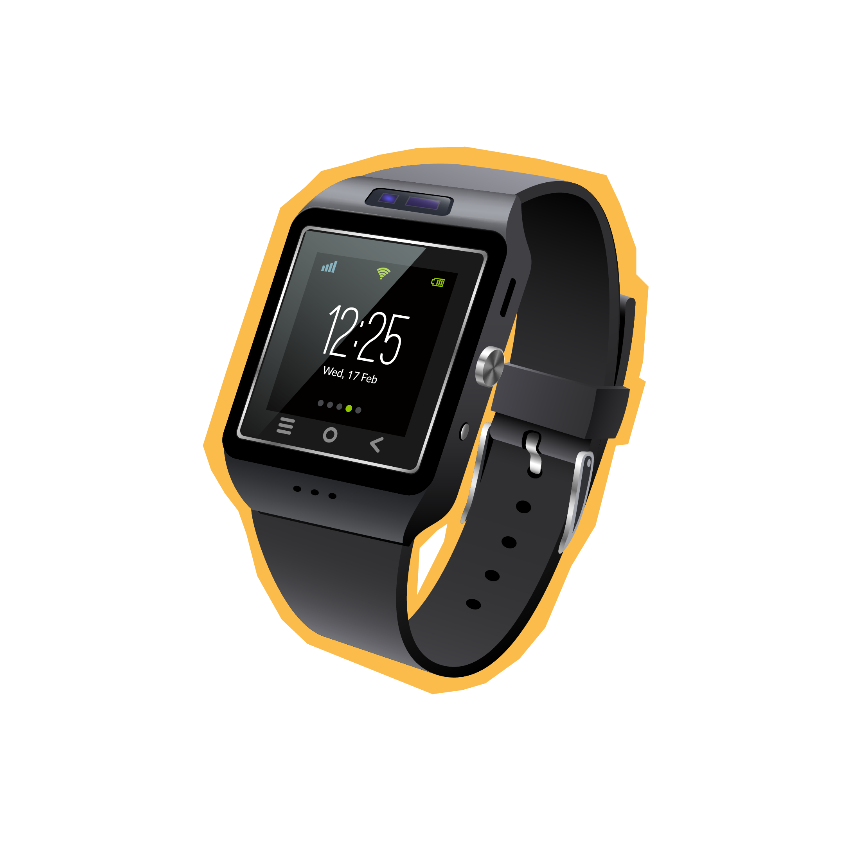



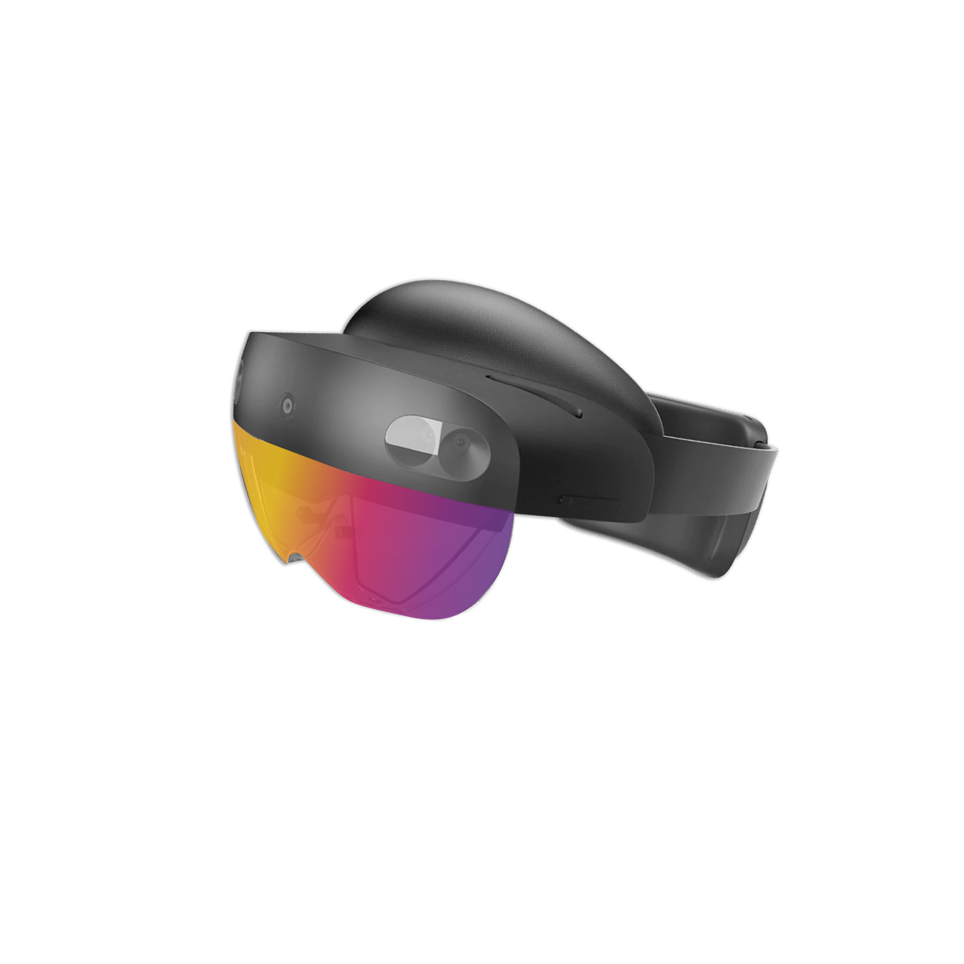

Few design elements for you to use.

Slide 16
This is not school, but we
love to get grades.
Please fill out our
questoineers and leave
us your feedback.
You may even win some
cool rewards.

Slide 19
Dataverse and Dynamics 365 Business Central integration capabilities
Milan Milinčević, Factorial
Renato Fajdiga, Derecjun

Slide 20
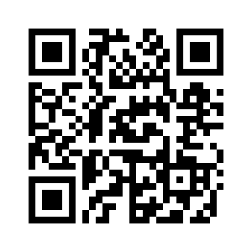
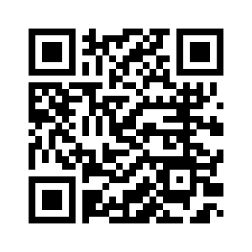

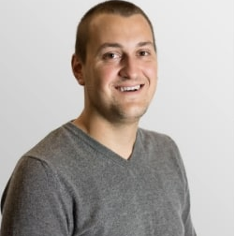
Renato Fajdiga
Milan Milinčević
Dynamics 365 F&O, BC, and Power Platform consultant @ Derecjun
MVP & MCT
Dynamics 365 Business Central Developer @ Factorial

Slide 21
Agenda
Why do we need Dataverse?
Data Synchronization
Virtual Entities
Data flows
Power Apps

Slide 22
Why do we need Dataverse?
Data storage & management layer for D365 Sales and Power Platform
Dynamics 365 Sales and Power Platform run on Dataverse
Integration between Dynamics 365 Business Central with Dynamics 365 Sales, Power Platform.
Data sync, Virtual Tables, Business Events, Data events

Slide 23












Data Synchronization
BC
Dataverse
Data sync

Slide 24
Demo
Data Synchronization Setup

Slide 25
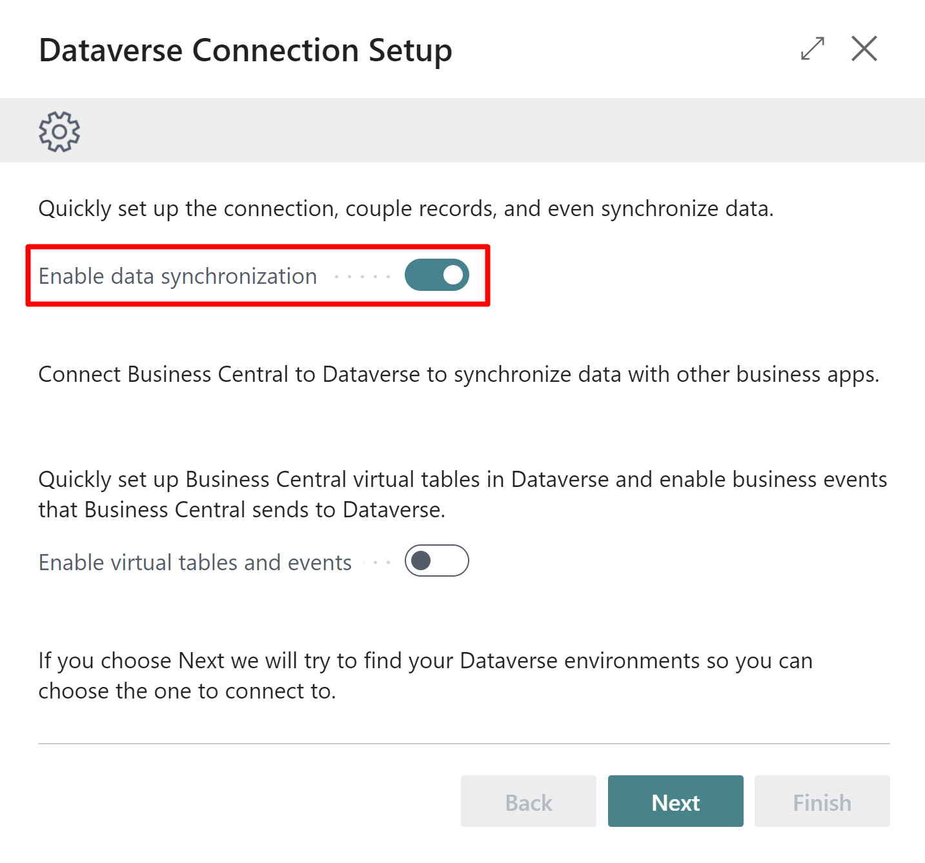
Data Synchronization Setup

Slide 26
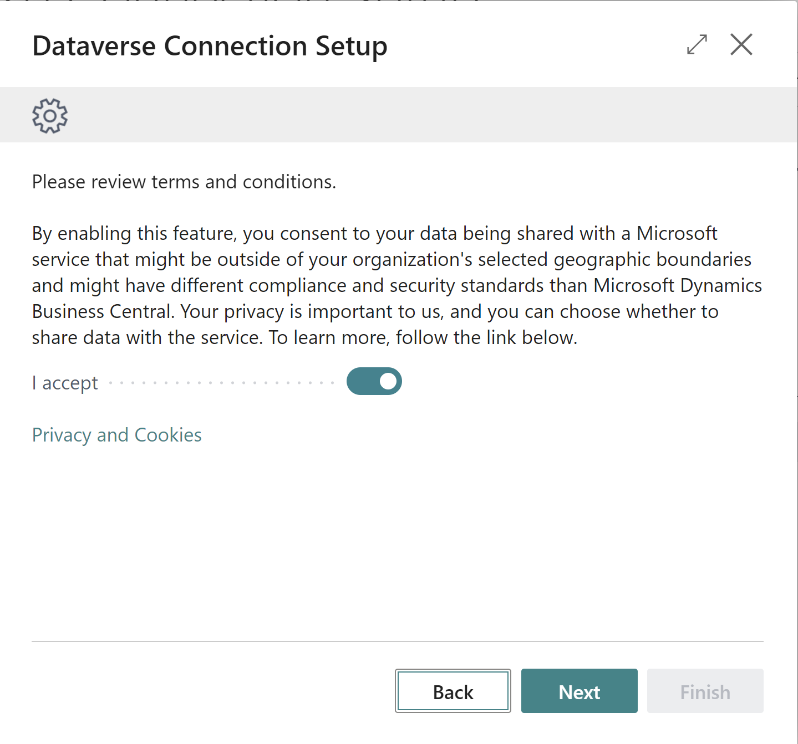
Data Synchronization Setup

Slide 27
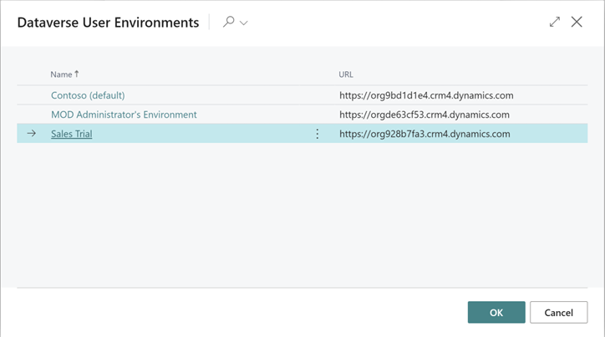
Data Synchronization Setup

Slide 28
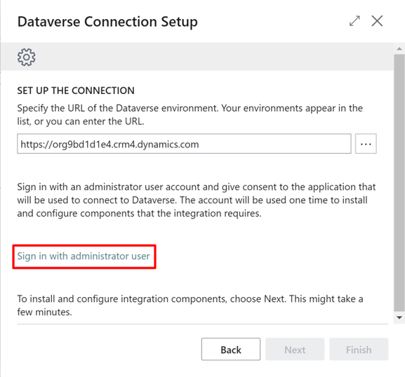
Data Synchronization Setup

Slide 29
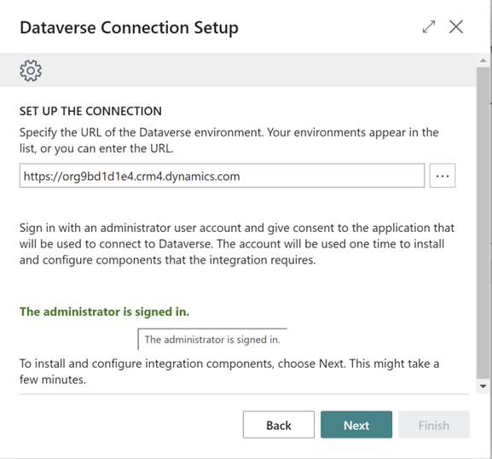
Data Synchronization Setup

Slide 30
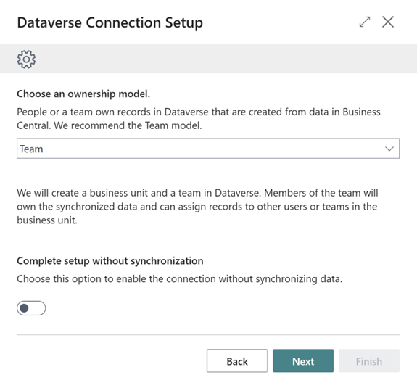
Data Synchronization Setup

Slide 31
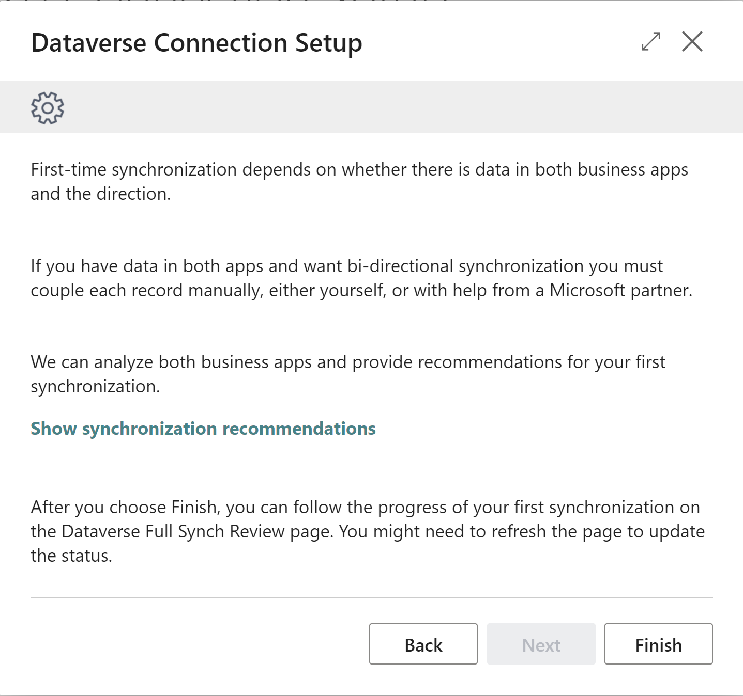
Data Synchronization Setup

Slide 32
Demo
Data Synchronization

Slide 33

Virtual Tables
„A virtual table is a custom table in Microsoft Dataverse that has columns containing data from an external data source. Virtual tables appear in your app to users as regular table rows, but contain data that is sourced from an external database, such as an Azure SQL Database.”
BC
Dataverse
Virtual tables

Slide 34
Demo
Virtual Tables (Entities) Setup

Slide 35
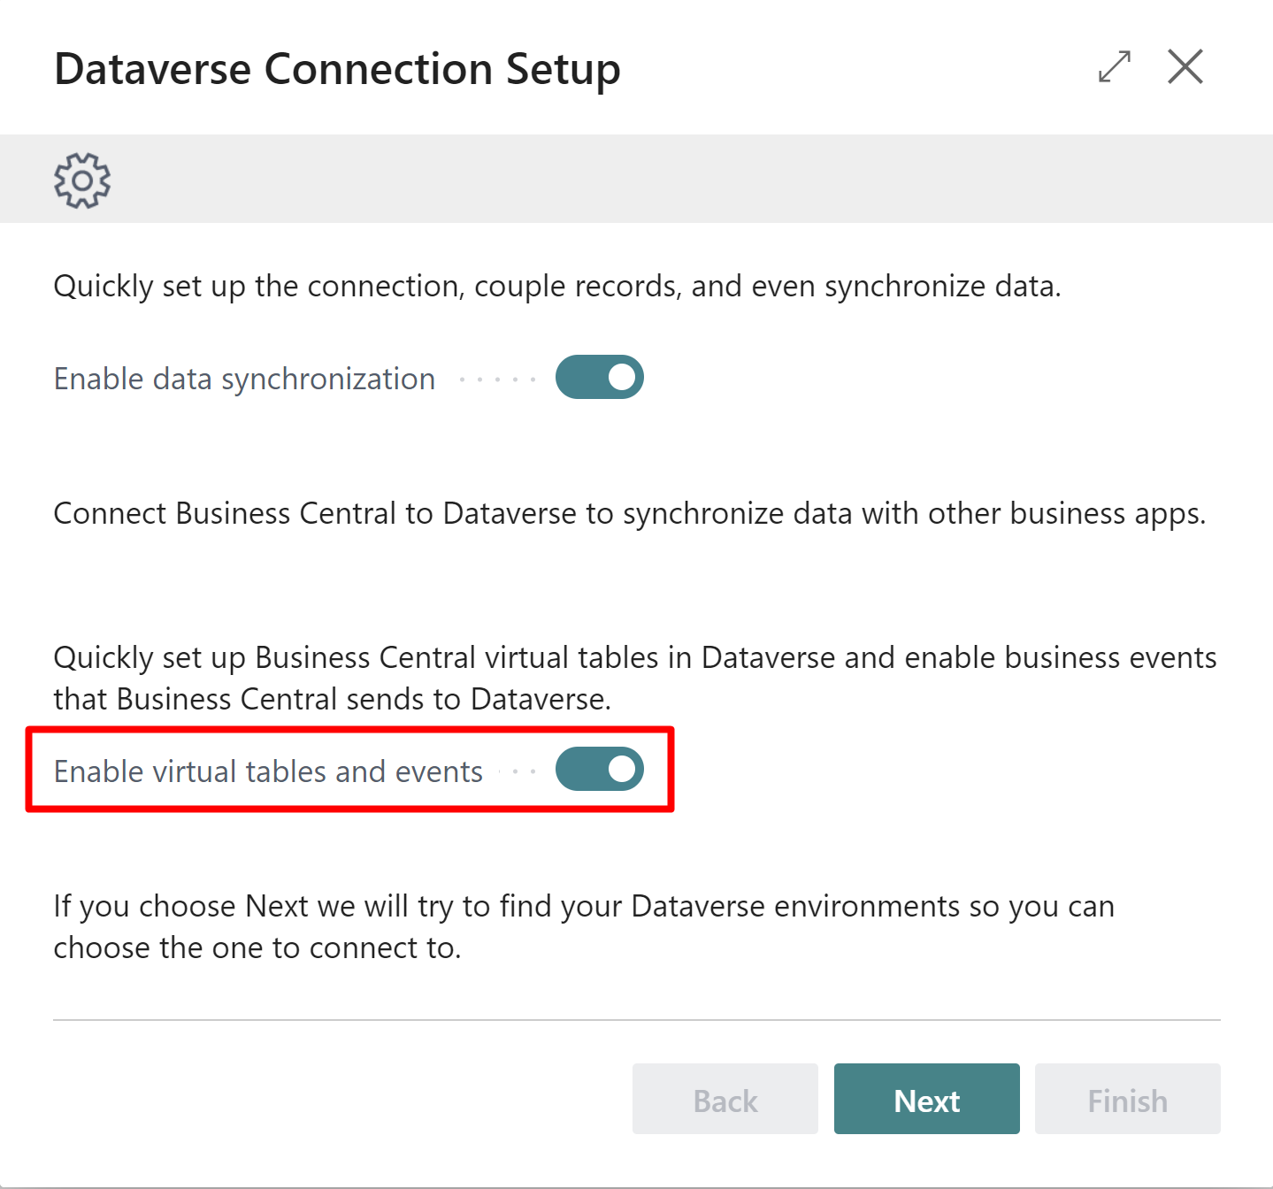
Virtual Tables Configuration

Slide 36
Virtual Tables Configuration

Slide 37

Virtual Tables Configuration

Slide 38

Virtual Tables Configuration

Slide 39

Virtual Tables Configuration

Slide 40
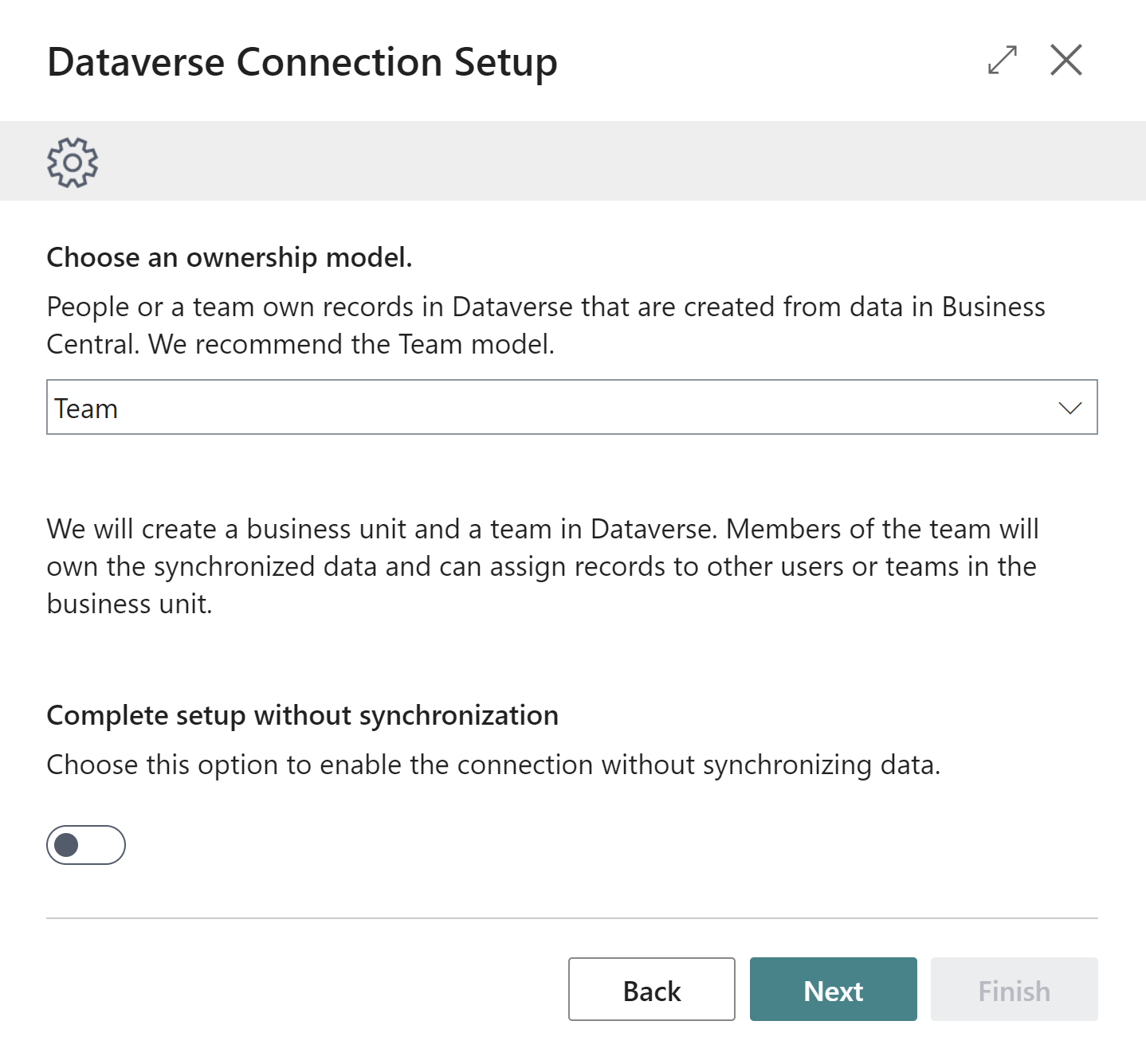
Virtual Tables Configuration

Slide 41
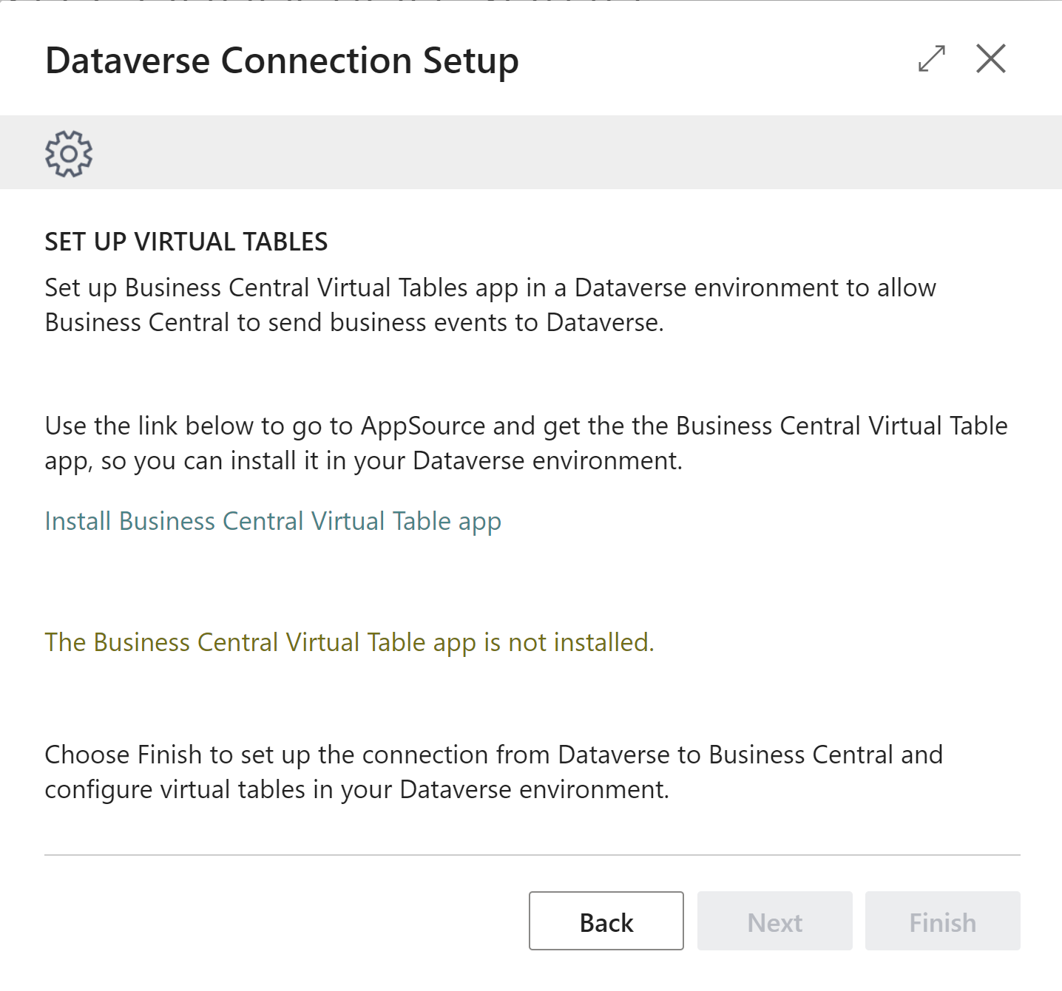
Virtual Tables Configuration

Slide 42
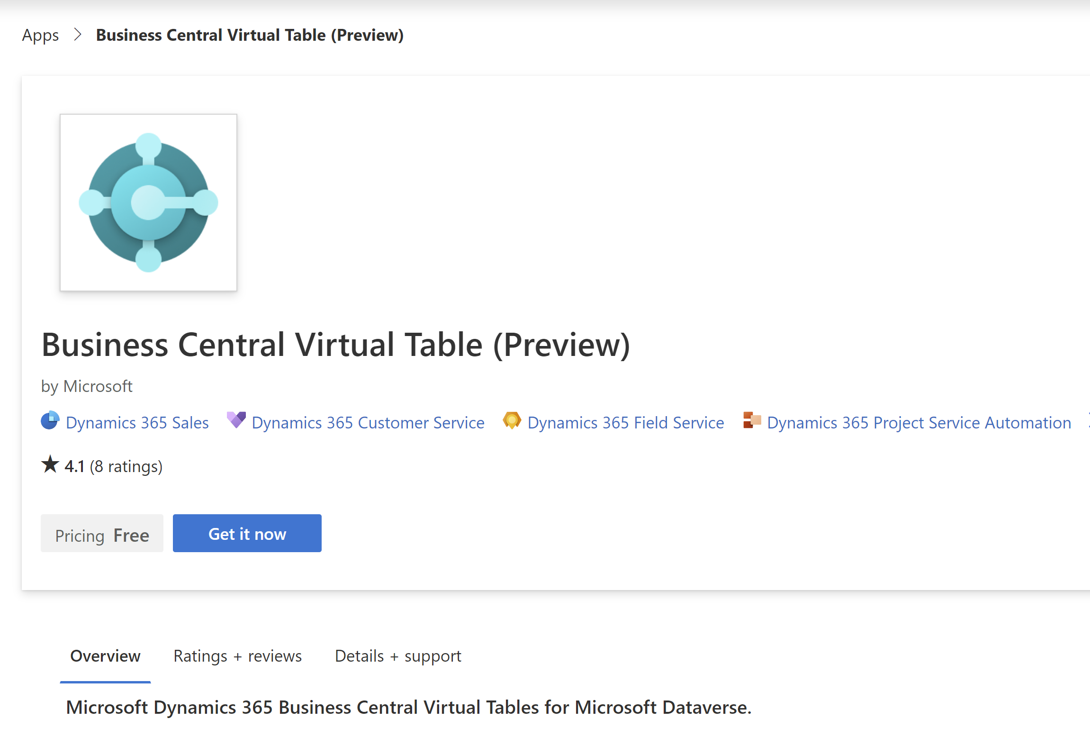
Virtual Tables Configuration

Slide 43
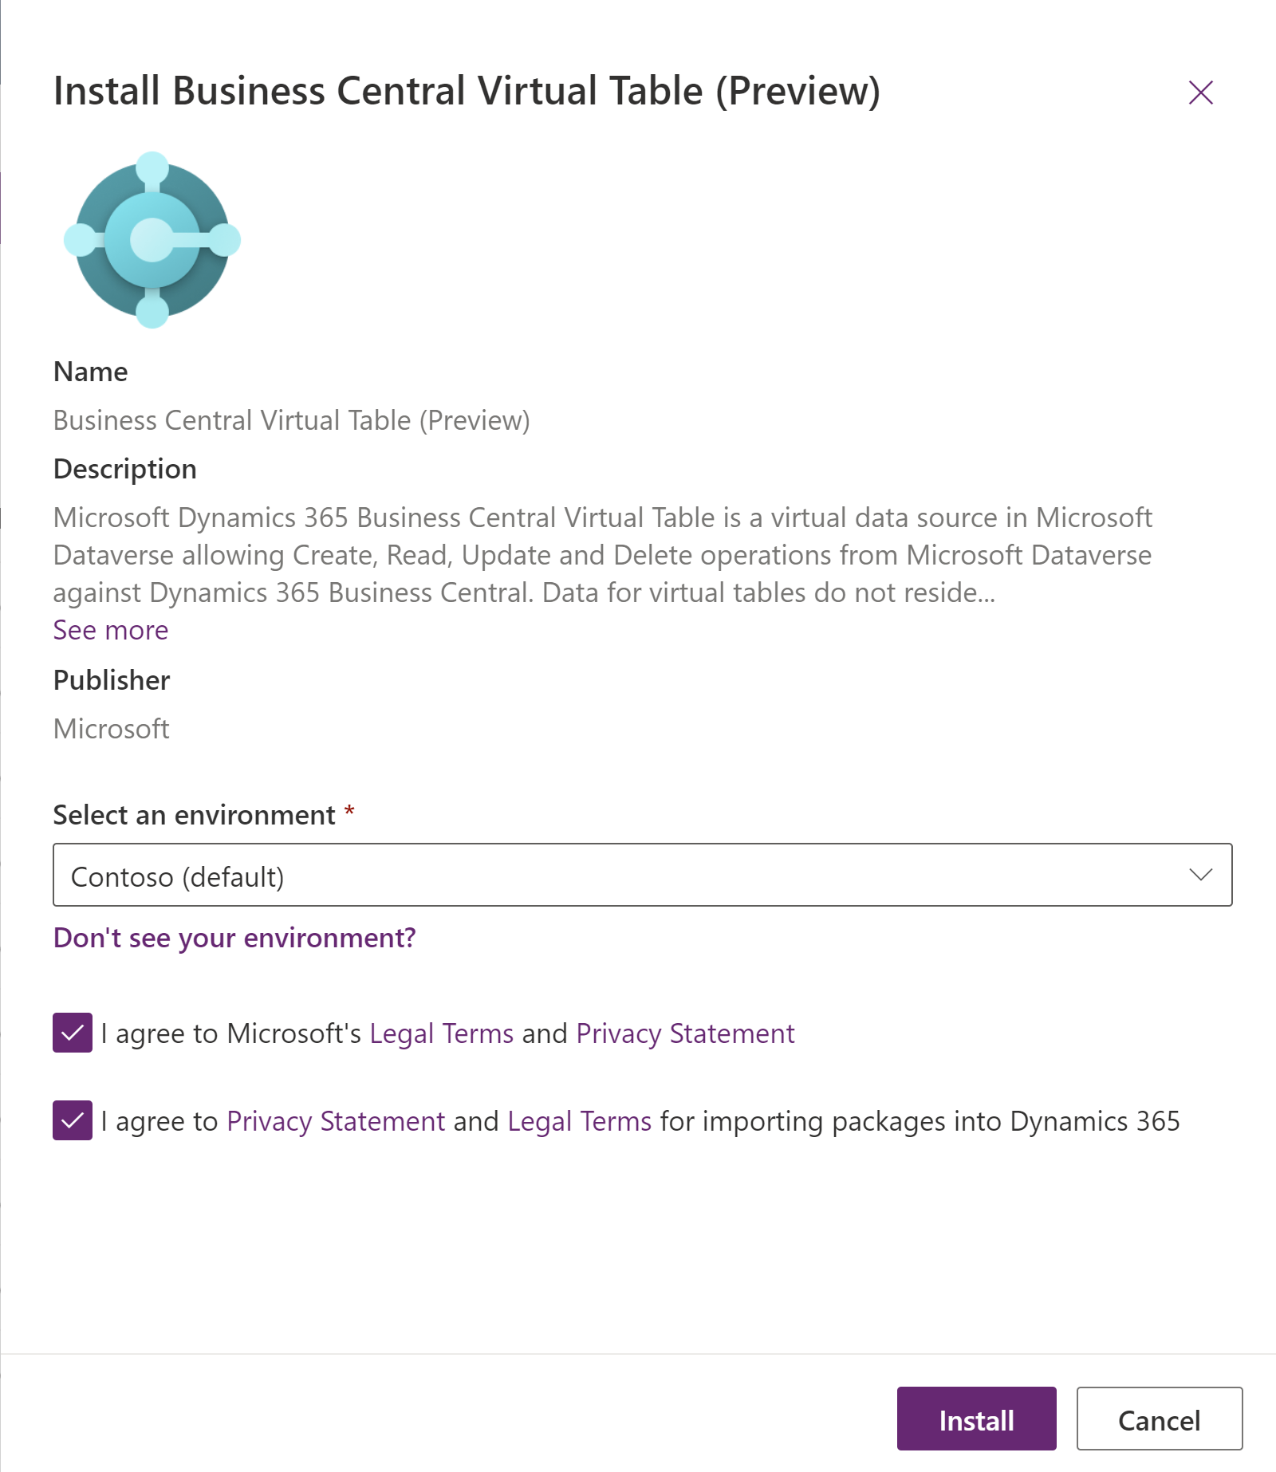
Virtual Tables Configuration

Slide 44
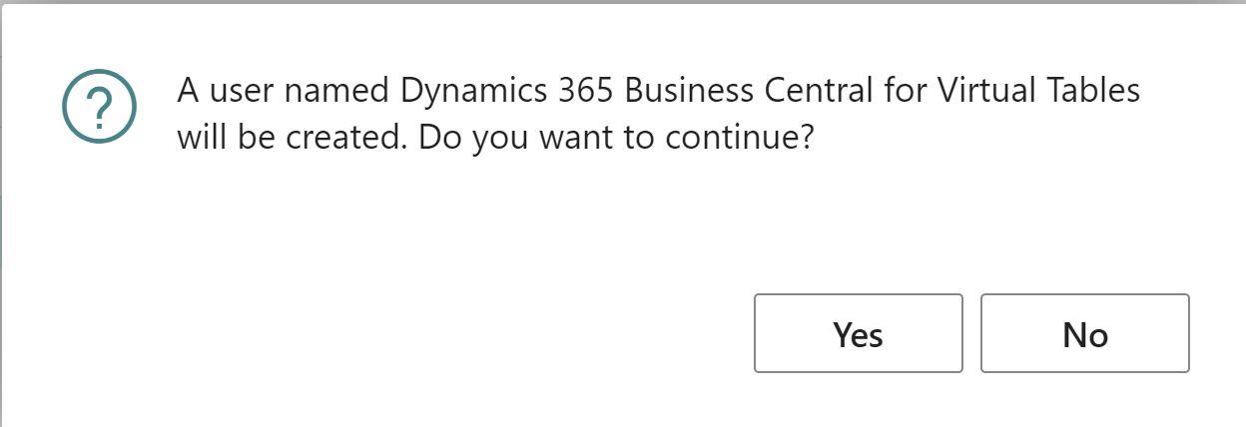
Virtual Tables Configuration

Slide 45
Demo
Virtual Entities

Slide 46
Business Events
New feature – in Public Preview
Mechanism of notifying external systems when specific actions are occured in BC
Limitation: Power Automate flows with the „When an action is performed” trigger are automatically subscribed to all accessible companies in BC, cannot select specific one
BC
Dataverse
Business Events

Slide 47
Demo
Business Events

Slide 48








Dataflows with Power Query
Self service data preparation technology.
Enable customers to transform and load data into Dataverse environment, Power BI workspaces or Data Lake.

Slide 49
Demo
Dataflows with Power Query

Slide 50
Power Apps
Build mobile first and web UI for custom Business Central scenarios.
Connect directly to Dynamics 365 Business Central or utilize Dataverse as data source.

Slide 51
Demo
Power Apps with Business Central data

Slide 52
Thank you for your attention!
Renato Fajdiga
renato@derecjun.com
Milan Milinčević
Milan.Milincevic@factorial.hr

Slide 53
This is not school, but we
love to get grades.
Please fill out our
questoineers and leave
us your feedback.
You may even win some
cool rewards.

