Slide 2

Azure Load Testing
Bojan Vrhovnik
Partner Solution Architect
Bojan.Vrhovnik@microsoft.com
@bvrhovnik
https://beyondlocalhost.tech
Notes:
Load testing is a type of performance testing that simulates a real-world load on a system or application to see how it performs under stress. The goal of load testing is to identify bottlenecks and determine the maximum number of users or transactions the system can handle.

Slide 3
Examples of load testing
Check the response times of a web application, according to the number of virtual users
Test differences in the behavior of the same application on two (or more) different runtime environments (for example, clustered environment versus non-clustered environment, or configuration 1 versus configuration 2)
Test the limits of an application (the number of users the application can accommodate before it crashes)
Functionally test an application automatically (with non-regression tests, functional validity tests, and so on), often coupled with a continuous integration tool
Reproduce a load-related production bug in a QA environment
Automate load testing in the continuous integration (CI) process
Test a database, a lightweight directory access protocol (LDAP) (or Active Directory) server, a mail server (SMTP or POP/IMAP), a message-oriented middleware (MOM) server, an FTP server, or a network service

Slide 4
Demo: Creating Azure Load Test

Slide 5
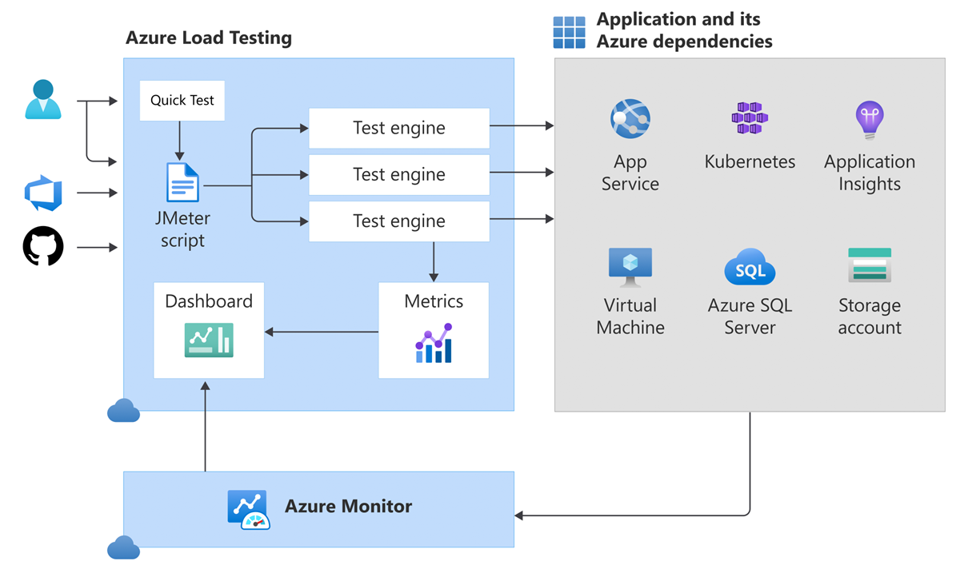
How does Azure Load Testing work?
Notes:
Load testing resource
The Azure load testing resource is the top-level resource for your load-testing activities. This resource provides a centralized place to view and manage load tests, test results, and related artifacts.
When you create a load test resource, you specify its location, which determines the location of the test engines. Azure Load Testing automatically encrypts all artifacts in your resource. You can choose between Microsoft-managed keys or use your own customer-managed keys for encryption.
To run a load test for your application, you add a test to your load testing resource. A resource can contain zero or more tests.
You can use Azure role-based access control to grant access to your load testing resource and related artifacts.
Azure Load Testing lets you use managed identities to access other Azure resources, such as Azure Key Vault for storing load test secret parameters. You can use either a user-assigned or system-assigned managed identity.
Test
A test represents a load test for your application. A test is attached to an Azure load testing resource. You can create a test in either of two ways:
Create a test based on an existing JMeter script.
Create a URL-based load test (quick test). Azure Load Testing automatically generates the corresponding JMeter script, which you can modify at any time.
A test contains a JMeter test script, or test plan, and related data and configuration files. Azure Load Testing supports all communication protocols that JMeter supports, not only HTTP-based endpoints. For example, you might want to read from or write to a database or message queue in the test script.
The test also specifies the configuration settings for running the load test:
Load test parameters, such as environment variables, secrets, and certificates.
Load configuration to scale out your load test across multiple test engine instances.
Fail criteria to determine when the test should pass or fail.
Monitoring settings to configure the list of Azure app components and resource metrics to monitor during the test run.
When you start a test, Azure Load Testing deploys the JMeter test script, related files, and configuration to the requested test engine instances. The test engine instances then initiate the JMeter test script to simulate the application load.
Each time you start a test, Azure Load Testing creates a test run and attaches it to the test.
Test engine
A test engine is computing infrastructure, managed by Microsoft that runs the Apache JMeter test script. The test engine instances run the JMeter script in parallel. You can scale out your load test by configuring the number of test engine instances. Learn how to configure the number of virtual users, or simulate a target number of requests per second.
The test engines are hosted in the same location as your Azure Load Testing resource. You can configure the Azure region when you create the Azure load testing resource.
While the test script runs, Azure Load Testing collects and aggregates the Apache JMeter worker logs from all test engine instances. You can download the logs for analyzing errors during the load test.
Test run
A test run represents one execution of a load test. It collects the logs associated with running the Apache JMeter script, the load test YAML configuration, the list of app components to monitor, and the results of the test.
You can view and analyze the load test results in the Azure Load Testing dashboard in the Azure portal.
Important
Existing test runs don't use the new settings when you update a test. When you rerun an existing test run, the initial configuration of the test run is used. The new settings will only be used when you run the test.
App component
When you run a load test for an Azure-hosted application, you can monitor resource metrics for the different Azure application components (server-side metrics). While the load test runs, and after completion of the test, you can monitor and analyze the resource metrics in the Azure Load Testing dashboard.
When you create or update a load test, you can configure the list of app components that Azure Load Testing will monitor. You can modify the list of default resource metrics for each app component.
Learn more about which Azure resource types are supported by Azure Load Testing.
Metrics
During a load test, Azure Load Testing collects metrics about the test execution. There are two types of metrics:
Client-side metrics are reported by the test engines. These metrics include the number of virtual users, the request response time, the number of failed requests, or the number of requests per second. You can define test fail criteria based on these client-side metrics.
Server-side metrics are available for Azure-hosted applications and provide information about your Azure application components. Azure Load Testing integrates with Azure Monitor, including Application Insights and Container insights, to capture details from the Azure services. Depending on the type of service, different metrics are available. For example, metrics can be for the number of database reads, the type of HTTP responses, or container resource consumption.

Slide 6
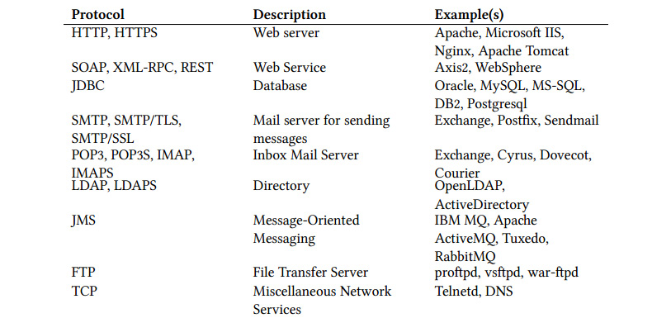
How does Azure Load Testing work?
Uses Apache JMeter version 5.5 for running load tests.
Supports all communication protocols that JMeter supports.
The application can be hosted anywhere: in Azure, on-premises, or in other clouds.

Slide 7
Key concepts for Azure Load Testing users
Virtual users
  Total virtual users = (virtual users in the JMX file) * (number of test engine instances)
Ramp-up time (amount time to get all users)
Response time
Latency
Requests per second (RPS) - throughput
  RPS = (number of requests) / (total time in seconds)
  Virtual users = (RPS) * (latency in seconds).
Notes:
General concepts of load testing
Learn about the key concepts related to running load tests.
Virtual users
A virtual user runs a particular test case against your server application and runs independently of other virtual users. You can use multiple virtual users to simulate concurrent connections to your server application.
Apache JMeter also refers to virtual users as threads. In the JMeter test script, a thread group element lets you specify the pool of virtual users. Learn about thread groups in the Apache JMeter documentation.
The total number of virtual users for your load test depends on the number of virtual users in the test script and the number of test engine instances.
The formula is: Total virtual users = (virtual users in the JMX file) * (number of test engine instances).
You can achieve the target number of virtual users by configuring the number of test engine instances, the number of virtual users in the test script, or a combination of both.
Ramp-up time
The ramp-up time is the amount of time to get to the full number of virtual users for the load test. If the number of virtual users is 20, and the ramp-up time is 120 seconds, then it will take 120 seconds to get to all 20 virtual users. Each virtual user will start 6 (120/20) seconds after the previous user was started.
Response time
The response time of an individual request, or elapsed time in JMeter, is the total time from just before sending the request to just after the last response has been received. The response time doesn't include the time to render the response. Any client code, such as JavaScript, isn't processed during the load test.
Latency
The latency of an individual request is the total time from just before sending the request to just after the first response has been received. Latency includes all the processing needed to assemble the request and assembling the first part of the response.
Requests per second (RPS)
Requests per second (RPS), or throughput, is the total number of requests to the server application that your load test generates per second.
The formula is: RPS = (number of requests) / (total time in seconds).
The time is calculated from the start of the first sample to the end of the last sample. This time includes any intervals between samples, for example if the test script contains timers.
Another way to calculate the RPS is based on the average application's latency and the number of virtual users. To simulate a specific number of RPS with a load test, given the application's latency, you can then calculate the required number of virtual users.
The formula is: Virtual users = (RPS) * (latency in seconds).
For example, given an application latency of 20 milliseconds (0.02 second), to simulate 100,000 RPS, you should configure the load test with 2,000 virtual users (100,000 * 0.02).

Slide 8
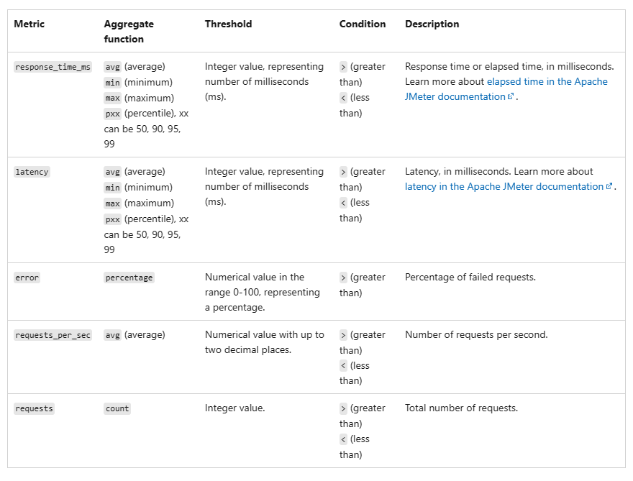
Supported client metrics for fail criteria
Notes:
The format of fail criteria in Azure Load Testing follows that of a conditional statement for a supported metric. For example, ensure that the average number of requests per second is greater than 500.
Fail criteria have the following structure:
Test criteria at the load test level: Aggregate_function (client_metric) condition threshold.
Test criteria applied to specific JMeter requests: Request: Aggregate_function (client_metric) condition threshold.
The following table describes the different components:
ParameterDescriptionClient metricRequired. The client metric on which the condition should be applied.Aggregate functionRequired. The aggregate function to be applied on the client metric.ConditionRequired. The comparison operator, such as greater than, or less than.ThresholdRequired. The numeric value to compare with the client metric.RequestOptional. Name of the sampler in the JMeter script to which the criterion applies. If you don't specify a request name, the criterion applies to the aggregate of all the requests in the script.
Don't include any Personally Identifiable Information (PII) in the sampler name in your JMeter script. The sampler names appear in the Azure Load Testing test run results dashboard.

Slide 9
Demo: Modifying Azure Test and creating Azure Load Test programmatically

Slide 10
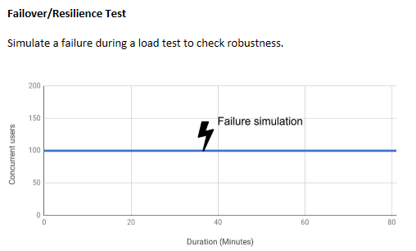
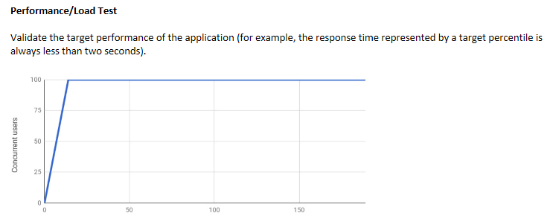
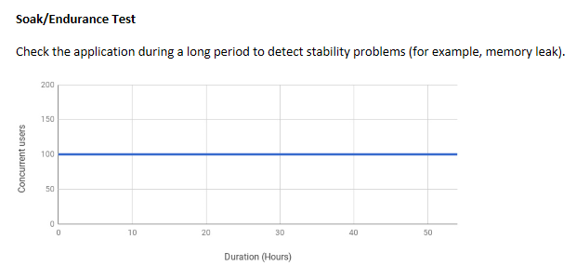
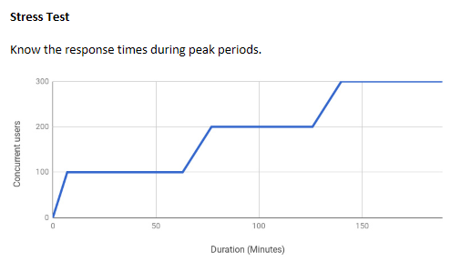
Few types of load tests

Slide 11
Load models
Choosing the correct load model is very important and depends on:
  What we want to test (the type of application and so on)
  The goal of the test (comparison between two versions and so on)
Closed Model – only a given number of users
Open Model – keep the flow of users
  Throughput model (number of transactions)
  Arrivals late (maintaining the arrival rate of virtual users)
Notes:
Closed model
There are only a given number of users in our system, and a new user cannot enter the system before the end of another one. This model is used in some ticketing websites to limit the number of concurrent users. The limit is made to prevent the website from crashing and customers from going to a competitor's site to buy their tickets. This model is also used in call center applications because the number of concurrent calls is limited by the number of operators. This model can be used in closed user groups (groups of employees in an intranet, private forums...) where we know the maximum number of users. In this case, we will simulate the maximum number of possible users. In this model, each VU depends on the previous user, so users are not independent of one another. So, if the System Under Test (SUT) slows down, the injector will stop creating new VUs.
Thread Group
Jmeter plugin Concurrency Thread Group
Jmeter Ultimate Thread Group
Open model
Whatever happens on the tested system, the injector keeps the flow of the arrival of VUs.
This model is used in most e-commerce websites. In this case, the virtual users are independent of each other, and if the SUT slows down, the injector will continue to create new virtual users.
Throughput model - number of transactions
Constant Throughput Timer
Precise Throughput Timer
Jmeter ThroughputShapingTimer
Arrivals late - maintaining the arrival rate of VU
To simulate an unhappy customer who abandons their navigation because of very slow response times, we can use:
Duration Assertion, which can be added to Thread Group to apply to all requests in our script
In the Advanced -> Timeout (milliseconds) -> Connect + Response option of HTTP Request
Jmeter Arrivals Thread Group
Jmeter free-form arrivals thread group

Slide 12
Demo: Load test examples
Notes:
Open jmeter and create tests

Slide 13
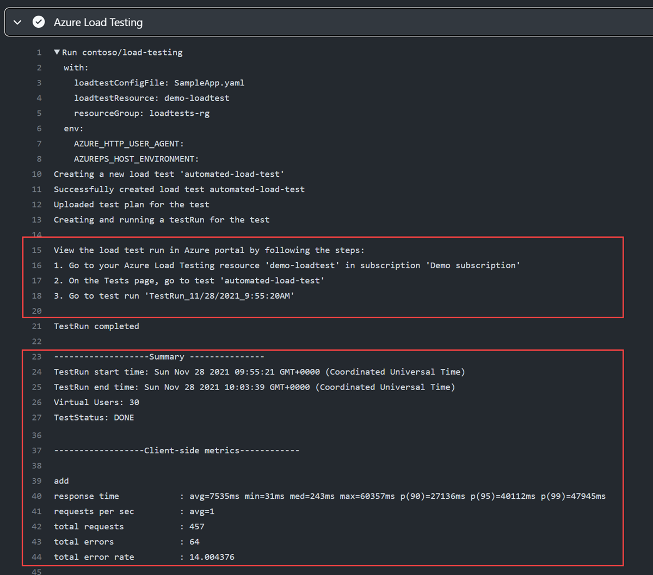
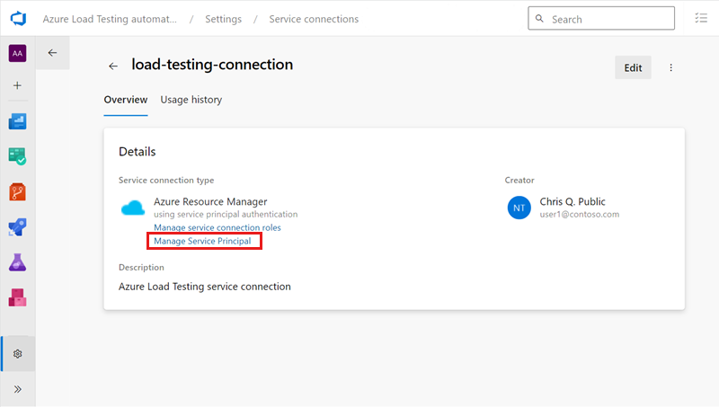
Integration with DevOps processes
DevOps / Github built-in actions / pipeline execution integration
Notes:
Tutorial: Automate regression tests with CI/CD - Azure Load Testing | Microsoft Learn

Slide 14
Demo: Integration with Azure DevOps

Slide 15

Additional information
Link collection about Azure Load Testing
Virtual user calculator
Configure for high scale load
jMeter DSL Azure Load testing

Slide 16
This is not school, but we
love to get grades.
Please fill out our
questoineers and leave
us your feedback.
You may even win some
cool rewards.

