Slide 1

// About Infobip
9,700+
Global Connections
40+
Data Centers
Vodnjan is the birthplace of our founders. It’s a small town, but for them, it’s the centre of their universe. Together, they started their story from a garage and created a business which transformed Vodnjan from a small town into a go-to destination for developers from across the world. And scaled Infobip to 75+ countries and connecting people across 6 continents.
38 bn+
Monthly messaging Interactions
10k+
Large Business Customers
Our vision
One Platform. All Channels. For developers and business alike.
Our mission:
To democratize the future of digital interactions between business and people by creating breakthrough innovations.

Slide 2
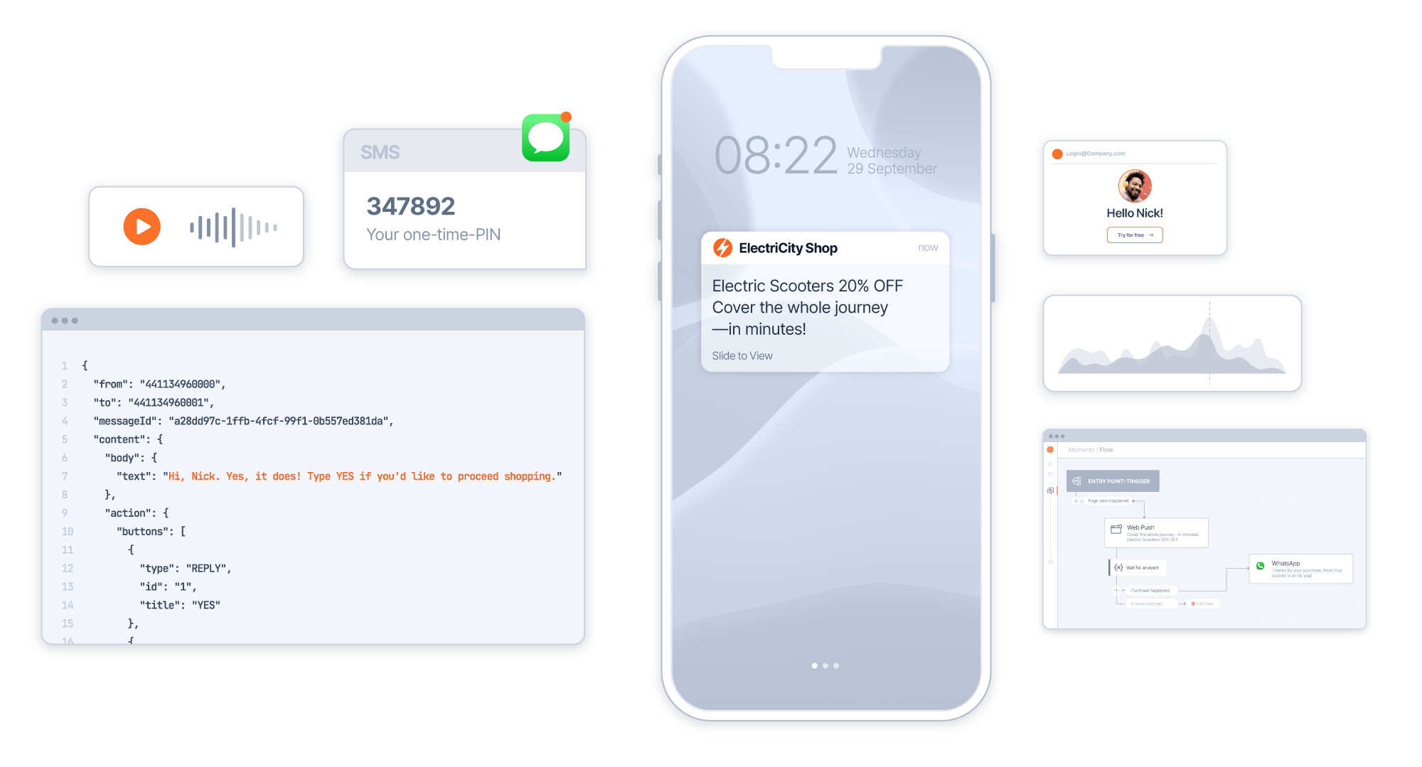
The one communications platform, for every business
Notes:
Platform/business

Slide 3
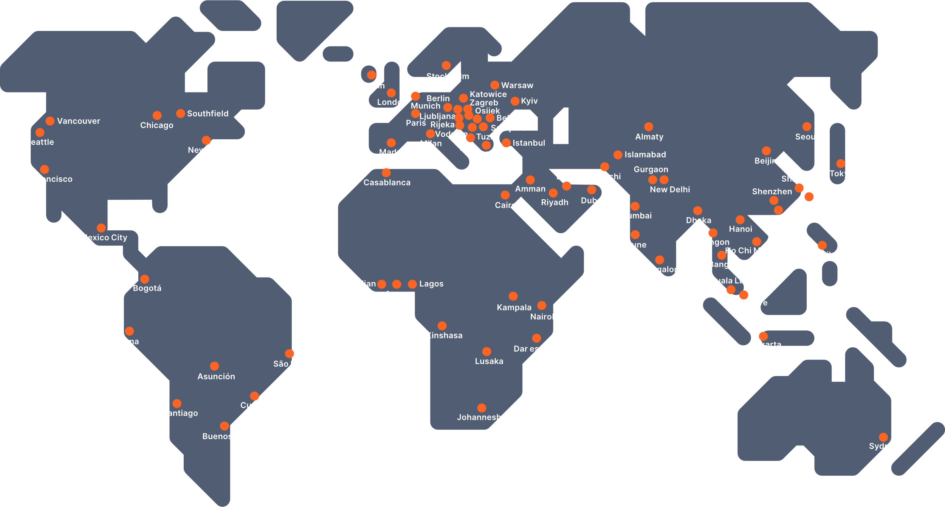















...is built for massive scale - #1 Globally
ONE PLATFORM. ALL CHANNELS. FOR DEVELOPERS AND BUSINESSES ALIKE.
GLOBAL FOOTPRINT
STELLAR GLOBAL CLIENT BASE
50+
Integration Partners
75+
Offices on 6 continents
3.3k+
Employees globally
40+
Data Centers globally
800+
Direct operator connections
14.5k+
Average interactions per second
80k+
Black Friday record
2.36 Bn+
Interactions in one day on Black Friday
Extensive Marketplace
Global reach >190 countries
Global presence, local reach
Scalable infrastructure
Largest global MNO network
Infrastructure to handle vast volume
Transactions per Second.
#wearejuststarting

Slide 4


Objectives
Simplify BI as self-service
HW limits + Reducing data processing time
Improve data-to-decision time with conversational analytics
Democratization of data and analytics for internal stakeholders
Reduce number of data transfers
Optimize on-premise hardware utilization
Ability to utilize AI for simple on-the-go data queries

Slide 5
Outcomes with Fabric
PowerQuery + shortcuts
DirectLake connectivity
Copilot
Power BI interface
Analyse model in Excel
DataFlow Gen 2 (familiar PowerQuery interface backed by Apache Spark)
OneLake Explorer experience
Zero data movement between DWH and BI software
Data readily available at any moment; no need for daily loads
Everything in cloud; no hardware administration
Strong AI product roadmap
Bonus: AI-powered development

