Slide 1
Azure App Service
Web App for Containers
Admir Tuzović
@woisttuza

Slide 2




About me
Chief Technology Officer
Author
Former Tech Evangelist

Slide 3
Agenda
Short introduction to containers and Docker
Overview of Azure offerings for containers
App Service architecture
Deployment options

Slide 4
Expectations (Level 300)
ASP.NET / ASP.NET Core elementary proficiency
Some experience with Microsoft Azure platform
Basic understanding of containers is helpful

Slide 5
Why Containers?
Deployment of runtime and dependencies with app
  Same environment expectations
  Platform limitations override
Better performance (deploy only what you need)
Faster delivery to customers

Slide 6
What is Docker?
Open source platform for containers
Secure, trusted by leading enterprises
Supported natively by Windows and Linux servers
Clients for Windows and Mac

Slide 7
Docker Image vs Docker Container
Image = template, containing multiple layers
Thin R/W layer
Container layers (R/W)
ubuntu: 15.04
54bd78ae9312
784eab9h521a
Image layers (RO)
f2h1aacb8d331
Container = executing instance created from image

Slide 8
Traditional hosting with app isolation
Physical Server (Host OS)
Hypervisor
VM 1
VM 1
VM 1
Windows OS
Linux
Windows OS
App 1
App 2
App 3

Slide 9
Docker-based hosting with app isolation
Physical Server (Host OS)
Hypervisor
VM 1
VM 1
VM 1
Windows OS
Linux
Windows OS
Docker Engine
Docker Engine
Docker Engine
App 1
App 2
App 5
App 6
App 9
App 0
App 3
App 4
App 7
App 8
App I
App J

Slide 10
Docker-based hosting without virtualization
Physical Server (Host OS)
Docker Engine
App 1
App 2
App 5
App 6
App 9
App 0
App 9
App 0
App 3
App 4
App 7
App 8
App I
App J
App I
App J
App 1
App 2
App 5
App 6
App 9
App 0
App 9
App 0
App 3
App 4
App 7
App 8
App I
App J
App I
App J

Slide 11




Containers/Microservices on Azure
Azure App Service
Azure Service Fabric
Azure Container Registry
Azure Container Service

Slide 12

Azure Service Fabric
App1
App2

Slide 13
App Service Plan
App Service Plan (Basic / Standard / Premium / Isolated)
Instance 1
Instance 2
Instance 3
Web App 1
Web App 1
Web App 1
W3WP
W3WP
W3WP
W3WP
W3WP
W3WP
SLOT A
SLOT B
SLOT A
SLOT B
SLOT A
SLOT B
Web App 2
Web App 2
Web App 2
W3WP
W3WP
W3WP
W3WP
W3WP
W3WP
SLOT A
SLOT B
SLOT A
SLOT B
SLOT A
SLOT B

Slide 14
App Service Characteristics
PaaS (Platform-as-a-Service) offering
Fully managed by Microsoft (patches, upgrades, etc.)
Horizontal (scale-out) and Vertical (scale-up) scaling by metrics (automated)
Billed on per-second basis
Integrated CI/CD
Deployment slots for seamless transition to new build

Slide 15


Web App - Flavors
Web App
Windows OS
Bring your source code
.NET Framework 3.5/4.7
PHP 5.6 / 7.0-7.2
Python 2.7/3.4
Java 7/8
Web App
Linux OS
Bring your source code
.NET Core 1.0-1.1/2.0
PHP 5.6/7.0-7.2
Node.js 4.4-9.4
Ruby 2.3
Web App for
Containers
Bring your container
Docker Hub
Azure Container Registry
Private Registry

Slide 16

Continuous deployment with Webhook
Register
/endpoint
ACR
Web App
POST /endpoint
docker push

Slide 17


Continuous delivery with remote builds
Visual Studio Team Services (VSTS)
Build
+
Tests
Release
Management
Commit/push to
version control
Build & Deploy
Write code
ACR
Web App

Slide 18


Get started for free!
Account at www.docker.com (www.docker.io)
Docker client for Windows OS (Community Edition, latest 18.03.0-ce-win59 (16762).
Microsoft Azure Subscription (check out VSTS Dev Essentials)
Visual Studio 2017 (Community, latest 15.6.6)

Slide 19
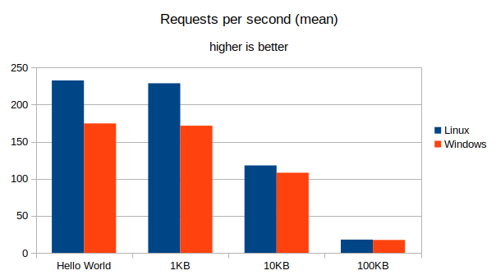
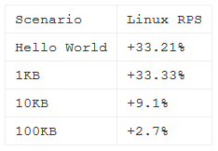
Windows vs Linux performance
https://robertoprevato.github.io/Comparing-Linux-hosted-to-Windows-hosted-ASP-NET-Core-applications-in-Azure-Application-Service-Plan/

Slide 20
docker.com Pricing
Plan | Price | Private Repos
Free | $0 USD / month | 0
Micro | $7 USD / month | 5
Small | $12 USD / month | 10
Medium | $22 USD / month | 20
Large | $50 USD / month | 50
XLarge | $100 USD / month | 100
XX-Large | $250 USD / month | 250
XXX-Large | $500 USD / month | 500

Slide 21
Azure Container Registry Pricing
Tier | Storage | Web hooks | Price / day | Price / month
Basic | 10 GiB | 2 | $0.167 USD | $5 USD
Standard | 100 GiB | 10 | $0.667 USD | $20 USD
Premium | 500 GiB | 100 | $1.667 USD | $50 USD
Additional storage per GiB, only Standard and Premium Tier: $0.003 USD / day

Slide 22
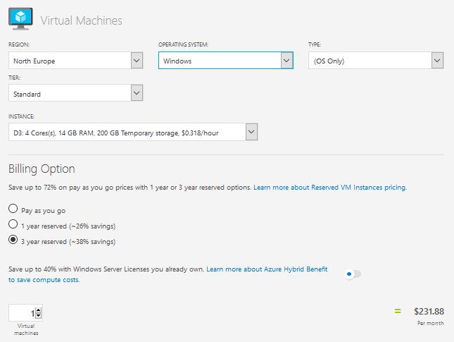
Windows vs Linux pricing – Windows VM

Slide 23
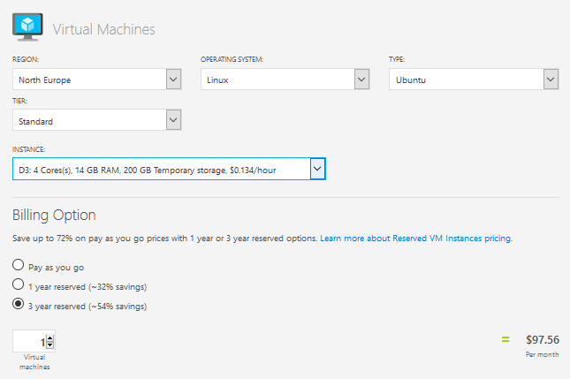
Windows vs Linux pricing – Linux VM

Slide 24
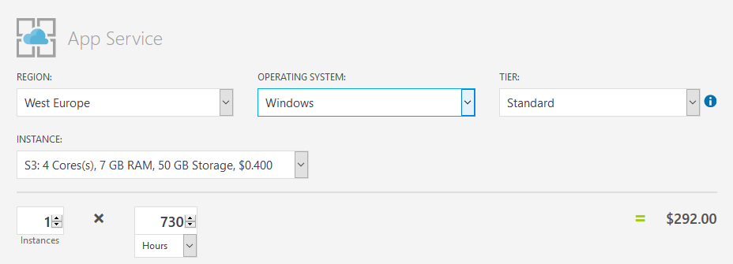
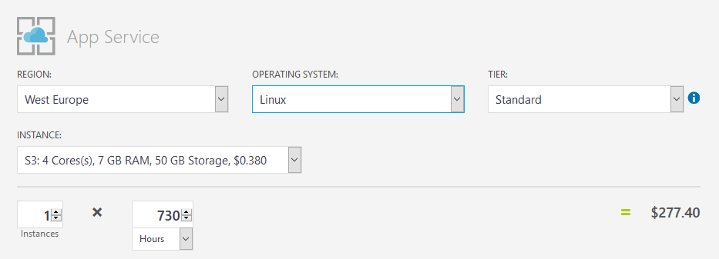
Windows vs Linux pricing – App Service
5% discount on
Linux instances

Slide 25
Thank you!

