Slide 2
Digitaly enabled
Healthcare services
Matija Klasinc dr. med.
Healthcare ICT consultant, Parsek d.o.o.

Slide 3


Slide 4


Slide 5


Slide 6


Slide 7


Slide 8

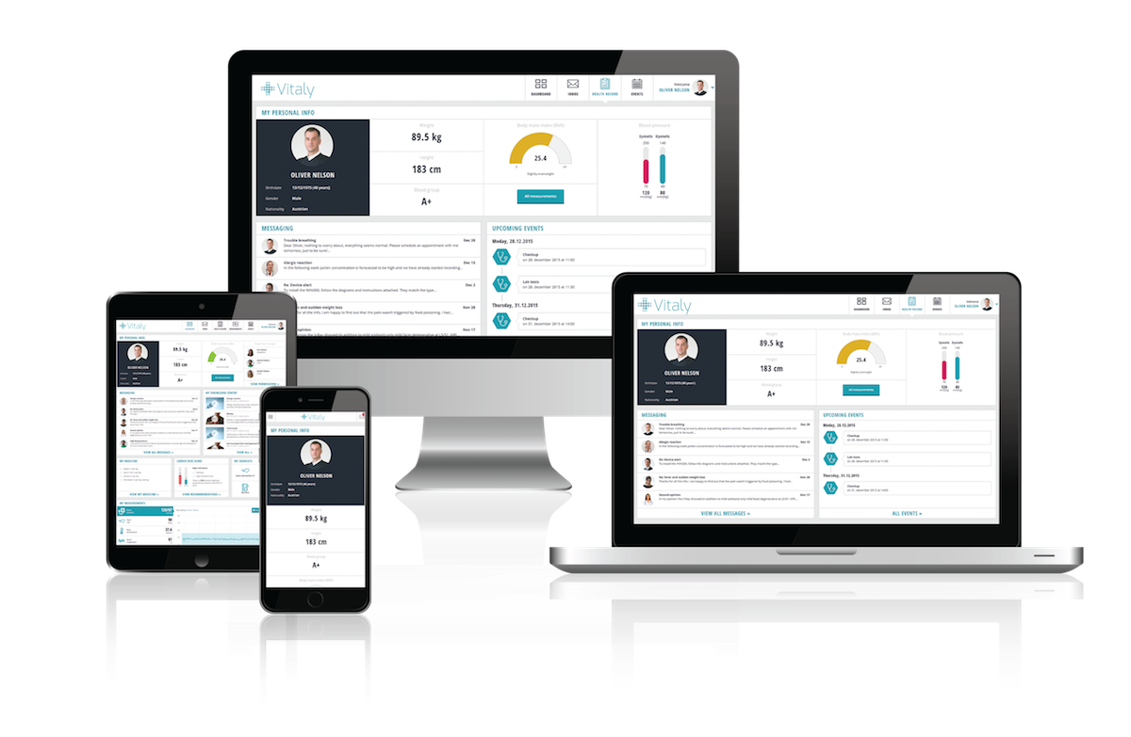

Slide 9


Slide 10


Slide 11
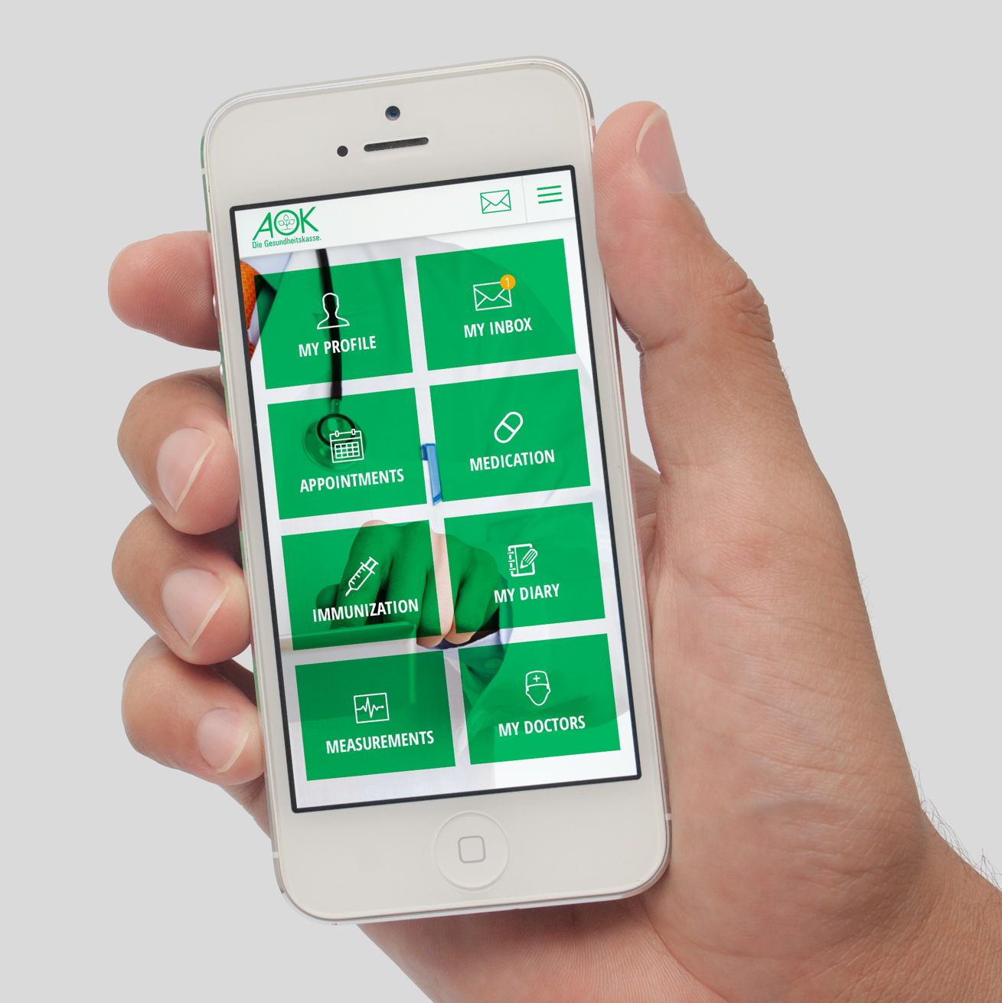
AOK – German insurance company

Slide 12

AI Care – Senior care platform

Slide 13
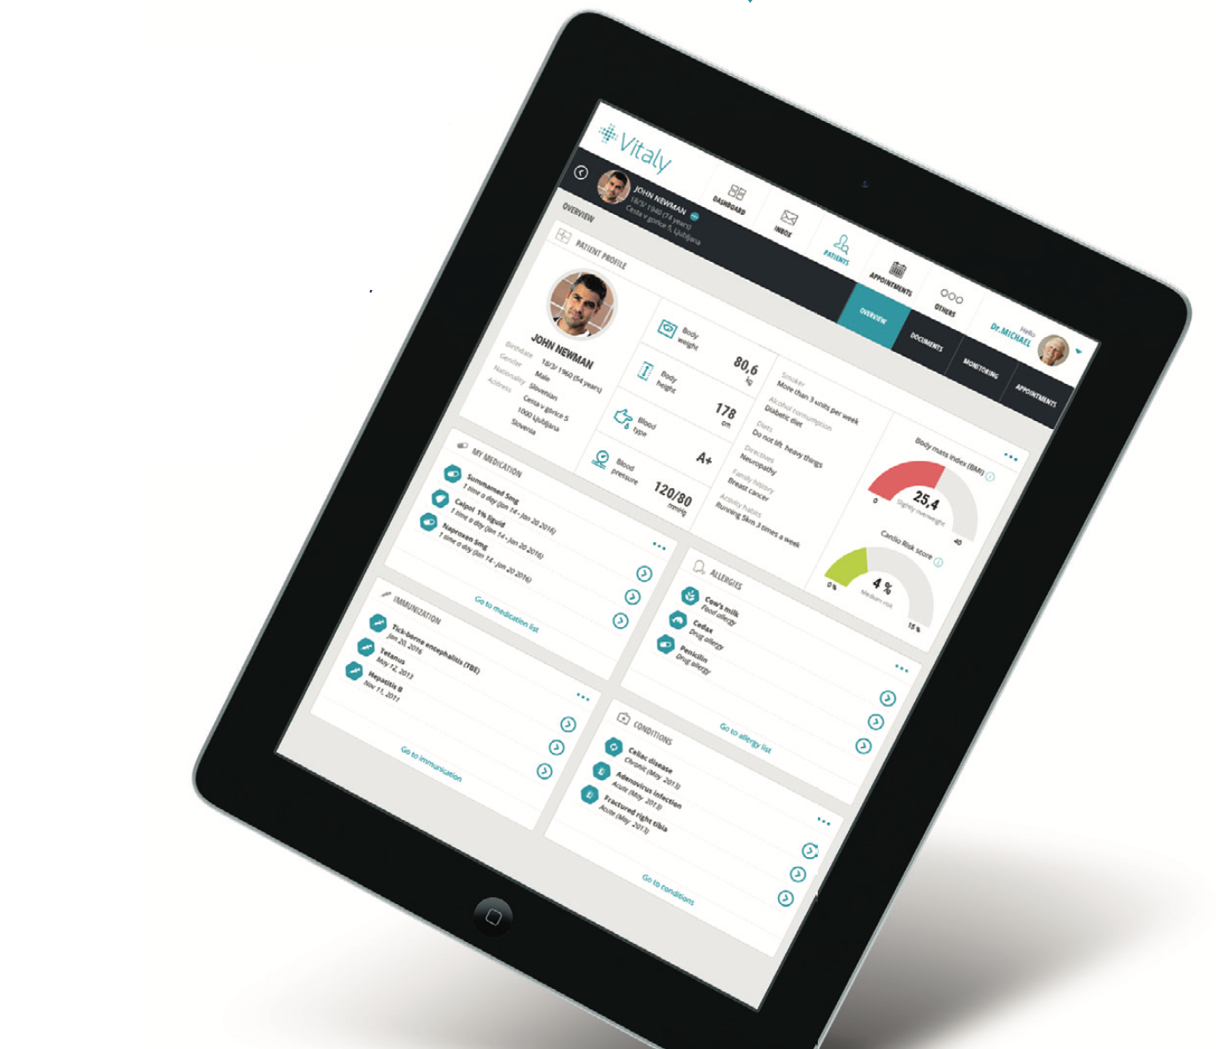
Personal profile

Slide 14
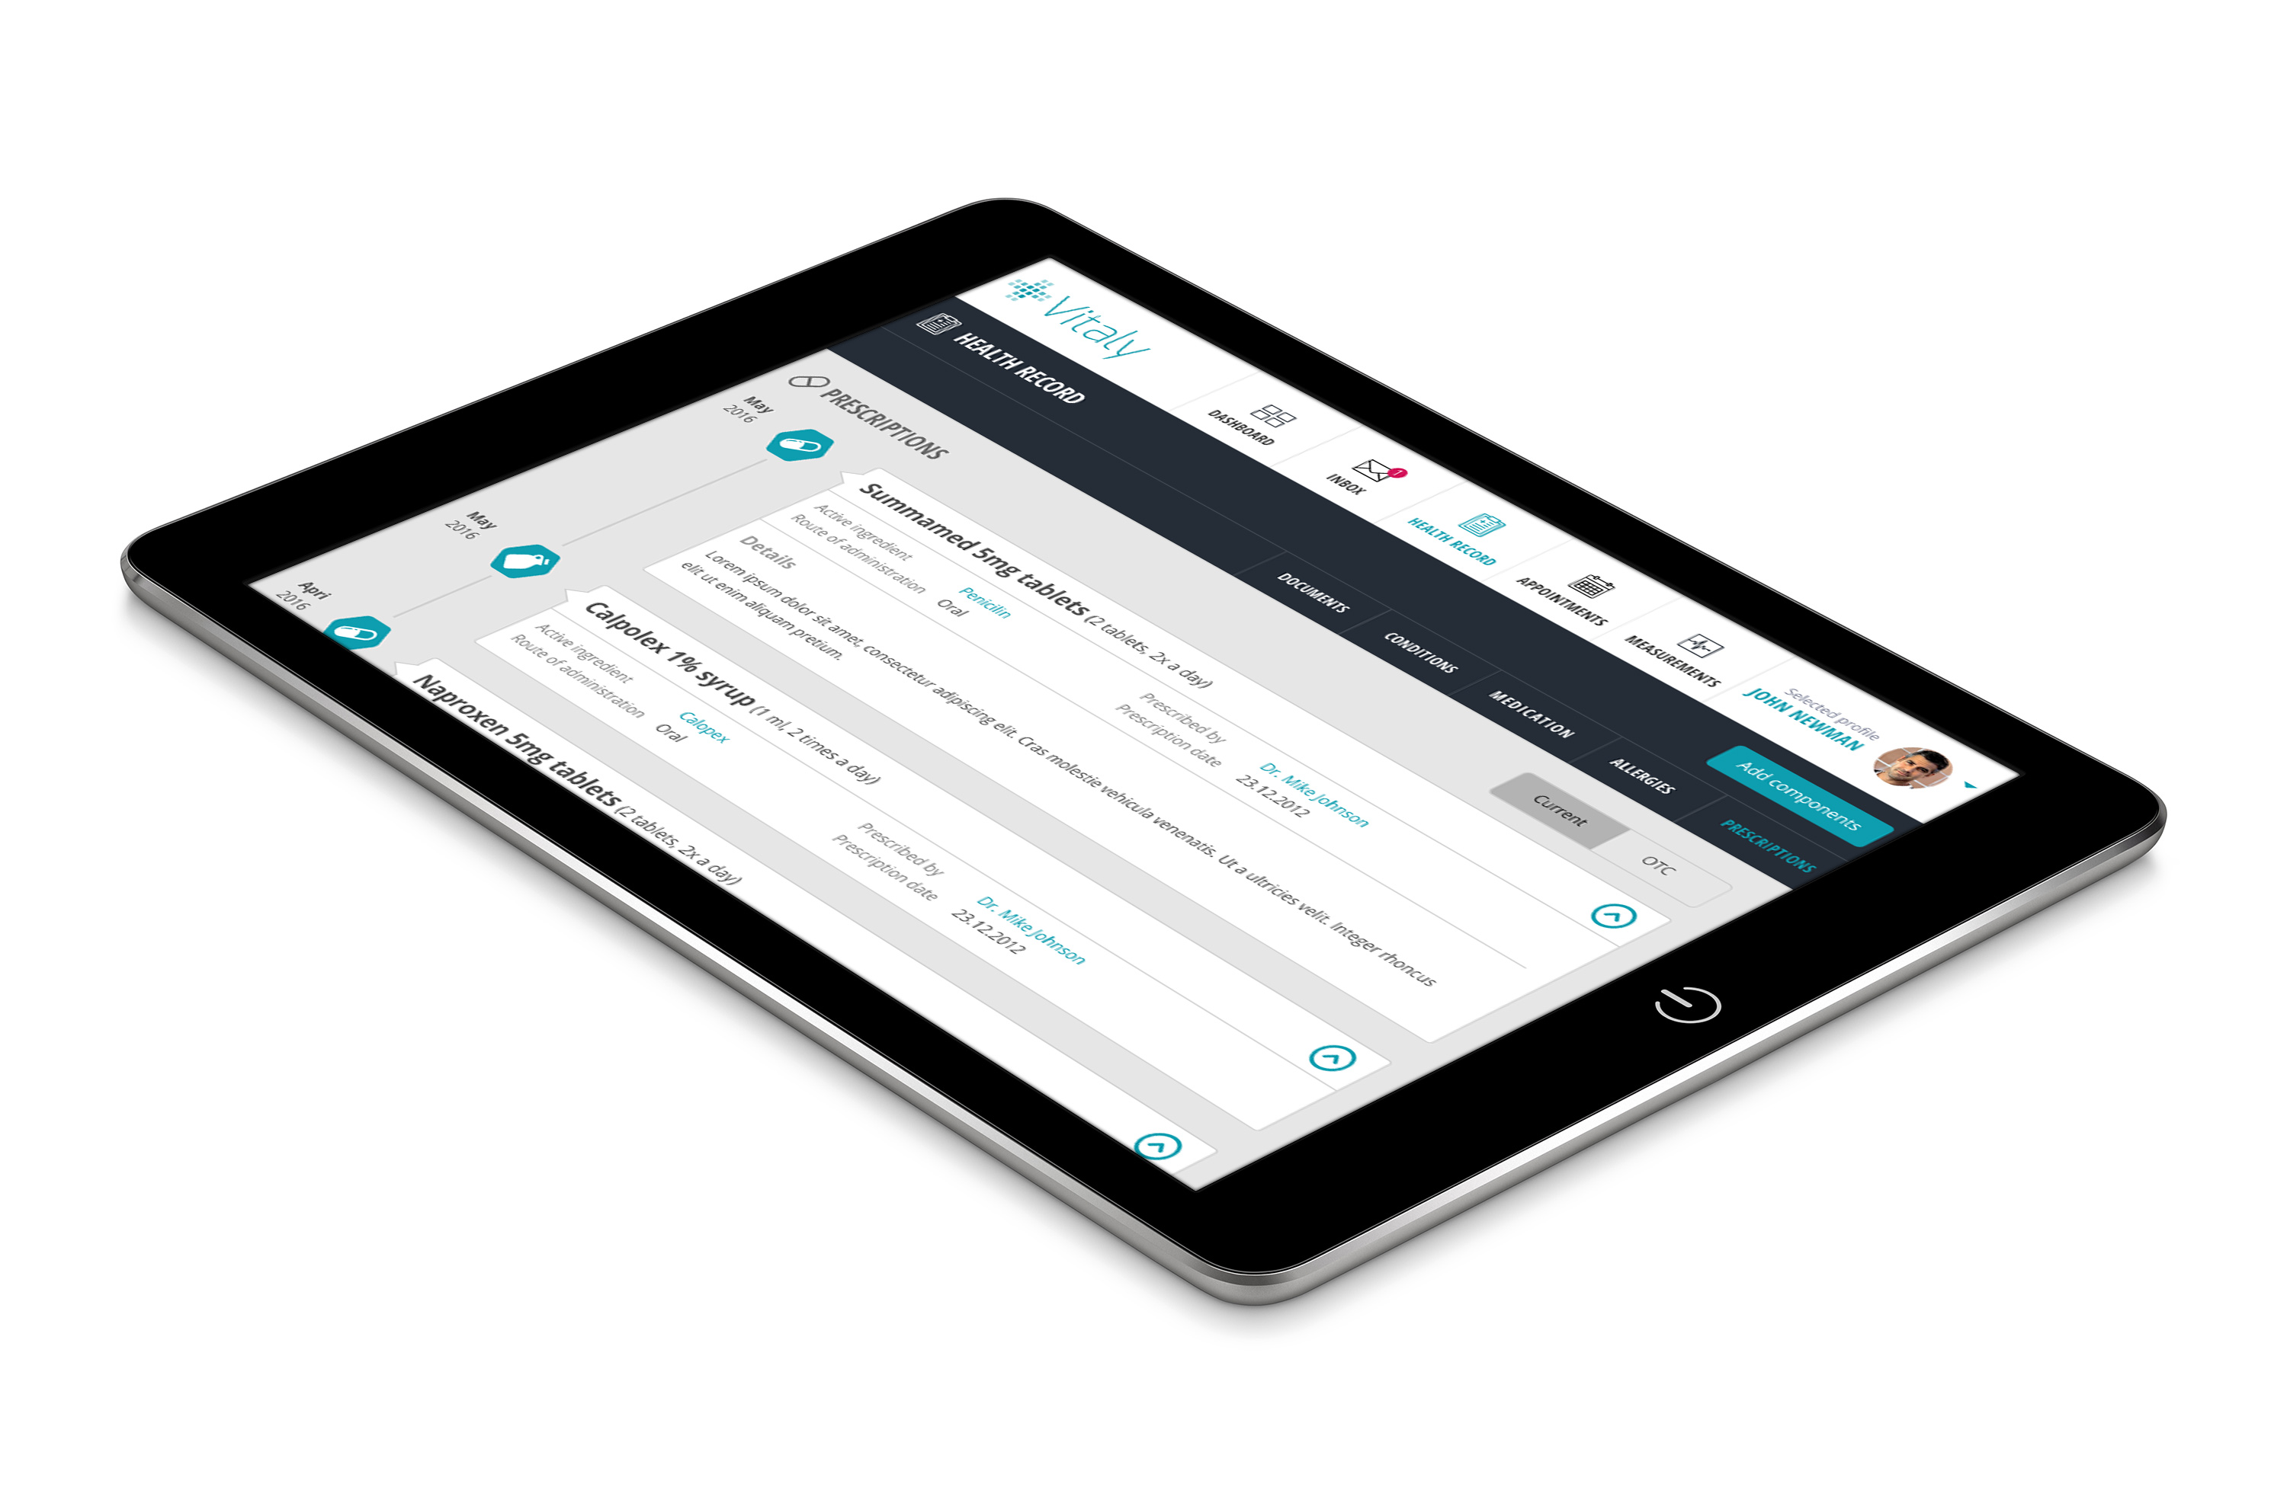
E-Prescription

Slide 15
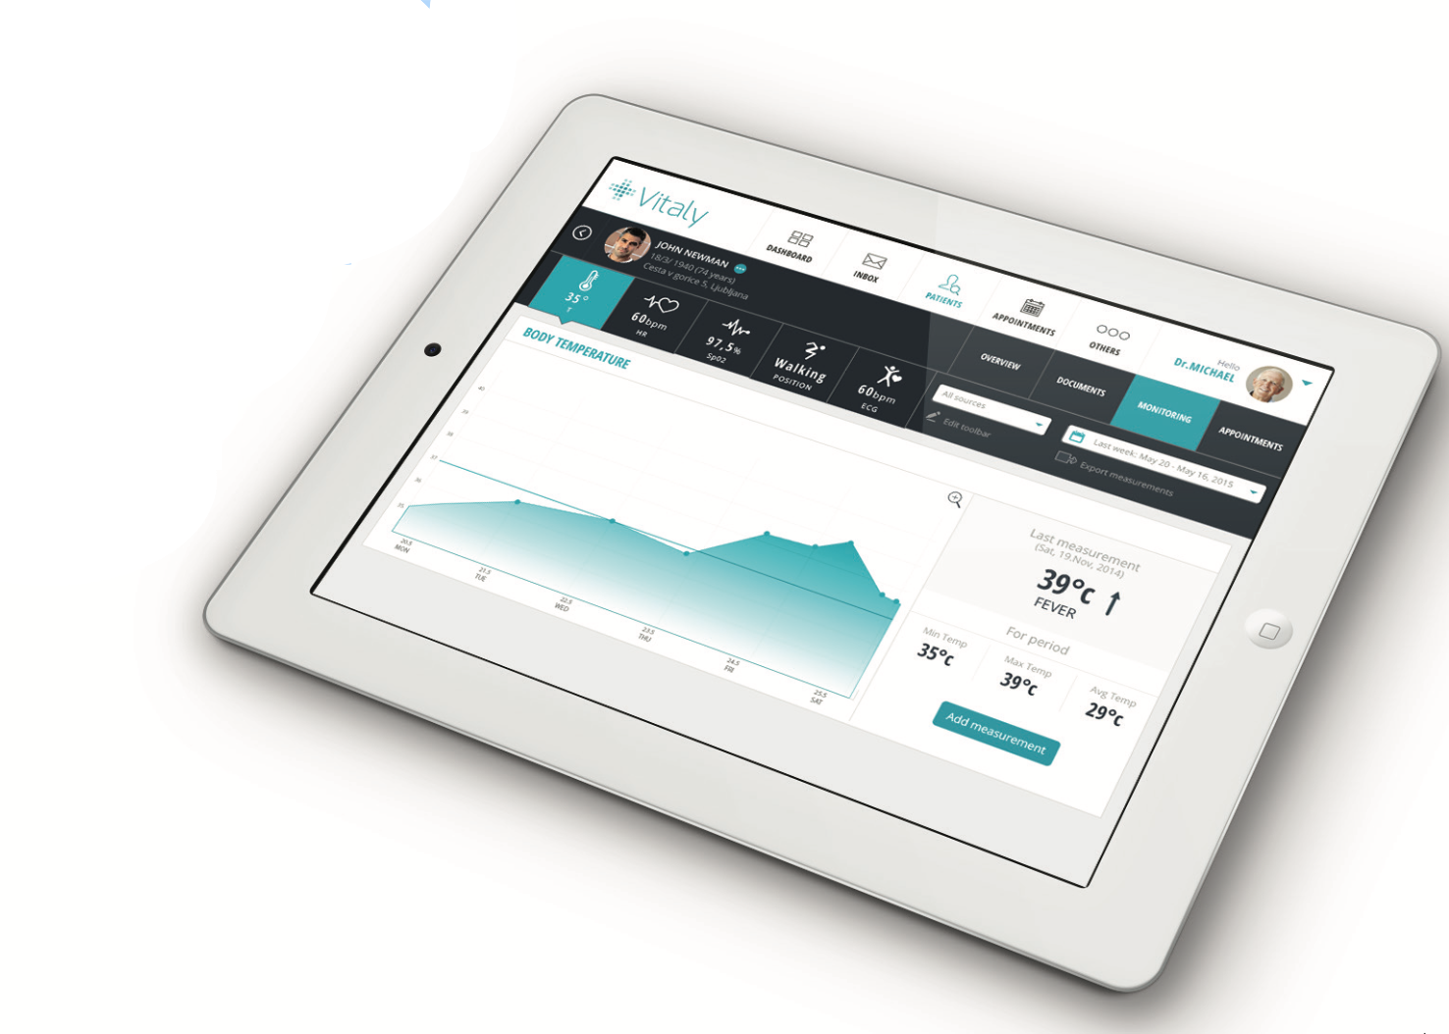
Remote patient monitoring

Slide 16

Remote patient monitoring
(TrekStor)

Slide 17
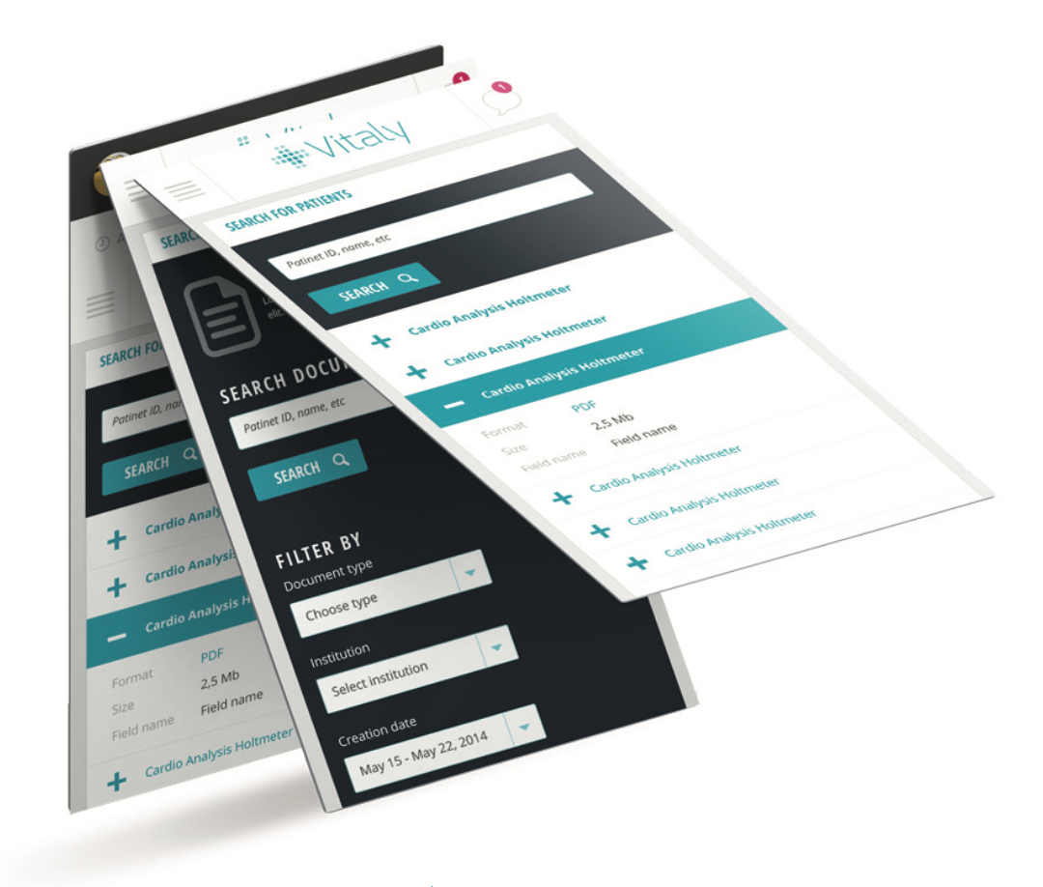
Patient record

Slide 18
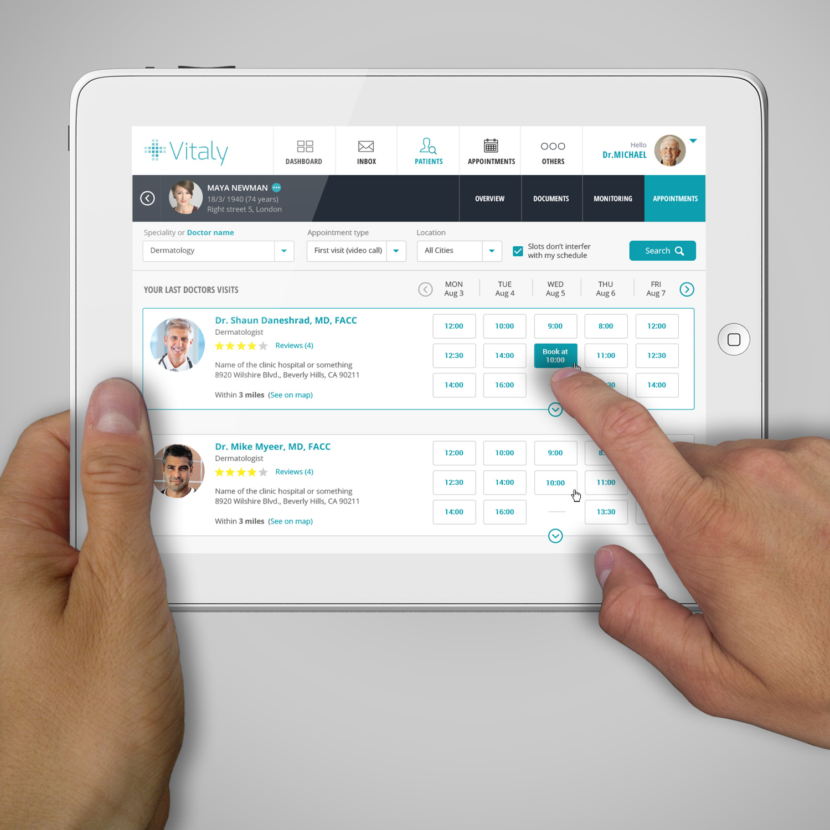
Appointments

Slide 19
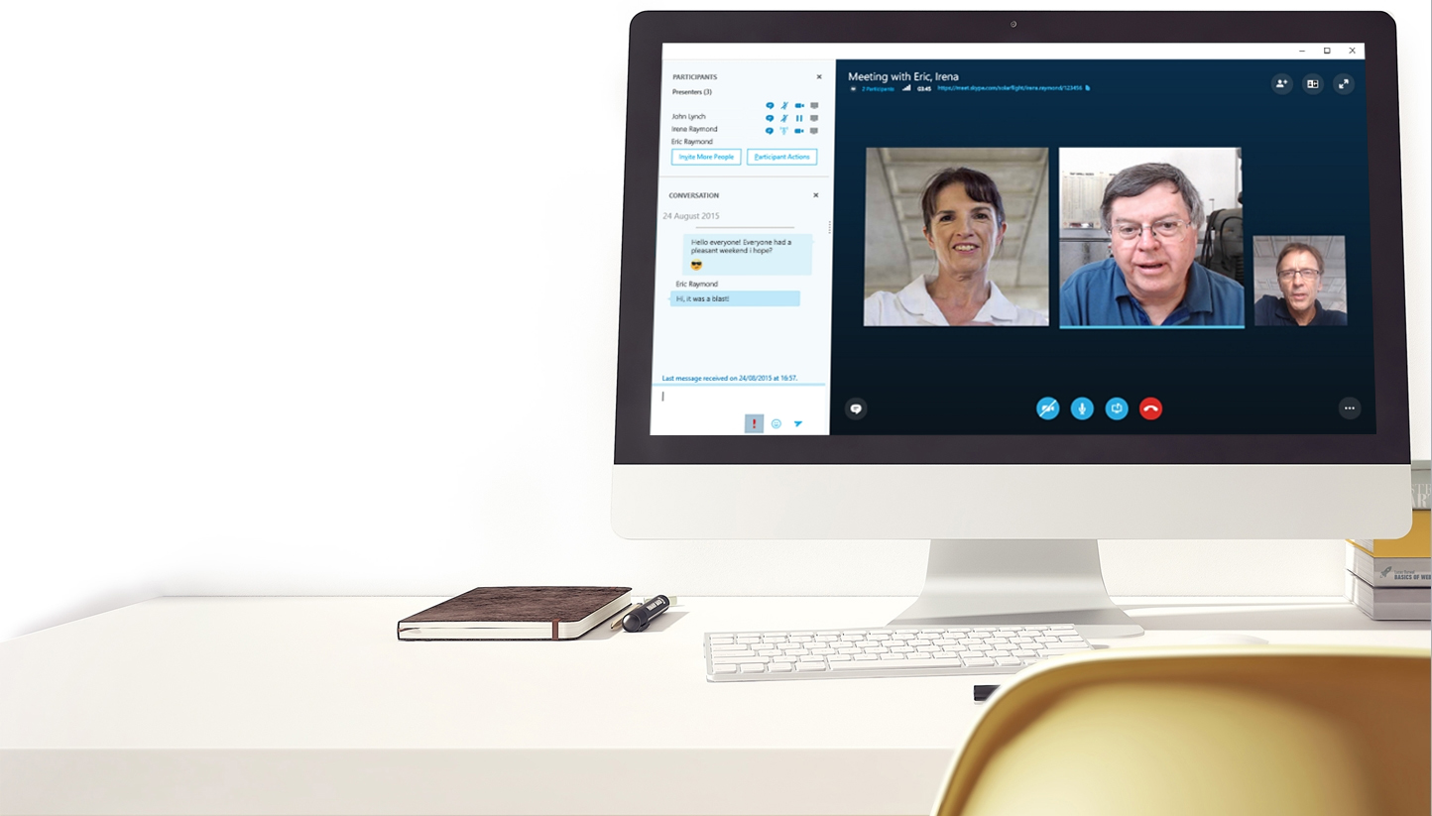
Video communication

Slide 21
Digitaly enabled
Healthcare services
Matej Železnik
vodja DevOps, Parsek d.o.o.

Slide 22
The road to here

Slide 23


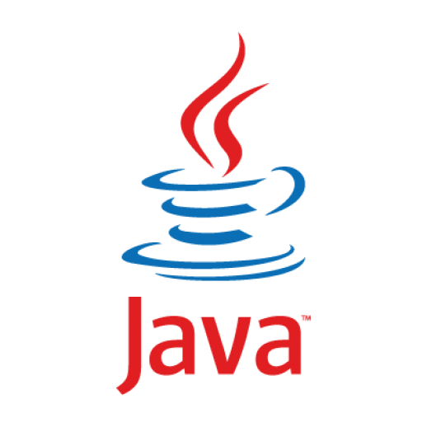
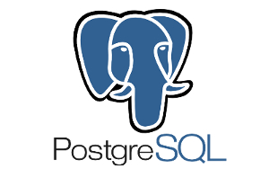
Using open source software
Notes:
OSS: Java company for more than 15 years, multiple OSS partnerships and many experts.

Slide 24
Traditionally conservative domain w/ high emphasis on security and privacy
Notes:
Matija has shown you what are the common issues a healthcare service consumer faces today and how Vitaly Health Platform solves that problem. I will now go into a little bit more detail about how Vitaly Health portal came to be and how our processes changed along the way.

Slide 25
Most systems are on premises and not interoperable
Started with interoperability (Parsek Health Service Bus)

Slide 26



Standards for interoperability

Slide 27
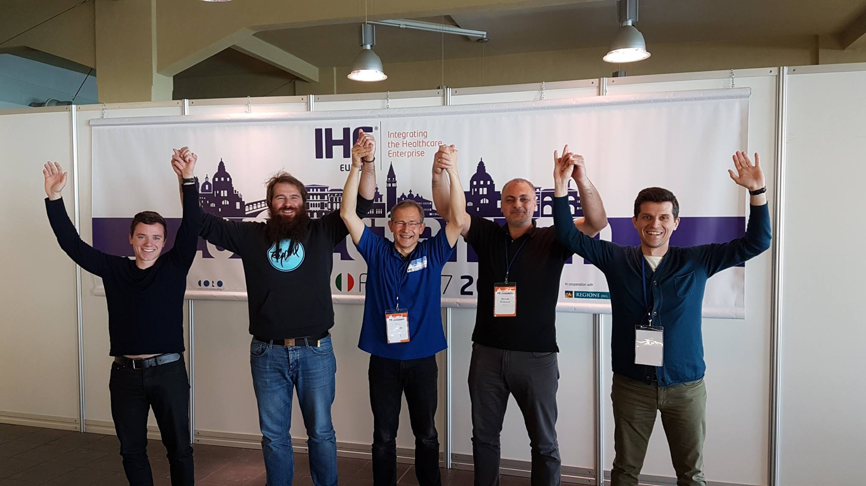
Rocking Connectathon
(3. – 7. 4., Venice)
Notes:
HL7, IHE, FHIR ... – Have several successfull Connectathon events behind us

Slide 28
Vitaly Health Platform

Slide 29
Connecting systems is not enough, users must be added to the equation
Birth of Vitaly Health Platform – natural extension of healthcare middleware.
Notes:
Middleware
Parsek has a long and rich background in blending complex systems and integrations with excellent user experience. UX draws users and sells solutions.

Slide 30
The solution becomes complex

Slide 31
Multi tier solution with highly modular architecture
High Availability by design, individual tiers are independently scalable
Notes:
Each tier adaptable to actual usage parameters – embedded monitoring system provides quick feedback for adapting resources and architecture.

Slide 32
Minimum standalone HA setup comprised of 15 virtual servers
Multiple dev/test/stage environments, separate environments for demos/marketing
Manual maintenance becomes „practically“ impossible
Notes:
Not quite „micro“ but definitely services.
Each tier adaptable to actual usage parameters – embedded monitoring system provides quick feedback for adapting resources and architecture.

Slide 33
DevOps to the rescue

Slide 34

Automatization and configuration management
Copyright by Jorge R Canedo Estrada
Notes:
Repeatability, automatization.
Ansible works on the push principle – the management server needs SSH access to target servers, which run ansible commands.
Since version 1.7, Ansible can also manage Windows machines – in this case, utilizing PowerShell instead of SSH.
Ansible has been acquired by RedHat in 2015, among other things, they provide Ansible Tower a controlling hub for ansible automation. While Ansible is open source, Ansible Tower is a commercial product.
Methods can be integrated with many tools used by the development team.
Jenkins, Slack, JIRA, Sonar..
Experimented with ChatOps, but chose Semaphore in the end. Ansible can be run directly, Semaphore provides a GUI and access control/user management. It also exposes a REST API, which can be used for instance, from Jenkins.

Slide 35
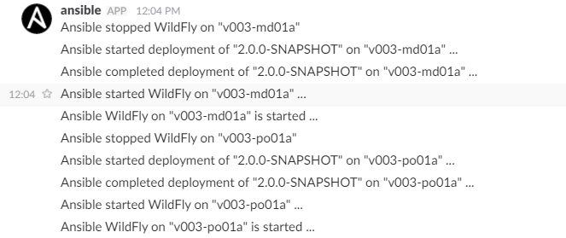
Ansible is a configuration management tool comparable to Chef, Puppet, Salt
Notes:
Repeatability, automatization.
Ansible works on the push principle – the management server needs SSH access to target servers, which run ansible commands.
Since version 1.7, Ansible can also manage Windows machines – in this case, utilizing PowerShell instead of SSH.
Ansible has been acquired by RedHat in 2015, among other things, they provide Ansible Tower a controlling hub for ansible automation. While Ansible is open source, Ansible Tower is a commercial product.
Methods can be integrated with many tools used by the development team.
Jenkins, Slack, JIRA, Sonar..
Experimented with ChatOps, but chose Semaphore in the end. Ansible can be run directly, Semaphore provides a GUI and access control/user management. It also exposes a REST API, which can be used for instance, from Jenkins.

Slide 36
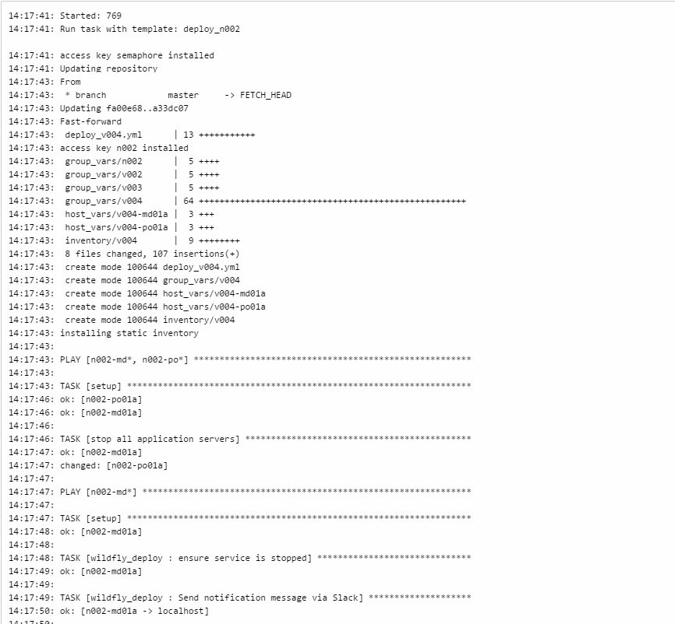
VMs are provisioned manually, configuration and deployment are automated using Ansible
Notes:
Repeatability, automatization.
Ansible works on the push principle – the management server needs SSH access to target servers, which run ansible commands.
Since version 1.7, Ansible can also manage Windows machines – in this case, utilizing PowerShell instead of SSH.
Ansible has been acquired by RedHat in 2015, among other things, they provide Ansible Tower a controlling hub for ansible automation. While Ansible is open source, Ansible Tower is a commercial product.
Methods can be integrated with many tools used by the development team.
Jenkins, Slack, JIRA, Sonar..
Experimented with ChatOps, but chose Semaphore in the end. Ansible can be run directly, Semaphore provides a GUI and access control/user management. It also exposes a REST API, which can be used for instance, from Jenkins.

Slide 37
Tasks can be run from a central location
As easy as clicking a button – literal „one-click“* deploy
Notes:
Not always so simple, infrastructure changes require additional tasks, no point in fully automating as they are rare events.
Recent discussion on a local technical slack group – one click deploy, multi stage complex, debugging live on production
On site support can be trained to handle most upgrades autonomously.

Slide 38
At this point, still mostly based on „classic“ virtualization. Clients have existing infrastructure that must be utilized
Notes:
Repeatability, automatization.
Ansible works on the push principle – the management server needs SSH access to target servers, which run ansible commands.
Since version 1.7, Ansible can also manage Windows machines – in this case, utilizing PowerShell instead of SSH.
Ansible has been acquired by RedHat in 2015, among other things, they provide Ansible Tower a controlling hub for ansible automation. While Ansible is open source, Ansible Tower is a commercial product.
Methods can be integrated with many tools used by the development team.
Jenkins, Slack, JIRA, Sonar..
Experimented with ChatOps, but chose Semaphore in the end. Ansible can be run directly, Semaphore provides a GUI and access control/user management. It also exposes a REST API, which can be used for instance, from Jenkins.

Slide 39
Starting to look at Terraform for infrastructure configuration
Infrastructure as Code – segment your configurations and reuse components
Notes:
Terraform is a configuration management tool by HashiCorp, used to describe states of entire infrastructures or even data centres. It is declarative, meaning that te configuration describes a state, which the Terraform provider must achieve. Each subsequent run of a Terraform „plan“ will check the destination state. If it matches the configuration, nothing will change, if there are changes, it will execute them.
HashiCorp is also behind Vagrant, a very well known CM tool, primarily used to configure single virtual servers (mostly for dev environments).
Ansible is more suitable for some types of tasks – in our case anything on the already created infrastucture – most commonly for deploying (rolling deploy)

Slide 40
First cloud installation – we use Terraform to automate entire infrastructure
Notes:
A proof of concept, at the time using AWS.

Slide 41
All the configuration is versioned within GitLab. Modifiying it is simple (for instance, adding resources, adding nodes)
Notes:
Terraform is a configuration management tool by HashiCorp, used to describe states of entire infrastructures or even data centres. It is declarative, meaning that te configuration describes a state, which the Terraform provider must achieve. Each subsequent run of a Terraform „plan“ will check the destination state. If it matches the configuration, nothing will change, if there are changes, it will execute them.
HashiCorp is also behind Vagrant, a very well known CM tool, primarily used to configure single virtual servers (mostly for dev environments).
Ansible is more suitable for some types of tasks – in our case anything on the already created infrastucture – most commonly for deploying (rolling deploy)

Slide 42

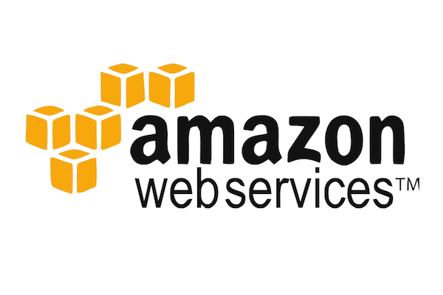

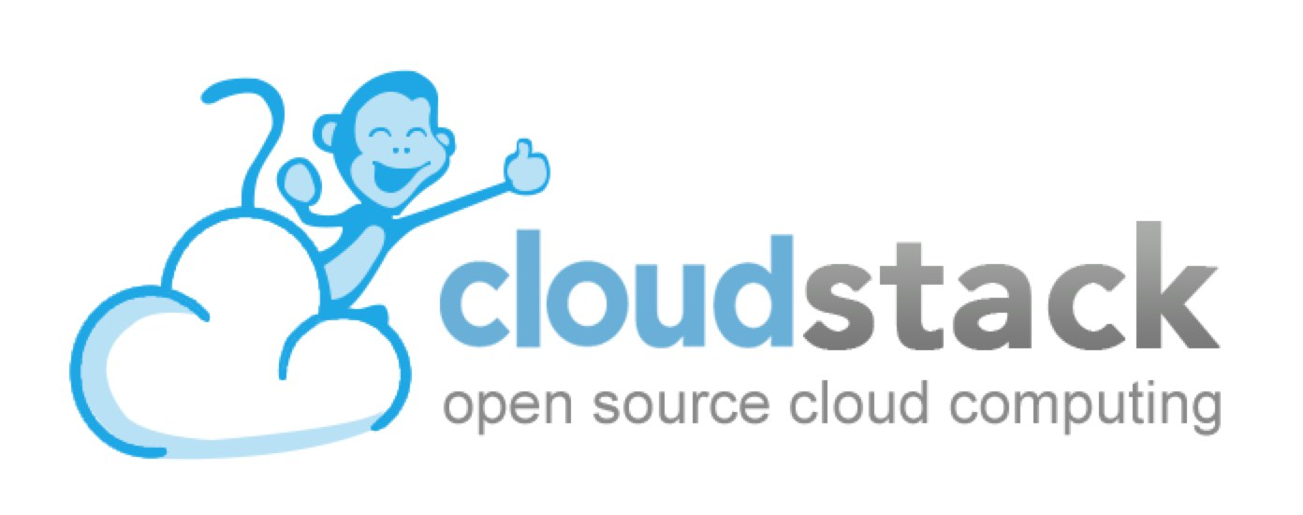
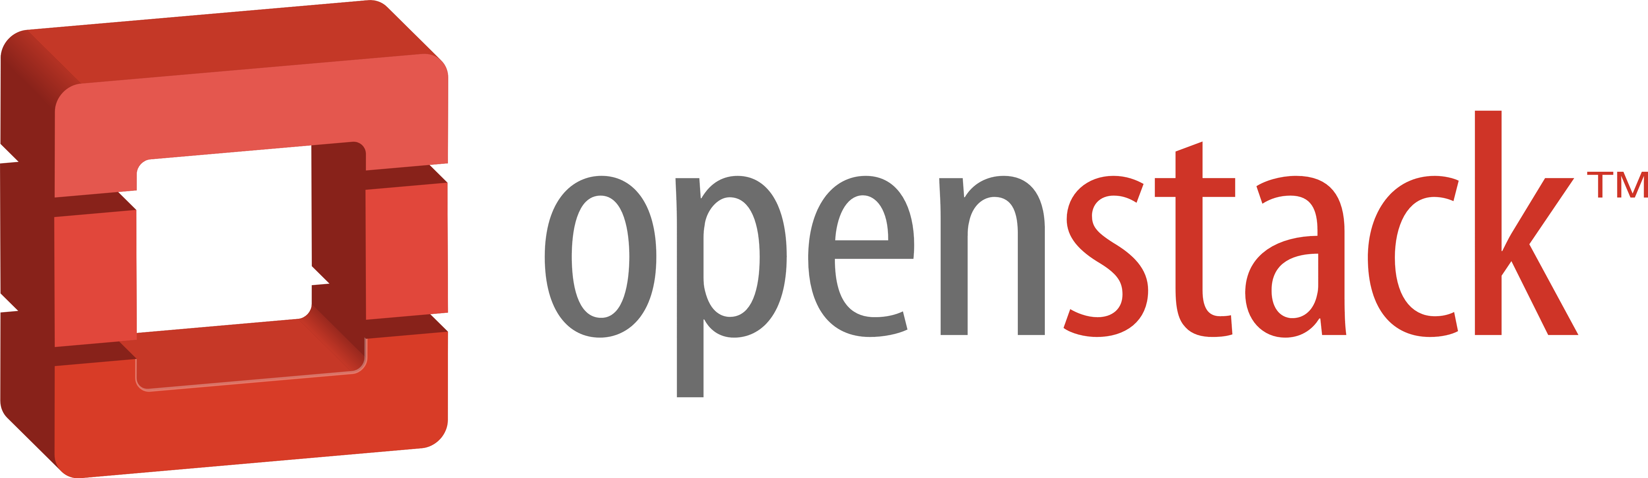

Terraform providers (components which communicate with IaaS, PaaS or SaaS APIs) exist for a number of different platforms

Slide 43
Deploying to the cloud

Slide 44
From the point of view of DevOps, automation is in most cases simpler. Most providers offer very well defined and powerful APIs, which enable all actions possible with the infrastructure
Notes:
For most platforms with provisioning API‘s, all that is required prior to start of deployment are account credentials. The plans will instance servers, install and configure software services, configure network interfaces and firewalls and deploy applications.

Slide 45
Working from an existing infrastructure plan and deployment plan, we prepared a working plan and deployed to Azure within one day
Notes:
The infrastructure was built using blank Linux VMs, which were then configured according to the plans. Deployment afterwards is handled by Ansible.

Slide 46
Vitaly Health Platform has a middleware layer, which connects to various external services (hospital information systems, e-prescription systems, terminology servers, video collaboration systems...). All these connections require additional network configuration (access control lists, secure tunnels...), which is all contained within the infrastructure configuration
Notes:
VHP can also utilize several platform services if available – these are provisioned the same as the rest of the infrastructure – from the configuration plans, via the API
Some components are interchangeable with services provided by PaaS or SaaS providers, such as load balancing, Elastic search cloud etc. In case these are used, the plans are simply adapted to utilize them.

Slide 47
Healthcare has been historically cautious when it comes to cloud solutions
Notes:
The highly sensitive nature of the healthcare data coupled with strict legislature has meant that for a long time, the only real options were local infrastructure or private clouds

Slide 48
With companies like Microsoft now providing geo-politically located cloud infrastructure with local security legislature compliance, it is finally time to start using the offerings

Slide 49
Conclusion

Slide 50
Cloud provided services, coupled with Infrastructure as Code principles and automation result in a maximally flexible solution – the solution is able to adapt to real world usage and load – optimizing costs and availability

Slide 51
As solutions and the supporting infrastructure grow in complexity, configuration management and automation become „must haves“

Slide 52
Using tools like Terraform, which „talk“ to cloud APIs, the response to changing requirements or installation of new solutions is much faster and much more manageable

