Slide 2
DevOps for AI
Adrian Calinescu (a.k.a Mr. AI DevOps) adcaline@Microsoft.com
Andrey Vykhodtsev (just tagging along) anvykhod@Microsoft.com

Slide 3
Plan
What | Who | Duration
Short intro | Andrey & Adrian | 5 min
Team Data Science process | Andrey | 5 min
Azure ML quick demo | Andrey | 15 min
Azure DevOps intro and demo with Azure ML | Adrian, Andrey | 25 min
Q&A | Adrian, Andrey | 10

Slide 4
Team Data Science process
Andrey

Slide 5
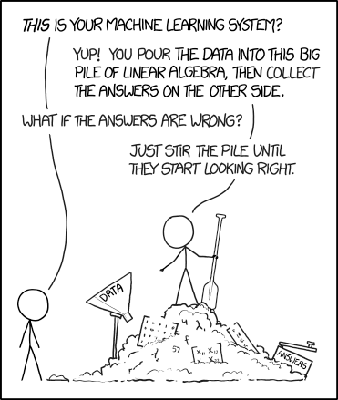
Typical Advanced Analytics project
https://xkcd.com/1838/

Slide 6

Problems with the “pile of scripts” approach
Why my model does not give the same great result it gave me just yesterday? Nothing have changed!
No traceability of work
No clear artifacts created
No governance
  What data has been used?
  What code?
  What code + data resulted in my model?
  What was the result for the model X?
No reproducibility
Not possible to hand over

Slide 7
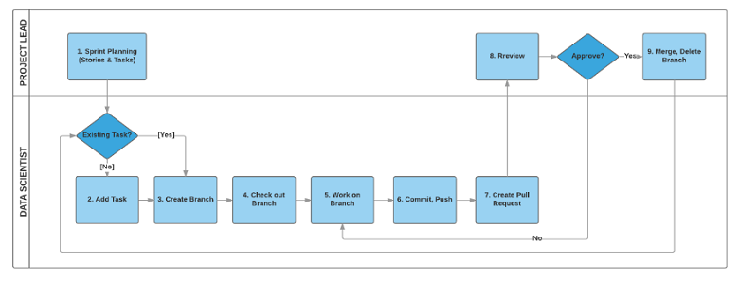
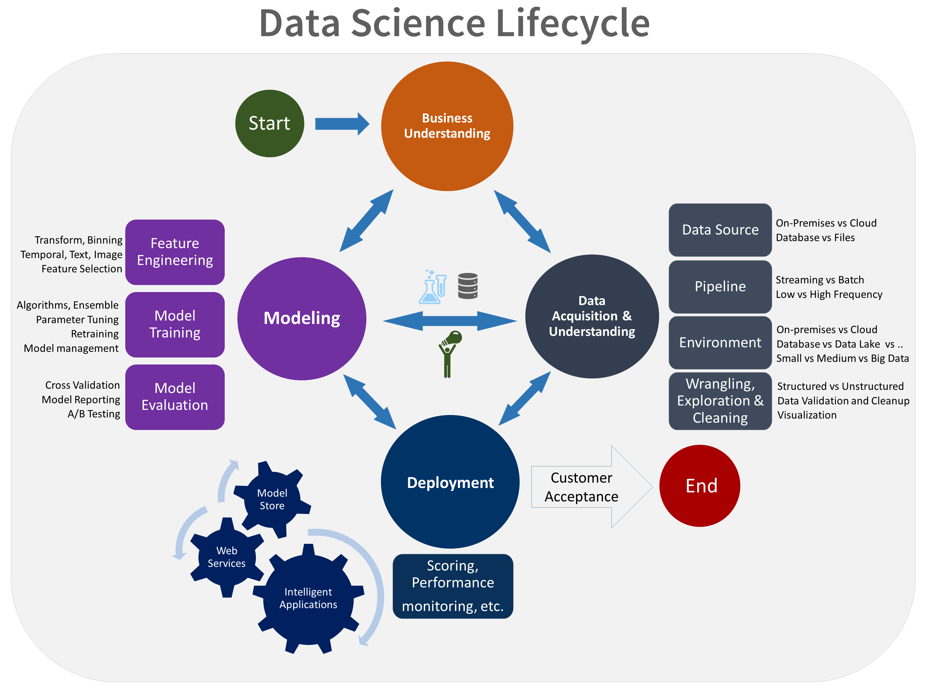
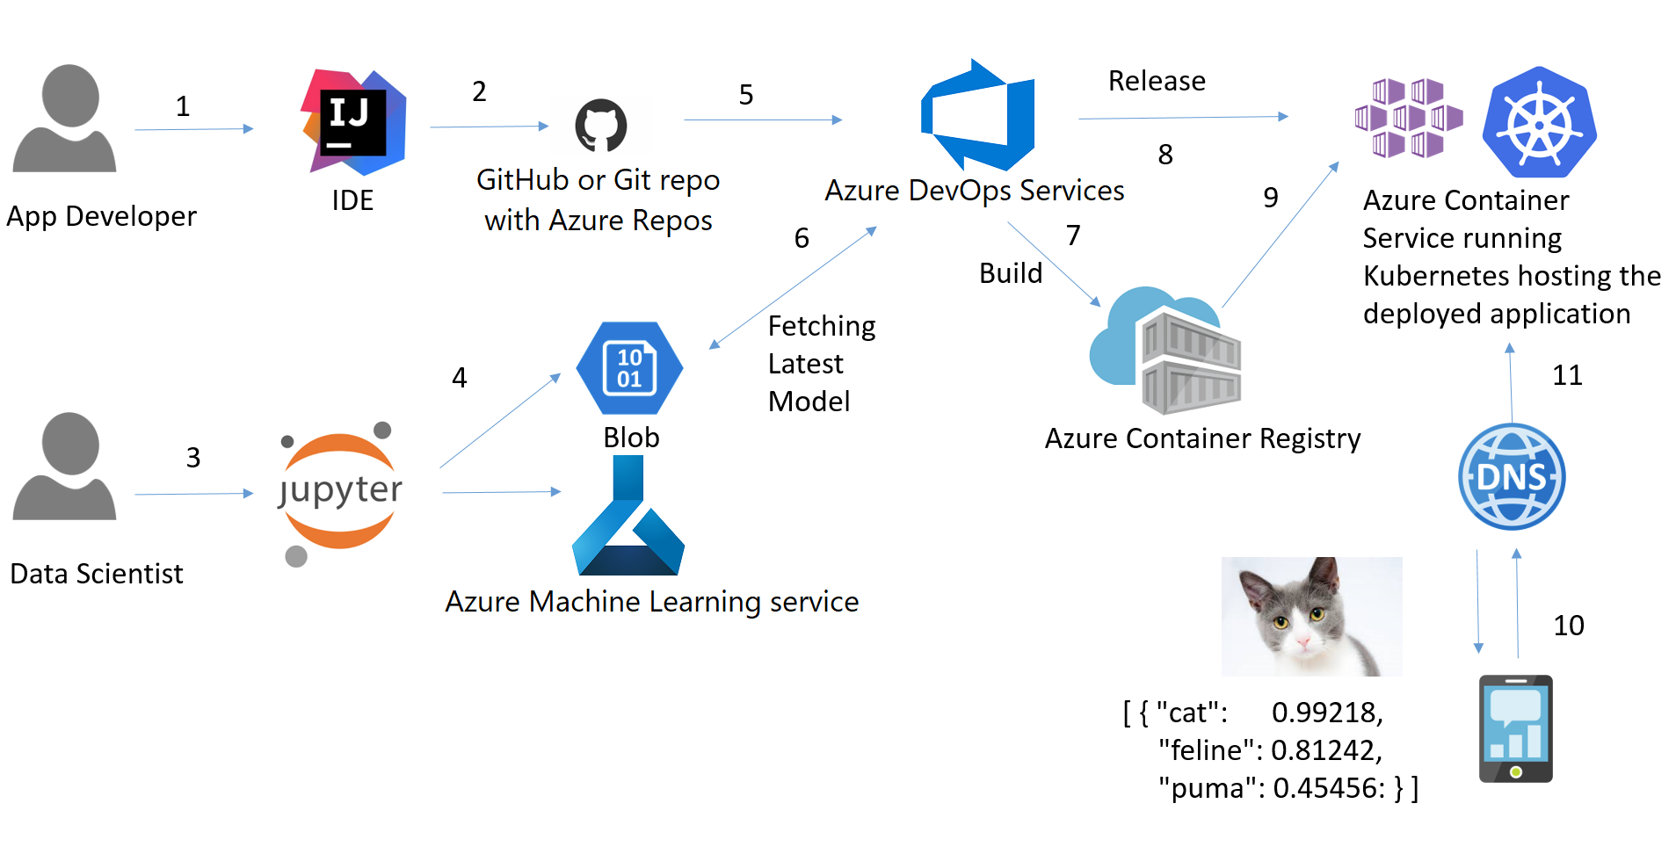
Team data science process
https://aka.ms/TDSP

Slide 8
Developing Prod-ready ML
Andrey

Slide 9






What makes an ML model (asset examples)
DATASET
10
5
5
6
7
8
1
2
3
4
9
EVAL
11
ETL
MODEL
1
Source Tests
4
Dataset tests
7
Serialized model
10
Evaluation code
2
Feature gen / ETL
5
Training code
8
Treatment group
11
Model efficiency tests
3
Cross validation code
6
Inference code
9
Control group

Slide 10
MLOps Benefits
Reproducibility / Auditability
Validation
Automation / Observability
Code drives generation and deployments
Pipelines are reproducible and verifiable
All artifacts can be tagged and audited
SWE best practices for quality control
Offline comparisons of model quality
Minimize bias and enable explainability
Controlled rollout capabilities
Live comparison of predicted vs. expected performance
Results fed back to watch for drift and improve model

Slide 11


Reproducibility for ML models – Azure ML Service
Prepare
Train &
Test Model
…
Register and
Manage Model
Build model
(your favorite IDE)
Prepare Data
Deploy Service
Monitor Model
Build Image
Deterministic - same set of parameters produces same result
Everything is a hyperparameter (features, model parameters)
Checking the inputs & results (more later)

Slide 12
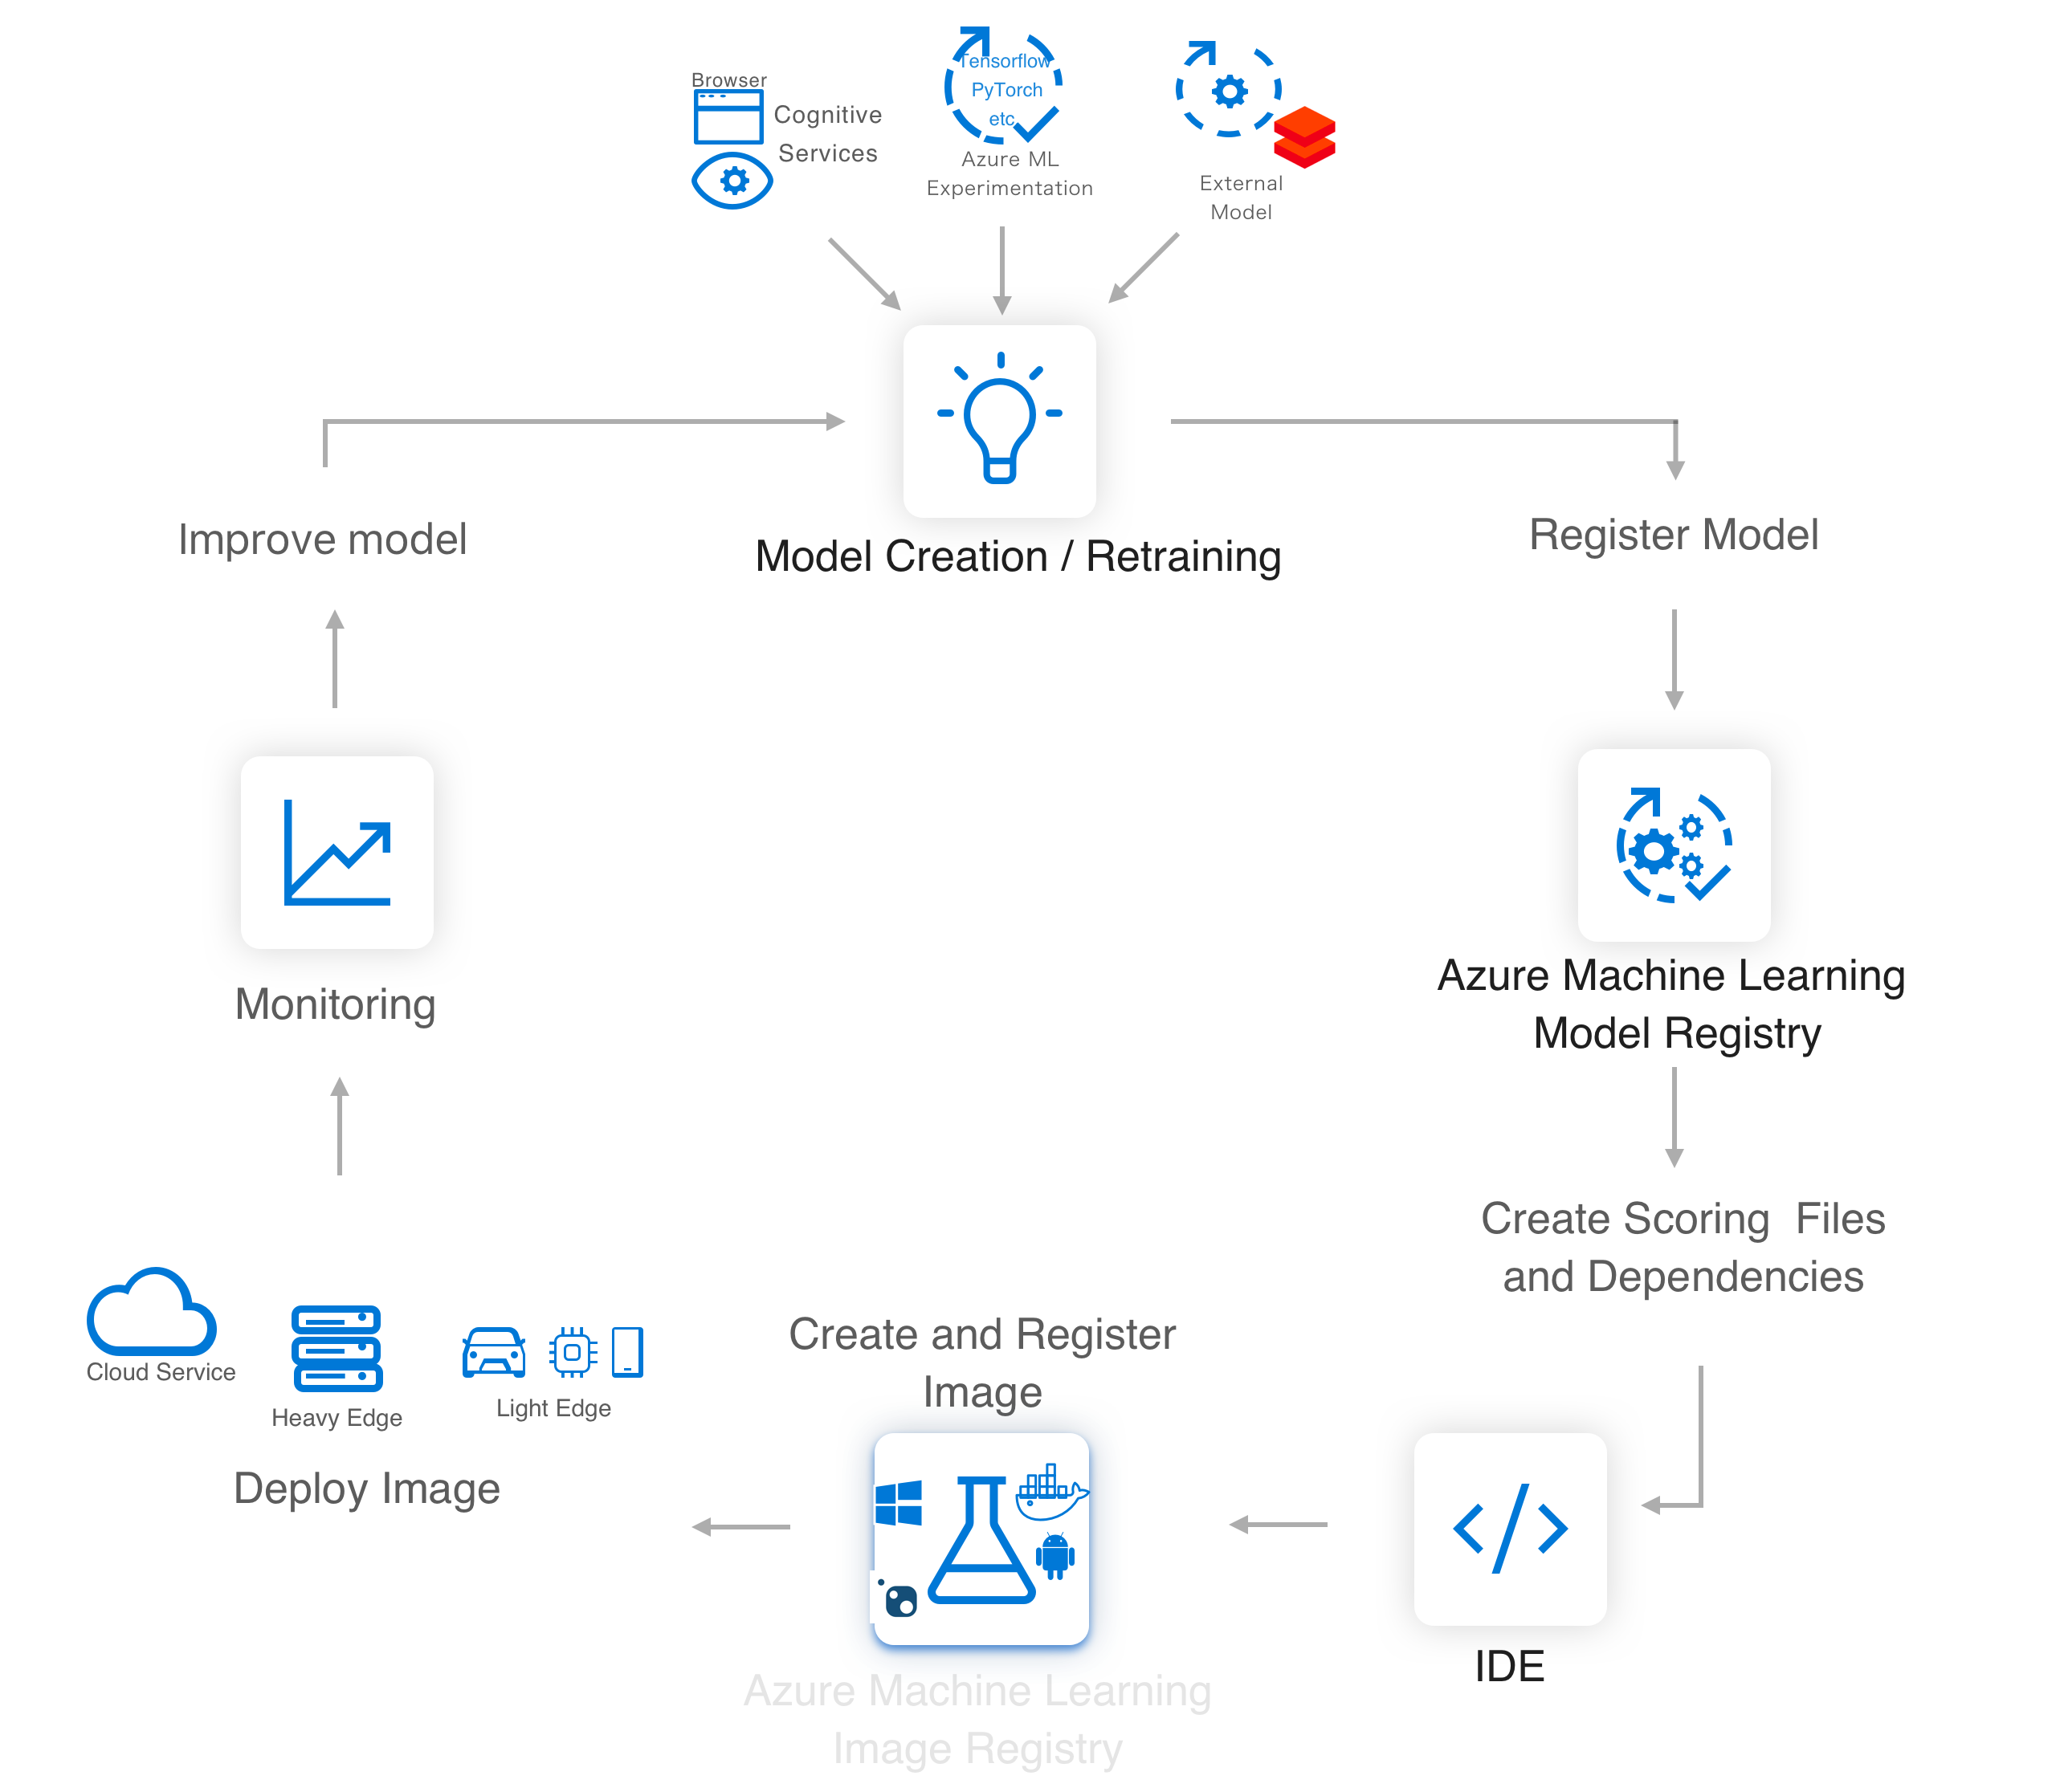

Azure ML service
Lets you easily implement this AI/ML Lifecycle
Workflow Steps
Develop machine learning training scripts in Python.
Create and configure a compute target.
Submit the scripts to the configured compute target to run in that environment. During training, the compute target stores run records to a datastore. There the records are saved to an experiment.
Query the experiment for logged metrics from the current and past runs. If the metrics do not indicate a desired outcome, loop back to step 1 and iterate on your scripts.
Once a satisfactory run is found, register the persisted model in the model registry.
Develop a scoring script.
Create an Image and register it in the image registry.
Deploy the image as a web service in Azure.
Azure
Machine Learning

Slide 13
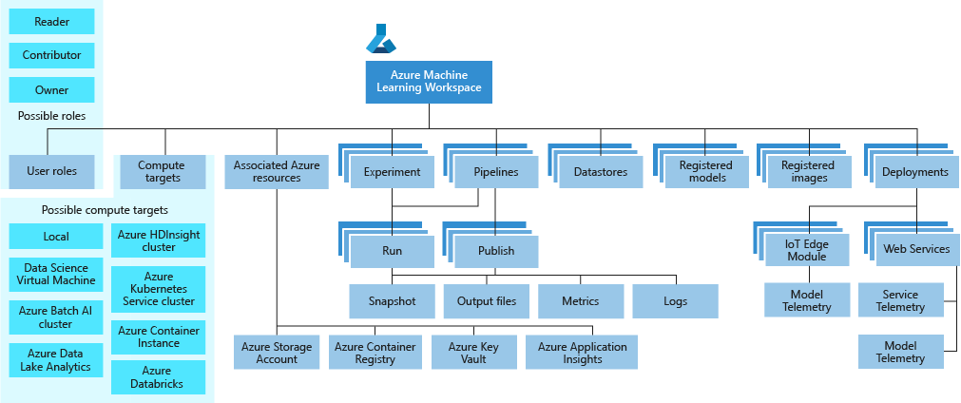
Azure ML service Workspace Taxonomy

Slide 14
Azure ML demo
https://github.com/nthacker/AML-service-labs
https://github.com/Azure/amlsamples
https://github.com/Azure/MachineLearningNotebooks
https://notebooks.azure.com/azureml/projects/azureml-getting-started

Slide 15
Demo: a whirlwind tour of Azure ML Service

Slide 16
“Best kept secret of AI is how it is de-abbreviated. Today we are going to reveal it.”
Andrey Vykhodtsev

Slide 17
“AI = Adrian Is going to do it”
Andrey Vykhodtsev

Slide 18
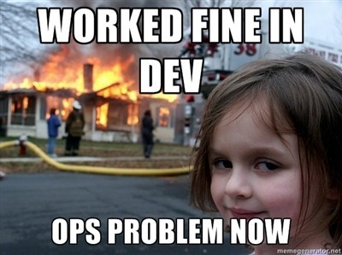
Azure Devops and AI
(Handled by Adrian)

Slide 19

Sprinkling DevOps on AI
Handled by Adrian

Slide 20
What is DevOps?
People. Process. Products.
Build& Test
Deploy
DevOps is the union of people, process, and products to enable continuous delivery of value to your end users.
“
Continuous
Delivery
Develop
Operate
”
Plan
&
Track
Monitor
&
Learn
@DonovanBrown

Slide 21





Azure DevOps
Azure Boards
Azure Pipelines
Azure Repos
Deliver value to your users faster using proven agile tools to plan, track, and discuss work across your teams.
Build, test, and deploy with CI/CD that works with any language, platform, and cloud. Connect to GitHub or any other Git provider and deploy continuously.
Get unlimited, cloud-hosted private Git repos and collaborate to build better code with pull requests and advanced file management.
Azure Test Plans
Azure Artifacts
➔
Test and ship with confidence using manual and exploratory testing tools.
Create, host, and share packages with your team, and add artifacts to your CI/CD pipelines with a single click.
https://azure.com/devops
@DonovanBrown

Slide 22
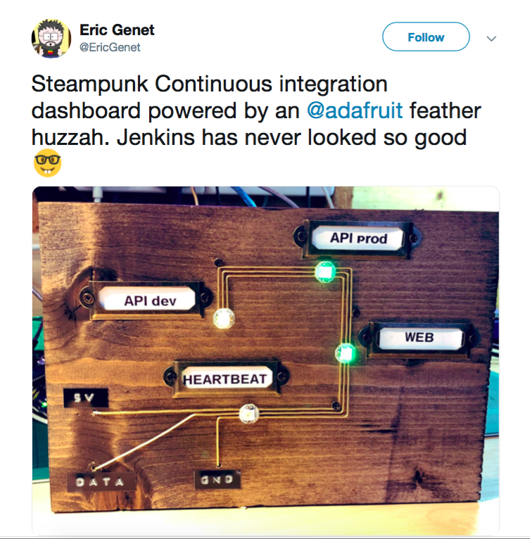

Slide 23
Agile Cards
(VS Marketplace)

Slide 24
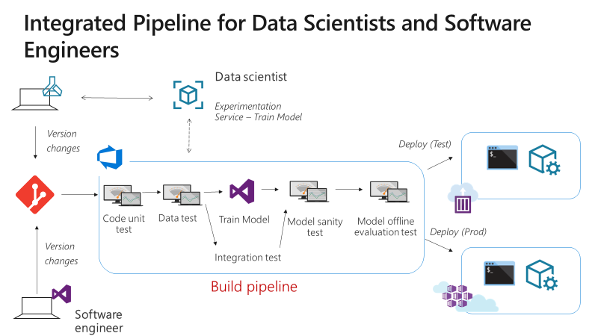

Slide 25
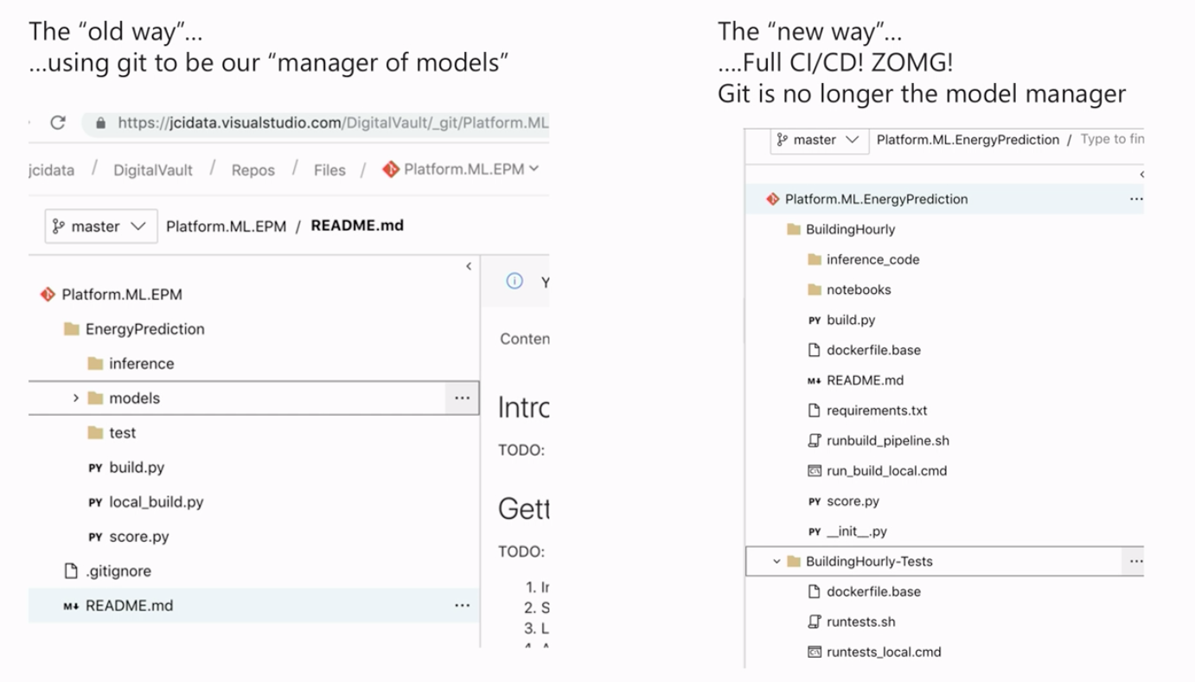

Slide 26
BUILD PIPELINE
TRAIN MODEL
Compare MSE
CHECK DEPENDENCIES AGAINST KNOWN CVEs
numpy, we’re looking at you.
PROMOTE MODEL (REGISTER)
CREATE SCORING IMAGE
PUSH TO IMAGE REGISTRY
Post to MS Teams
(Webhook)

Slide 27
RELEASE PIPELINE
QA
PROD
if (new_image)
UPDATE AKS DEPLOYMENT WITH NEW IMAGE
CREATE AZURE CONTAINER INSTANCE FROM NEW IMAGE
TEST WITH VALIDATION SET
TEST WITH VALIDATION SET
Post to MS Teams
(Webhook)
MANUAL APPROVAL GATE

Slide 28


Slide 29

Thank You

Slide 30
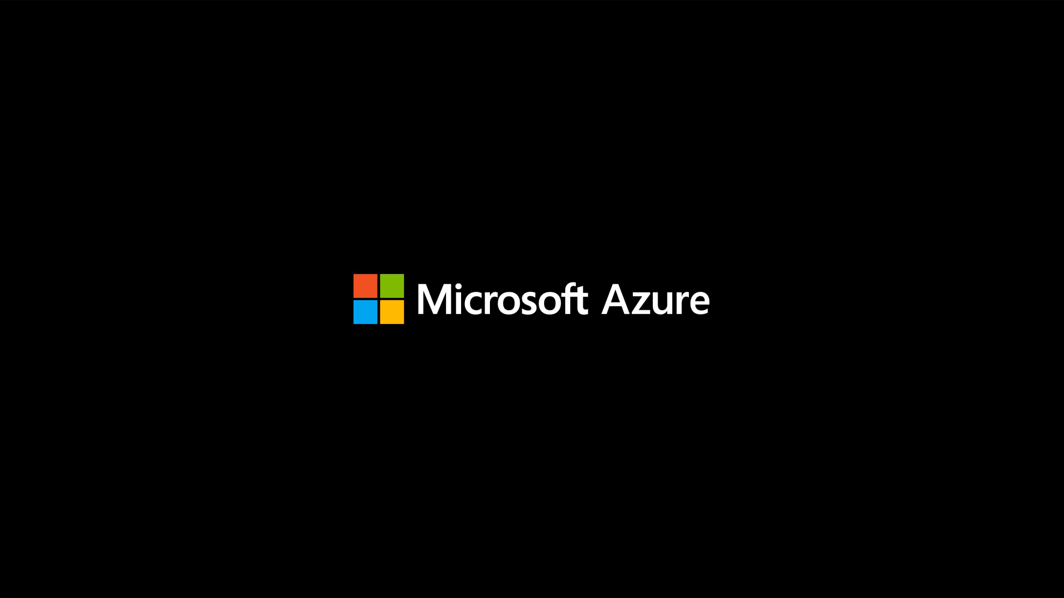

Slide 31





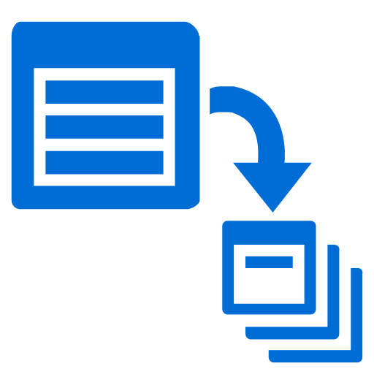







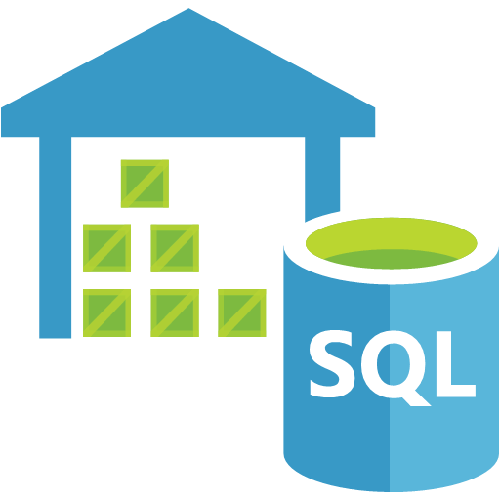



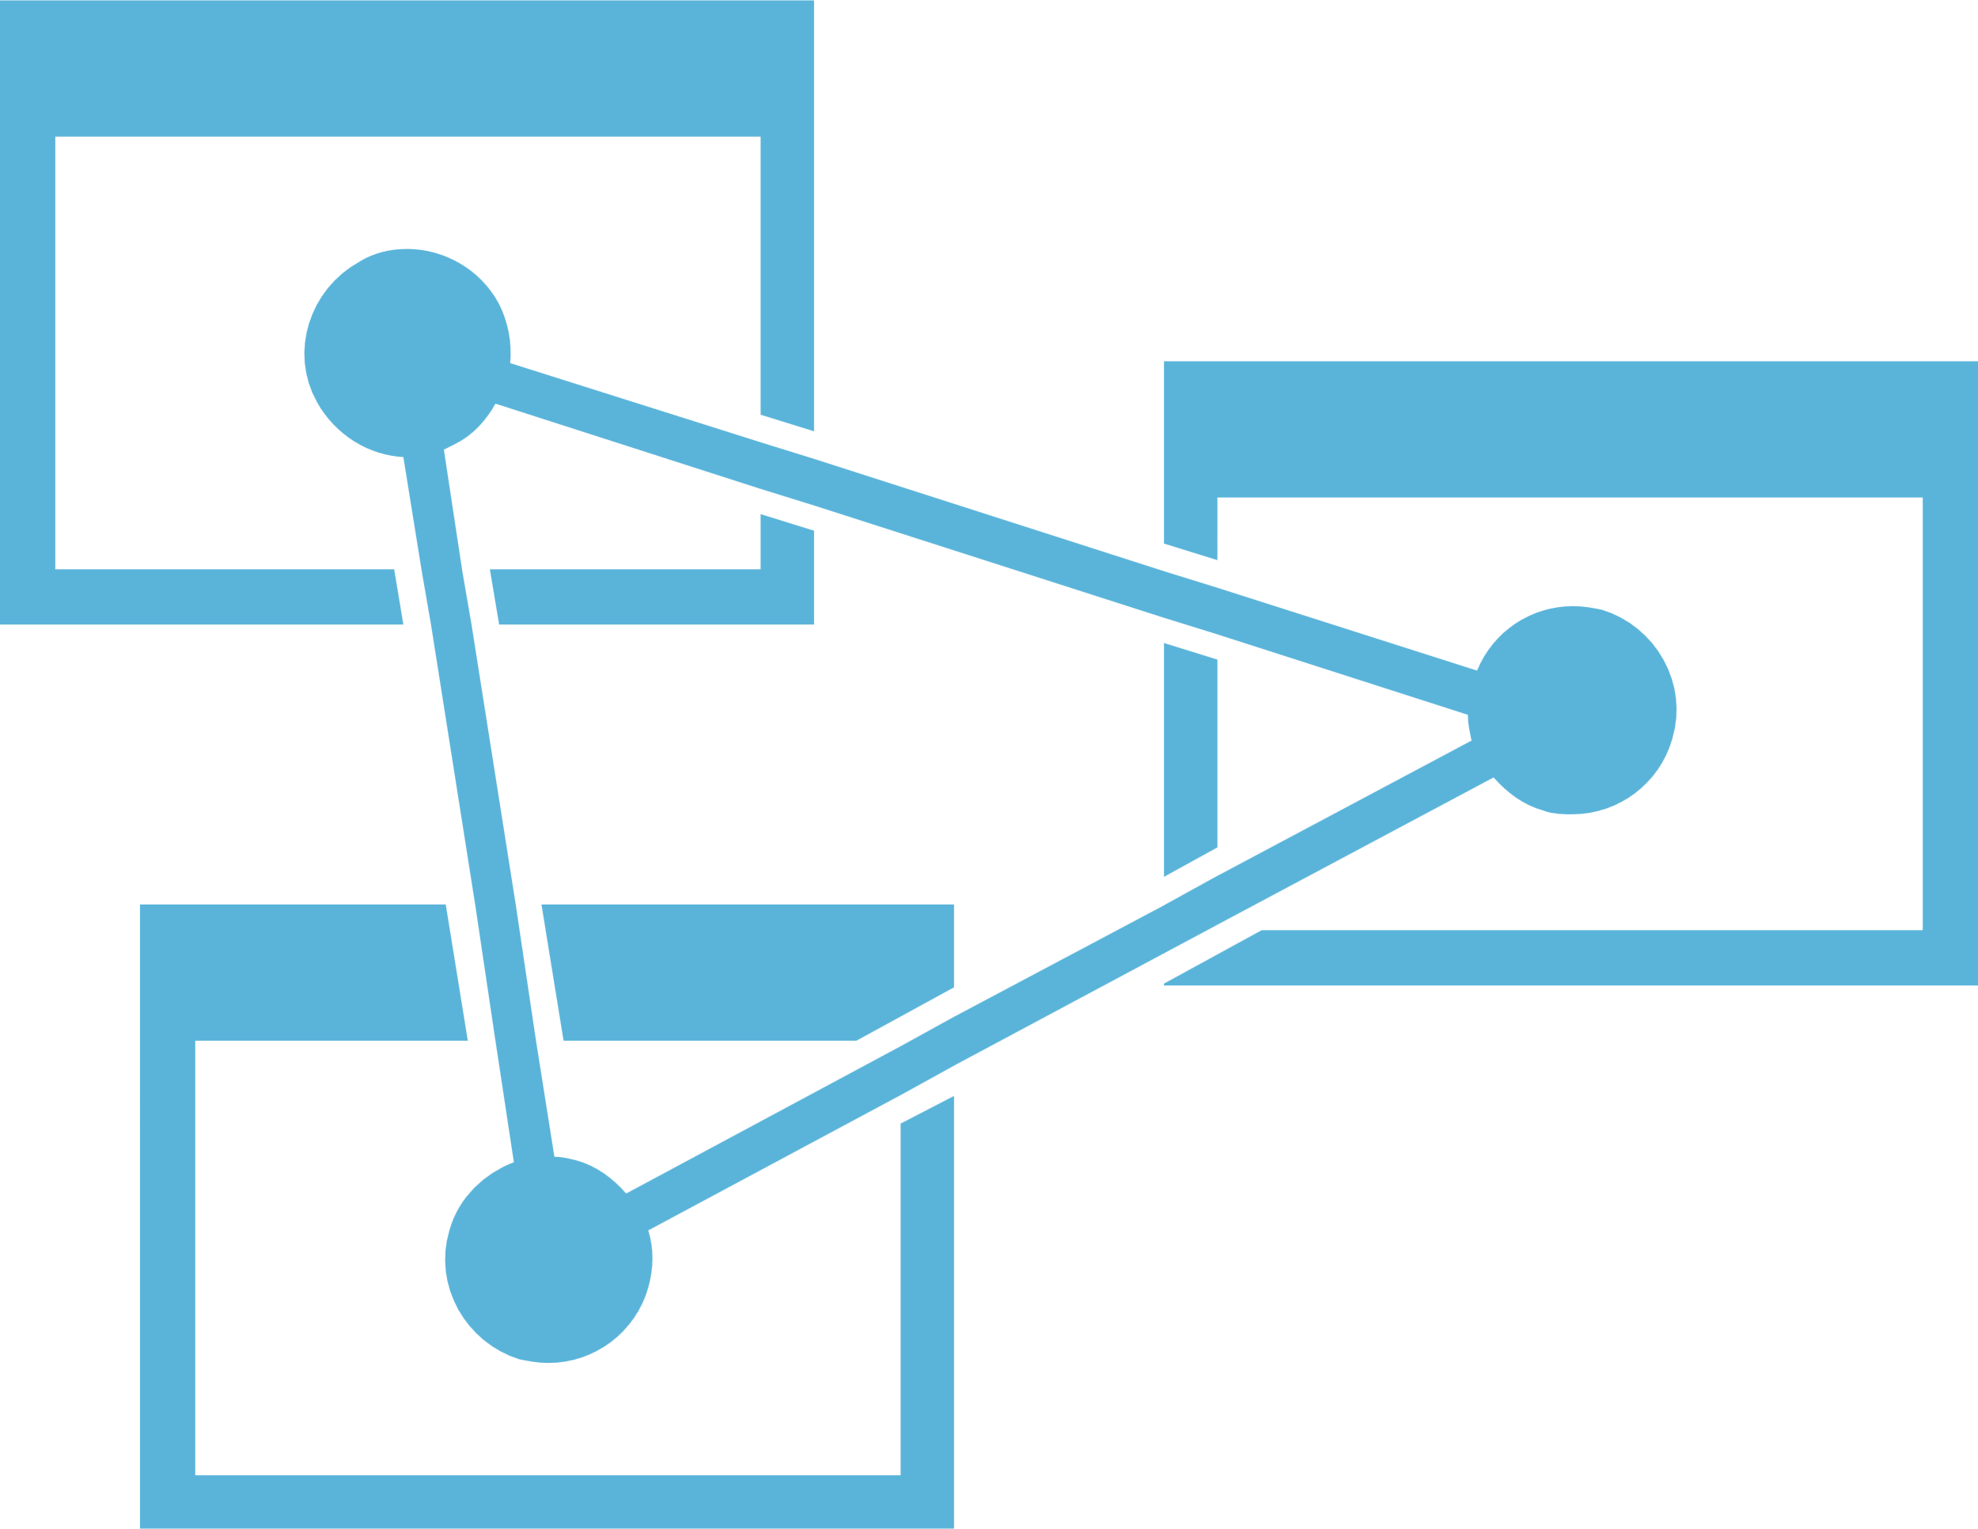
Advanced analytics pattern in Azure
  Data collection and understanding, modeling, and deployment
Model training
Serving storage
Sensors and IoT (unstructured)
Azure ML
Azure ML Studio
ML server
Azure Databricks
(Spark ML)
SQL Server
(in-database ML)
Data Science VM
Batch AI
Cosmos DB
Applications
Long-term storage
Data processing
r
SQL DB
Logs, files, and media (unstructured)
Azure Data Lake store
Azure Storage
Cosmos DB
SQL DB
Azure Data Lake Analytics
Azure Databricks
HDInsight
Orchestration
Trained model hosting
SQL DW
Business/custom apps (structured)
SQL Server
(in-database ML)
Azure Analysis Services
Dashboards
Azure Data Factory
Azure Container Service

