Slide 1
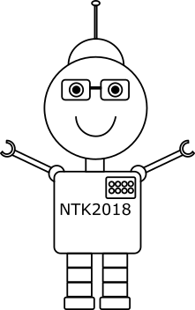
Bots, so you don't have to be always available to help your customers
Anton Sivic

Slide 2
Microsoft Bot Framework & Azure Bot Service
Anton Šivic
Anton.sivic@outlook.com
@antonsivic

Slide 3
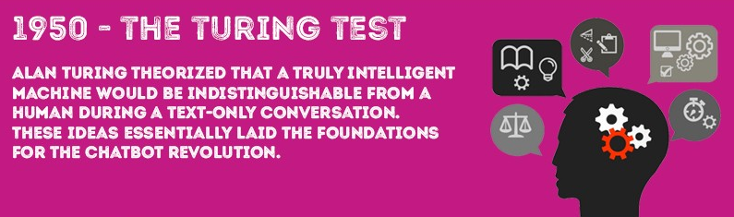
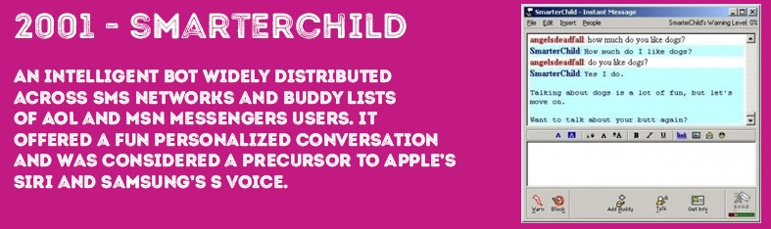
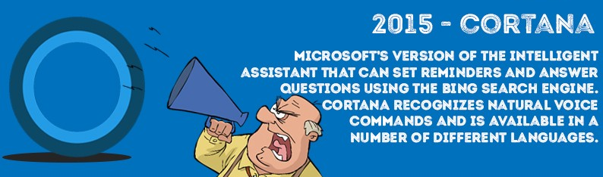
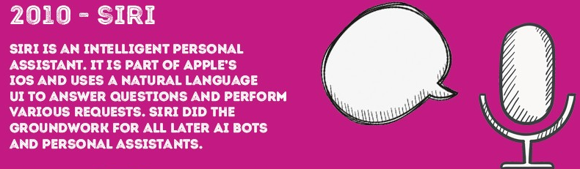
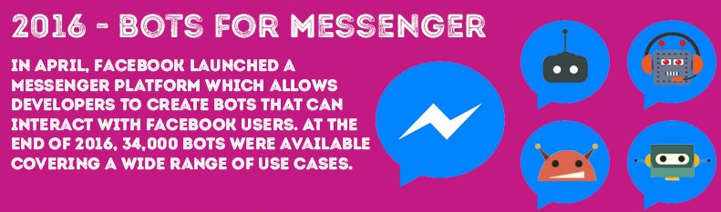



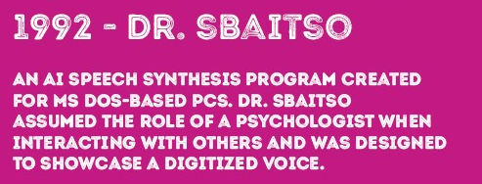
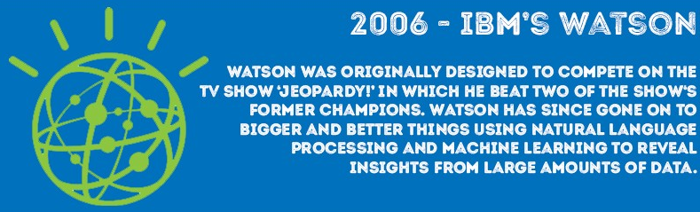
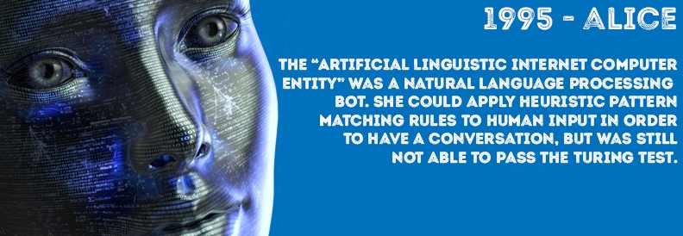
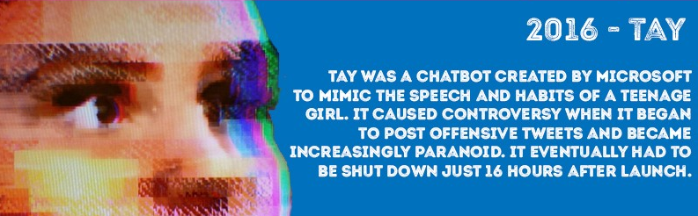
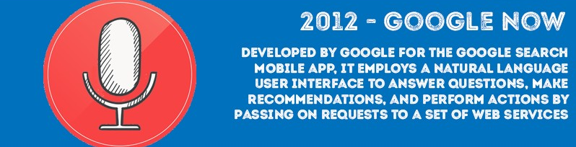
History of …
Source: https://chatbotsmagazine.com/a-visual-history-of-chatbots-8bf3b31dbfb2

Slide 4
Microsoft Bot Framework
Notes:
GA on December 13 2017

Slide 5
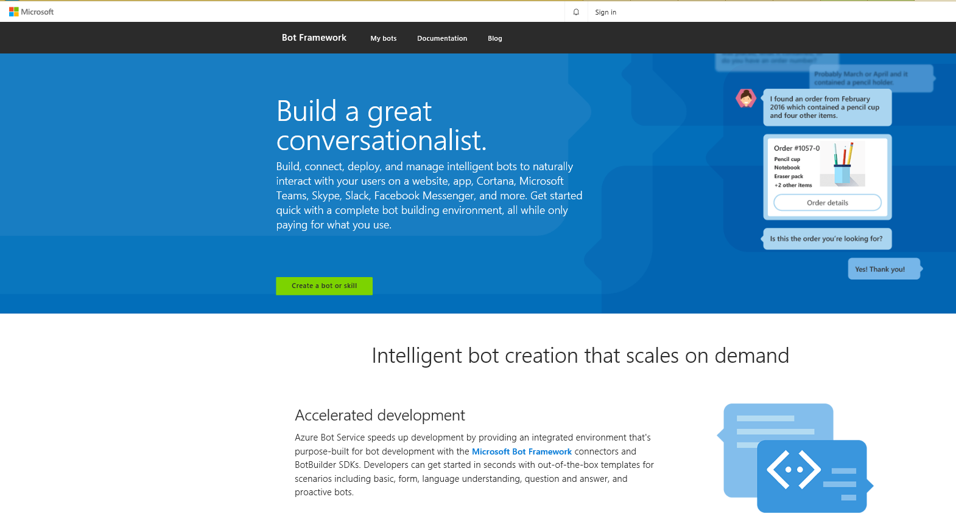

Slide 6
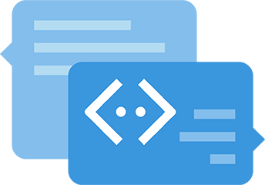
Microsoft Bot Framework
In its base a service – „go figure“
We could call it „CaaP“ … gues what this stands for ;-)
Accelerated development
  Azure Bot Service
Notes:
Caap – Conversation as a platform … in case I forget.

Slide 7
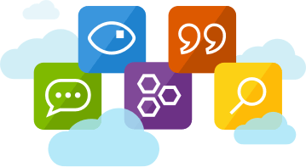
Microsoft Bot Framework
Use Cognitive Services
*AI services that are able to make your bot be more human like

Slide 8
Microsoft Bot Framework
Vision
  From faces to feelings, allow your
  apps to understand images and video
Speech
  Hear and speak to your users by filtering noise, identifying speakers, and understanding intent

Slide 9
Microsoft Bot Framework
Language
  Process text and learn how to recognize what users want
Knowledge
  Tap into rich knowledge amassed from
  the web, academia, or your own data
Search
  Access billions of web pages,
  images, videos, and news
  with the power of Bing APIs

Slide 10






Microsoft Bot Framework – Additional tools
  Language Understanding
  QnA Maker
  Text Analytics API
  Bing Spell Check
  Bing Speech API
  Bing Web Search API

Slide 11
Demo
Notes:
GA on December 13 2017

Slide 12










Microsoft Bot Framework – is in essence what?
  Different channels

Slide 13
Microsoft Bot Framework – why would we use it?
Implements standard protocols
Modeling conversations is hard
UI across multiple canvases is hard
Language understanding is hard
Common and well understood patterns

Slide 14
Microsoft Bot Framework – End goal?
Start simple. Add complexity. No dead-ends.
Bot adapts to the user, based on context
Composable and intelligent controls to manage complexity

Slide 15
Bot Builder SDK
Notes:
GA on December 13 2017

Slide 16
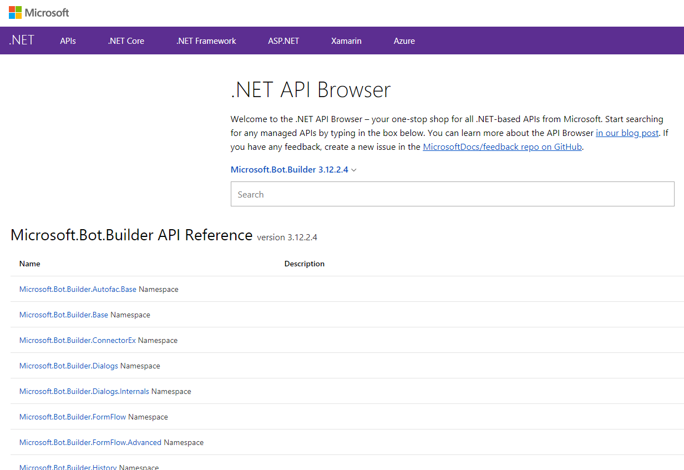
Bot Builder SDK
Powerful framework for constructing bots

Slide 17
Bot Builder SDK
Connector
Activity
Dialog
FormFlow
State**
Naming conventions
Security
Notes:
Key concepts in the Bot Builder SDK for .NET

Slide 18
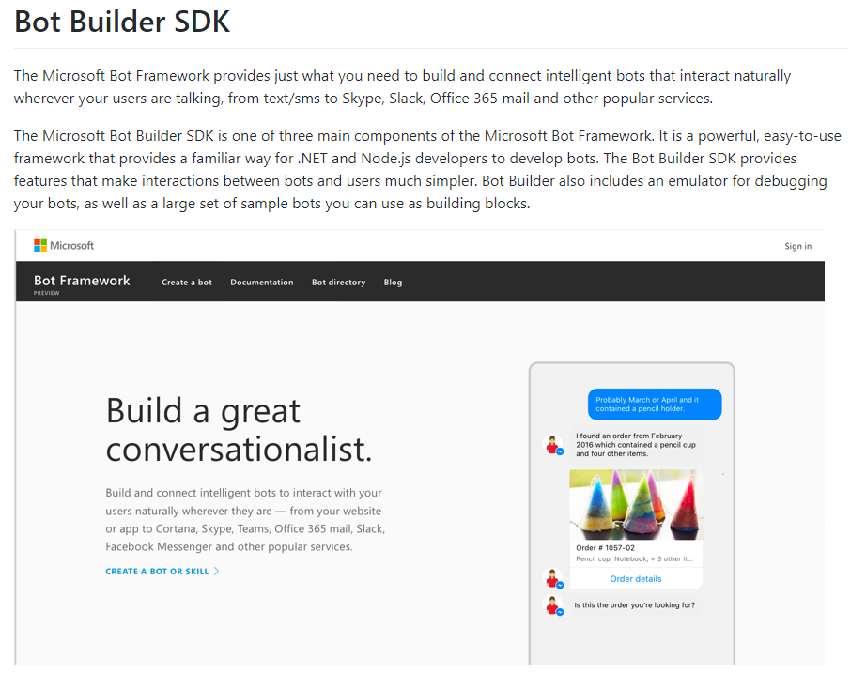
Bot Builder SDK
Available as a NuGet package and as open source on

Slide 19
Some links…
https://www.luis.ai
https://portal.azure.com
https://dev.botframework.com/
https://docs.microsoft.com/en-us/bot-framework/
https://github.com/Microsoft/BotBuilder
… this were just some quick ones … a lot is out there ☺

Slide 20
Demo
Notes:
GA on December 13 2017

Slide 21
THNX!
Preden odvihrate … še nekaj …
Notes:
GA on December 13 2017

Slide 22

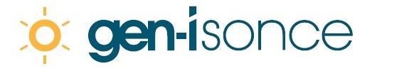
Looking for new challenges?
…is hiring
Data Scientists from San Francisco
.NET Developers from Geneva
IT Architects from Seattle
DBAs from North Pole
Smart people interested in
solving energy challenges of the future

